Slide 1
Fast Advanced Scintillator Timing: COST Action TD1401
Charalampos (Harry) Tsoumpas, PhD DIC
Division of Biomedical Imaging
University of Leeds
United Kingdom

Slide 2
Theory of Ernle Bradford (1964)
Laestrygonians
Ulysses

Slide 3

NOT

Slide 4
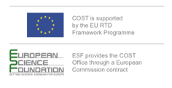
What is COST?
European Cooperation in Science & Technology (est. 1971)
COST Objectives
- Accelerate breakthrough scientific developments via collaboration
- Strengthen Europe’s research and innovation capacities
- Build capacity by connecting high-quality scientific networks
- Provide networking for Early Stage Researchers & monitor gender balance
- Address societal questions: connect policy makers, regulatory bodies and decision makers
36 Countries

Slide 5
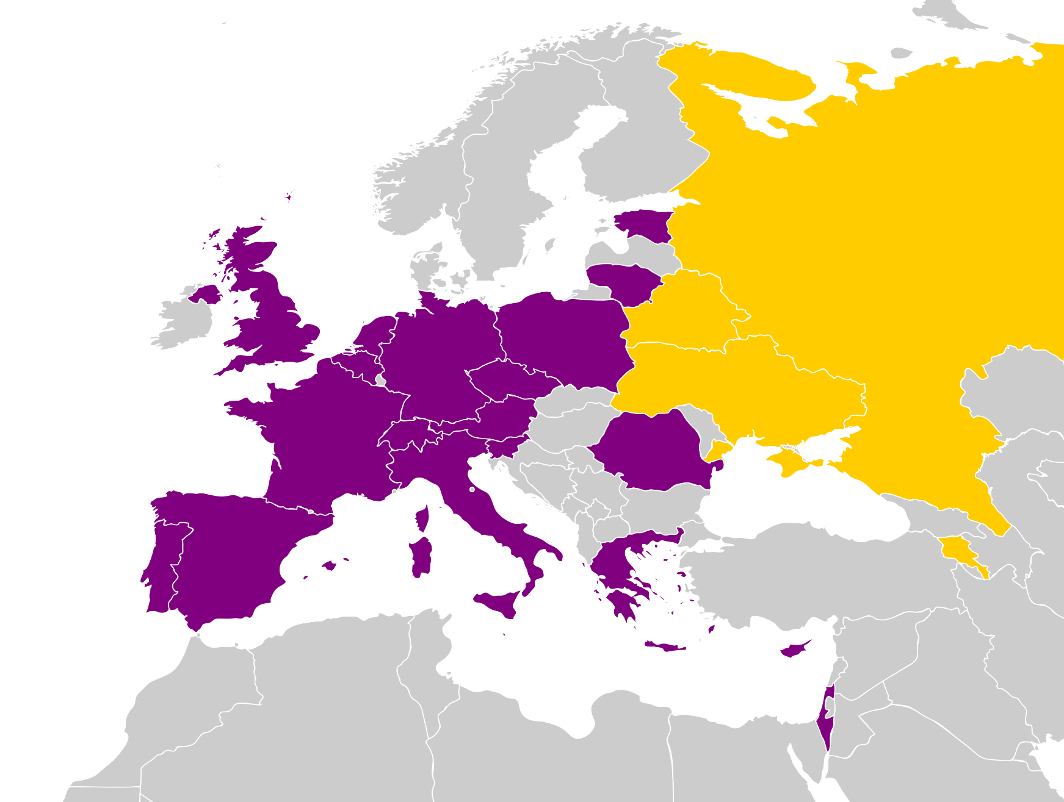
To date participating countries
(19 COST and 4 Near Neighbours)
TD1401: Fast Advanced Scintillator Timing (FAST)
Trans-Domain COST Action
COST countries
Austria
Belgium
Cyprus
Czech Republic
Estonia
France
Germany
Greece
Israel
Italy
Lithuania
Netherlands
Poland
Portugal
Romania
Slovenia
Spain
Switzerland
United Kingdom
?
COST Near Neighbour Countries
Armenia (1 institute)
Belarus (1 institute)
Ukraine (1 institute)
Russian Federation (3 institutes)
November 2014 – November 2018

Slide 6

Objectives
Bridge the gap between sectors, countries and research fields.
Investigate transient phenomena.
Conceive novel techniques towards high time resolution below 100 ps.
Provide common platform for designing fast photodetectors and ASICs.
What do we need?
  Basic research, engineering, industry lead innovation by design.

Slide 7
Potential Beneficiaries From Fast Timing
Biological Imaging

Slide 8
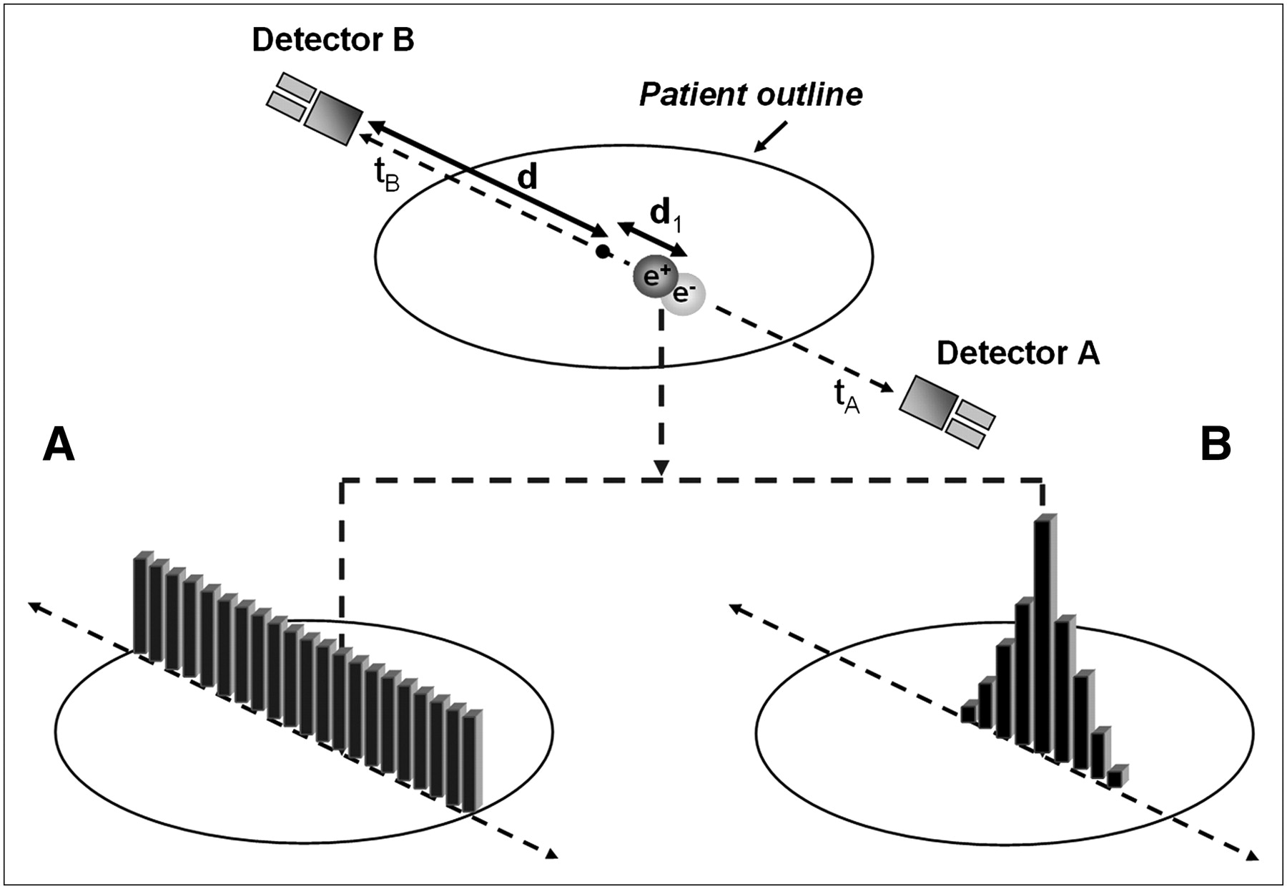
Why FAST is important in PET imaging?
In vivo: More precise, less invasive, more compact systems
In vitro: Faster analysis of disease biomarkers
Ultimatelly: Pave the way into precision medicine

Slide 9
Organization in 5 Working Groups (WG)
Chair: Etiennette Auffray (CERN); Vice Chair: Marco Paganoni
WG 1: Physics, Specifications & Supervision
Leader: Paul Lecoq; Deputy: Dennis Schaart
WG 2: Scintillators
Leader: Martin Nikl; Deputy: Christophe Dujardin
WG 3: Photodetectors
Leader: Claudio Piemonte; Deputy: Eduardo Charbon
WG 4: Electronics
Leader: Joao Varela; Deputy: Christian Morel
WG 5: Applications
Leader: Pedro Almeida; Deputy: Stefaan Tavernier

Slide 10
WG 1: Physics, Specifications & Supervision
Detector chain modelling and optimization
Design the roadmap for coincidence timing resolution towards 10ps
Interact with each working group (WG) and follow up progress
Crystal
Photodetector
Electronics
γ
Δt
θ2
t_{kth pe} =
Δt
+ t_{k’ ph}
+ t_{transit}
+ t_{SPTR}
+ t_{TDC}
Conversion depth
Scintillation
process
Transit time
spread
Single photon
time spread
TDC
conversion time
Understand key limiting factors of timing resolution & Propose routes towards 10ps

Slide 11
Types of emission in scintillating crystals and delay between energy deposit & photon emission:
WG 2: Scintillators
Define & understand key parameters for scintillators with best timing
How fast inorganic and semiconductor scintillators can be?
Develop ideas/exploit properties of materials for better possible timing resolution
What light producing modes prior to standard light generation exist?
Scintillator’s time resolution:
Scintillation mechanism
Light transport in crystal
Light extraction efficiency
Slow
Short
Excitonic emission (STE, anion complexes excitations)
Emission of activators (Ce, Pr, …)
Cross-luminescence
Quantum confinement driven luminescence
Intraband hot luminescence
Cherenkov radiation
Scintillator-based detector
Scintillator and geometry we can get a coincidence time res: 80-200 ps FWHM

Slide 12
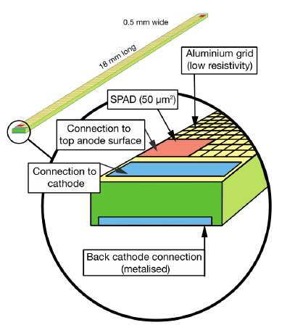
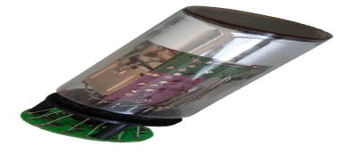
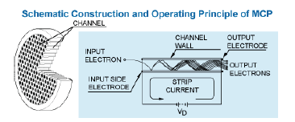
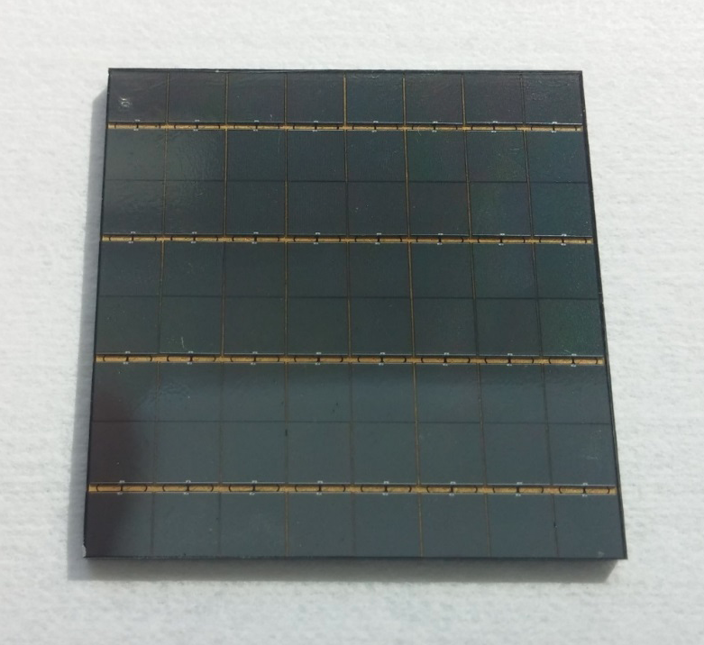
WG 3: Photodetectors
SPTR of available SiPMs is ~60-90 ps rms
Pursue key parameters for best timing performance
Investigate the timing of different detector technologies
Cooperate with industry to reassure feasibility of ideas
Competing technologies (are there more?)
Strip-SiPM?
PMT
SiPM
MCP

Slide 13
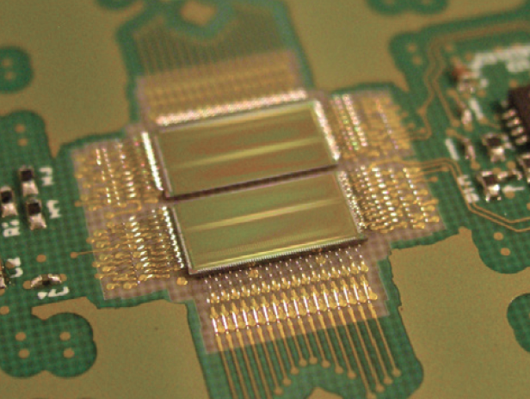
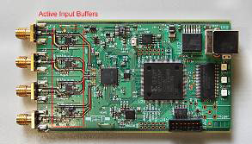
WG 4: Electronics
Contribution time of electronics on single photon measurement with SiPM < 30 ps
Key parameters & microelectronics technologies required for time precision < 10 ps
Design novel ASICs based on proposed specifications of the action
Coordinate a joint characterisation of prototype devices
Development of electronics with ps time resolution is challenging:
• ASIC design
• System level
Front-end systems with:
• Very large bandwidth
• Very low noise
• Very low power

Slide 14
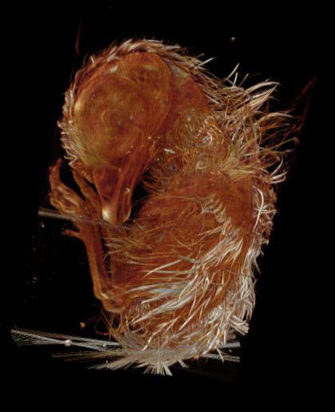
WG 5: Applications
Identify target applications
Discuss & evaluate requirements of end users with respect to timing
Possible applications of FAST detection chains
Medical Imaging: TOF-PET, Single-photon X-ray
Biological Imaging: Live Imaging, ballistic imaging, multi-thread flow cytometry, imaging in the mesoscale, laparoscopic applications
Security: Terrestrial border control of large volumes.
LiDAR applications: High-precision remote sensing
High Energy Physics: HLLHC experiment upgrade, Cerenkov Imaging
Courtesy of G. Martins
(IGC – PT)

Slide 15
Ultra FAST PET Scanner: 10 picoseconds
Efthimiou, Tsoumpas (unpublished)

Slide 16
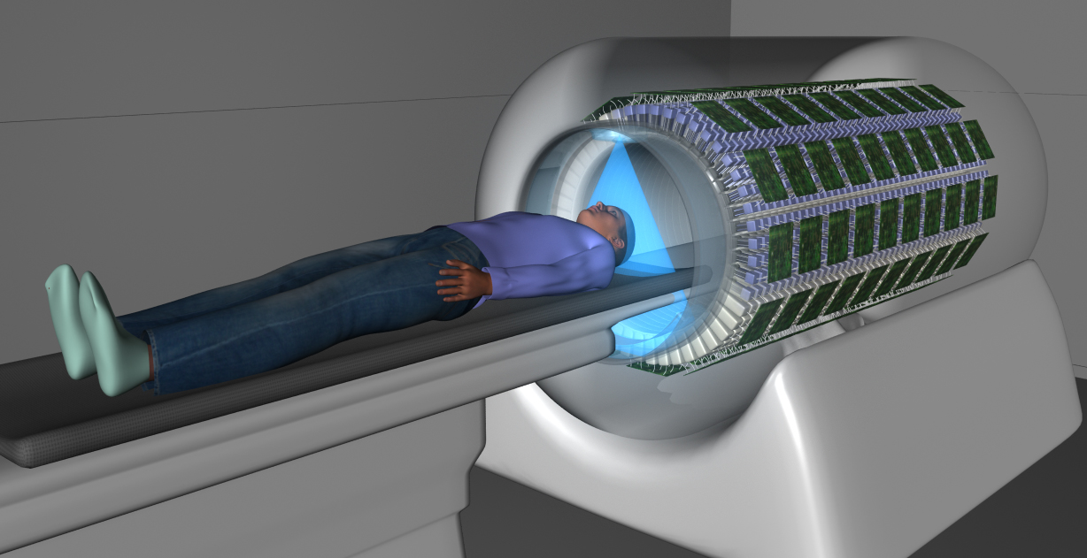
Sensitivity Gain
For an object with 30 cm diametre:
350 ps: 6x
130 ps: 15x
10 ps: 200x
Total Body PET Scanner: 40x-80x?
Budinger (1993) JNM
http://explorer.ucdavis.edu/about-explorer/

Slide 17
Limited Angle
Tomography
S Surti & JS Karp (2008) Design considerations for a limited-angle, dedicated breast, TOF PET scanner. Phys Med Biol

Slide 18
Joint Emission & Transmission Estimation
TOF resolutions:
40 cm 20 cm 10 cm 5 cm 2.5 cm
Rezaei et al., "Simultaneous Reconstruction of Activity and Attenuation in Time-of-Flight PET," in IEEE Transactions on Medical Imaging, 2012

Slide 19
Can we detect annihilation photons with 10 ps resolution?
Laser pulse shooting through a bottle and visualized at ps rate
Velten, Raskar, Bawendi, "Picosecond Camera for Time-of-Flight Imaging," in Imaging Systems Applications.

Slide 21
Contact details
Chair of the Action
Dr Etiennette Auffray - CERN
Etiennette.Auffray@cern.ch
Short Term Scientific Missions (STSM) Manager
Dr George Loudos – Technological Educational Institute of Athens
GLoudos@teiath.gr
Industrial Contact
Professor Karl Ziemons – Aachen University of Applied Sciences
K.Ziemons@fh-aachen.de
Dissemination Manager
Dr Charalampos Tsoumpas - University of Leeds
C.Tsoumpas@leeds.ac.uk

Slide 22
Workshop on the
Technology Frontier for Single Photon Detection and Advanced Scintillator Timing
Friday, 5th November 2016

