Slide 1
Enabling new trends in molecular imaging
Maurizio Conti, Siemens Healthcare, Molecular Imaging
MEDAMI workshop, May 2, 2016

Slide 2
Outline (1)
Enabling new trends: beyond “diagnostic-only” imaging (1)
Enabling new trends: beyond “diagnostic-only” imaging (2)
Enabling new trends: beyond “generic” FDG imaging
Enabling new trends: beyond “static” imaging

Slide 3
Outline (2)
Enabling better image quality
Enabling promising applications
Enabling better workflow and patient comfort
Enabling research

Slide 4

Siemens Healthcare, Molecular Imaging
Hoffman Estates (Chicago)
SPECT
Detectors
Oxford (UK)
Clinical appl
Forchheim (Germany)
CT components
MR components
Software development
Knoxville
PET
Clinical appl
Detectors
PETNET HQ
Bangalore (India)
Software development

Slide 5
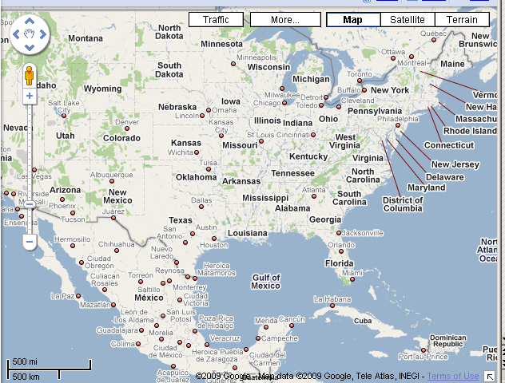

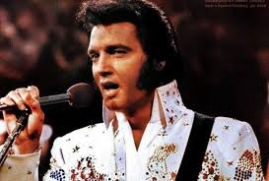
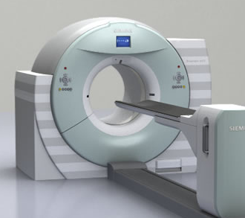
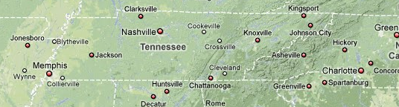
Where is Knoxville?

Slide 6
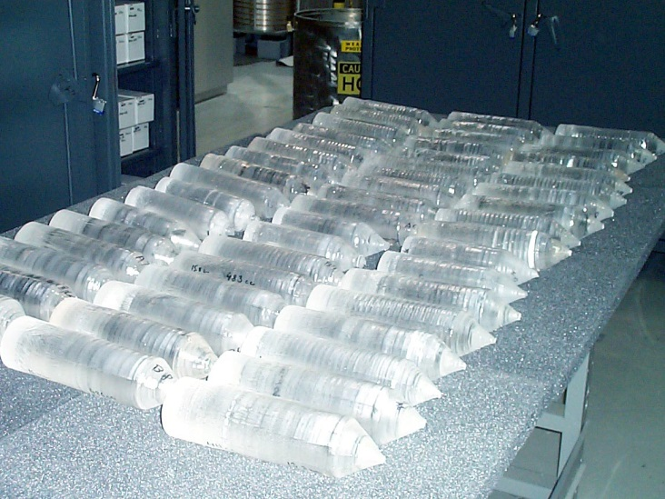
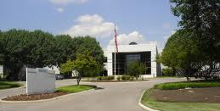
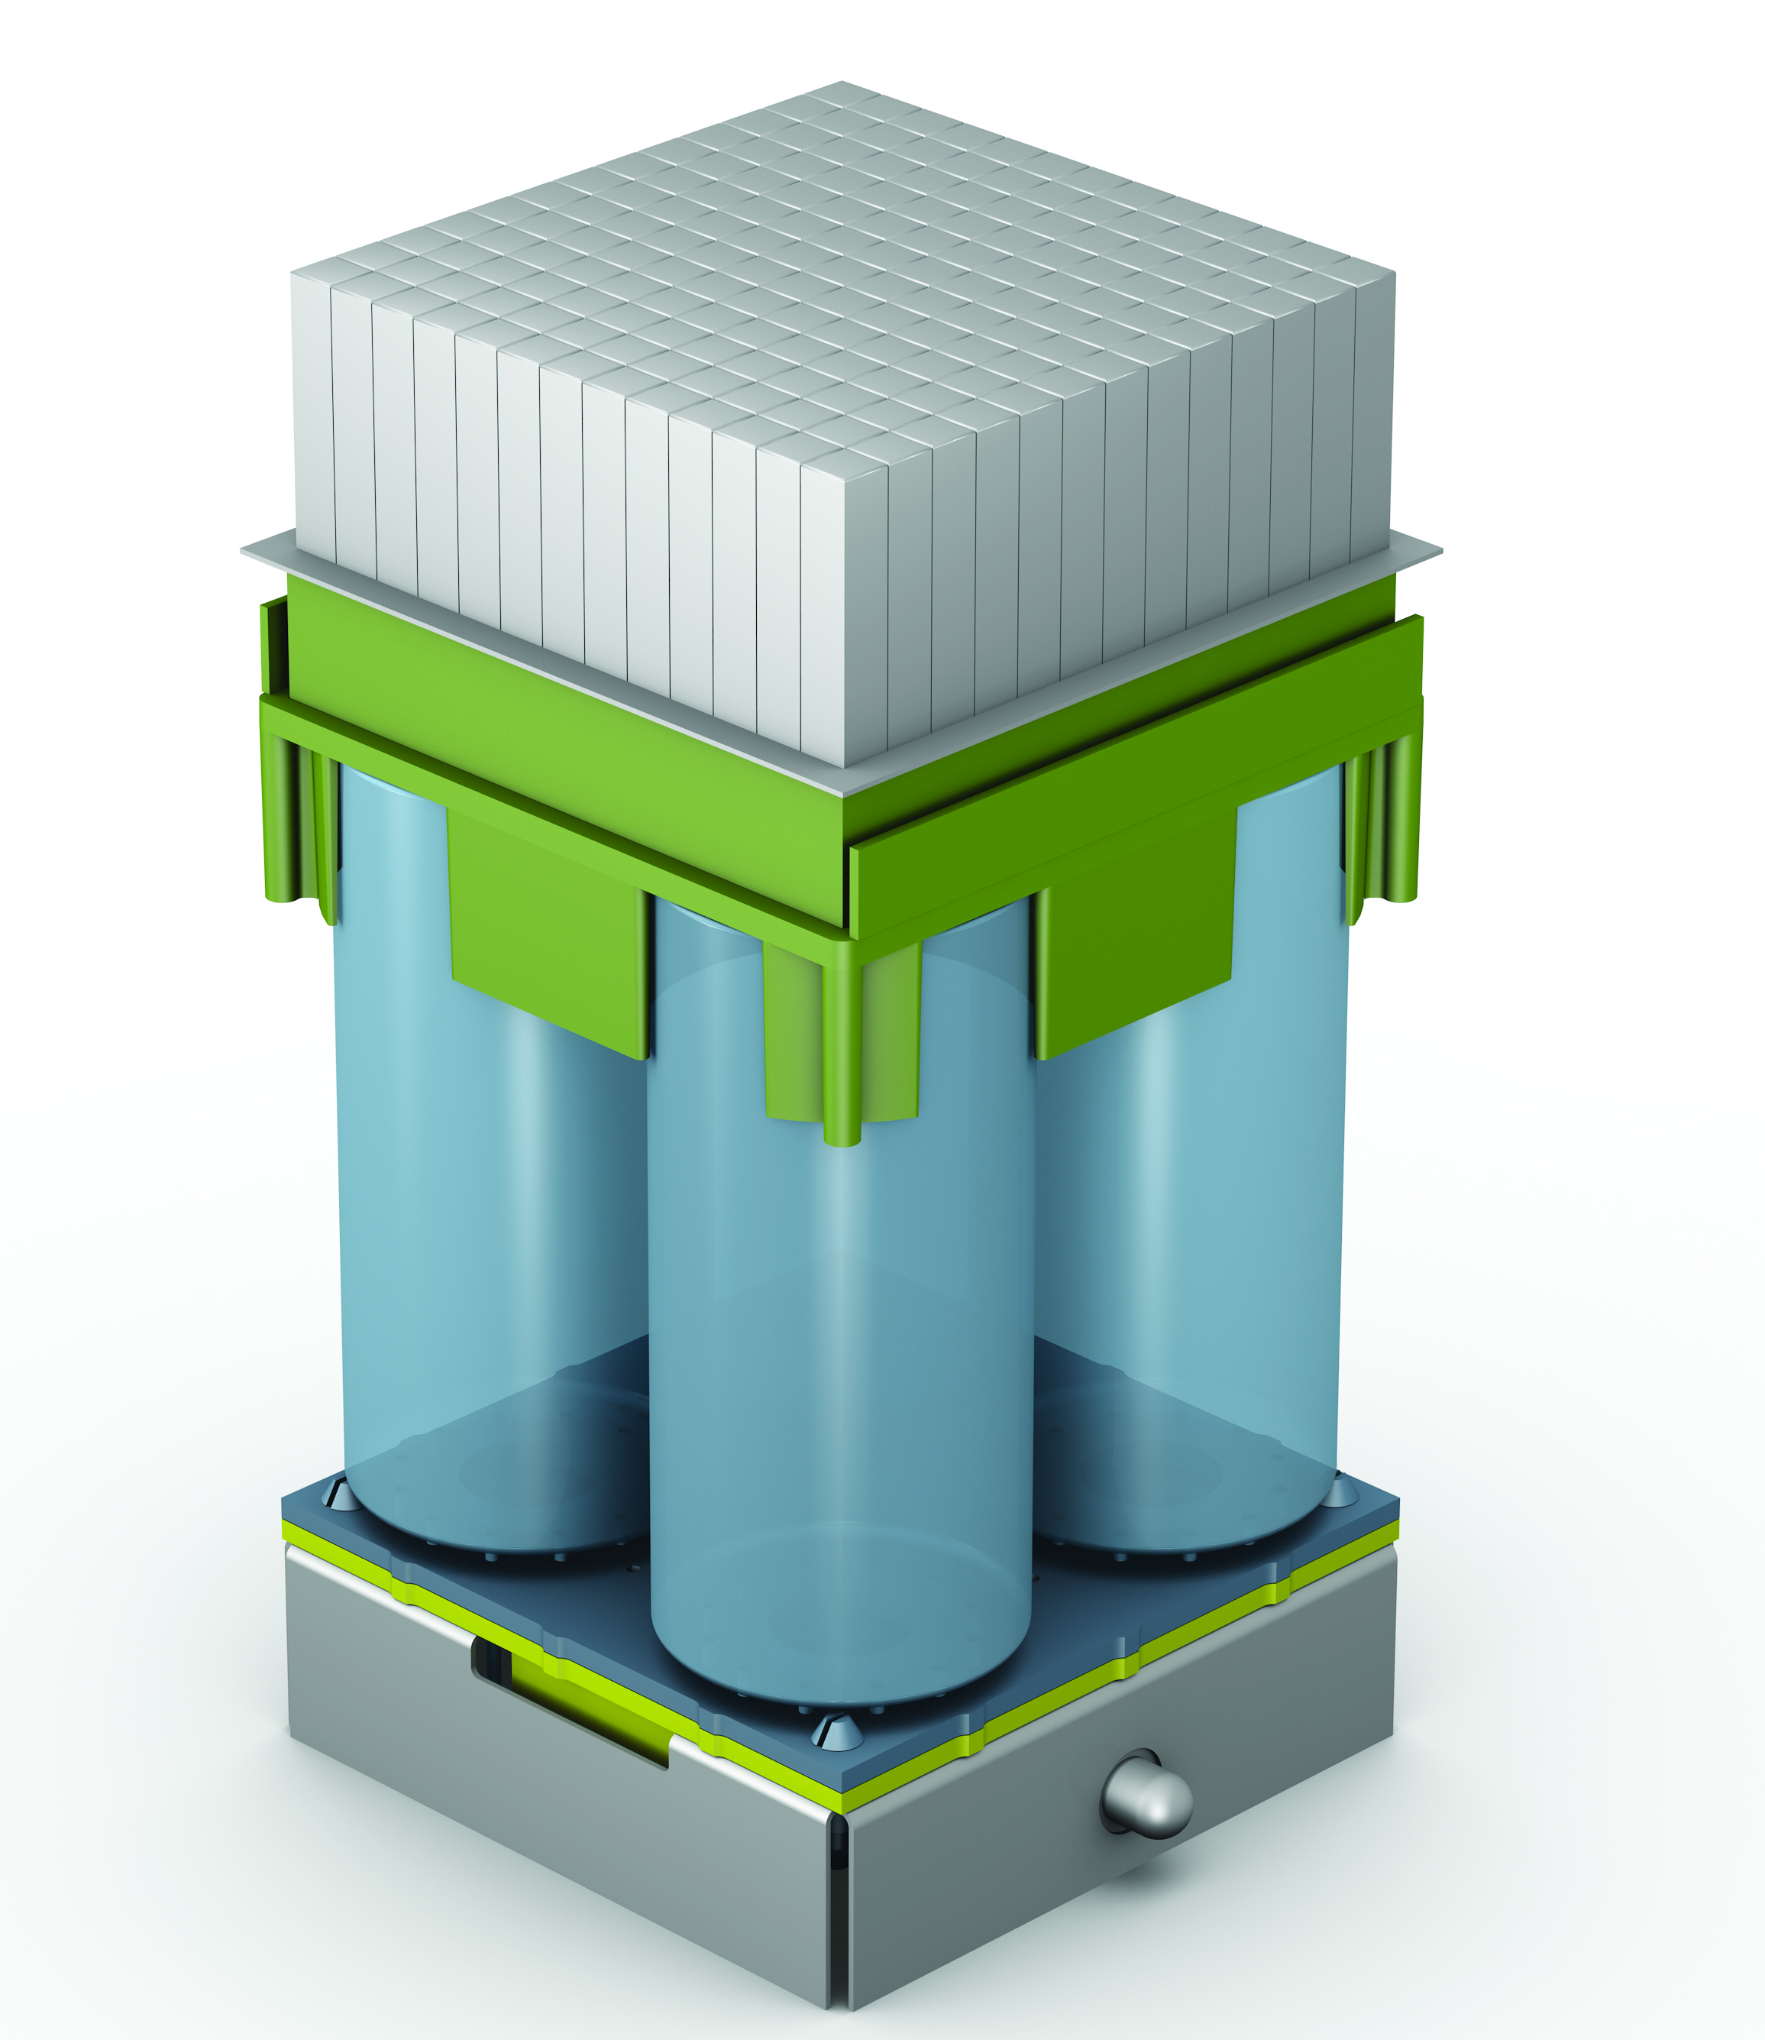
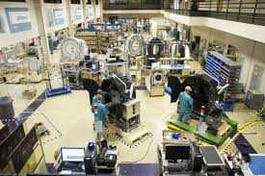
Siemens Healthcare Molecular Imaging, Knoxville

Slide 7
Enabling new trends: beyond “diagnostic-only” imaging (1)
Enabling new trends: beyond “diagnostic-only” imaging (2)
Enabling new trends: beyond “generic” FDG imaging
Enabling new trends: beyond “static” imaging

Slide 8
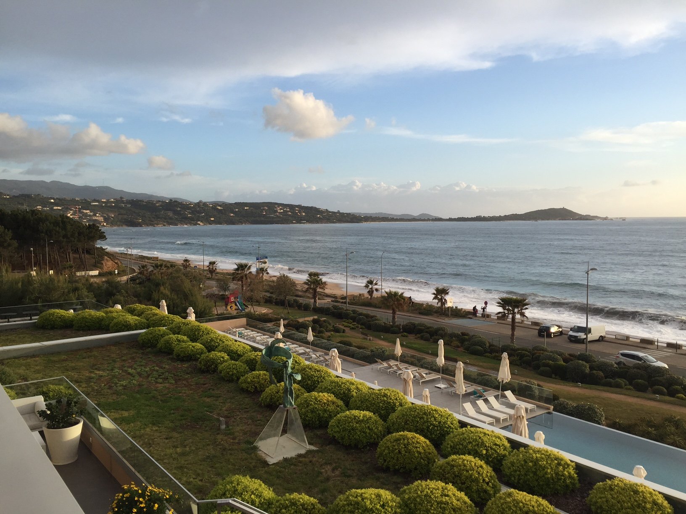
Challenges of theranostics and personalized therapy monitoring

Slide 9
Beyond “diagnostic-only” imaging
    Use imaging to plan therapy, monitor therapy, assess response to therapy.
    Personalize the medical treatment.
Theranostics
a targeting agent which specifically binds to a molecular target on the surface of a cell or tumor
an imaging agent and a therapeutic drug/radioisotope pair
a linker which serves to connect the two entities
Theramonitoring
Theranostics
Y90 therapy
mAb imaging
Small compound imaging
(photon) RTherapy
Hadron therapy
Gene targeted imaging

Slide 10
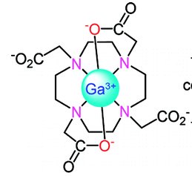
Theranostics: small compound imaging
    Matched imaging–therapeutic radioisotopes: ¹²⁴I and ¹³¹I, ⁸⁶Y and ⁹⁰Y
    Matched imaging–therapeutic agents:
    ⁶⁸Ga-DOTA-PSMA ¹⁷⁷Lu-DOTA-PSMA
¹⁷⁷Lu

Slide 11
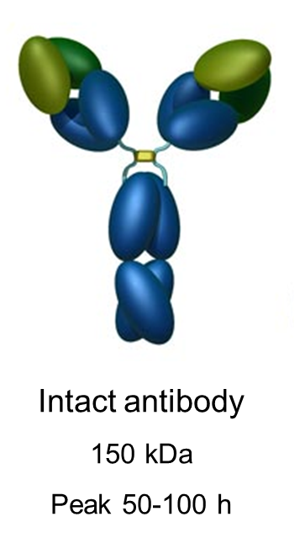
Theranostics: mAbs and immunoPET
Monoclonal antibodies (mAb) can target a specific tumor cell surface marker.
They can be used to disease-selective imaging and disease-selective therapy.
Intact mAbs have a long biological time in humans (days), and they are the format of choice for therapy (pharmaceutical or radiotherapy).
The corresponding imaging radioisotopes must have a long half-life

Slide 12
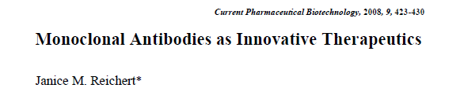
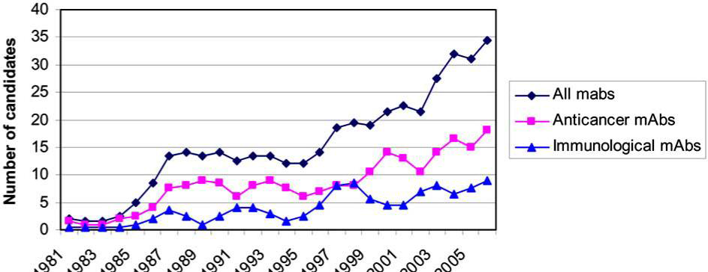
Theranostics: mAbs and immunoPET
Number of therapeutic monoclonal antibodies entering clinical study during 1980 to 2006

Slide 13
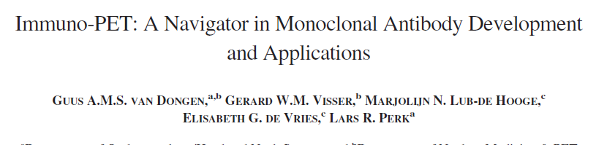
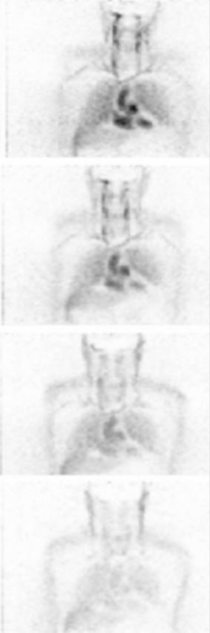
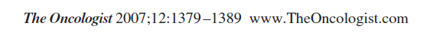
Theranostics: mAbs and immunoPET
⁸⁹Zr-labeled mAbs showed high tumor detection and accurate quantification.
Moreover, PET with ⁸⁹Zr-labeled mAbs appeared to be able to predict the biodistribution of ⁹⁰Y- or ¹⁷⁷Lu-labeled mAbs
PET image of Zr89-mAb-U36 in a patient with a tumor of the right tonsil (neck squamous cell carcinoma, lymph node metastasis). Images were obtained within 1 hour (A), at 24 hours (B), at 72 hours (C), and at 120 hours (D)

Slide 14
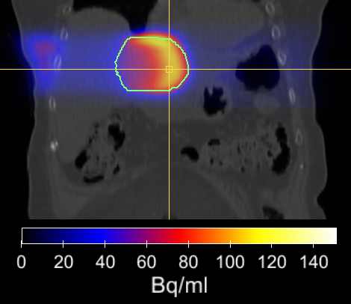
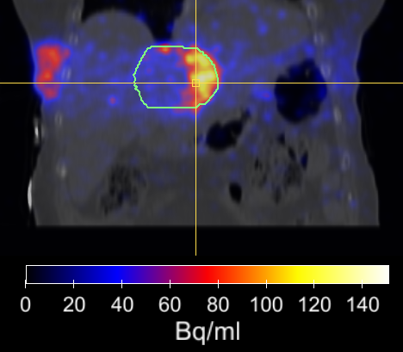
Monitoring of therapy: hadron/proton therapy
Proton and heavy ion therapy is prone to uncertainties (anatomical changes, mis-positioning, …)
Need to verify correct application of the planned treatment:
Dosimetry
Localization (edges)
    Compare:
    clinical treatment plan
    Monte Carlo simulation
    PET imaging
Prediction
Measurement
Courtesy of Heidelberger Ionenstrahl-Therapiezentrum (HIT)

Slide 15
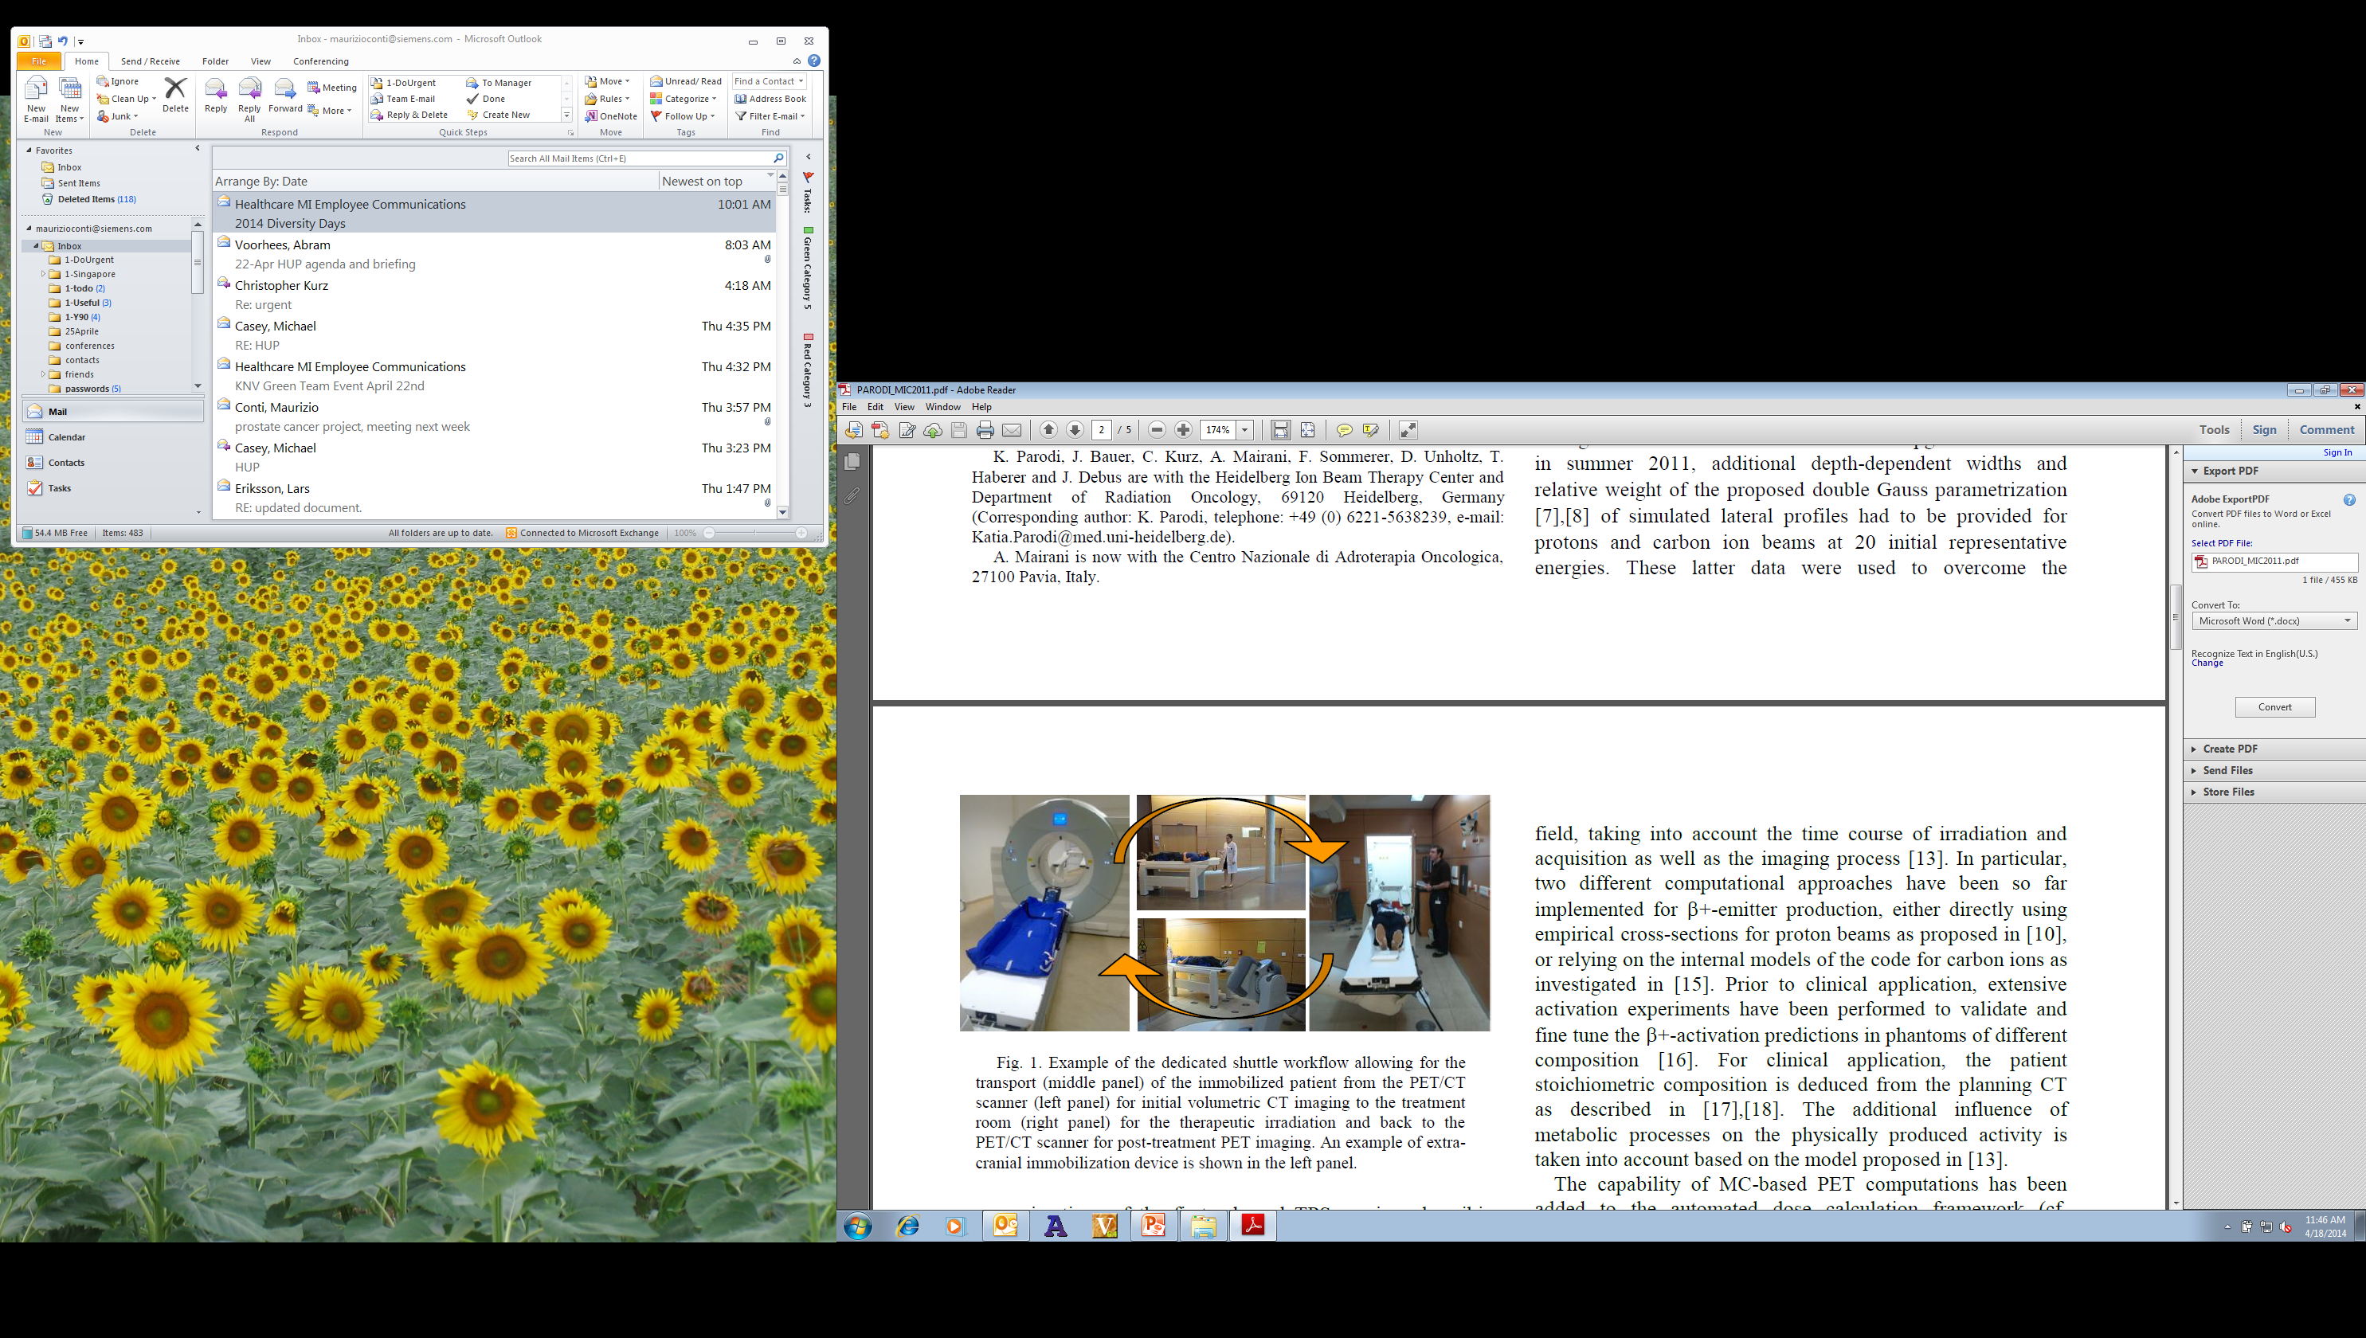
Monitoring of therapy: hadron/proton therapy
    PET imaging of irradiation with proton or ¹²C induces β⁺ emitter (¹⁵O, ¹¹C, etc)
    Hadron and proton therapy are used for local treatment of tumors: liver, brain, eyes, prostate.
    Very weak PET signal from nuclei activation inside the tissue.
PET scan characteristics:
long (30 minutes)
low number of counts [10⁵-10⁶], while typical FDG PET is [10⁷-10⁸]
with high random fraction (>80%)
    Off-beam PET (about 5-10 minutes post-therapy)
Courtesy of Heidelberger Ionenstrahl-Therapiezentrum (HIT)

Slide 16
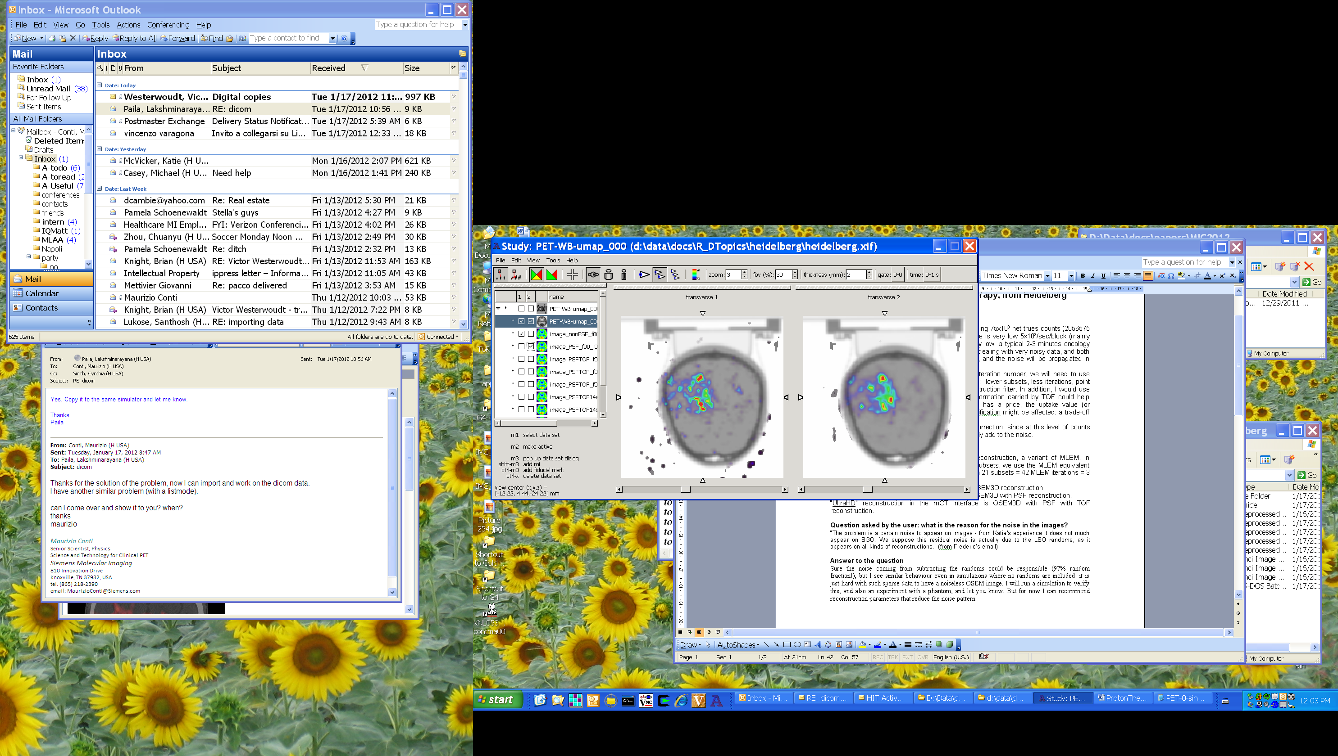
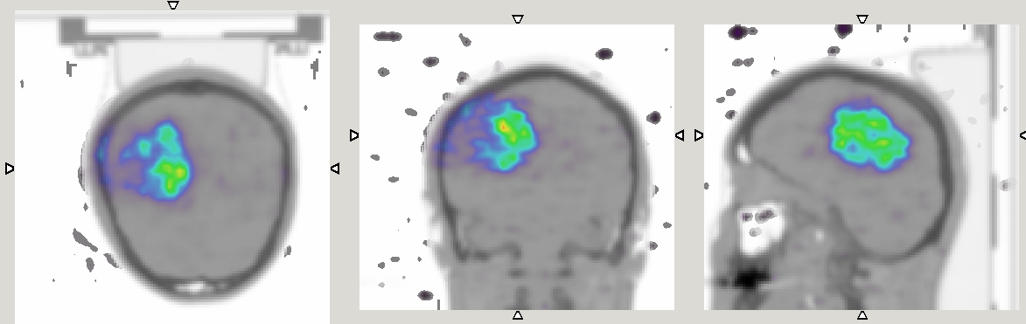
Monitoring of therapy: hadron/proton therapy
OSEM, 21 subsets,
3 iterations
OSEM+PSF+TOF, 14 subsets, 2 iterations
image size 200x200, 5 mm Gaussian filter
Reconstruction methods need to be tailored/optimized for challenging applications
Courtesy of Heidelberger Ionenstrahl-Therapiezentrum (HIT)

Slide 17
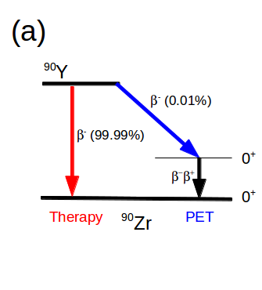
Monitoring of therapy: Y-90 therapy
⁹⁰Y is used as a therapeutic radioisotope in microspheres for targeted radiation therapy of the liver. Very weak PET signal from e⁺e⁻ pair creation (BR=30x10⁻⁶)
PET scan characteristics:
long (30 minutes)
low number of counts [10⁵-10⁶], FDG PET is [10⁷-10⁸]
with high random fraction (>80%)
high flux of Bremsstrahlung singles in ⁹⁰Y
LSO

Slide 18
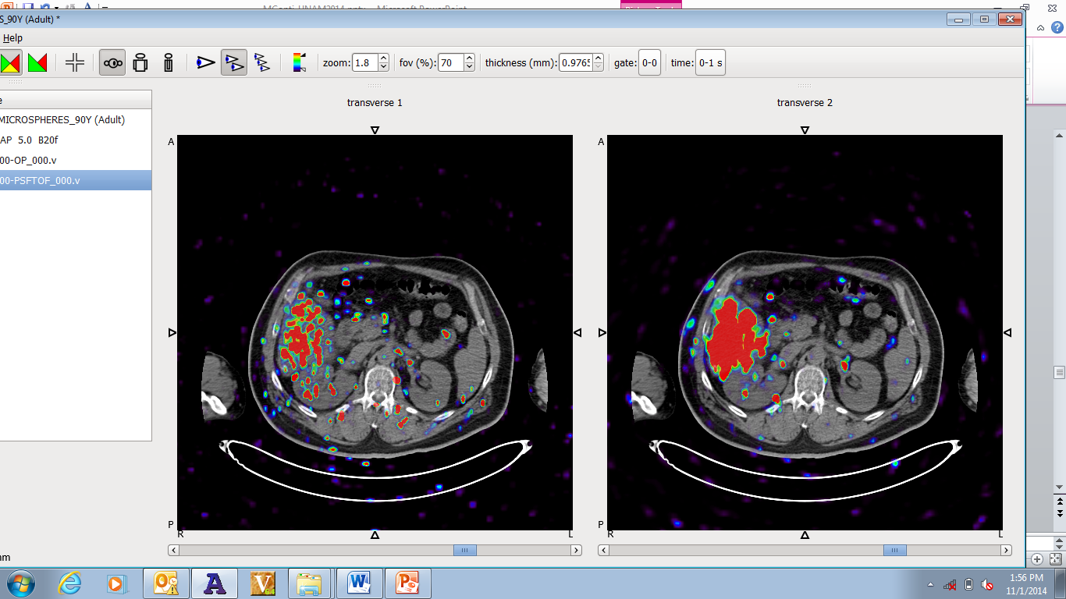
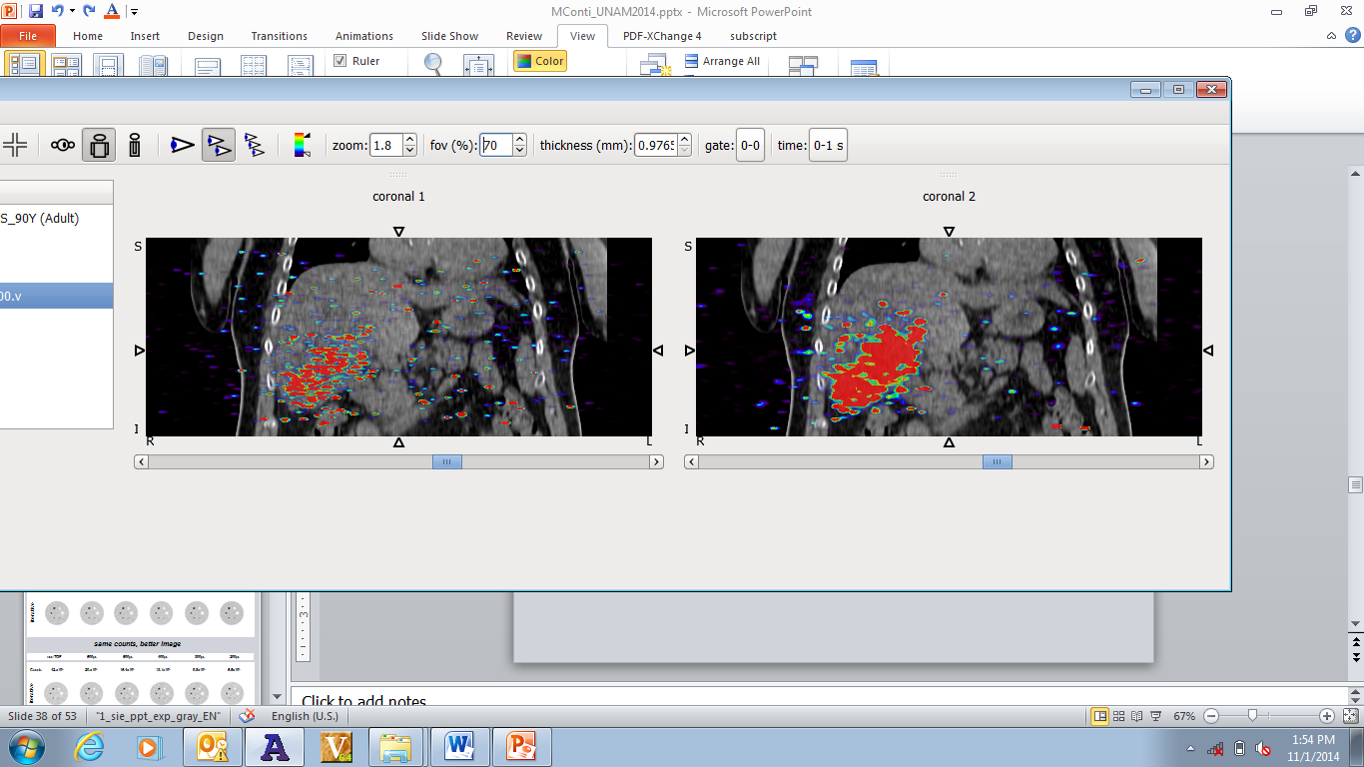
Monitoring of therapy: Y-90 therapy
Patient after Y-90 microspheres injection in the liver
(50000 counts, 95% random fraction)
non TOF
TOF
Courtesy of University Hospital, Nantes, France

Slide 19
Enabling new trends: beyond “diagnostic-only” imaging (1)
Enabling new trends: beyond “diagnostic-only” imaging (2)
Enabling new trends: beyond “generic” FDG imaging
Enabling new trends: beyond “static” imaging

Slide 20
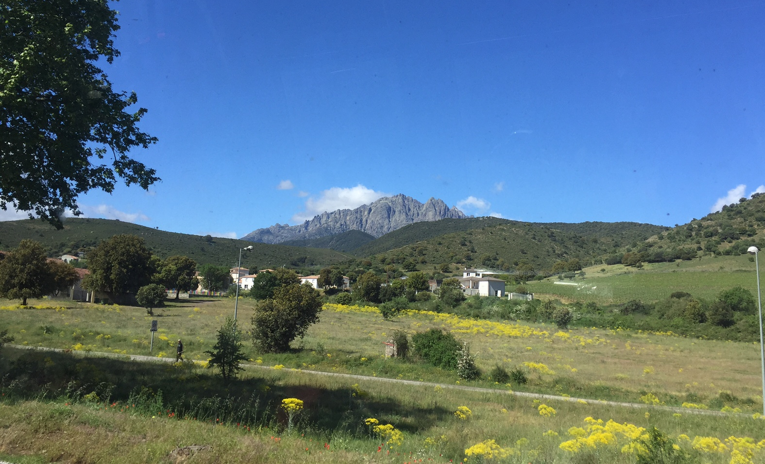
Challenges of theranostics and personalized therapy monitoring

Slide 21
Challenges of theranostics and personalized therapy monitoring
    Challenges for PET physics and reconstruction:
    non-pure beta decay -> accurate prompt gammas corrections
    Long positron range -> range deblurring
    Fewer counts -> reconstruction optimization
    Unknown kinetics or biological mechanisms

Slide 22
Positron Emitting Isotopes
Isotope | Half-life | Branching (β⁺) in % | E_{max} (MeV) | E_{mean} (MeV) | R_{max} (mm) | R_{mean} (mm)
¹¹C | 20.4 min | 99.8 | 0.960 | 0.386 | 4.2 | 1.2
¹³N | 10.0 min | 99.8 | 1.199 | 0.492 | 5.5 | 1.8
¹⁵O | 2 min | 99.9 | 1.732 | 0.735 | 8.4 | 3.0
¹⁸F | 110 min | 96.9 | 0.634 | 0.250 | 2.4 | 0.6
⁶⁴Cu | 12.7 hours | 17.5 | 0.653 | 0.278 | 2.5 | 0.7
⁸⁹Zr | 78.4 hours | 22.7 | 0.902 | 0.396 | 3.8 | 1.3
Isotope | Half-life | Branching (β⁺) in % | β⁺ E_{max} (MeV) | Branching (γ) in % | γ E (PG) (MeV)
⁶⁸Ga | 67.8 min | 87.7, 1.2 | 1.899, 0.821 | 3.2 | 1.077
⁷⁶Br | 16.2 hours | 25.8, 6.3 | 3.382, 0.871 | 74.0, 15.9 | 0.559, 0.657
⁸²Rb | 1.3 min | 81.8, 13.1 | 3.378, 2.601 | 15.1 | 0.777
⁸⁶Y | 14.7 hours | 11.9, 5.6 | 1.221, 1.545 | 82.5, 32.6 | 1.077. 0.627
¹²⁴I | 100 hours | 11.7, 10.7 | 1.535, 2.138 | 62.9, 11.2 | 0.602, 1.691
Pure beta emitters
Prompt gamma emitters

Slide 23
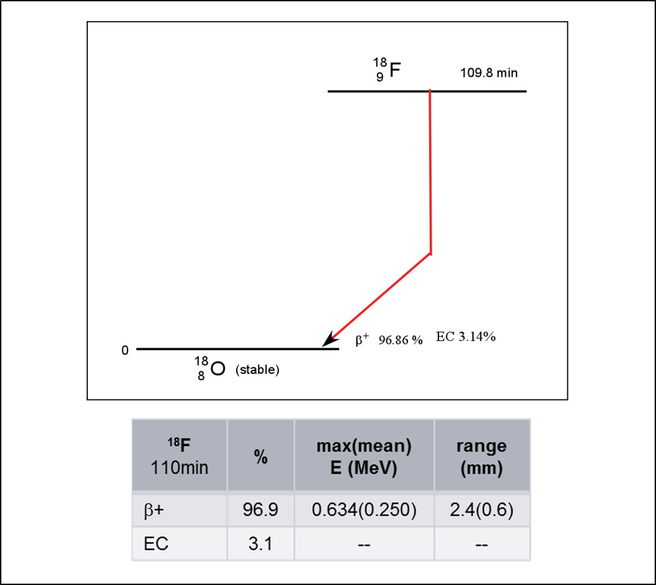
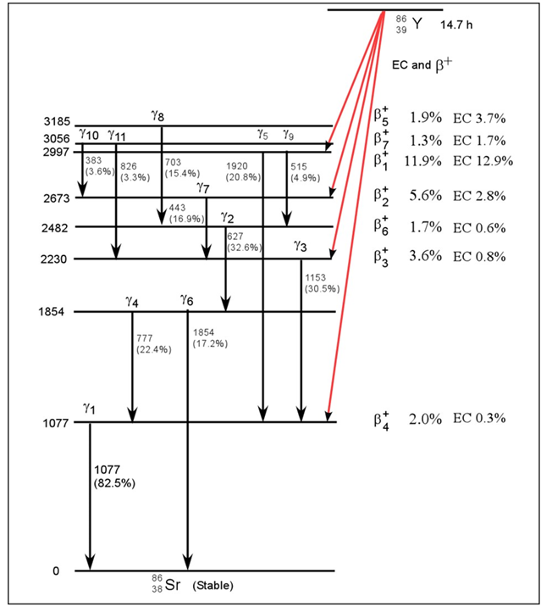
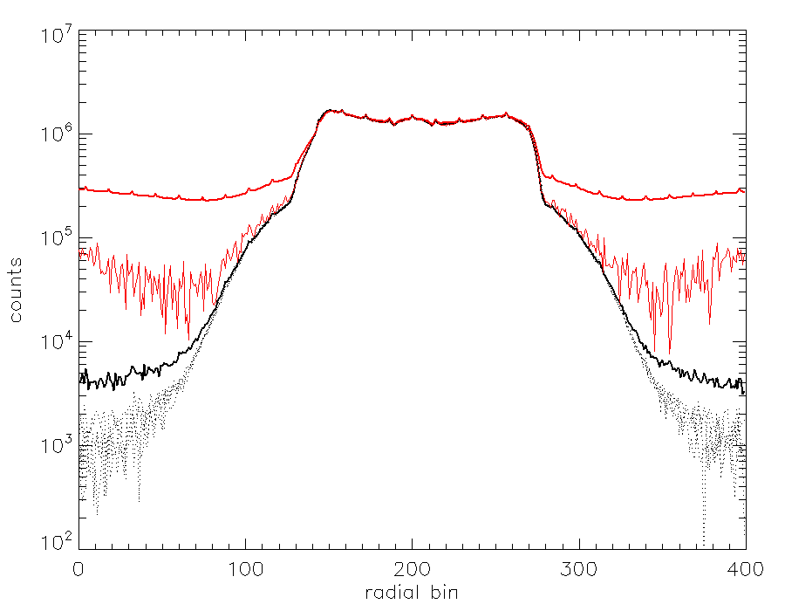
Challenges: prompt gamma corrections
¹²⁴I
⁹⁰Y
⁶⁸Ga
F18 decay scheme
⁸⁹Zr,¹¹C, ¹⁸F, ⁶⁴Cu
“simplified” Y86 decay scheme
Radial profile of phantom: comparison of different radioisotopes

Slide 24
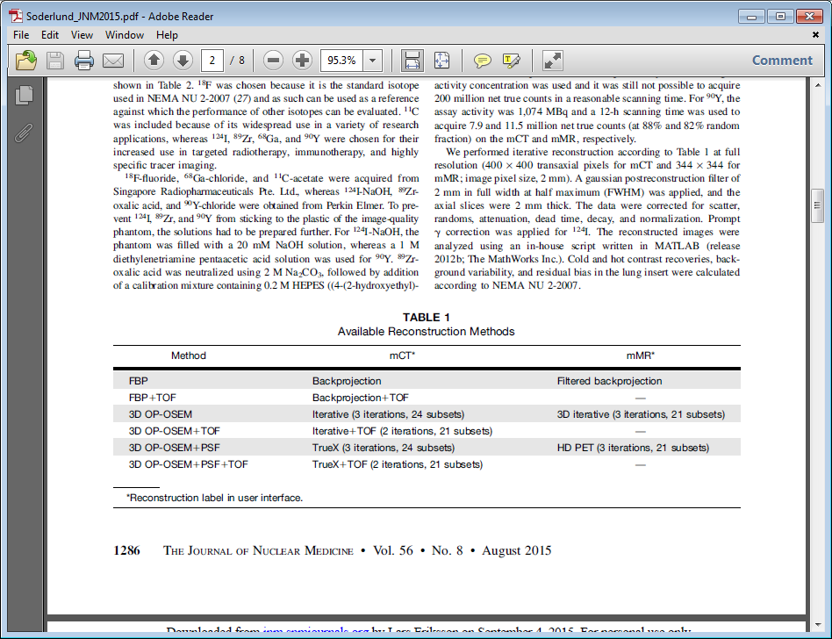
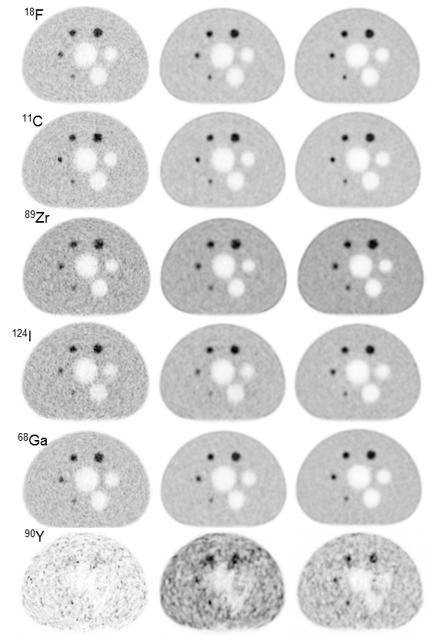
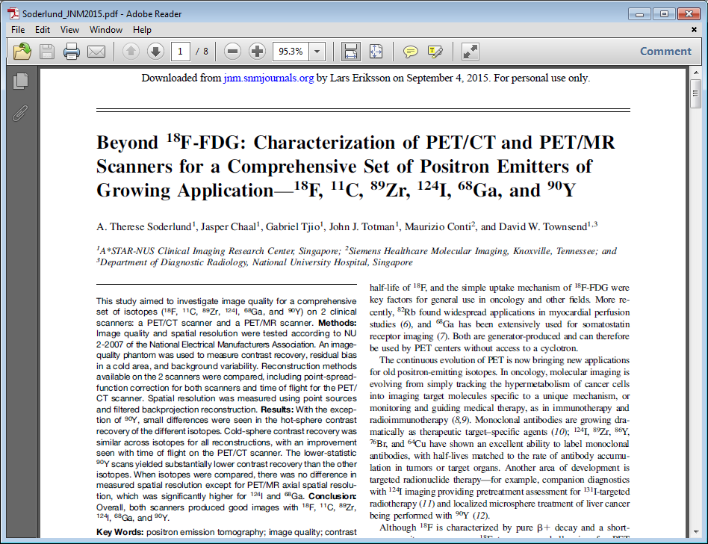
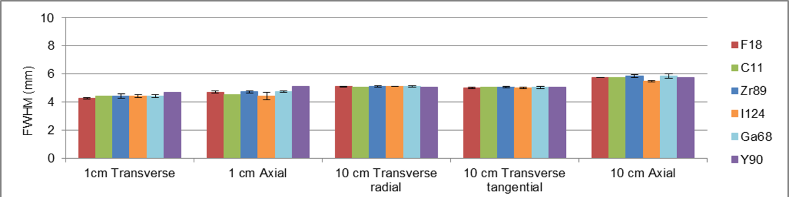
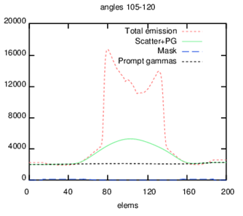
Scanner characterization for all radioisotopes
¹²⁴I
Prompt gamma correction prevents image artifacts
PG

Slide 25
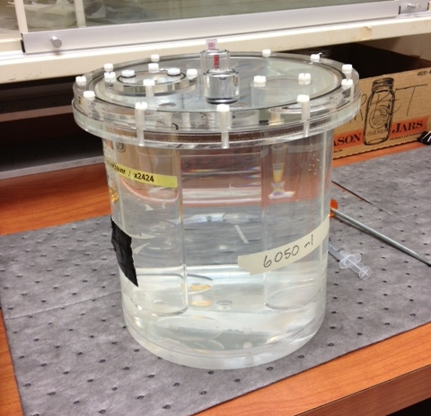
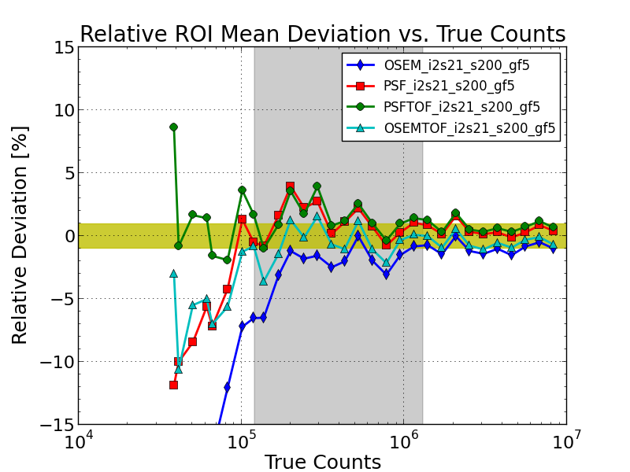
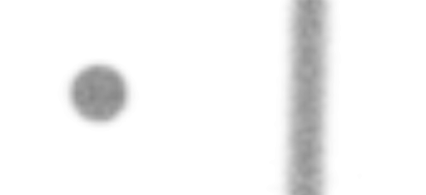
Monitoring of therapy: hadron/proton therapy
Quantification and reproducibility at extremely low counts
OSEM
OSEM+PSF
OSEM+TOF
OSEM+PSFTOF
Quantification with OSEM starts failing below 200k trues
PSF and TOF can overcome this limitation (best results PSF+TOF)

Slide 26
Enabling new trends: beyond “diagnostic-only” imaging (1)
Enabling new trends: beyond “diagnostic-only” imaging (2)
Enabling new trends: beyond “generic” FDG imaging
Enabling new trends: beyond “static” imaging

Slide 27

Tracers used in PET
Use of PET tracers, 2013
Main application today: oncology
Measuring Glucose Metabolism
But it is changing…
Radiopharmaceutical | # of Times Scanned | % of Total
Fluorodeoxyglucose (F-18) | 346442 | 90.68%
Rubidium chloride (Rb-82) | 10211 | 2.67%
Fluorethylcholine (F-18) | 5087 | 1.33%
Germanium (Ge-68) | 1790 | 0.47%
Gallium Solution (Ga-68) | 1468 | 0.38%
Fluoro-L-dopa (F-18) | 1264 | 0.33%
DOTA-TATE (Ga-68) | 1241 | 0.32%
Ammonia (N-13) | 1233 | 0.32%
Sodium Fluoride (F-18) | 1111 | 0.29%
Oxygen (O-15) | 938 | 0.25%
Solution (F-18) | 823 | 0.22%
Acetate (C-11) | 806 | 0.21%
Choline (C-11) | 787 | 0.21%
DOTA-TOC (Ga-68) | 726 | 0.19%
Fluorethyltyrosin (F-18) | 723 | 0.19%
Methionine (C-11) | 606 | 0.16%
Solid Solution (Ge-68) | 598 | 0.16%
Crossed Rods (Ge-68) | 550 | 0.14%
PSMA (Ga-68) | 442 | 0.12%
¹⁸F-FDG
(fluorodeoxyglucose)

Slide 28
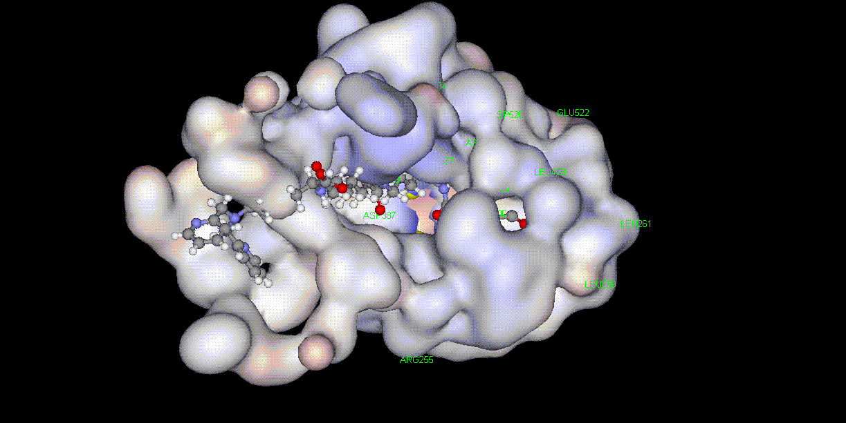
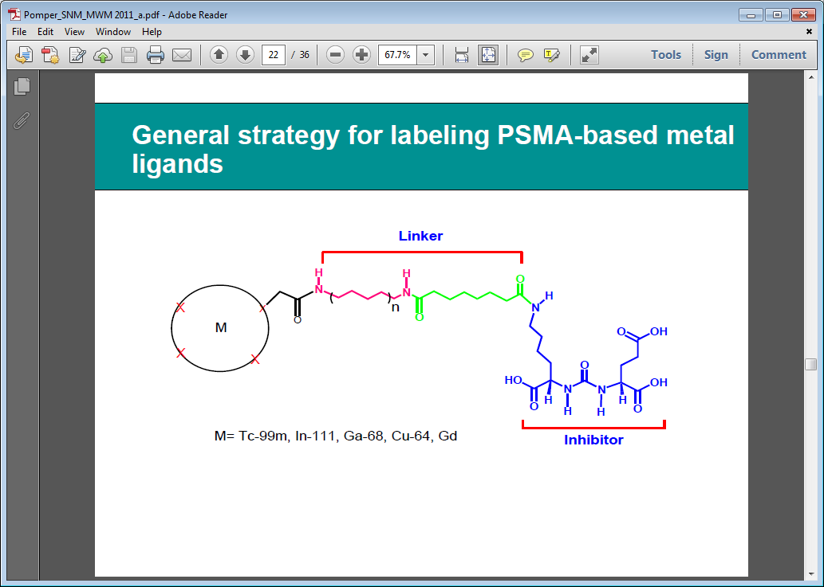
Beyond FDG: PSMA tracers for prostate cancer
Compound is inhibitor of a specific site in PSMA (high affinity):
It bounds strongly and only to PSMA
Low molecular weight (fast uptake)
* Banerjee et al.: “Synthesis and Evaluation of Technetium-99m- and Rhenium-Labeled Inhibitors of the Prostate-Specific Membrane Antigen (PSMA)”J Med Chem 51, 4504-4517, 2008
** Courtesy of Martin Pomper

Slide 29
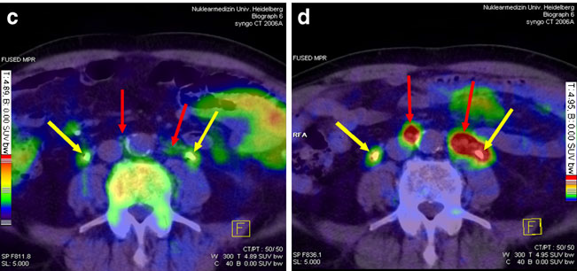
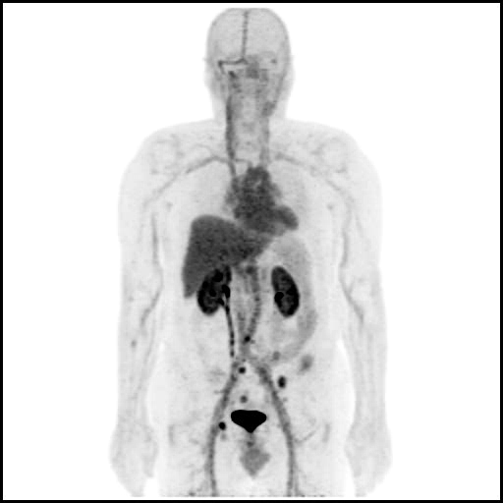
Beyond FDG: PSMA tracers for prostate cancer
Ga68-PSMA
A.Afshar-Oromieh et al.: “Comparison of PET imaging with a 68Ga-labelled PSMA ligand and 18F-choline-based PET/CT for the diagnosis of recurrent prostate cancer”, EJNMMI 41: 11-20 (2014)
F18-choline
Ga68-PSMA
F18-PSMA
F18-PSMA
R.C.Mease et al.: “N-[N-[(S)-1,3-Dicarboxypropyl]Carbamoyl]-4-[18F]Fluorobenzyl-LCysteine, [18F]DCFBC: A New Imaging Probe for Prostate Cancer”, Clin. Cancer Res. 14: 3036-3043 (2008)
* Courtesy of Martin Pomper

Slide 30
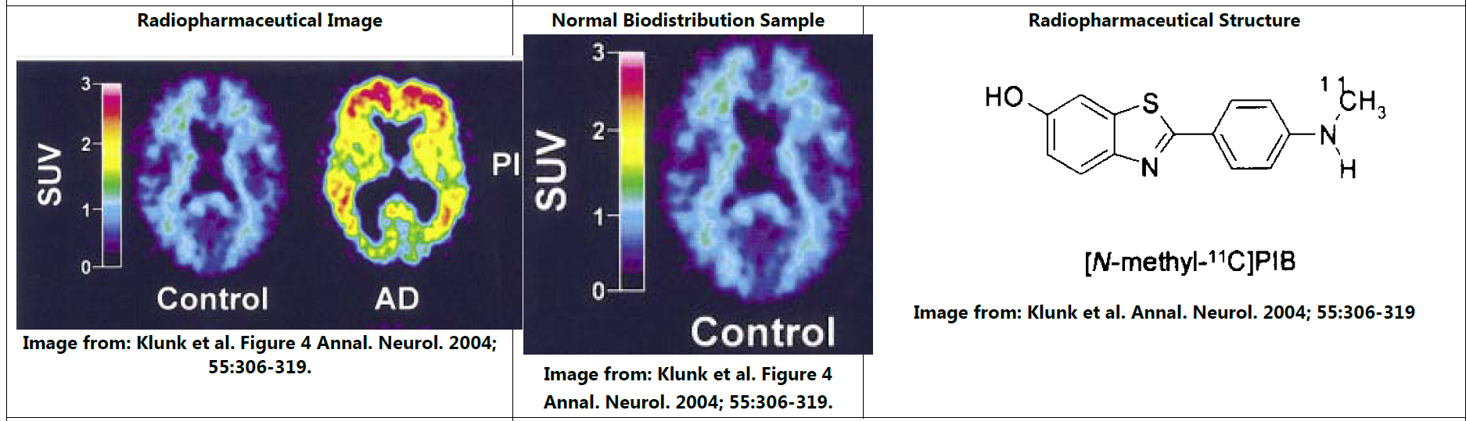
Beyond FDG: Amyloid imaging for Alzheimer’s disease
Several candidates to image amyloids, associated with Alzheimer’s disease
C11-PiB

Slide 31
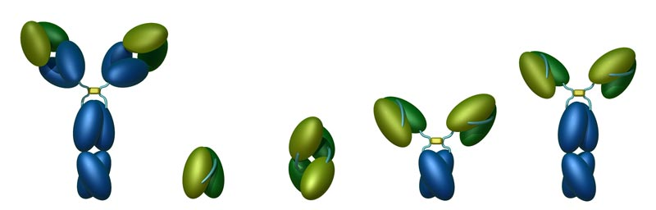
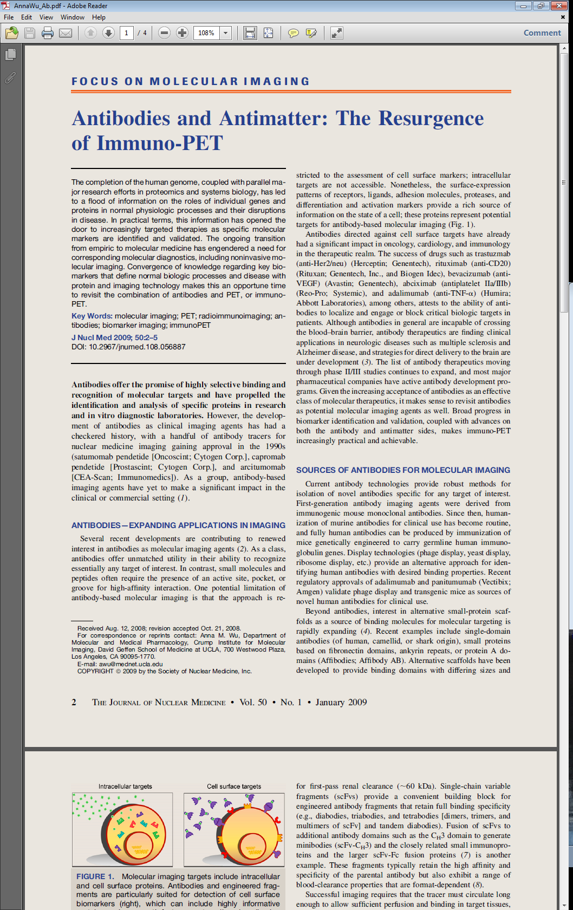
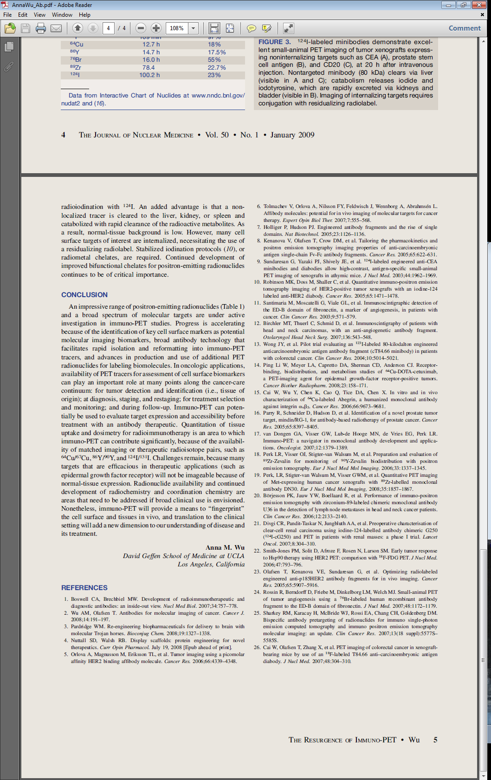
Beyond FDG: mAbs for specific cancer or immuno diseases
Engineering Antibodies
Targeted by mAbs:
Immuno diseases
Specific cancer cells
Intact antibody
150 kDa
Peak 50-100 h
Minibody
80 kDa
Peak 4-6 h
Diabody
55 kDa
Peak 1-2 h

Slide 32
Enabling new trends: beyond “diagnostic-only” imaging (1)
Enabling new trends: beyond “diagnostic-only” imaging (2)
Enabling new trends: beyond “generic” FDG imaging
Enabling new trends: beyond “static” imaging

Slide 33
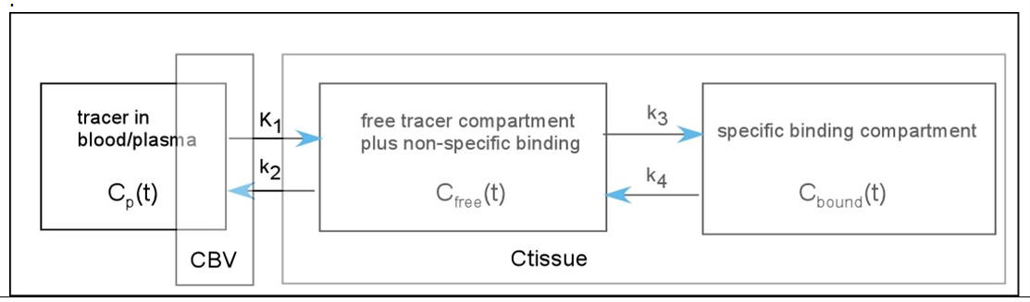
Beyond static SUV imaging
Is there more information beyond the simple static tracer uptake?
Tracers kinetics can bring information on:
  Disease characterization in general
  Disease preferred mechanism
  Disease differentiation between aggressive and indolent
  Drug mechanisms
Kinetics parameters of a model can carry that information
Imaging of the kinetic parameters can carry local information

Slide 34
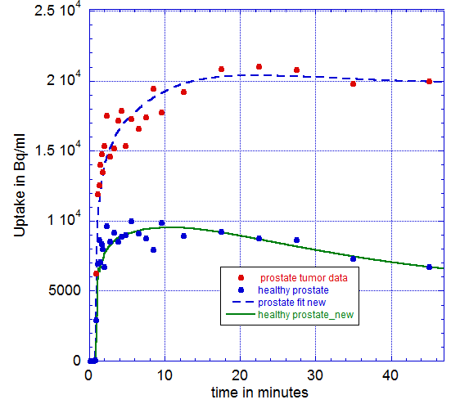
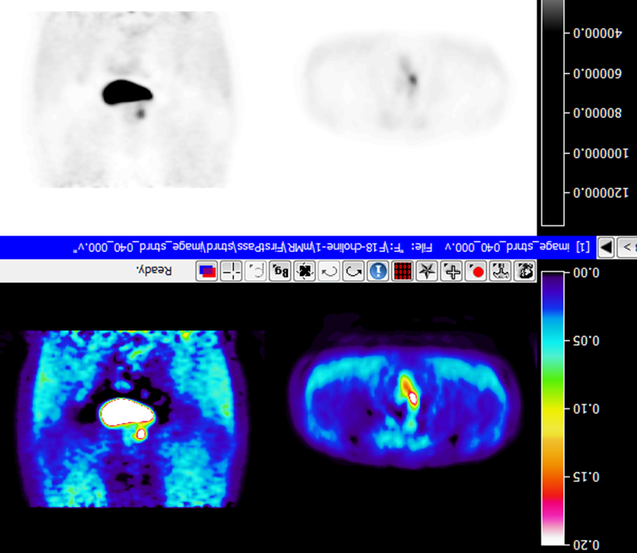
Beyond static SUV imaging: kinetic models and tumor characterization
Results: patient 1 and 2
Prostate cancer:
¹⁸F-choline
static imaging (SUV)
F18-choline | Prostate tissue
 | Healthy | Tumor*
K1 | 0.14 | 0.25
k3 | 0.007 | 0.02
Ki | 0.02 | 0.12
Parametric imaging (Ki)
Courtesy of D. Townsend, CIRC, Singapore

Slide 35
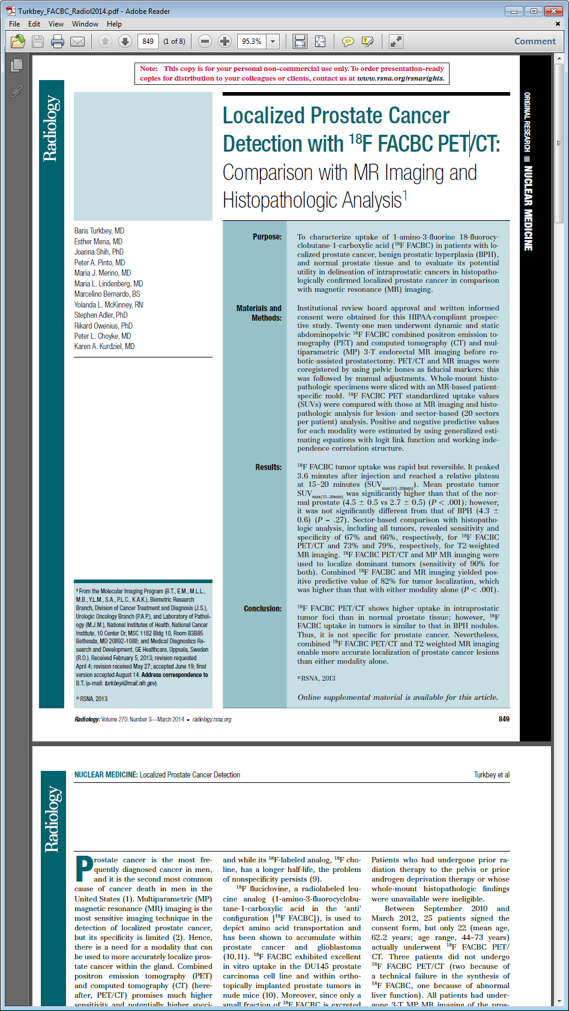
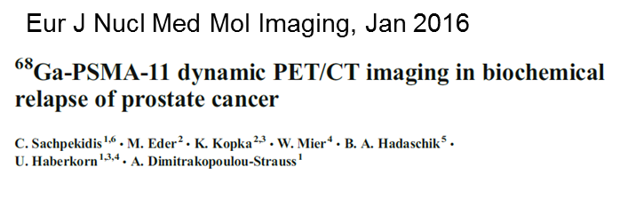
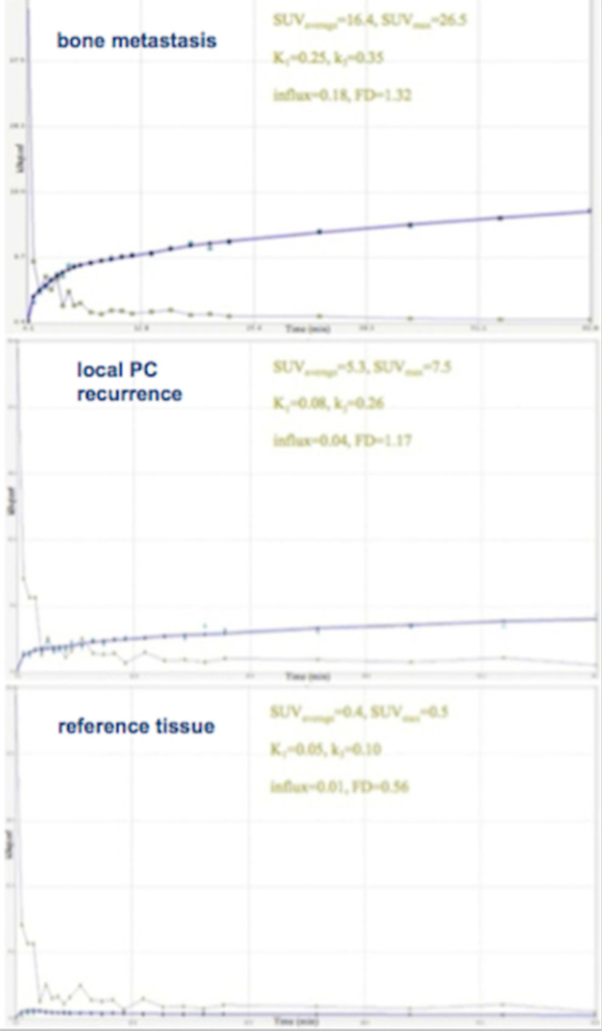
Beyond static SUV imaging: kinetic models and tumor characterization
Prostate cancer:
FACBC
and
PSMA
Reference is muscle tissue

Slide 36
Enabling better image quality
Enabling promising applications
Enabling better workflow and patient comfort
Enabling research

Slide 37


Slide 38


Better image quality via PSF reconstruction
3D-OSEM
3D-OSEM+PSF

Slide 39


Better image quality and higher sensitivity via TOF reconstruction
T2
T1
0
x
non-TOF
TOF
Data Courtesy of University of Tennessee, Knoxville, Tennessee, U.S.A.

Slide 40


Better image quality and higher detectability via PSF and TOF reconstruction
Non-TOF
TOF
Kadrmas, Casey, Conti, Jakobi, Lois, Townsend; “Impact of Time-of-Flight on PET Tumor Detection” J Nucl Med 2009; 50:1315–1323

Slide 41



Better image quality via reconstruction and scanner architectures
TOF reconstruction, large bore and high-capacity table enable studies of a broad patient population
Non-Hodgkin's Lymphoma: 13-year old, 155 cm, 217 kg, 90.3 BMI, 15.6 mCi
Images courtesy of the Ohio State University, USA

Slide 42


Better image quality via motion freeze
Respiratory motion can lead to bias in interpretation
respiratory gating technologies are methods to “freeze” motion
Static
HD•Chest
Ignores different respiratory cycles and sums up all data
Area with least motion found automatically and selected independently from respiratory pattern

Slide 43


Better image quality via motion freeze
Non-gated
HD•Chest
Non-gated image demonstrates only a single lesion
Gated image shows a second and third lesion
* Based on volumetric resolution available in competitive literature for systems greater than 70 cm bore size. Data on file.
Courtesy of the University of Michigan, Ann Arbor, MI, USA

Slide 44



Better image quality via motion correction
Compared to motion freeze (or gating),
motion correction
recovers more data
(reduced noise)
EMC=elastic motion correction
Cancer
Cardiac
Gated image
I.Hong, S.Furst, J.Jones, M.Casey, “The strategy of elastic motion corrections”, Proc. IEEE Medical Imaging Conference, Seoul, South Korea, 10/27-11/2, 2013.

Slide 45
Enabling better image quality
Enabling promising applications
Enabling better workflow and patient comfort
Enabling research

Slide 46

Promising applications for PET: prostate cancer
New applications for improved detectability: prostate cancer
    Prostate cancer is the leading cancer for men
    Imaging is very poor, “blind” biopsy is the common diagnostic tool
    Objectives:
    Imaging to guide or replace the biopsy
    exploit potential of new specific PET tracers (PSMA based and others)
    Accurate localization of primary tumor and local affected lymph nodes
Detection and localization of extra capsular lesion and lymph node
Simulation with ¹¹C-choline (6mm lesions, SUV 8)
Low resolution OSEM
5.5 mm pixel, 6 mm filter
High resolution OSEM+PSF+TOF
2 mm pixel, 2 mm filter

Slide 47




Promising applications for PET: lung cancer screening
New applications for improved detectability: lung cancer
Low-dose PET/CT ?
Low-dose CT screening of persons with high risk for lung cancer):
effective, but 95% false positives
10 mSv PET
Low-dose PET/CT screening of persons with high risk for lung cancer?
More effective, and much fewer false positives!
0.1 mSv PET
J. Schaefferkoetter, J. Yan, D. Townsend, and M. Conti, Phys. Med. Biol. 60 (2015) 5543–5556

Slide 48

Promising applications for PET: pancreas cancer
J Nucl Med. 2013;54:12-18.
Influx K_{i} = K₁*k₃/(k₂+k₃)
Tumor aggressiveness and survival in patients with pancreas cancer can be predicted by kinetic ¹⁸F-FDG uptake parameters generated by dynamic PET studies.
Specific tracers are being developed.
18F-FDG uptake in different tumors:
(blue) Ki=0.015; (red) Ki= 0.043.

Slide 49
Enabling better image quality
Enabling promising applications
Enabling better workflow and patient comfort
Enabling research

Slide 50


Better patient comfort: shorter scans
  TOF reconstruction produces comparable image with ½ of the counts
  An immediate direct advantage, for patient comfort, of improving reconstruction technology: shorter scans
non-TOF (120 sec)
TOF (60 sec)
Data Courtesy of University of Tennessee, Knoxville, Tennessee, U.S.A.

Slide 51


Enabling better workflow: continuous bed motion
Clinical Demand
Stop and Go
FlowMotion Clinical Result
Increased
Resolution
Speed
or Hi-Rez
Stop & Go
Hi-Rez
Hi-Rez
or Gating
Continuous
Flowing
Bed Motion
Stop & Go
HD•
Chest
Reduced Motion
Gating
or Speed
Stop & Go
Increased Contrast
and Fast Speed
Speed
Stop & Go
Speed
Speed
Stop & Go
IQ or fast
IQ and fast
* Based on volumetric resolution available in competitive literature for systems greater than 70 cm bore size. Data on file.

Slide 52




Enabling better workflow: continuous bed motion
0.8 mm/s
Hi-Rez
Conventional
90 cm
0.5 mm/s
HD•Chest
0.8 mm/s
2.0 mm/s
Higher Speed
FlowMotion

Slide 53
Enabling better image quality
Enabling promising applications
Enabling better workflow and patient comfort
Enabling research

Slide 54
Enabling research
    Provide tools to researchers to access full raw data:
    List mode data*
    Raw position, energy and time data
    Data corrections (normalization, scatter, attenuation)
    Provide platform to researchers to test new reconstruction:
    Flexible reconstruction interface
    Ability to accept research inputs (i.e. alternative scatter correction)
    Ability to provide intermediate and debug outputs
*http://usa.healthcare.siemens.com/molecular-imaging/petlink-documents

Slide 55




Enabling research
    Siemens present toolkit: JSRecon/e7tools
    Great flexible research tool !

Slide 56
Contact page
Maurizio Conti
Director, PET physics and reconstruction
Siemens Healthcare, Molecular Imaging
Research & Clinical Collaborations
810 Innovation Drive
Knoxville, TN 37919, USA
Phone: +1 (865) 218-2390
E-mail:
MaurizioConti@siemens.com
Answers for life.

Slide 57

Thanks!
Grazie !
Merci!
Knoxville, Tennessee

