Slide 1


Knowledge Transfer @ CERN
Photo: CERN
Photo: CERN
Manuela Cirilli
Medical Applications Section Leader
CERN Knowledge Transfer Group
Industry, Procurement, and Knowledge Transfer Department
Manuela.Cirilli@cern.ch

Slide 2
From physics to…
Medicine
and biology
Aerospace
Safety
Global
communities

Slide 3
Knowledge Transfer happens everywhere at CERN

Slide 4
cern.ch/knowledgetransfer

Slide 5
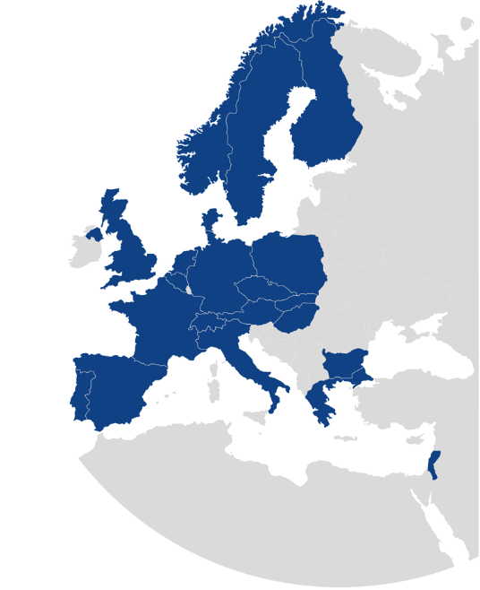
KT Mission
Maximize the technological and knowledge return to Society, especially in the Member States
Promote CERN’s image as a center of excellence for technology
Key words: dissemination and impact!

Slide 6
How to achieve impact?

Slide 7
Ways of doing KT

Slide 8

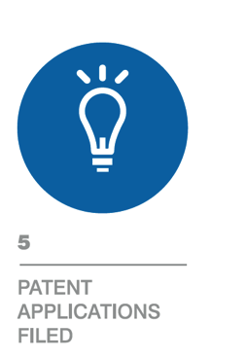

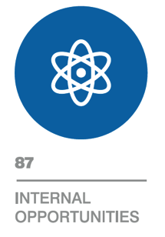
Results 2015
96
84
50
2

Slide 9
Patents filed (2015)

Slide 10
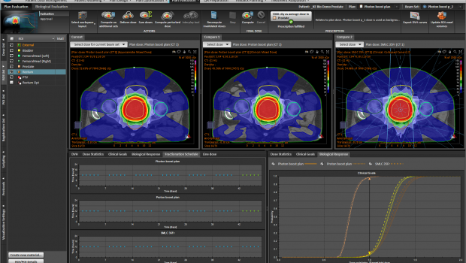
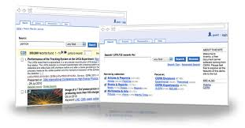
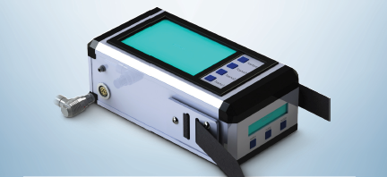
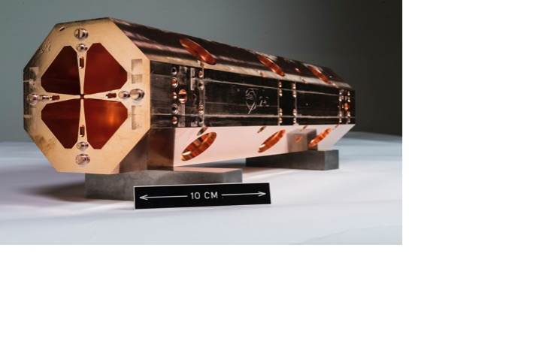
Examples of transfers 2015
Particle simulation software is used in patient treatment planning systems of a Swedish multinational medtech company
Document management software is used by a major university and a major international organization,
as a commercial service provided by a CERN spin-off.
Radiation monitoring technology is commercially available as an off-the-shelf product of a young Italian company
The «miniature accelerator» is being integrated into a commercial proton therapy system by a CERN spin-off.

Slide 11












































Knowledge Transfer Agreements 2015
Organisations
Companies
Universities

Slide 12
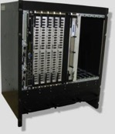



KT Contracts - examples
Giving the worldwide detector community access to standardized commercial grade readout electronics (SRS)
Medipix3: three commercial licenses to start-up companies
Kryolize, ActiWiz, Roxie softwares: 12 academic license agreements

Slide 13
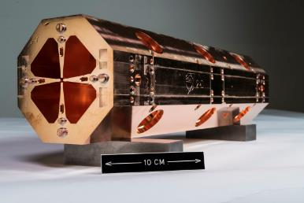
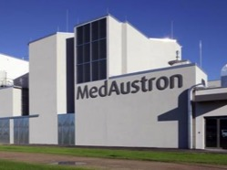

KT contracts - examples
License of the High Frequency Compact RFQ to ADAM SA
Medaustron: Extension of collaboration and exploitation of jointly developed know-how
FLUKA License to Raysearch for patient treatment planning

Slide 14
KT Strategy
KT
Society
Key Stakeholders
CERN Researchers
Engage
Promote
Communicate
Promote to CERN’s researchers the benefits of KT for the Organization, identify new opportunities, provide a high-quality and timely service | Engage with the outside world (in particular member states industry, institutes, and KT representatives) to disseminate and maximize the impact of CERN’s knowledge on society | Communicate on CERN’s KT activities to key stakeholders (in particular to decision makers in CERN’s Member states)

Slide 15
New technology/know-how
A low-threshold approach
Informal contact with KT
Meeting with KT officers
Technology disclosure form

Slide 16
Identify new kt opportunities
INET – Internal NETwork
representatives of all CERN departments
KT Innovation days
organised by KT for individual departments

Slide 17
The KT fund
CERN’s incentive scheme to help transferring our knowledge and technologies
Projects selected by a committee composed by
the Department Heads and the KT group
Since 2011:
32 projects financed, with amounts from 15 k to 190 k CHF
(not including 2016)

Slide 18
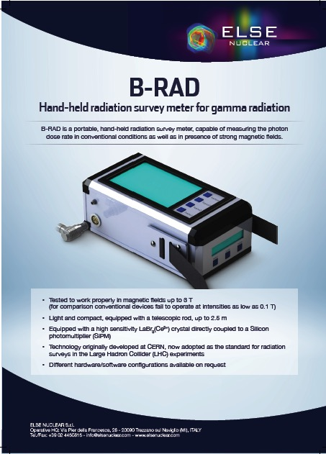
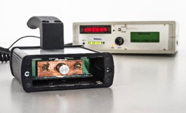
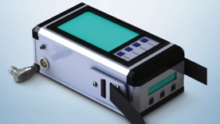
KT Fund Examples – B-Rad
Funded:
Prototype of a hand-held radiation survey meter operable in high magnetic fields
The KT Fund has catalysed the creation of
Off-the-shelf industrial-grade radiation survey meter by a company from a member state

Slide 19
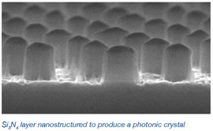
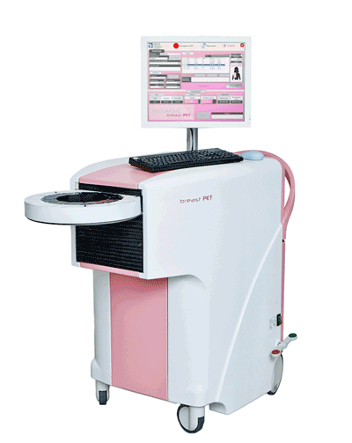




KT Fund Examples – Photonic Crystals
Funded:
Nanostructuring for improved light extraction from scintillating materials
The KT Fund has catalysed the creation of
An industry-driven collaboration to achieve breakthrough PET scanning performance for breast cancer diagnosis

Slide 20
Business Incubation Centres (BIC) in CERN Member States
BICs of CERN technologies assist entrepreneurs and small high-tech businesses in taking innovative ideas from technical concept to market reality
CERN contributes with technical visits to the Laboratory, support to the companies in the BICs, and preferential-rate licensing of CERN’s IP
The BIC managers provide offices, know- how, access to local and national networks, business and fundraising support

Slide 21
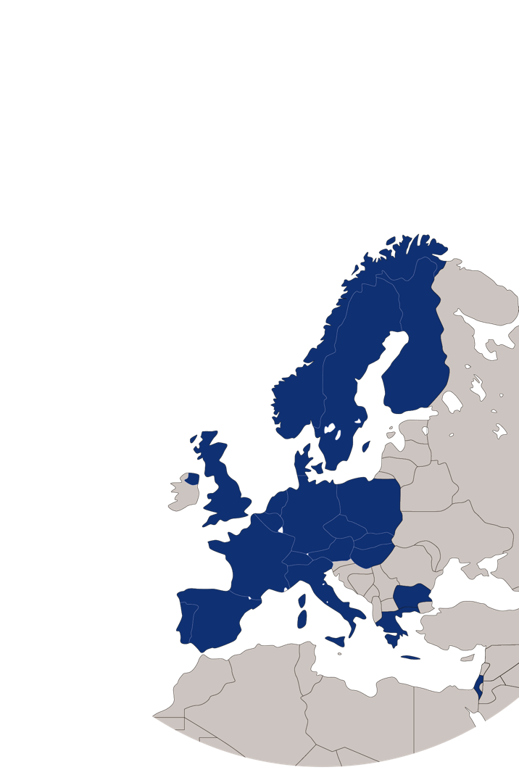
CERN BIC Network today
UK – STFC-CERN BIC
Netherlands – NIKHEF-CERN BIC
Norway – NTNU BIC of CERN Technology
Greece – Technopolis BIC of CERN Technology
Austria – Austria BIC of CERN Technology
France – InnoGEX BIC of CERN Technology
Finland – Finnish BIC of CERN Technology
Spain – Spanish BIC of CERN Technology

Slide 22












STFC-CERN BIC (UK, 2012)
NTNU BIC of CERN Tech. (NO, 2014)
NIKHEF CERN BIC (NL, 2014):
Austria BIC of CERN Tech. (AT, 2014):
InnoGex (FR, 2015):
CamsTech Ltd

Slide 23
Entrepreneurship@CERN
Support the entrepreneurial spirit through:
Activities and events:
  Entrepreneurship meet-up
  Global entrepreneurship week
  CERN-NTNU Screening Week
  Entrepreneurship support provided to THE Port Hackathon and IdeaSquare Challenge Based Innovation Programmes
Material and documents made available to CERN people:
  Business plan package tailored for CERN scientists and engineers
  Financial spreadsheets for start-ups with explanations
Notes:
There is ongoing work on creating a policy on start-up companies to provide clear and easily available guidelines on how internal and external people can engage in entrepreneurship with CERN, and set the course for CERN’s engagement in this process.
Several activities have and will be hosted this year on entrepreneurship. The entrepreneurship meet-up will me mentioned in the next slide.
The global entrepreneurship week is an event that takes place in many different cities around the world in November to emphasize and inspire to entrepreneurship. In Geneva it is coordinated by the University of Geneva. CERN contributed with one session at the university last year, and will contribute with one session at CERN and one at the university this year. (http://www.liberezvosidees.ch/)
CERN-NTNU Screening Week is an annual 1 week training programme for entrepreneurship students done with the Norwegian University of Science and Technology (NTNU). 30 Students come to CERN to evaluate the commercial potential of CERN technologies. A few students tried to start companies based on the technologies, one which has been successful, TIND Technologies. The screening week started in 2008.
In addition support on entrepreneurship has been provided to THE Port hackathon, an event arranged by the association THE Port in IdeaSquare at CERN, where NGO, such as the UN and the ICRC provides challenges, which multidisciplinary teams have a weekend to create a solution to, including a prototype (http://theport.ch/)
Support has also been provided to the Challenge Based Innovation Programme, a student programme in IdeaSquare. It is organized and coordinated in collaboration with universities and business schools. Using the design thinking philosopy and inspiration from CERN the students work on solving large challenges, sometimes provided by external sponsors or NGOs (http://ideasquare.web.cern.ch/content/cbi-course-challenge-based-innovation).
Finally, material that can be used by CERN people looking into creating a start-up has been made and is ready for use. Currently, given out only per request as a way of getting in touch with these people early in their process.

Slide 24
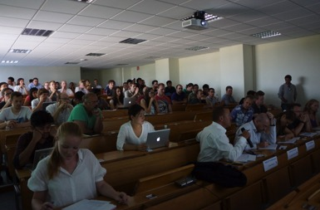
Entrepreneurship Meet-Up
Organized by KT every other Wednesday at 18:00
For CERN people interested in entrepreneurship
Often with external guest speakers
Usually around 20 people per meet-up
120 people on mailing list
Pitching competition:
8th of July 2015
13 Participants
~60 in the audience
Notes:
Every other week, KT organizes meetings where CERN people who are interested in entrepreneurship and innovation can meet. These informal meetings have an overarching topic, sometimes introduced by external guest speakers, other times by CERN people with extensive knowledge on a specific subject.
Usually around 20 people show up each time, some regulars and some new people. There per today 120 people on mailing list.
During the summer a pitching competition was arranged, where 13, students, fellows and users pitched their ideas in front of a panel of judges. This event attracted around 60 people in total from CERN.

Slide 25
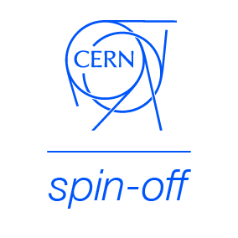
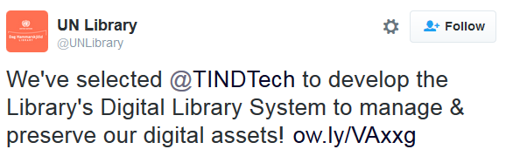


TIND Technologies
http://tind.io

Slide 26
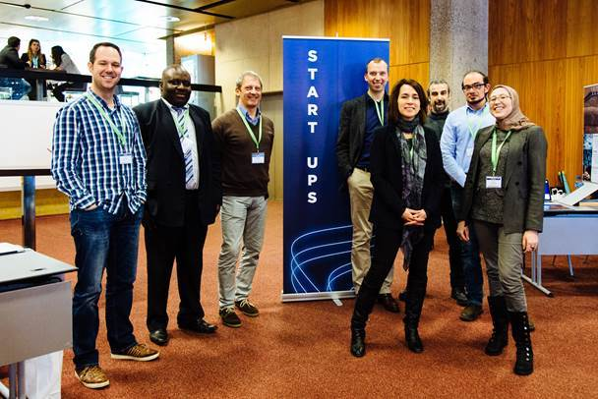
Photo Salvatore Fiore https://www.flickr.com/photos/salvafiore

Slide 27


Communication

Slide 28
SME network
Downloadable bi-annual
KT newsletter
(allows to create an
internal database of SMEs)
Accessible also to large corporations, research centres, universities, etc.

Slide 29
SME network
Launched November 2015.
Jan-March 2016:
more than 300 visitors
More than 100 subscriptions
(with 50 SMEs)

Slide 30
Open Knowledge
Open Access
Open Data
Open Source
Openlab
Open Hardware

Slide 31

Open Hardware License (OHL)
In the spirit of knowledge sharing and dissemination, the CERN–OHL governs the use, copying, modification and distribution of hardware design documentation, and the manufacture and distribution of products.
The CERN–OHL is to hardware what the General Public Licence (GPL) is to software. It defines the conditions under which a licensee will be able to use or modify the licensed material.

Slide 32
Contacts
General enquiries: mail-KT@cern.ch
KT Group Leader: Giovanni.Anelli@cern.ch
IP Dissemination: David.Mazur@cern.ch
Medical Applications: Manuela.Cirilli@cern.ch
Aerospace Applications: Enrico.Chesta@cern.ch

Slide 33

cern.ch/knowledgetransfer

Slide 34
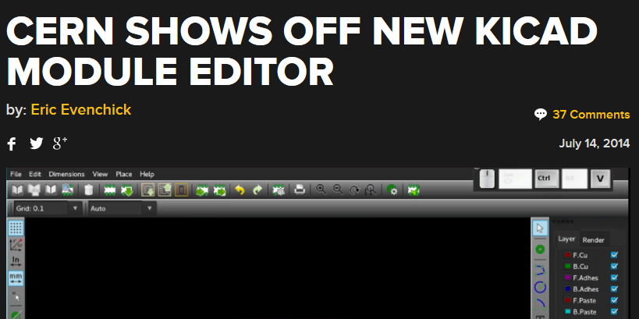
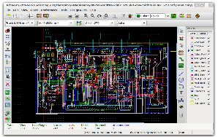
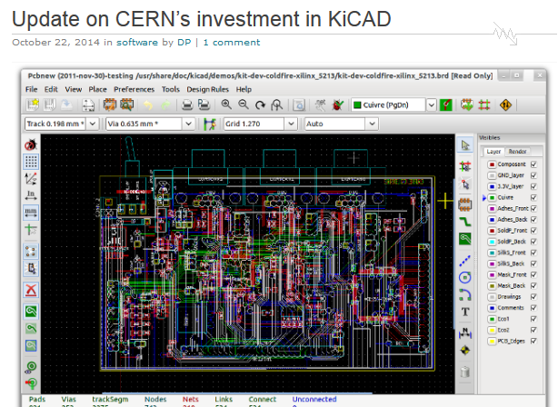
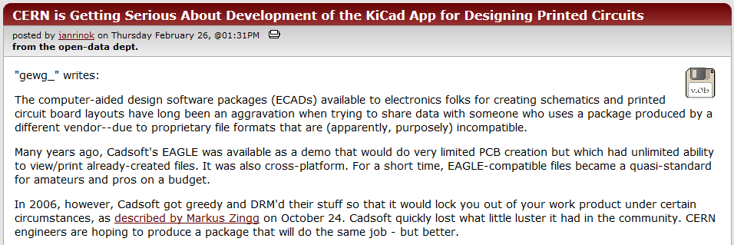
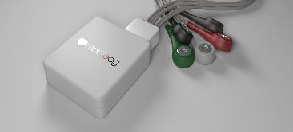
KT Fund Examples - KiCAD
Funded:
Development of additional functionality for open source Electronic Design Automation tool (KiCAD)
The KT Fund has catalysed the creation of
Access by the worldwide electronic design community to a free alternative to professional tools, thereby fostering creation and dissemination of new designs.

Slide 35
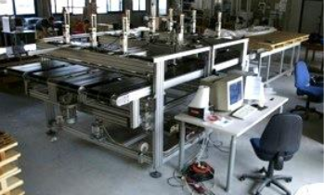
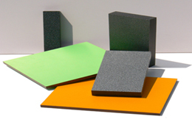
KT Fund Examples – High Pressure Laminates
Funded:
Improving production of high-pressure laminates for CERN detector lab
The KT Fund has catalysed the creation of
Durables laminates for surfaces in industrial and/or consumer environments.

Slide 36
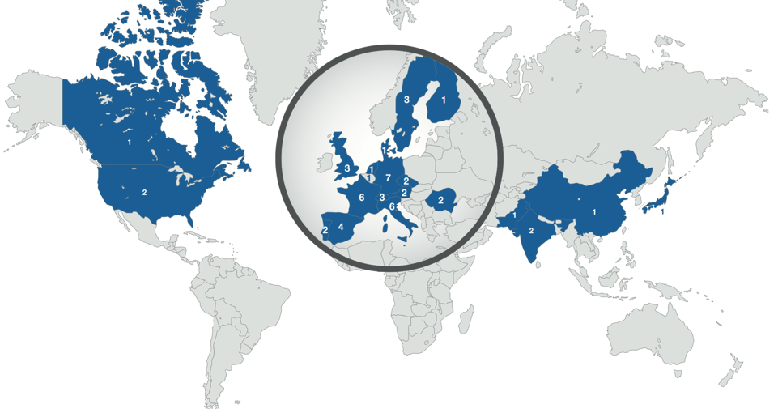
KT agreements geographical distribution

Slide 37
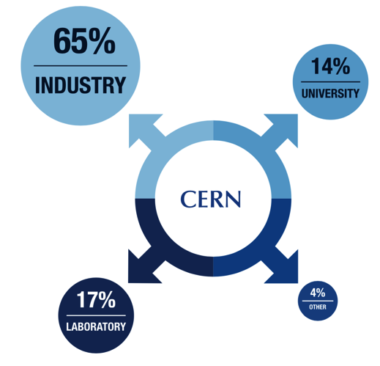
Type of partner

