Slide 1
EN-MEF involvement with the LS1 PSB Hardware tests.
David Hay EN-MEF

Slide 2
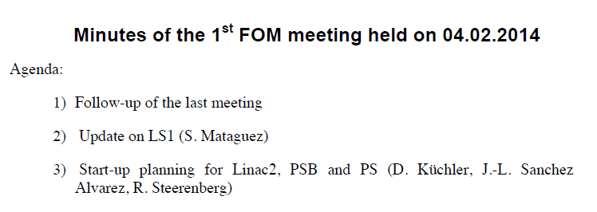
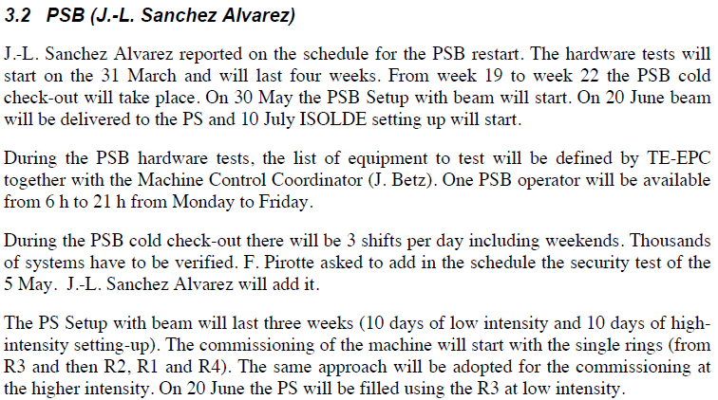
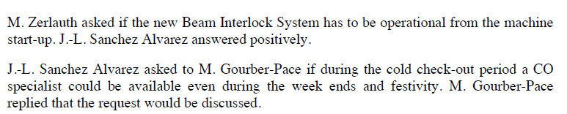
PSB Hardware tests followed up at FOM
EN-MEF involvement.
Schedule.
Access.
Field coordination (Safety).

Slide 3
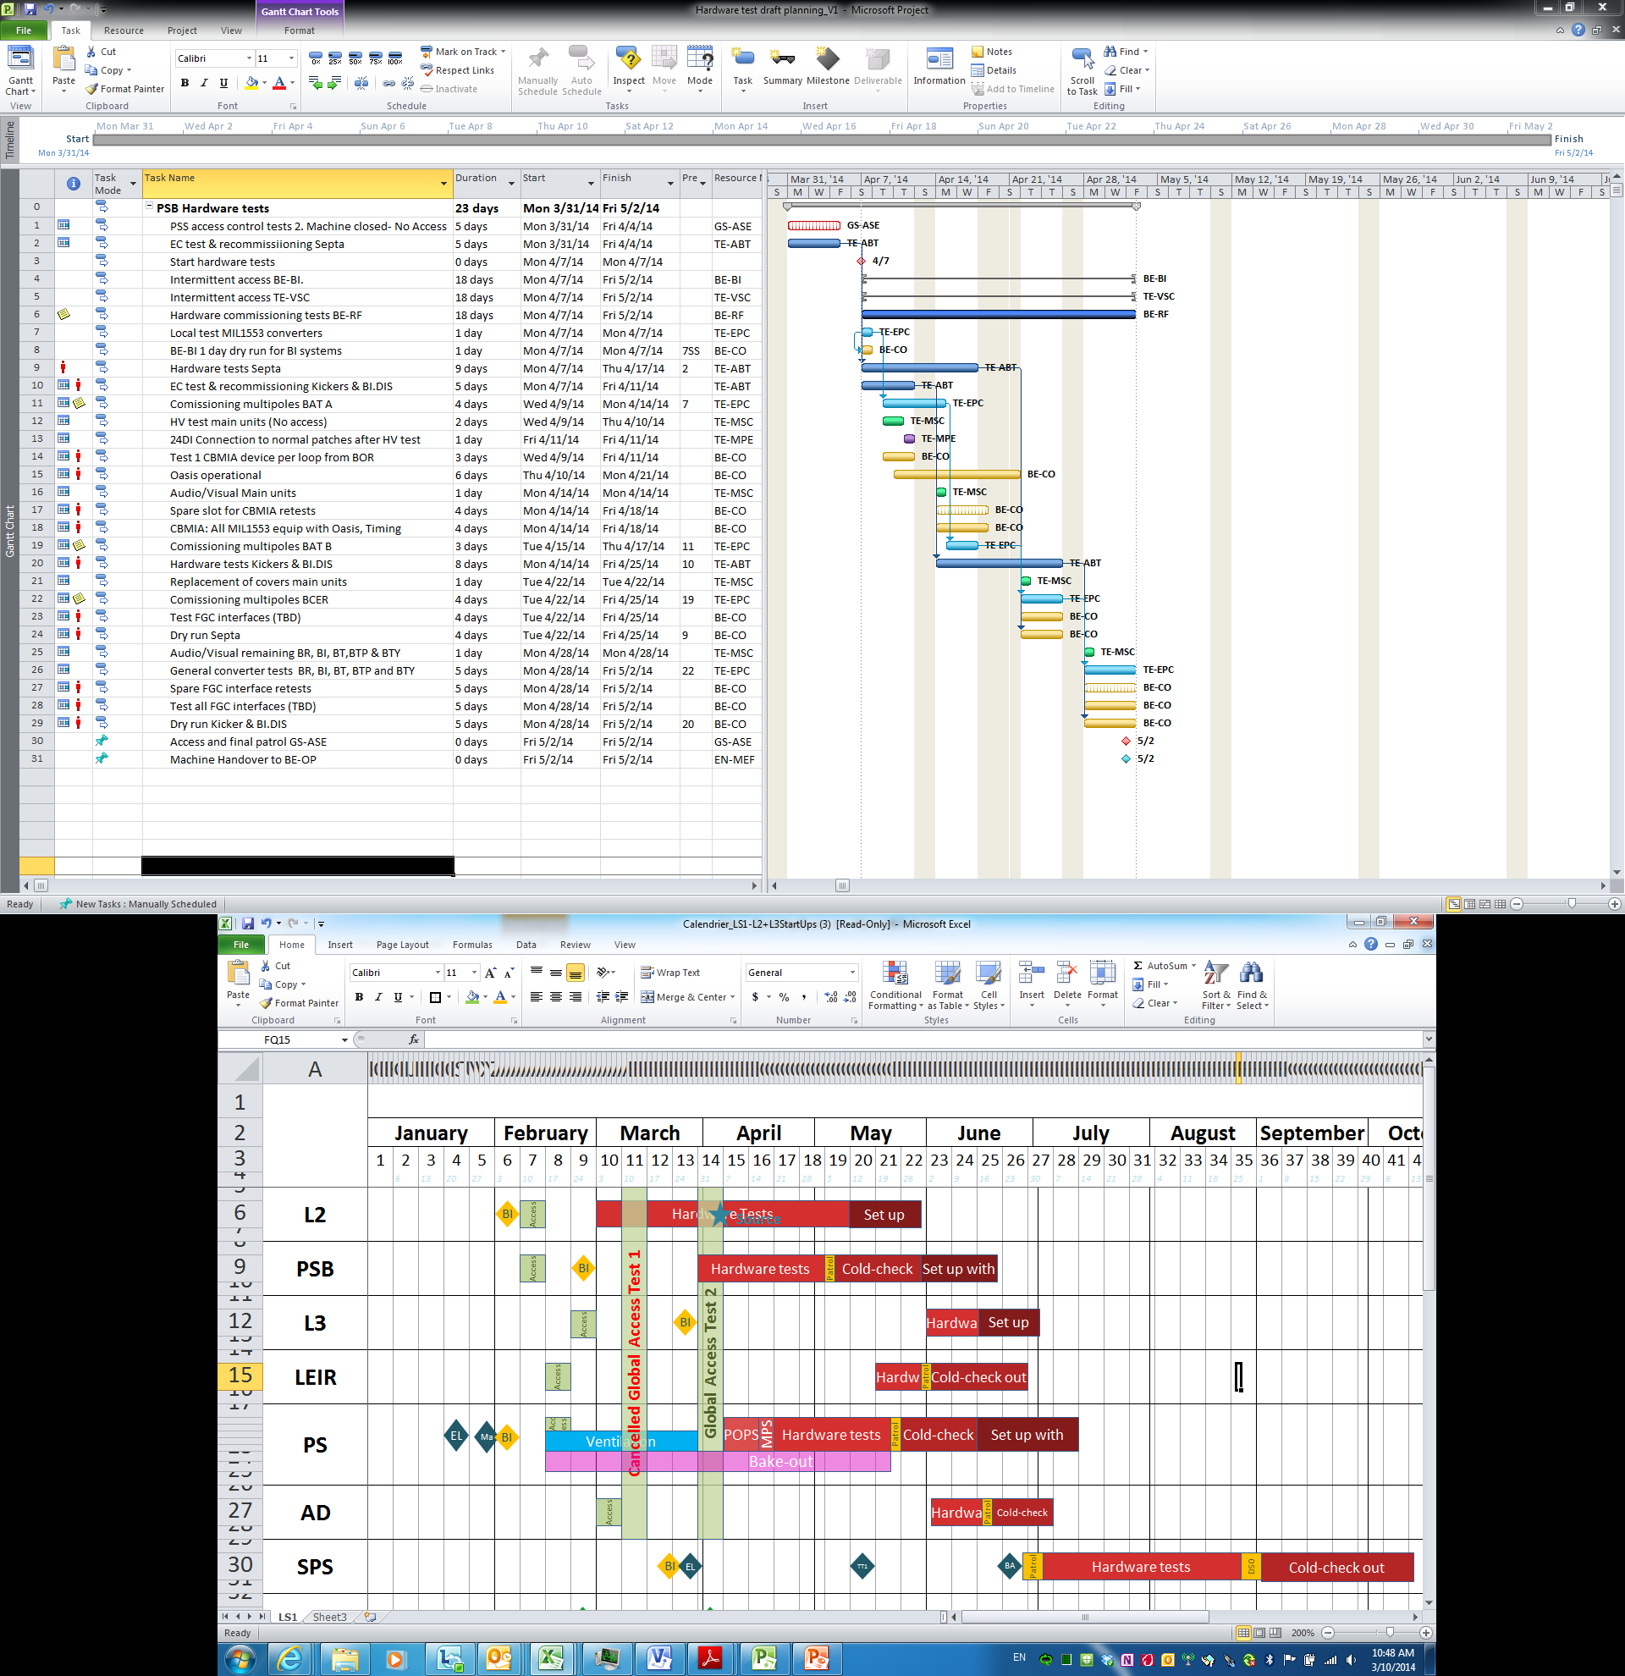
Global view
Courtesy K. Foraz

Slide 4
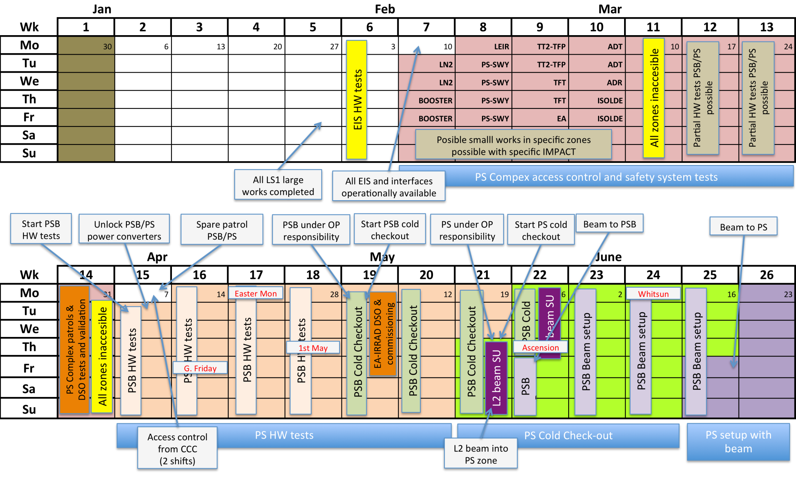
Planning Proposal: align and streamline activities
FOM 8/10/2013

Slide 5
Startup Schedule – Main Dates
Machine | Start HW Tests | Start Cold Comm. | Receiving First Beam
Linac2 | 03 March | 04/17 April | 24 April (L2 tunnel)
PSB | 31 March | 05 May | 30 May
PS | 31 March | 22 May | 20 June
Linac3 | 02 June | 16/19 June
LEIR | 19 May | 30 May | 30 June
ISOLDE | 10 April | 21 April (stable beams) | 10 July
AD | 03 June | 20 June | 10 July 1 August/29 September??
East Hall |  | 30 June | 10 July
n-TOF |  |  | 10 July
SPS | 03 July | 1 September | 8 September
North Area |  |  | 09 October
HiRadMat |  |  | after NA setup (tbc)

Slide 6
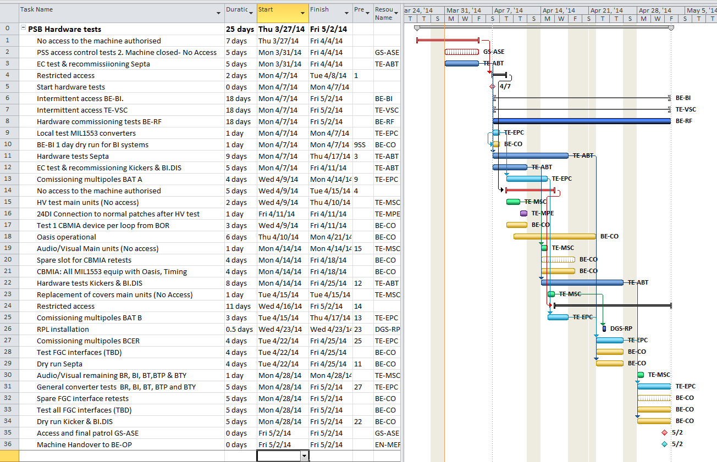
PSB Hardware test planning

Slide 7
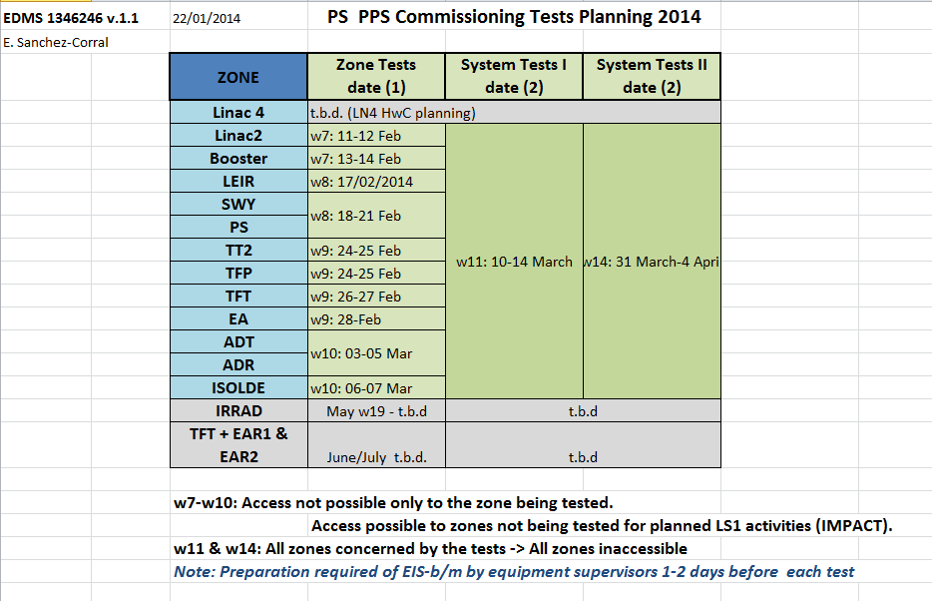
PS PPS Commissioning Plan
(E. Sanchez-Corral GS/ASE)
Cancelled

Slide 8
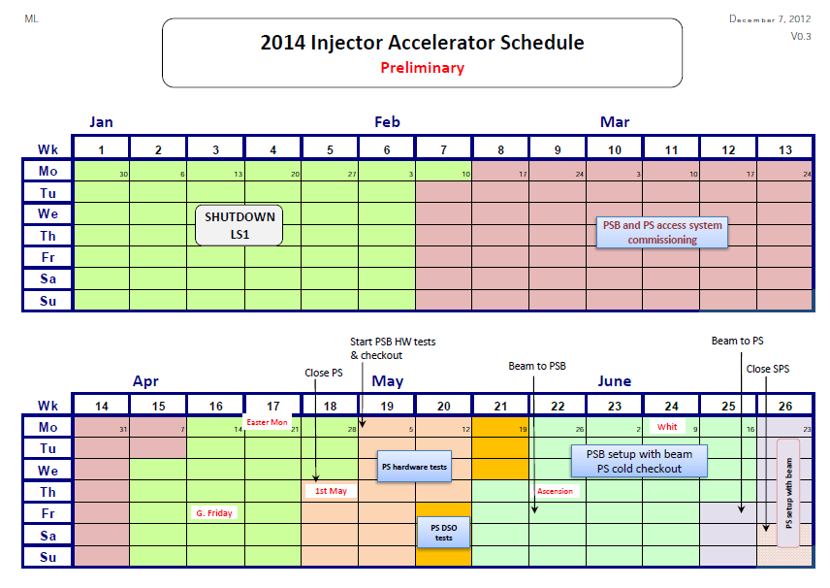
PSB & Access system commissioning

Slide 9
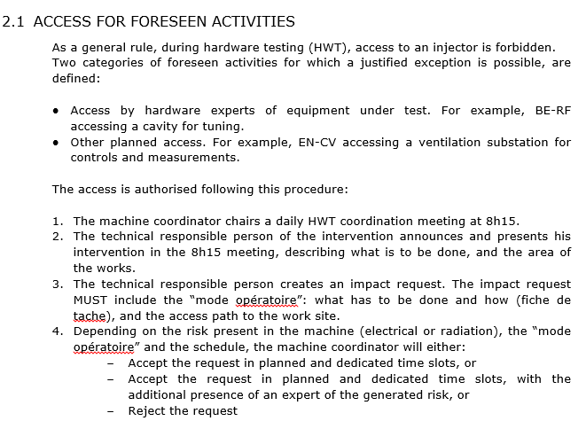

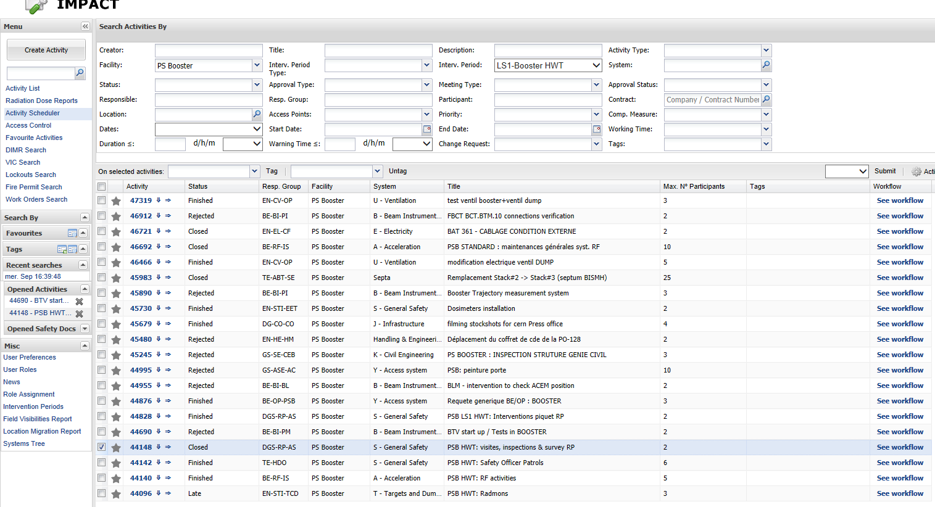
Accesses managed with IMPACT
Access mode special permit with MPS on

Slide 10
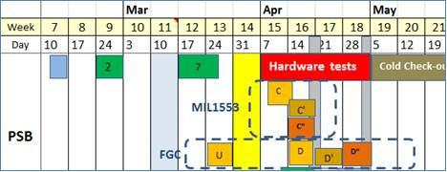
CO: Dry Runs ACCOR
Planning for tests with TE-EPC, BE-OP and BE-CO
PSB/MIL1553 :
Wk 15: On Wednesday 9/04/14 , all MIL1553 equipment available for tests.
  DryRun_Id = [C] will start Wednesday 9/04/14, tests with some equipment. Preparation starting at 8:30 AM.
  DryRun_Id = [C’], only if C fails.
  DryRun_Id = [C”] will start Monday 14/04/14, tests with ALL equipment. Preparation starting at 8:30 AM.
PSB/FGC:
Wk 13: FGC in simulation mode.
  DryRun_Id = [U] will start Monday 24/03/14, tests with ALL FGC in simulation mode. Preparation starting at 8:30 AM.
Wk 15: First batch of FGC equipment available for tests.
  DryRun_Id = [D] will start Wk.16, Monday 14/04/14, tests with some FGC equipment. Preparation starting at 8:30 AM.
Wk 16: Second batch of FGC equipment available for tests.
  DryRun_Id = [D’], only if D fails. Could be used to test additional FGC equipment.
Wk 17: All FGC equipment available for tests
  DryRun_Id = [D”] will start Monday 28/04/14, tests with ALL FGC equipment. Preparation starting at 8:30 AM.
Courtesy C. Dehavay

Slide 11
Start-up planning for PSB
J.L. Sanchez Alvarez (BE/OP/PSB)

Slide 12
PSB Schedule
 | April |  |  |  |  |  |  |  |  |  |  |  |  |  |  |  |  |  |  |  |  |  |  |  |  |  |  |  |  |  | May
W14 |  |  |  |  |  |  | W15 |  |  |  |  |  |  | W16 |  |  |  |  |  |  | W17 |  |  |  |  |  |  | W18
31 | 1 | 2 | 3 | 4 | 5 | 6 | 7 | 8 | 9 | 10 | 11 | 12 | 13 | 14 | 15 | 16 | 17 | 18 | 19 | 20 | 21 | 22 | 23 | 24 | 25 | 26 | 27 | 28 | 29 | 30 | 1 | 2 | 3 | 4
Hardware |  |  |  |  |  |  | Tests
May |  |  |  |  |  |  |  |  |  |  |  |  |  |  |  |  |  |  |  |  |  |  |  |  |  |  | June
W19 |  |  |  |  |  |  | W20 |  |  |  |  |  |  | W21 |  |  |  |  |  |  | W22 |  |  |  |  |  |  | W23
5 | 6 | 7 | 8 | 9 | 10 | 11 | 12 | 13 | 14 | 15 | 16 | 17 | 18 | 19 | 20 | 21 | 22 | 23 | 24 | 25 | 26 | 27 | 28 | 29 | 30 | 31 | 1 | 2 | 3 | 4 | 5 | 6 | 7 | 8
PSB cold check-out |  |  |  |  |  |  |  |  |  |  |  |  |  |  |  |  |  |  |  |  |  |  |  |  | PSB Set-up with beam
June |  |  |  |  |  |  |  |  |  |  |  |  |  |  |  |  |  |  |  |  |  | July
W24 |  |  |  |  |  |  | W25 |  |  |  |  |  |  | W26 |  |  |  |  |  |  | W27 |  |  |  |  |  |  | W28
9 | 10 | 11 | 12 | 13 | 14 | 15 | 16 | 17 | 18 | 19 | 20 | 21 | 22 | 23 | 24 | 25 | 26 | 27 | 28 | 29 | 30 | 1 | 2 | 3 | 4 | 5 | 6 | 7 | 8 | 9 | 10 | 11 | 12 | 13
PSB Setup with beam |  |  |  |  |  |  |  |  |  |  | PSB Setup operational beam |  |  |  |  |  |  |  |  |  |  |  |  |  |  |  |  |  |  |  | Isolde Setup
 |  |  |  |  |  |  |  |  |  |  | PS setup with beam

Slide 13
PSB Hardware test
 | April |  |  |  |  |  |  |  |  |  |  |  |  |  |  |  |  |  |  |  |  |  |  |  |  |  |  |  |  |  | May
W14 |  |  |  |  |  |  | W15 |  |  |  |  |  |  | W16 |  |  |  |  |  |  | W17 |  |  |  |  |  |  | W18
31 | 1 | 2 | 3 | 4 | 5 | 6 | 7 | 8 | 9 | 10 | 11 | 12 | 13 | 14 | 15 | 16 | 17 | 18 | 19 | 20 | 21 | 22 | 23 | 24 | 25 | 26 | 27 | 28 | 29 | 30 | 1 | 2 | 3 | 4
Hardware |  |  |  |  |  |  | Test
 |  |  |  |  |  |  | Dry-run 1st batch of FGC |  |  |  |  |  |  | Dry-run MIL1553 |  |  |  |  |  |  |  | Dry-run all of FGC
 |  |  |  |  |  |  |  |  |  |  |  |  |  | Dry-run 2nd batch of FGC
One PSB operator is available in the CCC from 6h to 21h to ensure support for the hardware test and dry-runs.
No operator during week-end and night.
List of equipment to be tested during a dry-run will be defined with TE-EPC and the MCC (Machine Control Coordinator Jochen Betz).
https://wikis/display/ACCOR/BOOSTER+DRY+RUN

Slide 14
PSB Cold check-out
May
W19 |  |  |  |  |  |  | W20 |  |  |  |  |  |  | W21 |  |  |  |  |  |  | W22
5 | 6 | 7 | 8 | 9 | 10 | 11 | 12 | 13 | 14 | 15 | 16 | 17 | 18 | 19 | 20 | 21 | 22 | 23 | 24 | 25 | 26 | 27 | 28 | 29 | 30 | 31 | 1
PSB cold check-out
3 weeks and half for the PSB Cold check-out
3 shifts per day including week-end.
OP will organize the cold check-out (with procedures and check-lists) :
    218 Pow. Sup. with MIL1553.
    94 Multipoles and 32 dipoles with FGC3.
    400 timings (TG8 replaced by CTRV).
    OASIS renovation (FEC, new Scopes, New Multiplexer)
      (780 analog signals + 400 DataSet signals).
    Instrumentations (New BPM injection, new FESA classes).
    BTM line dismounted to replace the Booster dump.
    New BIS (BIC and SIS).
    renovation of the low-level RF system.
    New amplifiers for the transverse feedback.
    …

Slide 15
PSB Set-up with beam
 |  |  |  |  |  | June
W22 |  |  |  |  |  |  | W23 |  |  |  |  |  |  | W24 |  |  |  |  |  |  | W25 |  |  |  |  |  |  | W26
26 | 27 | 28 | 29 | 30 | 31 | 1 | 2 | 3 | 4 | 5 | 6 | 7 | 8 | 9 | 10 | 11 | 12 | 13 | 14 | 15 | 16 | 17 | 18 | 19 | 20 | 21 | 22 | 23 | 24 | 25 | 26 | 27 | 28 | 29
 |  |  |  | Setting-up 4 rings low intensity H=1 4Rings = 400E10 (3 turns) |  |  |  |  |  |  |  |  |  |  | Setting-up higher intensity 4rings = 3000E10 |  |  |  |  |  |  |  |  |  | Beam to the PS
 |  |  |  | LTB-BI |  |  |  |  |  |  |  |  |  |  | ↑int. R3 Low Level TFB Multipoles |  |  |  |  |  |  |  |  |  | R3 low intensity
 |  |  |  | Inj. R3
 |  |  |  |  | Acc. R3
 |  |  |  |  |  |  | Ej. R3 |  |  |  |  |  |  |  |  |  | ↑int. R2 Low Level TFB Multipoles
 |  |  |  |  | Inj R2
 |  |  |  |  |  |  | Acc. R2
 |  |  |  |  |  |  |  |  | Ej. R2 |  |  |  |  |  |  |  |  |  | ↑int. R1 Low Level TFB Multipoles
 |  |  |  |  |  |  | Inj R1
 |  |  |  |  |  |  |  |  | Acc. R1
 |  |  |  |  |  |  |  |  |  |  | Ej. R1 |  |  |  |  |  |  |  |  |  | ↑int. R4 Low Level TFB Multipoles
 |  |  |  |  |  |  |  |  | Inj R4
 |  |  |  |  |  |  |  |  |  |  | Acc. R4
 |  |  |  |  |  |  |  |  |  |  |  |  | Ej. R4
3 Weeks of setting-up before send beam to PS.(2 long week-ends Ascension and White Monday)
Anymore Piquet control (list of specialist CO).
New Low Level RF hardware, new amplifiers on the transverse feedback and new power convector for the multipoles (FGC3).
  Low intensity setting-up 10 days
  High intensity setting-up 10 days

Slide 16
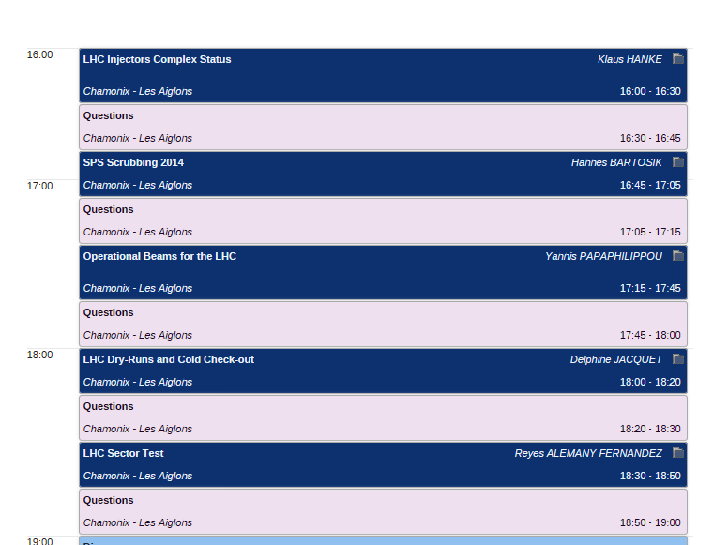
Conclusions presented at LHC performance workshop (Chamonix 2014) and LS1 debriefing day 31st March 2015
https://indico.cern.ch/event/373053/. & LS1 debriefing day 31st March 2015

