Slide 1
LS1 PS&TT2 H/W test period (31/03/14-21/05/14)
Simon Mataguez EN/MEF-OSS
More info about the PS machine? www.cern.ch/ps

Slide 2
Outline
Injectors Start-up Schedule
PS & TT2 H/W test period (31/03/14-21/05/14)
Organization H/W test period
Access during H/W test period
BE-CO Specification of Dry Runs
Auxiliary Magnets Power Supply Start-up
Magnet tests
Outcome

Slide 3
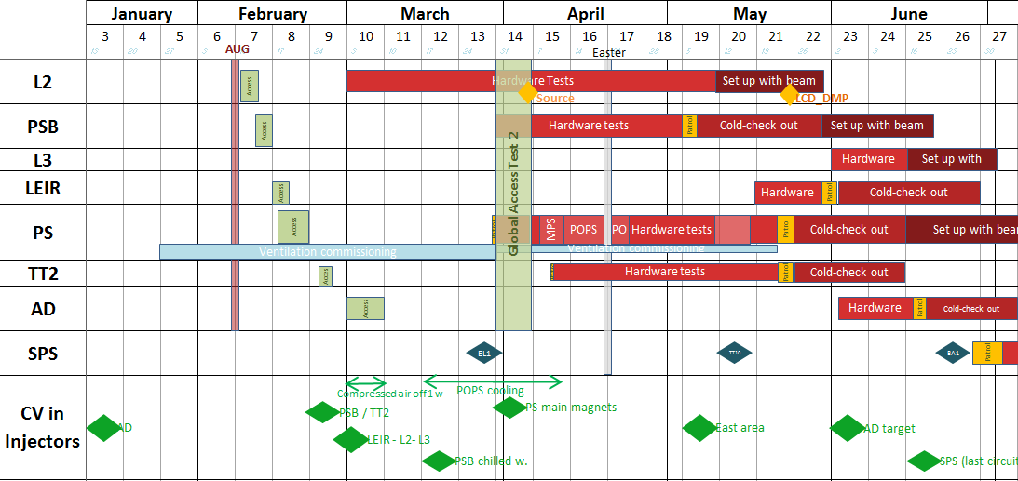
Injectors Start-up Schedule
www.cern.ch/LS1planning

Slide 4
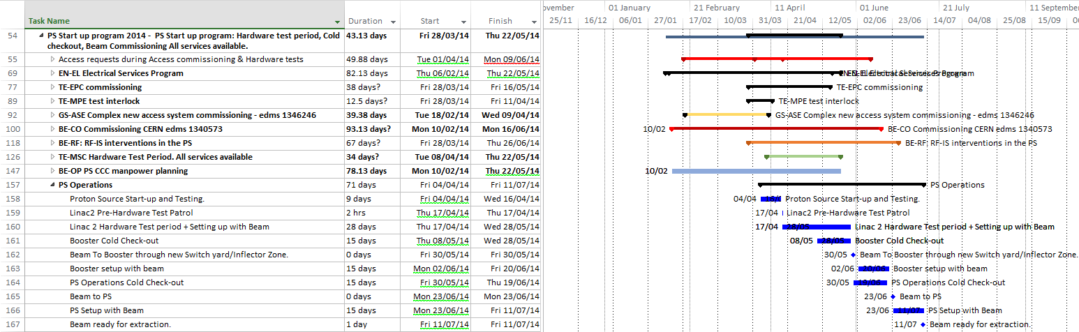
PS & TT2 H/W test period (31/03-21/05)
Global Access Test 2
Patrol
 | W14 31/03 → 06/04 | W15 W17 07/04 → 19/04 | W18 W19 22/04 →08/05 | W20 08/05 → 18/05 | W21 19/05 →21/05 | 22/05 → 23/05
from 6.00 to 08.30 |  |  |  |  |  | No access Hand-over DSO tests
from 8.30 to 17.00 | New Access | EPC team | MSC tests |  | MSC tests
from 17.00 to 21.00
week 14 to 19 all magnets are without covers and PS machine will no longer be electrically “locked-out”
week 14 & 16 « conditionings HV of SEH23 an SEH31 » X-Ray risks

Slide 5
Organization H/W test period
04/02 FOM Coordination Meeting #01 Update on the start-up Schedule and H/W test period
https://indico.cern.ch/event/366809/attachments/729188/1000520/02-04-2014.pdf
20/03 LS1 Coordination Meeting #14 (Last one) for the PS tunnel and TT2
and presentation of last H/W test period version EDMS 1363569
From 01/04 to 20/05 WEEKLY FOM Coordination meetings, follow-up/actions reporting
From 28/04 @ 18.00 PS has been put in "restricted mode access“
All LS1 IMPACT have been stopped and new one for intervention periods LS1 – PS - HWT → 93 IMPACT
From 13/04 to 22/05 24 Daily HWT Coordination meetings (6-2-004) at 8:15 – All slides presented available in EDMS 1373196
  Email sent to CPS Operations with daily program and instructions for operation and access (Only access requests approved in this e-mail are authorised)
  Copy of the Email in PS logbook http://elogbook.cern.ch/eLogbook/eLogbook.jsp?lgbk=401 (nota: All updates and modifications done in the PS are reported and documented in the PS Shutdown eLogbook)
Access during H/W test period
02/06 released Procedure: Access in LINAC2, PSB, PS and TT2 during the Hardware Commissioning and Tests EDMS 1371388

Slide 6
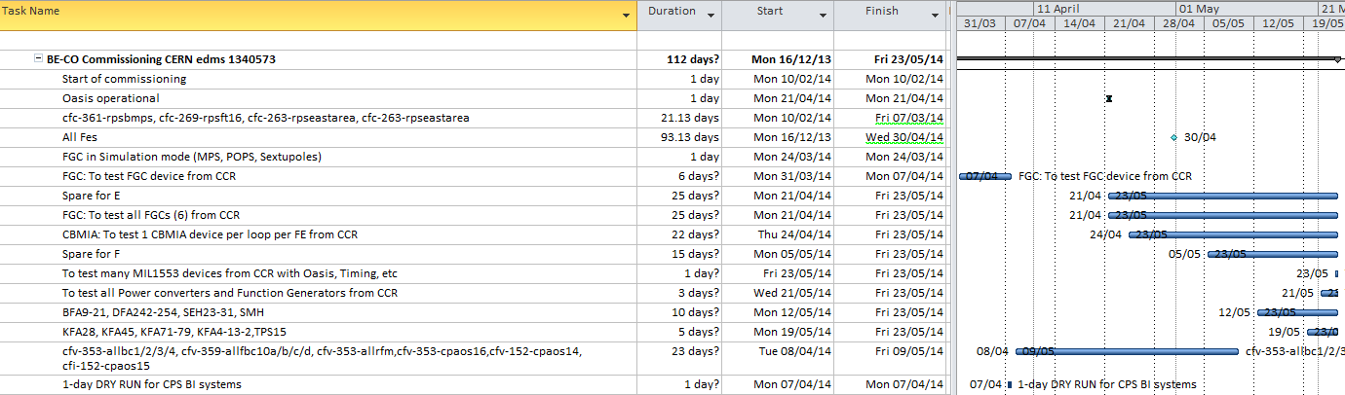
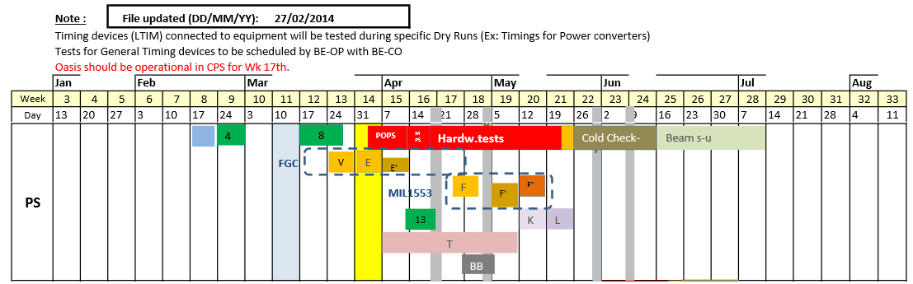
BE-CO Specification of Dry Runs
CO
EDMS 1340573 Courtesy Marine Gourber-Pace & Claude Dehavay

Slide 7
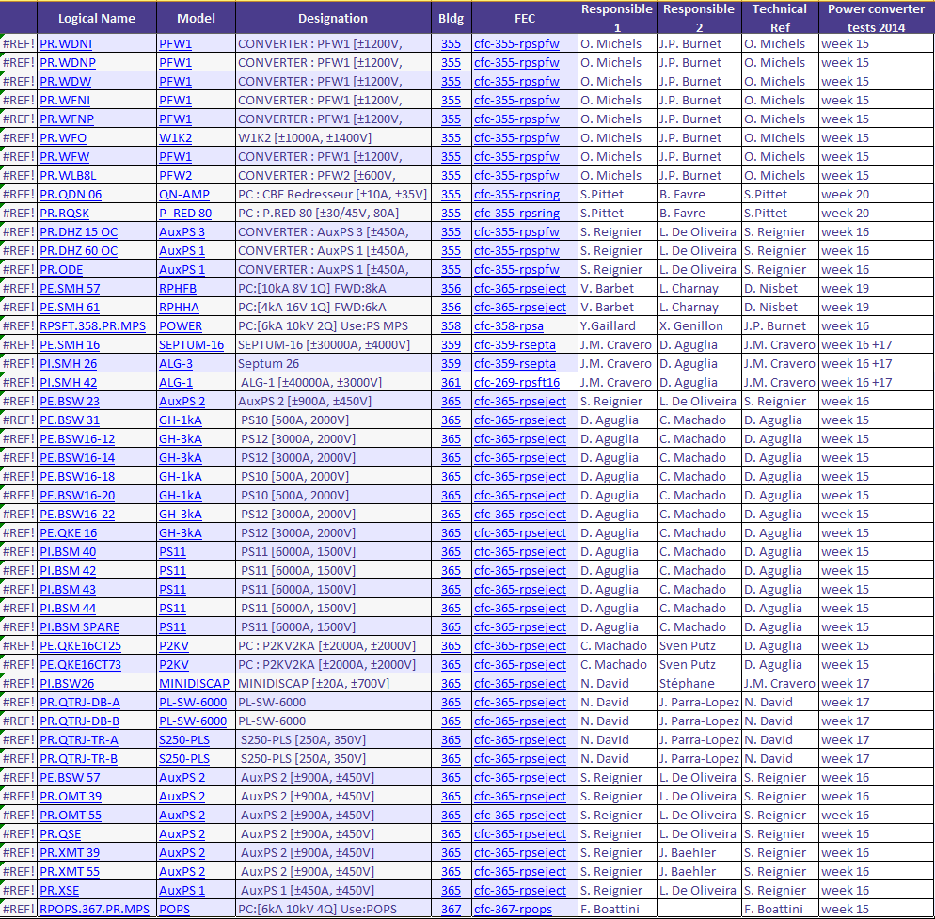
Auxiliary Magnets Power Supply Start-up
EPC
Courtesy Yves Gaillard Not complete list

Slide 8
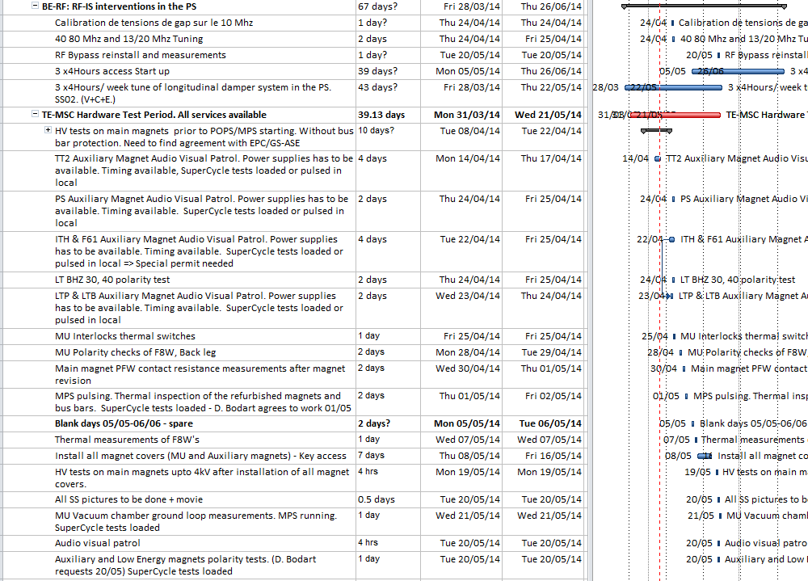
Magnet tests
MSC
EPC
CO
?
Power supplies will have to be controlled locally for magnets patrols and polarity checks.

Slide 9


Outcome
Coordination meetings, planning, dedicated time slots have to be respected (how to deal with request overestimated?).
All systems not ready at the same time and not synchronised for test (PS H/W test period came as total surprise)
Anticipation needed : test definition, equipment groups, quality plan, rigorous check-out (inverted polarities, faulty instruments…).
Objective : Improve stand-alone tests.
    Responsibility and safety procedure for H/W tests have to be sorted out and anticipated (PS Access during H/W tests EDMS 1369459, EDMS 1371388), power supplies will no longer be electrically “locked-out” / Habilitation électrique procedure has to be clarified.
To be noted / Feedback from groups : too many meetings (Leir, Linac2, Booster, PS…)
But PS activities for LS1 have been completed and the machine returned to BE/OP less than 24 hours later than planned after 15 months of work !!

Slide 10
References
[1] PS & TT2 LS1 First long shutdown Post-Mortem Edms EDMS 1394871
[2] Presentation at the IRWG on Thursday 26th March 2015, PS Feedback Indico 382770
[3] PS Planning LS1 2013-2014 EDMS 1252091
[4] Presentation at the IRWG on Thursday 25th June 2015, IEFC Feedback Indico 404520

