Slide 1
LS1 SPS H/W test period
David Mcfarlane EN/MEF/OSS

Slide 2
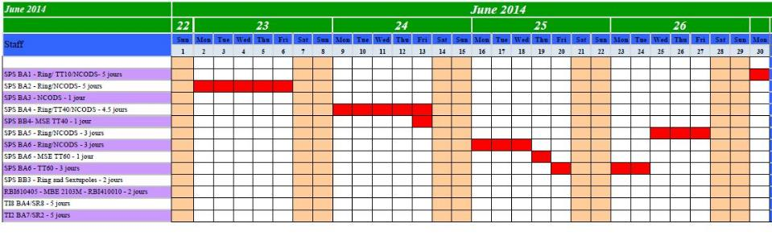
EPC tests of the Auxiliary Converters
(While the machine was open)
With this planning, OP can start the commissioning of the Software with a 1 week delay from our activities: e.g, OP tests for BA2 could start on 9th June.
What we need:
The magnet interlocks shall be tested in May by MPE (R.Mompo/P.Dahlen): support from EPC is requested during this period,
Services shall be present in each BA in time: water (magnet + surface building), no consignation (except BA1 until end of June),
A general signalisation that some tests are ongoing: coordination EPC/MSC,
EIS (https://edms.cern.ch/document/991272): from past experiences, this is a difficult point for us during our tests, especially for TI2/TI8. I propose that when the planning is agreed on, Marc Tavlet will be contacted by EPC.

Slide 3
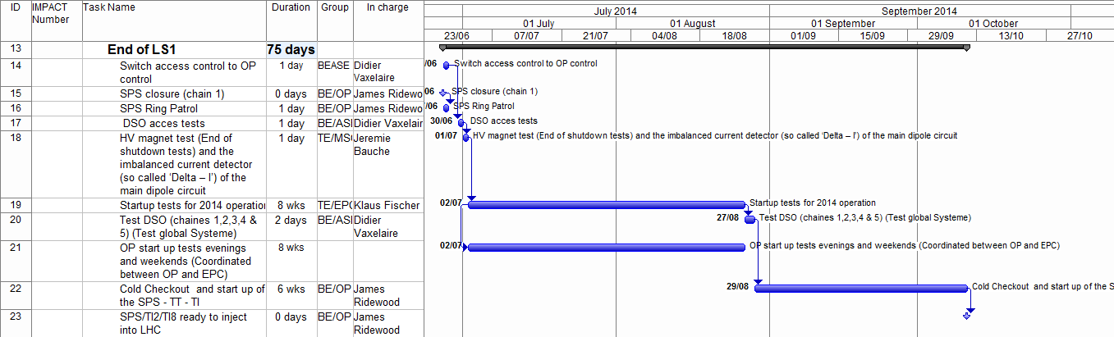
The end of LS1

Slide 4
Access after the 27th June.
ALL LS1-SPS IMPACTs ended on the 27th June!
Any accesses into any area of the SPS after this date required a NEW IMPACT.
  LS1-HWT-SPS (valid from 28th June to 31st August)
    Access into the SPS during Hardware commissioning phase
  LS1-BA80-SPS (valid from now to 30th September)
    Allowing continued access into BA80
  TAG41- AWAKE (Valid from now until October 2016)
    Allowing continued access into TAG41

Slide 5
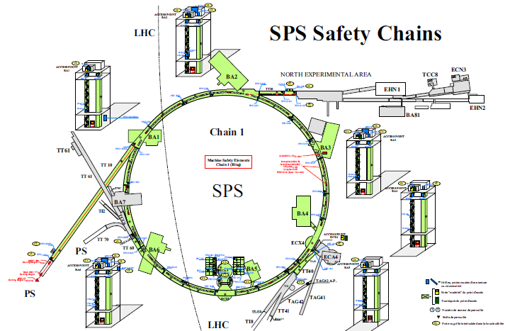
LS1-BA80-SPS
(valid until 30th September)
LS1-HWT-SPS
(valid from 28th June to 31st August)
TAG41- AWAKE
(Valid until October 2016)

Slide 6
Access during July/August
Access was controlled by OP in the CCC.
There were informal morning meetings everyday in the CCC to discuss if and when any accesses could be made.
Anybody who required access needed to contact the operators and be present at this meeting.

Slide 7
Conclusions
The closure of the SPS was originally planned for Friday the 27th June 2014. This date was achieved!
All tests that could be done with the machine open were done. This was coordinated by EN/MEF.
All tests that were done after the 27th June 2014 were coordinated by BE/OP and TE/EPC. (morning meetings)
  This allowed EPC and OP to conduct their tests in parallel and several weeks were saved.
I would like to repeat this procedure for LS2.

