Slide 1
General points, FCC week organization
FCC MDI Meeting
Jan. 22nd, 2016
W. Riegler

Slide 2
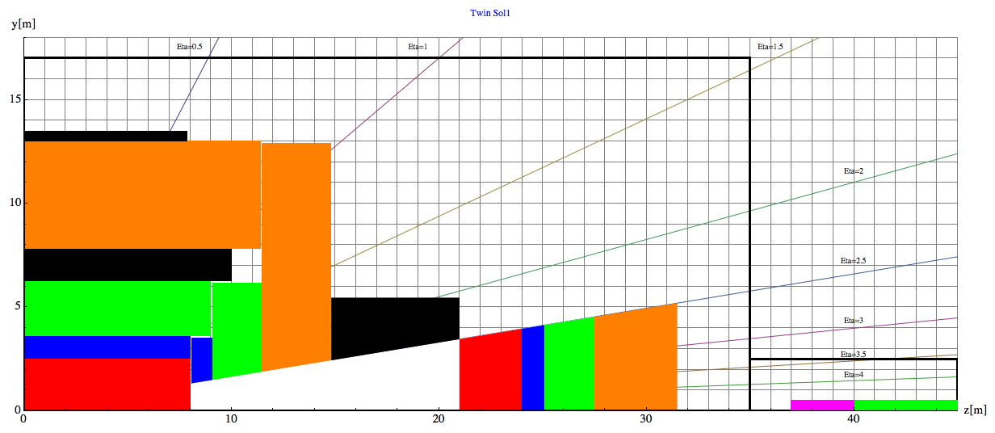
Baseline Geometry, Twin Solenoid, September 2015
L* = 40m
Barrel:
Tracker available space:
R=2.1cm to R=2.5m, L=8m
EMCAL available space:
R=2.5m to R= 3.6m → dR= 1.1m
HCAL available space:
R= 3.6m to R=6.0m → dR=2.4m
Coil+Cryostat:
R= 6m to R= 7.825 → dR = 1.575m, L=10.1m
Muon available space:
R= 7.825m to R= 13m → dR = 5.175m
Coil2:
R=13m to R=13.47m → dR=0.475m, L=7.6m
Endcap:
EMCAL available space:
z=8m to z= 9.1m → dz= 1.1m
HCAL available space:
z= 9.1m to z=11.5m → dz=2.4m
Muon available space:
z= 11.5m to z= 14.8m → dz = 3.3m
Forward:
Dipole:
z= 14.8m to z= 21m → dz=6.2m
FTracker available space:
z=21m to R=24m, L=3m
FEMCAL available space:
Z=24m to z= 25.1m → dz= 1.1m
FHCAL available space:
z= 25.1m to z=27.5m → dz=2.4m
FMuon available space:
z= 27.5m to z=31.5m → dz=4m

Slide 3
A few points of the baseline geometry are under revision
The gap between the two solenoid coils
Cryostat of Twin Solenoid and Dipole
Dimensions of Tracker/ECAL/HCAL
Use a long TileCal Barrel and assume Larg/Silicon+absorber for the endcap
L* for inclusion of the compensator magnet and infrastructure between TAS and Triplet.
This is a list of things where work is in progress
The impact will be on radiation studies and machine optics, but not on the detector performance parametrization for physics studies

Slide 4
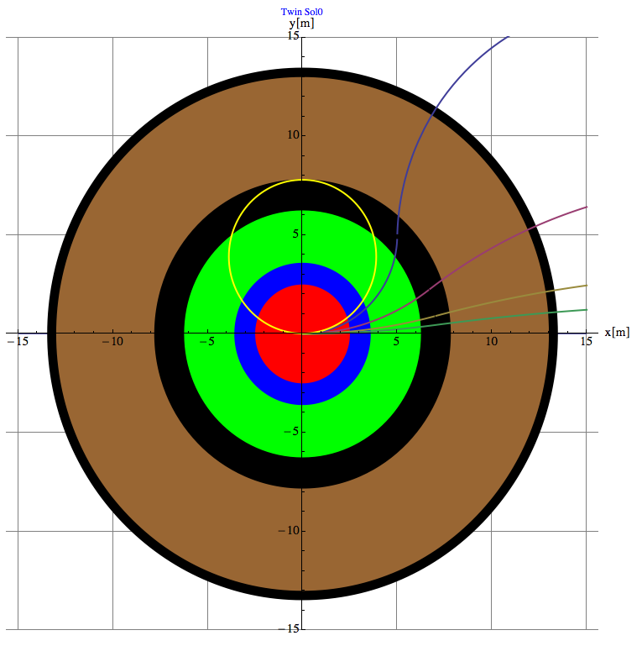
Twin Solenoid Size
θ
The gap between the two solenoid coils that is currently around 5m is being minimized in order to reduce the overall system size.
A smaller gap is fine for the muon measurement (Dec. 9th meeting).
Impact on shaft size, cavern size, cost …

Slide 5
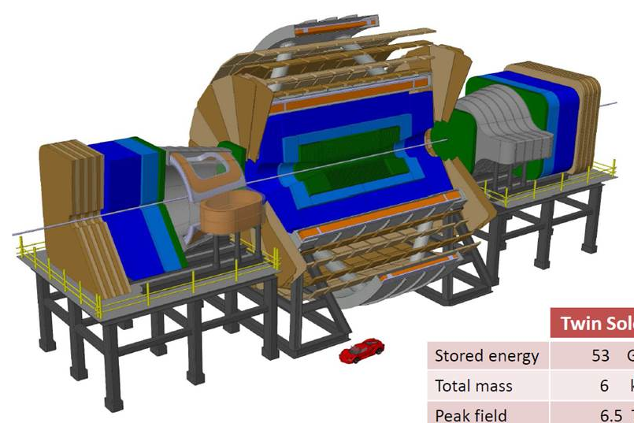
Solenoid and Dipole Cryostat
The geometry for the radiation calculation does for now only assume the cold mass (Aluminum) and not the cryostats.
→ To be implemented.

Slide 6
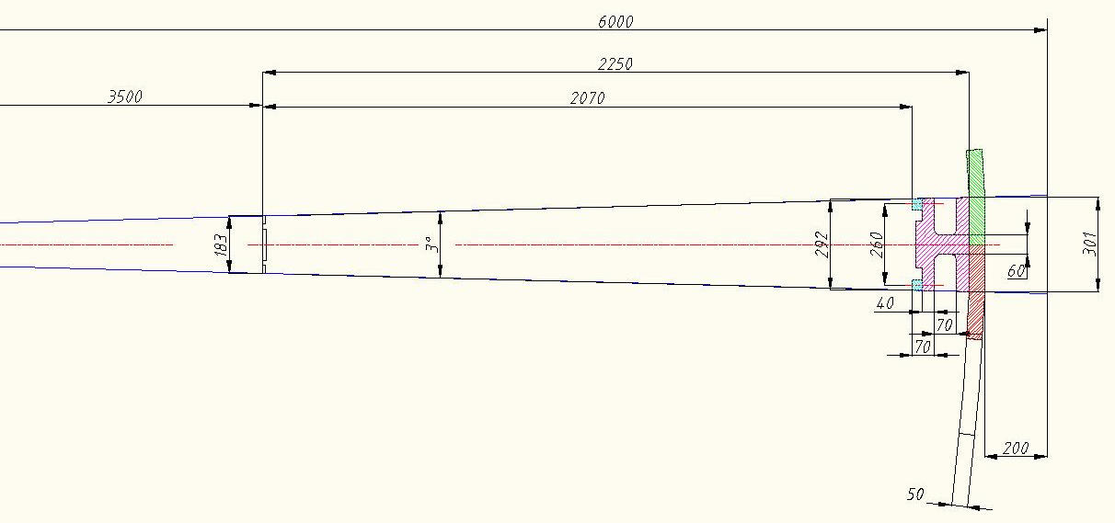
Tilecal Module Size
Baseline:
Tracker available space:
R=2.1cm to R=2.5m, L=8m
EMCAL available space:
R=2.5m to R= 3.6m → dR= 1.1m
HCAL available space:
R= 3.6m to R=6.0m → dR=2.4m
Update:
Rmin=3.5m (OR 3.4m IF em calo+tracker <2λ). Need to keep 12λ in total…
Rout =5.8m (with supports and Xbars). Need 20cm for supports/rails at least…
Depth active cells = 207 cm = 10λ (;1λ=20.7cm ).
Depth Outer Supports=20cm (15cm girder+5cm Xbars)
→ Look at realistic assumptions of EMCAL and adapt tracker and ECAL

Slide 7
Long TileCal Barrel
Radiation studies show that radiation load is excessive for the Tilecal Technology in the HCAL end cap.
Baseline
Update
Radiation load for the (scintillator based) TileCal barrel seems excessive.
→ long TileCal Barrel and make the hadronic end-cap with same technology as EMCAL (LArg/Si+absorber/…)

Slide 8
L* and Compensators
31.5m
40m
45m
For the baseline geometry we assumed an L* of 40m = distance from the IP to the start of the magnetic field in the triplet.
Up to now we assumed a TAS of 3m length with no free gap between TAS and Triplet.
We omitted necessary compensator magnets for the dipoles, that need to be placed between the dipole and the triplet.
Increase L* to 45m
Leave 2m between TAS and Triplet
8.5m envelope for a (normal conducting) dipole compensator + beampipe + infrastructure + …

Slide 9
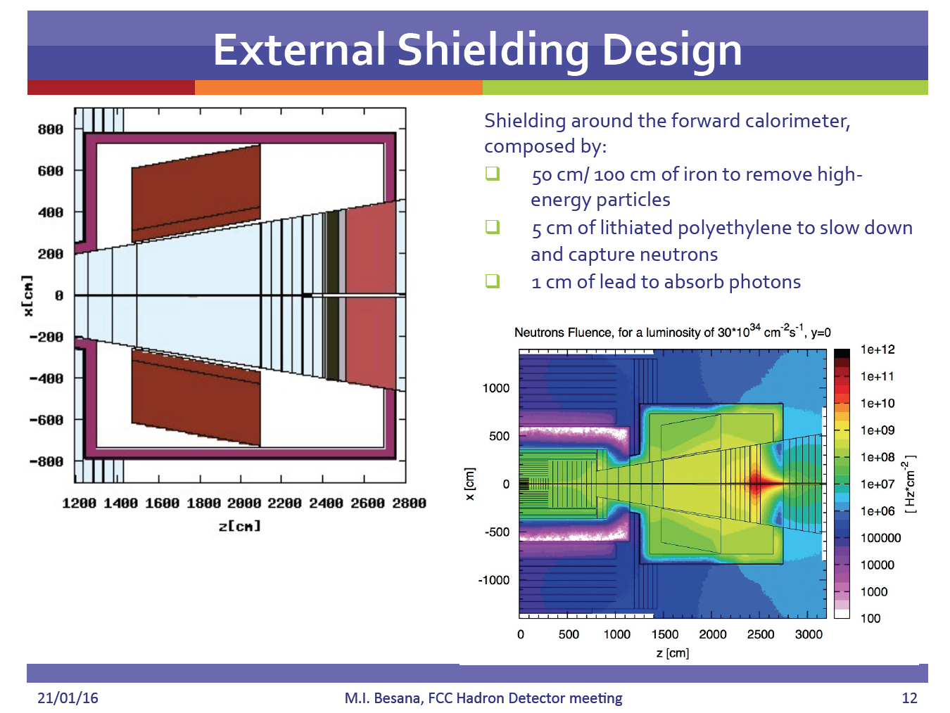

Slide 10
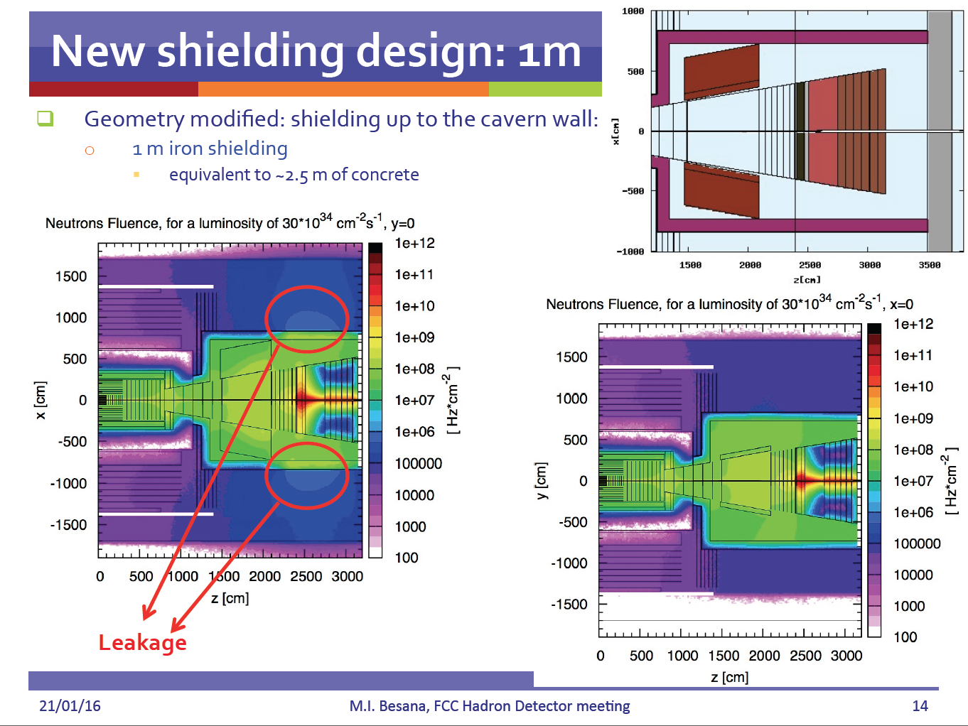

Slide 11
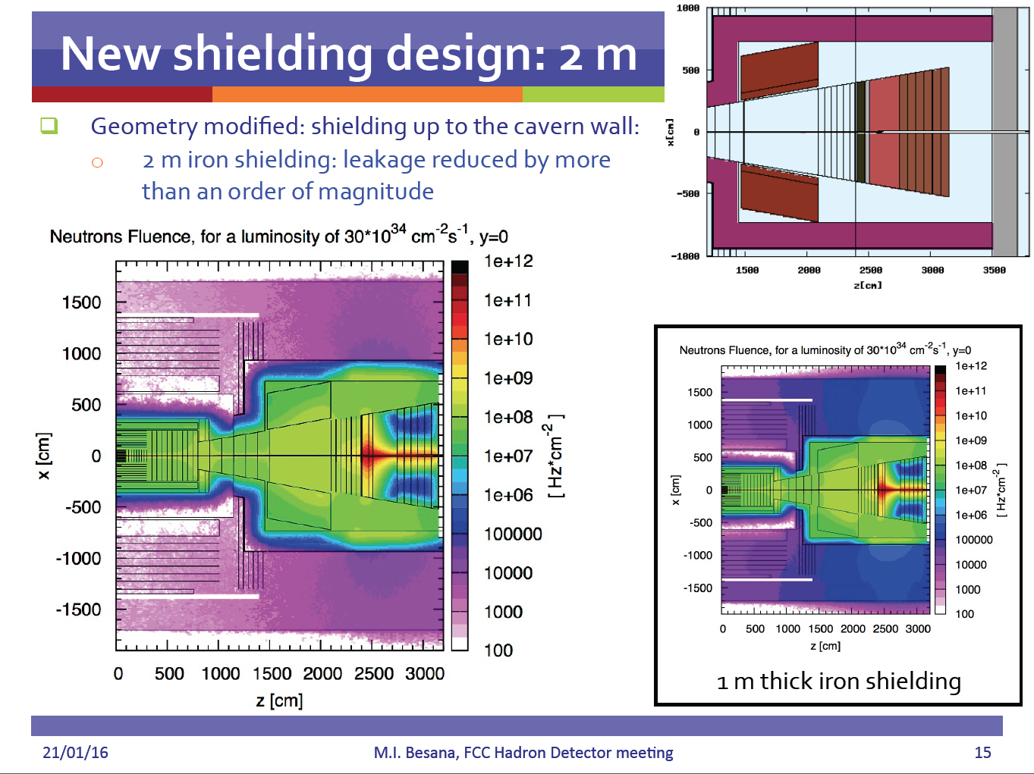

Slide 12
Baseline Detector, ‘partitioning’, installation etc.
We have a baseline detector with some baseline technology and shielding arrangement.
We should think about some principle aspects for partitioning, installation, servicing etc.
Brainstorming
Concepts
Review with experienced people who engineered the LHC detectors
To be seen how far we get before the FCC week in Rome …

Slide 13
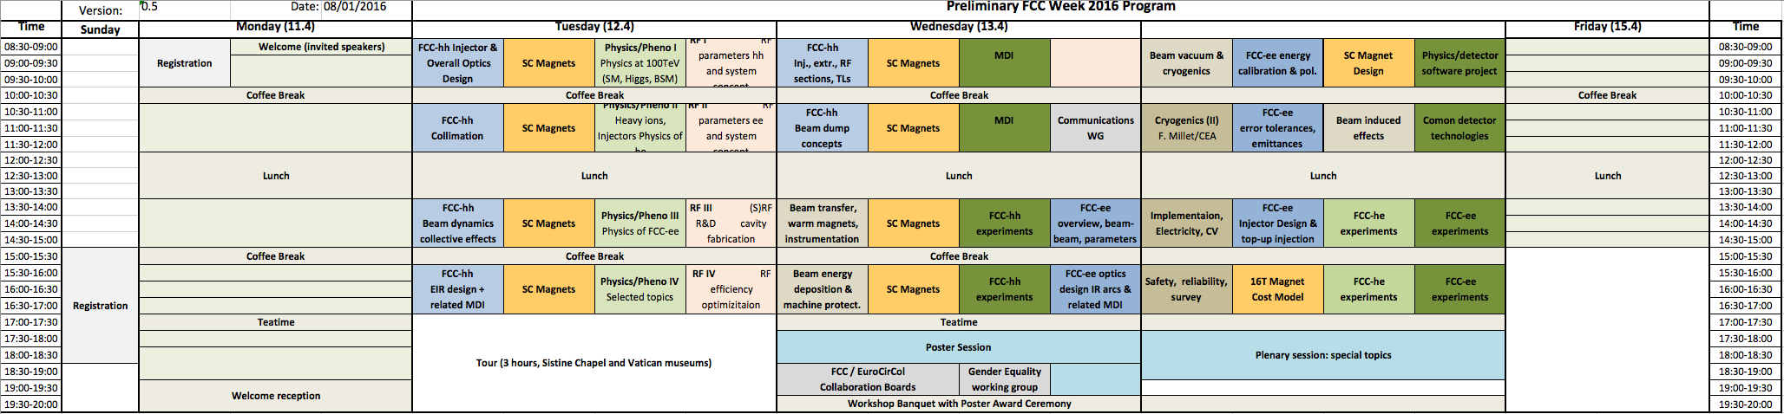
FCC Week Rome, April 11-15
Plenaries on Monday and Friday, 4 parallels Tuesday/Wednesday/Thursday.
Sessions of 90 minutes with 3-4 talks.
Tuesday:
4 sessions of Physics/Phenomenology (hh and ee)
Thursday for FCC-hh:
1 session on MDI (3-4 talks)
2 session of hh experiments (6-8 talks)
1 session on common software (3-4 talks)
1 session on common technologies (3-4 talks)
Discussion …

Slide 14
Tuesday Session 4, “Machine Detector Interface”
15:30-17:00
Chair: Lucie Linssen ?
- Experimental Insertion Design (A. Seryi, JAI)
- Radiation Effects in the Triplet (Ilaria Besana, CERN)
- Background into the arcs (Rob Appleby, Manchester) ?
- L* and Experiment Dipole Considerations (Roman Martin, CERN)
Wednesday Session 1+2 “Machine Detector Interface”
8:30-10:00 FCC-ee
10:30-12:00
Programme to be defined (in the detector group), should better not be in parallel with FCC-hh machine.

Slide 15
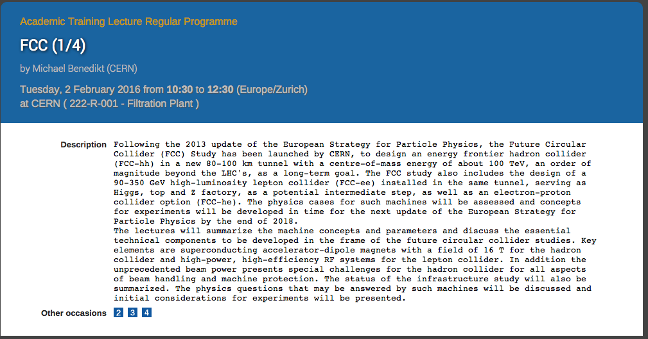
Academic Training Lecture on FCC, Feb. 2,3,4,5 10:30 – 12:30
Tue. 2nd: Physics
Wed. 3rd: Experiments
Thu. 4th: Machines
Fri. 5th: Infrastructure

Slide 16
Backup

Slide 17
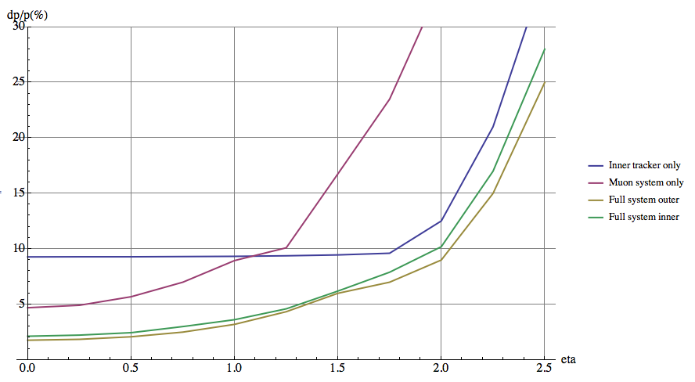
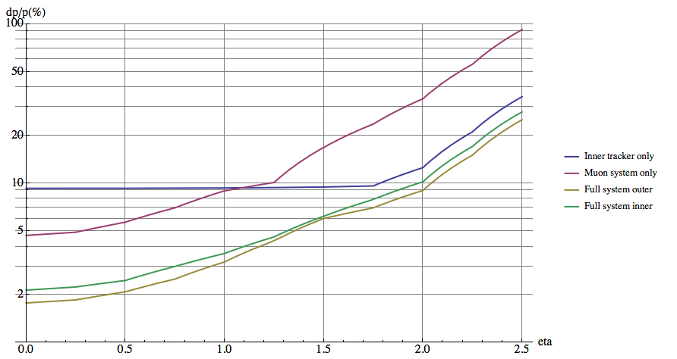
Momentum resolution for a 10 TeV/s muon vs. eta
Twin Solenoid assuminginner tracker with baseline resolution curves and multiple scattering limit in the muons system.
P_{T}=10TeV/c eta = 0: 5% muon standalone (angle)
10% inner tracker only
2% combined
P_{T}=10TeV/c eta=2.: 35% muon standalone (angle) 12.5% inner tracker only
8% combined
Compare to the CMS numbers:
P_{T}=1TeV/c, 0<eta < 0.8: 20% muon standalone (angle)
10% inner tracker only
5% combined
P_{T}=1TeV/c, eta 0<eta<2.4: 40% muon standalone (angle) 20% inner tracker only
10% combined

