Slide 1
FCC week agenda, Overview
FCC MDI Meeting
Mar. 18th, 2016
W. Riegler

Slide 2
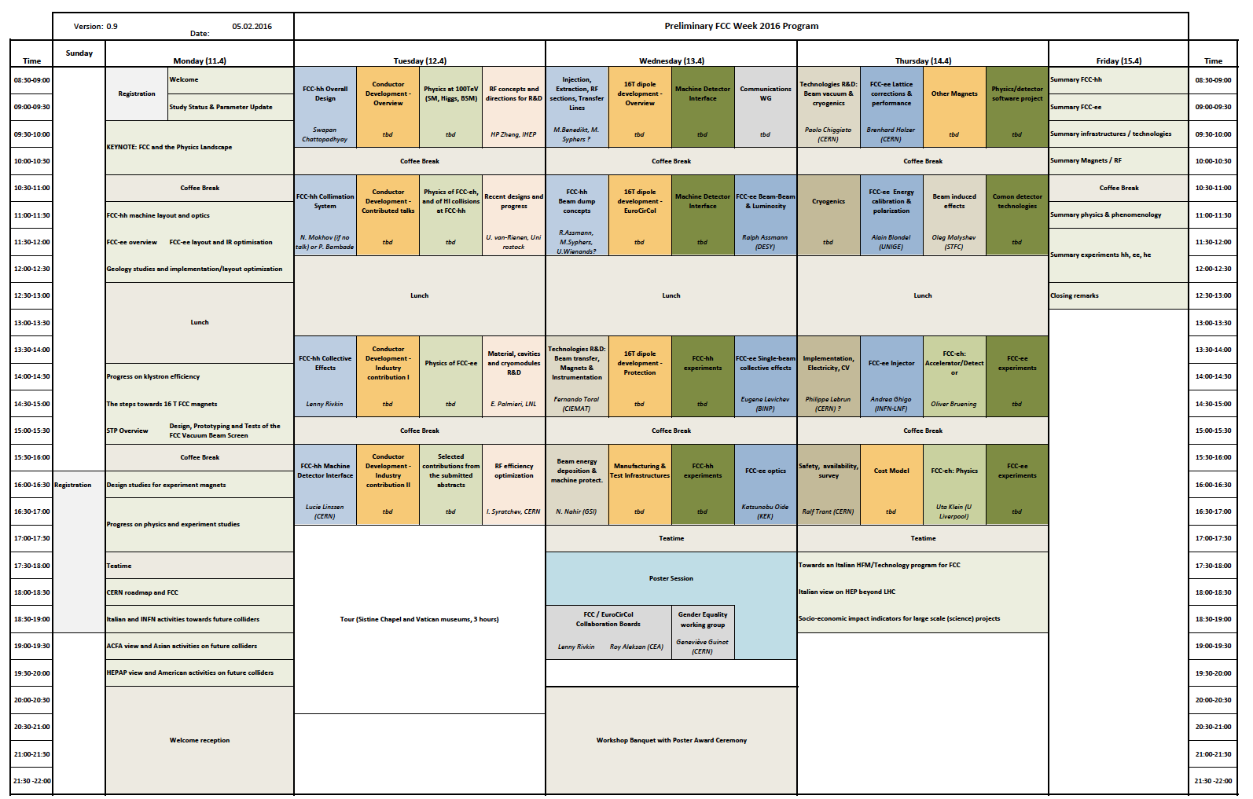
Common Exp. SW
FCC Exp. and Det. I
CommDet. Techn.
Summary (Werner)
FCC Exp. and Det. II
Exp. Magnets (Herman)
FCC hh MDI
FCC Exp. and Det. III
FCChh exp progress (Joe)

Slide 3
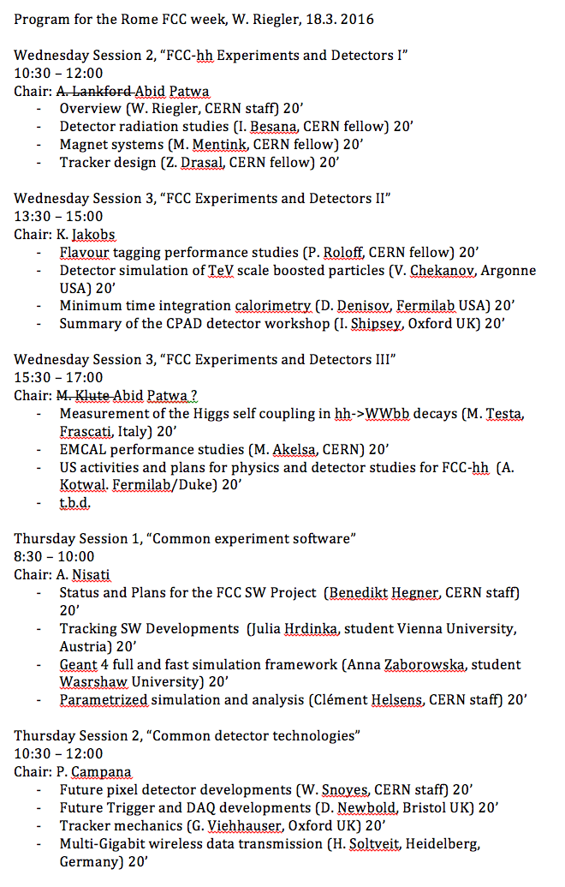

Slide 4
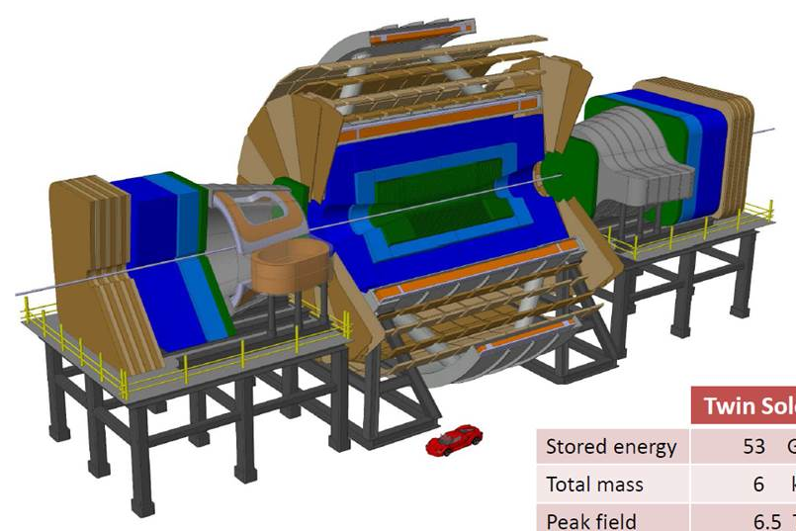
Baseline: Twin Solenoid + Dipoles

Slide 5
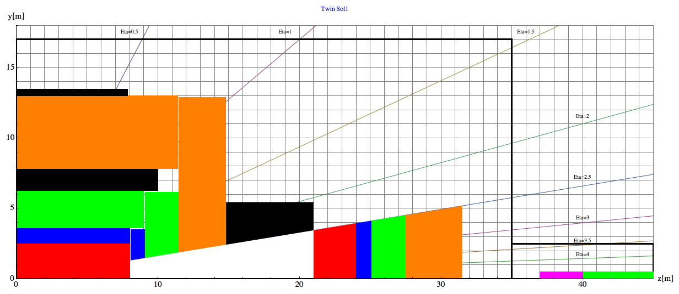
Barrel:
Tracker available space:
R=2.1cm to R=2.5m, L=8m
EMCAL available space:
R=2.5m to R= 3.6m → dR= 1.1m
HCAL available space:
R= 3.6m to R=6.0m → dR=2.4m
Coil+Cryostat:
R= 6m to R= 7.825 → dR = 1.575m, L=10.1m
Muon available space:
R= 7.825m to R= 13m → dR = 5.175m
Coil2:
R=13m to R=13.47m → dR=0.475m, L=7.6m
31.5m
40m
45m
Endcap:
EMCAL available space:
z=8m to z= 9.1m → dz= 1.1m
HCAL available space:
z= 9.1m to z=11.5m → dz=2.4m
Muon available space:
z= 11.5m to z= 14.8m → dz = 3.3m
Forward:
Dipole:
z= 14.8m to z= 21m → dz=6.2m
FTracker available space:
z=21m to R=24m, L=3m
FEMCAL available space:
Z=24m to z= 25.1m → dz= 1.1m
FHCAL available space:
z= 25.1m to z=27.5m → dz=2.4m
FMuon available space:
z= 27.5m to z=31.5m → dz=4m

Slide 6

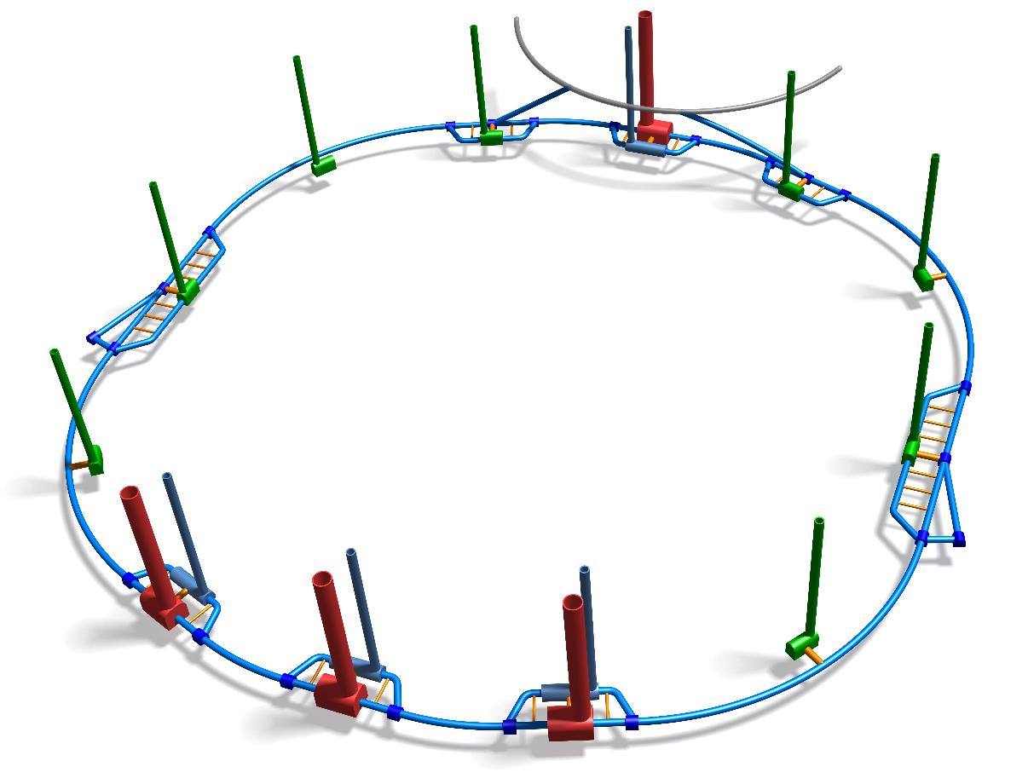
FCC Schematic
The needs for the size and the number of main shafts depends critically on the detector configuration.
This is still being evaluated.
Service caverns – 90 x 20 x 13 (LxWxH)
w. single access shaft – diameter tbc

Slide 7
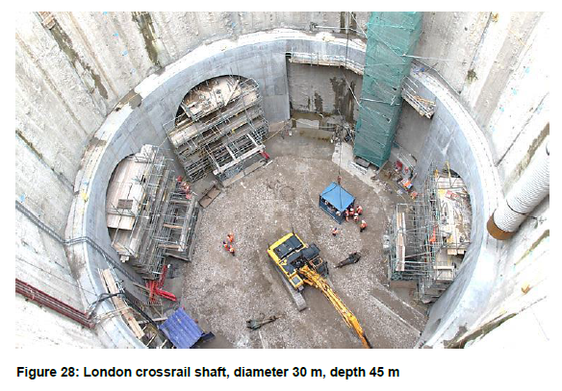
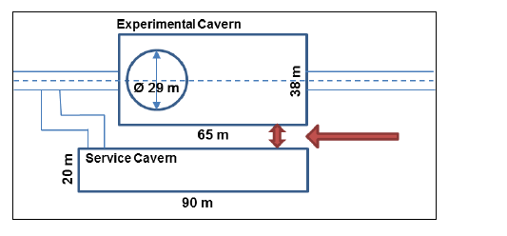
Main shaft 30m
At present a main shaft of 30m diameter is required to mange the transport of the Twin Solenoid Coil.
The need for a second shaft is being evaluated.

Slide 8
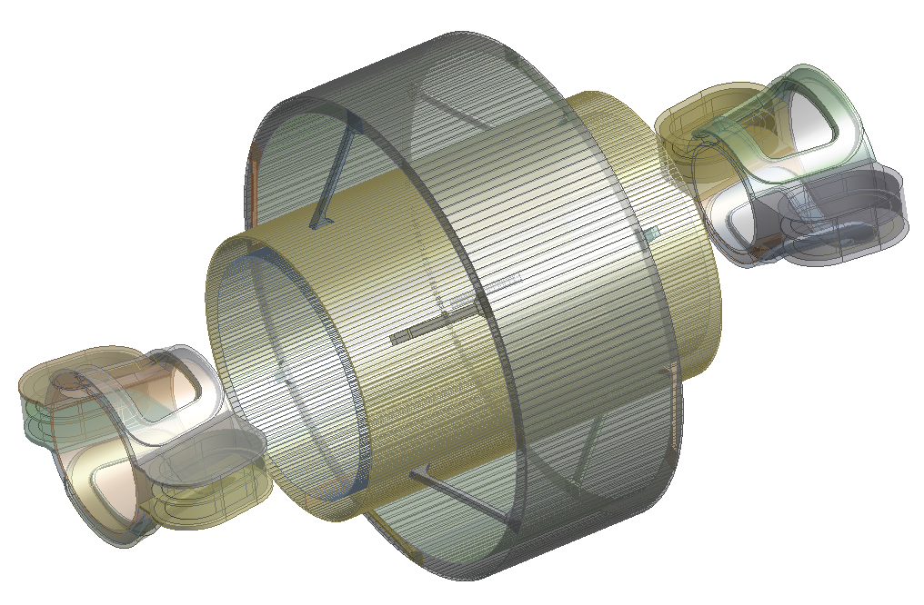
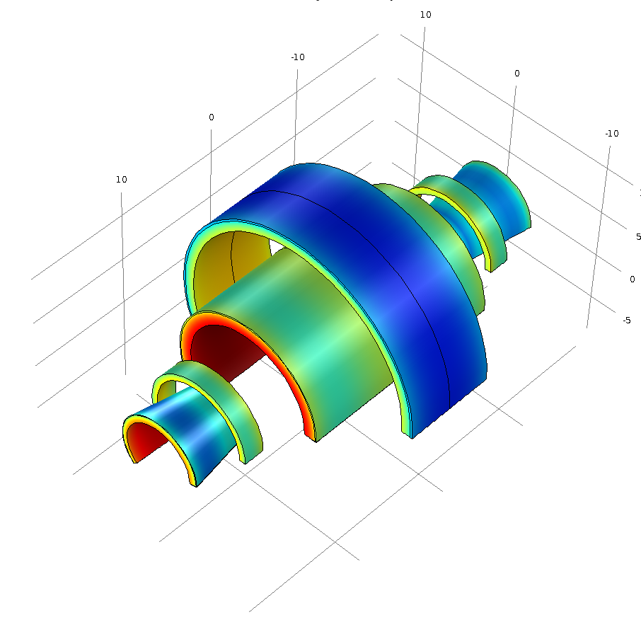
A study of replacing the forward Dipoles by Solenoids in ongoing
Twin Solenoid
y
x
z
Main dipole coil
Lateral dipole coil
H. Ten Kate, M. Mentink

Slide 9
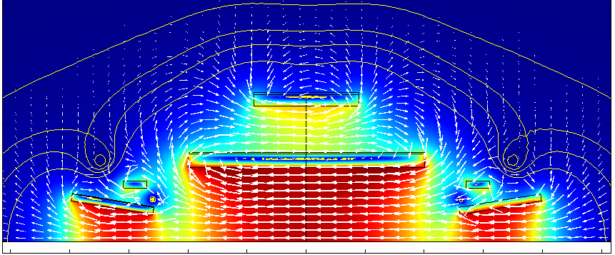

3. New option: a Balanced Conical Solenoid (BCS) magnet
20
15
10
5
0
0.1 T
B [T]
0.2 T
0.3 T
0.5 T
Balancing coil
(Counter clockwise)
Radial position R [m]
Conical coil
(Clockwise)
-25 -20 -15 -10 -5 0 5 10 15 20 25
Axial position Z [m]
Tracking performance for such a solenoid is being studies. Looks interesting …
The question on the need for the shielding solenoid is frequently coming up:
Since we probably do not use the return field for ‘particle bending’ – the second coil is just there to return the flux. What if we remove the second coil … ?

Slide 10
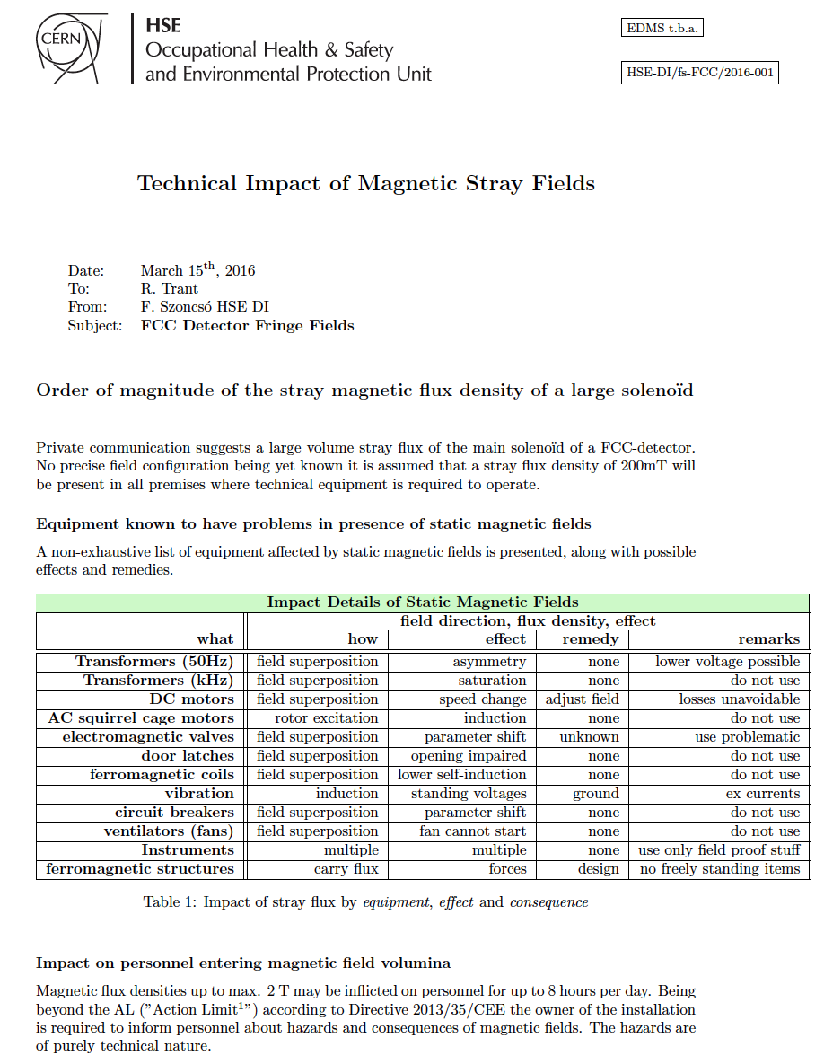
Can we concluded that the impact is just on technical aspects and neither on legal nor personnel aspects ?
… except for proper training and procedures for use of materials when accessing the fields etc. …

