Slide 1
EHN1 cryostats
24/9/2015

Slide 2
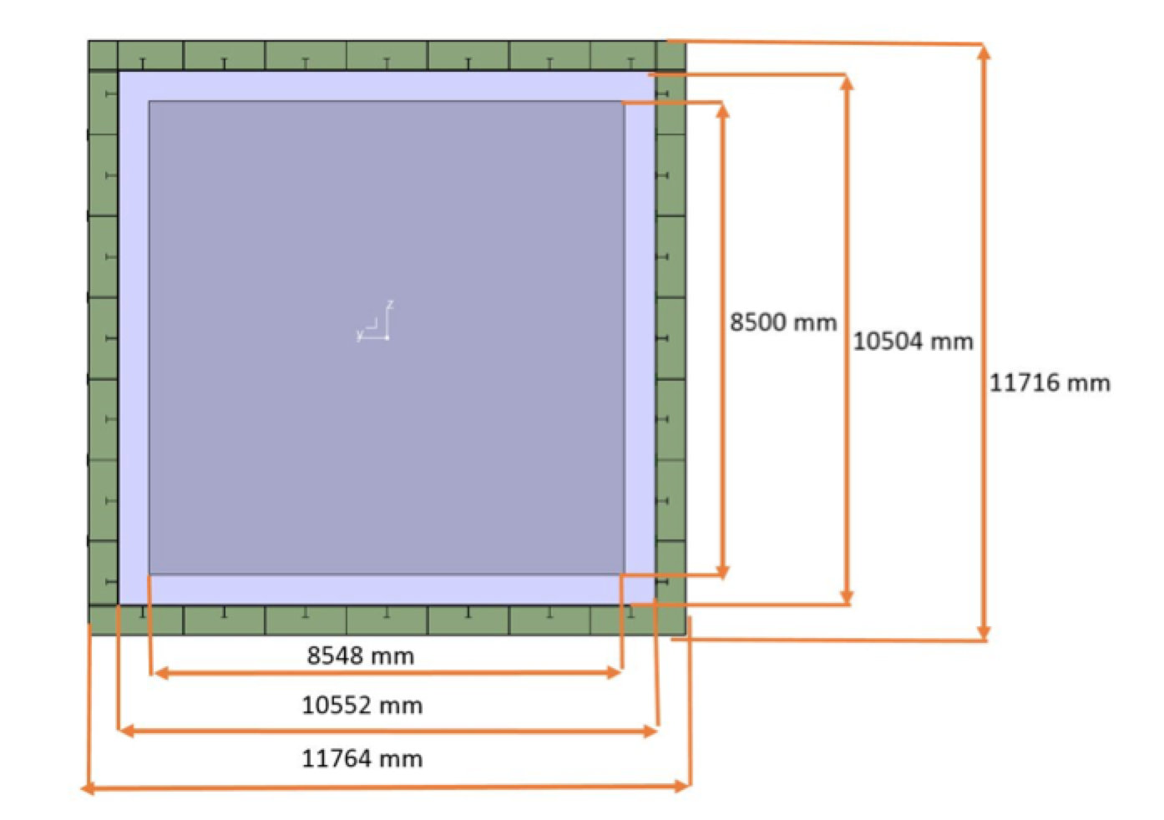
2 cryostats: Wa105 and protoDUNE
2 identical cryostats, with different penetrations

Slide 3
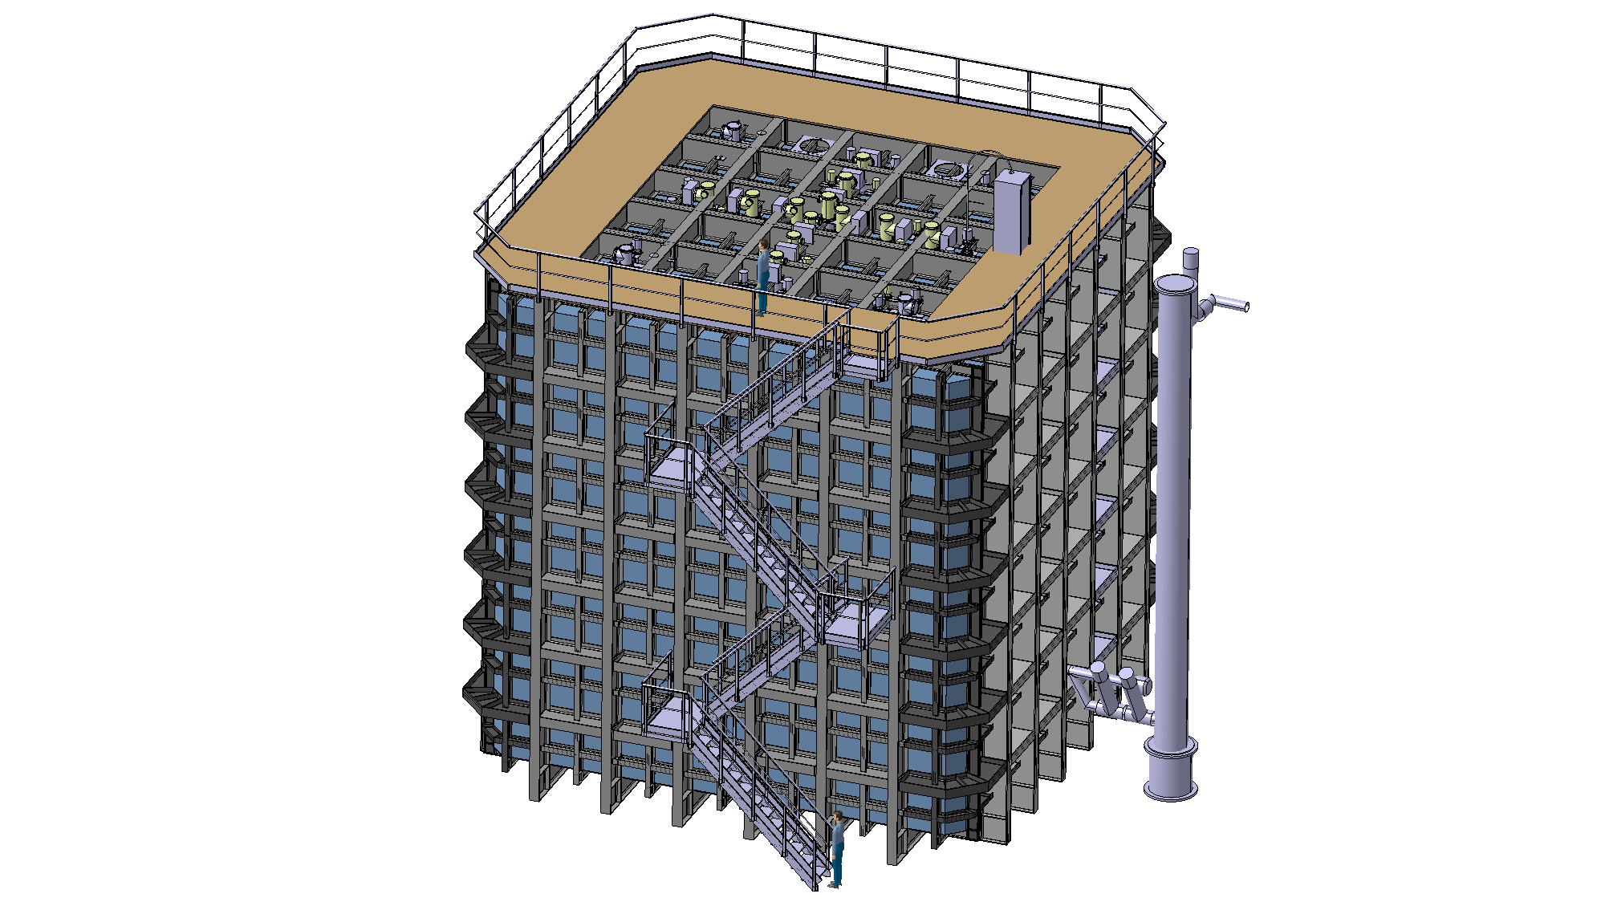
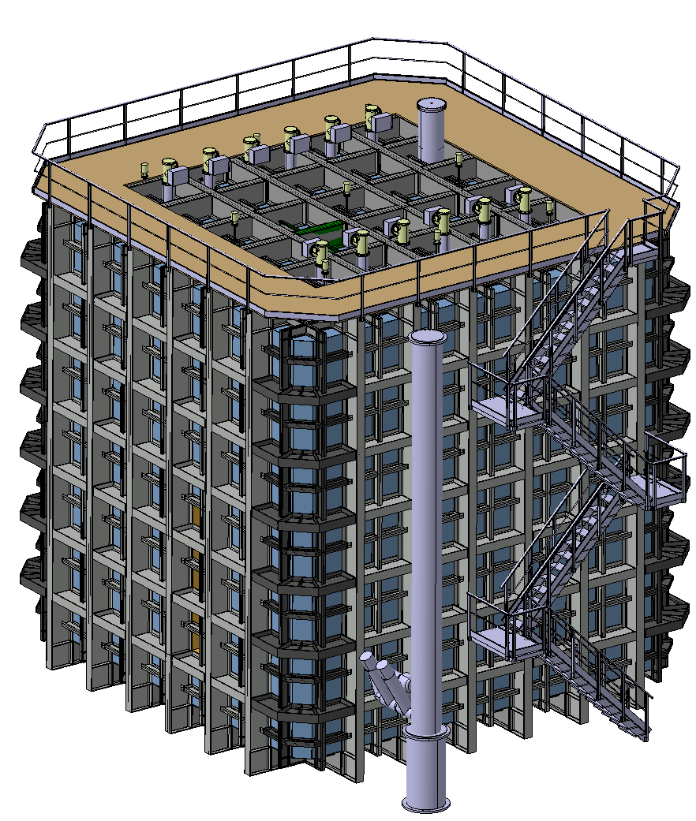

Slide 4
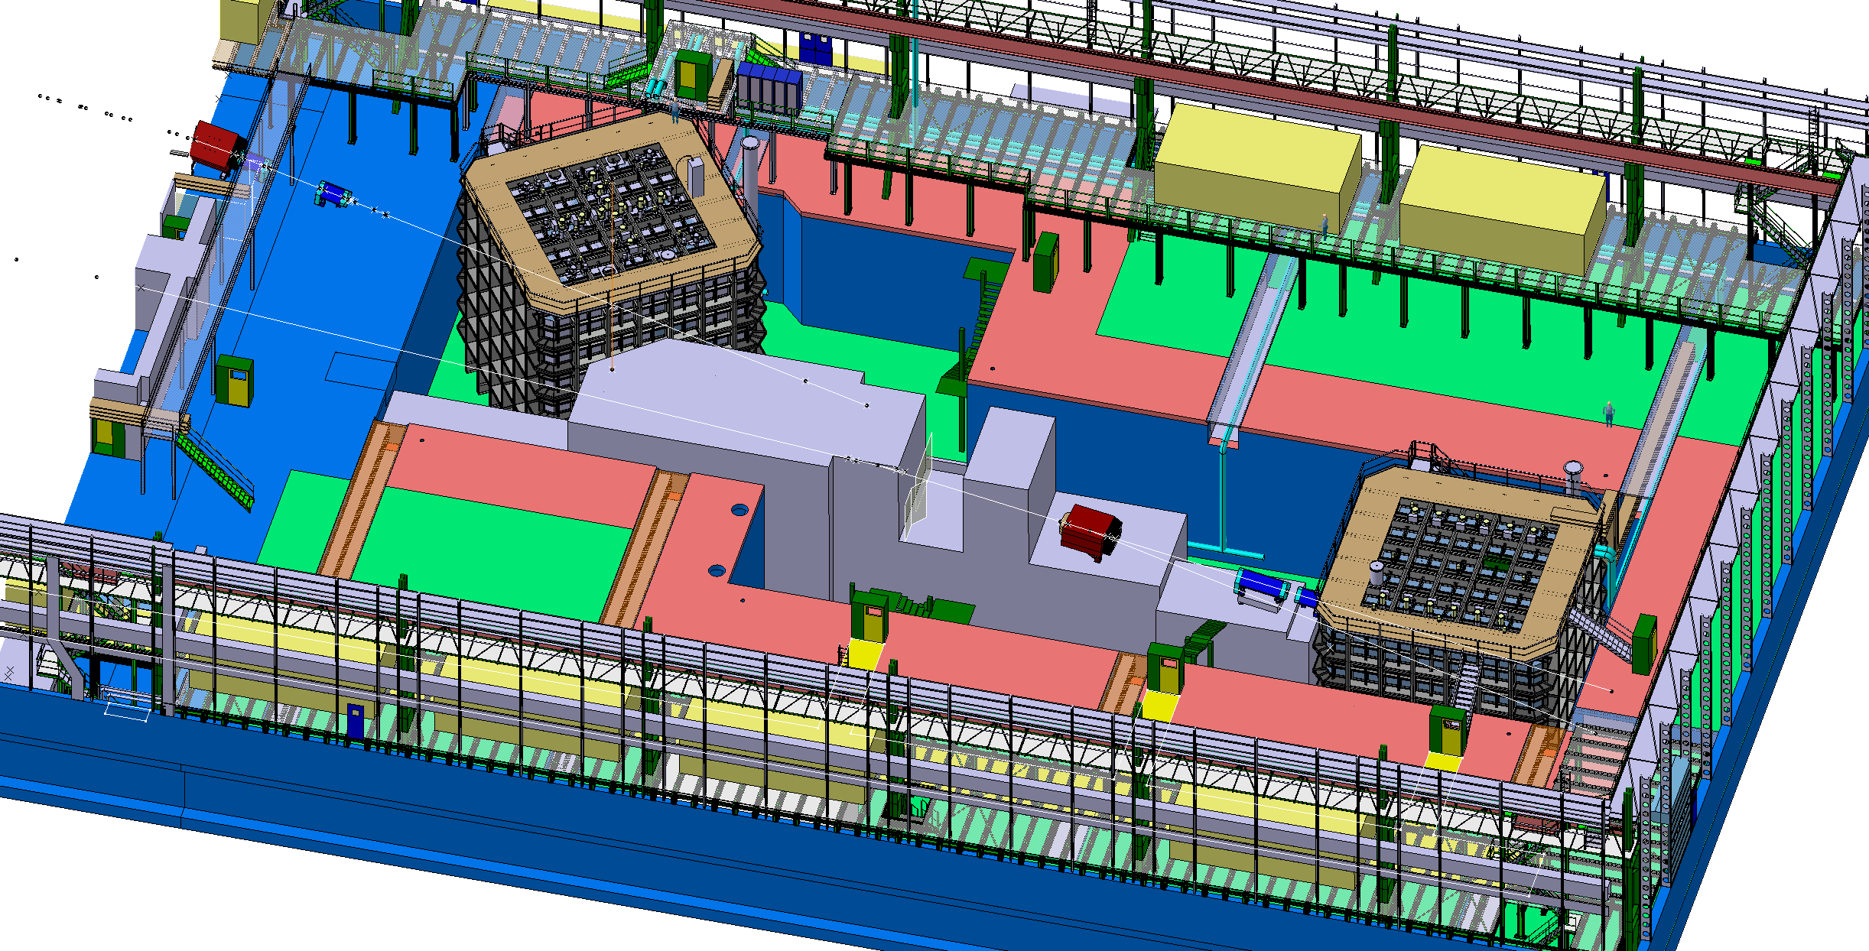

Slide 5
Warm FE structure
Specification, layout, design:
https://edms.cern.ch/document/1531438
3D CAD model :
https://edms.cern.ch/document/1531439
Design : finished
Structural analysis done, missing final report
The structure has been given to an external firm for verification (final report in 3 weeks)
Open issue to clarify: 6mm SS plate, bolted connections, interface to the floor and grounding
Next issue production drawings by end of October, then the tendering can start.
Some modification sin the drawings might become necessary for handling all penetrations

Slide 6
GTT cold structure
Specification, layout, design:
https://edms.cern.ch/document/1543254
Design : GTT contacted to make an offer for the engineering study
In the next 3 weeks we need to freeze the spec document and in particular the level and quantity of penetrations (3 model available) : we will now consult all partners.
Once we have an offer from GTT we will submit a contract for an engineering implementation study (in October?).

Slide 8
http://cenf.web.cern.ch/
General pages
Twiki project details linked to EDMS

