Slide 1
Status of the PMTs activities of WA104
C. Montanari – CERN / INFN-PV

Slide 2
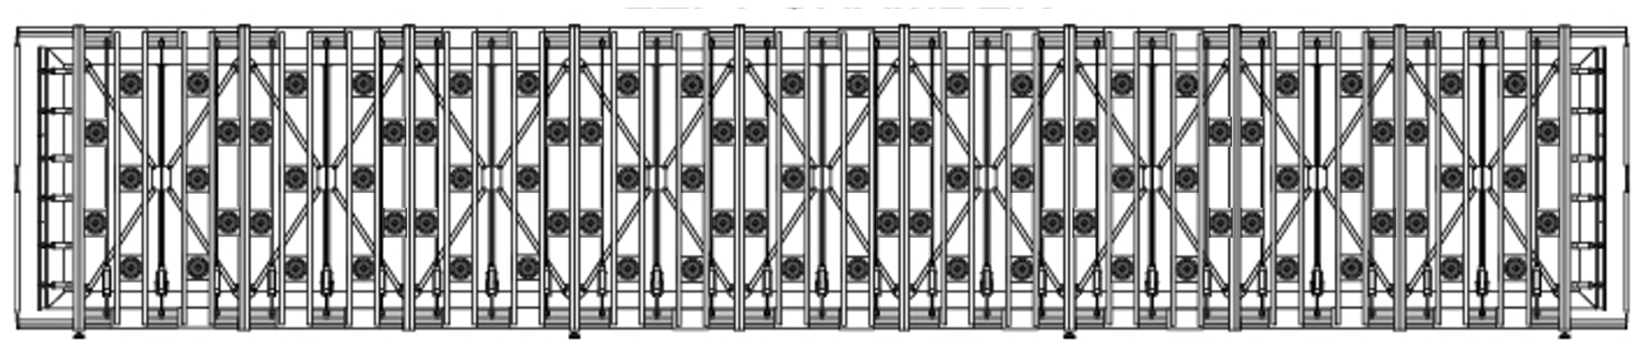
New T600 light detection system
The refurbished light collection system consists of 90 PMT 8‘’ HAMAMATSU R5912-MOD for TPC, installed behind each wire planes (360 PMT in the whole T600). About 200 μg/cm² of TPB wavelength shifter is deposited on each PMT window. The photo-cathode coverage corresponds to 5% of the wire plane area.
The number of photoelectrons collected per MeV of deposited energy in a single TPC is ~ 15 phe/MeV, allowing the possibility to trigger low energy events with fairly high threshold and multiplicity.
X axis
(vertical direction)
Z axis (beam direction)
An event localization better than 0.5 m and an initial classification of different topologies (cosmic μs, e.m. showers, νμ CC) can be obtained exploiting the arrival time of prompt photons and the collected light signal intensity.
Fast laser pulses will be provided to each PMT by a system of optical fibers for timing calibration.

Slide 3
New PMTs system deployment
    The mechanical design of the new scintillation light collection system has been completed for the chosen configuration; the first prototypes have been built. Offers for the full production have been processed. Delivery is expected around half of November.
    The PMTs order has been sent to Hamamatsu, that accepted all our technical specifications with slight modifications, including the cold test at the production location. The 20 pre-series samples are expected to CERN have been sent to CERN, they should arrive the week of Sep 26.
    Design of the new bases has been completed. Prototypes have been realized and tested. Components for the full production have been delivered. The full production has been ordered and a pre-series has been delivered.
    The setup for testing and pre-assembling of the PMTs is being organized: two locations, B182 for cold tests and Ideasquare for warm tests and pre-assembly. Materials have been delivered and installation is almost complete.
    The TPB evaporator is being installed in B169, preparation of the site and installation of the evaporation station is almost complete.

Slide 4
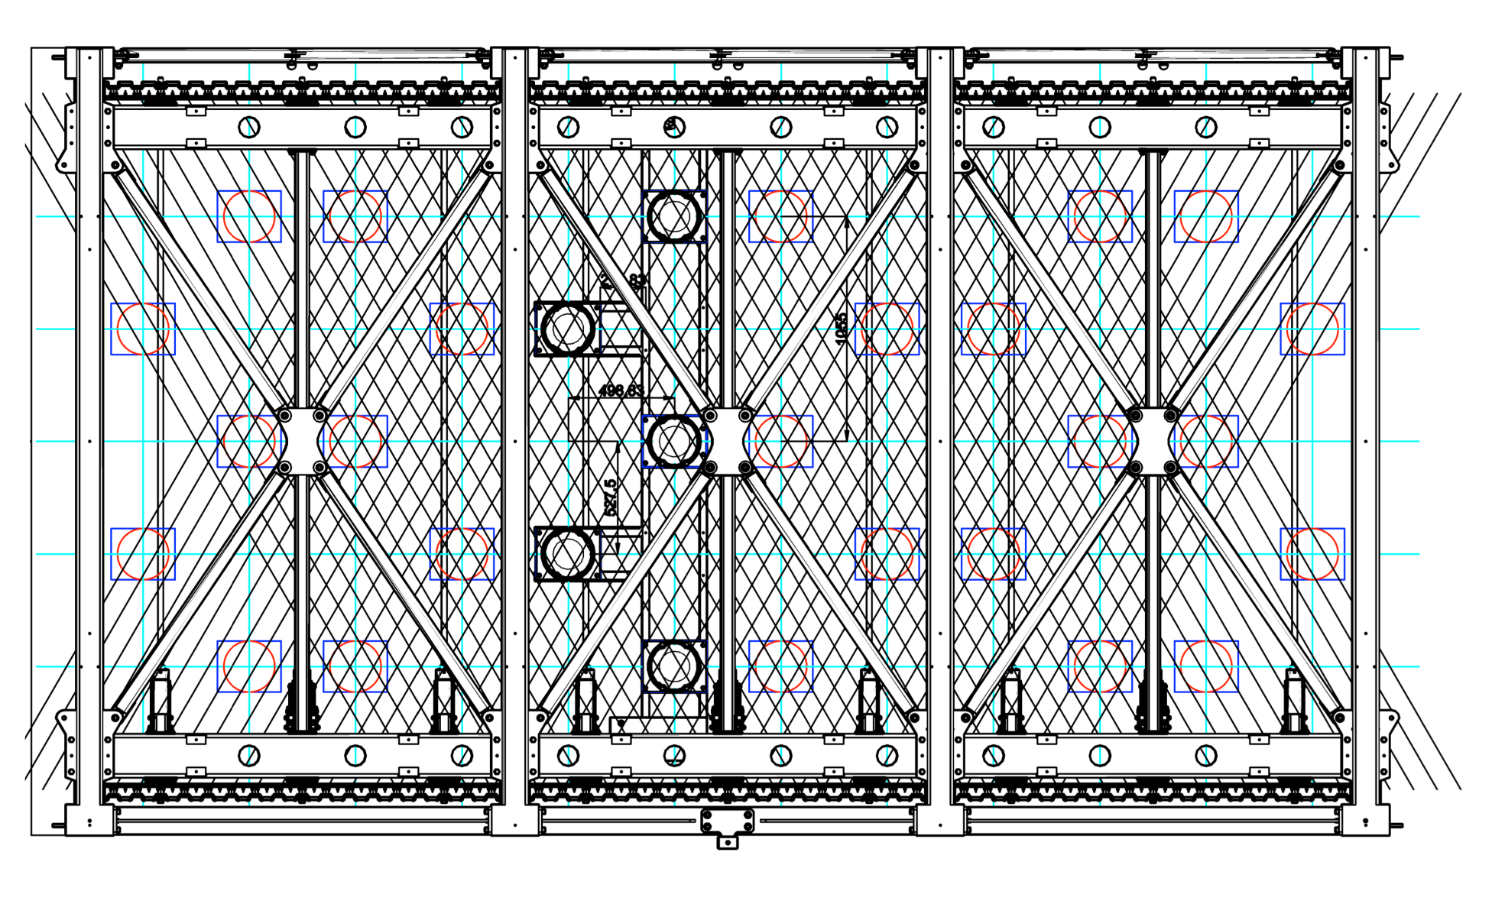
New PMTs system deployment and mechanics

Slide 5
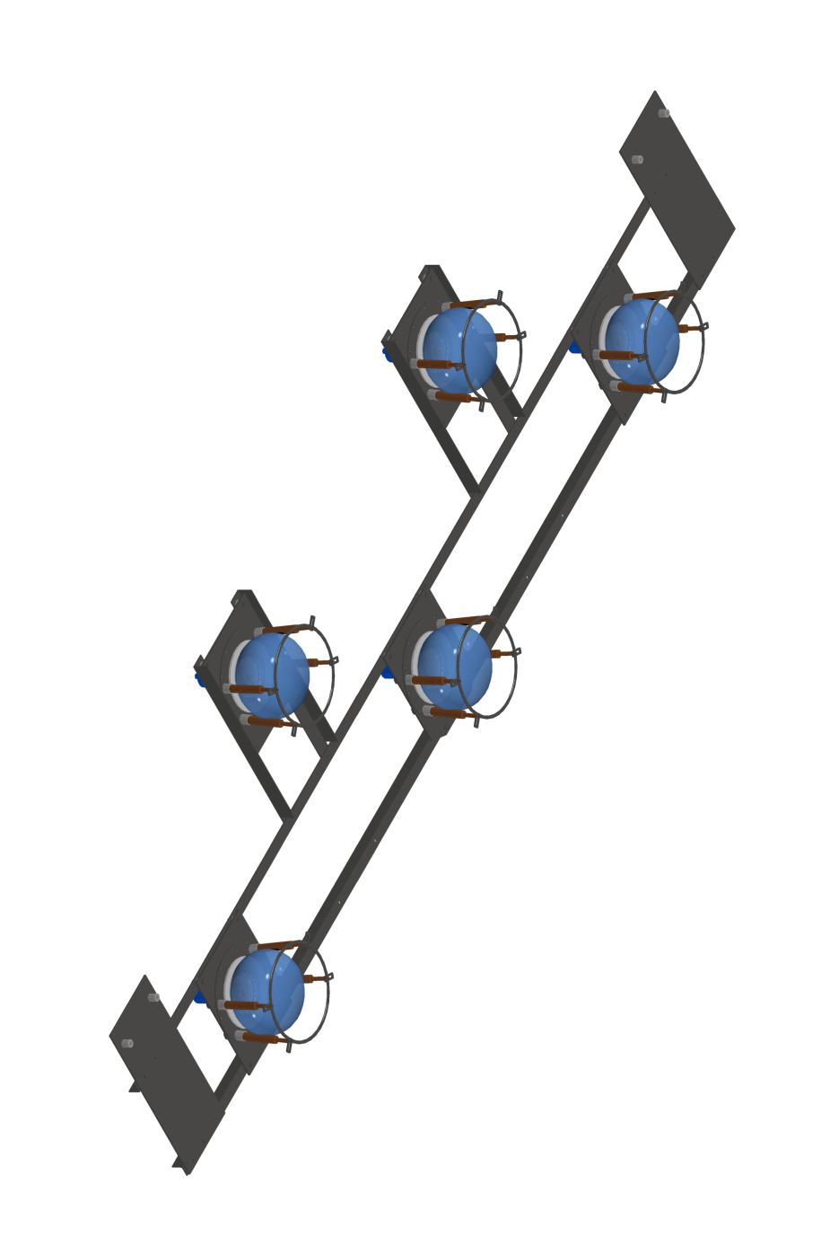
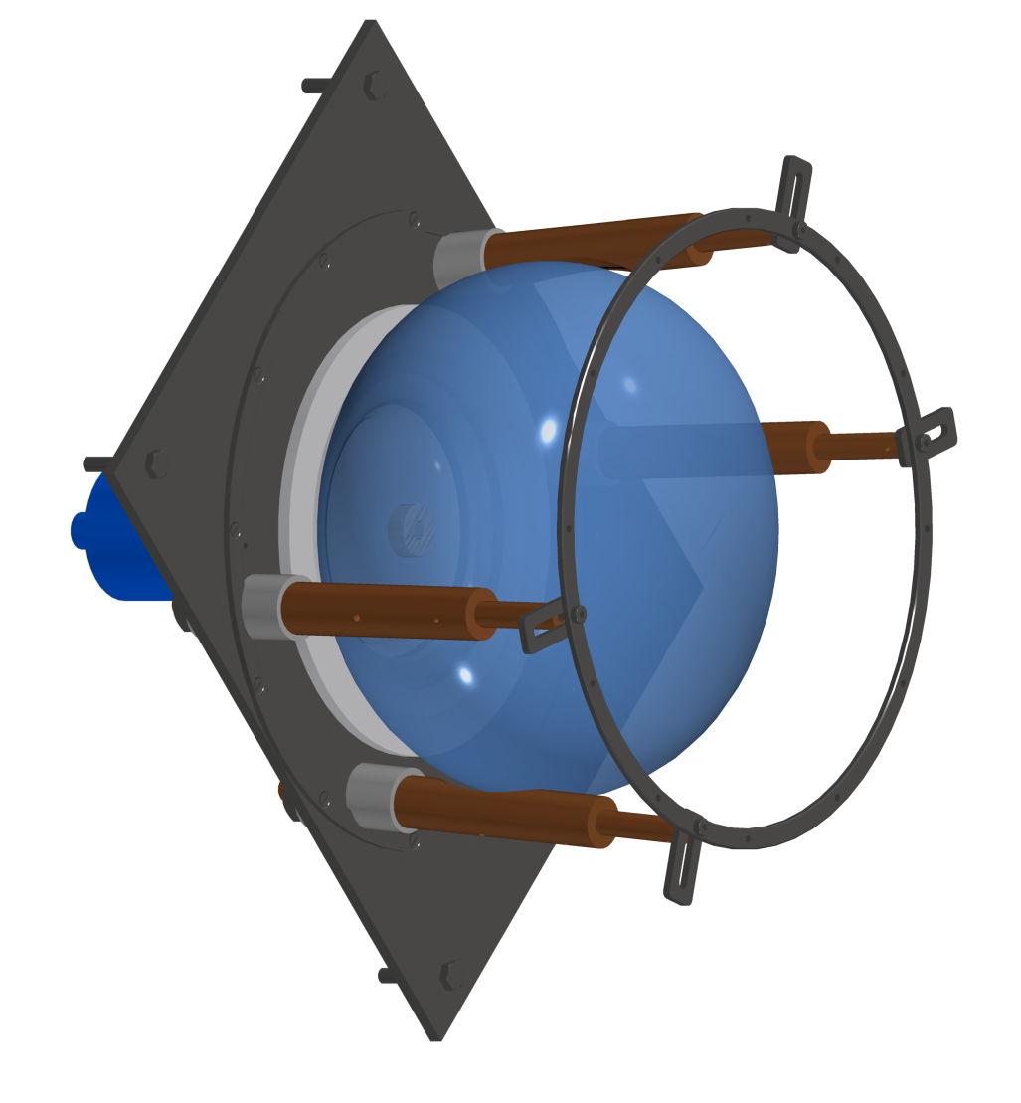
PMTs mechanics
Basic Unit
(36 / T300 module)
Shielding grid

Slide 6
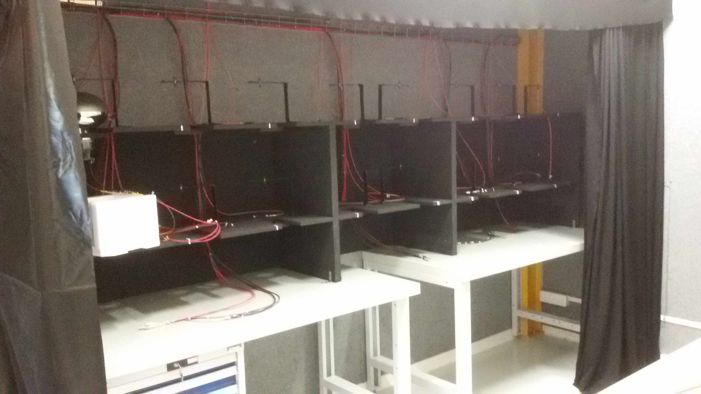
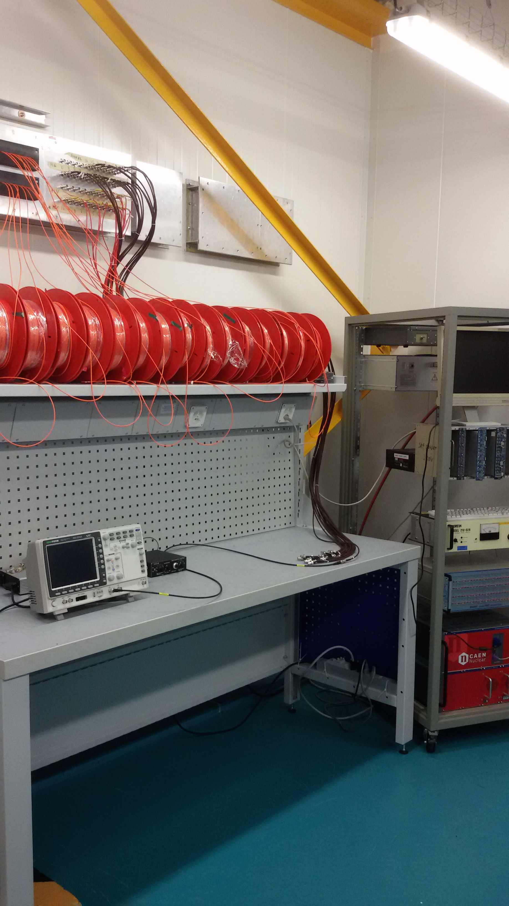
Preparation of the dark room for PMT testing (I)
Test Area
Dark room
Control Area
Dark room
Electronics Lab
Electronics Lab
Ideasquare Lab

Slide 7
Dark room for PMT testing (II)
Equipped for simultaneous testing of 20 PMTs

Slide 8
Dark room for PMT testing (III) – Control Area
Contains power supply, readout electronics and optical equipment.
Ready. First samples being tested to verify the test chain and the quality of the dark room.

Slide 9
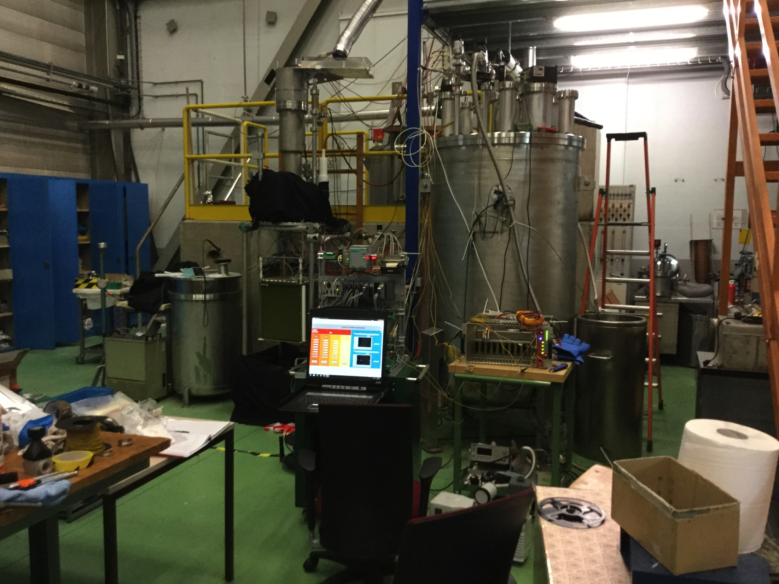
Cold Tests – B185
Mechanical supports, cables and readout chain ready for installation
Cryogenic system presently in use by WA105; should be available at beginning of October

Slide 10
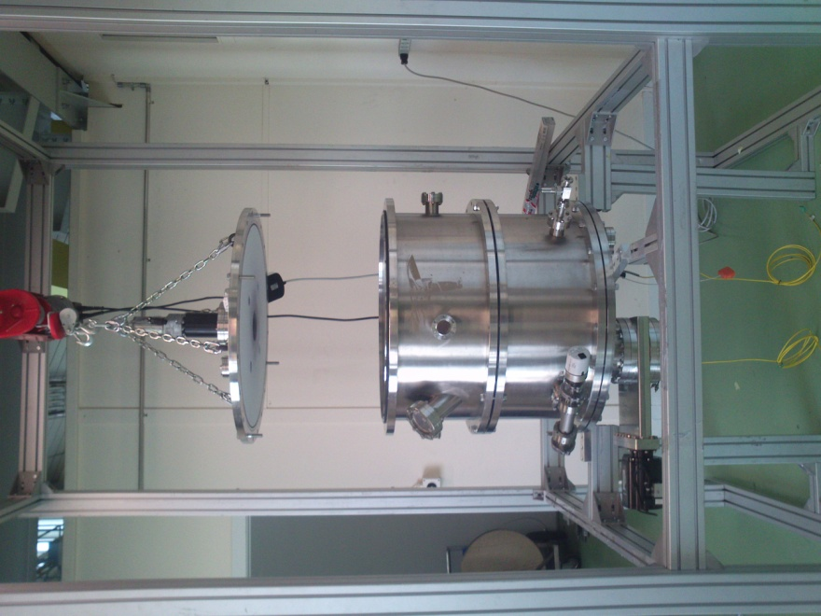
TPB Evaporation – B169
The evaporator was pre-installed in B169 at the beginning of September and the moved to Prevessin for cleaning.
It will be re-installed in B169 the last week of September. First evaporation tests (definition of TPB thickness and uniformity) will start at the beginning of October.
Production will start at the end of October with the pre-series units.

Slide 11
Conclusions
    The first 20 new PMTs (pre-series) will arrive at CERN the last week of September.
    We are ready to start the warm tests at Ideasquare.
    The facility for the cold test will be readied as soon as the dewar will become available (shared use with WA105).
    The area for the TPB evaporation is being readied with the required water cooling line. The evaporator installation will be completed the last week of September.
    Mechanics for the new PMTs is being ordered; it will be delivered mid November.
    We will be ready for the full production chain according to the original schedule.

