Slide 1
YETS 2015-16: recall CMS plans
…thanks to TE colleagues for various material herein
Top priorities:
-complete the cleaning /replacement of the cryo system (TE+EN+CMS )
-replace damaged cryo valve on 6000l dewar (Intermediate Cryostat) TE +CMS
-diagnose & fix water leaks & repair any collateral damage
Other activities (original YETS programme):
-left-overs/snagging from LS1 activities + prep for YETS 2016-17
-repair of RPC chambers damaged by ventilation incident on 4 Jan
-major cooling system maintenance including control system upgrade
-precautionary replacement of cooling block in ECAL power supplies
Before going any further….an important message of THANKS:
- for the excellent collaboration with TE & EN depts, as well as PH of course,
in attacking the serious magnet cryogenic problems in 2015.
- and for the cooperation we also had from BE dept (also the other LHC experiments)
in getting the best out of a rather sick CMS last year.

Slide 2
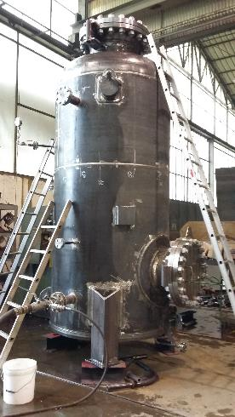
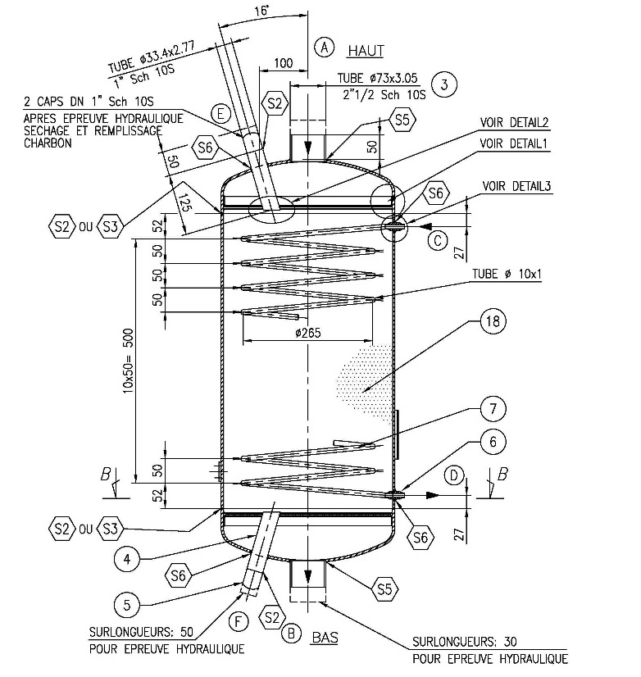
Cryo: Oil removal system
Oil removal equipment pressure and leak tested at factory.
Separator & Coalescer systems will both arrive end Jan.
New adsorbers
delivered to CERN
by Air Liquide

Slide 3
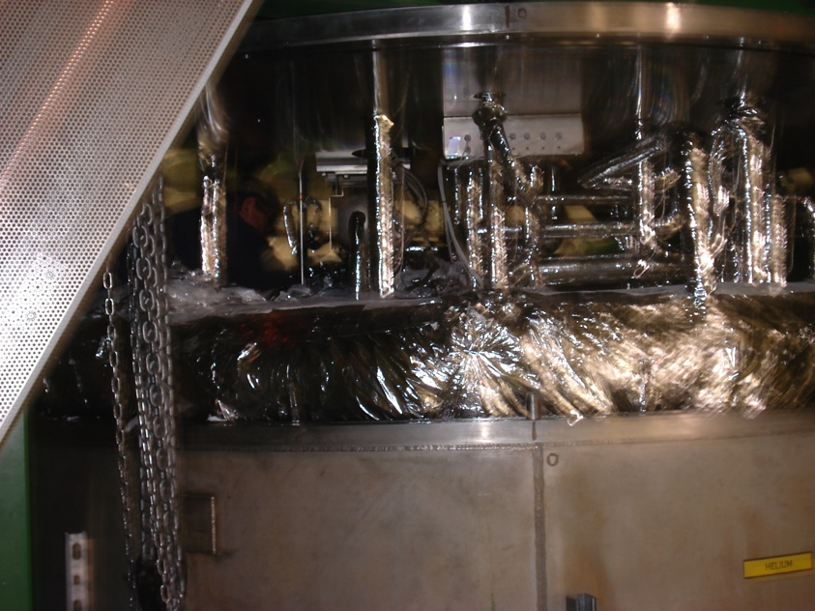
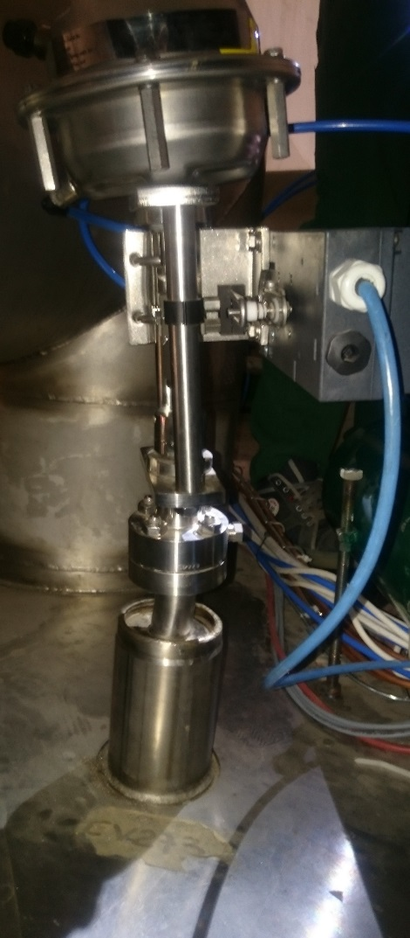
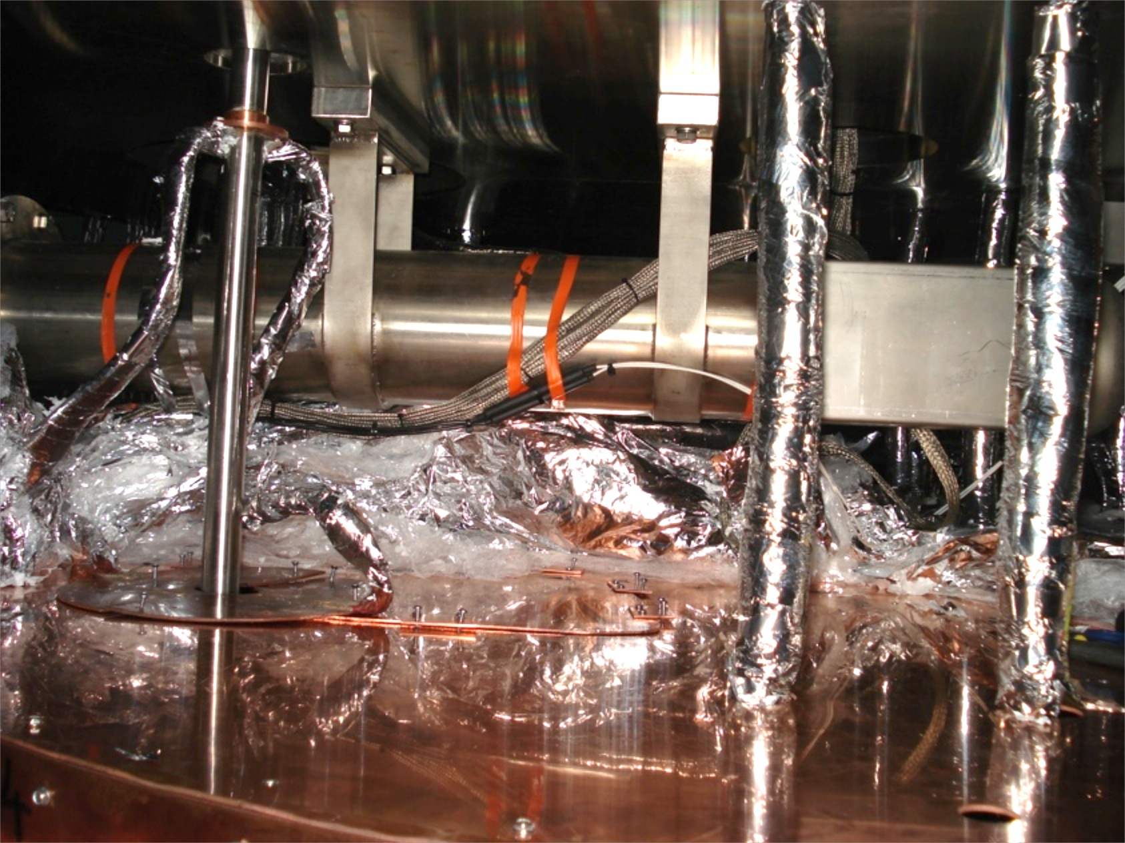
Cryo: CV273 valve replacement: UXC
Replacement valve arrived at CERN.
All preparations for access to 6000l
Dewar complete by 18 Jan.
Repair started 22 Jan (when mech.
interventions on the cold-box
finished)
Tank casing lowered, MLI removed
Next task is to cut Cu heat shield

Slide 4
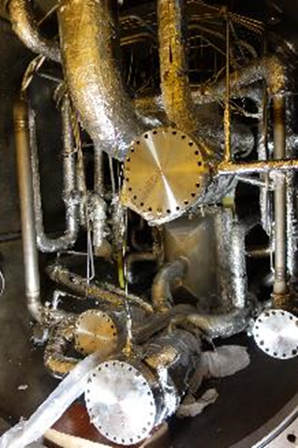
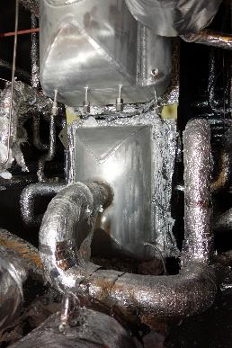
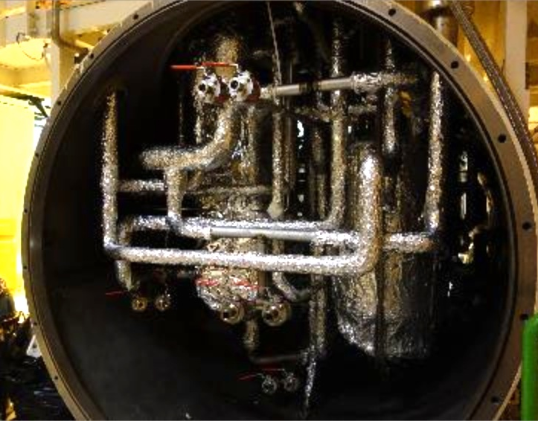
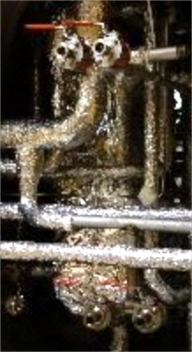
Cold box open both ends
Modifications to isolate cold client & divide into 4 circuits for cleaning
Cold end
modifications
Warm end modifications

Slide 5
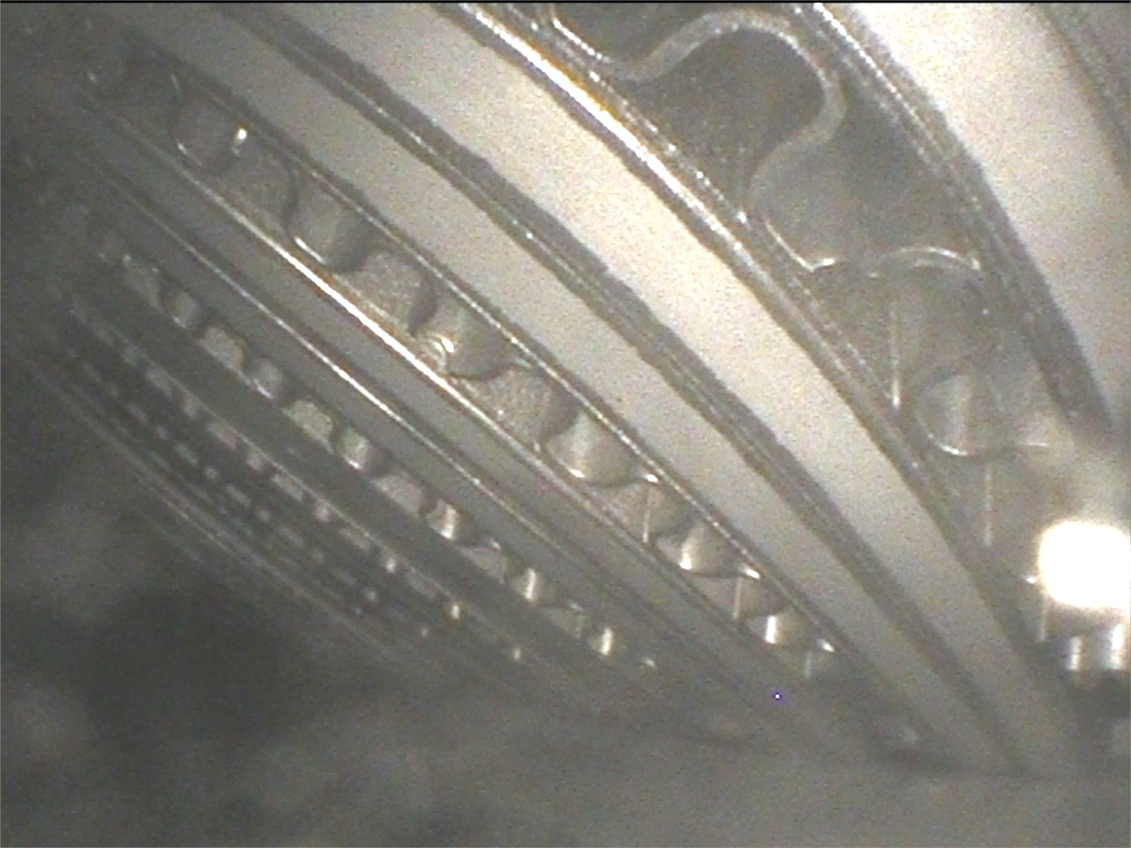
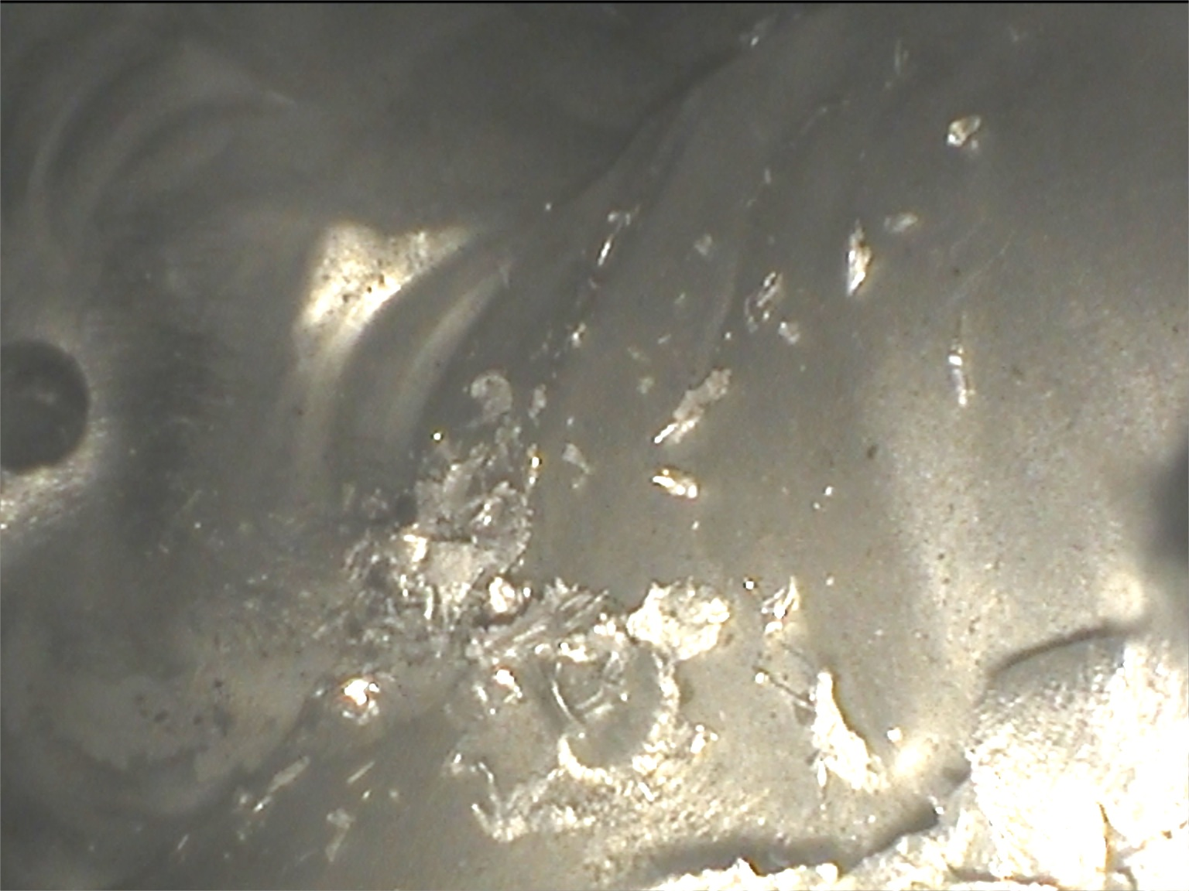
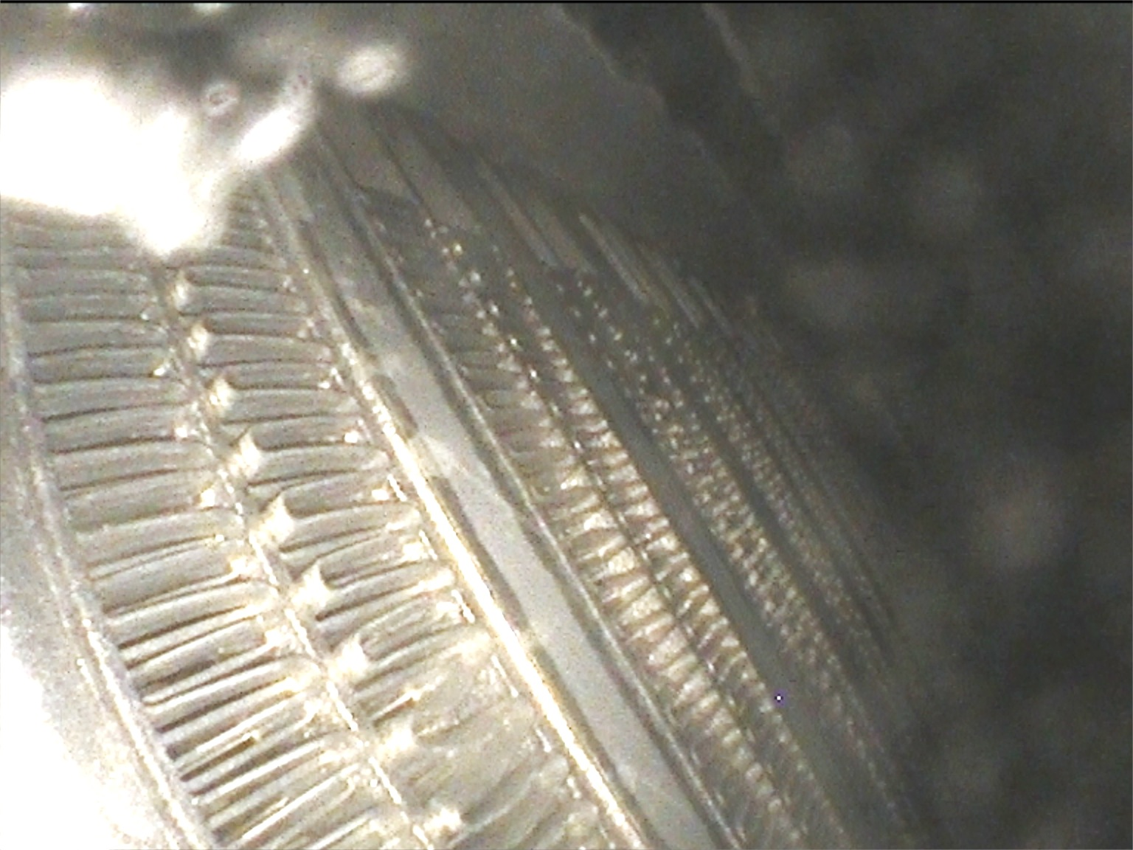
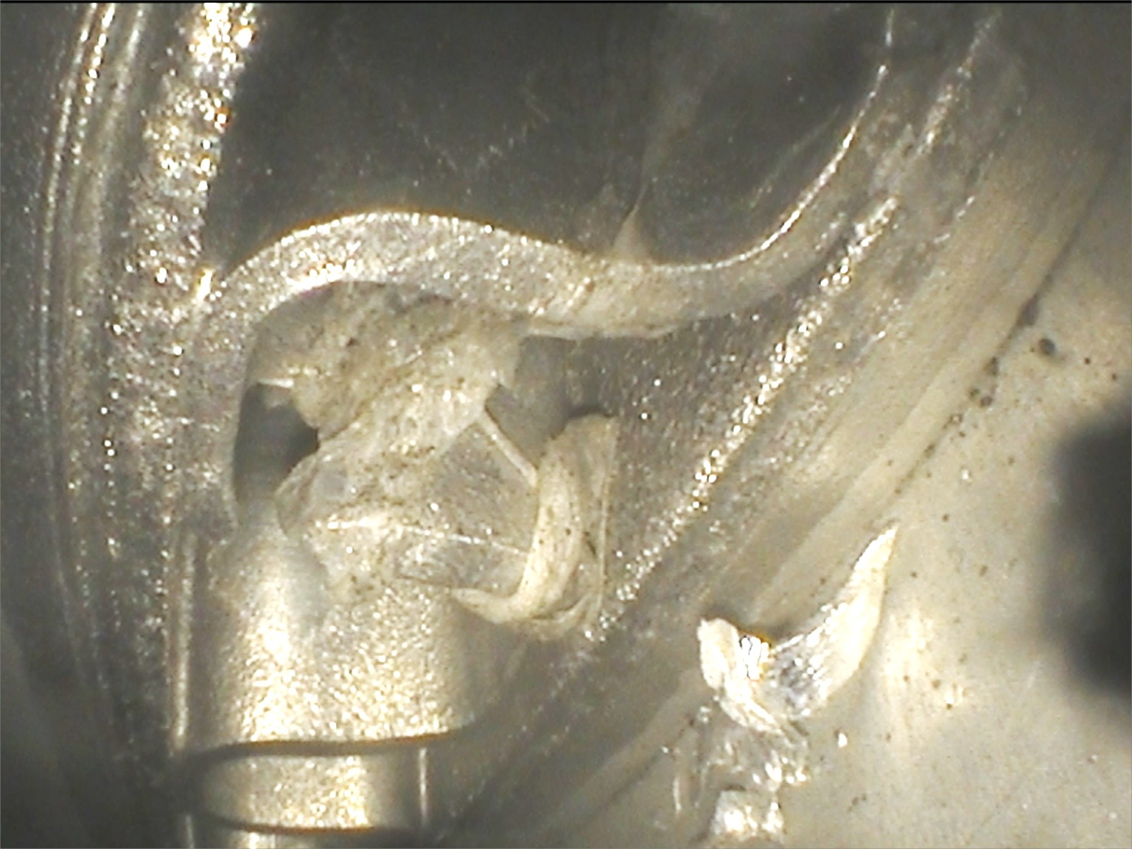
CMS Endoscope check inside heatex’s
Clean except for
v. small metal chips
One small piece of
soft material
(few mm)
- likely MLI

Slide 6
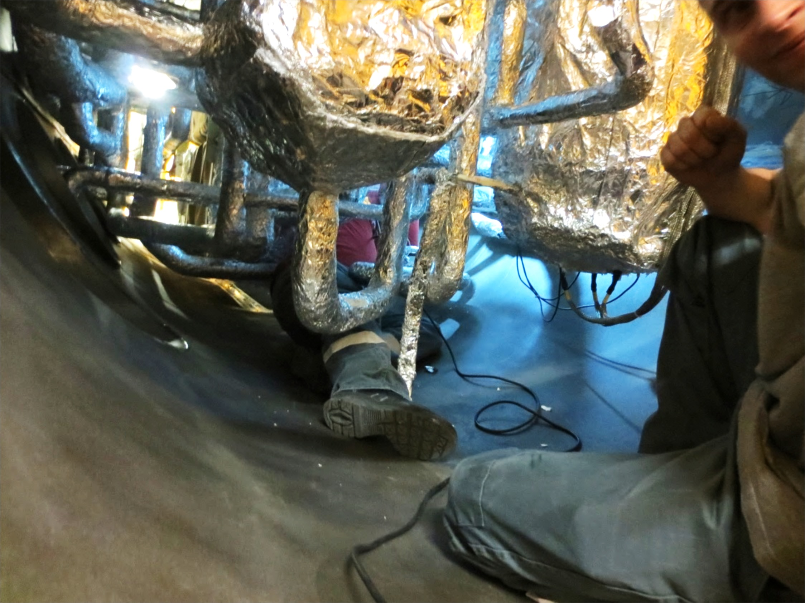
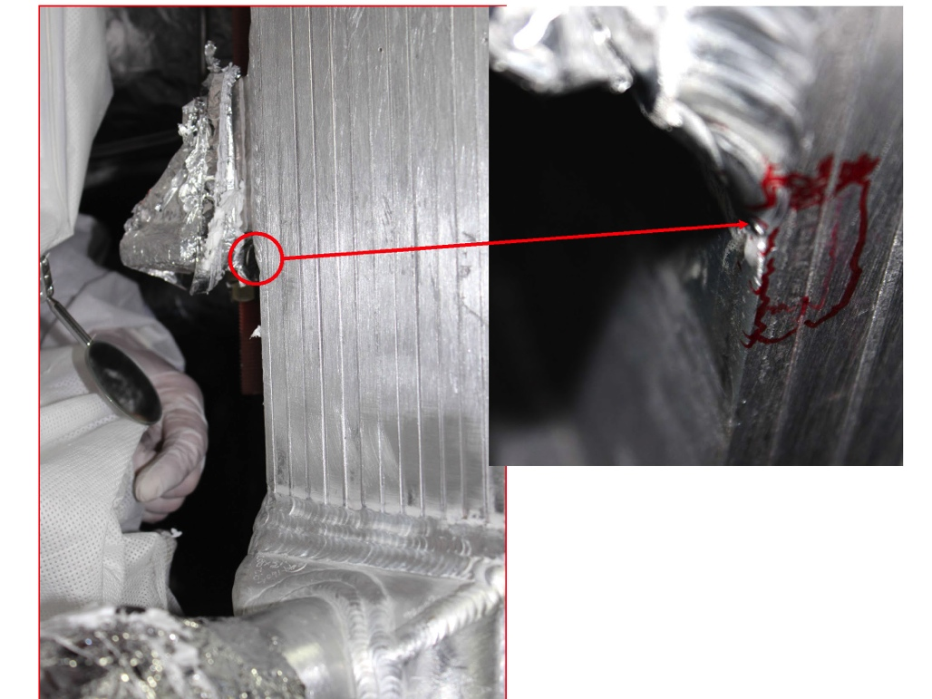
N2 pre-cooler leak repaired
Spot the welder : puzzle # 3
Exchanger accessed
Leak identified
Repaired by specialist company
-preliminary leak check looks good
-final check after CB cleaning complete

Slide 7
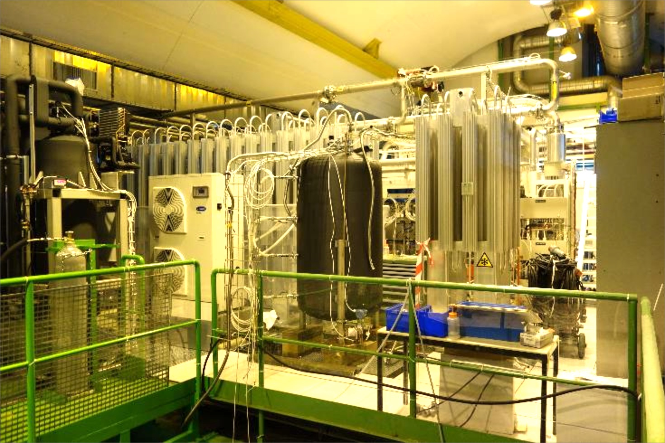
Dryer condenser: installed USC -2

Slide 8
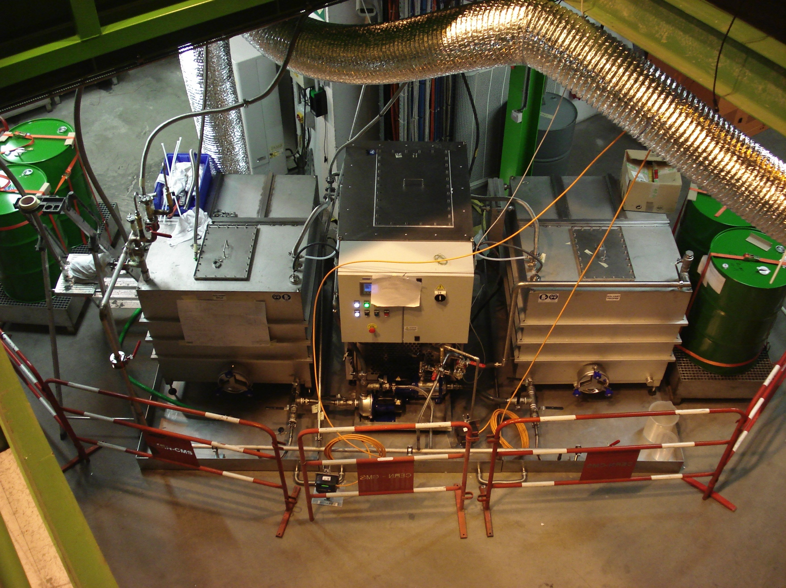
Cleaning machine & fluid: USC -3
Vertrel XF
solvent
drums
Installed & commissioned, circulation in 1st circuit started

Slide 9
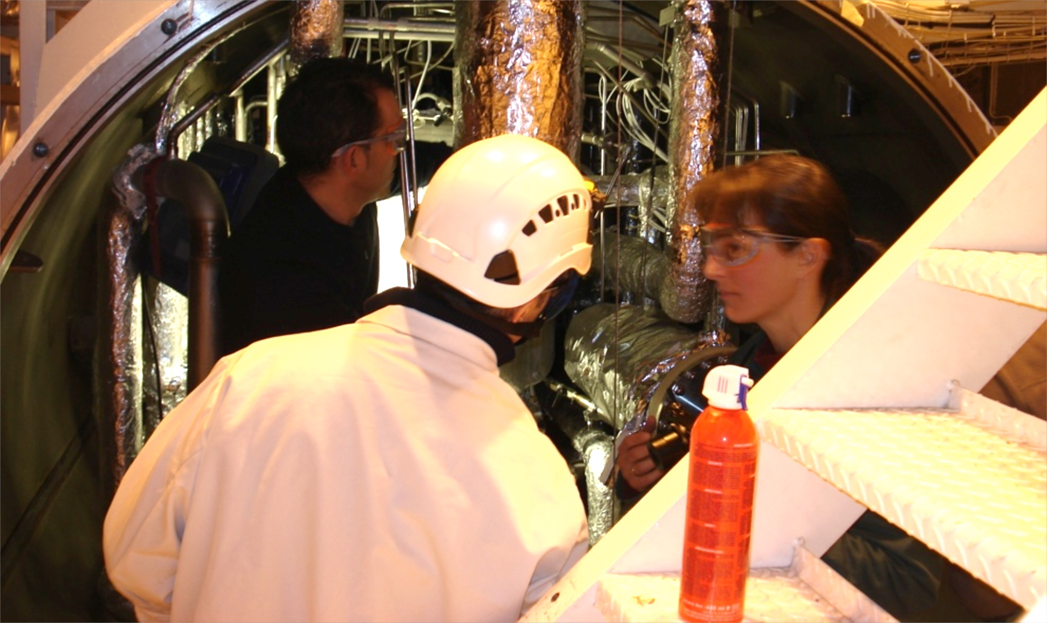
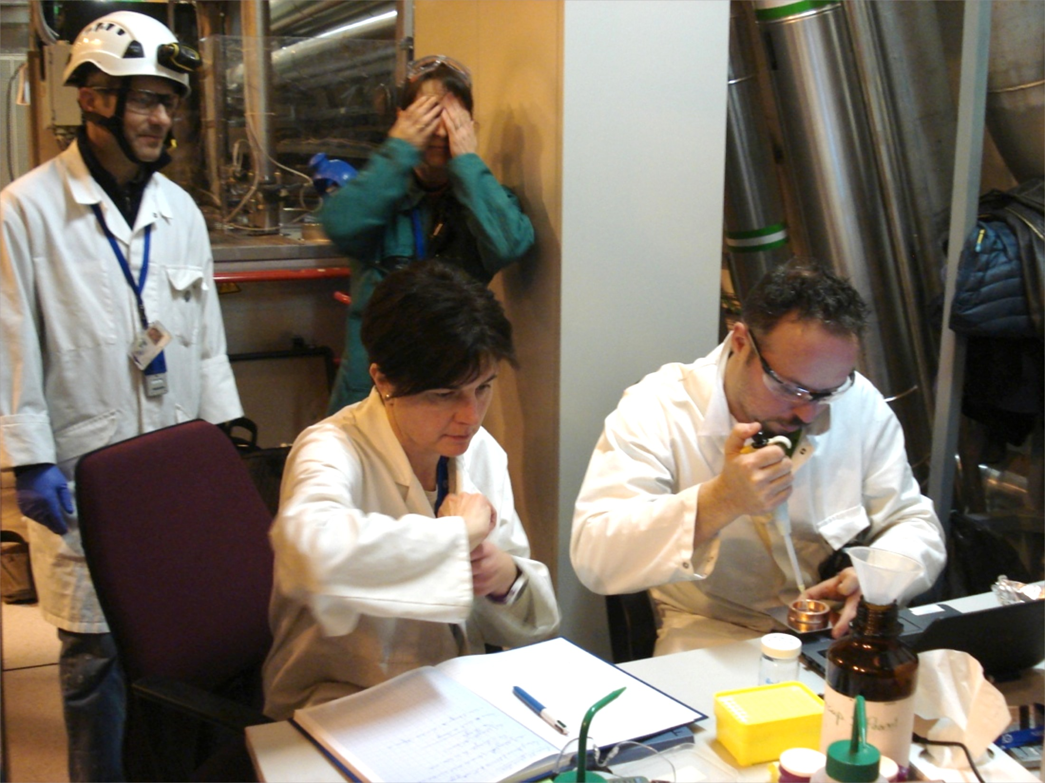
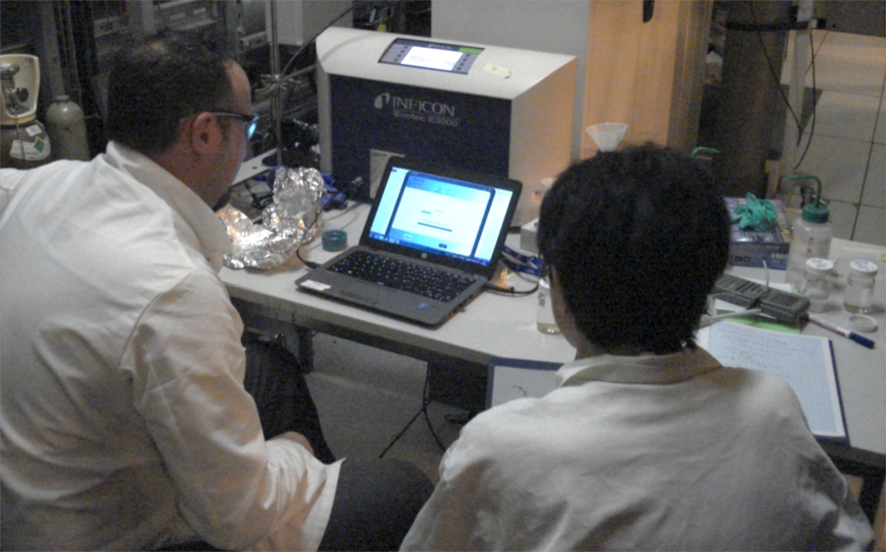
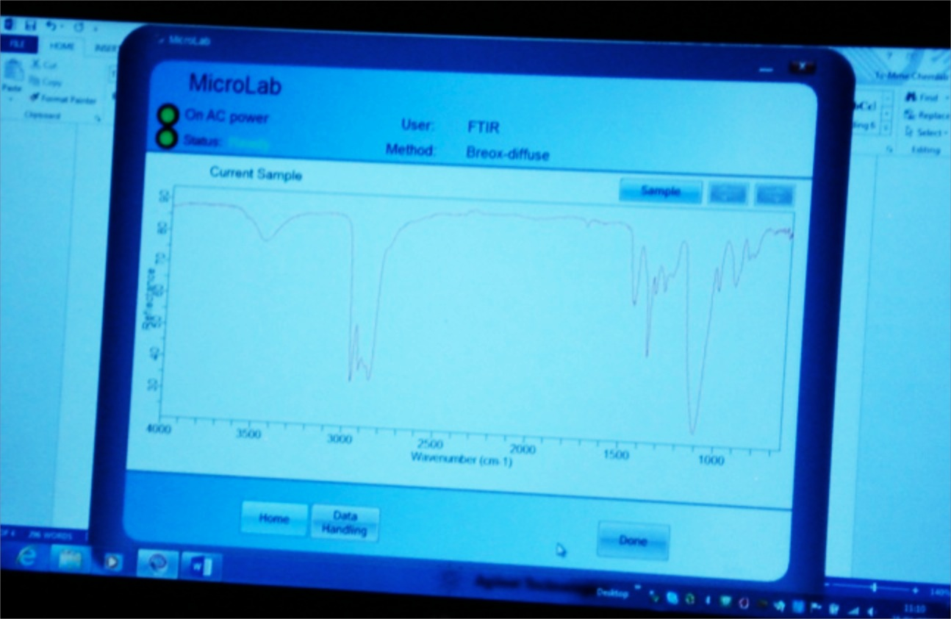
Moment of truth: is there Breox in the solvent?
This morning: 10am
Taking samples from full circuit
Preparing IR analysis
Awaiting result…..
Bingo! strong Breox
signature….
Looks like we are on
the right track

Slide 10
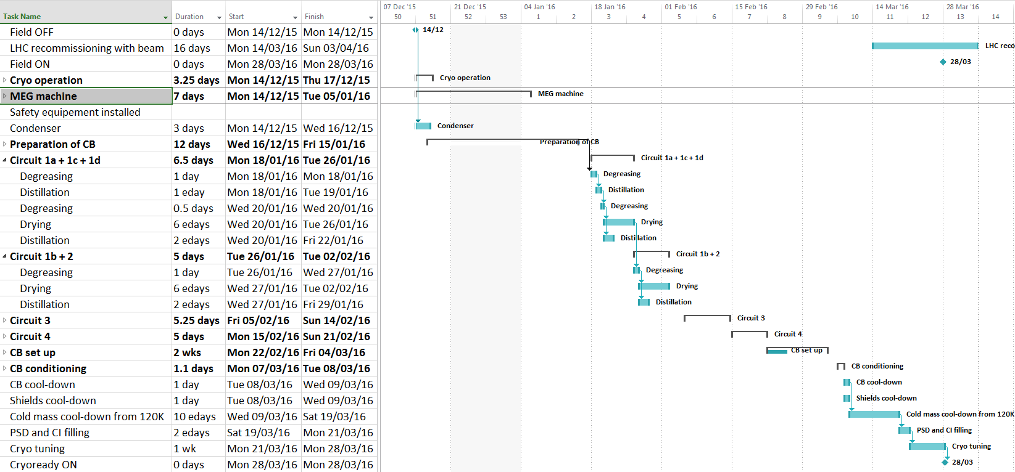
Planning for all CB intervention driven by the
“cleaning / drying” procedure
28 March
Consistent with planning within errors. Drying procedure is biggest uncertainty
Planning for cold-box cleaning, J Bremer
18/11/2015

Slide 11
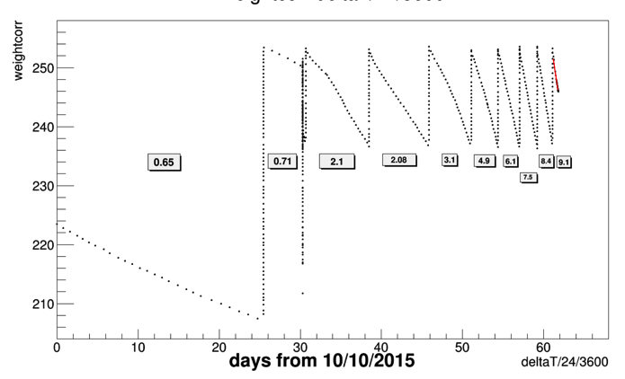
Water leaks seen near end of HI run
2x lowest ME1/1 +
YB0 and YB-2 leak detection cables
RE4 +
Puddles on X1 floor
Refill rate of yoke-endcap cooling circuit buffer tank

Slide 12
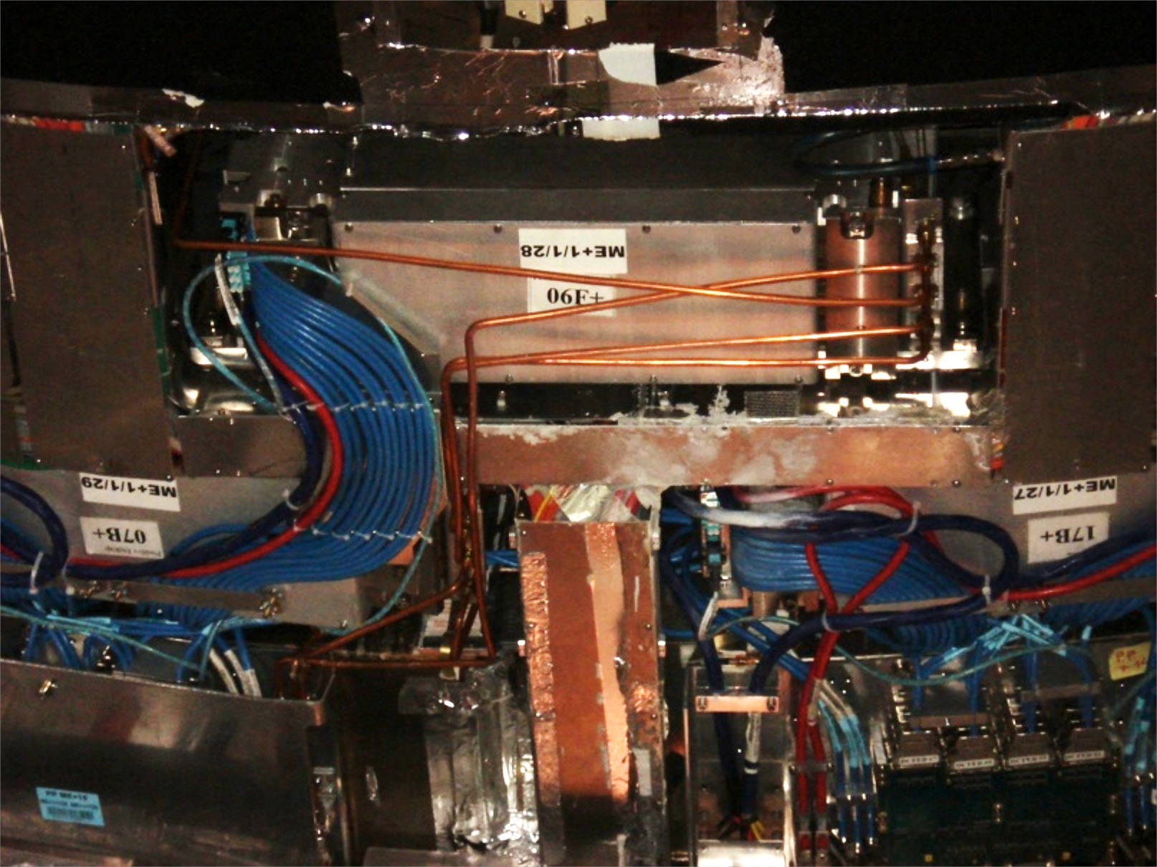
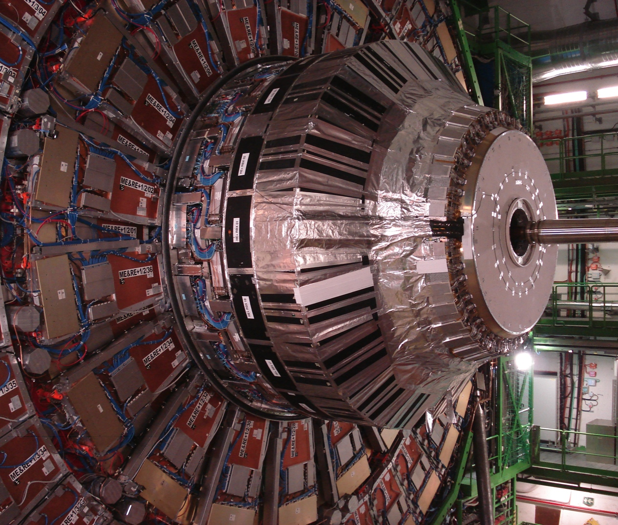
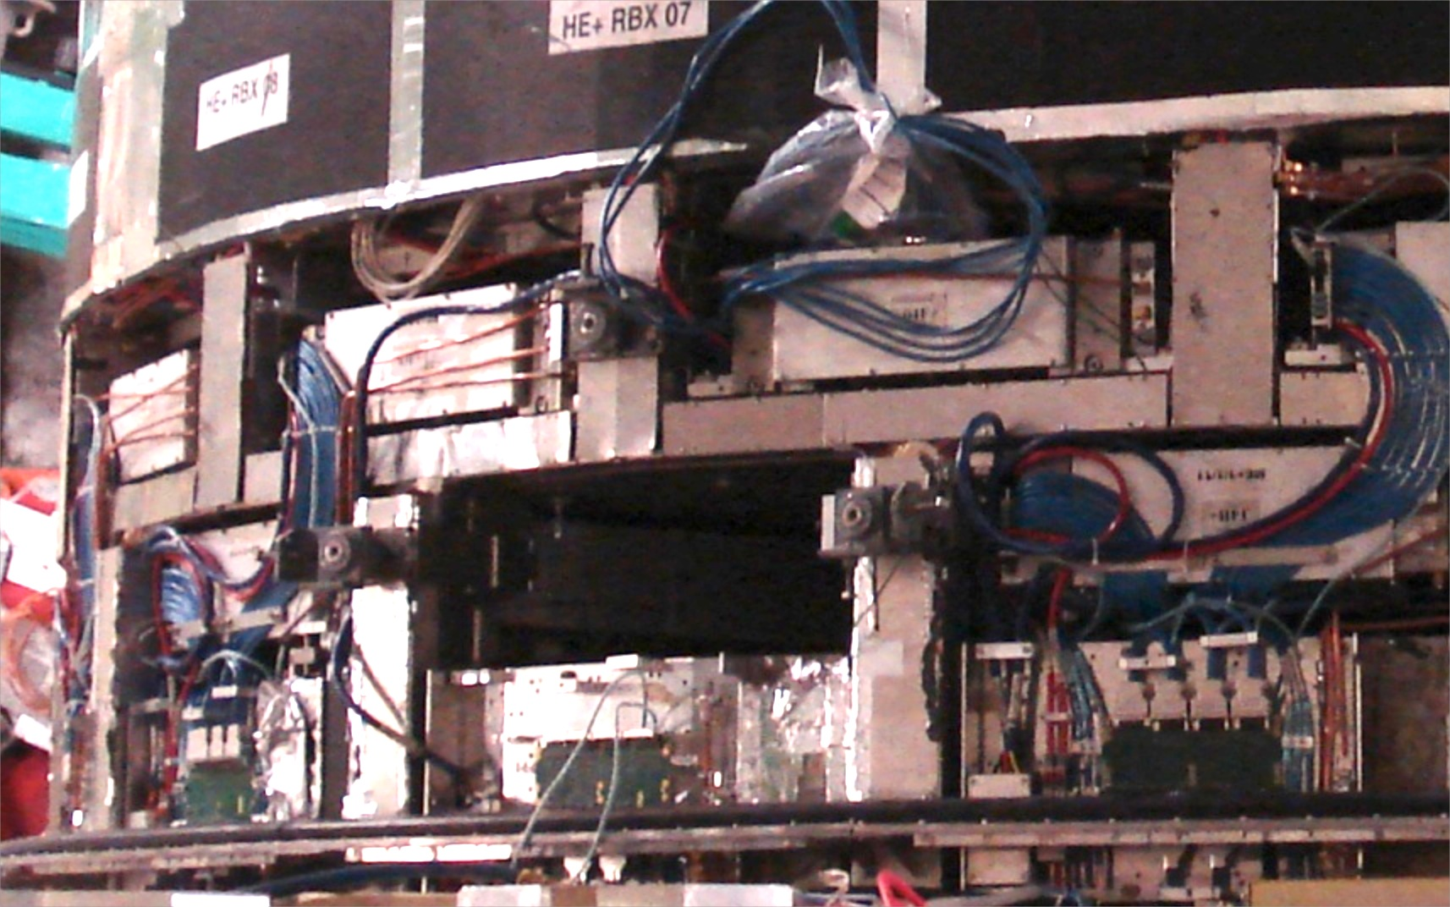
Search for the leak on YE+1
…obvious where the water came out
YE1 disk (1500t) withdrawn from barrel
(beampipe in place)
--source eventually traced to chamber 13
Removed on Sat 23 Jan

Slide 13
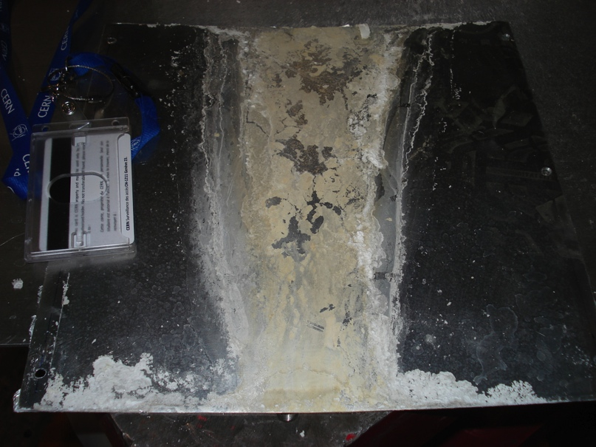
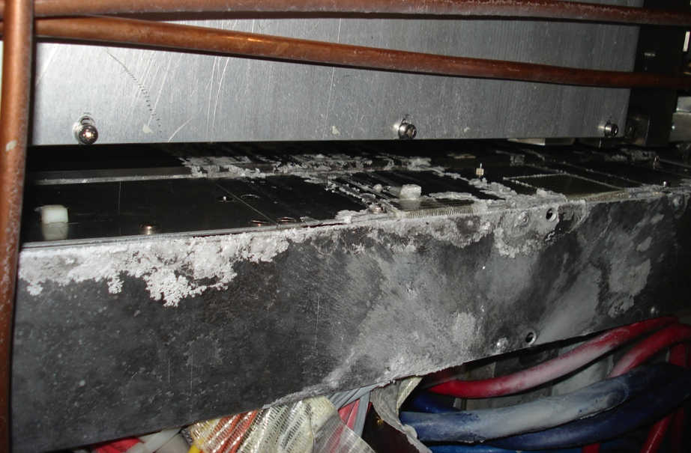
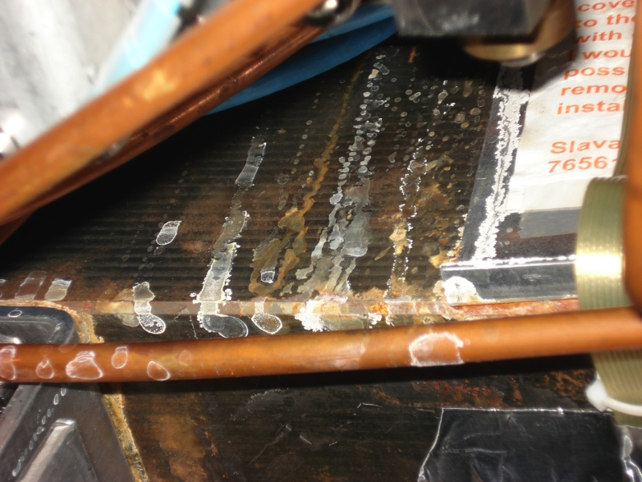
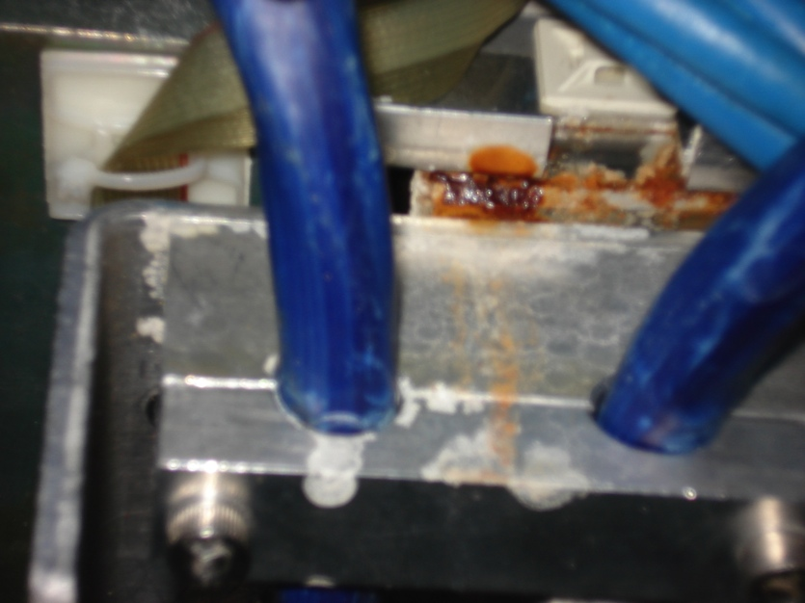
Corrosion, sediment at exit from YE+1
Plate sent to Chem
group for analysis
Deposit has high
Pb & B content

Slide 14
Exit from YE+1 to vac tank

Slide 15
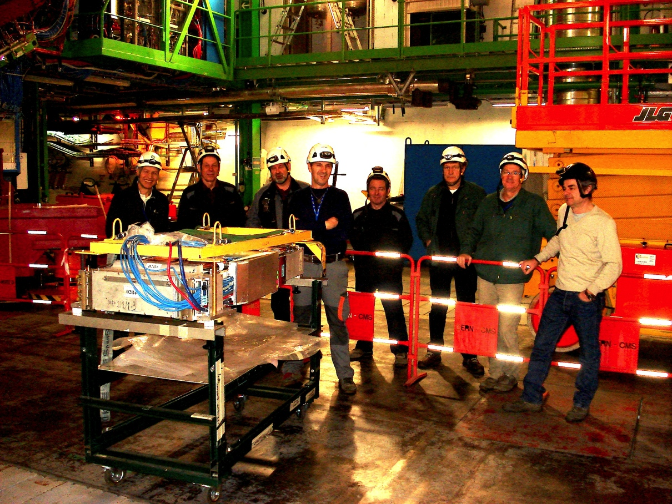
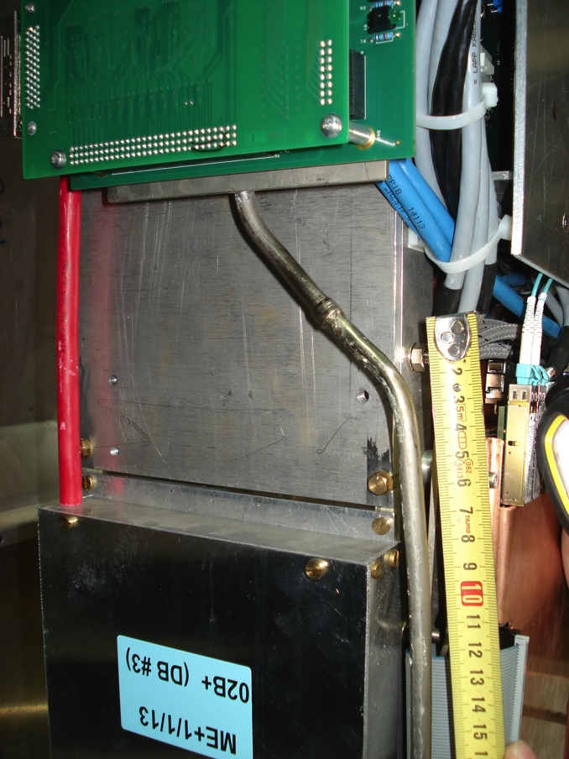
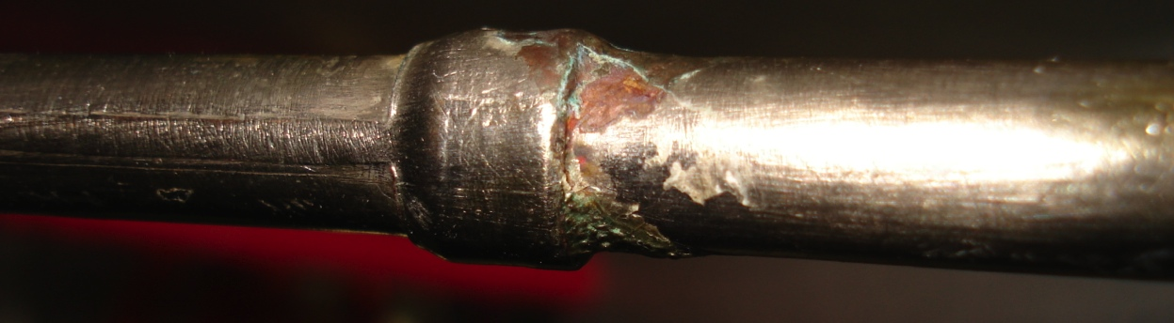
Chamber 13
Removed Sat am – thanks to transport, CMS & HSE crews
Leak from internal joint
Is this a on-off (eg mech damage) or 1st
symptom of a generic corrosion problem?

Slide 16
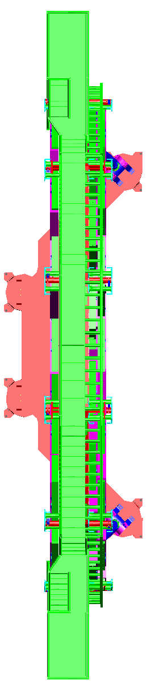
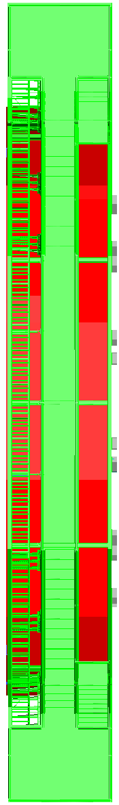
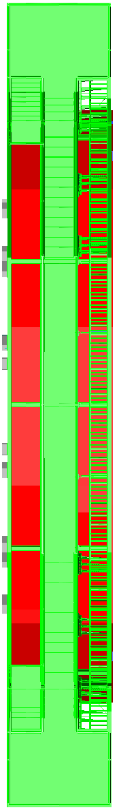
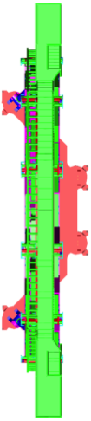
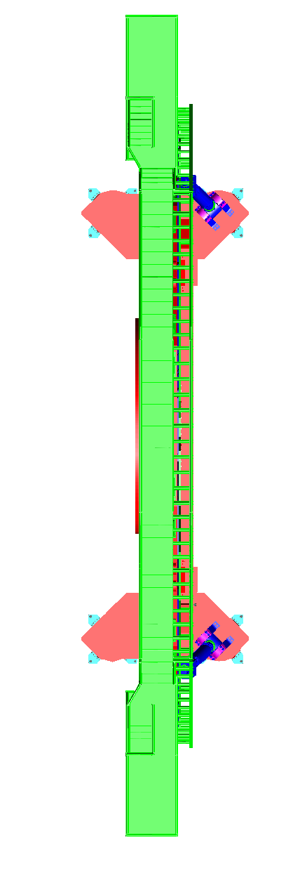
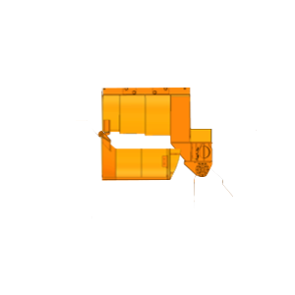
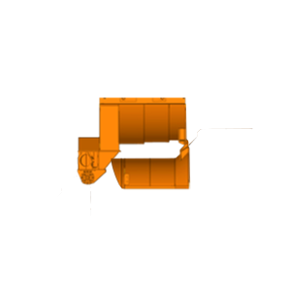
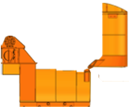
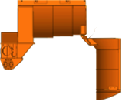
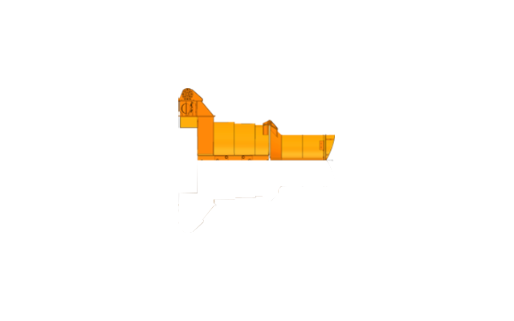
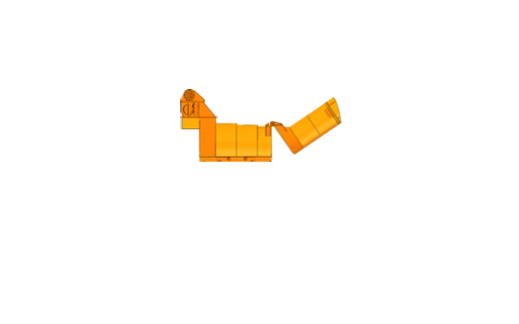
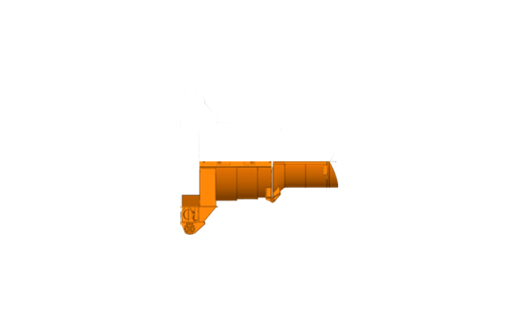

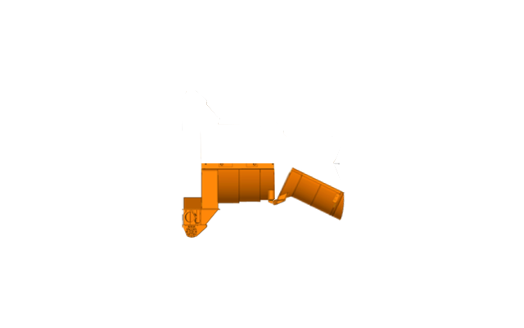

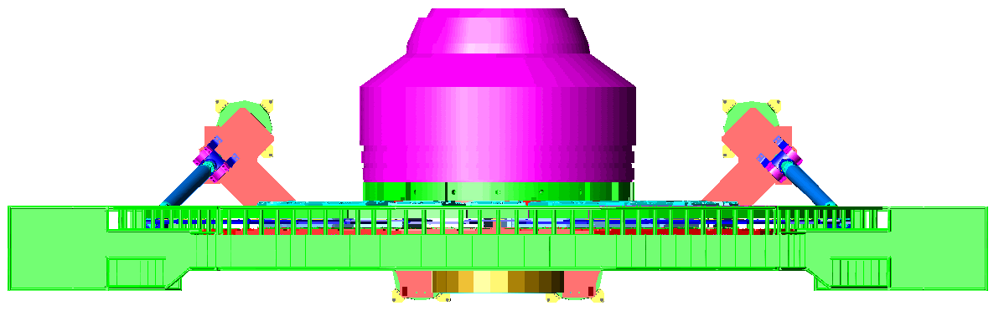
PX56 Plug OPEN
Wednesday
TX54 Plug CLOSED
27. January 2016
Next :open other endcap to attack collateral damage from water exit thru vac tank
RPC gas leak measurement
1. Move YE-3
Pascal + 2 Fsu 2h
2. Move YE-2
Pascal + 2 Fsu 2h
3. Move YE-1
Pascal + 2 Fsu 3h
4. RP Sweep VAC tank
RP 3h
4’. Install BP Column support
3VSC + Sandro + 1Altead 1h
Activity on top of detector
Crane activity to be co-ordinated with CMS SAFETY
5. Re-install HF+ I beams (near/far)
Eric + 3 Altead 2h
SL 10m
SL 10m
Replace Barrel turbines
Houari
Then : separate +z endcap disks (3 & 4) to check small RPC leak – correlated with main one?

Slide 17
Can CMS stick to the nominal YETS schedule?
Chamonix mtg
Latest date to start closing to be ready 21 Mar
21 Mar
18Apr
25 Apr
Cryo system/cleaning/replacement: looking good….
finish valve repair in UXC: : mid Feb
finish cold box cleaning + new oil removal: end Mar
Water leak repair:
replace ME1/1 chamber 13 : end Jan
collateral damage clean-up : mid Feb
secondary leak (RE4) diagnosis & repair : mid Feb
Water leak precautionary measures (if generic fault)
no estimate yet –stay tuned please!!

