Slide 1
Beam induced RF heating…
…including TDI
O. Aberle, M. Albert, R. Alemany, F. Antoniou, M. Barnes, P. Baudrenghien,
O. Berrig, N. Biancacci, J. Boyd, F. Carra, F. Caspers, E. Chapochnikova,
P. Chiggiato, A. Danisi, H. Day, M. Deile, M. Ferro-Luzzi, S. Gilardoni, S. Jakobsen,
J. Kuczerowski, M. Lamont, A. Lechner, I. Llamas Garcia, R. Losito, A. Masi, E. Metral,
J.E. Mueller, N. Minafra, A. Nosych, A. Perillo Marcone, S. Redaelli, F. Roncarolo, G. Rumolo, B. Salvant, A. Tauro, J. Uythoven, A. Valimaa, J. Varela, C. Vollinger, N. Wang,
M. Wendt, J. Wenninger, C. Zannini.
Special thanks to our collaborators
at INFN Frascati, la Sapienza, DESY, TU Darmstadt and IHEP Beijing!

Slide 2
Main questions for this talk
Is beam induced RF heating expected to be a limitation in 2016?
What about injection protection collimator TDI8 that was still a significant limitation in 2015?
Will we need to implement bunch length control in 2016?
Note: heating due to electron cloud is not addressed here. See the previous talk from Gianni.

Slide 3
Agenda
Recap on beam induced RF heating
Reminder of issues before LS1
Situation in 2015
Outlook for 2016
Proposed actions

Slide 4
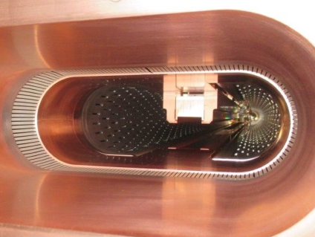
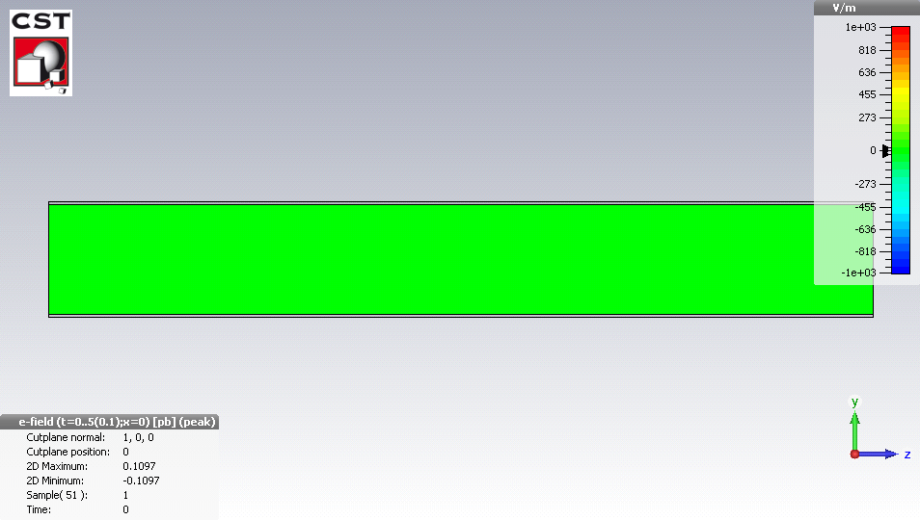
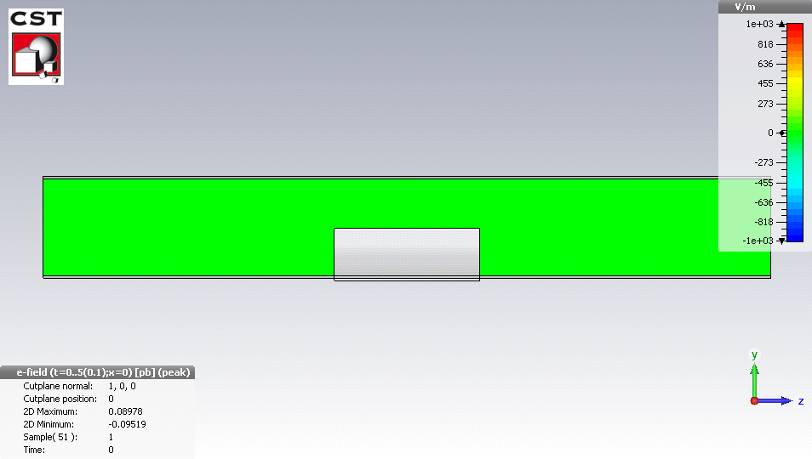
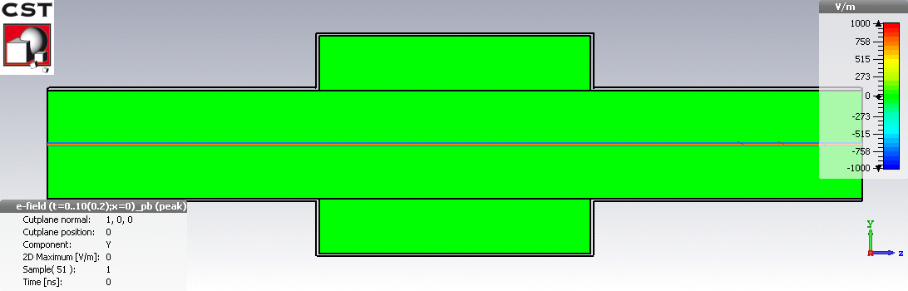
Beam induced RF heating?
When the LHC beam traverses a device which
  is not smooth
  or is not a perfect conductor,
  it will produce wakefields that will perturb the following particles
  → resistive or geometric wakefields (in time domain) and impedance (in frequency domain).
3D simulation of electromagnetic perturbation caused by an obstacle or a dispersive beam pipe:
In a round beam pipe
In a round beam pipe with sharp obstacle
→ resonant RF mode
→ energy left behind by the bunch
→ eventually dissipates in the surrounding walls
In a round beam pipe made of dispersive material
→ fields penetrate inside the material
→ dissipation of energy inside the surrounding walls
→ Energy lost by the bunch heats up the surrounding walls

Slide 5
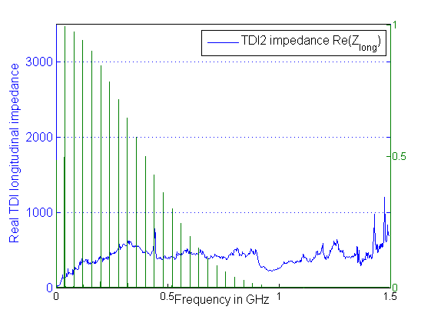
Beam induced RF heating?
Can be computed from the impedance and the longitudinal beam spectrum
Power lost by a beam of intensity I_{beam} and normalized power spectrum λ² in a device of longitudinal impedance Z_{long}
Power spectrum for 25 ns beam (cos² distribution and 9.75 cm)
and measured 2015 TDIs impedance vs frequency
For 2248 bunches with 1.15 p/b,
we would compute:
Normalized Power spectrum λ²
TDI2: Ploss ~ 2 kW

Slide 6
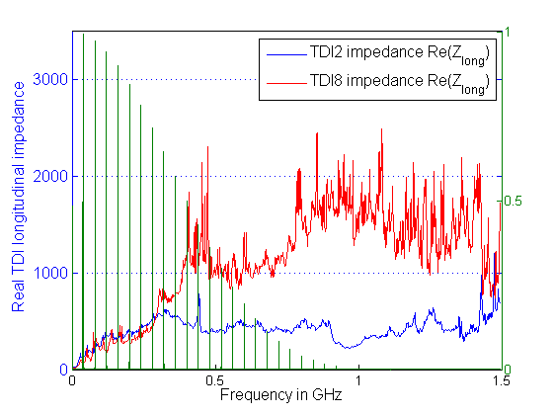
Beam induced RF heating?
Can be computed from the impedance and the longitudinal beam spectrum
Power lost by a beam of intensity I_{beam} and normalized power spectrum λ² in a device of longitudinal impedance Z_{long}
Power spectrum for 25 ns beam (cos² distribution and 9.75 cm)
and measured 2015 TDIs impedance vs frequency
For 2248 bunches with 1.15 p/b,
we would compute:
Normalized Power spectrum λ²
TDI8: Ploss ~ 3 kW
TDI2: Ploss ~ 2 kW
Depending on available cooling at the location of the dissipated power, could lead to problems or not
(e.g. outgassing, structural issues)

Slide 7
Agenda
Recap on beam induced RF heating
Reminder of issues before LS1
Situation in 2015
Outlook for 2016
Proposed actions

Slide 8
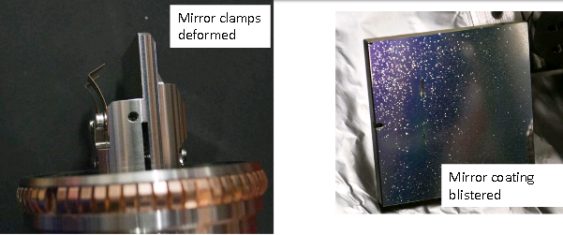
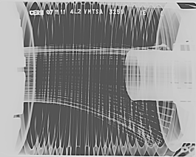
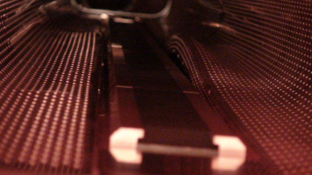
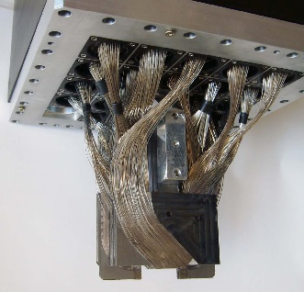
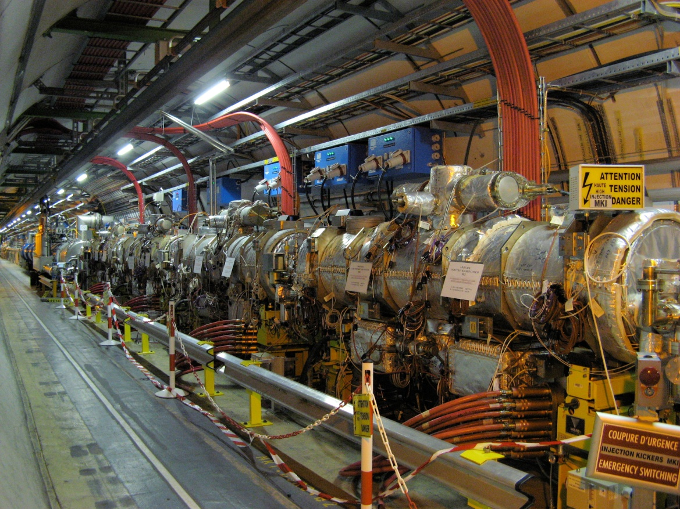
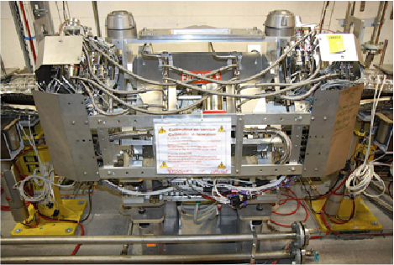
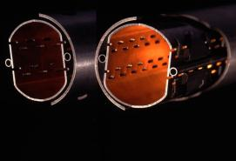
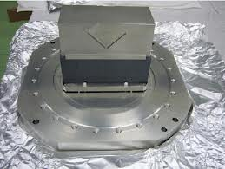
Reminder: heating issues in LHC before LS1
Damaged synchrotron light monitor → Design not robust
Damaged vacuum modules
→ Design not robust
Damaged injection collimators
→ Design not robust
ATLAS-ALFA detector almost
reached damage level
→ Design not robust
2 collimators reached
temperature interlock dump levels
Cooling non conformity
Spurious temperature readings
One injection kicker delays injection
→ Non conformity
One single cryogenic module (Q6R5) has no margin for cooling, likely linked to TOTEM outgassing.
→ TOTEM ferrite not baked

Slide 9
Summary table of heating issues in LHC before LS1
equipment | Problem | 2011 | 2012 | 2015 | 2016
Vacuum module VMTSA | Damage |  | removed
TDI | Damage |  |  | Beam screen reinforced, copper coating on the jaw | New design should solve problems
MKI | Delay |  |  | Beam screen upgrade and non conformity solved
Collimators | Few dumps |  | 2 TCTVB removed | Non conformity solved. TCTVB removed
TOTEM/Q6R5 Beam screen | Regulation at the limit |  |  | Valve upgrade + new TOTEM design
ATLAS-ALFA | Risk of damage |  |  | New design + cooling
BSRT | Damage |  |  | New design + cooling
BGI | vacuum increase |  |  | To be followed up | To be followed up
Beam induced heating: major LHC limitation before LS1.
A lot of effort invested by equipment groups before and during LS1 to mitigate these issues
Damaged
Limited operation
Worry that can limit operation
Was fine fine

Slide 10
Agenda
Recap on beam induced RF heating
Reminder of issues before LS1
Situation in 2015
  The good news
  The TDI
  Heating monitoring
  Bunch length
Outlook for 2016
Proposed actions

Slide 11
Summary table
equipment | Problem | 2011 | 2012 | 2015 | 2016
VMTSA | Damage |  |  | removed | removed
TDI | Damage |  |  | Beam screen reinforced, copper coating on the jaw | New design should solve problems
MKI | Delay |  |  | Beam screen upgrade and non conformity solved
Collimators | Few dumps |  |  | Non conformity solved. TCTVB removed.
Beam screen | Regulation at the limit | Q6R5 and TOTEM | Q6R5 and TOTEM | Upgrade of the valves + ferrites baked out.
ATLAS-ALFA | Risk of damage |  |  | New design + cooling
BSRT | Deformation suspected |  |  | New design
BGI | vacuum increase |  |  | To be followed up | To be followed up
Non conformity
with TDI8, most
likely the hBN jaw
and its coating
All the efforts paid off: 2015 went much better!
Damage
Limits operation
Worry that can limit operation
Should be fine

Slide 12
Agenda
Recap on beam induced RF heating
Reminder of issues before LS1
Situation in 2015
  The good news
  The TDI
  Heating monitoring
  Bunch length
Outlook for 2016
Proposed actions

Slide 13
Situation of beam induced heating in 2015
Great success and big relief that new designs have worked so far!
  Shielded and cylindrical Roman pots (both ATLAS-ALFA and TOTEM)
  → a lot of margin gained in 2015 for ALFA
  → no vacuum problems with Q6R5 for TOTEM

Slide 14
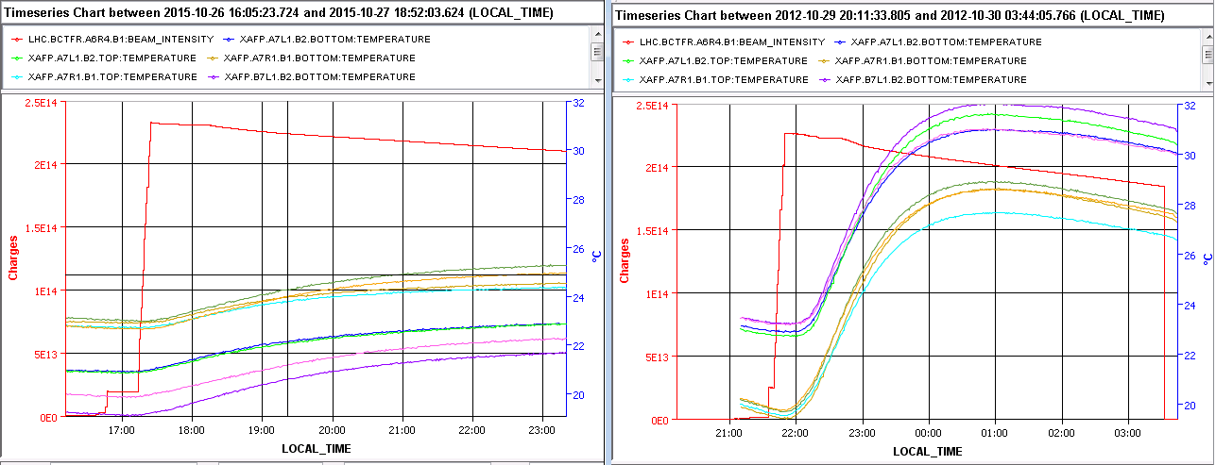
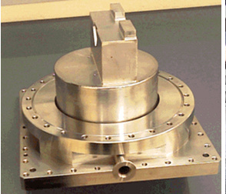
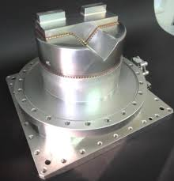
2012 vs 2015: ATLAS-ALFA Roman pots
Beam
intensity
Beam
intensity
ATLAS-ALFA temperatures
in October 2015
ATLAS-ALFA temperatures
in October 2012
→ Clear gain with new shielded design

Slide 15
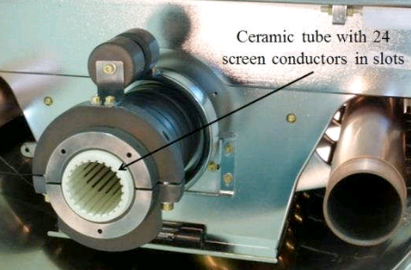
Situation of beam induced heating in 2015
Great success and big relief that new designs have worked so far!
  Shielded and cylindrical Roman pots (both ATLAS-ALFA and TOTEM)
  → a lot of margin gained in 2015 for ALFA
  → no vacuum problems with Q6R5 for TOTEM
  New design for synchrotron light telescope (BSRT) followed up with BI-TB
  → barely any temperature increase (compared to more than 300C in 2012)
  New collimator design with ferrite (TCTP), followed up with collimation WG
  → no significant difference observed so far with respect to the design without ferrite
  Full shielding of ceramic tube for injection kickers (MKI) – 24 instead of 15 screen conductors.
  followed up with MKI strategy meetings
  (see talk of Lee at Evian 2015)

Slide 16
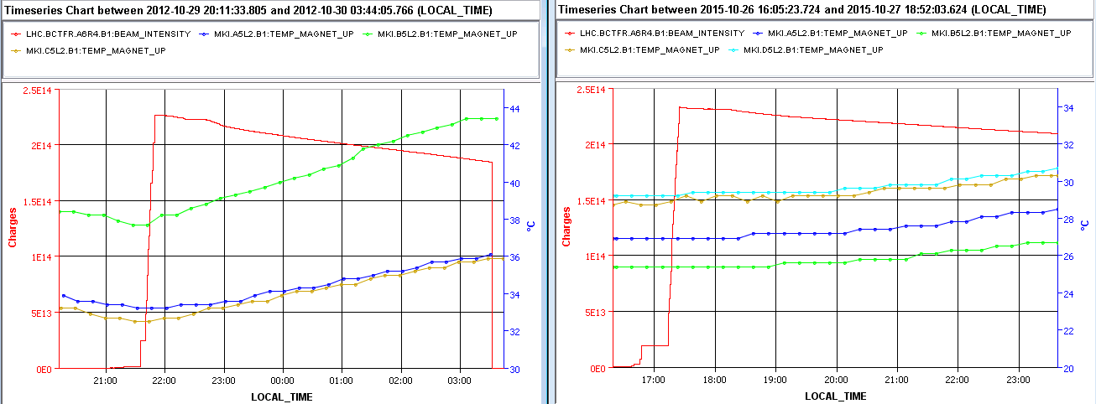
2012 vs 2015: injection kicker MKI
Beam
intensity
Beam
intensity
MKI2 temperatures
in October 2012
MKI2 temperatures
in October 2015
Significant reduction of the temperature slope, but temperature has reached 50C after series of long fills.
Injection interlock kept low by TE-ABT (55C), but threshold can be incrementally increased once kicker behaviour is checked using softstarts.
MKIs are not expected to be a hard limitation for Run2 parameters.
In case it becomes too hot, it is then advised to keep the bunch length above 1 ns.
  We should be ready to control bunch length by bunch flattening

Slide 17
Agenda
Recap on beam induced RF heating
Reminder of issues before LS1
Situation in 2015
  The good news
  The TDI
  Heating monitoring
  Bunch length
Outlook for 2016
Proposed actions

Slide 18
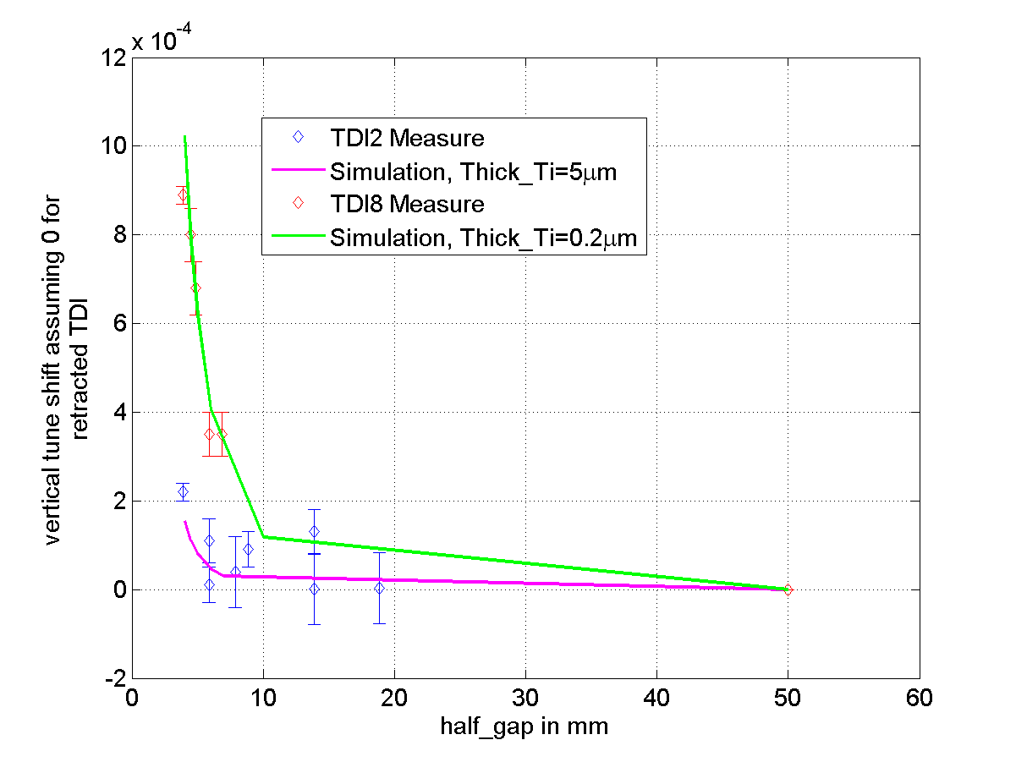
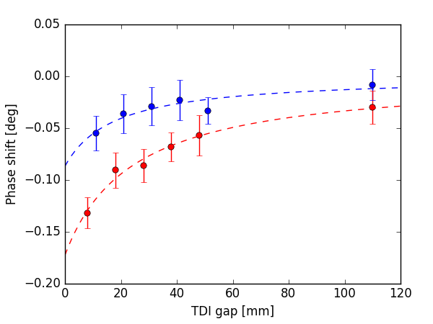
TDI issues
Technical issues with implementing our recommendation to apply copper coating to reduce TDI impedance.
Abnormal vacuum behavior on TDI8→ serious limitations during scrubbing and injection
Abnormal impedance observables (both longitudinal and transverse) observed during the run.
TDI2
→ TDI8 has 4x more
transverse impedance
TDI8
TDI8
→ x2 more power lost in TDI8
TDI2
→ Observations point towards a coating issue for TDI8 (LMC237 in Sept 2015).

Slide 19
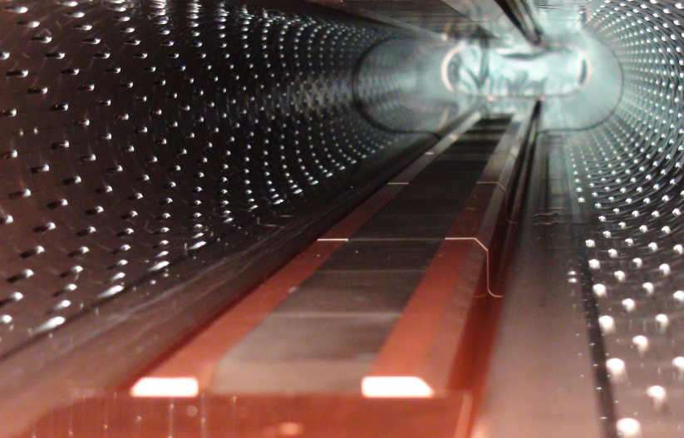
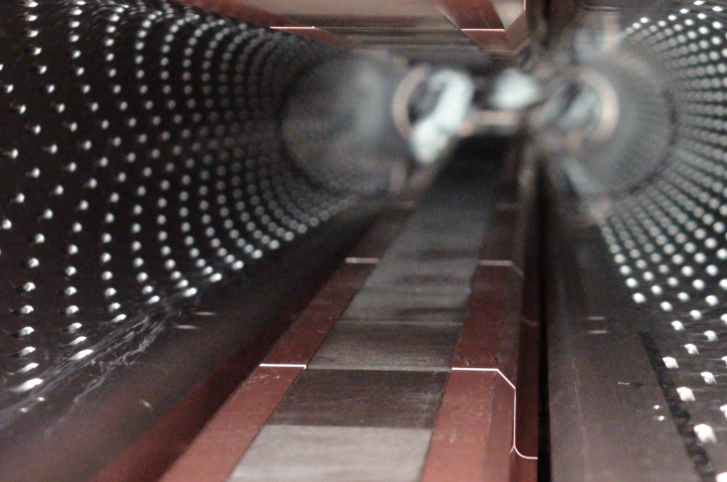
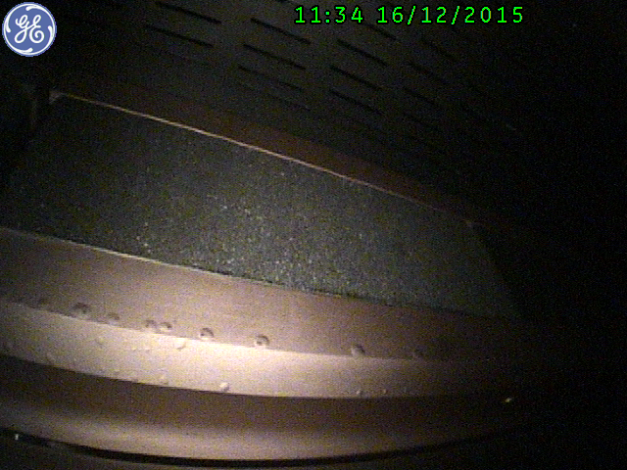
TDI issues
TDIs were taken out of the machine in December.
Indeed the coating on TDI8 is heavily compromised.
TDI2
TDI8
Blisters in Cu coating

Slide 20
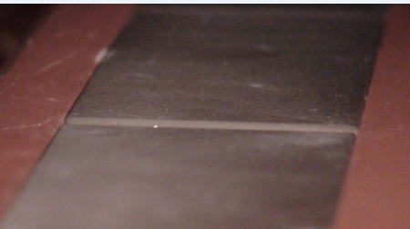
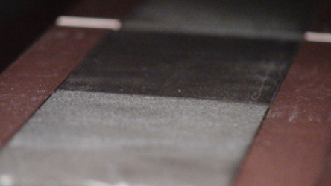
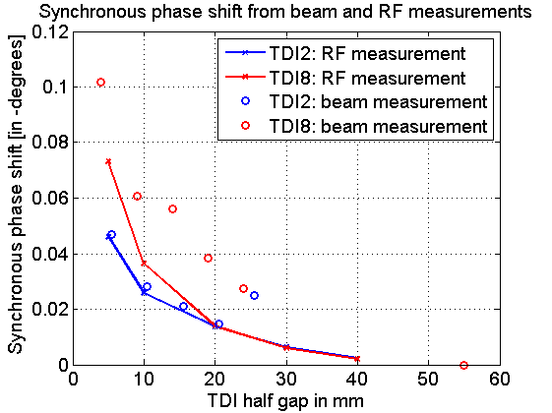
TDI issues
TDI2
TDI8
Something somewhere went terribly wrong.
More damage analysis (electromagnetic,
chemical, structural) are planned to understand the origin of this non conformity.
Last week, bench impedance measurements
confirmed the measurements with beam:
the main suspect is the jaw material
and its coating.
see N. Biancacci et al at LMC247.

Slide 21
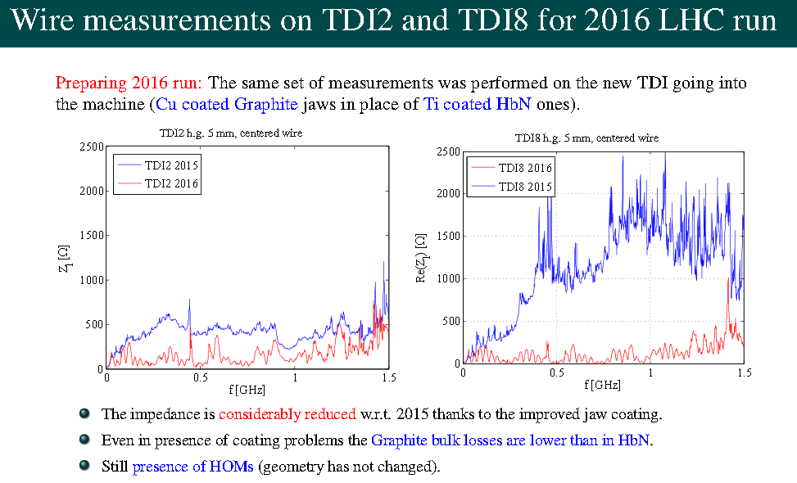
TDIs: what about 2016?
N. Biancacci et al, LMC247
2015
2015
2016
2016
→ The 2016 TDIs are better in terms of impedance and more robust in case of coating issues

Slide 22
Agenda
Recap on beam induced RF heating
Reminder of issues before LS1
Situation in 2015
  The good news
  The TDI
  Heating monitoring
  Bunch length
Outlook for 2016
Proposed actions

Slide 23
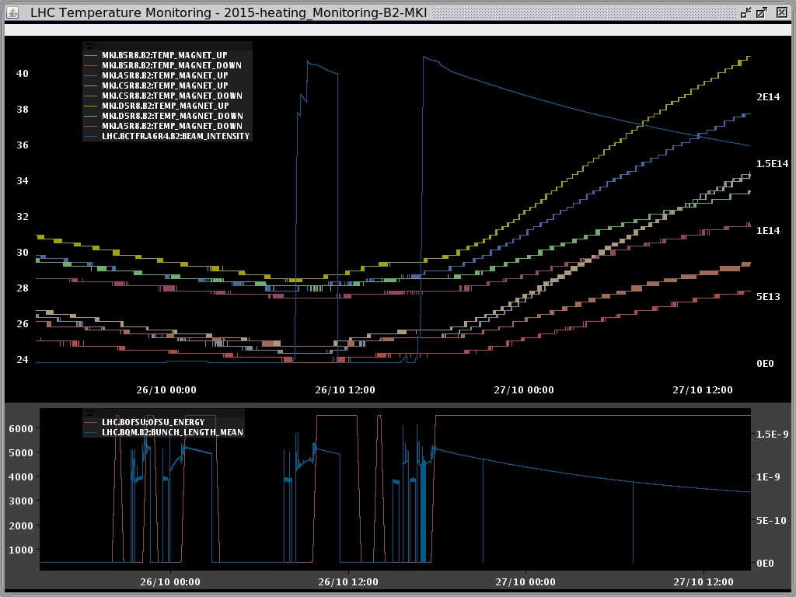
Heating monitoring in 2015
Action from Chamonix 2014
→ put surveillance tools in place for Run 2
Available tools during 2015:
  Temperature fixed displays (many thanks to our BE-CO colleagues!)
  Systematic fill analyzer
  Collimator webpage
  Synchronous phase error with observation box (for TDI)
  BigSISter can send prewarning text messages (no dump threshold).
  Beam spectrum fixed display, but unfortunately there is a serious issue with the scopes and they crash very often

Slide 24
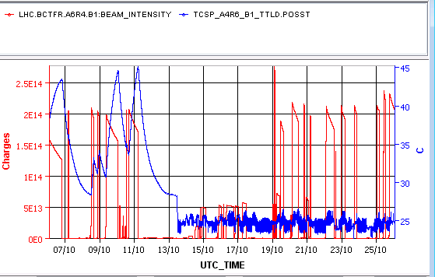
Heating monitoring in 2015
Cooling connection non conformity on one secondary collimator:
  → Minor issue that was identified early and solved before it could lead to limitation.
Intervention to
swap cooling pipes by EN-STI
Heating monitoring working well but technical issues remain to be solved:
  Several temperature probes of some collimators seem strongly perturbed by beam presence (especially TDI and TCLIA probes)
  → Measured ΔT of 10C to 100 C in 10 s when beam is dumped → not physical
  → Problem not addressed for the new TDIs and should still be there in 2016.
  → studies ongoing to understand and mitigate these issues

Slide 25
Agenda
Recap on beam induced RF heating
Reminder of issues before LS1
Situation in 2015
  The good news
  The TDI
  Heating monitoring
  Bunch length
Outlook for 2016
Proposed actions

Slide 26
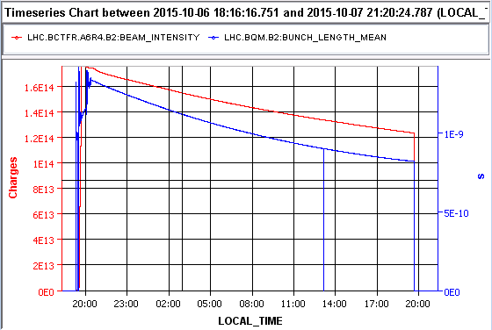
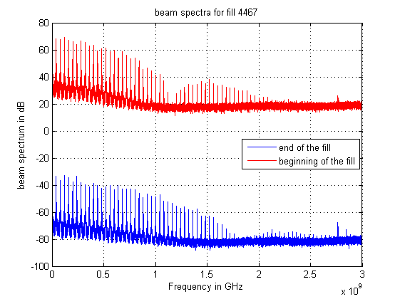
Impact of bunch length reduction during the fill:
start of stable beams:
Bunch length =1.35 ns
Beam intensity
Bunch length
~22h later
Bunch length = 0.82 ns
  Power spectrum extends to higher frequency → more beam induced heating
  → not a showstopper so far as intensity also decreases.
  More luminosity
  → not a showstopper either (!): expected gain with 2016 parameters ~2 % (from Fanouria’s model).
  Reducing luminous region (input from Jamie)
  → request of LHCb/ALICE to keep the luminous region more constant.
  → ATLAS and CMS do not mind too much as long as there is a gain in luminosity.
  Longitudinal instabilities at very low bunch length
  → not an apparent issue in 2015 from bunch by bunch luminosity
→ It would be useful to be ready to control bunch length by bunch flattening

Slide 27
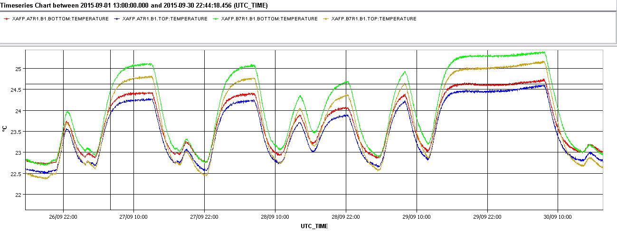
No adverse effect of bunch length reduction?
→ Case of ATLAS-ALFA in September 2015.
Temperature does not reach equilibrium
This observation did not come back after the target bunch length was increased
Mild increase in any case
→ We should be ready to control bunch length by bunch flattening

Slide 28
Agenda
Recap on beam induced RF heating
Reminder of issues before LS1
Situation in 2015
Outlook for 2016
Proposed actions

Slide 29
Heating issues in LHC before LS1
equipment | Problem | 2011 | 2012 | 2015 | 2016
VMTSA | Damage |  |  | removed | removed
TDI | Damage |  |  | Beam screen reinforced, copper coating on the jaw | New design should solve problems
MKI | Delay |  |  | Beam screen upgrade and non conformity solved
Collimators | Few dumps |  |  | Non conformity solved. TCTVB removed.
Beam screen | Regulation at the limit | Q6R5 and TOTEM | Q6R5 and TOTEM | Upgrade of the valves +TOTEM ferrites baked out. | ~12 W/half cell predicted
ATLAS-ALFA | Risk of damage |  |  | New design + cooling
BSRT | Deformation suspected |  |  | New design
BGI | vacuum increase |  |  | To be followed up | Temperature monitoring will be added
2016 looks “cool”, but beware of non conformities!
Damage
Limits operation
Worry that can limit operation
Should be fine

Slide 30
Main questions for this talk
Is beam induced RF heating expected to be a limitation in 2016?
→ no (with what we know).
What about TDI8 (injection protection collimator) that was a significant limitation in 2015?
→ the new TDIs are expected and were measured to have a lower impedance than both 2015 TDIs.
→ the new solution should be more robust in case of coating issues
→ There is hope that TDIs will not be a limitation in 2016
Will we need to implement bunch length control in 2016?
→It is very likely and bunch flattening should be tested early in commissioning

Slide 31
Agenda
Recap on beam induced RF heating
Reminder of issues before LS1
Situation in 2015
Outlook for 2016
Proposed actions

Slide 32
Recommendations for 2016
Test and validate impedance of the new TDIs during commissioning (4h).
Keep monitoring temperature, vacuum and beam spectra to identify issues in close collaboration with MPP and equipment groups.
Find a mitigation for the spurious temperature readings.
In view of HL-LHC, monitor in particular power lost in MKIs, TDIs, beam screen and ALICE beam pipe to assess the need for further modifications.
Test and validate bunch flattening during intensity ramp up in case bunch length levelling at ~1 ns or ~1.1 ns would be required by either heating or experiments.

Slide 33
Thank you for your attention!

Slide 34
Beam screen heat load from impedance
(LHC and HL-LHC)
Power dissipated by the beam in the beam screen in mW/m (for 2 beams)
Beam screen | Radius (mm) | 2012 4TeV 1374b 1.7e11 1.25 ns | 2015 6.5 TeV 2248b 1.2e11 1.25 ns | 2016 6.5 TeV 2748b 1.2e11 1.25 ns | Nominal 7TeV 2808b 1.15e11 1 ns | HL-LHC 7TeV 2748b 2.2e11 1.08 ns
Arc⁽*⁾ | 18.4 | 187 | 176 | 216 | 290 | 927
Current Q1⁽*⁾ | 24 | 143 | 135 | 165 | 222 | 710
Current Q2-Q3⁽*⁾ | 18.95 | 181 | 171 | 209 | 282 | 900
⁽*⁾ Assumes 1 weld (2mm wide) on the side of the beam screen

Slide 35
Beam screen heat load from impedance
(LHC and HL-LHC)
Power dissipated by the beam in the beam screen in W/half cell (for 2 beams)
Beam screen | Radius (mm) | 2012 4TeV 1374b 1.7e11 1.25 ns | 2015 6.5 TeV 2248b 1.2e11 1.25 ns | 2016 6.5 TeV 2748b 1.2e11 1.25 ns | Nominal 7TeV 2808b 1.15e11 1 ns | HL-LHC 7TeV 2748b 2.2e11 1.08 ns
Arc⁽*⁾ | 18.4 | 10 W | 9 W | 11.5 W | 15.5 W | 49 W
⁽*⁾ Assumes 1 weld (2mm wide) on the side of the beam screen

Slide 36
References
Beam induced heating at Chamonix (Elias, 2012), (Benoit, 2014)
Evian talk by Lee (2015)

Slide 37
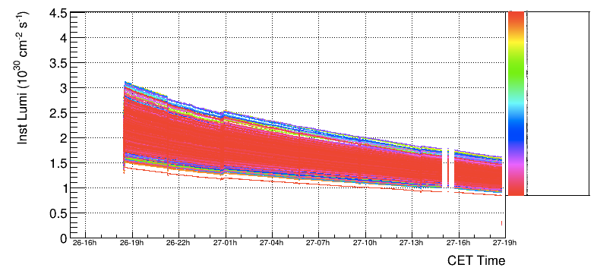
ATLAS instantaneous luminosity with longitudinal instabilities
Jamie Boyd
→ Even looking at bunch by bunch individually, no striking change of slope visible on the curve.
→ However, should be quantified if one needs % level.

Slide 38
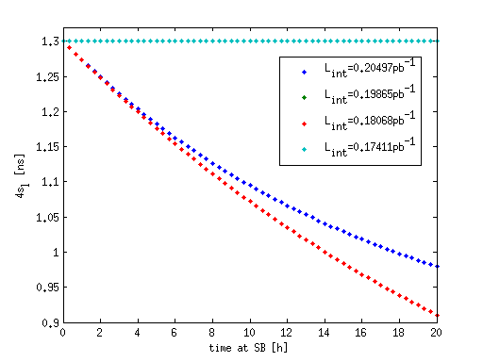
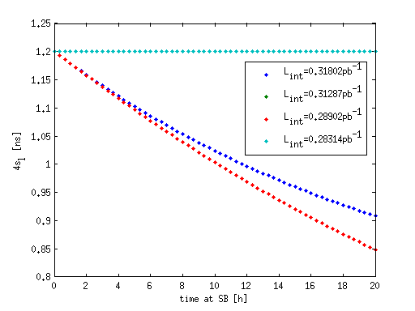
Effect of bunch length levelling on integrated luminosity
From Fanouria Antoniou’s model (for fills of 20h)
2015
2016
Keeping bunch length constant at 1.3 ns
would have led to 3.1% to 3.6 % loss in integrated luminosity compared to leaving the bunch length decrease freely
Keeping bunch length constant at 1.2 ns
would lead to 1.6 to 2% loss
in integrated luminosity compared to leaving the length decrease freely
3.1%: full model IBS+SR+Burnoff
3.6%: bunch length follows model but transverse emittance evolves slowly

Slide 39
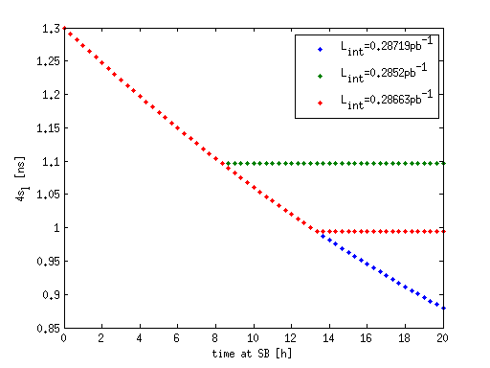
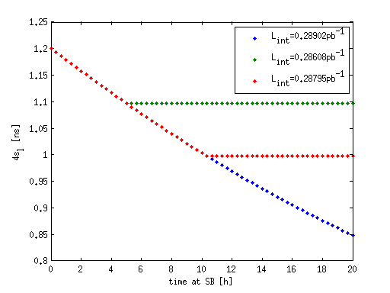
Effect of bunch length levelling on integrated luminosity
From Fanouria Antoniou’s model (for fills of 20h)
2015
2016
Starting from 1.3 ns and levelling at 1.1 ns or 1 ns would lead to resp. 0.1% to 0.6 % loss in integrated luminosity compared to leaving the bunch length decrease freely.
Starting from 1.3 ns and levelling at 1.1 ns or 1 ns would lead to 0.3 to 1% loss
in integrated luminosity compared to leaving the length decrease freely
(bunch length follows model but transverse emittance evolves slowly)

Slide 40
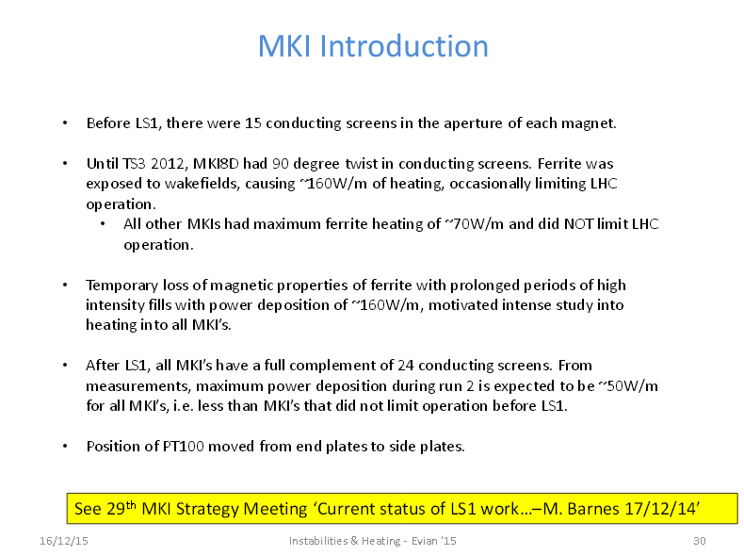

Slide 41
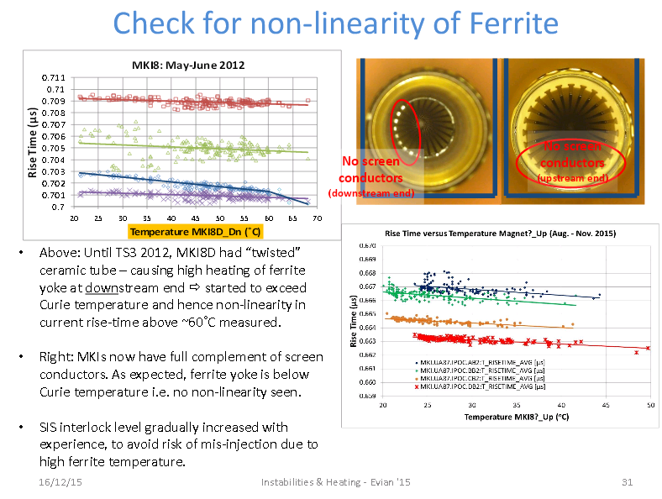

Slide 42
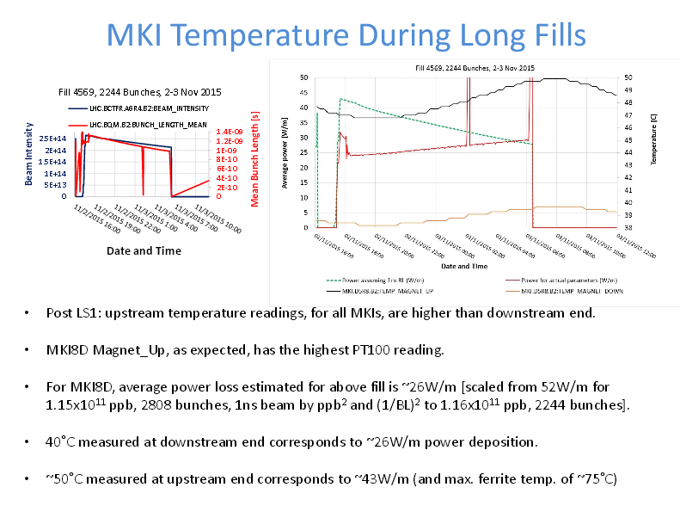

Slide 44
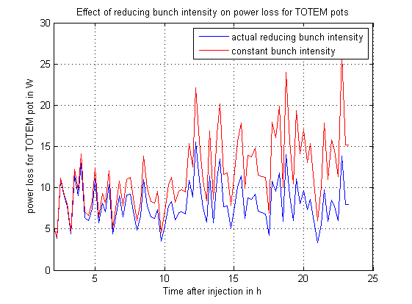
Impact of bunch length on beam induced heating
Bunch length decreases
but intensity also decreases
→ Power loss leveling (here for TOTEM pot)
True for most devices, but…

