Slide 2
LIU-IONS PS Injectors: Baseline, Outcome from 2015 Operation, Performance Reach and Options
R. Scrivens, D. Manglunki
And the PS ion injector team
Chamonix 2016

Slide 3
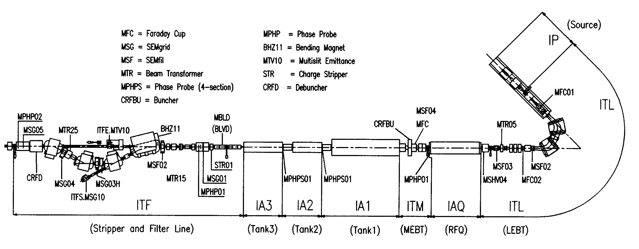
The PS Ion Injectors
The Ion Source, Linac3 and LEIR.
Linac3, multi charged ECR source.
Selection (Pb²⁹⁺) and acceleration -> 4.2MeV/u
Stripping -> Pb⁵⁴⁺
Multi-turn injection into LEIR
Multiple injections.
Electron cooling.
Capture in 2 bunches.
Acceleration ->72 MeV/u
Extreme High Vacuum

Slide 4
PS Ion Injector – Project Goal
What is the baseline goal of Linac3 - LEIR in LIU-Ions?
 | Achieved 2015 | LIU-Ions Baseline
Ions Before RF Capture | 7.8 x10⁸ /bunch | 9.3 x10⁸ /bunch
Ions At Extraction | 6.0 x10⁸ /bunch | 7.4 x10⁸ /bunch
# Injections | 7 @ 200ms | 13 @ 100ms
Ions At LHC Injection | - | 1.7 x10⁸ /bunch
Xe
LS2
PHASE 1 with LIU studies, installation and beam commissioning
LS3
HL-LHC installation
PHASE 2

Slide 5
Boundary Conditions for the ion luminosity requirements in LHC
Most recent calendar shared with HL-LHC (see John’s presentation)
2016 – Pb+p
2017 – No LHC ion run (Xe to experiment NA61)
2018 – Pb+Pb
2019/2020 – LS2
2021 - Pb-Pb 2.85 nb⁻¹
2022 - Pb-Pb 2.85 nb⁻¹
2023 - pp reference run
2024, 2025.6 - LS3
2027 - Pb-Pb 2.85 nb⁻¹
2028 - ½ Pb-Pb 1.5 nb⁻¹ + ½ p-Pb 50 nb⁻¹
2029 - Pb-Pb 2.85 nb⁻¹
2030 LS4
LIU Ion project hardware installation completed
Commissioning and full production run 1st year after LS2
4 years without ions – run L3 and LEIR in 2026 for training?

Slide 6
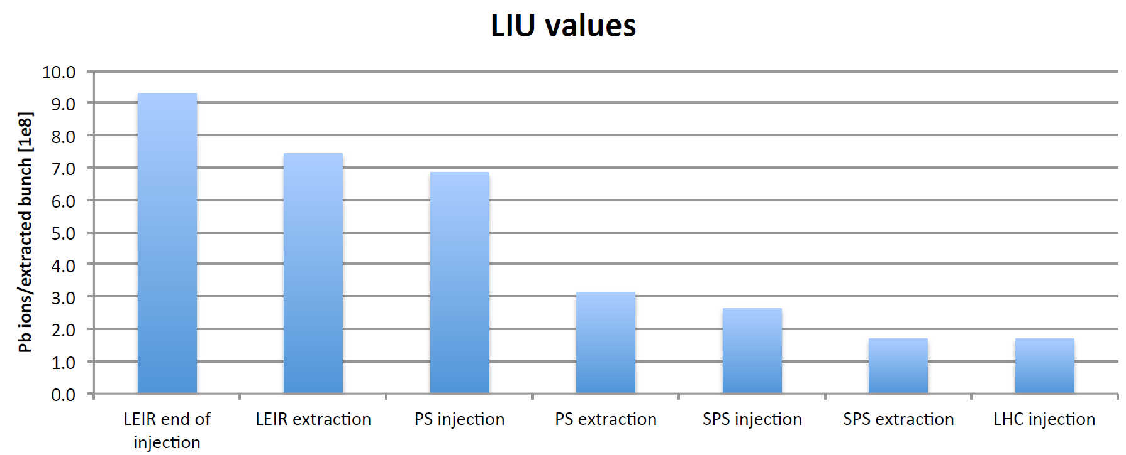
Baseline Beam Parameters
LEIR
Increase at maximum the intensity per bunch.
  More intensity from LEIR
  More intensity from L3
  and increased rep. rate.
  Reduction of losses at RF capture in LEIR.
Transverse emittance is less
important than intensity
Twice 7.4x10⁸ ions/bunch
max. 13 injections
200ns
PS
100ns
PS – Intermediate flat top splitting
100ns
150ns
SPS
~2μs
50ns spacing
1.7 10⁸ ions/bunch @ injection
LHC
50ns spacing

Slide 7
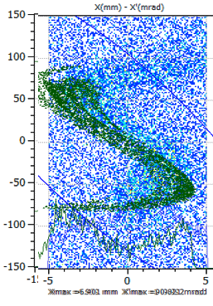
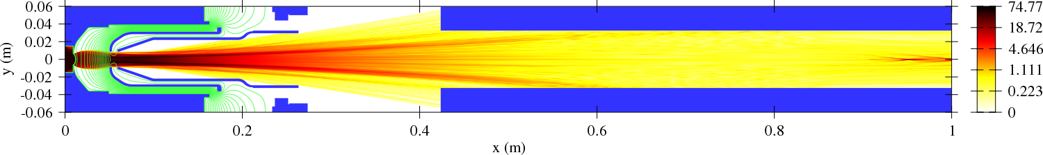
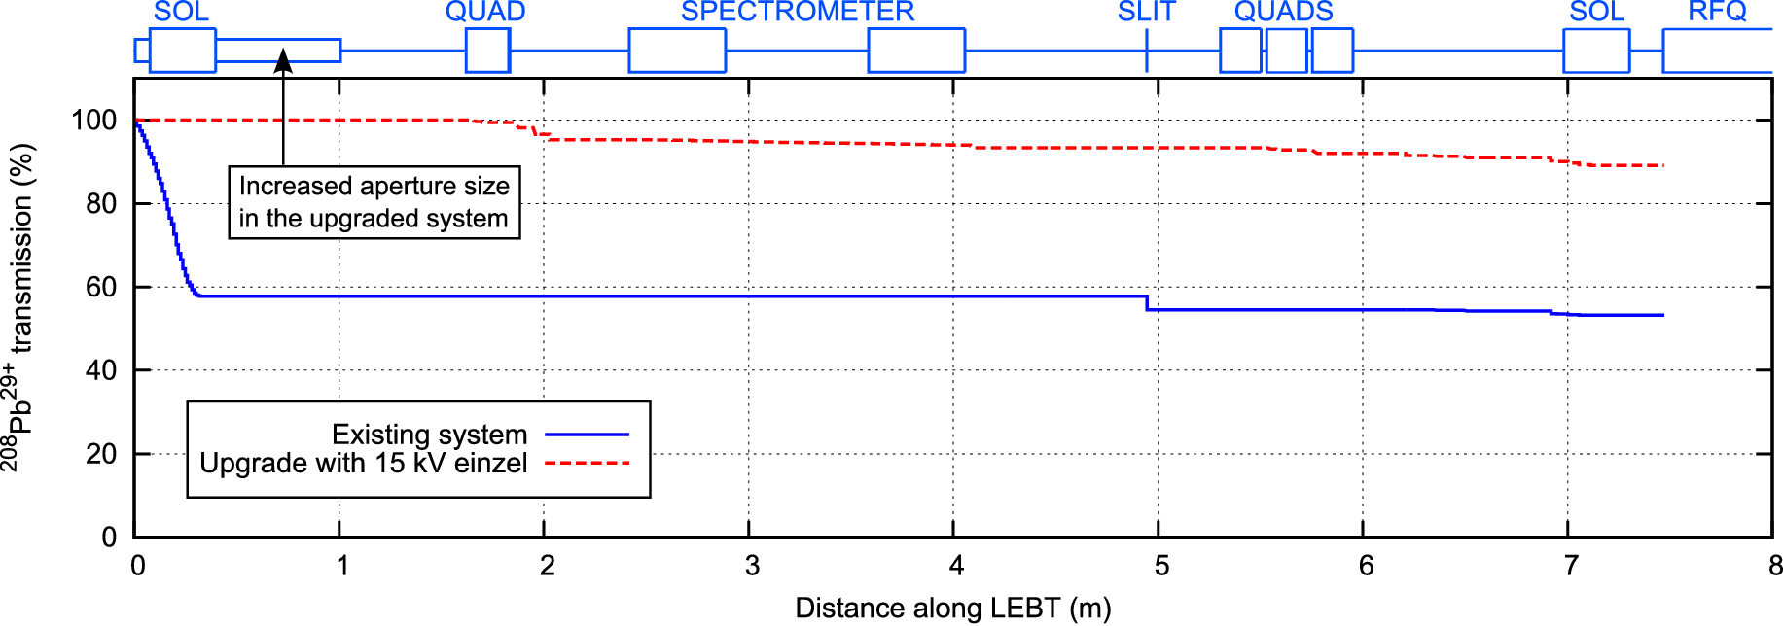
2015 Progress – Source and Low Energy
Strongly divergent beams is an inherent property of the current GTS-LHC extraction system when operated in afterglow mode.
Simulation predicts large beam loss straight after extraction.
Extensive simulations to match model to simulation for transport through spectrometer.
The best estimates from simulations is the 10-15% more intensity can be transported inside the acceptance of the RFQ.
Implementation in YETS15-16.

Slide 8
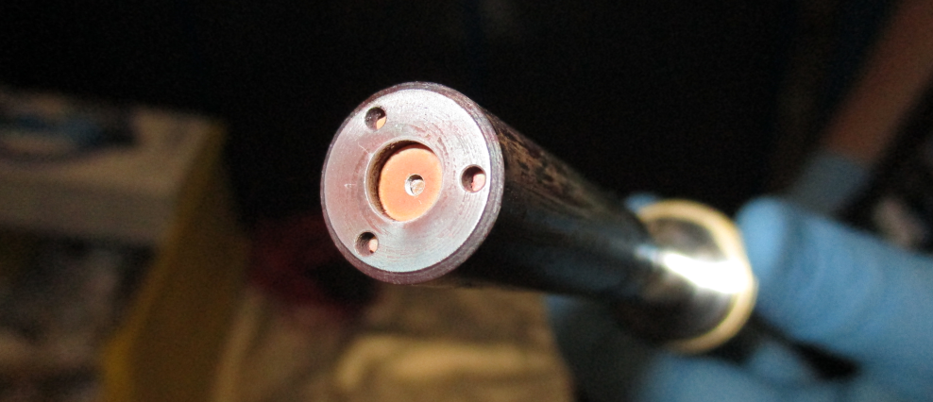
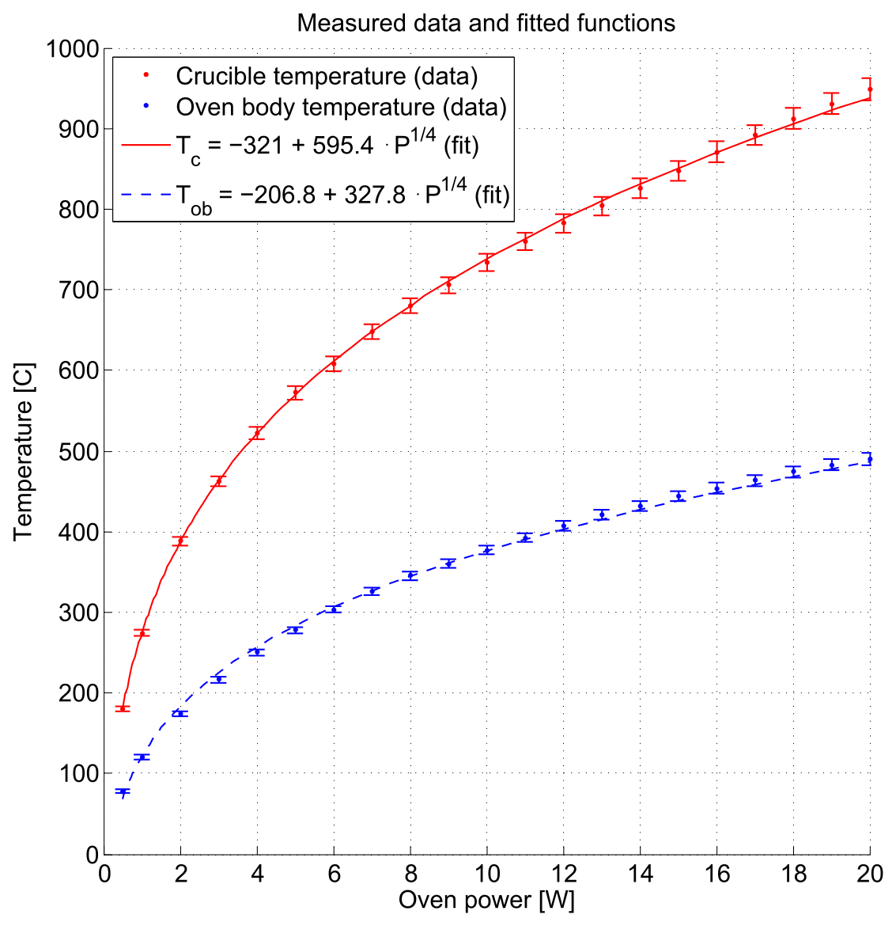
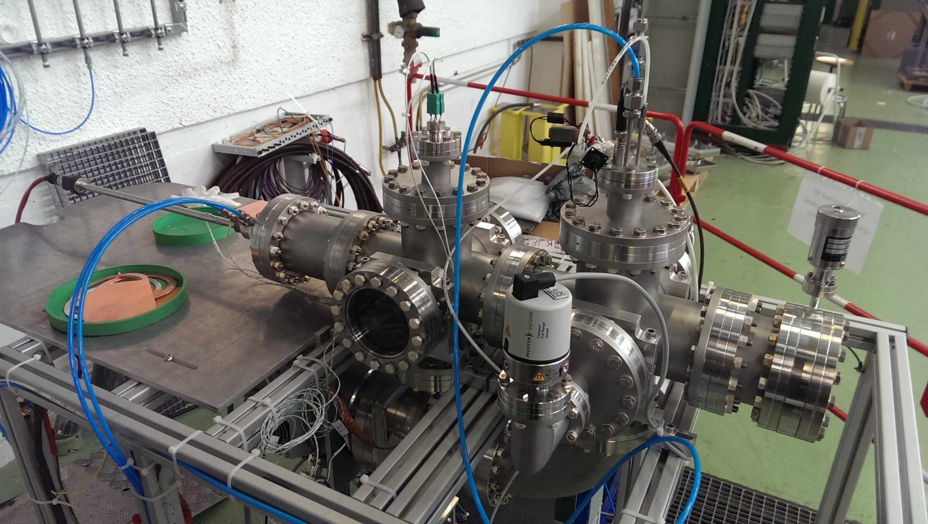
2015 Progress – Oven Test Stand
Oven test stand has been constructed.

Slide 9
2015 Progress
From October 2015 an intensive study programme started, with new team members.
Using the available equipment, the performance could already be increased for the 2015 Pb-Pb run.
The studies converged on the likely reason for the losses at RF capture.

Slide 10
2015 Progress – Understanding LEIR limitation 1
Total Charge x10¹⁰
  Iso-adiabatic capture in single/double RF with and without gun modulation (longitudinal blow-up)
  Clear dependence of losses on line charge density
  Highest intensities achieved with flat bunch profile in double harmonic (hollow distribution)

Slide 11
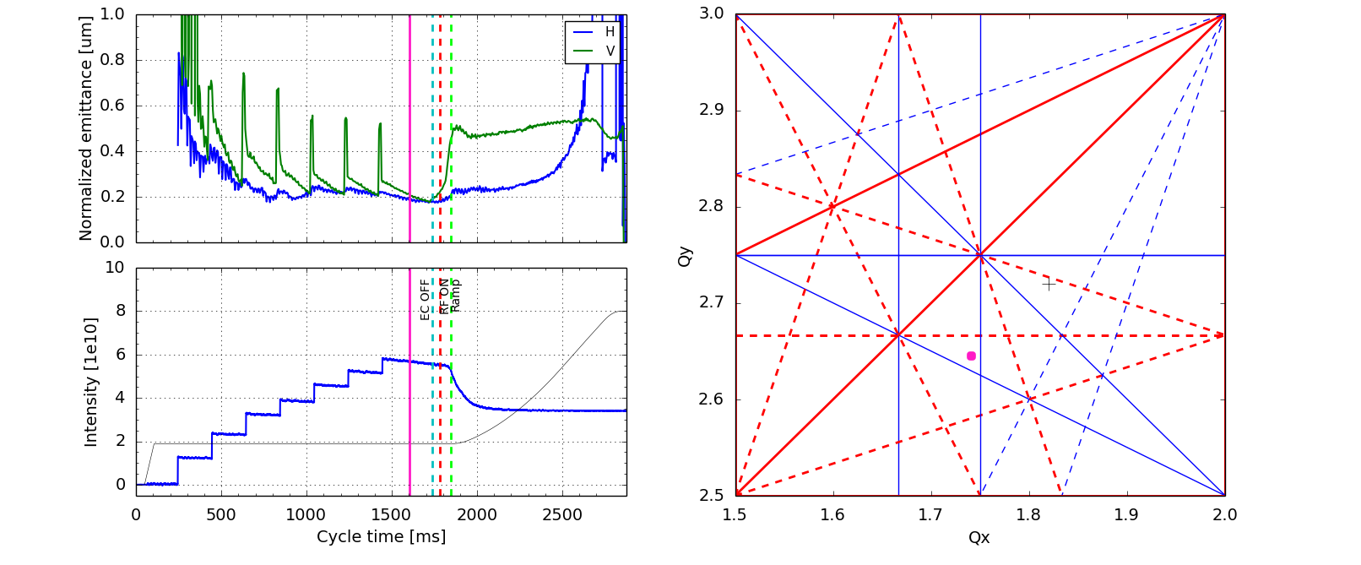
2015 Progress – Understanding LEIR limitation 1
Accumulation
  Space charge tune spread increases along with injections and cooling

Slide 12

2015 Progress – Understanding LEIR limitation 1
Accumulation
  Space charge tune spread increases along with injections and cooling.
Capture
  Space charge tune spread increases (~ factor 2) and particles are pushed onto betatron resonances → emittance blow-up and losses.
Notes:
Some resonance lines have been shown already to lead to losses.

Slide 13
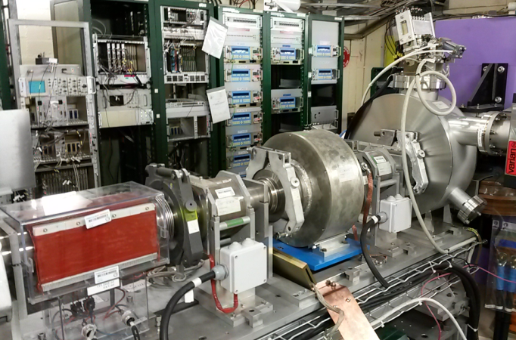
YETS 2015-16 : What is happening
Baseline implementations, towards more intensity:
  Upgrade of power convertors in Linac3 and transfer line, magnet thermal interlocks, and Linac RF to allow 100ms spaced injections into LEIR in 2016. The schedule for these is advanced to take advantage of the 2016 Pb running.
    Caveat: Available for testing but not for production until consolidation of Linac hall ventilation in LS2.
  Modification to source / Low energy region to remove aperture limitation and add focusing.
Improvements in instrumentation:
  Changes to intensity (Linac3) and profile (transfer line) and low Linac energy emittance measurement hardware.
  More Transverse feedback signals to be available.
  Open the LEIR extraction sector to look for an obstacle that required a large bump to be created in 2015.

Slide 14
2016 Priorities
Commission the Linac3 modifications.
Test LEIR performance with more (higher rep-rate) injections in June.
Complete studies (with beam and simulation) to identify more clearly brightness limitations, and what can be done to reduce losses e.g.:
  Further increase bunching factor / longitudinal emittance (further advances could be made with 2 cavity operation, requires DLLRF modifications – manpower limitations).
  Move to a working point further from resonances (optics study).
  Understand and implement resonance compensation with available magnets.
  Impedance model of LEIR.
Decide on further improvements to instruments. Several improvements desired, but not yet included fully into the baseline. As examples:
  Turn by turn position trajectory to look for resonances.
  Online pick ups in the (100m) transfer line would improve operability.

Slide 15
2016 Further Mitigations to be Explored
Consider alternative methods of gaining intensity (within specs).
  Source second frequency tuning test of Linac3 – First test in Spring 2016.
  Different Linac stripper foil type – First test in 2016.
  Alternative RF schemes in the ion chain…
  Shorter LEIR cycles (2.4 s cycle with approx. 2015 intensity)…
Work is already underway to quantify these proposals, to give the cost and performance improvement.

Slide 16
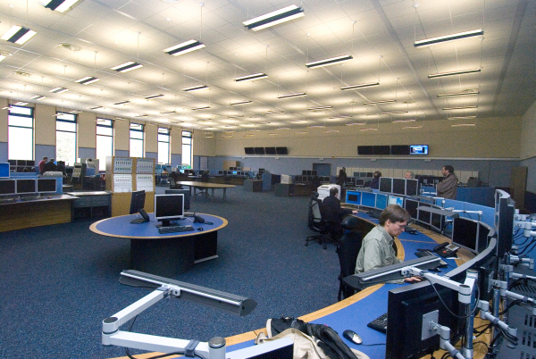
Making LEIR like the other LHC injectors
Operation – Long term goal to better integrate LEIR into operation of SPS:
  Use more LSA and YASP to speed up operational
  setting up and tuning.
  Develop applications for some tasks, (by SPS operators, with look and feel of SPS, e.g. equip state).
  Training for operators.
  Get the operators involved in:
    Cold check out
    Beam setting up through scanning (specifically for optimization).

Slide 17
Making LEIR like the other LHC injectors
Beam Physics
  Reinforced accelerator physics (ABP / RF / OP / electron cooling) measuring, analysing and modelling LEIR. This support (and from other groups) needs to be maintained at a high level.
  Dedicated time for Machine Development in 2016 (~18 weeks – restart).

Slide 18
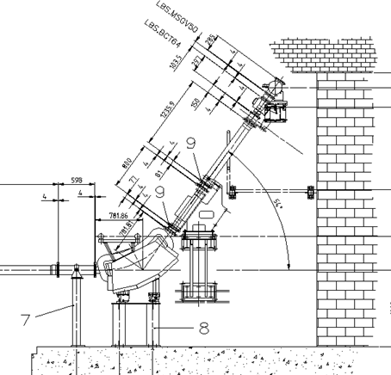
Other Hardware Baseline Modifications
  LEIR External beam dump.
  Provide a safe beam dump for accelerated ions not request by the PS.
  Thermal and radiation modelling ongoing.
  Layout and integration needs finalisation.
  Aim to install in YETS 17-18. Activity coordinator(s) will pick this up very soon with all the stake holders.
  Linac High Energy Spectrometer Line (LBS)
  Recover this for ion use. Replace magnet, power convertor and improve controls.
  Will lead to same accuracy but better operability.

Slide 19
Summary
The PS Ion Injectors have been profited from a lot of beam study in 2015. The achieved intensity has increased by 30% over LEIR/LHC nominal parameters.
For the present LIU-IONS baseline a ~25% increase (over 2015) to 7.4x10⁸ ions per bunch are expected out of LEIR.
Several methods for doing this are in progress, and will be tested in 2016 Machine Developments:
  7 -> 13 Linac3 injections with 10-15% more intensity.
  Further machine modelling, and tests of ways to increase the space charge limit.
  By the end of 2016, all hardware modifications for intensity improvement will have been implemented.
The beam performance and operations team have been reinforced, and the ions project reorganised to confirm the importance of ions.
2016 is a critical year for development and study, and it is vital that the high level of support towards Linac3/LEIR is maintained throughout the LIU project.

Slide 20
Thanks
Thanks for your attention
And thanks to the work of the whole Linac3 and LEIR LIU team…
R. Alemany Fernandez, M-E. Angoletta, J. Axensalva, S. Albright, H. Bartosik, G. Bellodi, A. Blas, M. Bodendorfer, J. Broere, C. Carli, J-M. Cravero, P. Dahlen, A. Findlay, A. Dworak, A. Frassier, S. Gilardoni, H. Hancock, B. Holzer, A. Huschauer, D. Kuchler, S. Jensen, V. Kain, M. Maintrot, D. Manglunki, J. Marques, C. Mastrostefano, A. Michet, R. Mompo, M. O’Neil, S. Pasinelli, A. Perillo, G. Rumolo, S. Sadovich, L. Soby, G. Sterbini, V. Toivanen, G. Tranquille, F. Wenander, M. Zerlauth, + more….

