Slide 2

LINAC4: 2015 Progress, Lessons and Implications on the Performance Reach and Options
LINAC4 team
Alessandra Lombardi, Chamonix 2016, 27th January 2016

Slide 3

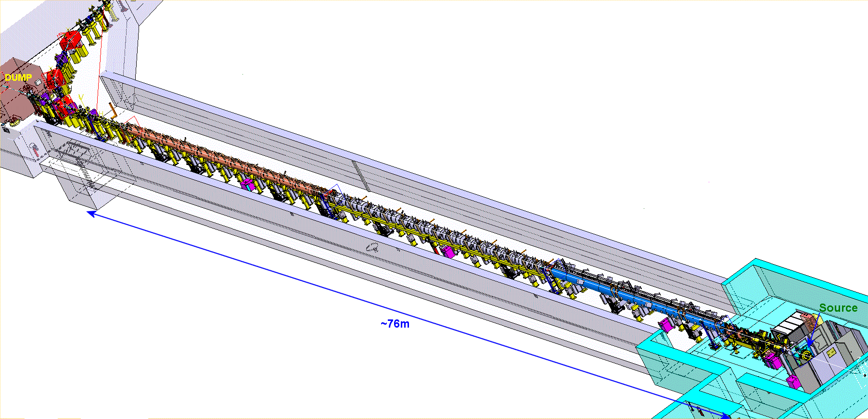
Status of commissioning / installation
LINAC4 machine layout- 352MHz
Pre-injector (9m) |  | DTL (19m) |  | CCDTL (25m) | Π-mode (23m)
3MeV |  | 50 MeV |  | 100 MeV | 160 MeV
SOURCE Plasma Generator Extraction e-Dump LEBT 2 solenoids Pre chopper | RFQ CHOPPER LINE 11 EMQ 3 Cavities 2 Chopper units In-line dump | 3 Tanks 3 Klystrons : 5 MW 1 EMQ 114 PMQ 2 steerers |  | 7 Modules 7 Klystrons : 7 MW 7 EMQ + 14 PMQ 7 steerers 4/7 installed 6/7 conditioned | 12 Modules 8 Klystrons: 12MW 12 EMQ 12 steerer 10/12 delivered 6/12 assembled 1/12 conditioned
Beam Commissioning stages
45 keV | 3 MeV | 12 MeV | 50 MeV | 105 MeV | 160 MeV
Not yet the final source – details later (50mA standalone) (30mA-Nov15)***** | Chopping validated (10mA- Aug 14) (30mA-oct 15) (20mA-Nov15) | Completed (10mA- Aug 14) (20mA – Nov15) | November 2015 (20mA – Nov 15) | April 2016 | September 2016

Slide 4
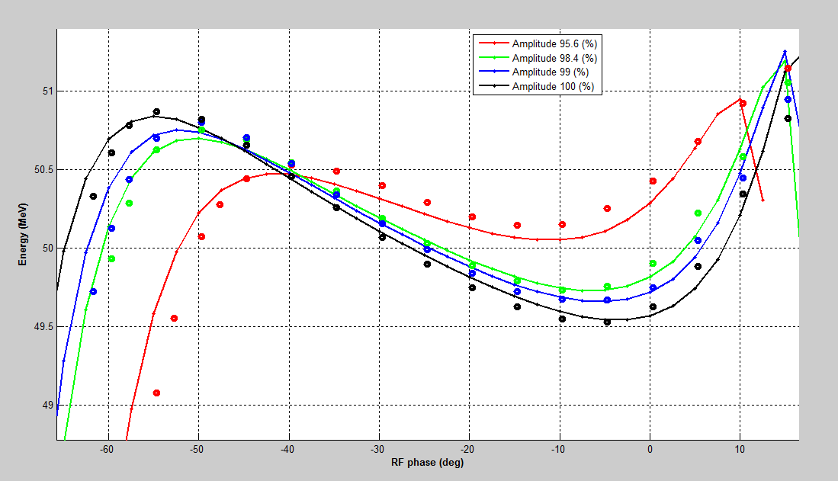
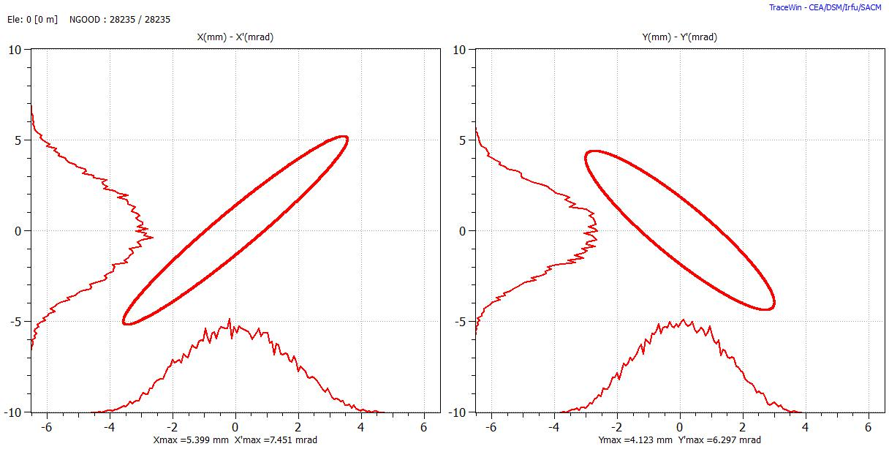
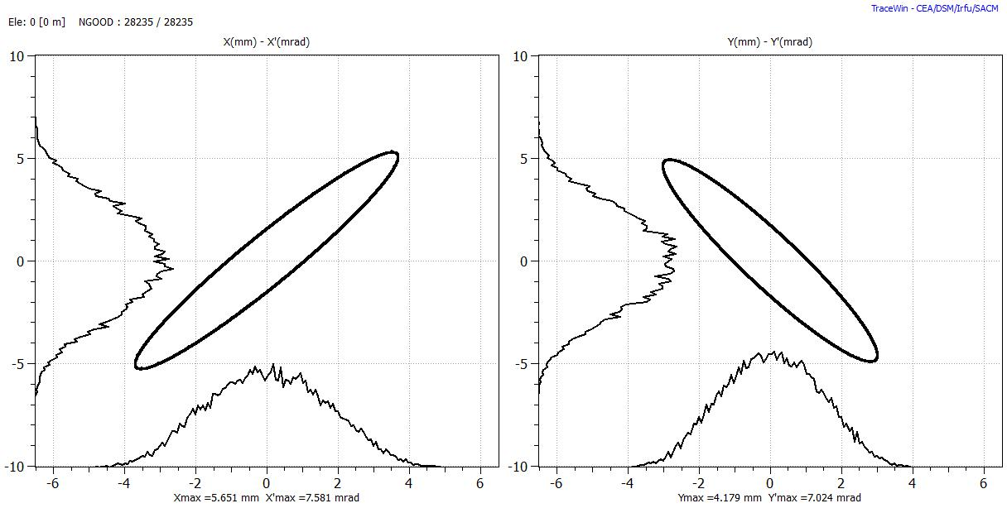
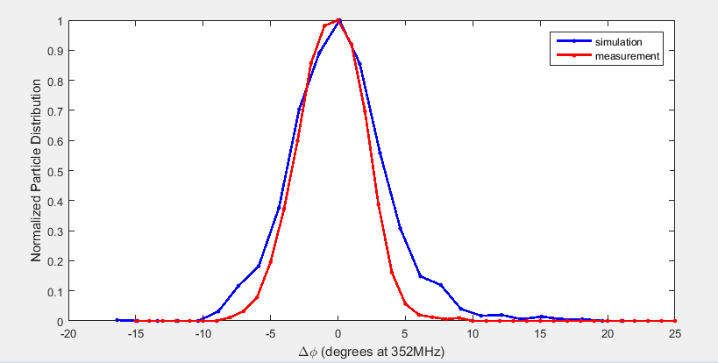
50 MeV commissioning : 20mA in 0.45 mm mrad rms
T.o.F (dots) vs expectation (solid lines) | Emittance meas (black) vs expectations (red)
Micro-bunch longitudinal profile | Summary 1)Transmission : ok 2)Understanding and description in tracking codes is excellent 3) Both transversally and longitudinally the beam is what we predict 4)DTL tanks, the RF , the quads are validated 5) Diagnostics works very well and is adapted to the task.

Slide 5
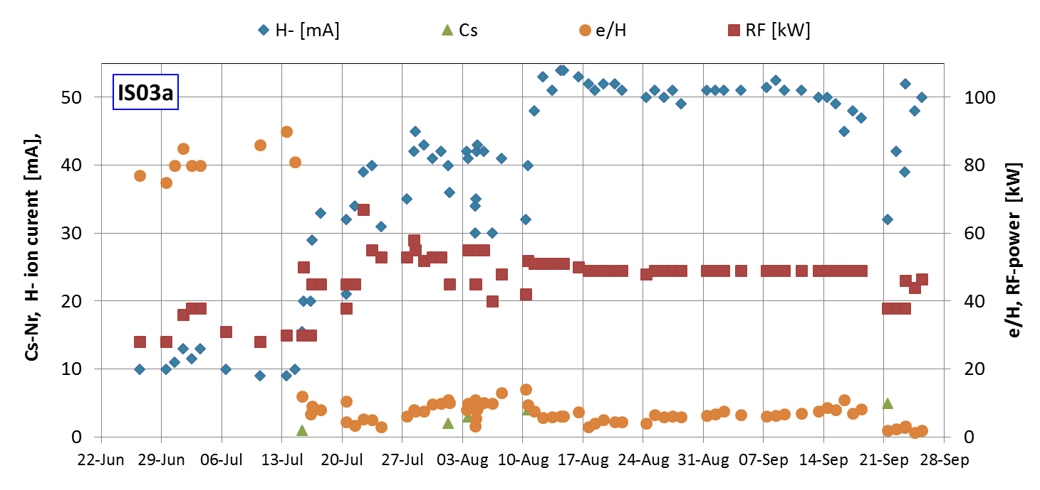
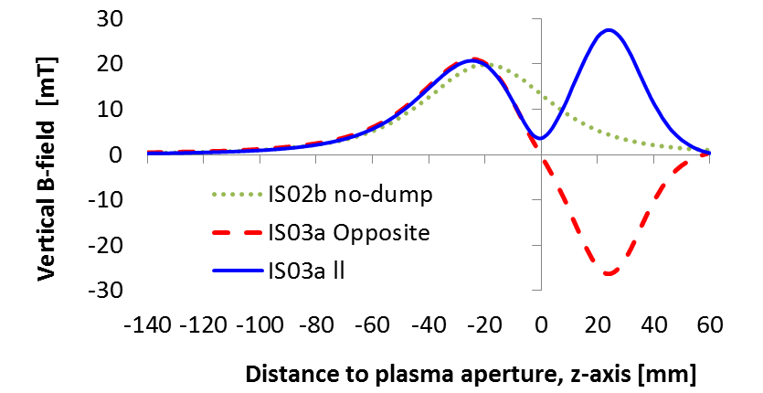
Source – what’s solved
Has the potential to provide 50 mA of H-.
Operation is stable/reliable/dependable. [from the 50 MeV commissioning]
Caesiation is mastered and is done remotely. Needs 3 hours/month.
Fast restart time: experience from Christmas break (6h).
No Cond. effect
9-weeks
2015
Filter & dump B-Field
Plasma chamber Extraction / e-dump
Opposite
Parallel

Slide 6
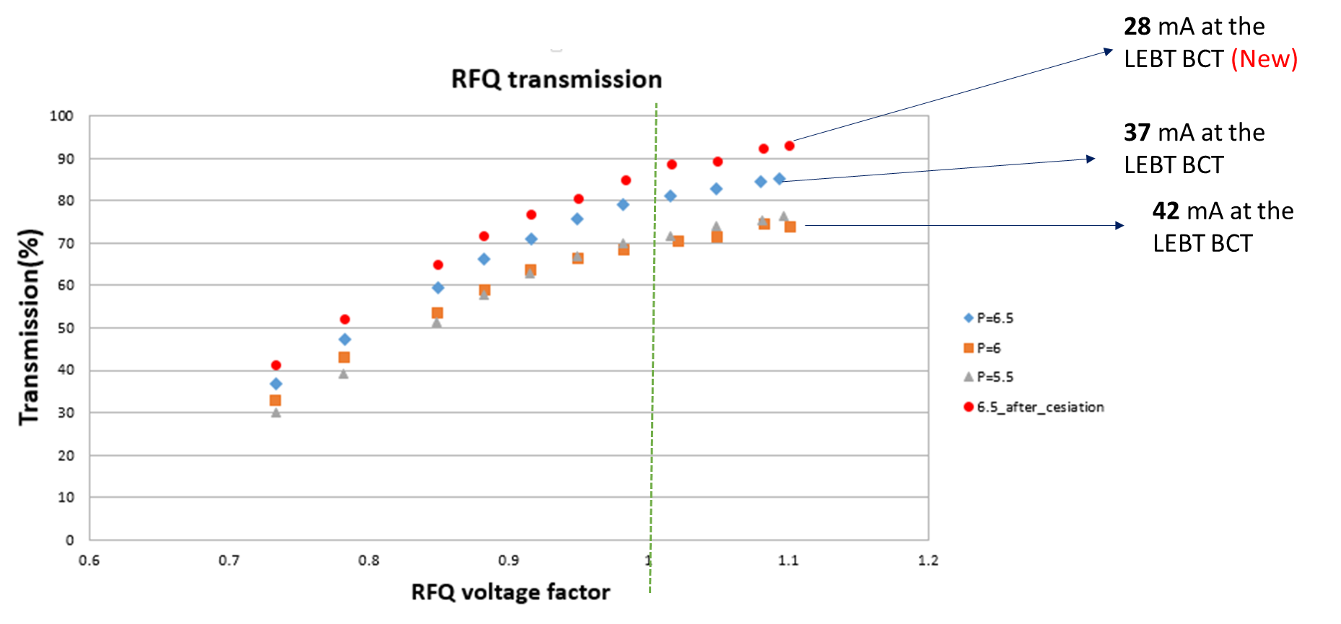
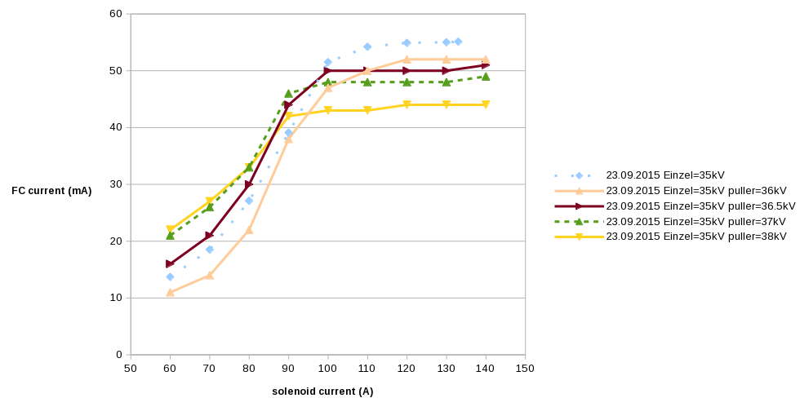
Source – what still needs attention
Mismatch between the source and LEBT: Beam losses already in the first solenoid
Increase of the Einzel lens strength beyond today’s nominal voltage holding capability (35 kV)
Modification of the dynamics in the solenoid.
No influence on emittance/intensity
The emittance of the beam from the source exceeds the RFQ acceptance
geometry of the extraction system
Extraction system defines the emittance of the beam entering the LEBT
Theoretical/computational prediction still to be refined and compared to results on the test stand. Complexity includes effect of the extraction system on the plasma and the dynamic of the co-extracted electrons which are dumped in this region.

Slide 7
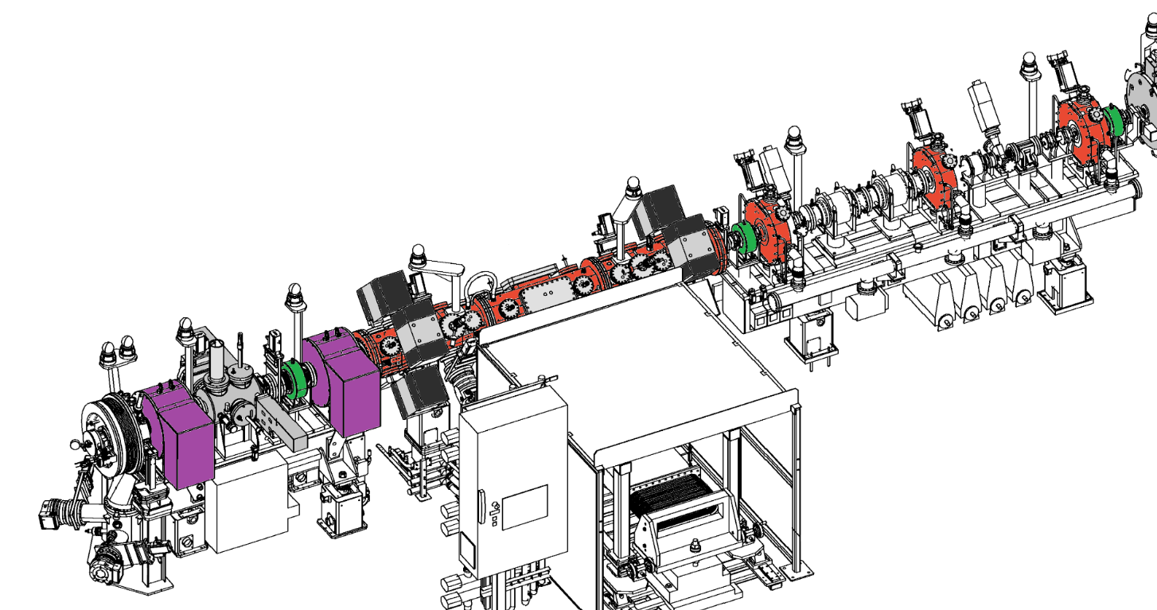
source and pre-injector
3MeV BCT2
Current at 3 MeV before chopping
Obtained LINAC4 | 20 mA
Nominal LIU | 40 mA
Beyond LIU | 60 mA
45 keV
BCT1
Issue | Action | Expected schedule | current at 3MeV | Impact on LIU
Mismatch Source – LEBT | 35-40 kV pulsed Einzel lens | Test stand results by March 2016 | 30 mA | More L4-to-PSB injection turns. (V. Forte+ E. Benedetto)
Emittance from the source | Optimize Extraction | New extraction results by May 2016 | 35-40 mA
Mismatch Source-LEBT | New LEBT | from 2017 | 45 mA
Number of particles | New plasma generator |  | 60 mA | Non LIU

Slide 8
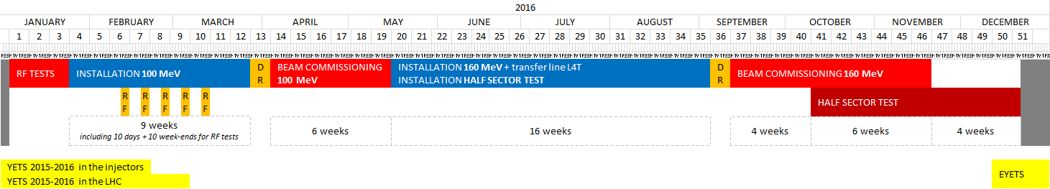
Next steps and planning for 2016
ready at 50 MeV
Start of the Half sector test
Today
completion at 100 MeV
completion at 160 MeV
For 100 MeV beam :
need all CCDTL conditioned
need LLRF system
For 160MeV Beam :
need all PIMS delivered/fitted and conditioned
need LLRF
For the Half Sector Test:
all the hardware on the LINAc4 side is in place

Slide 9
Backup for LINAC2 : protons at 50MeV from L4
.
In case of a unrepairable failure of LINAC2 the PSBooster could be filled with protons from LINAC4
Readiness :
All hardware to connect is ready (blank vacuum chambers…)
Proton source : a source is ready, optimised one to be designed.
Reposition BHZ20
Time for emergency connection : between two months and two weeks depending at what moment in the L4 commissioning stage.
Expected PBS performance : 75% of the present performance for the LHC beam. (CERN-ATS-Note-2012-047 PERF. – 2012)
Unwanted side effects :
incompatible with Half Sector Test
will delay the commissioning to 160MeV and H- operation

Slide 10
Spare RFQ – risk analysis completed
Ref : https://edms.cern.ch/document/1560355/0.1
Recently a LIU/HL-LHC Executive Committee has
  Endorsed mitigations to reduce the risk of a RFQ failure
  Approved the budget for the procurement of a quantity of copper and special steel for a full RFQ
  Cost analysis for rough machining/machining a full module/ machining a full spare to follow

Slide 11
Summary
We have obtained 20mA of H- at 50 MeV (half of the LIU-PSB current) .
We have a staged plan to improve the current from the pre-injector by improving the current/reducing the emittance from the source and improving the matching through the LEBT. These measures should allow to meet the LIU- intensity requirement by summer 2016.
The source reliability and the conditioning time have been improved to a satisfactory level during 2015. For linac4 operation a total of 2 full spares sources is mandatory.
The schedule presented is dependent on the delivery schedule of the PIMS structures, on the time it takes to condition the remaining structures and the readiness of the LLRF systems.
The next steps foresee commissioning stage at 100 MeV and then 160MeV and are compatible with a beam delivered to the Half Sector Test in 2016.

Slide 12
SPARE SLIDES

Slide 13
In this paper we report the status of the LINAC4 beam commissioning and detail the strategy for the remaining commissioning steps. The H- source present performance, the intensity achieved and its impact on the LIU parameters will be discussed. The overall schedule with emphasis on the beam availability for the half-sector test will be presented.

Slide 14
List of activities and draft schedules of LS2
Be ready for an early connection by the end of 2016
  Linac4
New Mid-term and Long-term Schedule of the Linac4
ready at 50 MeV
Start of the Half sector test
Today
completion at 100 MeV
completion at 160 MeV
EYETS
YETS
LS2
Ref. Alessandra Lombardi’s talk (session 6)

Slide 15
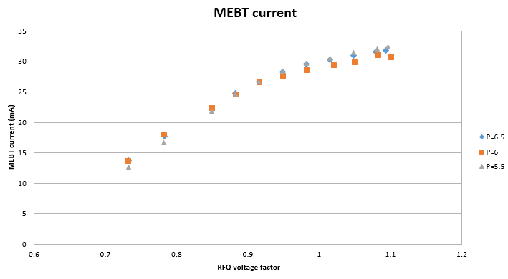
1) 30 mA at 3MeV | 2) The emit from the source exceeds the RFQ acceptance
3) Due to mismatch between the source and the LEBT we lose some beam already in the first solenoid
3MeV BCT2
45 keV
BCT1

Slide 16
Risk rating
 | Risk | Analysis | P | I | S | Mitigation | P' | I' | S'
1 | Electrode damage (sputtering of copper) due to beam loss at the RFQ entrance | Certainly occurring, effect is limited because of the low duty cycle of Linac4 (0.08%) and of the presence of a pre-chopper | 5 | 1 | 5 | Mitigation measures already present: a) surveillance on beam transmission; b) pre-chopper cutting unused beam. Additional measure: a mask in the LEBT to scrape beam out of RFQ acceptance (to be installed when beam is stable). | 3 | 1 | 3
2 | Electrode contamination due to Cs deposition / normal caesiation. | Certainly occurring, effect is limited because Cs penetrating in the RFQ immediately oxidises (oxide is not e- emitter) | 5 | 1 | 5 | Implement a hard-wired interlock on top of existing procedure to assure that the amount of Cs that can enter the RFQ is always a controlled quantity. | 3 | 1 | 3
3 | Electrode contamination due to Cs deposition / caesiation accident. | Might happen (ISIS); in the worst case, would require a cleaning of the RFQ | 2 | 4 | 8 | Implement a hard-wired interlock on top of existing procedure to assure that the amount of Cs that can enter the RFQ is always a controlled quantity. | 1 | 4 | 4
4 | Damage of the RF power coupler (mechanical deformation or surface effects) | Already well protected mechanically, surface problems quite unlikely | 1 | 4 | 4 | A "box" around the coupler is already implemented. Additional mitigation would be to build a spare Ridge 1 | 1 | 2 | 2
5 | Vacuum degradation due to a cooling circuit water leak (e.g. from erosion of the brazed joints of the water circuit caps). | The caps on the cooling circuits are brazed over a long distance, if happens differential pumping can be applied | 1 | 2 | 2 | No mitigation measure can be envisaged; the risk is evaluated as low. | 2 | 1 | 2
6 | Mechanical deformation of the RFQ. | No stresses present on the cavity, thermal load is low, field can be corrected | 2 | 4 | 8 | Build 12 additional tuners or variable tuners. | 2 | 3 | 6
7 | Vacuum contamination of the RFQ from hydrocarbons. | Pumps are dry, oil quantity is minimal, voltage is not too high | 2 | 3 | 6 | Accept reduced beam transmission during re-conditioning. | 2 | 2 | 4
8 | Flanges for RF tuner or RF pick-up are broken because of mechanical stress. | Weldings and brazes are strong, if happens repair or differential pumping can be applied | 4 | 2 | 8 | Install a protection on critical elements. | 2 | 3 | 6

Slide 17
Source – what still needs attention
Mismatch between the source and LEBT: Beam losses already in the first solenoid
Increase of the Einzel lens strength beyond today’s nominal voltage holding capability (35 kV)
Modification of the dynamics in the solenoid.
No influence on emittance/intensity

Slide 18
Source – what still needs attention
BCT1-LEBT – BCT2-RFQ
The emittance of the beam from the source exceeds the RFQ acceptance
Modify/optimise the geometry of the extraction system
Extraction system defines the emittance of the beam entering the LEBT
Theoretical/computational prediction still to be refined and compared to results on the test stand. Complexity includes effect of the extraction system on the plasma and the dynamic of the co-extracted electrons which are dumped in this region.

