Slide 1
Machine Protection at 6.5 TeV
LHC Performance Workshop – Chamonix 2016
25 January to 28 January 2016
Jan Uythoven and Daniel Wollmann
for the MPP team

Slide 2

Machine Protection at 6.5 TeV
Experience during the 2015 Run
  Moments of increased risk
  Machine Protection Commissioning
  Intensity Ramp Up
  Ions
  Machine Development
Outlook MP 2016

Slide 3

Moments of Increased Risk
Everything which is not standard ….
Whenever you change anything on the MP system
Or when availability is low
Low availability of a safety system
Scrubbing
BLM threshold changes
Machine Development

Slide 4
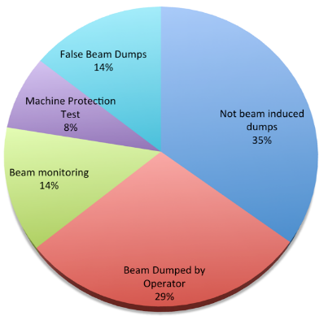
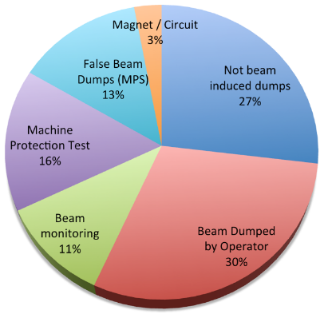
Availability of Safety Systems
Beam dump causes 2015 versus 2012
above injection
2012 (536)
2015 (442)
False beam Dumps by Machine Protection Systems stable (LBDS, PIC, BLM, BIC, SIS, QPS, FMCM):
14 % in 2012 ➔ 13 % in 2015: OK

Slide 5
Machine Protection Issues
When availability is low
If there is an availability issue with a Machine Protection Element, there is a potential Machine Safety Issue
  Failure rate of some components is above prediction
11 beam dump Triggers by mDQQBS (opening of interlock loop)
Out of 57 times SEU in mDQQBS boards detected
Firmware update was tried first
Complete replacement of all boards in TS#2, back to DQQBS
Problem solved

Slide 6

Was the mDQQBS a Safety Issue?
Question asked to Reiner Denz, partially his answer:
Radiation caused a data corruption problem of the splice protection part of the QPS
  Error correction was enabled, but too many errors → overloaded
  Resulting in a beam dump request
    Safe
    But not good for availability
Safety aspects
  Corruption of data could make you miss real ‘quench data’
  However, the system is redundant → Safe, if not hit both redundant systems AND a quench at the same time
On top of this, the system is separated from the magnet protection part
More on QPS in R.Denz’s talk
on Tuesday

Slide 7
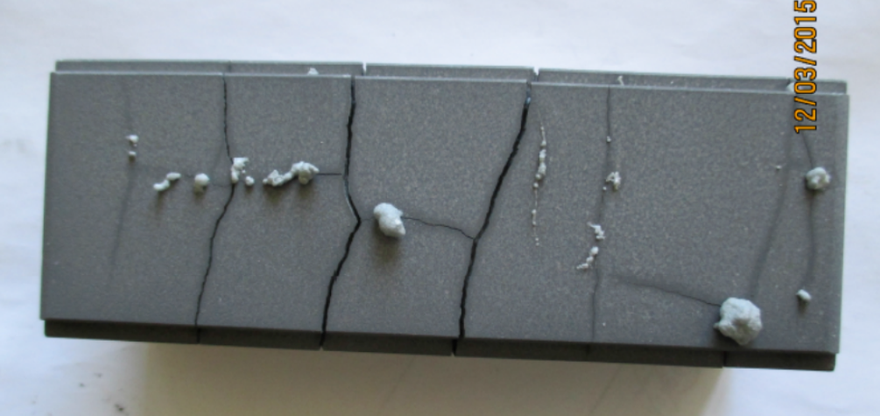
Injection Absorber TDI
Also a safety system having low availability in some way: it limited operation due to bad vacuum
Issue with hBN absorber discovered during bake-out of spare system during LS1
  Imposed limit so that temperature of absorber blocks should not go above 400 degrees C
  Derived maximum intensity for given beams to be injected
    Limited number of bunches to be injected to 144
    Halved injection kicker MKI pulse length, considering stored beam
    SPS interlock on total intensity and flat bottom length
  Handled OK. Replaced for 2016 run.

Slide 8
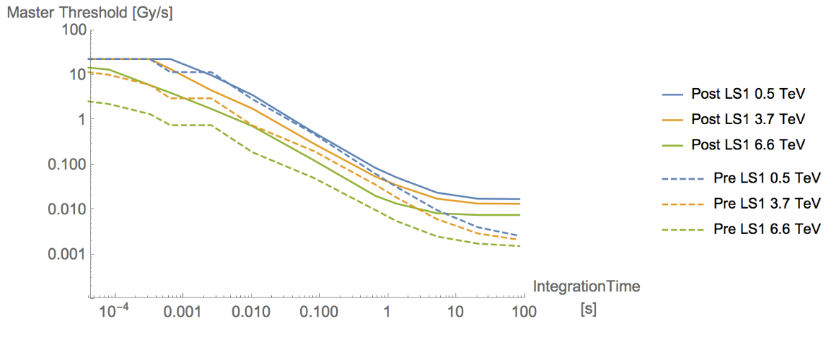
BLM threshold changes
Balance between Quenches and unnecessary dumps
  UFOs, 15R8 etc.
  This is an availability issue, not a machine protection issue, talking about quench levels
Damage thresholds of collimators (TCTs), adjustment at TCLs etc.
  Equipment protection
Would be a Safety Issue if BLM thresholds calculations would largely overestimate damage or quench levels, or a plain mistake
Level of threshold changes generally around 50 %, well below damage threshold, well communicated, automated and checked
  Automatic tools to cross-check are extremely important with 4000 BLMs and have proven their usefulness
B. Auchmann

Slide 9
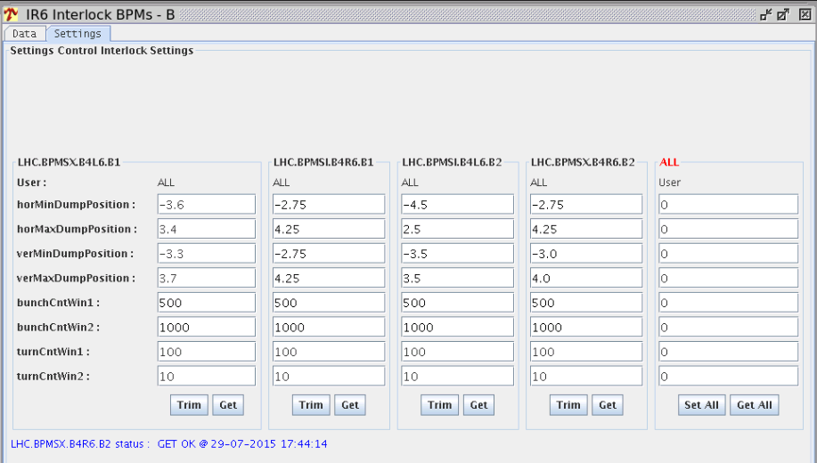

Scrubbing and Doublet beams
Interlocked BPMs: adjustment of interlock settings
  Change of reference position compared to singlets
  Window kept at ± 3.5 mm, tested with bumps
  Increased number of allowed readings outside interlock window because beam only at injection energy
Worked, but manual change of settings. Procedures.
Future upgrade, PM not automatic yet (needs expert)

Slide 10
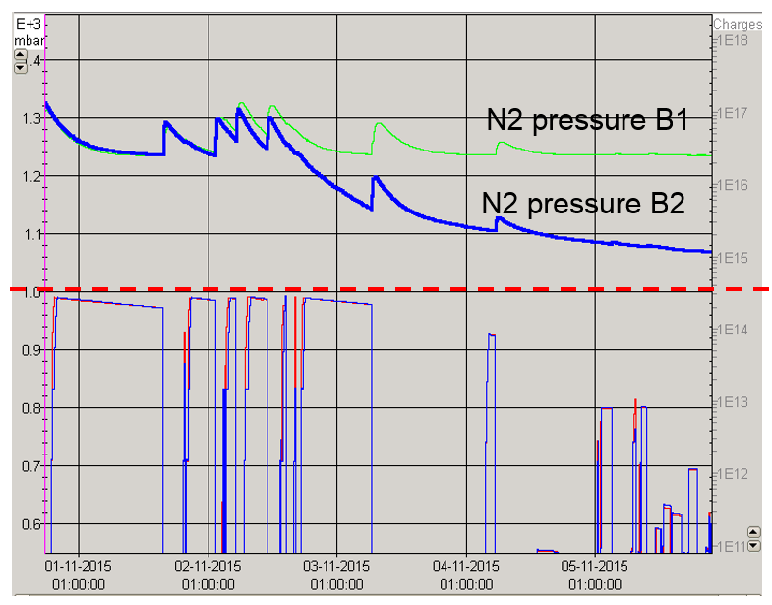
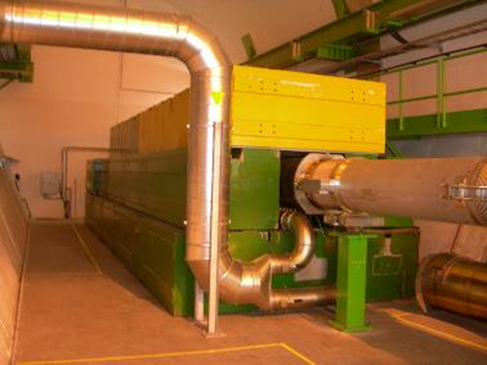
Beam Dump block N₂ leak
TDE normally runs at 1.2 bar Nitrogen overpressure
Nitrogen leak on TDE B2. Fixed by tightening the flange after some days
Manometer on the bottle was found closed, causing initial pressure drop
The only ‘interlock’ is presently in the XPOC
The only gauge is far away from the dump block, on a long line. Gives the correct pressure in stable conditions…
To consider
  Separate TDE N₂ overpressure more clearly from other signals in XPOC.
  Install a second, hardware interlock on the TDE pressure.
  Consider a second pressure gauge on the TDE for complementary information.
  Derive operational procedure and intensity limits in case of a leak in the TDE

Slide 11
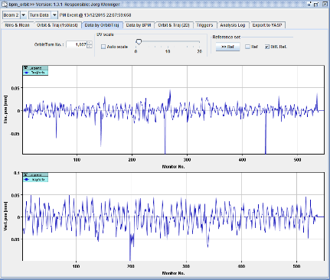
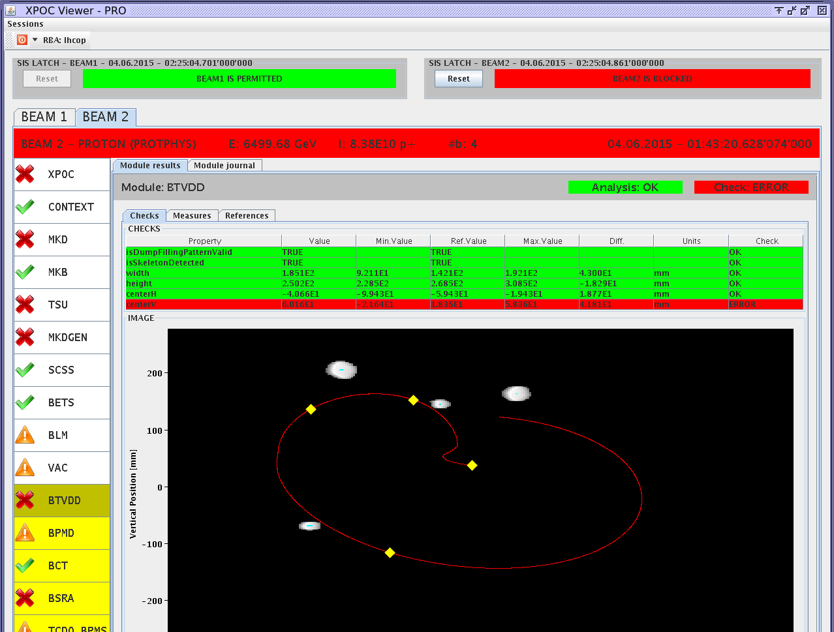
Other Good News
Quenches with beam
  7 Training quenches, 6 beam induced quenches
  No beam losses seen
    Beams dumped before orbit is affected
  As designed, but good to see it in real
Only one asynchronous beam dump due to MKD erratic
  Below 3/beam/year announced after LS1 reliability run
  MKD switch exchanged
  Asynchronous beam dumps are
  to be avoided as the machine
  survival in case of high intensity
  beam being swept across the
  aperture is determined by the
  correct positioning of the TCDQ
  absorber: limited redundancy
  of the safety net

Slide 12
Beam Current Change Monitor
Talking about Safety Nets
An ultimate Safety Net, talked about since a long time
Activated after test phase with some conservative interlock setting
Results presented at the MPP of 9 October 2015
  Showed some noise problems still present
  Same day: spurious beam dump → interlock deactivated on BIS
Proposal: Technical review of system status end February 2016, if correct functioning is verified commission and activate BCCM in BIS after YETS.
Issues to be understood and solved following 1st operational experience:
Suspected phase instability leading to loss spikes which are uncorrelated to orbit movements or real losses.
Intensity dependent baseline.

Slide 13
Many other issues identified, non alarming
Courtesy Daniel Wollmann
Magnet Powering
  SEUs in QPS board for splice protection → trips of RBs sectors OR partial trip of sector by PIC due to intermittent opening of quench loop → beams dumped but RBs staid powered → Replacement of boards in TS2 AND activation of opening 13kA EE switches via SIS.
  QPS_OK flickering → signal masked
  Transient earth fault in RB.A78
  Earth fault in RCS.A78.B2 → circuit condemned
  Malfunction power supply in EE switch of RQTF.A56.B2
  Training quenches at flat top.
  Trip of Undulator L4 due to slow increase of offset in U_RES → sequencer check re-activated.
  QPS mBS boards loosing communication due to SEU → resets, sometimes heaters fire
  Unexplained dump probably due to SEU in QPS-PIC-PC interface.
Interlocks
  UFO dumps and UFO induced quenches → see talk of B. Auchmann
  BCCM false dump
  Unbalanced rupture of the Quench Interlock Loops
  BLM thresholds: rounding issues discovered
  BIS: 3 beam dumps due to attenuation of signal in optical fiber → switch to other fiber
  FMCM triggers due to small electrical perturbations → mitigation in EYETS 2016/17
Collimation
  Beam dump due to timeout (limit controlling CPU stuck) on TCL6
  UFO dumps on TCTs → BLM thresholds adjusted.
  TCSP.A4R6.B1 B1 (IR6) heating up → bad cooling pipe connection identified and corrected.
  Disabled temperature sensors and thresholds increase at some collimators.
Operation
  Instabilities
  Blow up of B1 bunches within the first ~300 buckets → disappeared after TS2
  BBQ-B1 gating on bunches with high gain → not usable below 2-3TeV
  Orbit drifts in stable beams due to IR triplet drifts mitigated by low gain orbit feedback.
  SBF stuck / flickering (depending on BCT stability) → (partially) mitigated.
LBDS
  MKD compensation power converter trip during ramp-down → replaced.
  MKB(HA.B2) self trigger → generator replaced.
  Leak in B2 TDE → temporarily limiting intensity → solved by tightening bolt in collor flange.
Injection
  Losses at TDI reaching >60% of dump threshold → Detail see talk of F. Burkart
  Vacuum spikes at TDI IR8 during high intensity operation (as during scrubbing) → increase of vacuum threshold to 8x10⁻⁶ mbar → replacement during YETS
  MKI flashover
  On rare occasions inj. oscillation data missing.
  MKI temperature interlock increased to 52C.
Heating
  Decrease of bunch length during fill → increase of target bunch length at flat top (1.25ns→1.35ns)
  Transients on sector 12 increasing with intensity: now 10 W on top of an heat load of 15 W. Abrupt transients appear after injection and disappear during the ramp on most sectors.
  Beam screen: cryogenics at the limit reached, but the normalized heat load decreases thanks to conditionings. Impedance heat load still negligible.
  TDI temperature reaching 80C.
  TOTEM pressure increase in both 6L5 and 6R5 when moving roman pots in.

Slide 14
Machine Protection Commissioning
Reviewed at MPP
Mixture of ‘techniques’
  Google docs and Excel (SIS, Injection, LBDS, BLM … ), ACCTESTing (PIC, WIC, FMCM, Collimation partially), MTF for documentation of results (Collimation)
Review status before intensity ramp-up: MP workshop 12/06/2015: OK
Procedures to be cleaned up before 2016 start-up. YES !
The future is in AccTesting, but needs to be based on approved procedures
MPS System | MPP presentation | Approval Status
Collimation System | 13.05.2014 | Released
Injection Protection System | 24.10.2014 | In work
Beam Interlock System | 25.04.2014 | In work
Powering Interlock System | 31.01.2014 | Under approval
Vacuum System | 31.10.2014 | Engineering check
Beam Dump System | 21.03./13.05.2014 | Updated procedure received
FMCM | 31.01.2014 | Under approval
BLM System | 24.10.2014 | Engineering check
Warm Magnet Interlock System | 21.02.2014 | Under approval
Safe Machine Parameter System | 25.04.2014 | Updated procedure received
Software Interlock System | 31.01.2014 | In work
Beam Current Change Monitor | 30.01.2015 | Draft procedure
Don’t reduce MP commissioning time !!

Slide 15
Example of MP test: UPS tests
Campaign to validate the redundant UPS power distribution for LHC equipment systems after LS1.
Important non-conformities on Machine Protection (QPS, BIS, PIC, WIC, FMCM, BPM, BLM, Collimation, PC) systems were revealed.
Test on LBDS was performed B2 only
  Non conformity found and corrected
  B1 not tested, could not close BIS loop at moment of test
A new UPS campaign will be done during 1 – 8 March 2016 and repeated on a yearly basis (approved by the LMC).
Ivan Romera
Report on UPS test results to LMC 25.03.2015
Test report EDMS 1505860
Test procedure EDMS 1405966

Slide 16
Intensity Ramp-up
50 ns proposal (and similar to what we did):
  3 – 12 – 48 – 144 – 288 – 480 – 768 – 1092 – 1380 bunches
25 ns, second proposal
  3 – 72 – 144 – 288 – 432 – 588 – 1164 – 1740 – 2316 bunches
Stayed with Run 1 strategy:
  At each step at least 3 fills and 20 hours of stable beams
  Basically followed without too much discussion
  At each step MPP checklist filled by experts
    In total 17 ramp-up check lists were filled in (edms)
    Sometimes a bit short notice, at weekends etc. but worked out
  From 1000 bunches with 25 ns intensity steps were smaller as we conditioned the machine while doing physics
    MPP checklist to be determined by time and not by intensity steps

Slide 17
Could we have gone faster ???
Better not
  Would have been stopped by mQPS boards < 500 bunches
  TDI would also have stopped the beam by the vacuum
    But if there would have been an MKI erratic while sending 288 bunches into the LHC in the early days, you could have damaged the TDI and caused a long down time ….
If something else would have gone wrong, we might not have noticed ‘before it is too late’
  We are looking for unknown failure modes against we are not protected
Conclusion
  Better be prudent and don’t break the machine. In 2015 there would have been a real risk with the TDI
  Experiments also need some ramp-up time
  Cannot go that much faster any way
    Need to set-up the machine with trains
    Few steps increasing intensity
    Then will most likely be limited by electron cloud

Slide 18
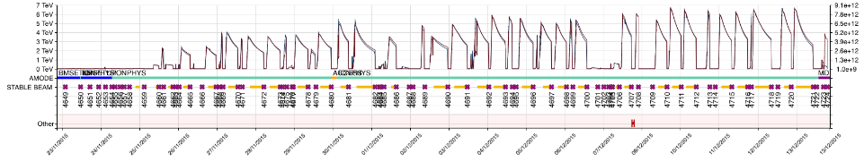
Ions: 2.51 TeV reference run and 6.37 TeV/Z ion run
Max stored beam energy achieved 2015:
  Protons @ 6.5 TeV: ~ 280 MJ; Protons @ 2.51 TeV: ~ 84 MJ;
  Ions @ 6.37 TeV/Z: ~ 9 MJ
Ions and ions ref. run: New machine settings and fast intensity ramp-up without check list procedure to allow max physics production
Optics changes and validations well under control, some (minor) challenges:
  Limiting beam losses by BLMs on cold magnets and TCTs and did not reduce IR7 BLM thresholds: not ideal
  Increased un-buched beam due to not optimal RF phase loop
  ADT gain for abort gap cleaning adjustments required
  BLM thresholds flat top corrected down to 6.37 TeV
474Pb
518Pb
51Pb
426Pb
10Pb
250Pb
Ion run
1/24/2016
Document reference
18
6th Evian Workshop, 16.12.2015
Daniel Wollmann
Chamonix 2016, 25/01/2016
Machine Protection, Jan Uythoven
18

Slide 19
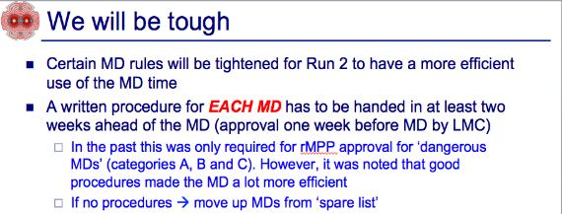
Machine Development
J. Uythoven Chamonix 2014
We had MD procedures for ALL MDs: well done everybody!
  No MD without procedure
  50 MD procedures checked and classified by rMPP
  17 of them became class C and were presented in rMPP meeting and approved via EDMS
Generally 1 week between procedures available and MD taking place: tight → aim for having two weeks ….
MDs took place under safe conditions
  Even the quench MDs

Slide 20
Outlook for 2016
….or where we can do better
Commissioning Procedures of System
  Can be more explicit in tests required and book keeping of tests successfully performed
  AccTesting is the way forward
  UPS tests ! Don’t limit time for tests
Running
  Act immediately on equipment failures which can be a potential risk → define mitigation actions in small committee. Report to LMC.
  As was done in 2015
Points which need constant attention and surveillance
  QPS, interlocked BPMs, asynchronous dumps, new TDI,
  Changes of BLM thresholds
Improve our safety net
  Beam Current Change Monitor to be put in operation
  CIBDS full automatic check after each dump
  Check again full procedures in case of a non-working dump

Slide 21
2016
Machine Development
  Continue on the same path, ‘create’ sufficient time between MD procedures published, rMPP check, update if required and the actual MD
Intensity Ramp Up
  Cannot really go much faster – what do we talk about?
    3/12 bunches to establish the cycle: 1 fill with few hours Stable Beams
    48/72 – 288 bunches to establish trains: 3 fills with 20 h Stable Beams
    570 – 860 bunches: only two ‘normal intensity steps’, still longer trains
    Expect UFO / ecloud / cryo to limit intensity ramp up …..: checklist every 2 weeks during intensity ramp up
Keep in mind that in 2016 we will have an increased safety risk, compared to 2015:
  Most likely smaller beta*
  Less aperture margin and less margin in collimator hierarchy
  Beam-Beam and other instabilities can kick in again

Slide 22

Conclusions
Exceptions to normal operation is when machine safety margin is the smallest. Several examples of 2015 given
This is generally recognised and the bodies are in place to give a platform to discuss potential issues: ®MPP
Mitigation measures have been put in place when required
But we can do better on some fronts
Generally speaking:
Especially when we start LHC Run 2 production phase ….

