Slide 1
Experiment Control System
&
Electronics Upgrade

Slide 2
ECS & Upgrade Electronics
ECS Design doesn’t change (in principle)
  Same tools:
    Communications: DIM
    Supervision: WinCC-OA
    Sequencing and Automation (FSM): SMI++
  Same philosophy:
    Generic tools to describe the hardware (FwHw)
      Board Types -> “chips” -> registers => Boards
    Operation tools to Configure/Monitor boards
      “Recipes” for different configuration modes
      Stored in Configuration DB
  New electronics will be interfaced like before

Slide 3
Electronics Interfaces
Two types of boards to control:
  Back-End boards (Readout Boards, etc.)
    Physically only one board type (PCIe40):
    But logically different types
    TELL40, S-ODIN, SOL40
    (Past equivalent: fwCcpc)
  Front-End Boards
    Sub-detector Specific
    Several protocols available (via GBT-SCA)
    (Past equivalent: fwSpecs)

Slide 4
BE Board Interface
Physically only one board type (PCIe40) for:
TELL40, S-ODIN, SOL40, etc.
  But logically different types
  ( different firmware -> different “registers”)
Tools will be provided centrally:
  Low-level libraries and command-line tools:
    Allow accessing the different registers (PCIexpress)
  A DIM server:
    Will implement higher-level commands to configure and monitor the board components
  A WinCC-OA component
    Providing the high-level description and access of all electronics components

Slide 5
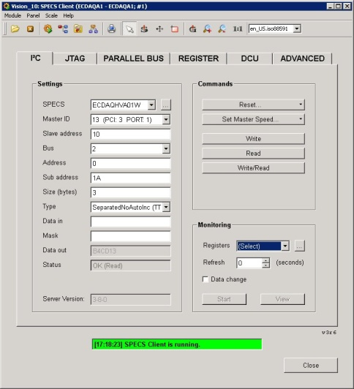
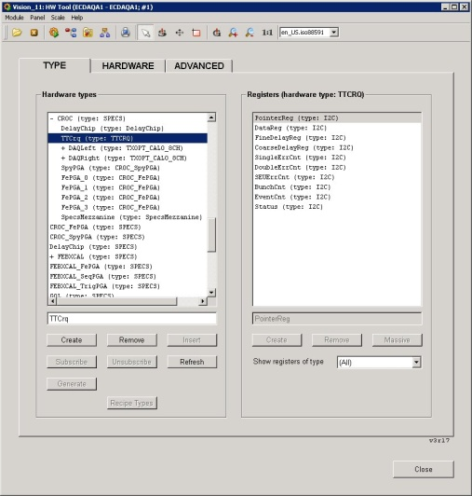
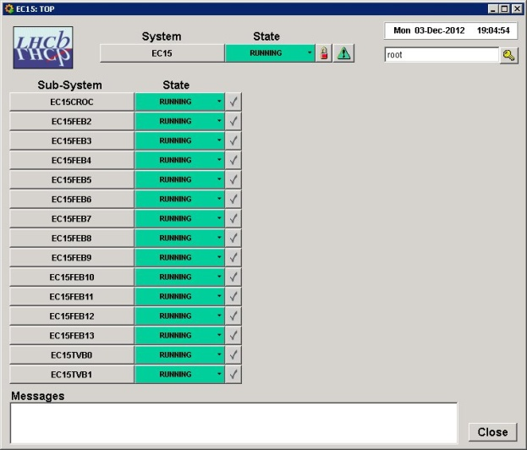
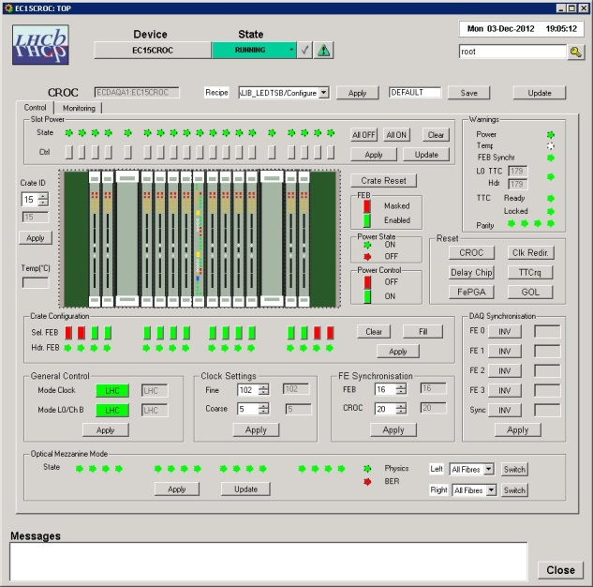
ECS BE Dataflow
Test UI
HW Description UI
Operation UI
WinCC-OA
Control PC
Firmware
GbtServ
DIMServer
PCIe Library P
FPGA
PCIe driver P
PCIe40
PCIe
Host PC

Slide 6
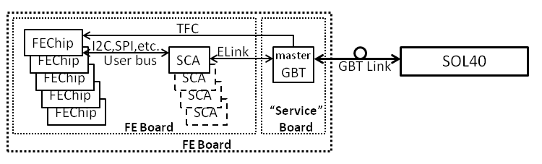
FE Board Interface
Interface to FE Electronics
  Two Architectures envisaged:
    FE electronics in one single FE board
    FE electronics accessed via a “Service” board (masterGBT <-> SCA via “long” Elink)

Slide 7
FE Board Protocols
Interface to the FE Chips
  The GBT-SCA provides the following protocols:
    16 x I2C master controllers
    1 x JTAG master controller
    32 x ADC channels (multiplexed)
    1 x Memory bus (32 bits) controller
    4 x PIA (Parallel Interface Adapter) controllers
    1 x SPI (Serial Peripheral Interface) bus
    4 x DAC channels
  Recommended protocols (for bulk transfers) are:
    I2C
    SPI using independent chip selects
    (daisy chained SPI not allowed)

Slide 8
FE Addressing
FE Chip Register Address:
<SOL-ip><GBT-i><SCA-j><ProtoCode><I2C-k><I2C-add>[<I2C-s.add>]
  fixed variable
Control PC

Slide 9
ECS FE Dataflow
Test UI
HW Description UI
Operation UI
WinCC-OA
Control PC
Firmware
GbtServ
DIMServer
GBT Link
PCIe Library P
FPGA
PCIe driver P
SOL40
PCIe
SOL40
Host PC

Slide 10
FE ECS Software/firmware
Will be centrally provided:
  The FPGA firmware for the SOL40 board
    Will prepare, send and receive the GBT-SCA frames for the various user protocols
      Should take load away from CPU as much as possible
  Low-level libraries and command-line tools:
    Will allow accessing the different FE chips
  A DIM server:
    Will implement higher-level commands to configure and monitor the FE chips
  A WinCC-OA component
    Providing the high-level description and access of all electronics components

Slide 11
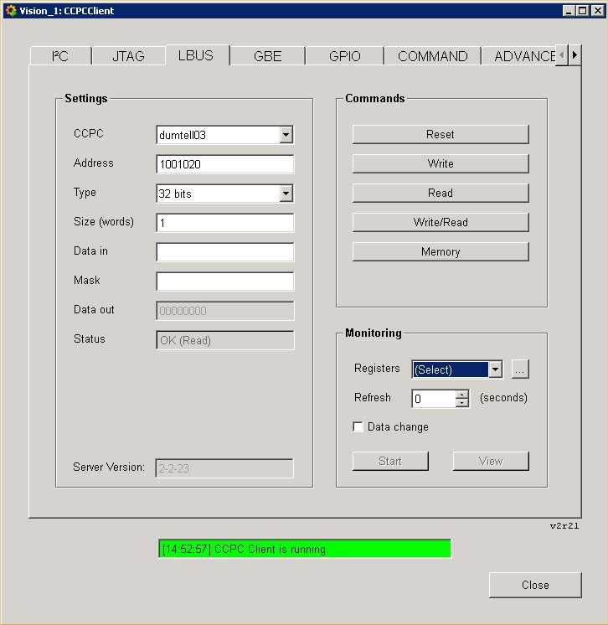
WinCC-OA: Test UI
For both
BE and FE
boards

Slide 12
WinCC-OA: HW tool
HW Description UI
XML
Description
WinCC-OA
Control PC
Firmware
GbtServ
DIMServer
GBT Link
PCIe Library P
FPGA
PCIe driver P
SOL40
PCIe
SOL40
Host PC

Slide 13
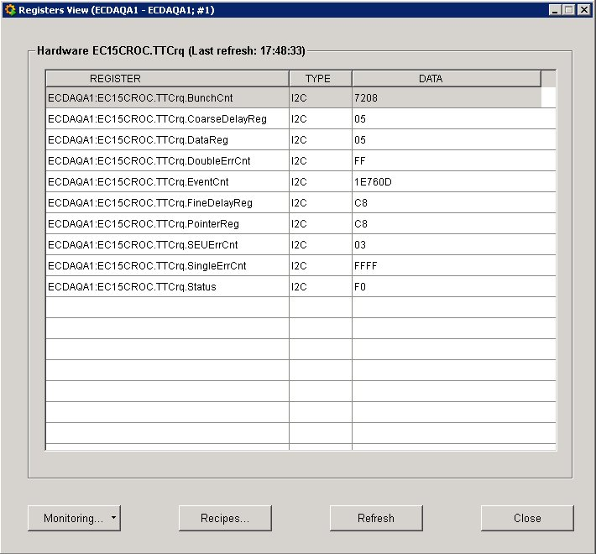
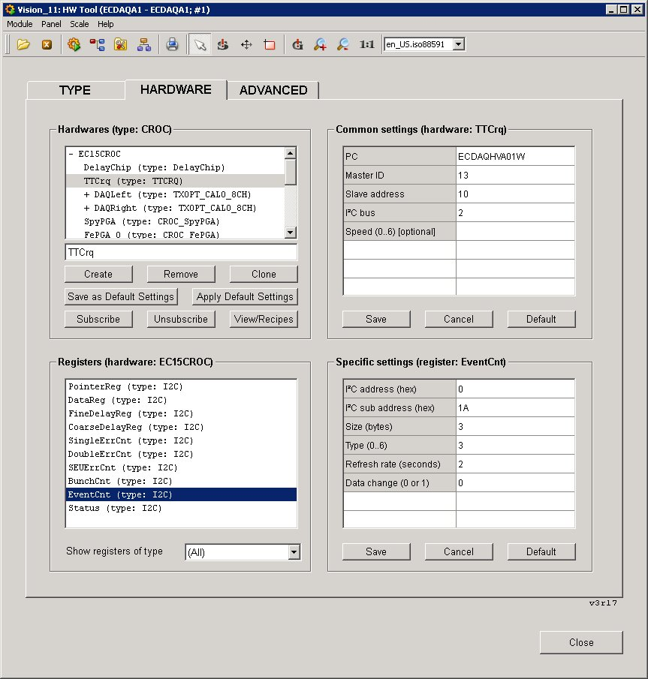
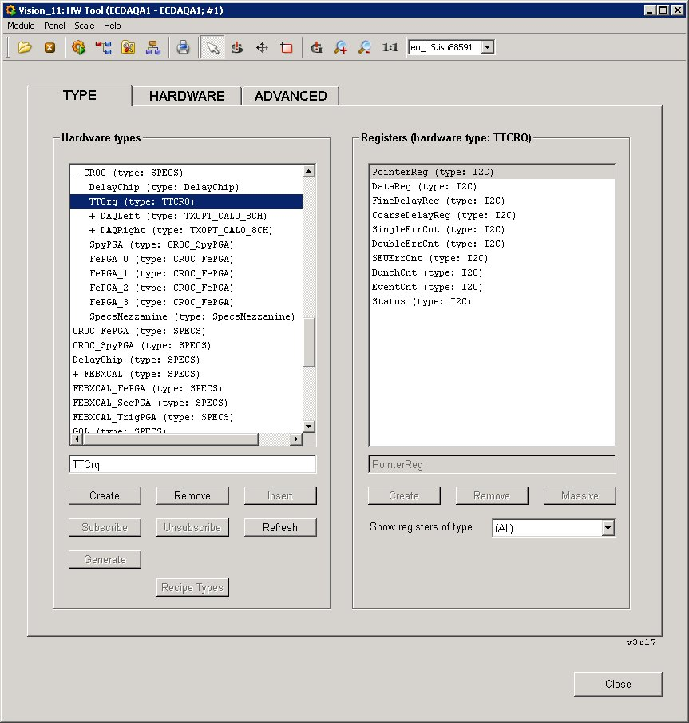
WinCC-OA: HW tool

Slide 14
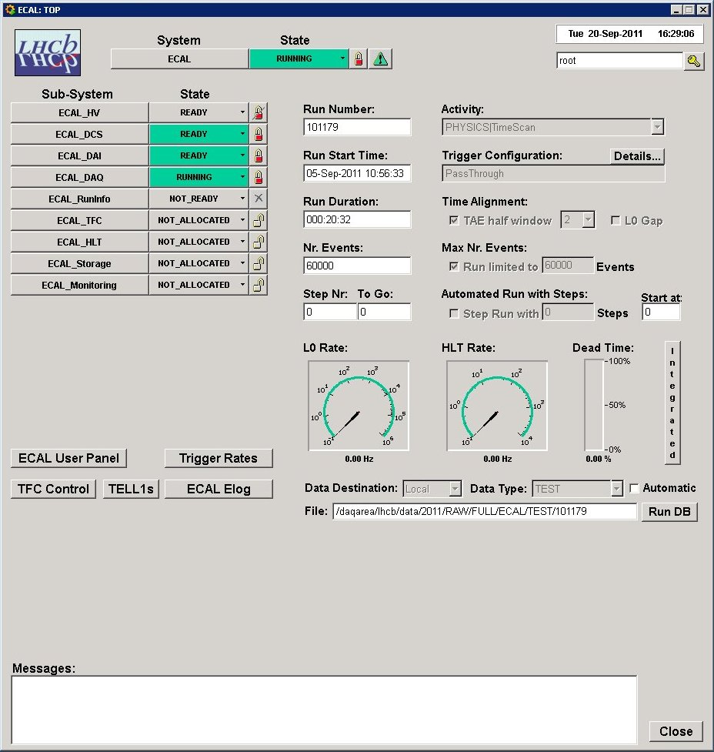
WinCC-OA: Configuration
HW Description UI
Operation UI
Configuration Tools
  Use “Recipes”:
  Groups of settings
  for many registers
WinCC-OA
Conf.DB
Control PC
Firmware
GbtServ
DIMServer
GBT Link
PCIe Library P
FPGA
PCIe driver P
SOL40
PCIe
SOL40
Host PC

Slide 15
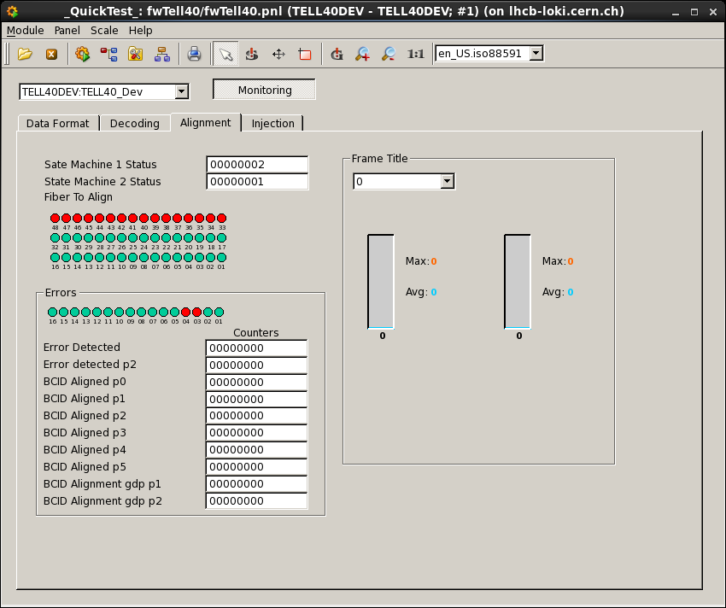
Current Status
MiniDAQ Based
  BE boards:
    DIM Server adapted
    FwCcpc/FwHw adapted
    accepts XML input
    Started building Tell40 panels
  FE Boards:
    SOL40 Firmware 1st version exists
    Building low-level libraries (GBT-SCA protocols)
    Extending the XML description
  In general:
    FwCcpc / Ccserv (tell1)
    FwSpecs / SpecsServer
Firmware
Ccserv
DIMServer
PCIe Library P
FPGA
PCIe driver P
CCPC
Mini DAQ
PCIe
FwGbt / GbtServer
15

Slide 16
Scalability & Efficiency
Configuration and Monitoring speed
  Is not just data size / bandwidth
  Depends on:
    How the data is distributed, for ex.:
      A few large registers or many small ones
    Are blocking operations needed, for ex.:
      A register needs to be set and read-back before configuring the next one
      or read-modify-write operations that need to be done by the back-end
    Which user protocol is used and how it is used, for ex.:
      Some I2C devices needed an extra I2C operation to write a sub-address before the block of data could be written
      Some did not implement auto-increment so block transfer could not be used
  Try to influence design early enough…

