Slide 1
LHCb Upgrade Electronics
Meetings in 2015 (Thursday, 2pm):
3rd December
http://lhcb-elec.web.cern.ch/lhcb-elec/html/upgrade.htm
Mailing list:
Go to egroups.cern.ch, search for lhcb-upgrade-electronics
ALSO:
cern-electronics email group has a lot of activity

Slide 2
Common components
GBTXs:
pre-pre-series delivery next week
=> special components for Velo (no heatsink)
DC-DCs:
CLP version coming in November, then testing
=> available early 2016
Standard version mid-2016
MONEY MUST BE READY TO PAY FOR THESE
(payment via CERN TID)
LHCb ordered 6’300 CLPs = 220 kCHF

Slide 3
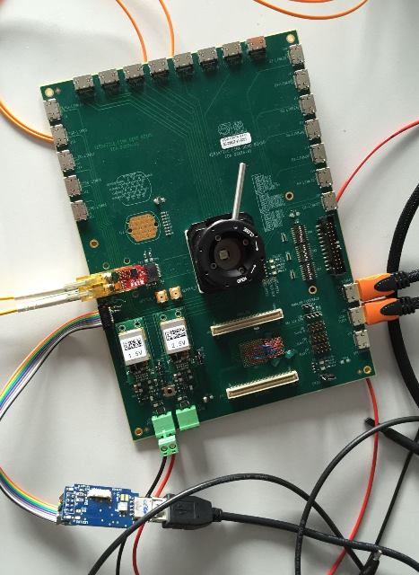
VLDB
VLDB + sundries: available now. Contact VLDB team
But please note current shortage of VTRx……
alternative is commercial SFP+
VERY useful tool:
already heavily used by UT for
SALT8 testing
good template to use for designing
boards with GBT chip-set

