Slide 1
VELO Upgrade Electronics Cooling
Not covered by this talk
Front-end electronics: CO₂ cooled in vacuum
Off-detector electronics: racks in D3 and on the surface
Covered by this talk
Electronics mounted on the vacuum tank (OPBs)
Front-end control, O/E and DC/DC conversion

Slide 2
VELO Electronics overview
off-detector electronics
(remote)
2 x front-end hybrids
(1 detector module)
< 1 m
1 x opto & power board (OPB)
vacuum feed-through
3 data links
GBLD
2 x VTRx
SOL40
V_{MON}
2 x GBLD
VP5
VP4
VP3
GBTx_OPB
VTRx_OPB
SCA
4 x DC/DC (OPB)
2 x SCA
6 x CLK
6 x TFC
6 x ECS
6 x RST
GBTx
V_{MON}
VP2
2 x 10 data links
11 x VTTx
TELL40
VP1
7 data links
T_{OPB}
12 x DC/DC (Hybrids)
LV PS
LV
VP0
T_{H}
Temp R/O & Interlock
HV
4 x HV
HV PS
High-speed control
High speed data
Control signals
Low voltage
High voltage
Monitoring

Slide 3
Power dissipation
OPB: Opto- and Power Boards, mounted on the vacuum tank
Each OPB has 5 supply voltages: 5 V @ 0.8, 4.5, 4.5, 2.2 & 2.2 A
  Estimates are hopefully conservative
  Assuming 0.5 and 1.0 Ω cable resistance
  Fits just about in the current CAEN LV specs
    Long distance cable voltage drop close to the limit
Upgraded VELO | PS output power (W) | Power dissipation (W)
 |  | Cables | OPB | Module
1 module | 100.5 | 30.1 | 33.8 | 36.6
½ VELO | 2610 | 780 | 880 | 950
Full Velo | 5220 | 1560 | 1760 | 1900

Slide 4
Power dissipation: current vs. upgrade
Current VELO* | PS output power (W) | Power dissipation (W)
 |  | Cables | Repeater Boards | Module
1 module | 42.2 | 13.4 | 12.3 | 16.5
½ VELO | 930 | 300 | 270 | 363
Full Velo | 1860 | 600 | 540 | 725
*Measured values, ignoring binary part of the pile-up modules & RPT boards
Upgraded VELO | PS output power (W) | Power dissipation (W)
 |  | Cables | OPB | Module
1 module | 100.5 | 30.1 | 33.8 | 36.6
½ VELO | 2610 | 780 | 880 | 950
Full Velo | 5220 | 1560 | 1760 | 1900
*Conservative estimates, hopefully less

Slide 5
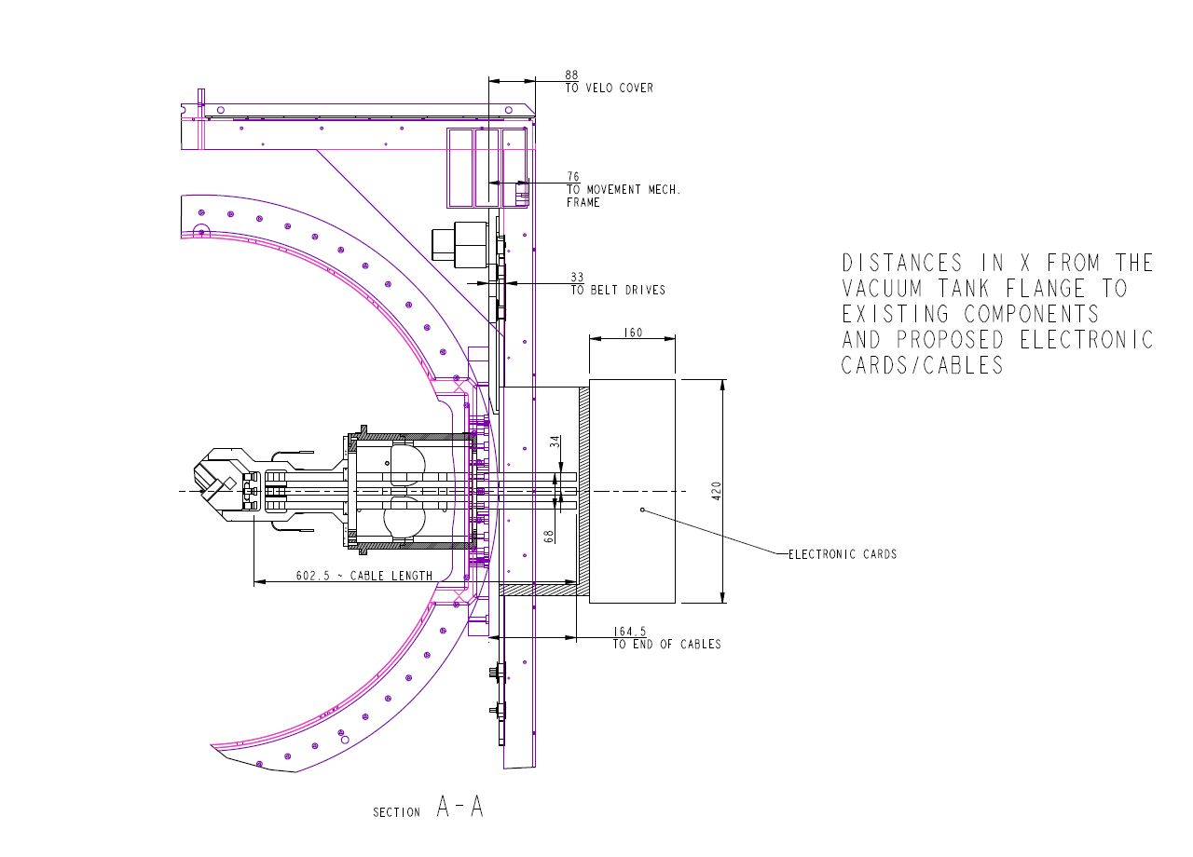
OPBs: physical location

Slide 6
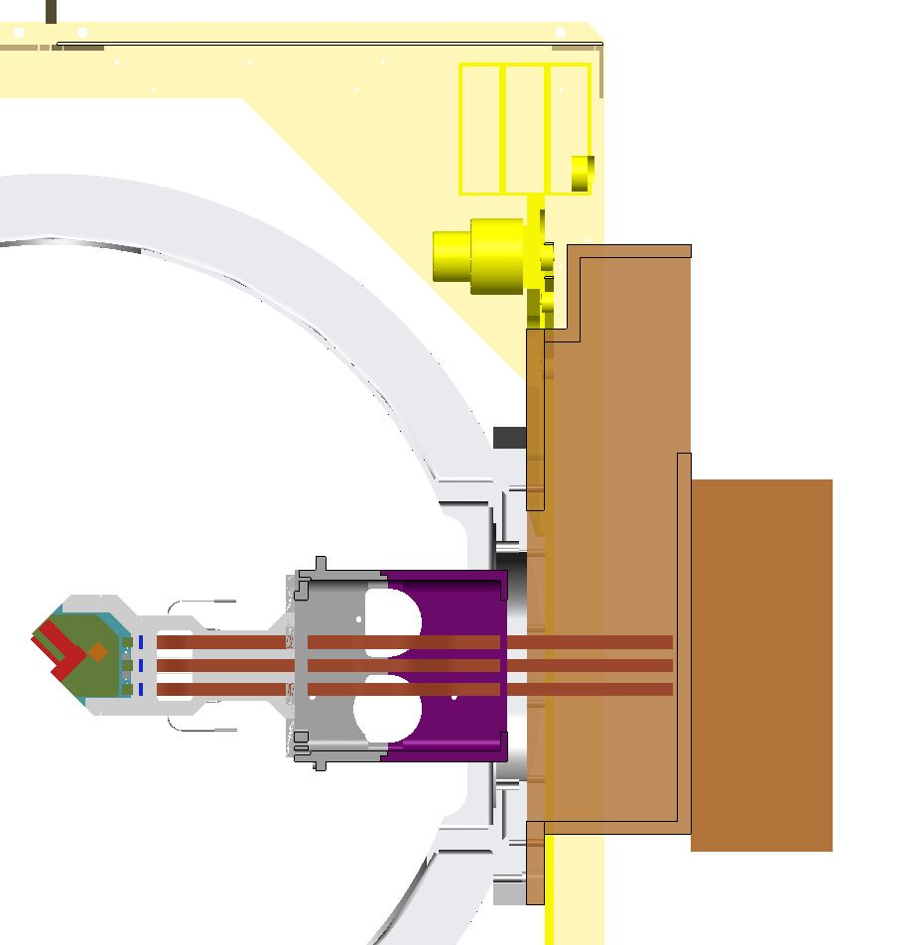
OPBs: physical location
Tertiary vacuum: CO2 distribution & safety valves
(access required)
OPBs: indicates the card size, not including crates or cooling
Vacuum ports for pumping

Slide 7
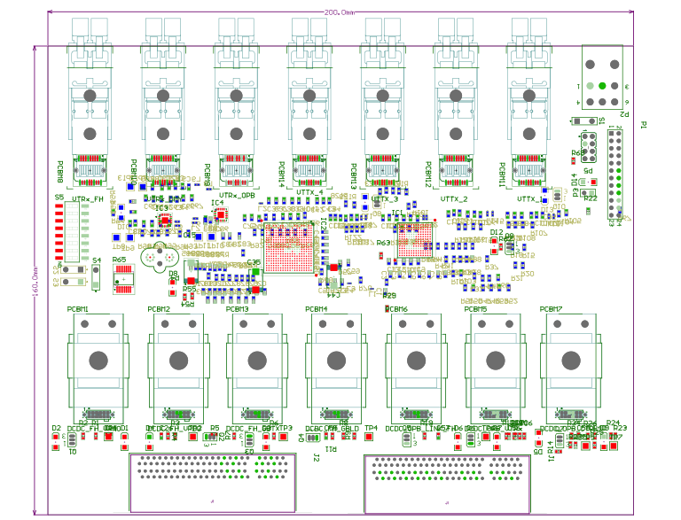
OPB: cooling, heat path
Layout of prototype OPB, full size board expected to be 160 x 420 mm²
Heat dissipation mainly in
  DC/DC converter
  VTT/Rx modules
Distance between boards
  30 mm
Maximum component height
  approx. 20 mm
Cooling concept
  Vertical heat sinks (bars) on the board
  Running along the ‘hot’ component
  Fins for air cooling?
  Transport the heat to the board edge?
vacuum feed-through
optical fibres & LV connection
DC/DC converters
VTT/Rx

Slide 8
Cooling options
Passive air cooling
  Crates have open top and bottom to allow vertical air flow
  Pros: Simple, cheap, no maintenance
  Cons: Probably not enough and heats up the VELO alcove
Forced, chilled air cooling
  Heat exchanger plus fans, like most off-detector crates
  Pros: Simple on the PCBs, relatively simple crates
  Cons: Radiation and magnetic field tolerance
Circulating chilled water
  Either in the crate, cooling the bars from the card edges
  Or through the cooling bars themselves
  Pros: chilled water is easy to provide
  Cons: Complicates board and crate designs. The area is already very busy (CO₂ distribution, feed-thoughs, …)

