Slide 1
SciFi Electronics Cooling
Christophe Insa, Antonio Pellegrino
LHCb Upgrade Electronics Meeting, October 8, 2015
Introduction
FE Electronics design and power consumption
Cooling system specifications
Summary and Outlook

Slide 2
General Setup
→ 3 stations,
→ 4 planes (X, U, V, X),
→ 2 sides (left(A), right(C)),
Station 3
Station 2
Station 1
Beam
Left
ReadOut Boxes
on top & bottom
Right

Slide 3
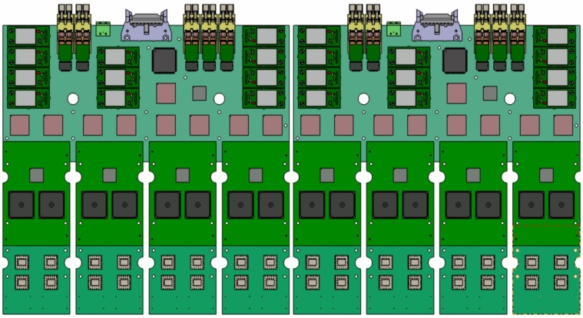
Half plane setup
3 m
Note : 2 half-layers
on the same C-Frame
=> 6 C-Frames per side
ROB = SiPM + FE boards
528mm
40mm thick.
6 m
Warm box
94 W
259mm
6 Sci-Fi Modules
Cold box (SiPM & cooling)
118mm
Cold box
~6 W
(Novec cooling –
not detailed herein)
(to SciFi modules)

Slide 4
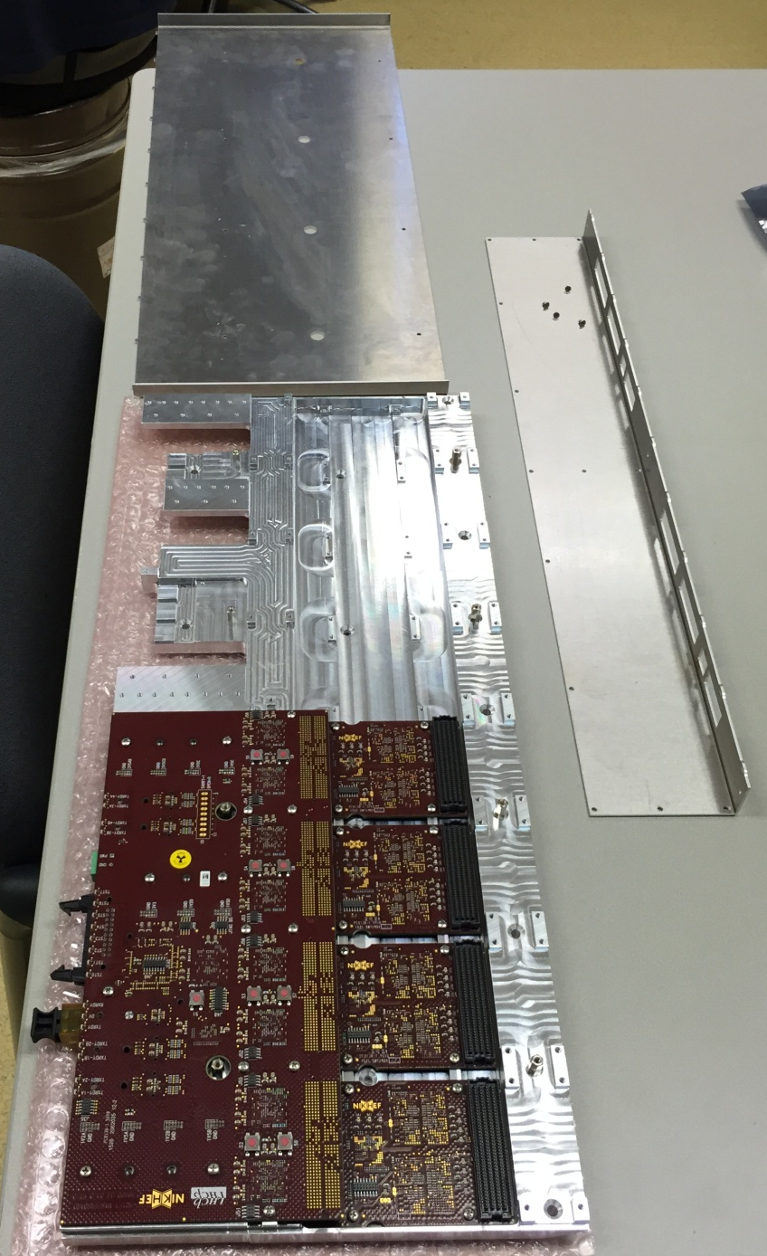
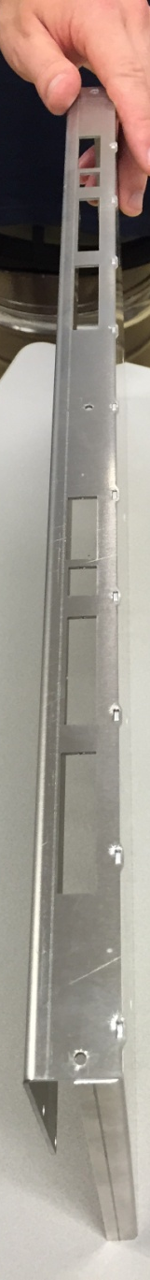
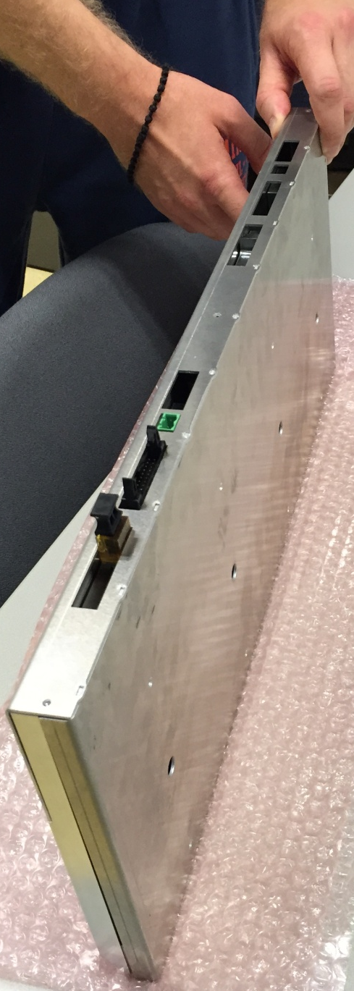
FE Box Prototypes @Nikhef
Front Plate
Top Cover
Clustrering Boards
Master Board

Slide 5
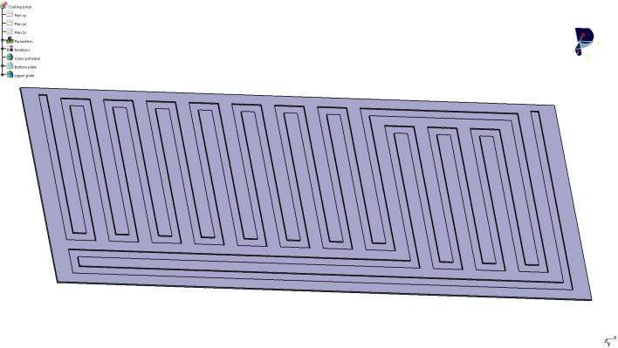
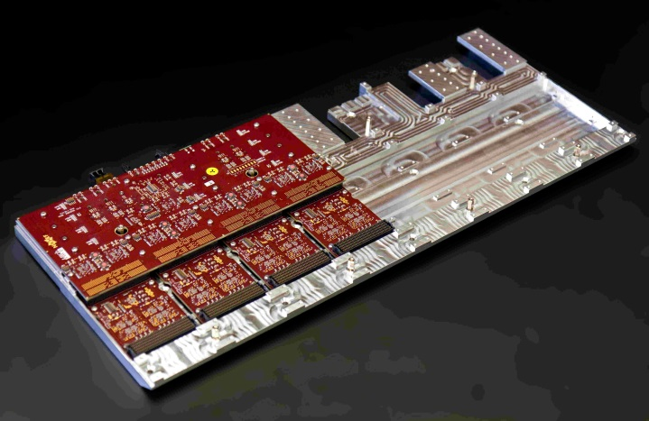
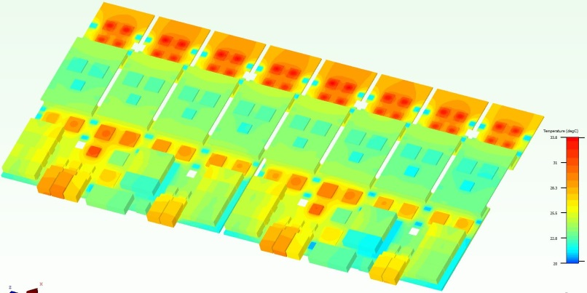
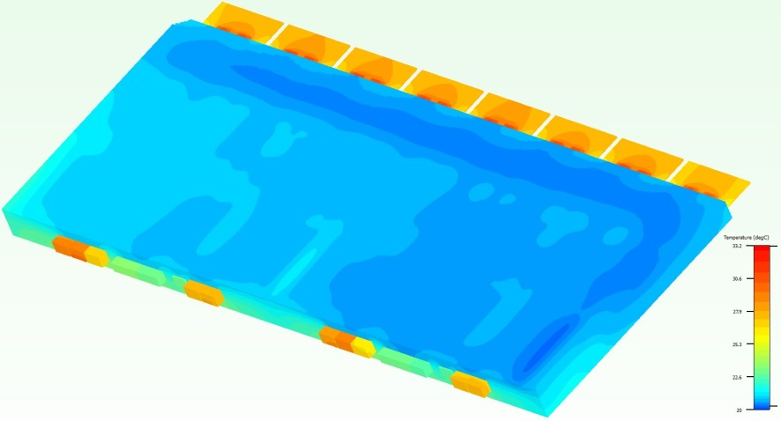
FE boards cooling simulations
Preliminary study based on prototype config.
1,4 l/min @20°C
outlet
inlet
Cold plate as
heat exchanger
Alu block as heat spreader w. thermal pads
Box
94 W heat load (tbc)
FE boards
Simulation results
Warmest : PACIFIC chip @ 34°C
Connectors to SiPM @ 28°C (spec. tbd)
ΔT water 1°, with 1,4 l/min

Slide 6
Water cooling distribution
Baseline : cooling 2x6 ROB in parallel (tbc)
2 half-layers per C-frame
Total heat load : 27 kW
Total vol. flow : 403.2 l/min (24.2 m³/h)
6 distribution points on each side of detector
Use flexible hose between distribution and detector to allow C-frame opening without disconnecting (cooling in open position too)
Inlet 16.8 l/min
Outlet 1.2 kW

Slide 7
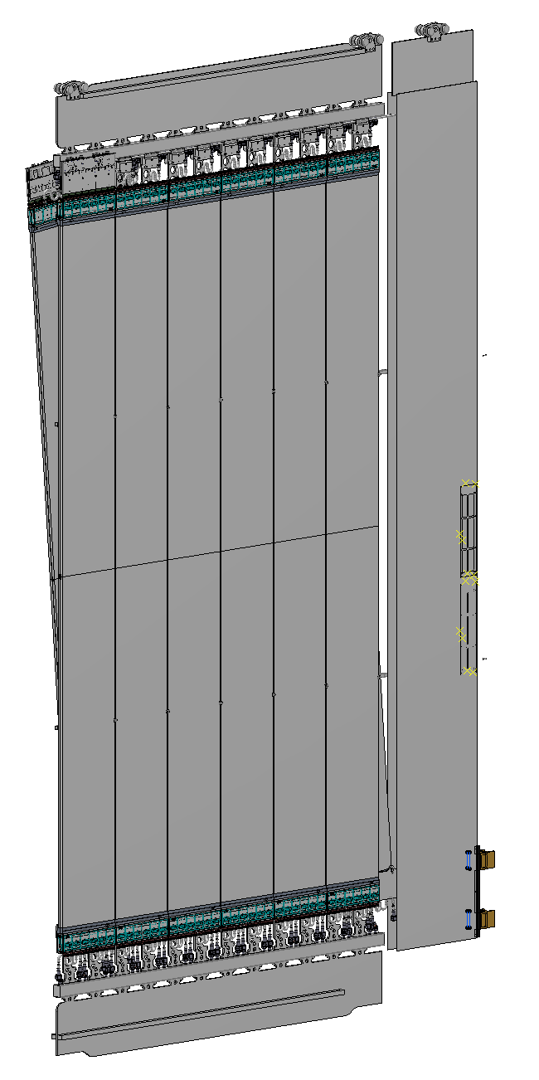
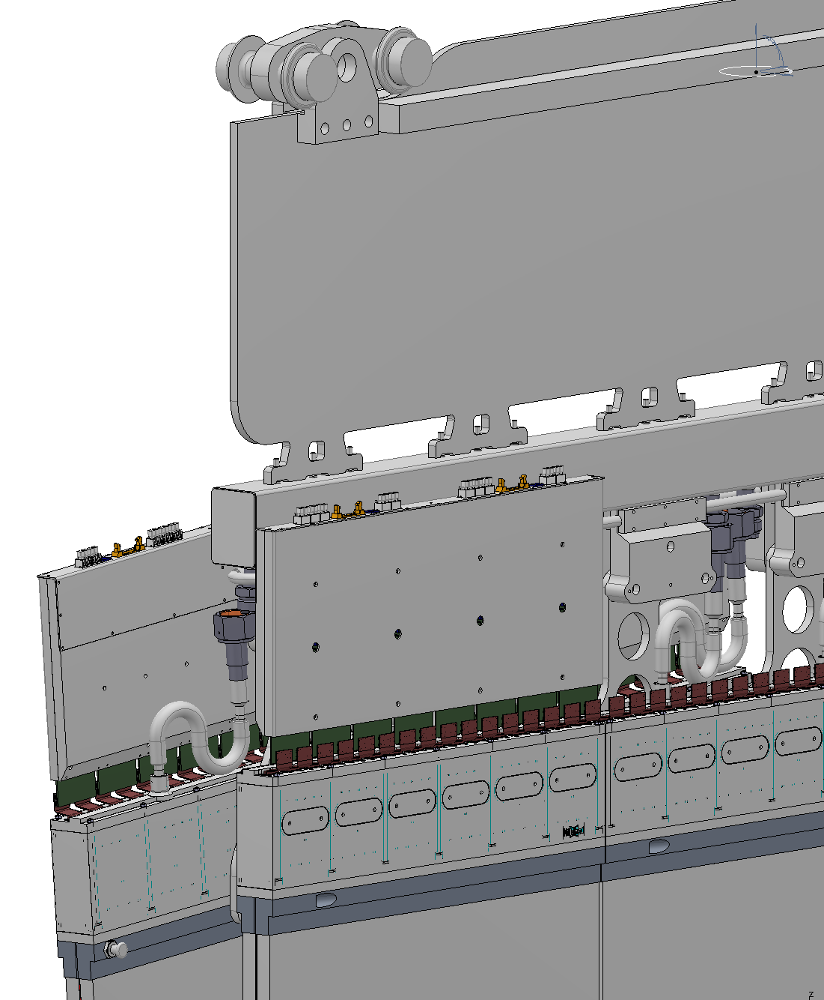
How it could actually look like (prelim.)
Pipes in this profile

Slide 8
Water cooling supply
Current features of water cooling station for Outer Tracker:
[see http://www.nikhef.nl/pub/experiments/bfys/lhcb/outerTracker/Cooling]
Cooling capacity = 23 kW [15 kW × 1.5 safety factor]
Flow rate = 10 m³/h
Inlet temperature in detector = 19°C
Demineralized water (conductivity < 1 μS/cm)
Typical pressure at detector inlet ~1 bar
Specifications evaluated for SciFi electronics cooling :
Coolant = demineralized water
Water temperature : det. inlet = 20°C (simu) / det. outlet = 21°C (simu)
Maximum ΔT inlet = +/- 1°C
Flow rate for entire detector = 24,2 m³/h (if parallel config. validated)
Water pressure inlet of detector = tbd (work underpressure preferred)
Cooling capacity = 30 kW (10% margin included)
Can the current cooling station be upgraded ?
When can we begin study in details in collaboration with EN/CV ?

Slide 9
Summary & Outlook
SciFi Electronics cooling studied with simulation
First Electronics prototypes produced and available @ Nikhef
Tests on Electronics performance have begun and tests on thermal behaviour is foreseen in near future :
  Actual power consumption and temperature measurements possible once FE prototypes can be fully configured (soon)
  Setup with Master and cluster boards + alu. block + cold plate for heat load and temperatures validation
  Complete FE prototypes with Pacific boards (and later chip-to-SiPM flex)
Results expected in 6 months before Electronics EDR
In the mean time, can start discussion about cooling plant
  Stay with present (OT/PS) demi-water plant (closed circuit, excellent water quality, never had problems with impurities, filters, etc.)
  Design upgrade to higher cooling power

