Slide 1
FCC-ee booster: preliminary design study
Dmitry Shwartz
BINP
25.09.2015

Slide 2
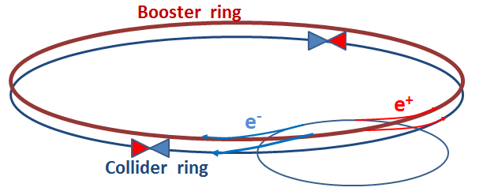
FCC-ee complex possible scheme
20 >> 45 ÷ 175 GeV; top-up; polarization!
Pre-booster (SPS?), 1-2 GeV >> 20 GeV
Damping Ring with strong wigglers for rapid radiative polarization, 1-2 GeV
Linac,1-2 GeV
e- >> e+
e- Linac

Slide 3
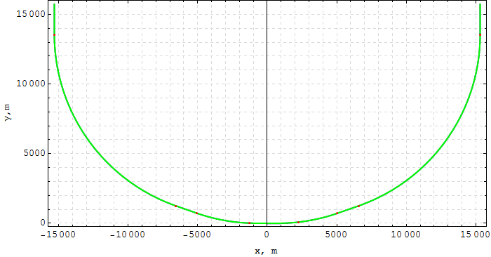
Geometry
Booster vs collider: same circumference, same tunnel, same emittance.
Thus, the ring is cloned of Katsunobu Oide’s version collider “inner” quarter-ring, except the IR. Two-fold & mirror-symmetry.
RF-section
arc-1
straight
arc-2

Slide 4
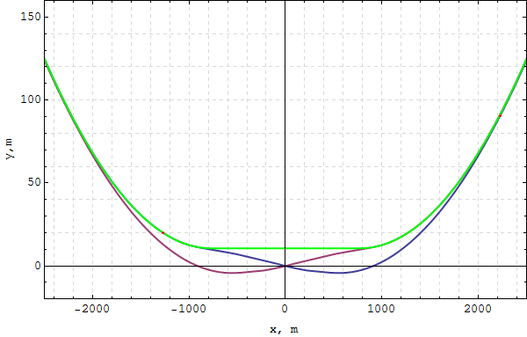
Geometry (2)
Inner arc & bypass was chosen by chance.
Probable problems with MeV SR photons showering the detector (?)
10.6 m

Slide 5
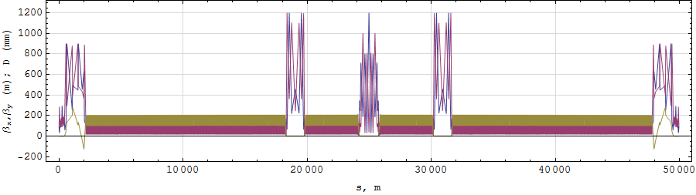
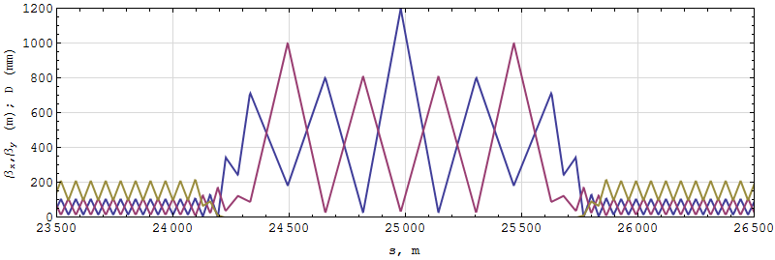
Lattice functions
Half ring:
Bypass:

Slide 6
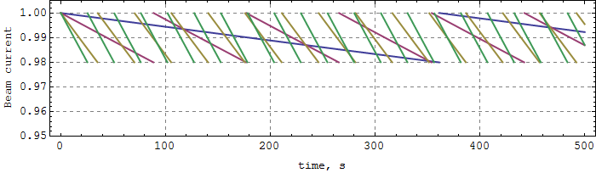
Top-up injection
Collider bhabha scattering lifetime:
E [GeV] | 45.5 | 80 | 120 | 175
Lifetime [min] | 298 | 73 | 29 | 21
Inj. Cycle [sec] | 361 | 88 | 35 | 25
<< Injection both e+ & e-
Beam current decay in the collider for the set of energies.
Note: L∝ I⁺ I⁻ : 2% I >> 4% L

Slide 7
Parameters
Energy [GeV] | 20 | 45 | 80 | 120 | 175
Cycle time [s] | 12
Stacking | no
Circumference [m] | 99918.2
Bending radius [m] | 11653.8
FODO-cell length [m] | 64.245
Betatron tunes per cell | 0.25
Betatron tunes | 334.45 / 333.2
Radiative emittance [nm] | 0.024 | 0.12 | 0.38 | 0.85 | 1.81
Bending field [Gs] | 57 | 129 | 229 | 343 | 509
Energy Loss / turn [MeV] | 1.21 | 31.1 | 310 | 1572 | 7109
Transv. Damping time [s] | 11 | 0.965 | 0.172 | 0.051 | 0.017
Transv. Damping time [turns] | 32974 | 2895 | 516 | 153 | 50
Critical energy [MeV] | 0.0015 | 0.017 | 0.097 | 0.33 | 1.02

Slide 8
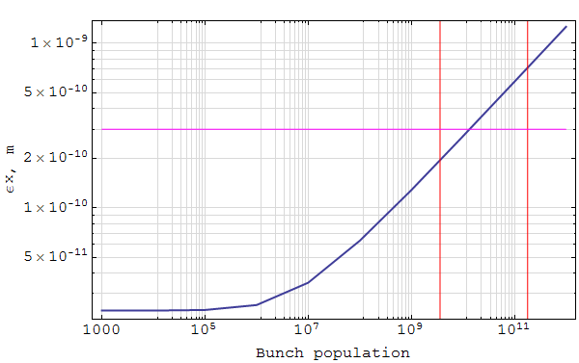
Intrabeam scattering
Energy: 20 GeV
Total voltage: 141 MV
“Nominal” bunch length: 0.63 mm
Damping time: 11 s
100% collider bunch intensity
1% collider bunch intensity
SPS lowest emittance:
0.3 nm @ 20 GeV

Slide 9
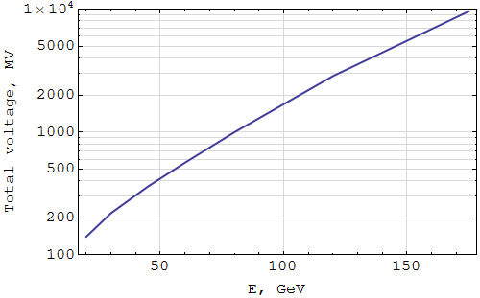
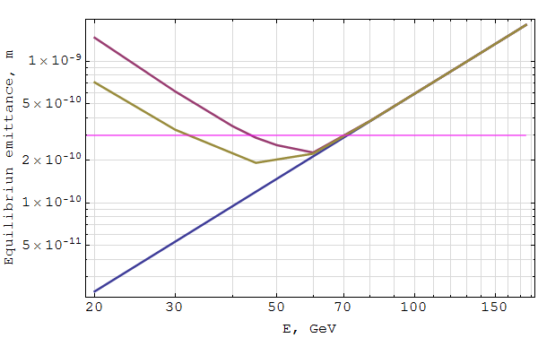
IBS (2)
Voltage following energy with invariant bucket width ~0.06 (9.6 GV with 7.1 GeV energy loss @ 175 GeV).
Emittance (equilibrium) growth due to IBS.
N_{bunch} = 1.8×10¹¹.
SPS lowest emittance:
0.3 nm @ 20 GeV

Slide 10
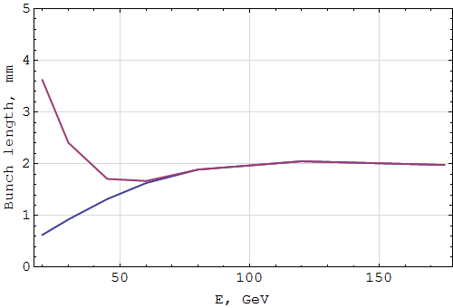
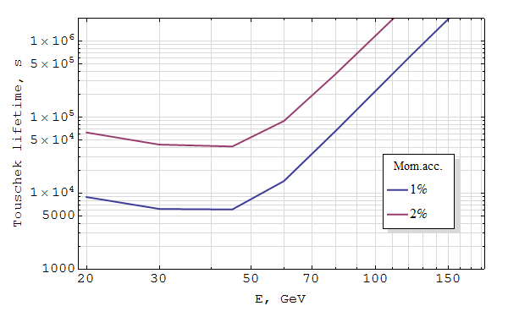
IBS (3)
Same conditions:
voltage variation,
N_{bunch} = 1.8×10¹¹.

Slide 11
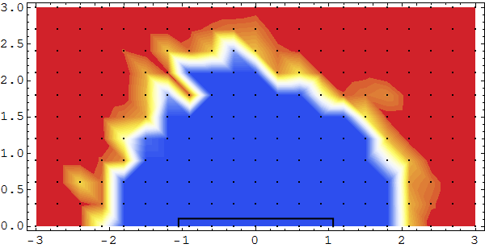
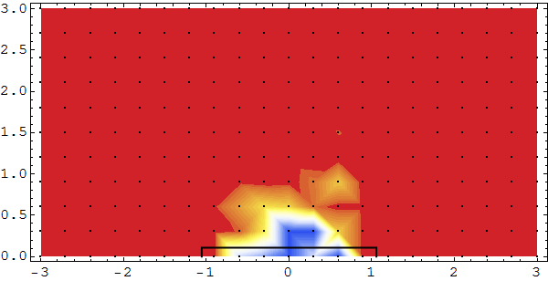
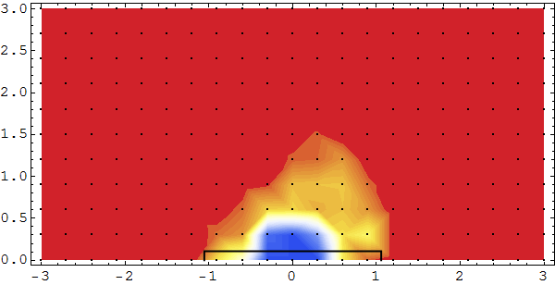
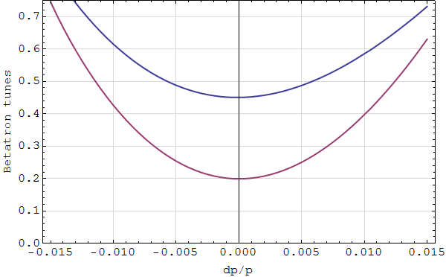
Dynamic Aperture estimations
Primitive tune chromaticity correction: two non-interleaved families SF, SD
On-energy
1000 turns (damping off)
Off-energy (±1%)
25σ
cm
Strong second-order tune chromaticity

Slide 12
Siberian snakes
Polarization preservation during acceleration demands two Siberian snakes placed with proper azimuthal angle proportion (Ivan Koop).
3.53 mrad (41.2 m) dipole
12 T (@175GeV), 76.3 m solenoids
0.7 m
half-ring “arc”
half-ring “arc”
±I matrix quads knob
~ 500-600 m

Slide 13
Plenty of work to be done!
Lowest energy? Injection chain?
Cycling, filling, intensities…
Arrangement in the tunnel
Injection to collider scheme
50 Gs dipoles – practical possibility (cycling, shielding, stability, quality)
Polarization aspects & insertions
Tapering?
Linear optics (depending on energy?)
Nonlinear optics
etc

