Slide 1


Tapering options in the future low emittance high energy collider FCC-ee
Andreas Doblhammer (CERN, Geneva) for the FCC-ee lattice design team

Slide 2
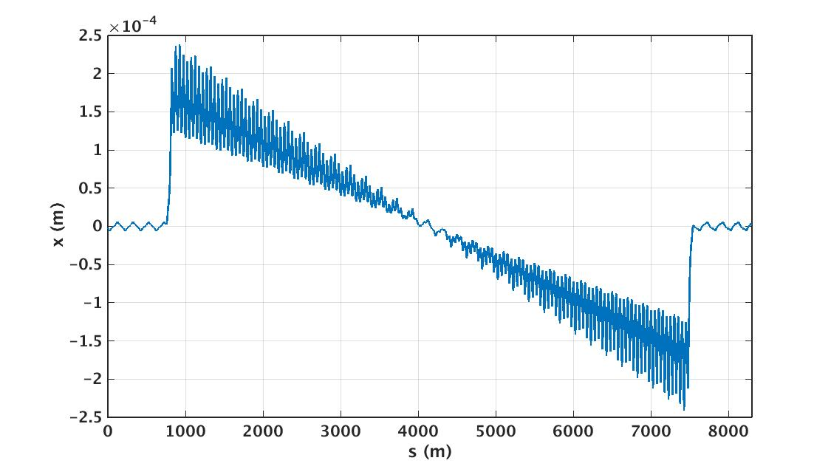
Sawtooth-Effect
Energy loss through synchrotron radiation and energy gain in RF cavities leads to characteristic “Sawtooth-Effect”
Notes:
Sawtooth-Effect wird größer, weil wir ein gemeinsames Layout mit den Protonen haben. So number of RF sections will be reduced which makes the sawtooth larger and there are large offsets of the beam through. As we share a layout with FCC-hh, they want to reduce the number of RF sections as far as possible. With that, the orbit becomes really large (mm-Range)

Slide 3
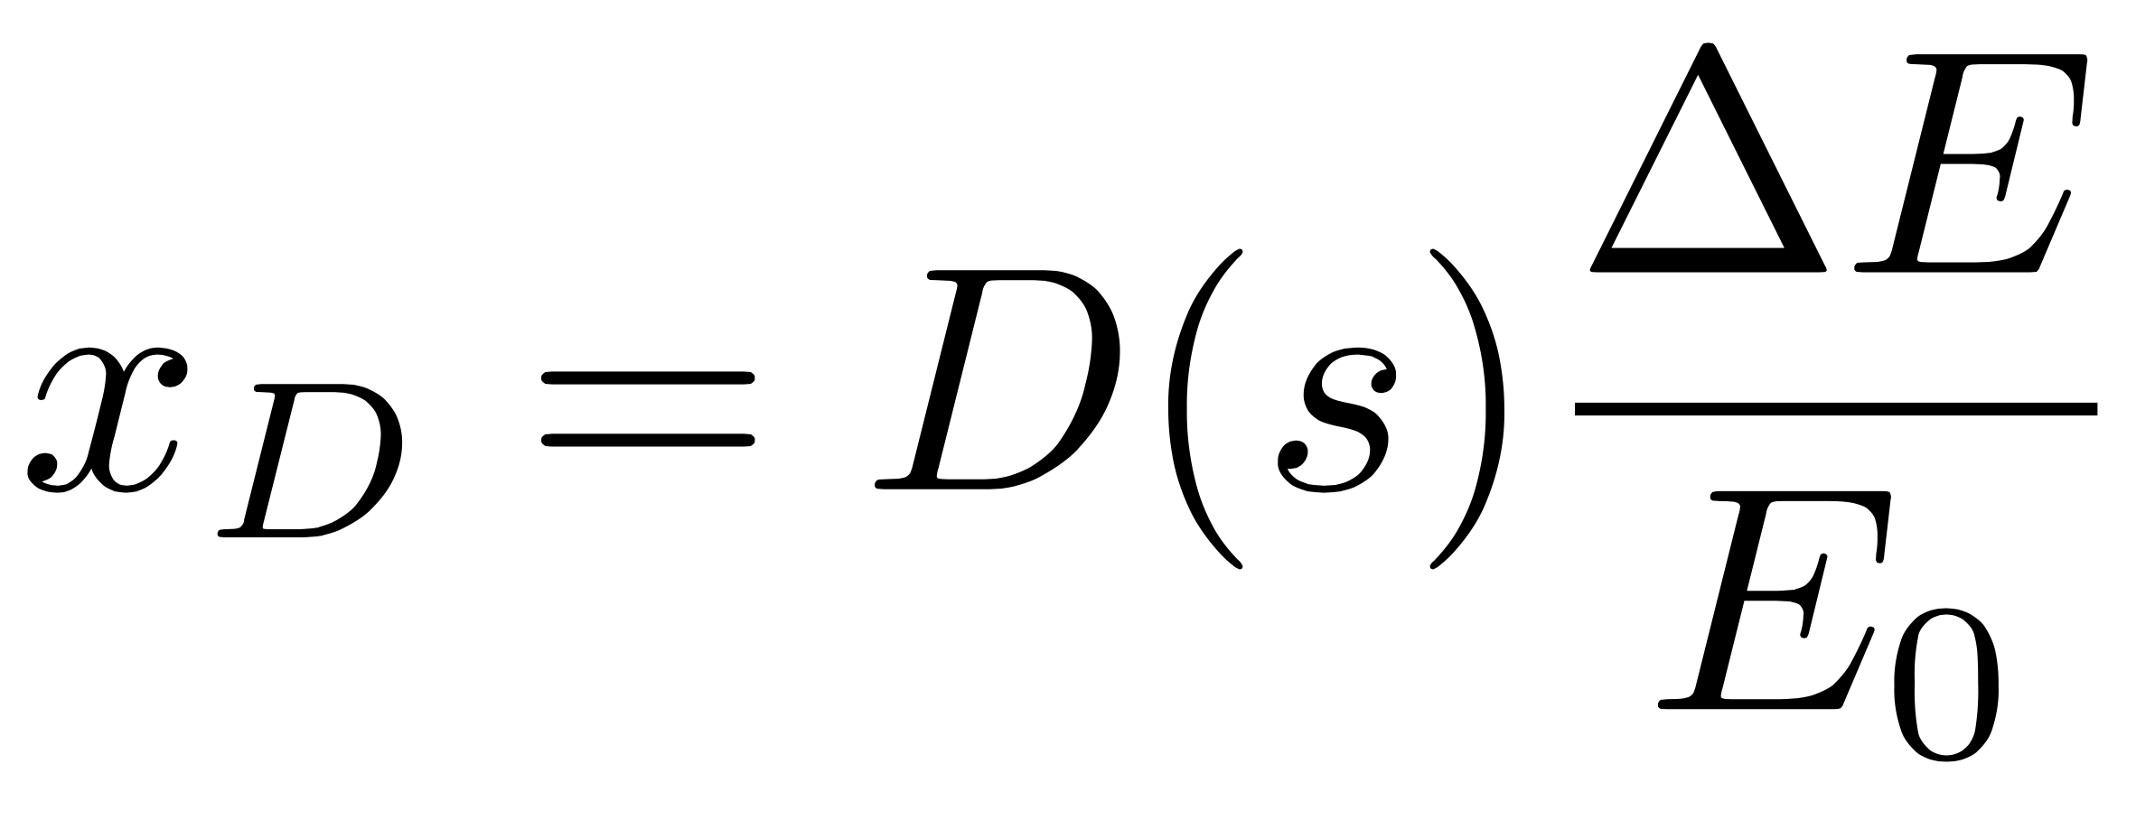
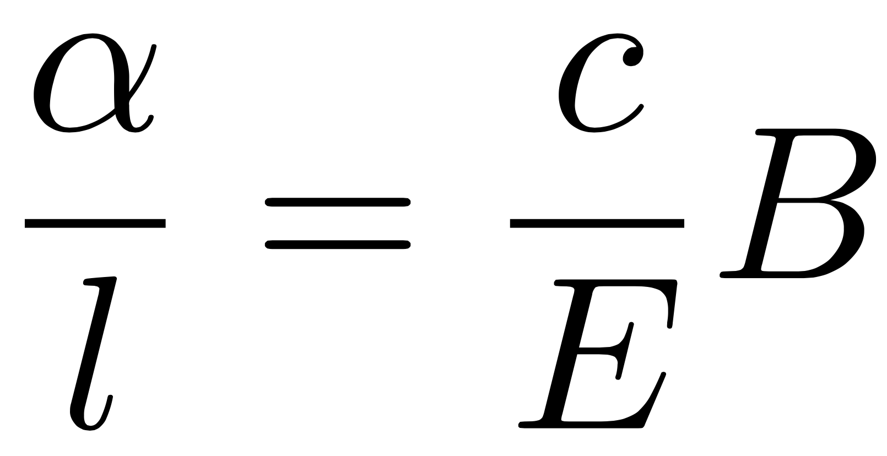
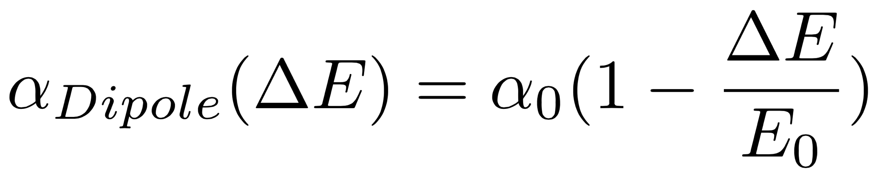
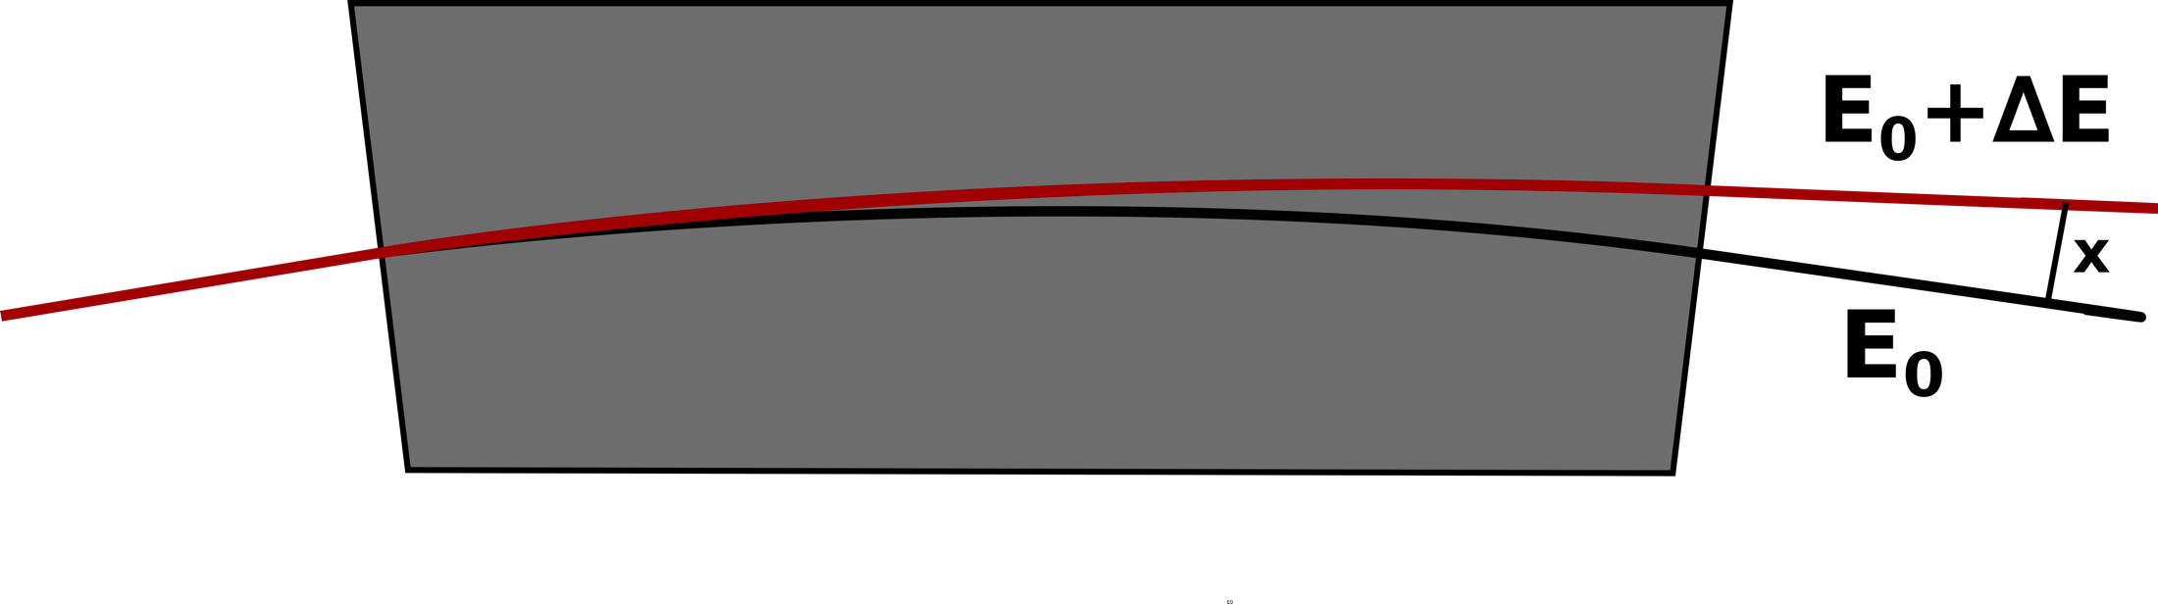
Energy Dependent Bending Angle

Slide 4
Energy Dependent Bending Angle
Normally the sawtooth-effect would just be accepted, but in FCC-ee, the sawtooth orbit is in the mm-range ➔ feeddown-effect of sextupoles and quadrupoles creates additional magnetic fields that distort the optics

Slide 5
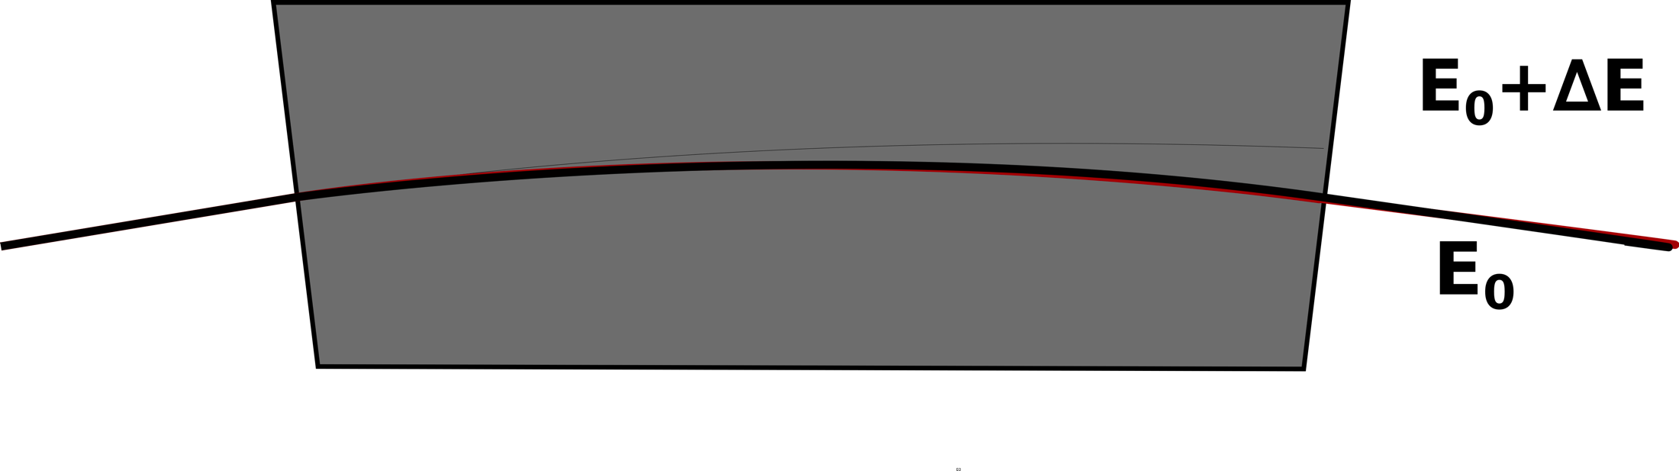
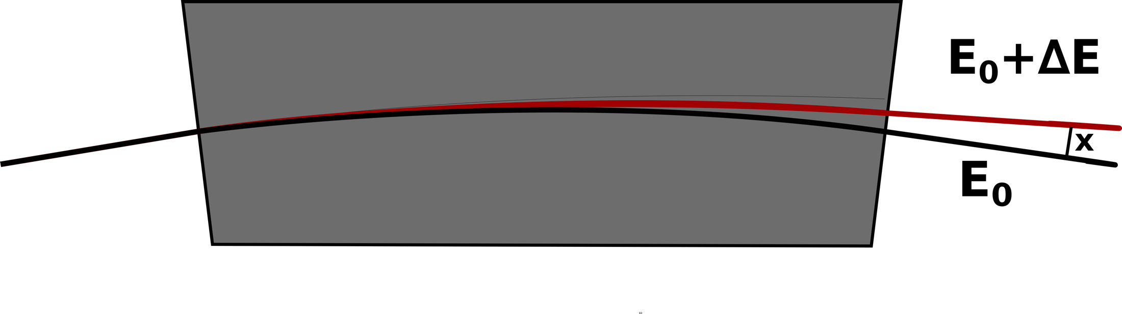
What is Tapering?
Tapering: Adjusting the strength of each magnet so that the beam with local energy of E₀+∆E is on the design orbit
Of course tapering every magnet in the ring is both expensive and difficult to maintain ➔ just dipole tapering and remachting the optics using dispersion suppressors and matching sections
Notes:
Rematch the quads in the dispersion and matching sections to get rid of the optics distortions, reasonable beta beat

Slide 6
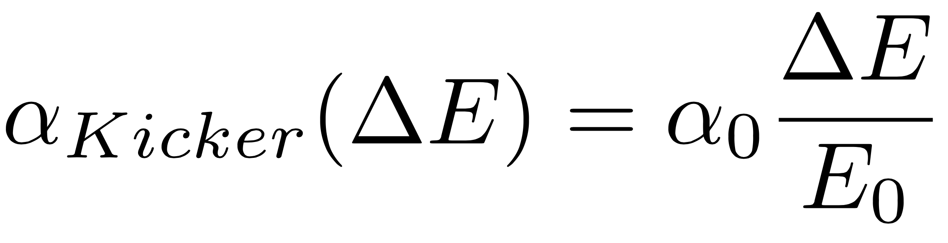
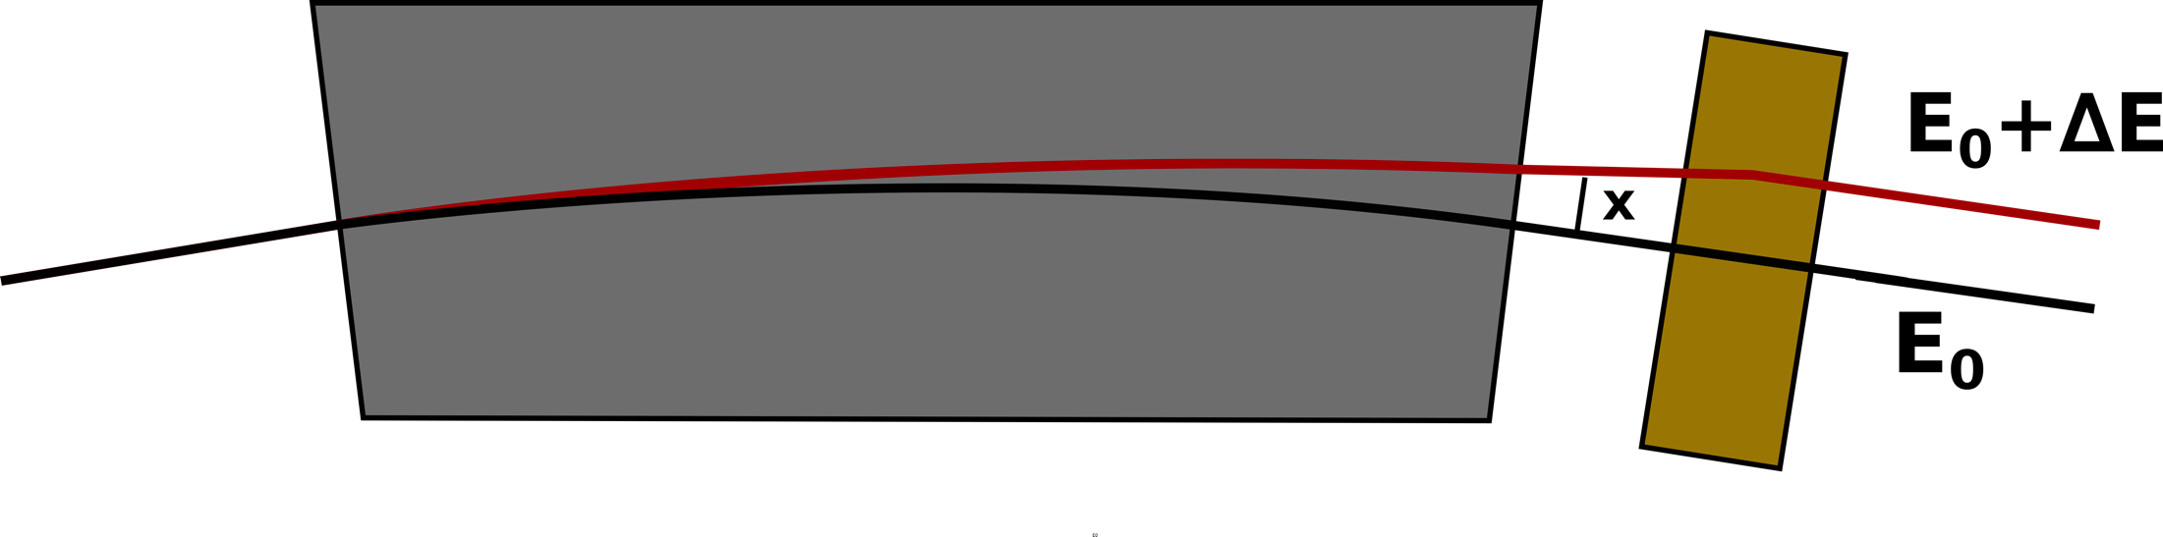
Analytical Tapering

Slide 7
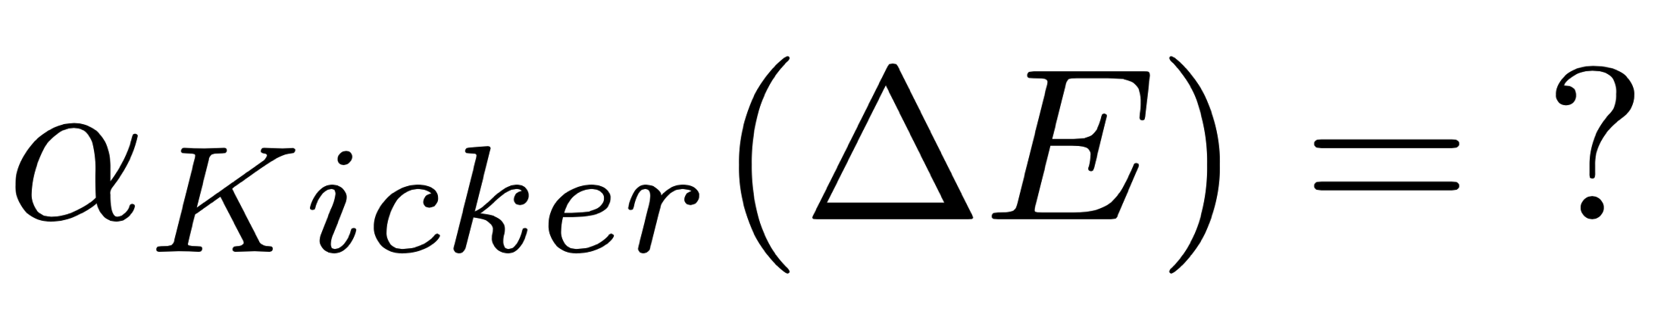
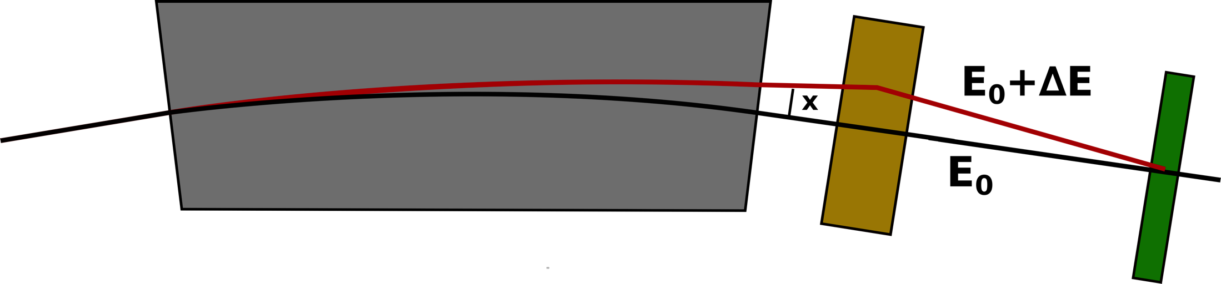
Numerical Tapering
Kicker don’t just compensate the energy dependent dipole bending angles, but the orbit is optimized numerically
Kicker strength α_{Kicker} calculated using orbit correction in MAD-X
BPM

Slide 8
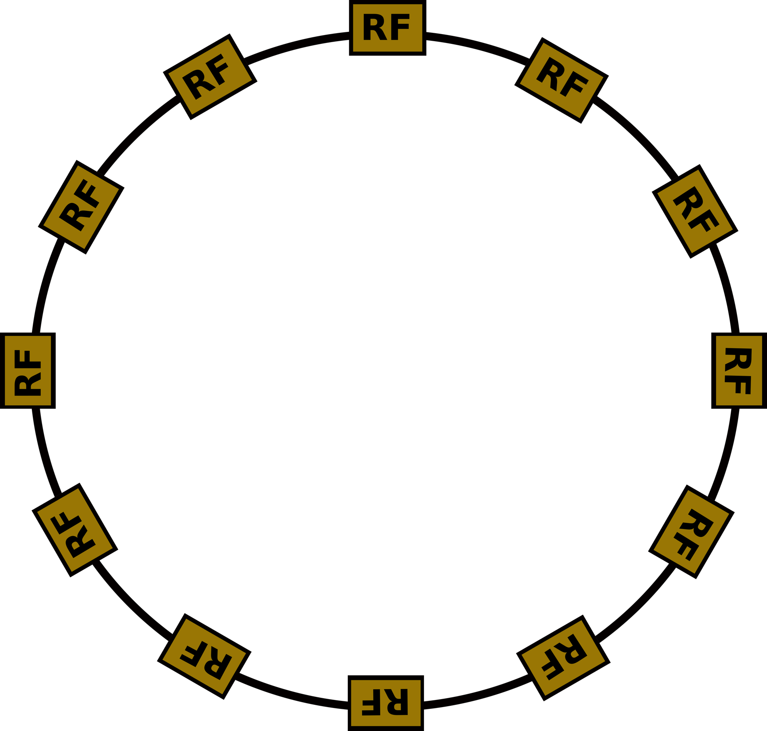
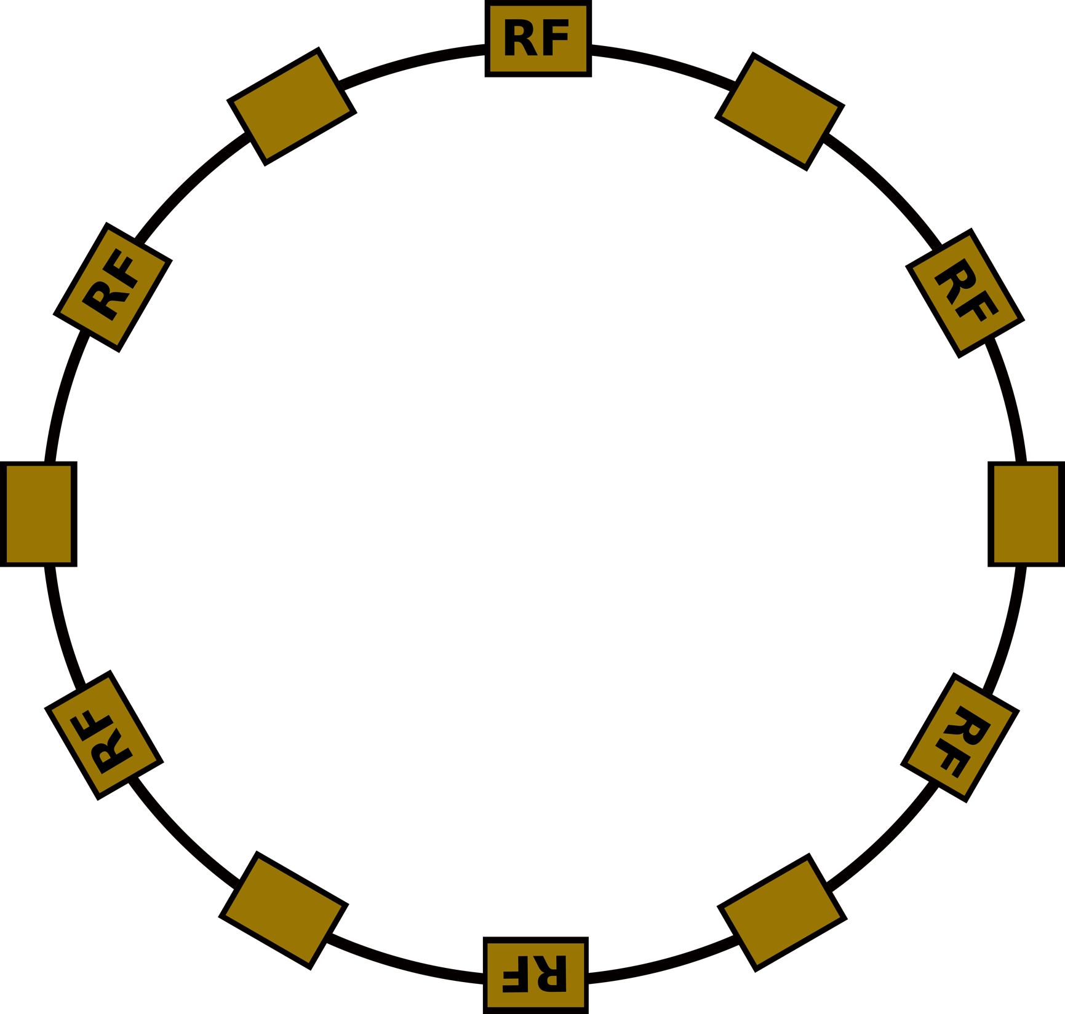
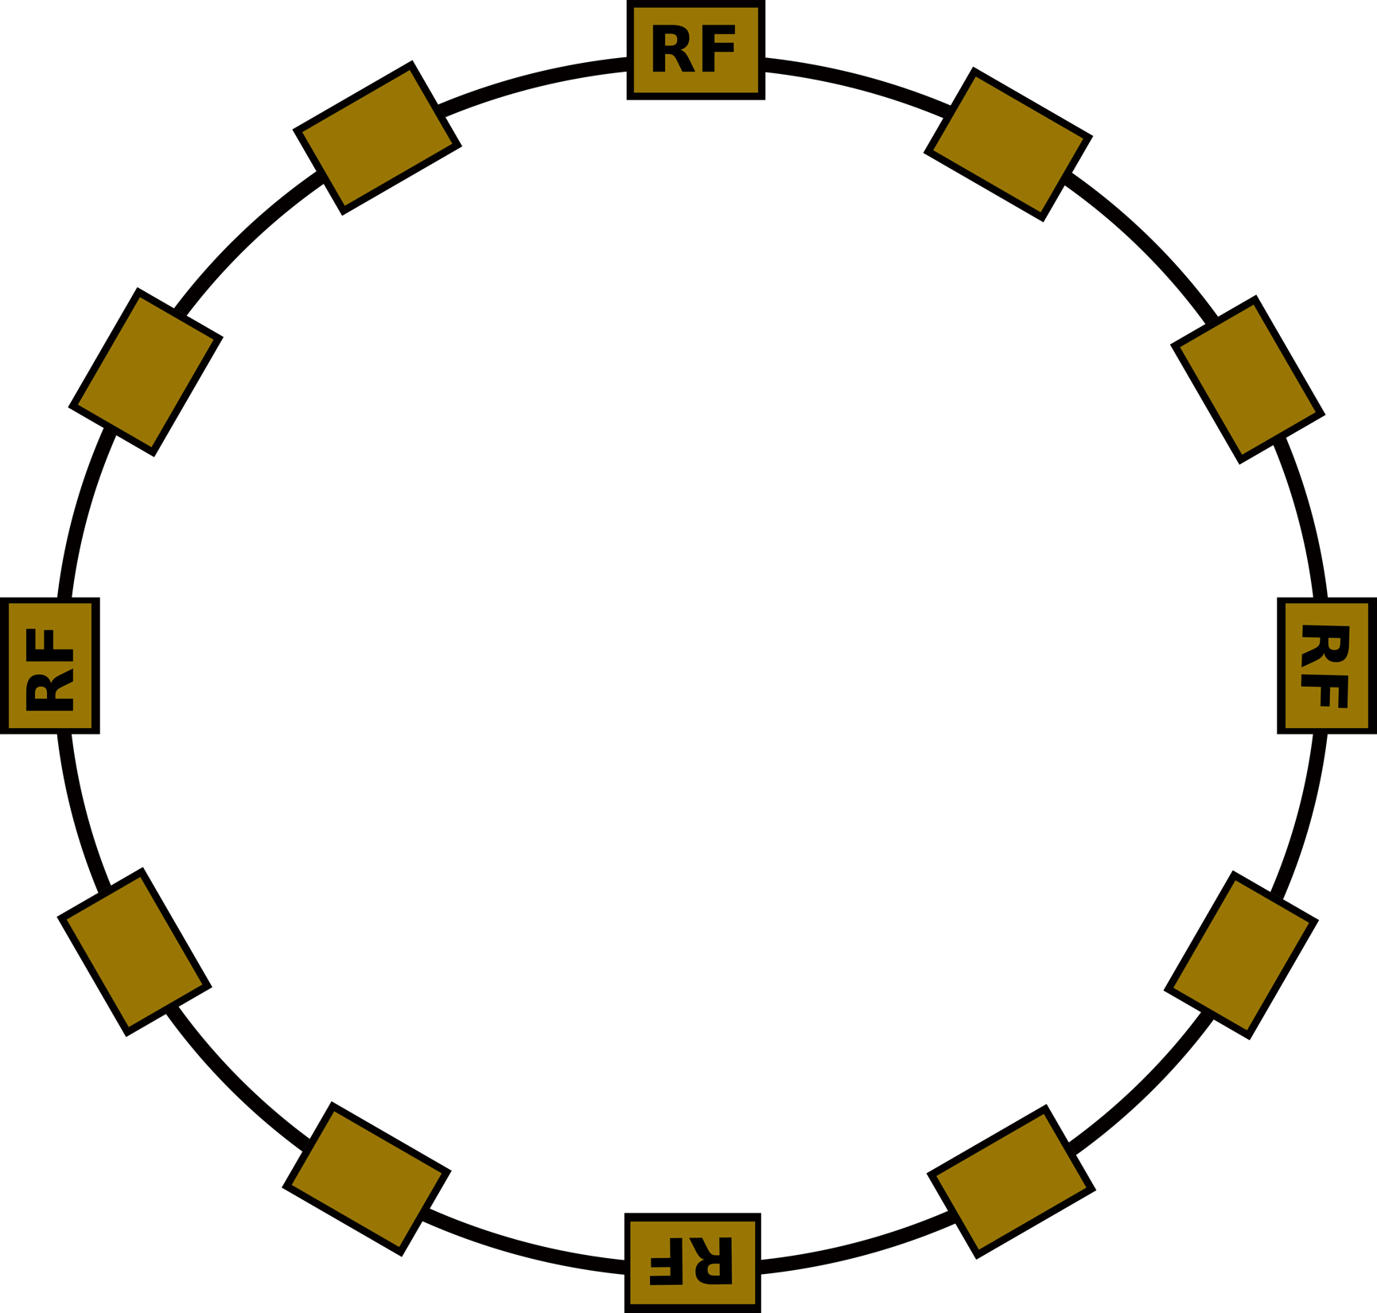
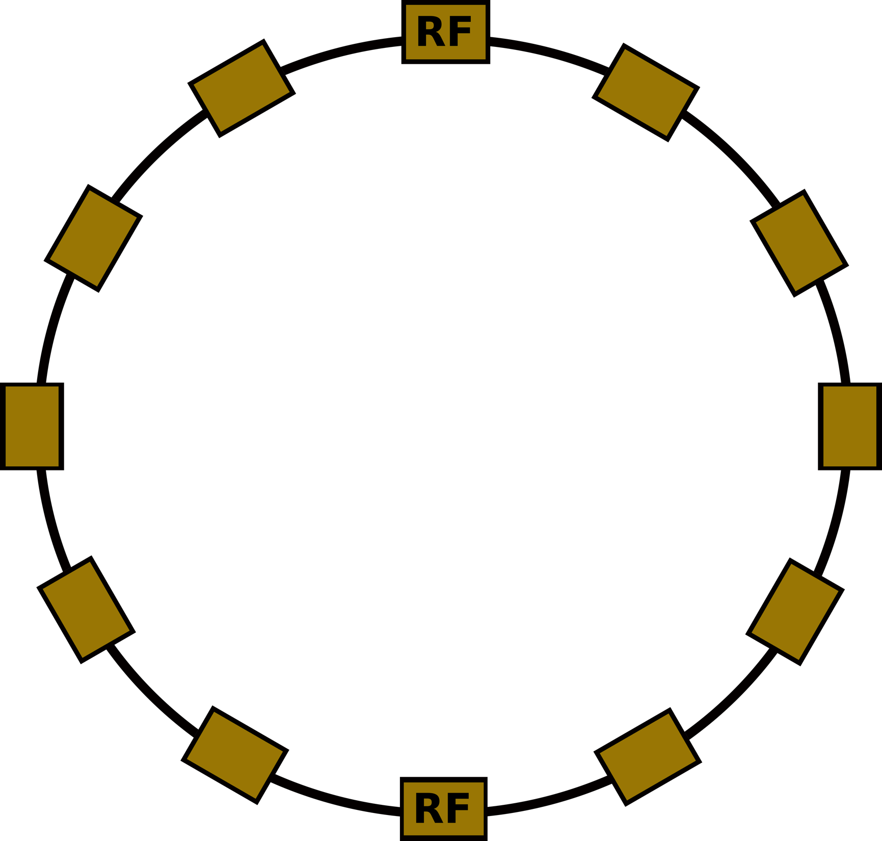
The Lattices
FCC-ee 12-fold
Circumference: 100 km
Energy: 175 GeV
Energy Loss/Turn ≈ 8046 MeV
12 RF Sections (L= 1.8 km)
12 Arcs (L= 6.8 km)

Slide 9
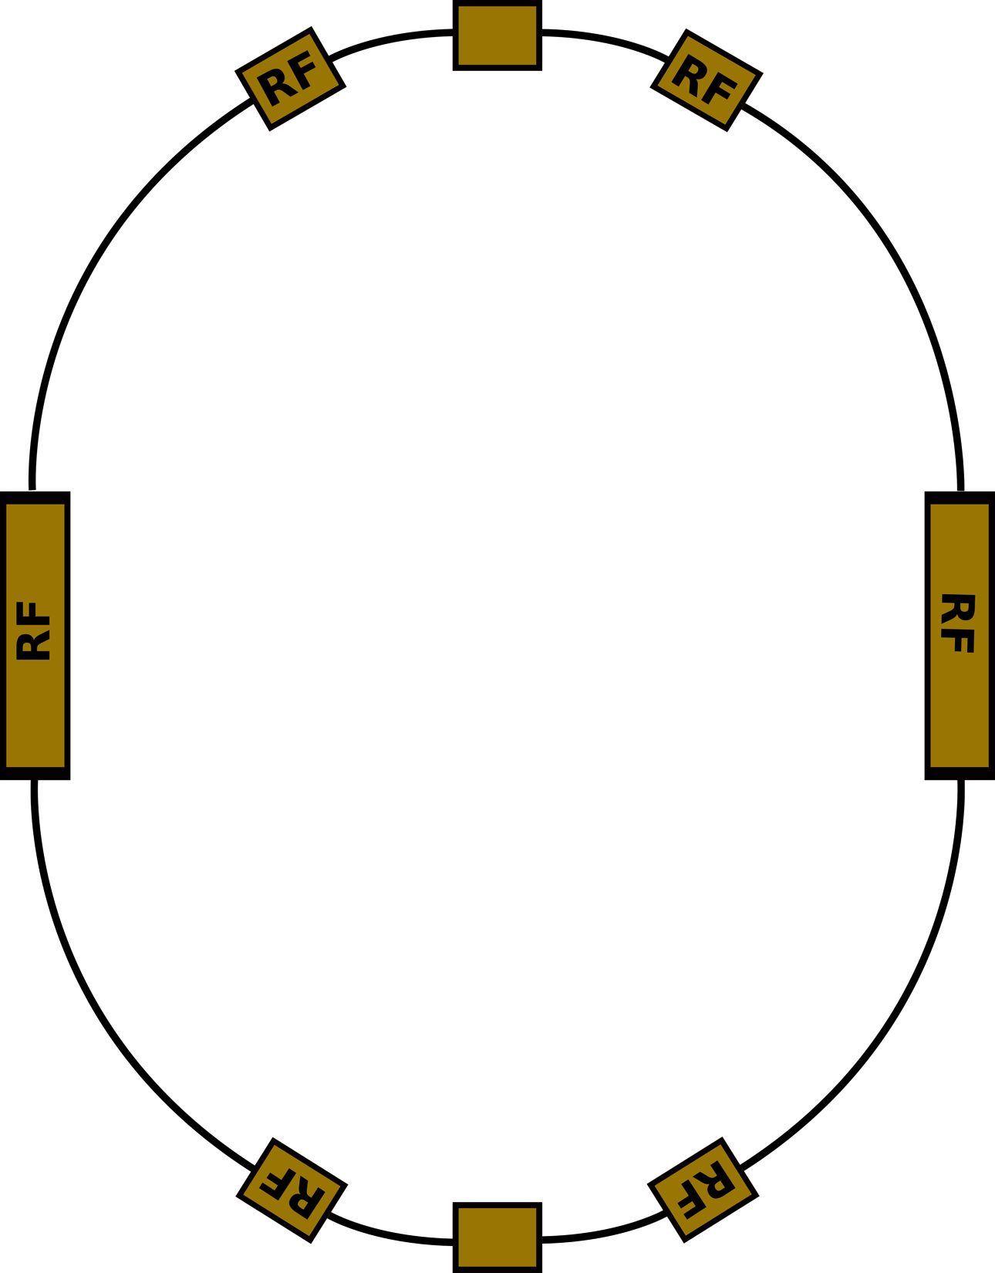
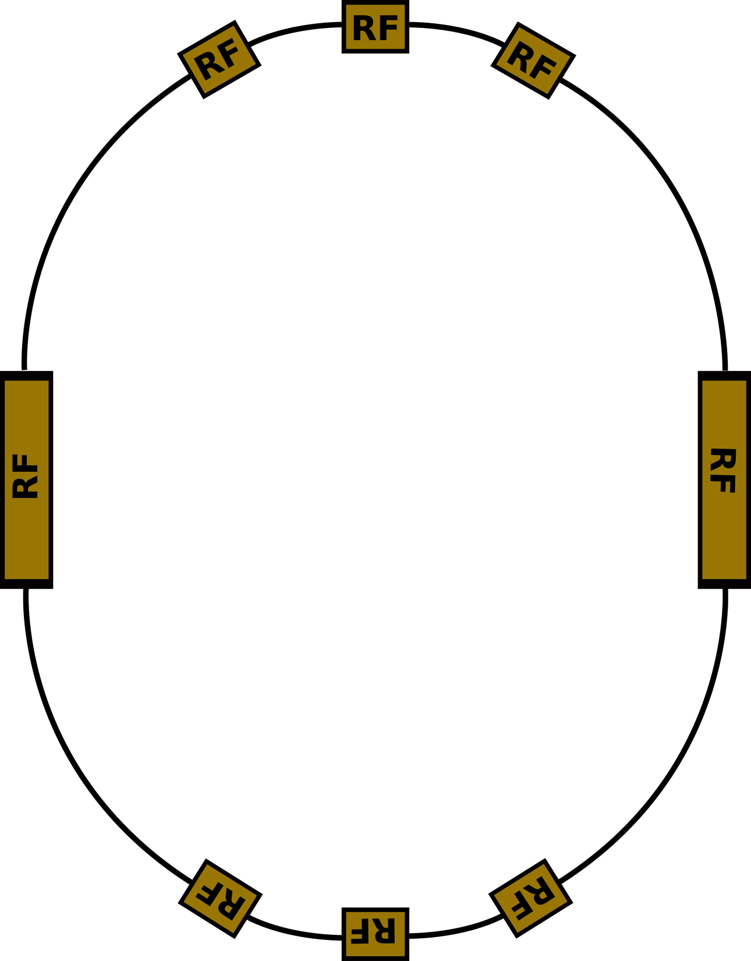
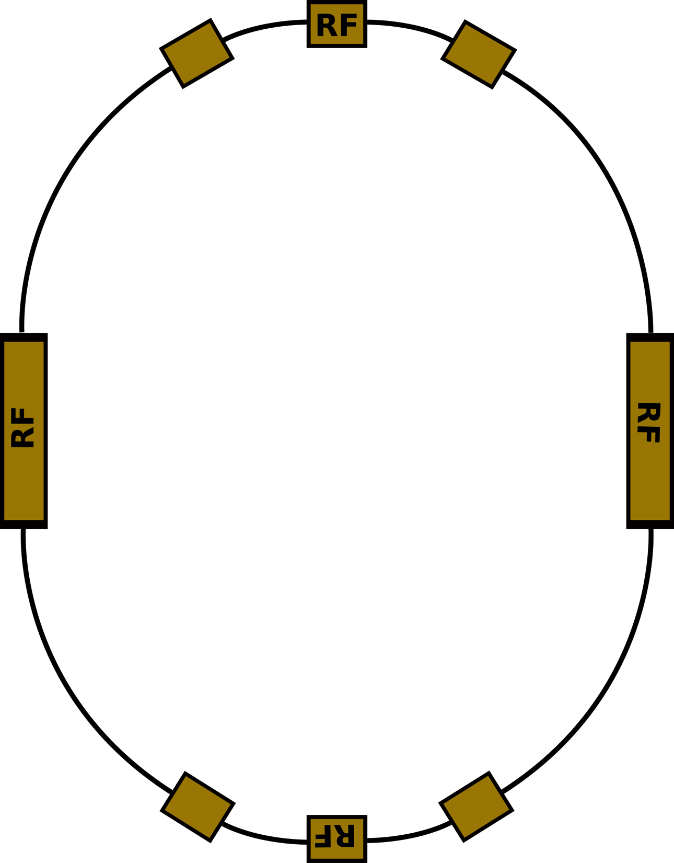
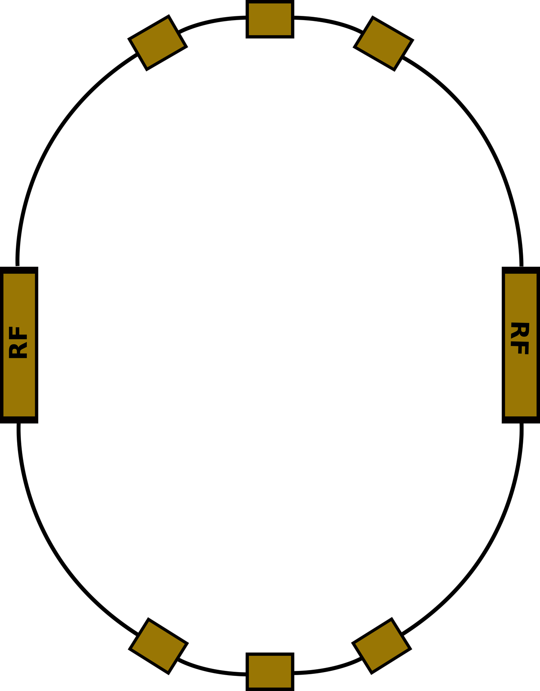
The Lattices
FCC-ee Racetrack
Circumference: 100 km
Energy: 175 GeV
Energy Loss/Turn ≈ 7870 MeV
4 Short Arcs (L= 4,4 km)
4 Long Arcs (L= 16,4 km)
6 Short RF Sections (L= 1,4 km)
2 RF Section (L= 4,2 km)

Slide 10
The Lattices
FODO-design
Cell Length: 50 m
ε_{x} ≈ 1 nm*rad

Slide 11
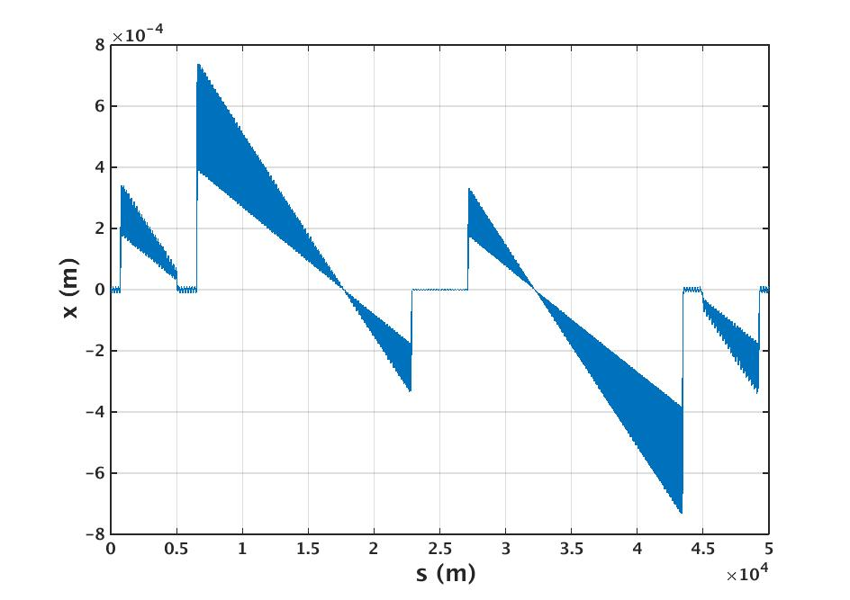
Racetrack Lattice, 8 RF Sections

Slide 12
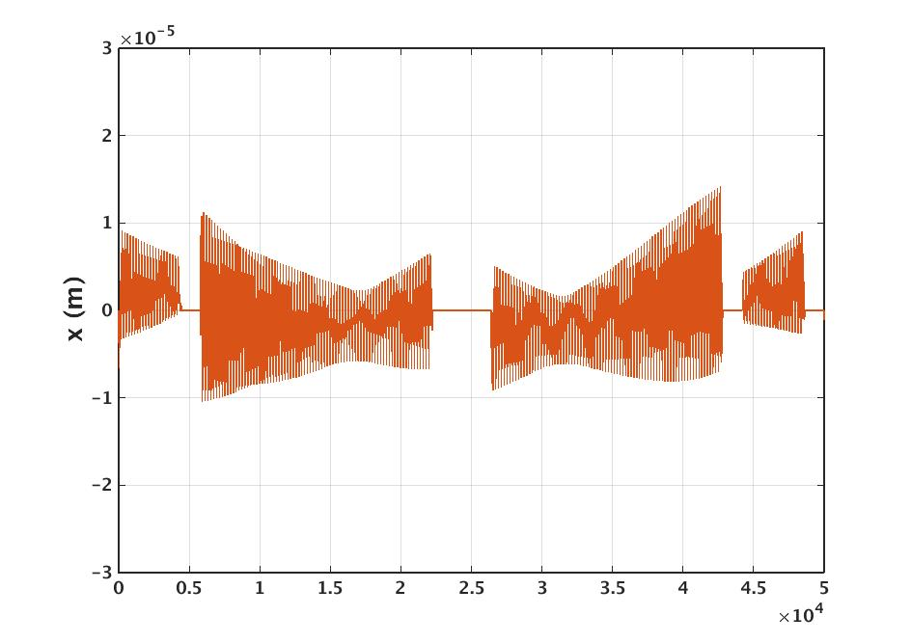
Racetrack Lattice, 8 RF Sections
sextupoles off
no IPs
kicker length: 0.0 m
β_{x}-Beat: 1%
β_{y}-Beat: 1,5%
D_{x}-Beat: 4%
analytical Tapering

Slide 13
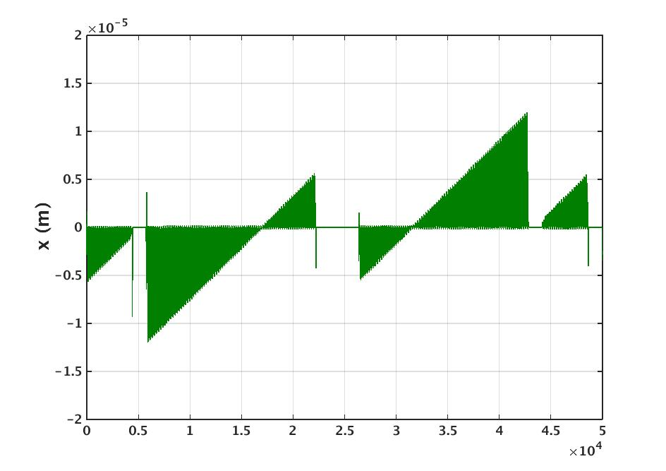
Racetrack Lattice, 8 RF Sections
sextupoles off
no IPs
kicker length: 0.0 m
β_{x}-Beat: 2%
β_{y}-Beat: 2%
D_{x}-Beat: 5%
numerical Tapering

Slide 14
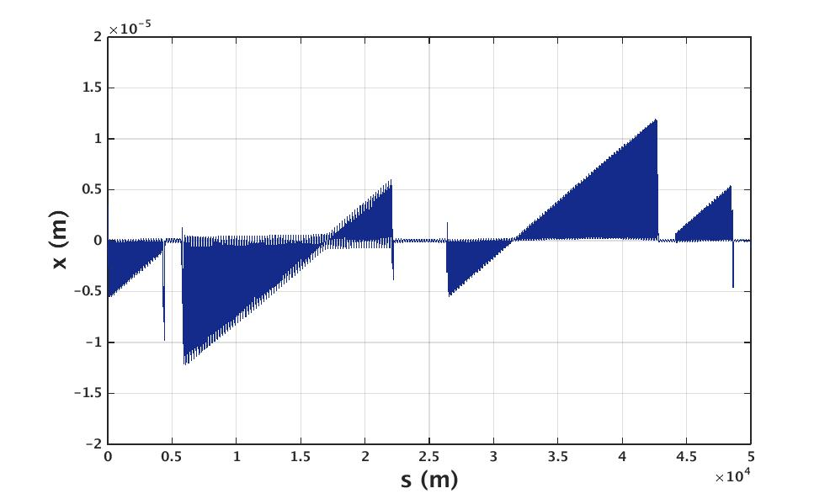
Racetrack Lattice, 8 RF Sections
sextupoles on
2 IPs
kicker length: 0.2 m
β_{x}-Beat: 6%
β_{y}-Beat: 12%
D_{x}-Beat: 5%
analytical Tapering
numerical Tapering
numerical Tapering

Slide 15

Racetrack Lattice, 8 RF Sections
➔ tapered orbit ≈ factor 70 smaller

Slide 16
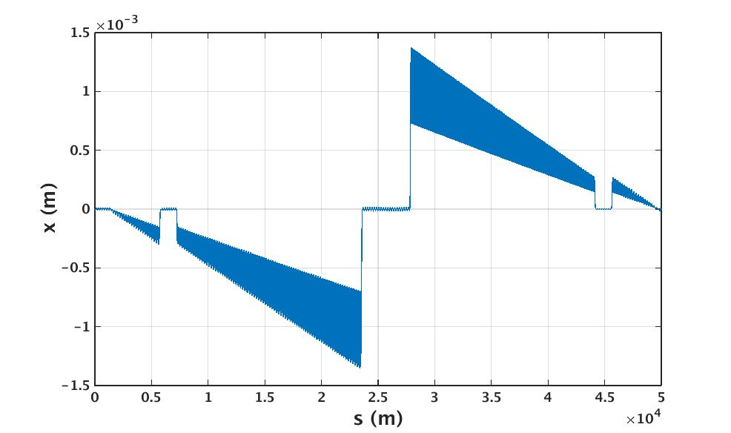
Racetrack Lattice, 2 RF Sections

Slide 17
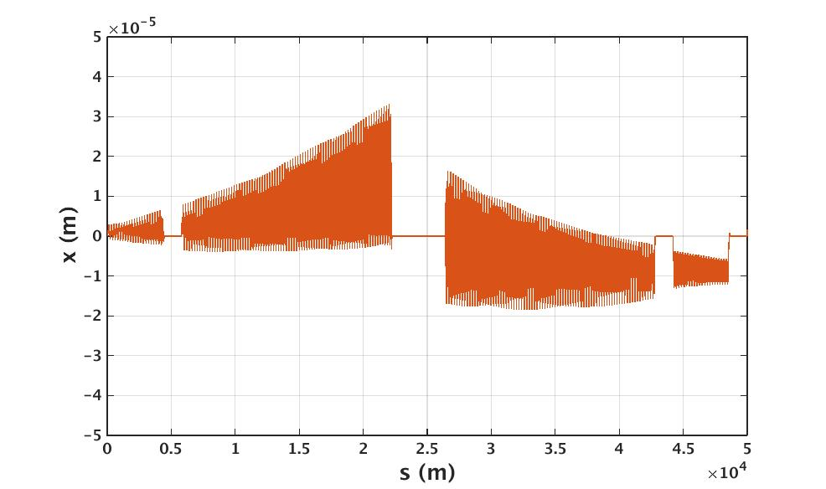
Racetrack Lattice, 2 RF Sections
sextupoles off
no IPs
kicker length: 0.0 m
β_{x}-Beat: 3%
β_{y}-Beat: 5%
D_{x}-Beat: 5%
analytical Tapering

Slide 18
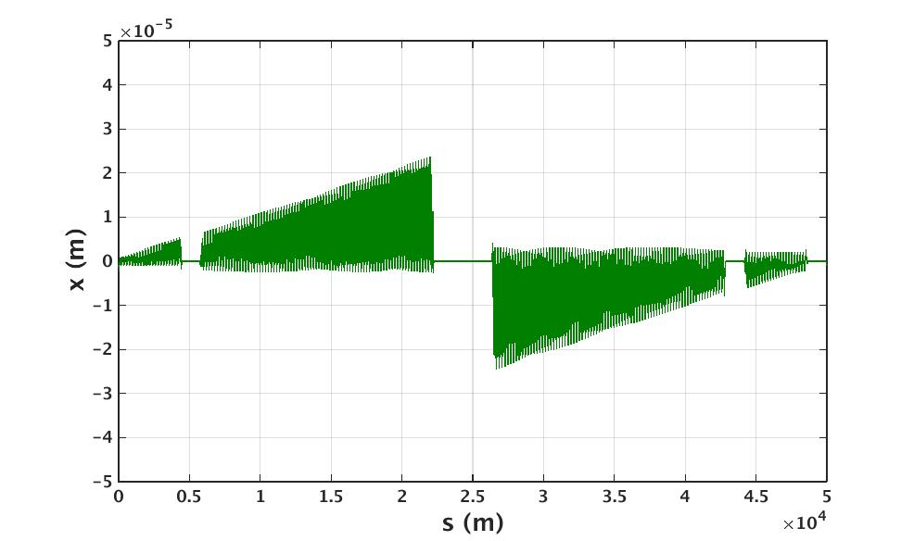
Racetrack Lattice, 2 RF Sections
sextupoles off
no IPs
kicker length: 0.0 m
β_{x}-Beat: 5%
β_{y}-Beat: 6%
D_{x}-Beat: 6%
numerical Tapering

Slide 19
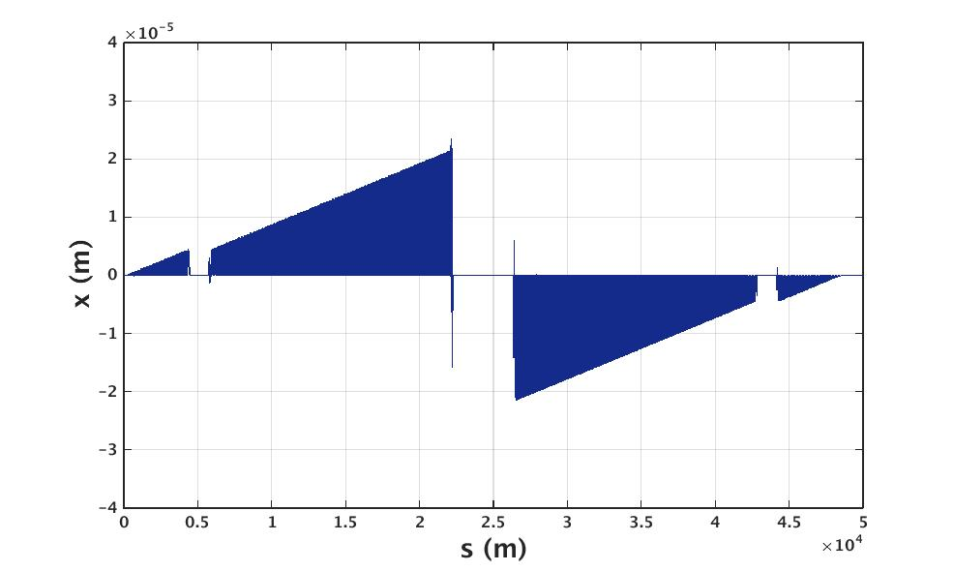
Racetrack Lattice, 2 RF Sections
sextupoles on
2 IPs
kicker length: 0.2 m
β_{x}-Beat: 9%
β_{y}-Beat: 14%
D_{x}-Beat: 2%
numerical Tapering

Slide 20

Racetrack Lattice, 2 RF Sections

Slide 21
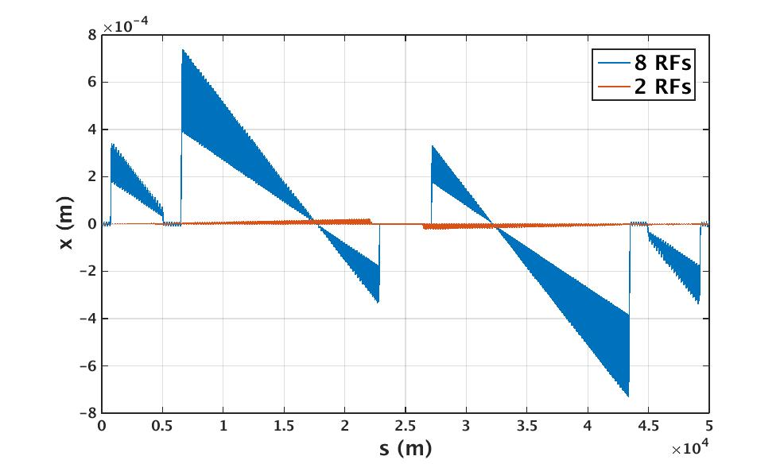
8 vs. 2 RF sections
➔ tapered orbit with 2 RF sections still ≈ factor 40 smaller than untapered orbit with 8 RF sections

Slide 22
Kicker Strengths & Emittances
Magnet: | B*l (Tm):
Arc Dipole | 5.56*10⁻¹
Kicker (175 GeV, 8RFs) | 7.82*10⁻⁴
Kicker (175 GeV, 2RFs) | 6.42*10⁻³
e.g.: for a kicker length of 0.2m, B_{kick} ≈ 0.07*B_{dipole} for 8 RFs ➔
B_{kick} ≈ 0.57*B_{dipole} for 2 RFs ➔
U_{0, Kick} ≈ 400 keV
U_{0, Kick} ≈ 26 MeV
Lattice: | ε_{x} before tapering (nm*rad): | ε_{x} after tapering (nm*rad):
8 RFs | 0.9263 | 0.9512
2 RFs | 0.9269 | 0.9728

Slide 23
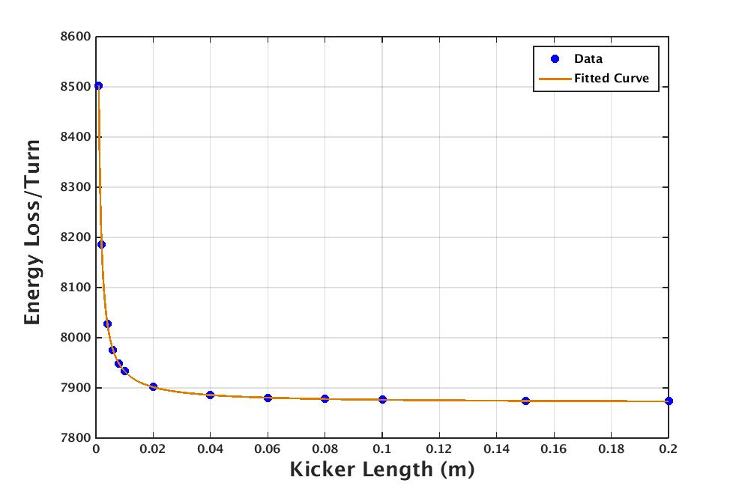
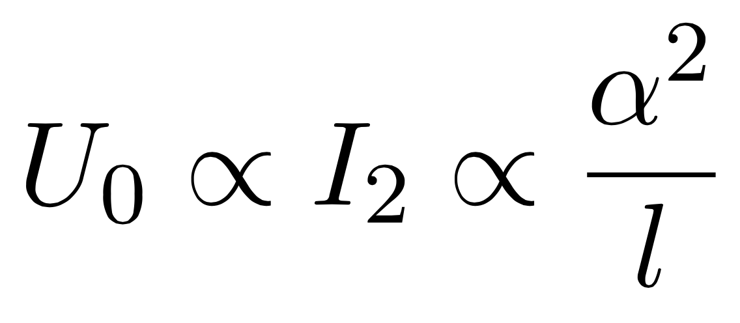
Correction Kickers in MAD-X
Are correction kickers suited for tapering studies in MAD-X?
in agreement with calculations:
fitted curve

Slide 24
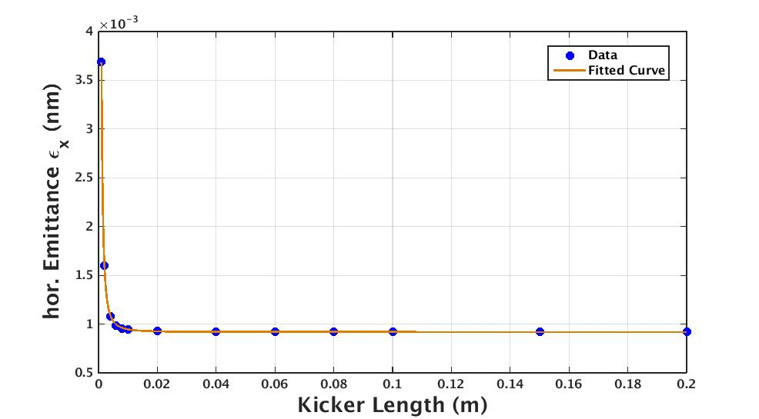
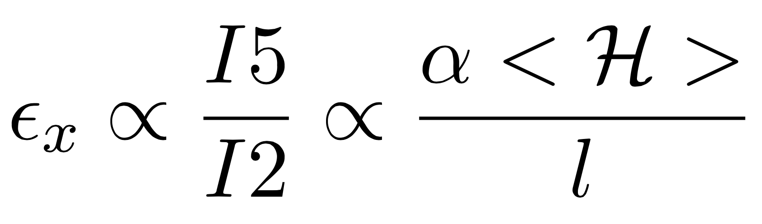
Correction Kickers in MAD-X
Are correction kickers suited for tapering studies in MAD-X?
fitted curve
?

Slide 25
Summary & Conclusions
Several Tapering Methods possible
Orbit improvement through dipole tapering with kickers: ≈ Factor 50-80 (depending on method, lattice, number of RFs,...)
Integrated strengths of the tapering kickers are ≤ 1% of the integrated strengths of the arc dipoles
Emittances are nearly unaffected by the tapering process
Next Steps: Checking the effects of the kicker magnets on orbit tolerances, using orbit correction kickers (already in the ring) for tapering

Slide 26
Thank you for your attention!

