Slide 1
Processing of SPL cavities to obtain design performance
Introduction
Sergio Calatroni

Slide 2
Tasks
Main goal of the SPL Collaboration Meeting:
  « To propose how to demonstrate 25 MV/m (β = 1) and 19 MV/m (β= 0.65) before mid-2011 »
Goals within this Working Group - Subtask:
  (β = 0.92 or β = 1?)
  Define strategy to reach full performance (25 MV/m for
  β = 1 cavities) for a fully equipped prototype cryomodule
  Identify required equipment (e.g. electro-polishing, HPWR) and what is missing

Slide 3
EUCARD WP 10.2 (from Dieter Proch)
Cavities for Proton Linacs, Electropolishing and surface investigations
  Sub-task 1: Design and fabrication of β = 0.65 ; 704 MHz elliptical cavity equipped with a titanium helium reservoir. Preparation and assembly in clean room. Test of the cavity in vertical cryostat.
  Sub-task 2: Design and fabrication of β = 1 ; 704 MHz elliptical cavity. Preparation of the cavity and assembly in clean room. Development of a vertical EP bench.
  Sub-task 3: Study of interfaces between the cavity and the cryomodule.

Slide 4
Why EP?
SPL goal: 25 MV/m accelerating field for β =1
SPL goal: 19 MV/m accelerating field for β= 0.65
These values have been chosen because they are (and we want to achieve) state-of-the art performance.
Must be obtained reliably on fully equipped cryomodules
Statistically, only EP processed cavities can reach these goals (FE, quenches, etc.)
Cavity | Accelerating field [MV/m] | Peak surface electric field [MV/m] | Peak surface magnetic field [mT]
β=1 | 25 | 50 | 100
β=0.92 | 24.5 | 50 | 105
β=0.65 | 19 | 50 | 100

Slide 5
E_{p}=56.2 MV/m

Slide 6
B_{p}=120 mT

Slide 7
E_{p}=40.4MV/m
(BCP only)
E_{p}=46.7 MV/m

Slide 8
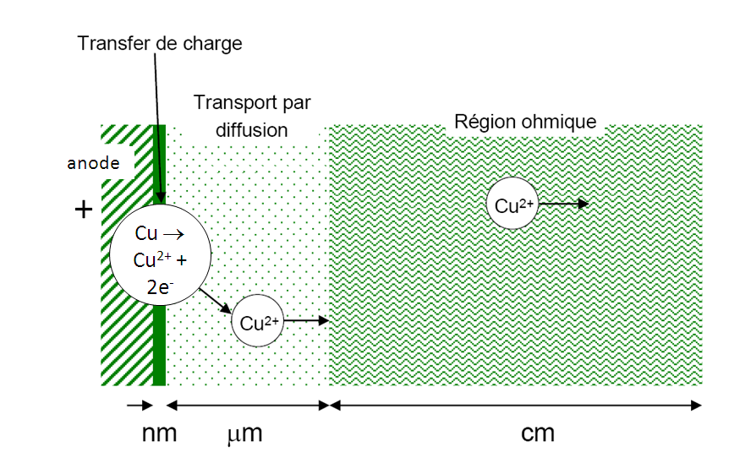
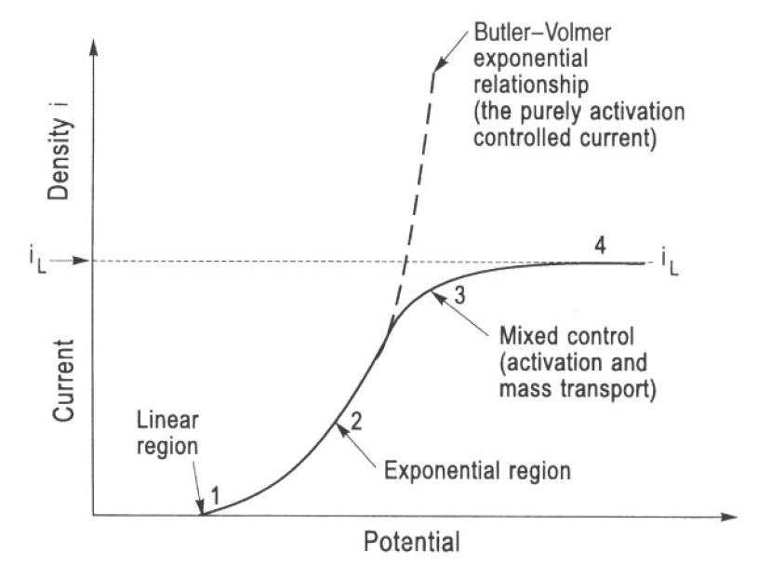
Electropolishing: diffusion layer
At the cathode, with no competing reaction:
Overpotential, in practice the voltage across the cell

Slide 9
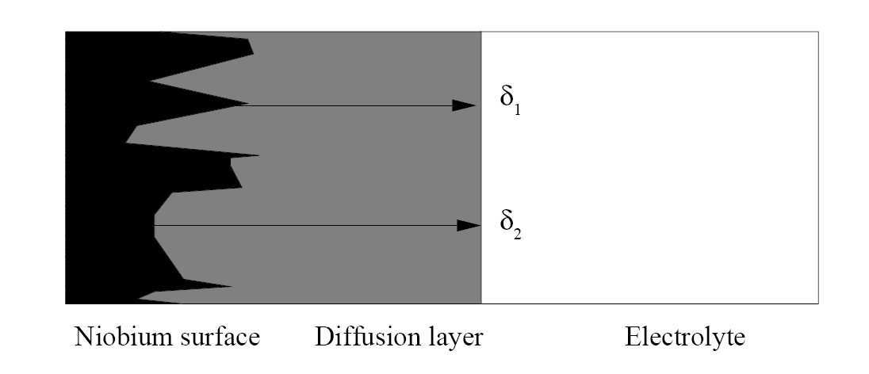
Polishing effect
From: Leonel Ferreira

Slide 10
Polarisation curves
Niobium
Copper
Polishing
Production of O₂ bubbles, electrolysis of H₂O
From: Leonel Ferreira

Slide 11
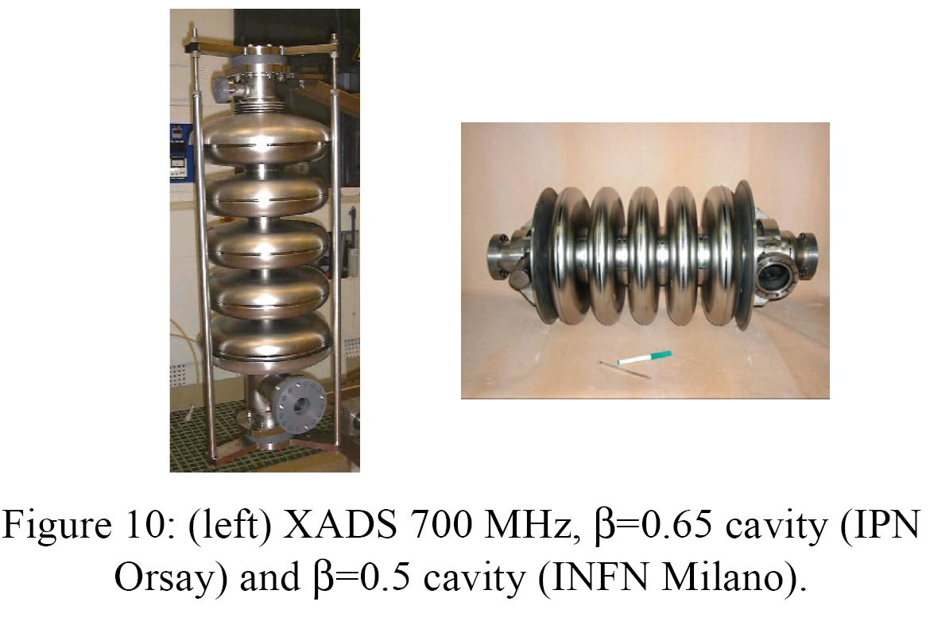
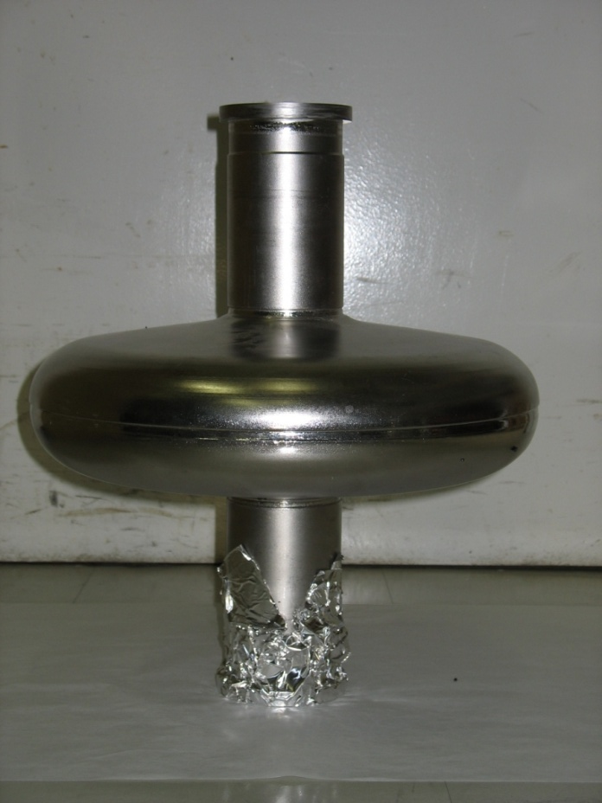
Low-β cavities
HIPPI 704 MHz β=0.5 cavity

Slide 12
EP difficulties
To uniformly distribute the potential all-over the cavity surface (in particular for β=0.65)
  Computer simulations of cathode shape
To cope with the mass transfer limitations
  Include simulations of flow. Circulation vs. stirring.
To cope with the heating generated by the process
  Cooling capacity must be adapted to keep the acid within the optimal temperature window
To handle potentially harmful acids in a safe way
  Vertical electropolishing simplifies assembly
Post-treatment not 100% understood
  Chemical etching vs. detergent cleaning.
...

Slide 13
Further needs for surface preparation
EP before cavity welding (cortical layer removal)
  Lab or industry?
Vacuum firing of niobium
  Lab or industry?
Final HPWR
  opportunity for nozzle optimisation?
“Mild” bakeout
  Almost certainly needed. Experience in low β cavities?
...

Slide 14
Goals and beyond
Fabrication, surface preparation and vertical test of one (or few) β=1 cavity: under control within EUCARD (CEA)
Fabrication, EP and vertical test of one β=0.65 cavity: under control within EUCARD (IN2P3), EP to be done either at CEA or CERN
Fabrication, surface preparation of the full complement of β=1 cavities for a cryomodule: options?
  Needs for resources
  Availability of industry for manufacture
  Needs for infrastructure in labs: surface preparation, assembly, vertical test, cryomodule assembly, horizontal test

Slide 16
WP10.2 Deliverables
10.2.1 | Results of SC proton cavity tests (b = 1 and b = 0.65) | R | M33
10.2.2 | Reproducibility of the process as a Function of the EP-Mixture | R | M36
10.2.3 | Summary of test results with vertical EP | R | M42
10.2.4 | Evaluation of enhanced field emission in Nb samples | R | M48

Slide 17
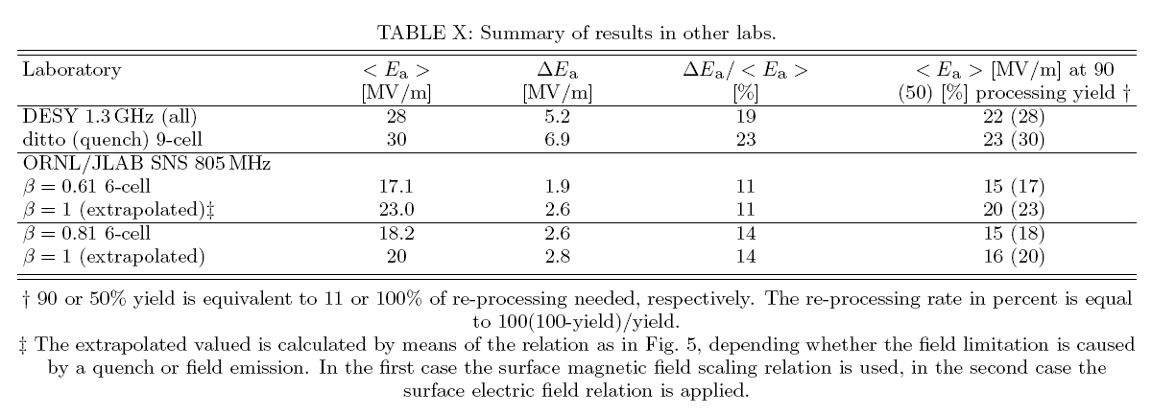
Relative comparison
From: Assessment of the basic Parameters of the CERN SPL - O. Brunner, S. Calatroni,
E. Ciapala, M. Eshraqi, R. Garoby, F. Gerigk, A. Lombardi, R. Losito, V. Parma, C. Rossi,
J. Tuckmantel, M. Vretenar, U. Wagner, W. Weingarten - CERN-AB-2008-067 BI/RF

Slide 18
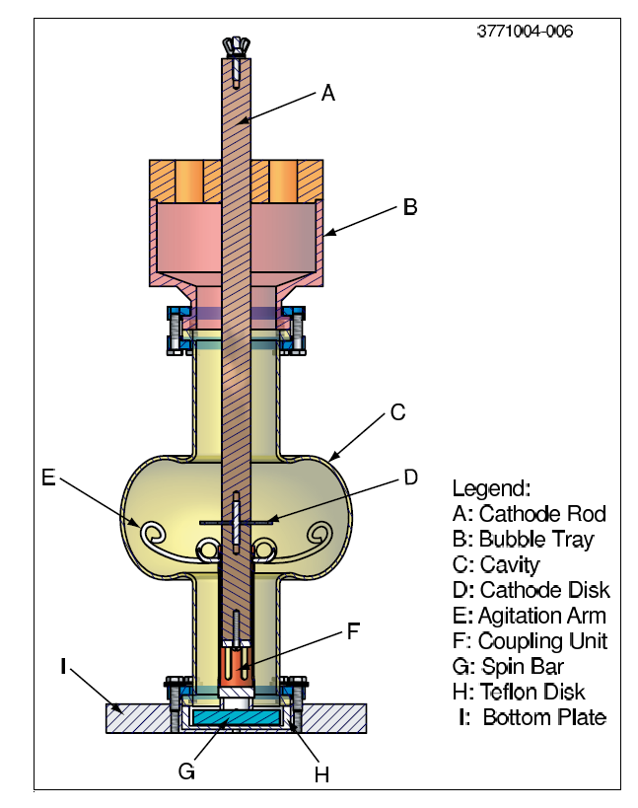
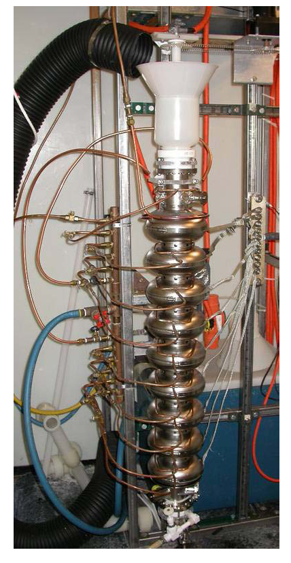
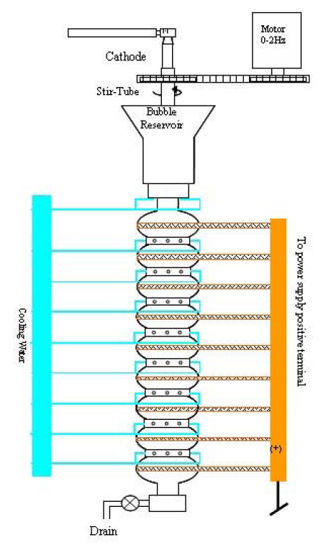
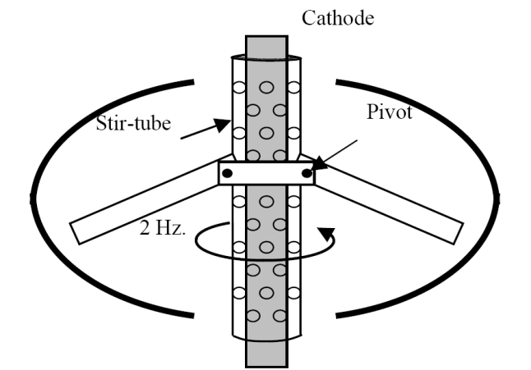
Vertical EP in Cornell
No forced circulation
Cooling by water spraying on the outside

Slide 19
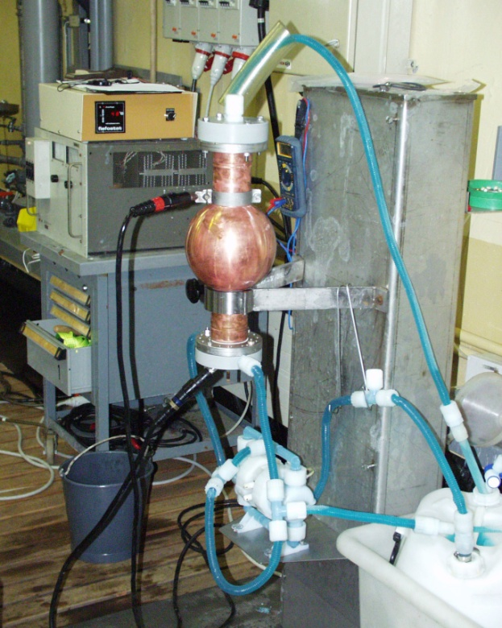
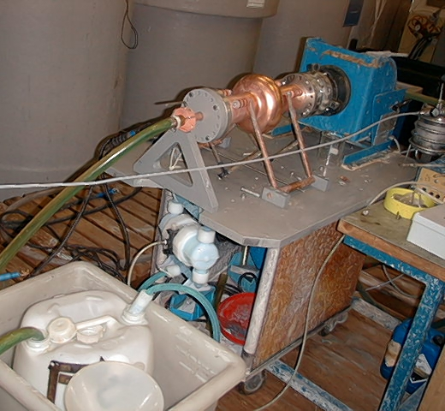
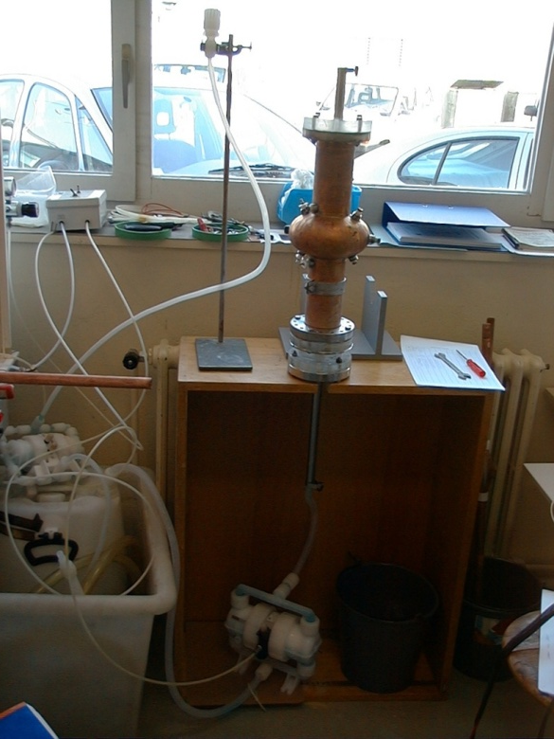
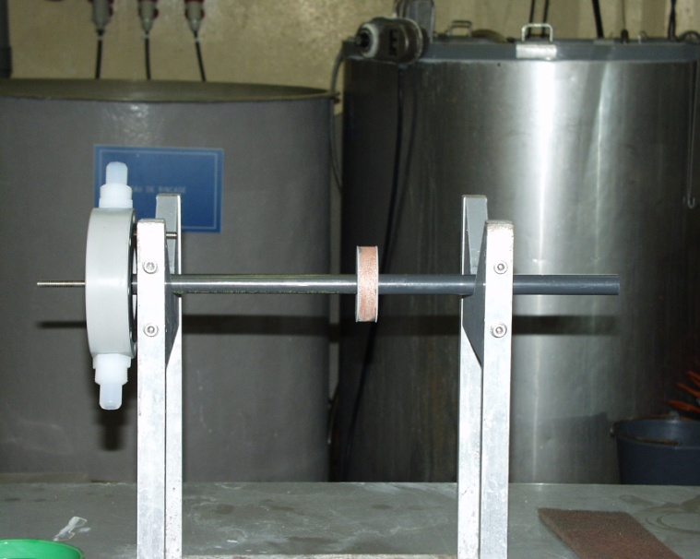
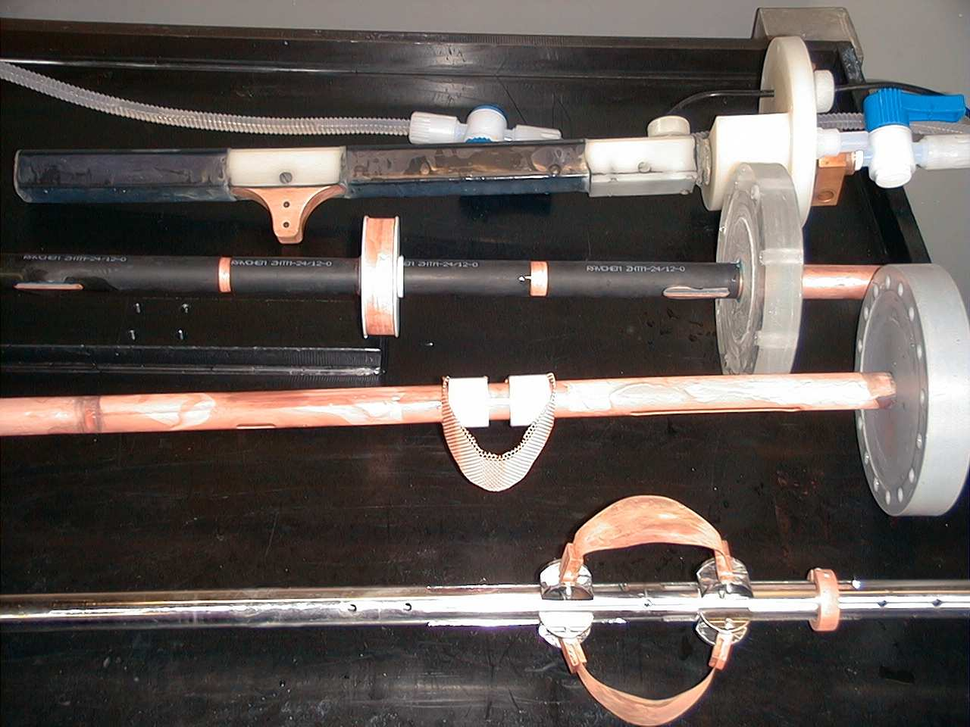
EP system for 1.5 GHz Cu cavities at CERN

