Slide 1
Quadrupoles for the SPL
THE REQUIREMENTS
DC operated
Cold (4.2 or 1.9 K)
Aperture 100 mm
Gradient 6 T/m
Magnetic length 450 mm : the same for all magnets ?
Supplied in series or individually ?
Requirements on the fringe field ?
Requirements on field harmonics ?
How many ?
Beam losses ?

Slide 2
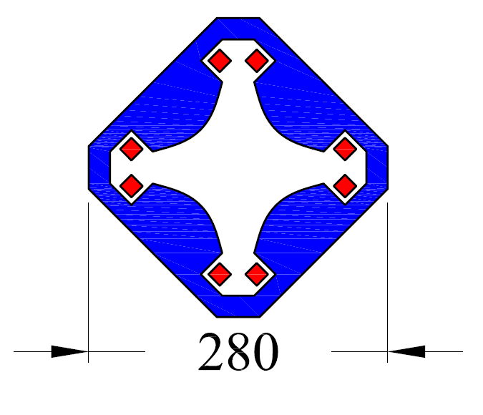
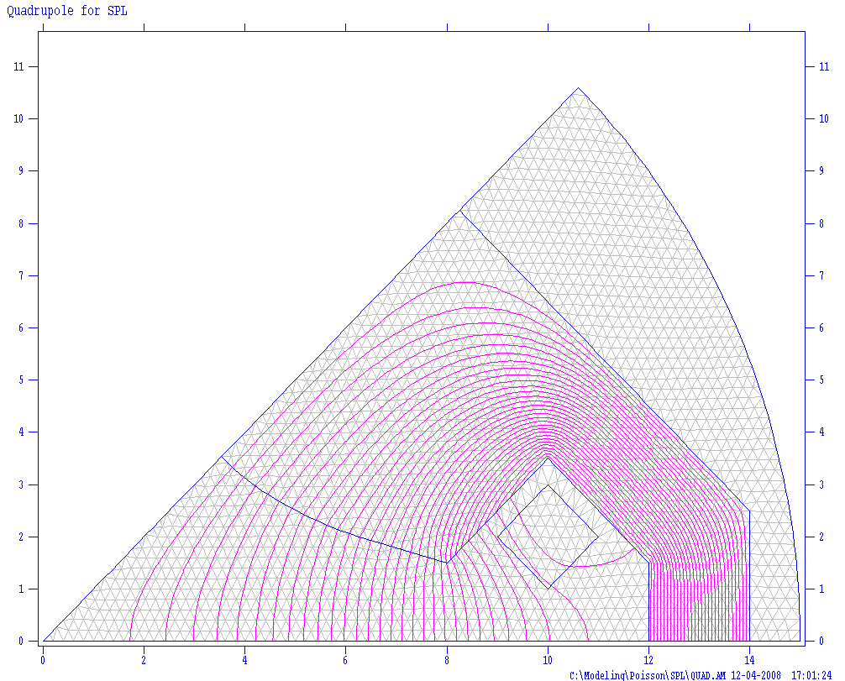
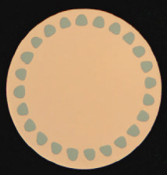
Iron Dominated Superconducting Quadrupole
High Cu/Sc (MRI)
NI=6000 A for G=6T/m in 2D
Cross-section by ONE SINGLE lamination !

Slide 3
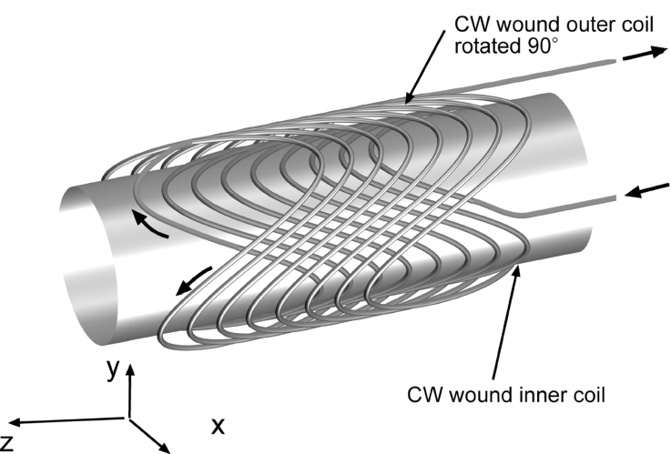
Current Dominated Double Helix Quadrupole

Slide 4
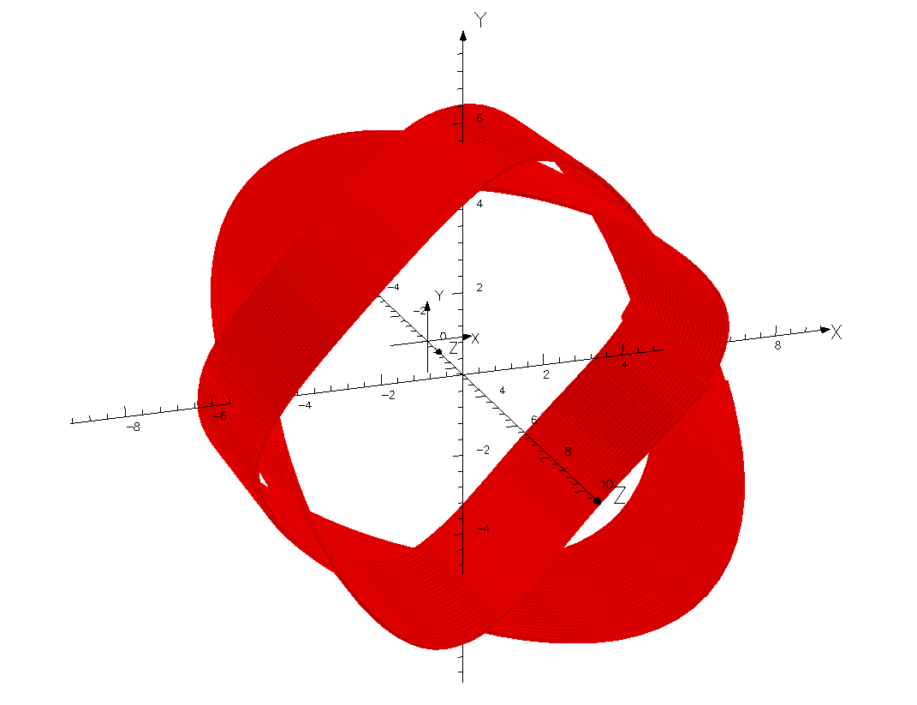
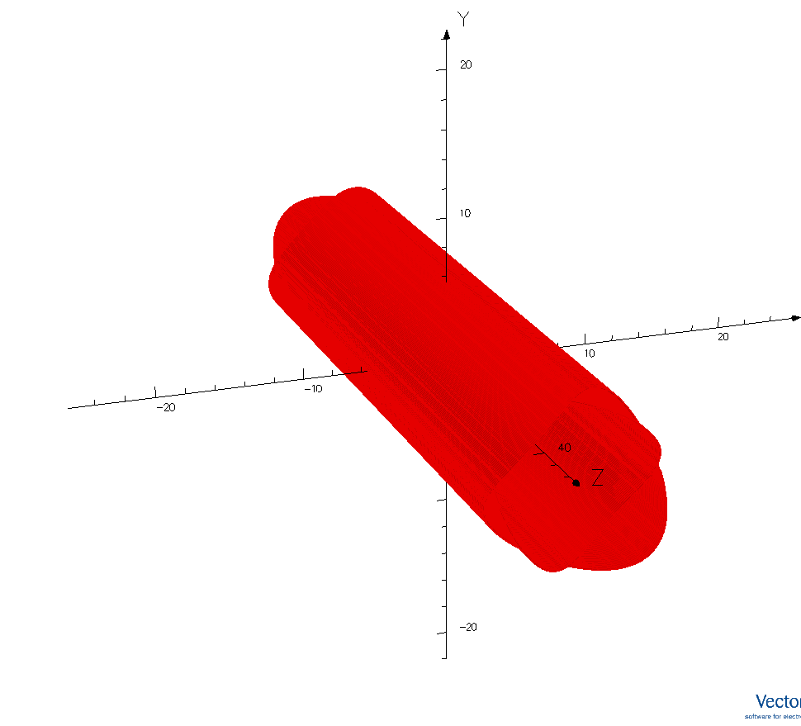
Current Dominated Double Helix Quadrupole
Design by Simona Bettoni & Eugenio Paoloni

Slide 5
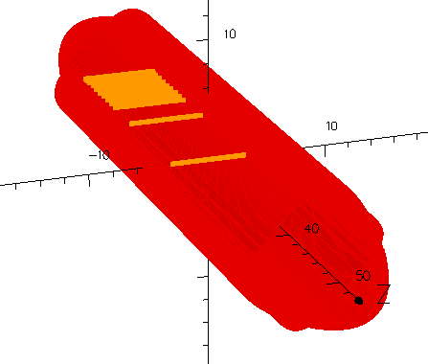
Field quality along the z axis
At the coil center (z = 22.5 cm, x_fit = ±3 cm)

Slide 6
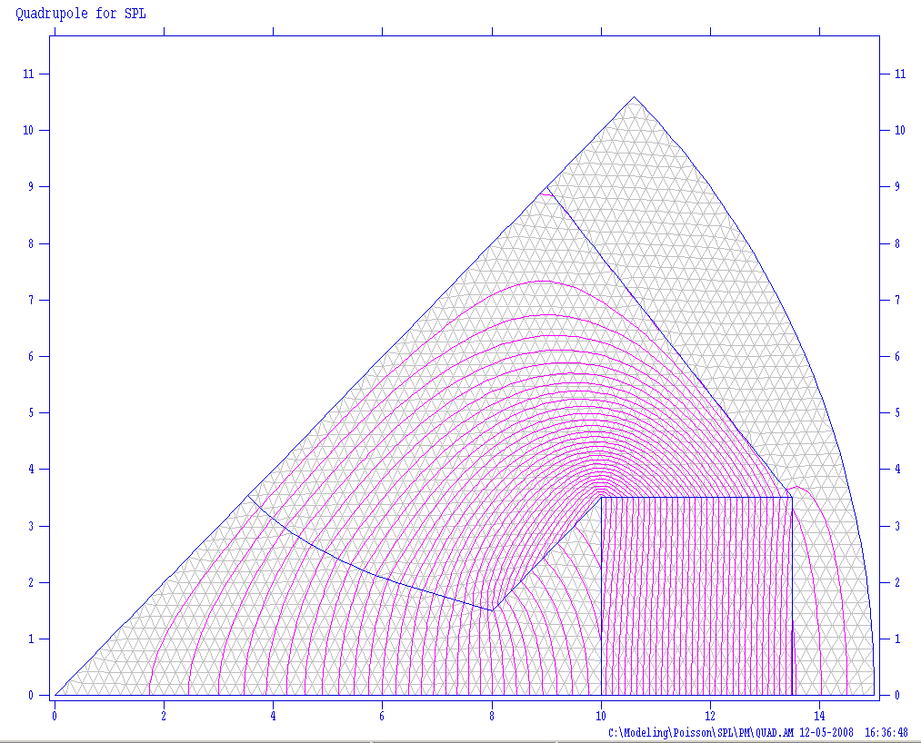
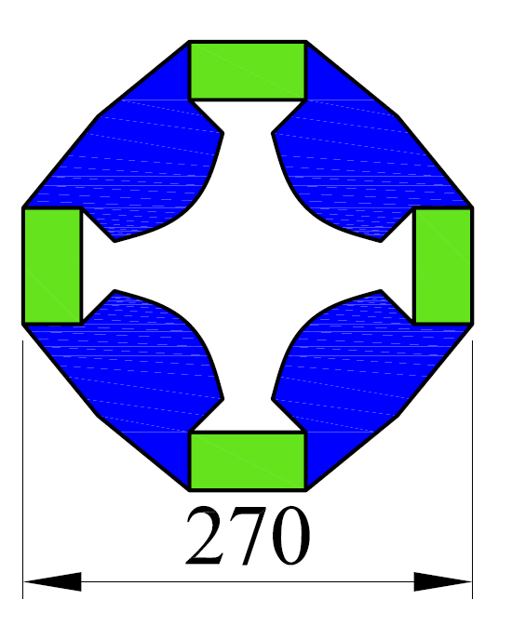
Environmental Friendly Quadrupole
Different configurations are possible with permanent magnets
Hybrid solution with trimming coils can also be envisaged

Slide 7
Quadrupoles for the SPL
CONCLUSIONS
The required field gradient is not an issue and can be achieved with several designs
The magnet size can be very compact
3D design to compute the influence on adjacent systems and possibly design shielding plates
Some of the requirements anticipated in the introduction need iteration

