Slide 1

EuroCirCol
WP4 – Cryogenic Beam Vacuum
F. Perez & P. Chiggiato

Slide 2
WP4 – Beam Screen Desing

Slide 3
Design Updates
Symmetrical design
  Better impedance
  Pumping holes hidden by the screen
Thermal copper coating on the outer side
Bigger pumping holes – no constraint for the distribution

Slide 4
Design – Main dimensions
Cold bore diameter: 44/47 mm
Beam screen wall:
  1.25 mm P506 (high-Mn high-N st. steel)
  0.3 mmcopper
Nominal aperture:
  H:~ 29.9 mm
  V:~26.4 mm
Slit height: ~ 3.2 mm
Cooling channel:
  Thickness 1 mm
  Internal 53.58 mm²
  Hydraulic diameter: 5.61 mm
Copper for heat transfer: 0.3 mm

Slide 5
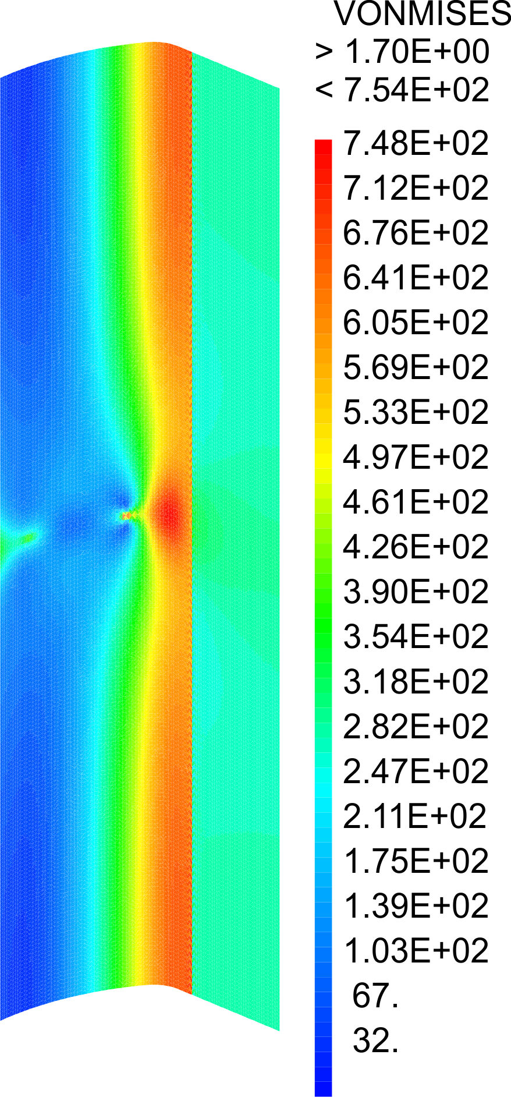
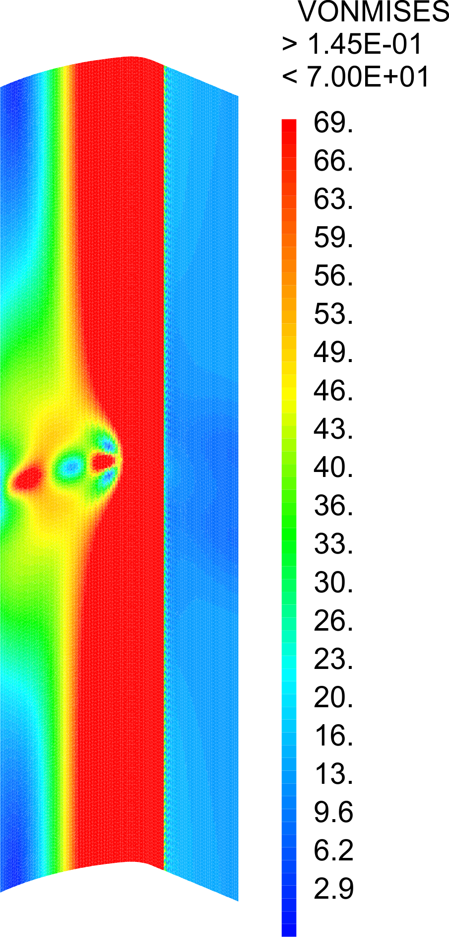
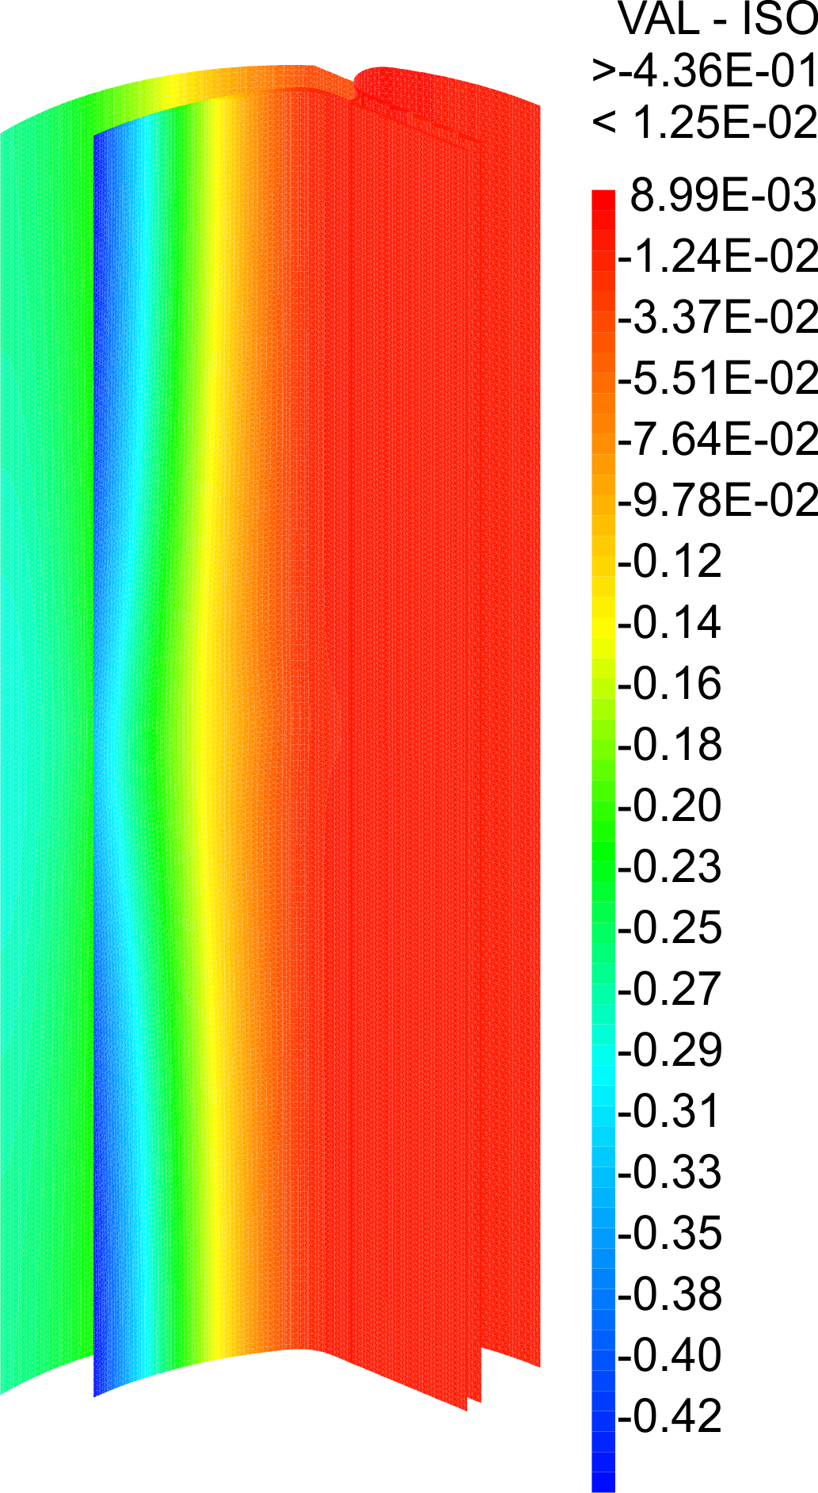
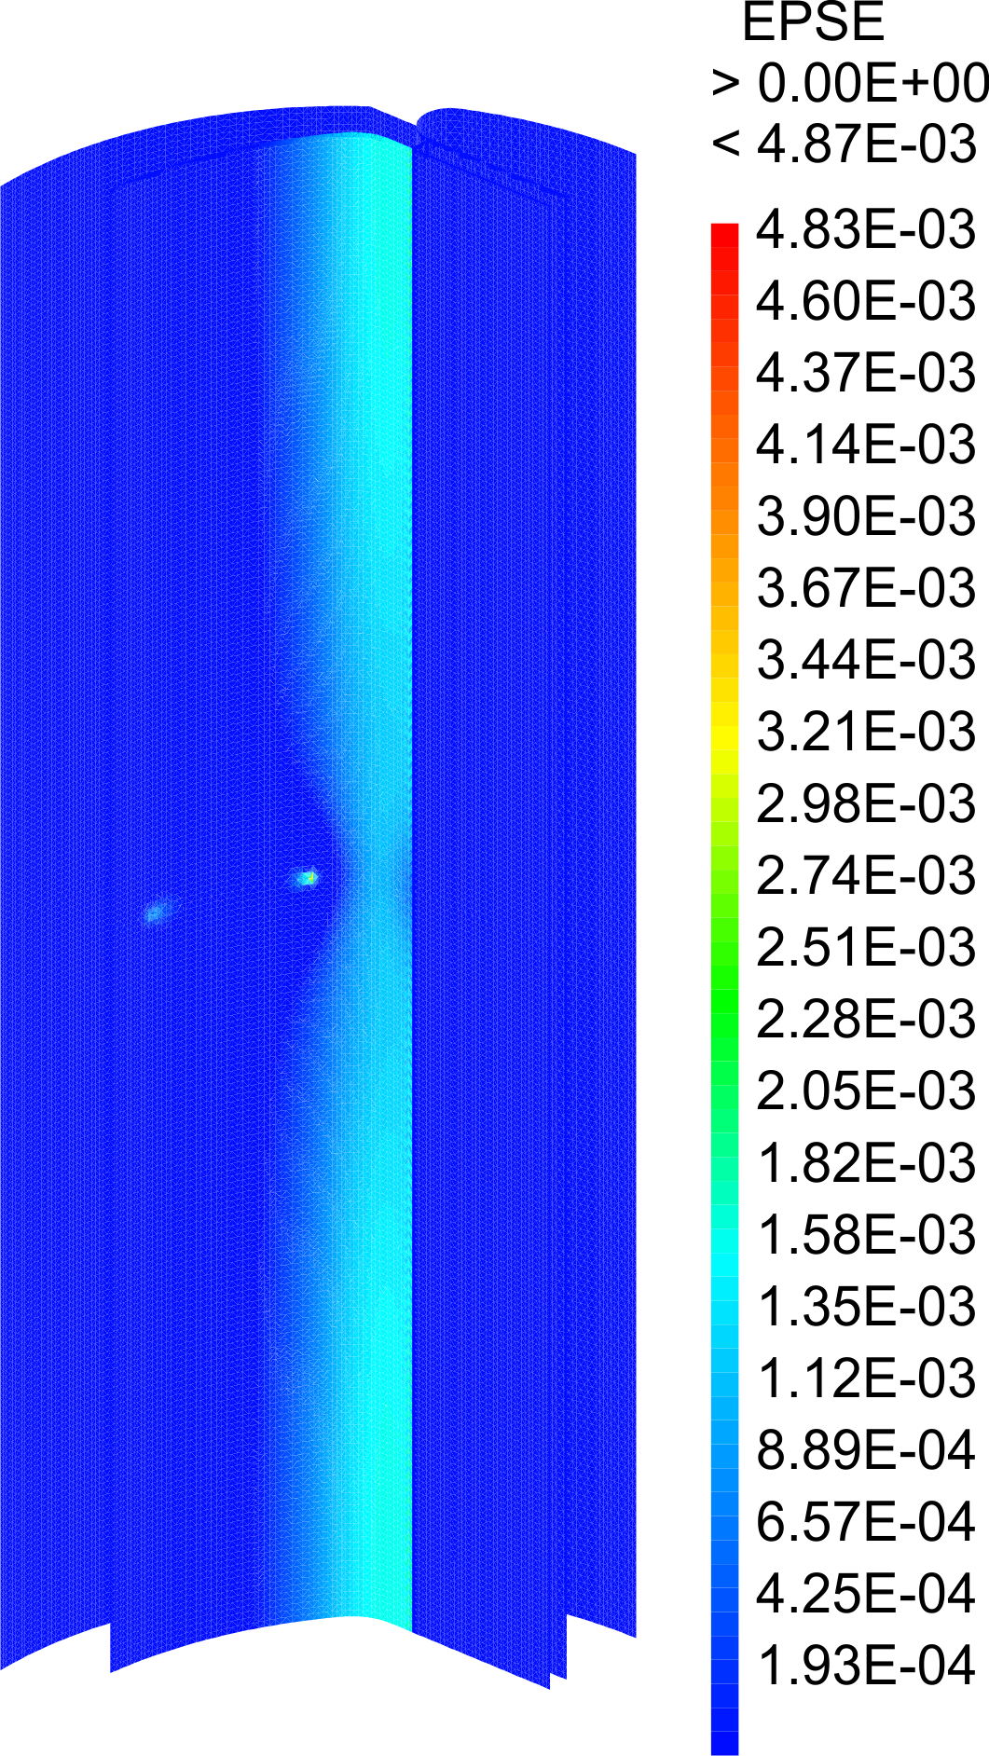
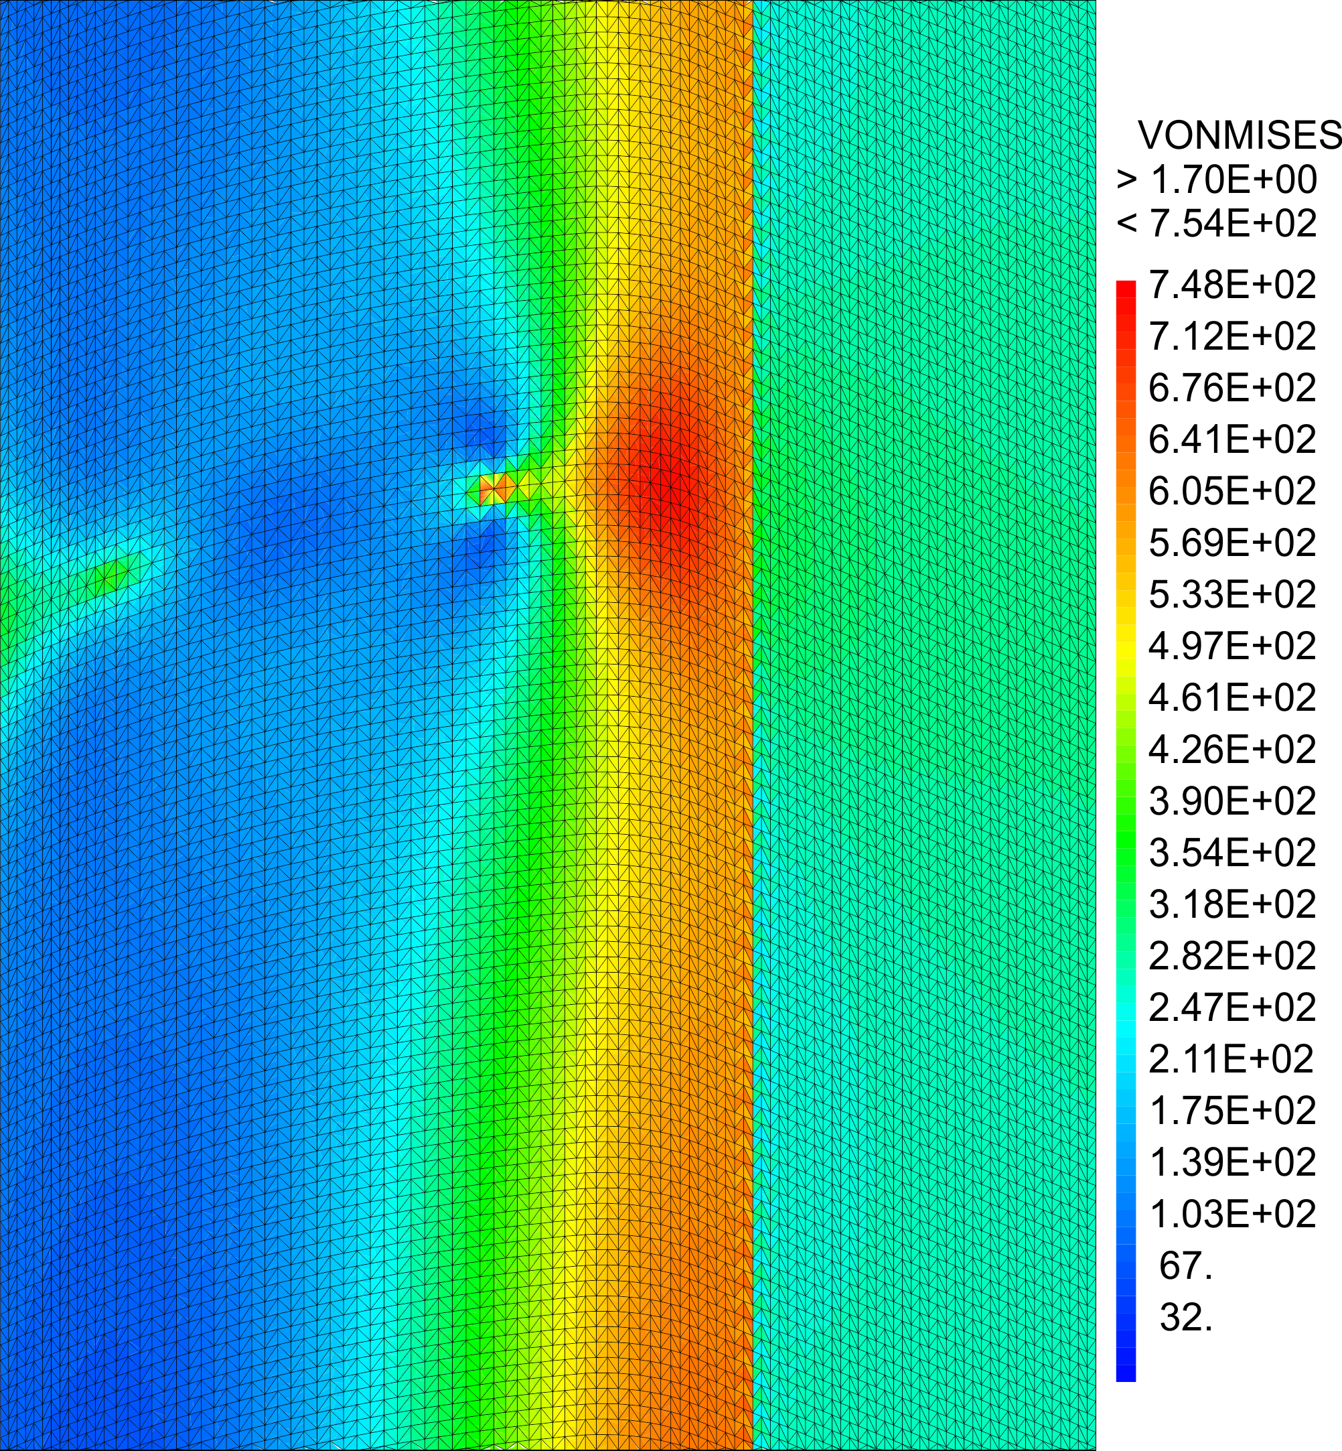
Mechanical analysis
Magnet quench
Horizontal displacement: ~ 0.5 mm
Plastic strain in the copper layer: ~ 10⁻³
Maximum Von Mises stress in the beam screen: ~ 750 MPa
Even if the model has to be refined, results of the beam screen behaviour during a quench are promising.

Slide 6
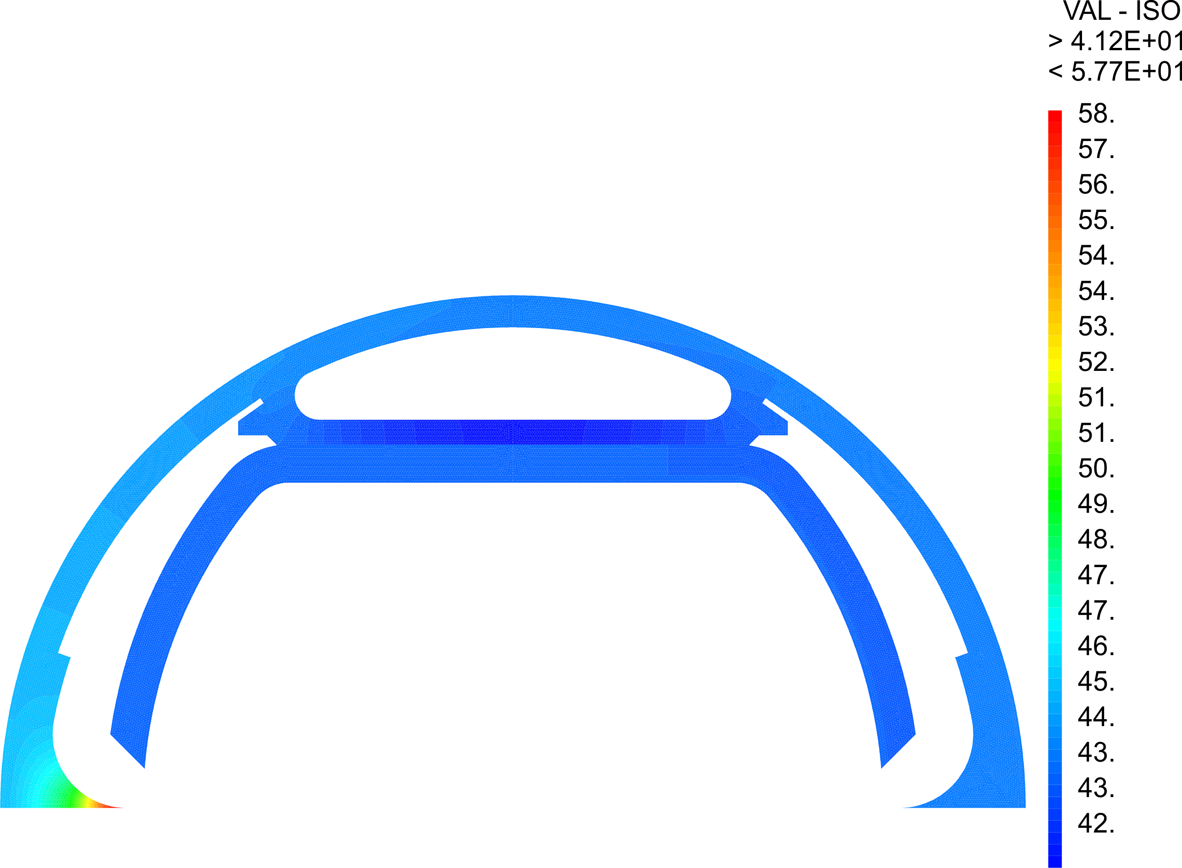
Thermal analysis
Nominal behaviour
Temperature profile
Local temperature increase (reflector tip)
Screen temperature a few K higher than the helium temperature

Slide 7
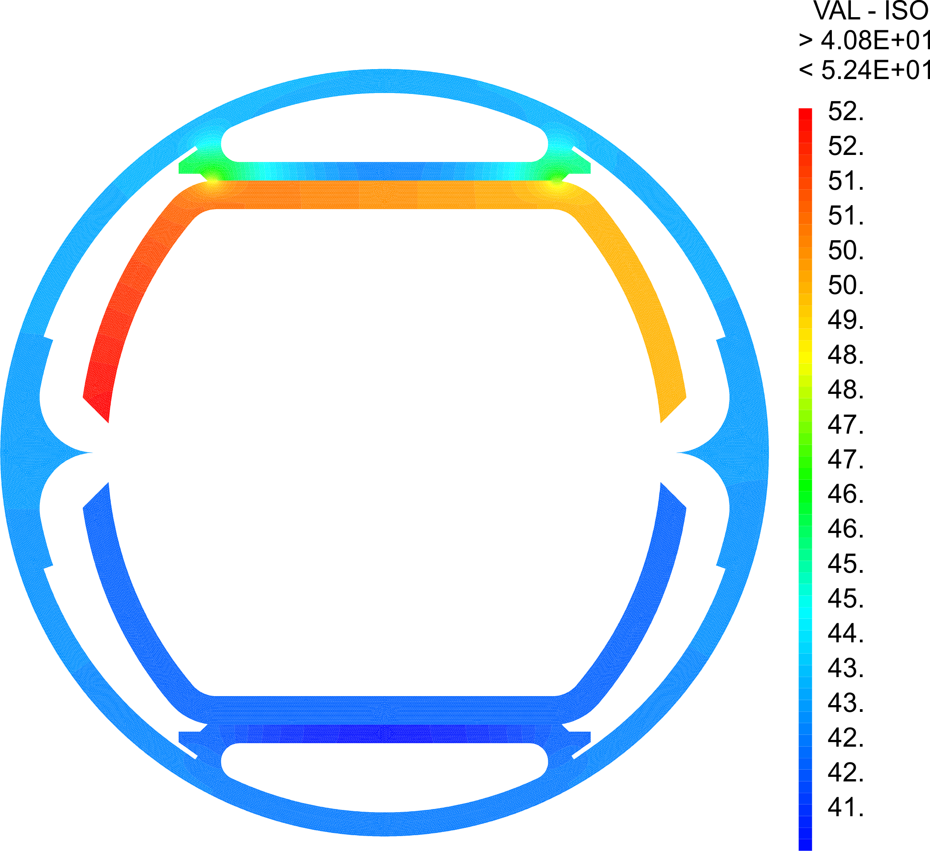

Thermal analysis
Nominal behavior
Model:
2D massive model
Heat deposition of 31 W/m on one beam screen edge
Thermal conductivity of copper estimated at 50 K and under 16T ~ 700 W.m⁻¹.K⁻¹ (need to be measured)
Thermal conductivity of stainless steel at 50 K ~ 6 W.m⁻¹.K⁻¹
Convection coefficient of 150 W.K⁻¹.m⁻²
Heat deposition
Temperature profile

Slide 8
WP4 – Beam Screen Prototyping

Slide 9
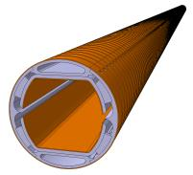
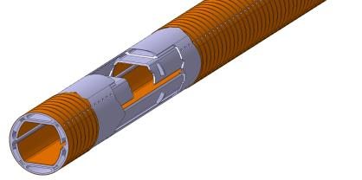
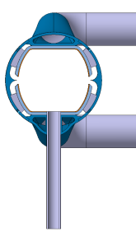
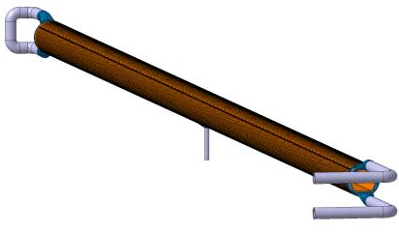
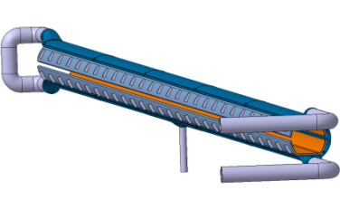

Beam Screen (15m long)
Beam Screen Prototype (≈2m)
ANKA Facility Current Status Next Steps Schedule Conclusion

Slide 10
Prototypes
prototype #1
Assembly:
~ 40 cm long
Transition and special central pieces
Cooling channel
Powder
3D printing
Machining
Welding
Welding
Machining & Laser Treatment
Beam screen wall
Sheet
Forming
Coating
Welding
Coating
Reflector
Flat bar
Machining
Forming
polishing
Welding
Reinforcement
Sheet
Cutting

Slide 11
Next steps
From the design point of view:
Check the design of the cooling channels for pressure test conditions
Refine the model for the quench analysis:
  Joule effect
  Influence of the copper strip (3D model for the current field)
From the prototyping point of view:
First samples to qualify the different processes involved in the manufacturing (Q1/2016)
Manufacture ~2m long prototypes

Slide 12
WP4 – Test Setp-Up in ANKA

Slide 13
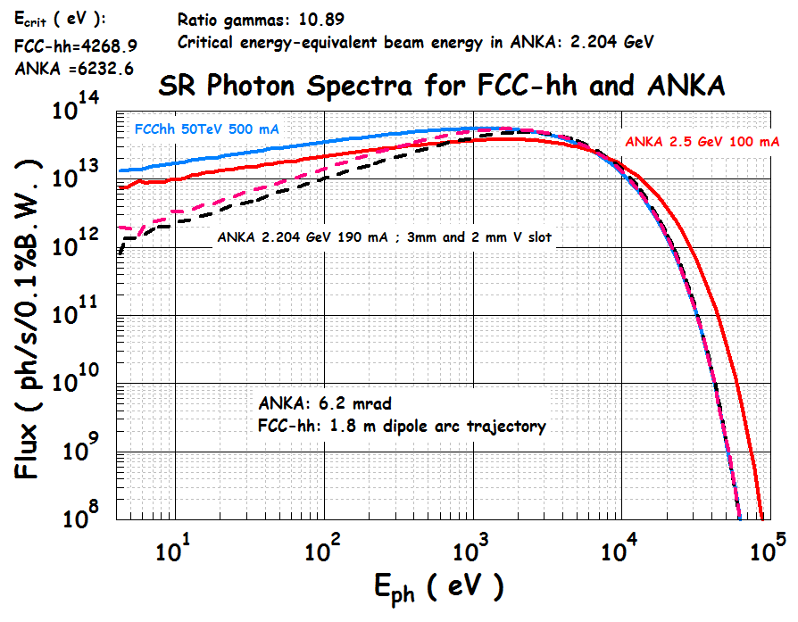
Contrary to the LHC, where the SR flux and power are marginal, the FCC-hh is a powerful light source; Its SR flux spectrum at 50 TeV is compared to that of the 3rd generation light source ANKA;
A 1.8 m long arc of bending magnet trajectory corresponds, on average, to 2 m of BS length in the arc sections of FCC-hh (filling factor), giving the correct 31.5 W/m average SR linear power density
SR photon flux: F (ph/s/mA) = α/2π · γ · 4.1289E+14 · K_{F}

Slide 14
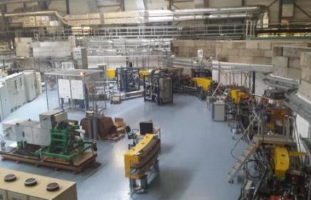
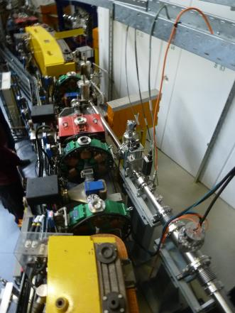
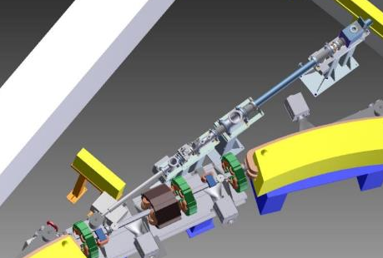
ANKA Facility
position
ANKA Facility Current Status Next Steps Schedule Conclusion

Slide 15
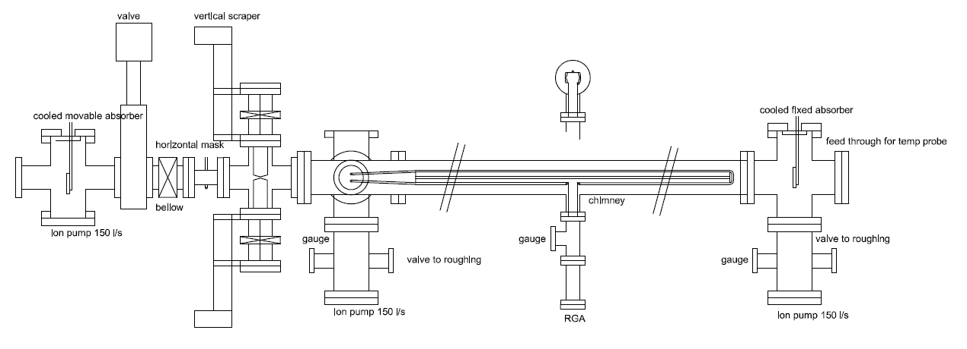
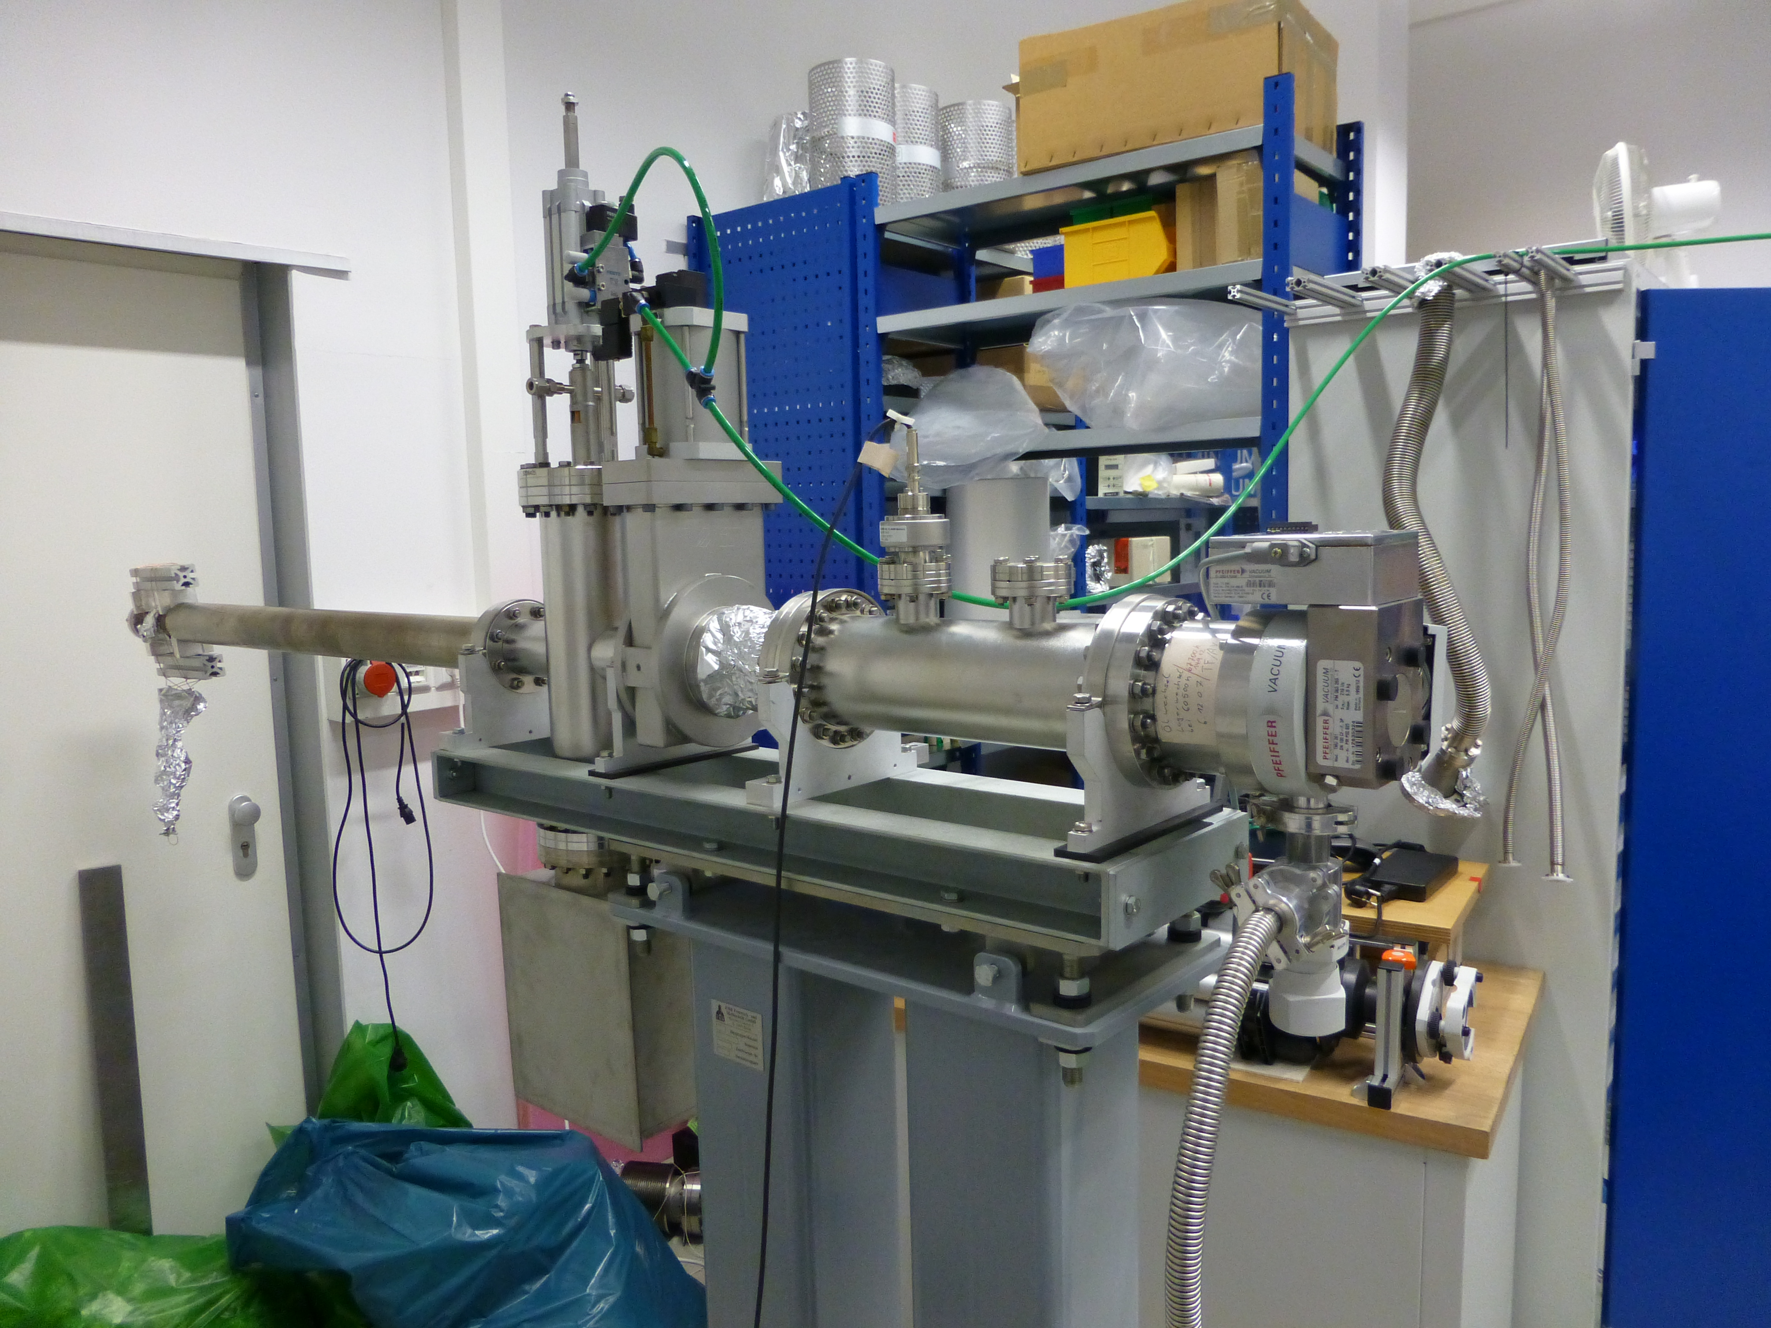
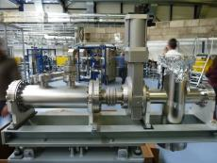
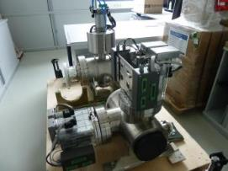
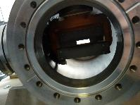

Some components are available on site
Proposition Sketch beam line + set up (thanks to E. Huttel)
Vertical scrapper with fixed horizontal mask
ANKA Facility Current Status Next Steps Schedule Conclusion

Slide 16
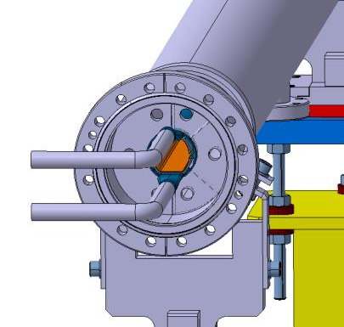
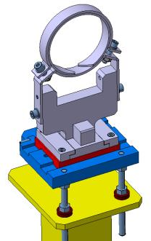
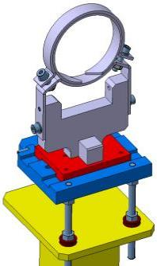
ANKA FCC Test Bench
Supports adaptation from an existent design
FCC Beam Screen Prototype Centring System
ANKA Facility Current Status Next Steps Schedule Conclusion

Slide 17
WP4 – Vacuum Stability

Slide 18
Conclusion and Tentative Plan:
Post DOC’s will start next January
maintenance and use of existing resources ongoing.
Now: identify/prepare good samples (CERN)
first part of 2016: first results with existing set up on available samples.
    SEY and TPD to contemporarily study physisorbed gas
Now: Clearly identify LNF contribution (other than what already agreed) to Anka project.
Soon: If of interest officially plan/state any eventual co-funding. (needed to get INFN funds)

Slide 19
Funding
In July 2015 we (LNF) applied for additional funding to support experimental activities @LNF for FCC-hh.
  Maintenance, Consumables, Travel money for the 2016-2019 period (60k€ / Year).
  Hardware for best performing LT desorption studies (~300 k€ total)
In the October Meeting no funds have been allocated by INFN !
    Different scientific priorities
    Unclear Contribution and Co-funding from CERN.
Hope in some reconsideration during 2016 !
    Some lobbing and clearer co-funding would help!
We are now forced to count on available resources (with very limited mobility etc.).
No impact to our tasks but “only” on their quality!

Slide 20
WP4 – Mitigation beam induced effects

Slide 21
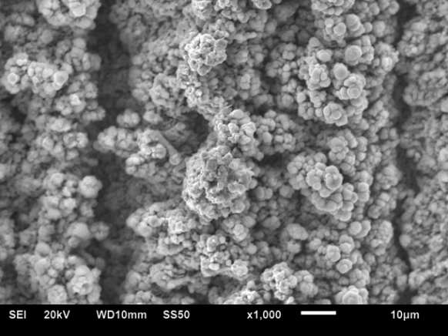
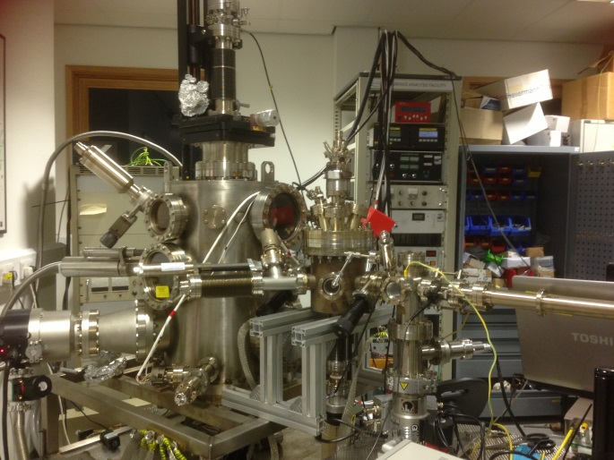
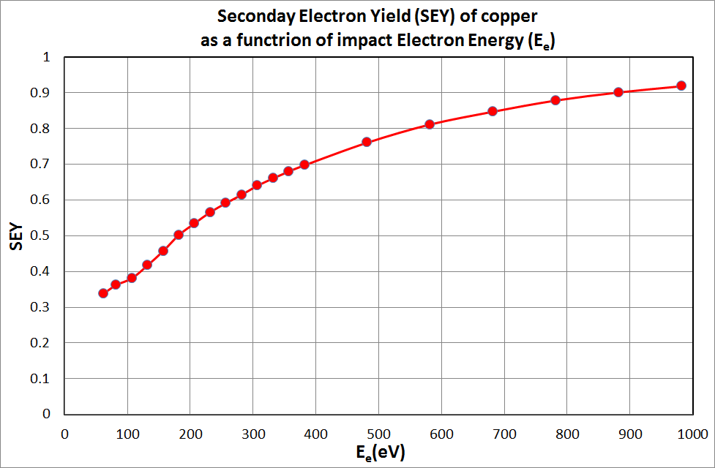
Baseline: Low SEY laser surface treatment
Laser treated surface can provide δ<1
In addition it is compatible with other accelerator requirements: low impedance, low outgassing, low photon and electron stimulated desorption, etc.
A SEM image of laser treated copper
Cost effective (at least 10 times cheaper than other existing technologies)
Nature friendly
There is no need for vacuum or clean room facilities.
The laser is capable of fabricating the desired micro/nanostructure in a single step process.
Hierarchical structures containing both micro- and nanostructures can be created in a single machining step
Machining is performed through a beam of light and thus contactless.
The process is applicable to the surfaces of any 3D object.
Many parameters can be easily adjusted resulting in a great variety of possible structures.
It is possible to laser in many different environments, such as gases, liquids, or in a vacuum.
A facility
for SEY studies

Slide 22
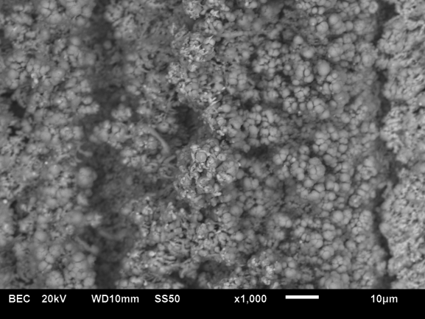
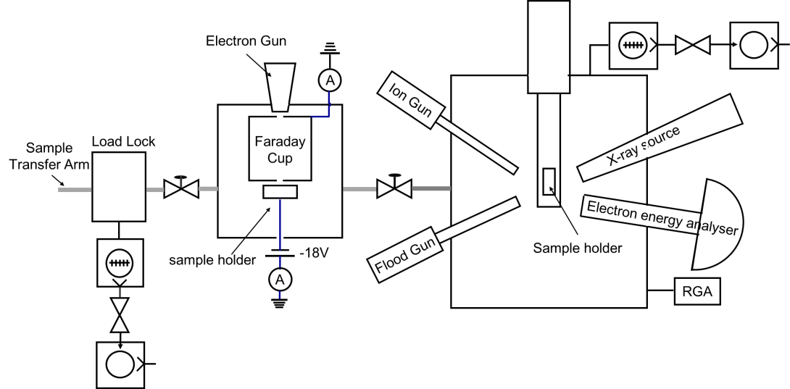
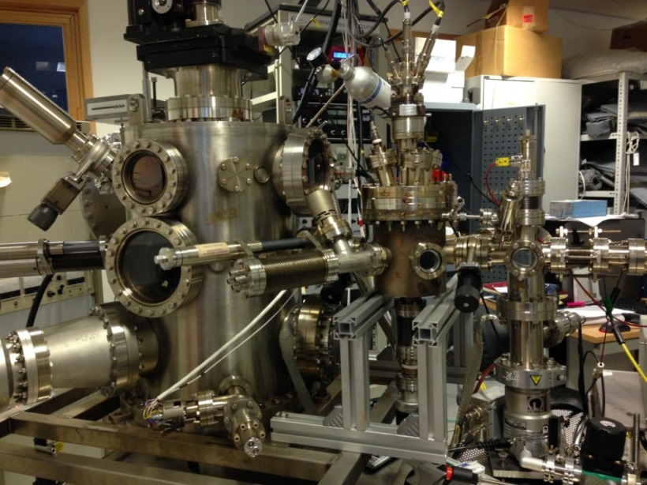
Baseline: Low SEY laser surface treatment
PhD student’s (Taaj Sian) work:
The main emphasis will be on the Laser Induced Micro/Nano Surface Structures (LIMNSS)
Oct 2015 –Sep 2018
  Studying various LIMNSS obtained with various lasers and their parameters at room temperature:
    Measuring the SEY (as-received, after electron bombardment, after bakeout, after ion bombardment).
    Measure surface resistance of LIMNSS
    Measure ESD and thermal outgassing of selected LIMNSS with low SEY
    Study the LIMNSS stability to ultrasound (measuring SEY before and after wash)
    Study the particulates generation
  Studying selected surfaces obtained by other techniques such as coatings, etching, etc., provided by sample exchange with other WP partners.

Slide 23
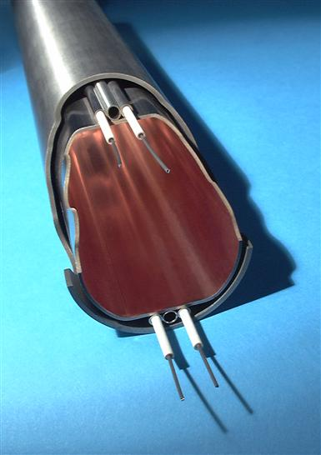
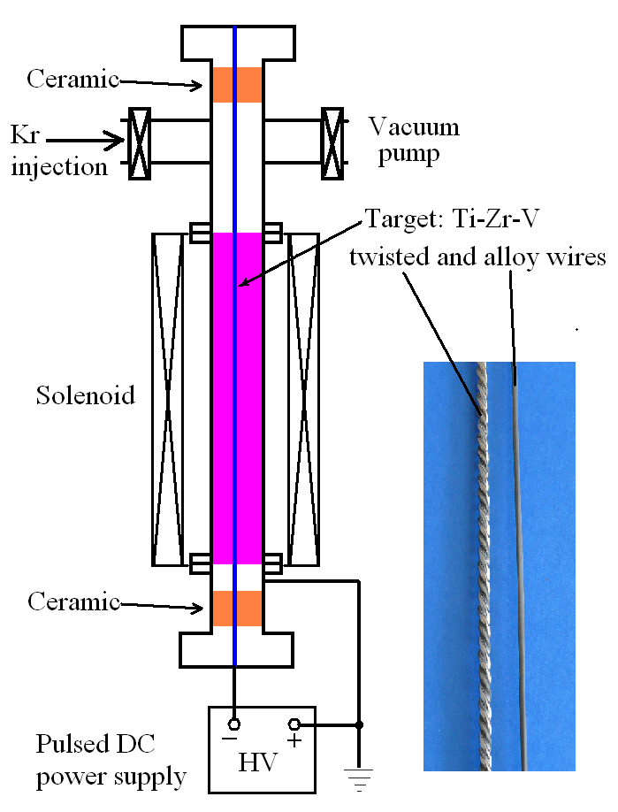
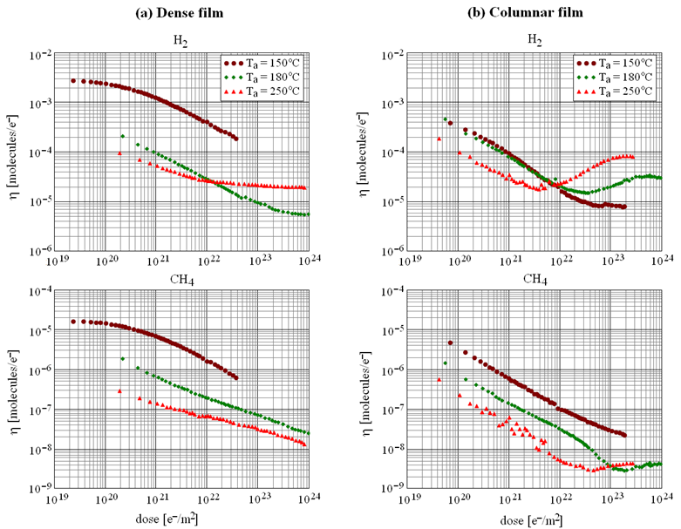
Optional: Non-evaporable getter (NEG) coating
What NEG coating does:
  A pure metal film ~1-μm thick without contaminants.
  A barrier and/or getter for molecules diffusing from the bulk of vacuum chamber.
  Distributed pumping speed after activation at 150°C
Other highlights:
  Photon stimulated activation
    to be verified at cryogenic temperatures
  NEG deposition on vacuum fired vacuum chambers allows to reduce PSD/ESD by another 10 times
Benefits:
  No additional pumping required
  Beam vacuum is separated from magnet bore vacuum
  Low SEY
316LN
(baked: 250 ºC, 24 h)

Slide 24
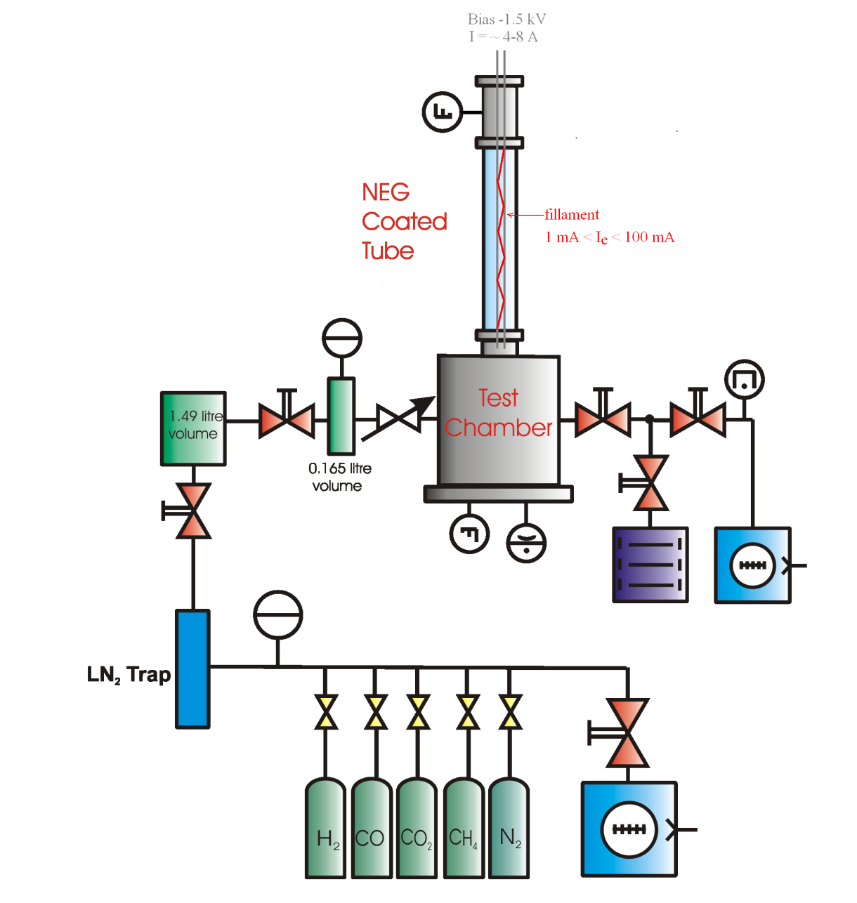
Optional: Non-evaporable getter (NEG) coating
PhD student’s work:
Jan 2016 – Mar 2016 – familiarisation with NEG depositions and evaluation facilities
Apr 2016 – Mar 2017
  Studying various NEG coatings and their parameters at room temperature:
    Depositing NEG coating on standard ASTeC sample tubes (ID=38 mm, L=0.5m)
    Analysing coupons deposited together with tubes with XPS, SEM, XRD.
    Measuring the ESD as a function of electron dose after activation to 150, 180 and 200 °C, then measuring H₂ and CO sticking probabilities and CO pumping capacity.
Measuring the ESD and pumping propertied for samples from CERN (if provided)
DC, pulsed DC, RF power supply,
HiPIMS

Slide 25
Reminder
Coordination needed for:
  Cold bore space
  Cold mass temperature: 1.9 vs 4.5 K
  Impedance issues
  E cloud
  Multipacting

Slide 26
Conclusion
Work is progressing well
Still some recruitment pending
Design progressing towards prototyping
ANKA Set-Up underway
Laser surface treatment as baseline for e-cloud mitigation
Some concerns on finding extra matching funding from National Institutes

Slide 27
WP4 – Cryogenic Beam Vacuum System
Task 4.1. Coordination
Francis Perez
Paolo Chiggiato
Task 4.2. Modeling
Carles Colldelram
Roberto Kersevan
Task 4.3. Mitigation
Oleg Malyshev
Reza Valizadeh
Task.4.4. Stability
Roberto Cimino
Javier Munilla
Task 4.6. Test
Vicent Baglin
Sara Casalbuoni
Open PostDoc
Mauro Taborelli
Task 4.5. Design
Cedric Garion
Ignasi Bellafont
Raquel Monge
Joan Casas
Marcos Quispe
Pedro Costa
Taaj Sian
Peter McIntosh
Open Doct
Elisa Garcia-Tavares → 4.4
Miguel Costa → 4.6
Open PostDoc
Luis Garcia-Tavares
Jose Manuel Perez
Erhard Huttel
Sara Casalbuoni
New PJAS - CIEMAT
Anke-Susanne Mueller

Slide 28
FCC Week 2016 - Rome
Overview WP4 – Paolo & Francis
Screen Design – Cedric
Vacuum Simulation – Roberto Kersevan
ANKA Setup up – Sara
Surface Laser Treatment – Reza
Beam Screen Reflectivity - Roberto Cimino

Slide 29
Rejected on 15-11
ERC Advanced Grant 2015 by R. Cimino
(Submitted the 2-6-15).
GECO
Green Circular Colliders
GECO aims to bring to maturity the possibility offered by a highly X ray reflecting beam screen, to control and dissipate the SR induced heat load in the warm part of any future hadron accelerator at the energy frontiers. This will results in a much more cost effective accelerator. The proposed solution has to be solid, stable and validated to be compliant to all the functionalities required to a BS for optimum machine performance.

Slide 30
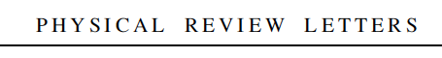
FYI:
The scientific base of GECO:
accepted yesterday for Publication in:
One referee said: “The method described in the paper has the potential to solve a critical outstanding problem and therefore to pave the way for notable progress in the field”

