Slide 1

WP4 (INFN-LNF):
Status Report
R. Cimino
LNF-INFN, Frascati (Italy)

Slide 2
Information:
Recruitment at LNF
(Additional) Experimental funding.
Status of the Experimental activities.
    Desorption Studies at LNF.
    SR Experimental studies.
Identification of relevant Samples.
Conclusion

Slide 3
Recruitment at LNF:
Two two-year post doc positions have been opened
(deadline 2-10-2015):
    one on: Vacuum issues at FCC-hh (2 candicates)
    One on: Synchrotron Radiation induced Photodesorption studies (3 candidates)
    the committee in charge will meet on 25-11-2015 to see the CVs and if all candidates are eligible.
    Than they will inform the candidates.
    Generally the Oral will be held after 15 days (~10 of Dec.)
    The winners have 15 days to accept
Most probably from January 2016 we will have the two new Pos doc on board!

Slide 4
Funding
In July 2015 we (LNF) applied for additional funding to support experimental activities @LNF for FCC-hh.
  Maintenance, Consumables, Travel money for the 2016-2019 period (60k€ / Year).
  Hardware for best performing LT desorption studies (~300 k€ total)
In the October Meeting no funds have been allocated by INFN !
    Different scientific priorities
    Unclear Contribution and Co-funding from CERN.
Hope in some reconsideration during 2016 !
    Some lobbing and clearer co-funding would help!
We are now forced to count on available resources (with very limited mobility etc.).
No impact to our tasks but “only” on their quality!

Slide 5
As now:
Instrumentation
maintenance
upgrades.
LNF-INFN is ready to:
Make partially available the existing laboratory for FCC-hh experiments
Request further grants for maintenance and upgrade (late 2016 /2017-2019)

Slide 6
Activities @ LNF: Vacuum desorption with SEY and TPS.
See what can be measured with the available set-up: SEY and TPD to contemporarily study physisorbed gas.
Ions?
Photons?
Benchmarking results with “large surface” CERN approach.
It is essential that CERN provides asap realistic samples (Cu, a-C, etc) with different (and known) roughness to provide relevant data for the collaboration.

Slide 7
Activity on SR desorption studies (@ANKA)
Need to define (best NOW) the scientific role and involvement of LNF to this activity (also given the INFN funding).
As agreed (if the board goes well) the post doc hired (insured, formed for safety etc by LNF) will be available to the ANKA sub-project (best if a person in charge is clearly identified).
  EuroCircol grants <15% of the budget available for this 2 year position for travel money (~ 10/14 k€ in total: ~1 month/year) or ~6 months extention.
INFN renders available to the project (at no cost for INFN):
  1 senior Mechanical Designer (A.Zolla) expert in design, construction and installation of many installations at CTF3, SPARC, DAFNE, CNAO..
  Scientifc additional support (if needed)

Slide 8
Rejected on 15-11, motivation to come
ERC Advanced Grant 2015 by R. Cimino
(Submitted the 2-6-15).
GECO
Green Circular Colliders
GECO aims to bring to maturity the possibility offered by a highly X ray reflecting beam screen, to control and dissipate the SR induced heat load in the warm part of any future hadron accelerator at the energy frontiers. This will results in a much more cost effective accelerator. The proposed solution has to be solid, stable and validated to be compliant to all the functionalities required to a BS for optimum machine performance.

Slide 9
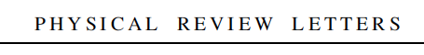
FYI:
The scientific base of GECO:
accepted yesterday for Publication in:
One referee said: “The method described in the paper has the potential to solve a critical outstanding problem and therefore to pave the way for notable progress in the field”

Slide 10
The collaboration EuroCircol (or most probably CERN-FCC management) should decide what to do with this proposal:
We tried (hard) to generate independent resources for this project via EU but failed!!!
We are ready to share our project to validate this innovative approach experimentally and continue working on this topic….
(if of interest to the collaboration!)

Slide 11
Conclusion and Tentative Plan:
Post DOC’s will start next January
maintenance and use of existing resources ongoing.
Now: identify/prepare good samples (CERN)
first part of 2016: first results with existing set up on available samples.
Now: Clearly identify LNF contribution (other than what already agreed) to Anka project.
Soon: If of interest officially plan/state any eventual co-funding. (needed to get INFN funds)
Soon: Identify the interest to further study also the “GECO” approach, and in case, generate resources!

Slide 12
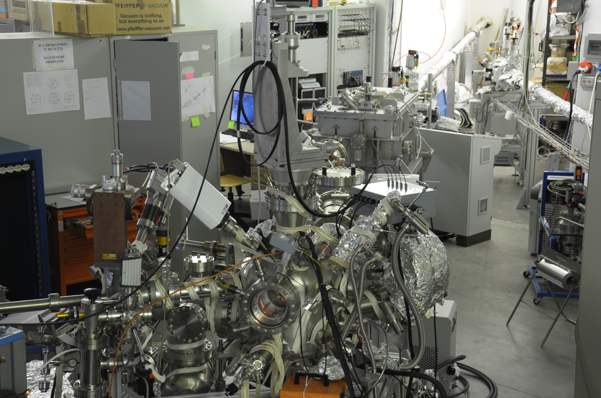
The available laboratory: (~3M€)
Our laboratory is devoted to the growth and study chemical, structural and electronic properties of thin and ultrathin
Two ultra-high vacuum systems equipped with several growth facility (Chemical Vapour Deposition, physical evaporation, magnetron sputtering) and with in-situ, UHV, electronic diagnostics (Low Energy Electron Diffraction, X-ray and UV Photoelectron Spectroscopy, Secondary Electron Yield and Raman Spectroscopy) and scanning probe microscopy (variable temperature Scanning Tunneling Microscopy also recently implemented for UHV use).
One of the system is equipped with a low temperature (~ 7 K) manipulator.

Slide 13
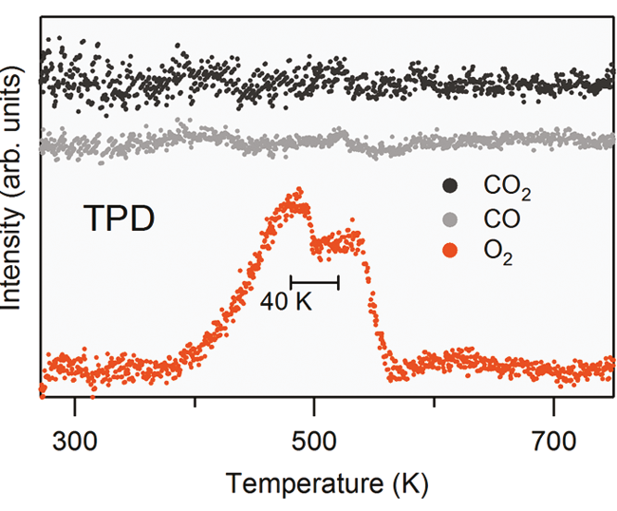
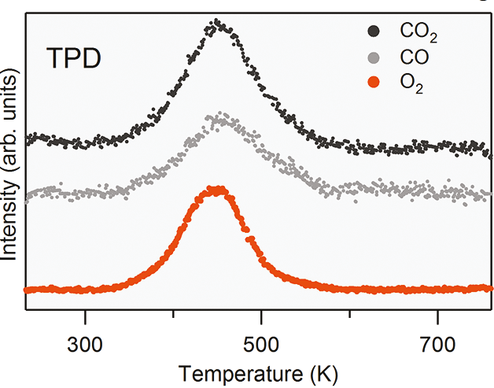
Activities @ LNF on small samples: TPD.
The TPD (Temperature Programmed Desorption) can be recorded with a quadrupole mass spectrometer with a “Feulner cup” with a sample-size opening.
O₂ θ = 0.03 ML on Graphene /Ir
O₂ θ = 0.25 ML on Graphene /Ir
Dual Path Mechanism in the Thermal Reduction of Graphene Oxide Rosanna Larciprete, Stefano Fabris, Tao Sun, Paolo Lacovig, Alessandro Baraldi, and Silvano Lizzit Journal of the American Chemical Society 2011 133 (43), 17315-17321

Slide 14
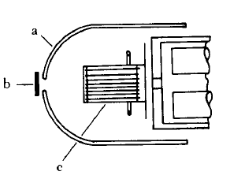
Activities @ LNF on small samples: TPD.
a “Feulner cup”
Glass cage
Quadrupole mass spectrometer
Sample
Ion source
Feulner, P.; Menzel, D. J. Vac. Sci. Technol. 1980, 17, 662–663.

Slide 15
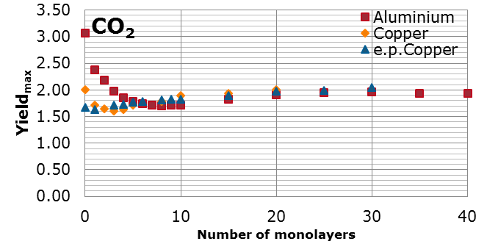
Activity @ LNF Vacuum desorption with SEY.
Assume (very low current) SEY does not perturb the physisorbed gas:
A. Kuzucan et al. J.Vac.Sci. A. 30, 051401 (2012)
SEY can monitor Vacuum desorption

