Slide 1


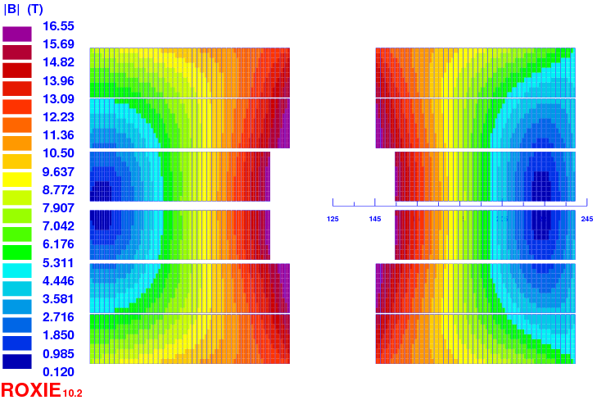
Block design
CEA
C. Lorin & M. Durante
19 Nov. 2015
Acknowledgements:
To anybody who contributed via email interaction!

Slide 2
Contents
Magnetic design
  3 old fit designs
    4 blocks + no-grading
    3 blocks + no-grading + low Cu/NonCu
    4 blocks + internal-grading
  1 new fit design
    3 blocks + no-grading
Margins discussion

Slide 3
Part 1
Magnetic design

Slide 4
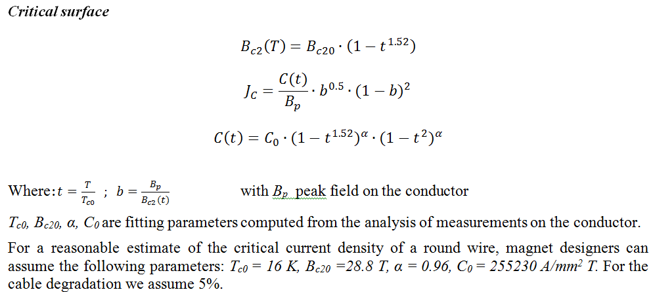
Critical current density – v1
Bernardo Bordini CERN
Top = 4.2 K

Slide 5
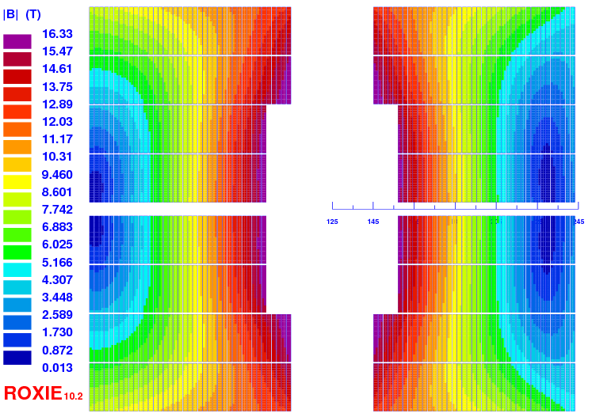
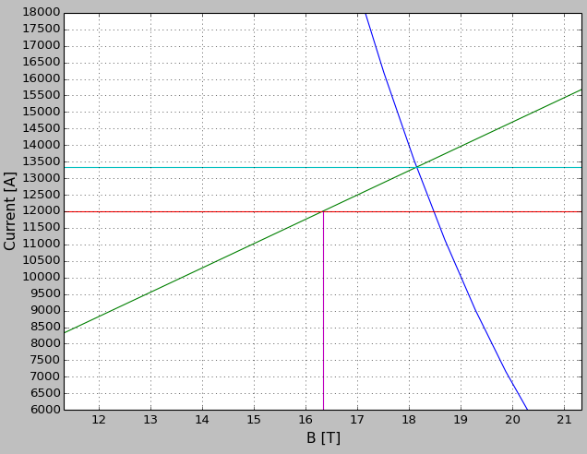
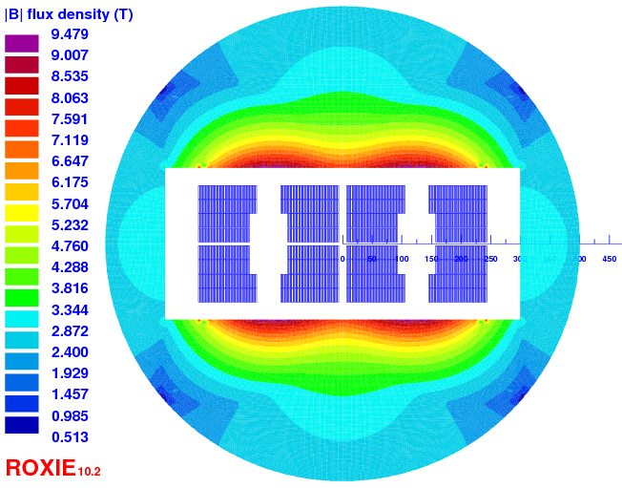
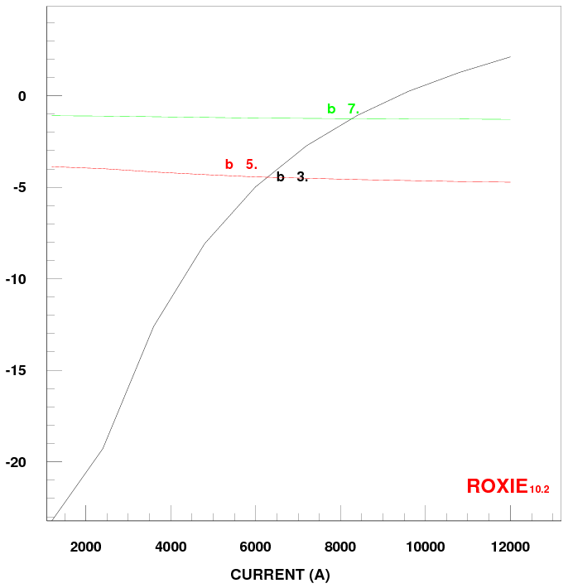
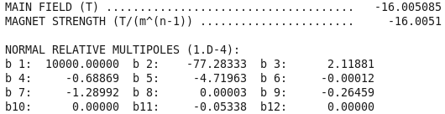
Design no-grading 4 blocks (v14)
Quantity | Unit | Value
W_bare | mm | 23.1
T_bare | mm | 2.0
Insul. | mm | 0.2
Cu/nonCu | . | 1.0
N strands | . | 40
Ф | mm | 1.1
Quantity | Unit | Value
Iop | kA | 12.0
N turns | . | 154
Bpeak | T | 16.33
Margin LL | % | 10.0
Cu/nonCu | . | 1.0
Outer dia | mm | 800
Fx per ½ coil | kN/m | 11,840
Ld 2 ap. | mH/m | 79
Energy 2 ap. | kJ/m | 5852
Strand area 2 ap. | m² | 0.0468

Slide 6
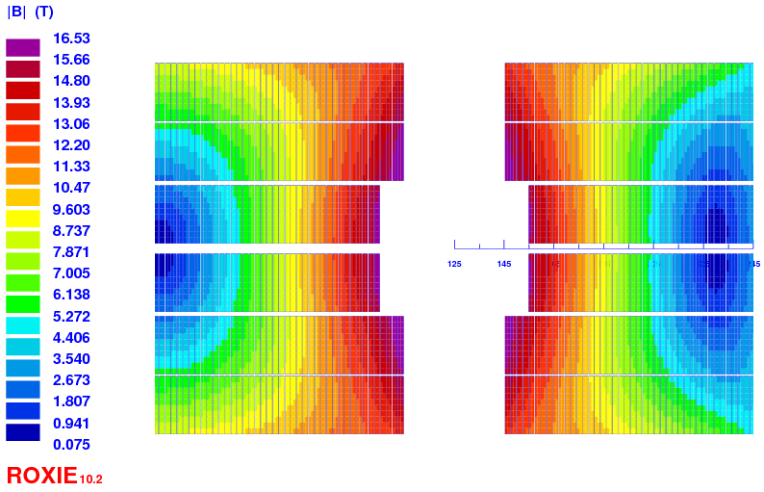
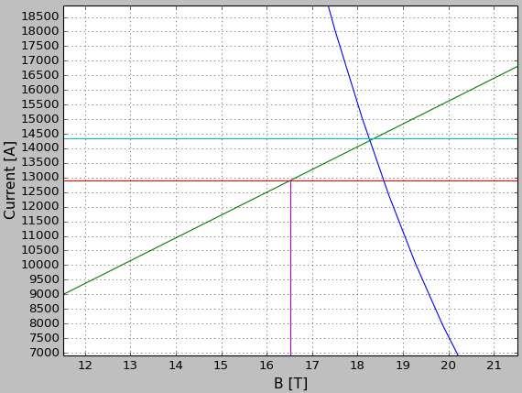
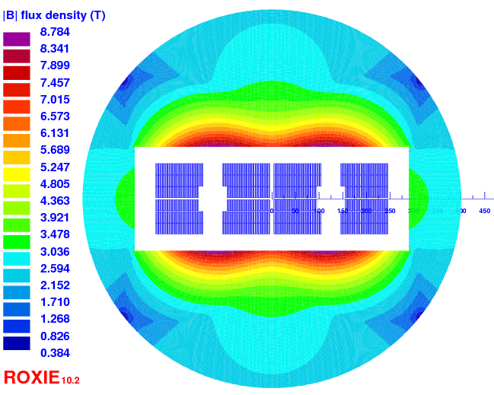
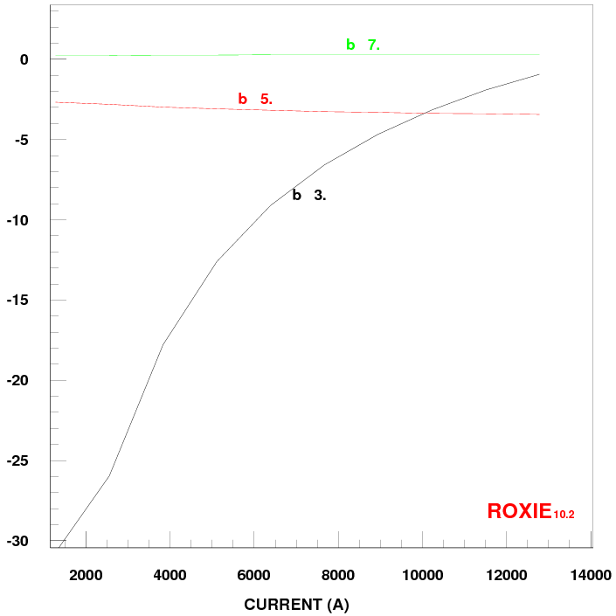
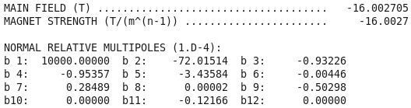
Design no-grading 3 blocks (v17)
Quantity | Unit | Value
W_bare | mm | 23.1
T_bare | mm | 2.0
Insul. | mm | 0.2
Cu/nonCu | . | 0.8
N strands | . | 40
Ф | mm | 1.1
Quantity | Unit | Value
Iop | kA | 12.78
N turns | . | 122
Bpeak | T | 16.53
Margin LL | % | 9.7
Cu/nonCu | . | 0.8
Outer dia | mm | 800
Fx per ½ coil | kN/m | 9,660
Ld 2 ap. | mH/m | 56.4
Energy 2 ap. | kJ/m | 4862
Strand area 2 ap. | m² | 0.0371
can be protected

Slide 7
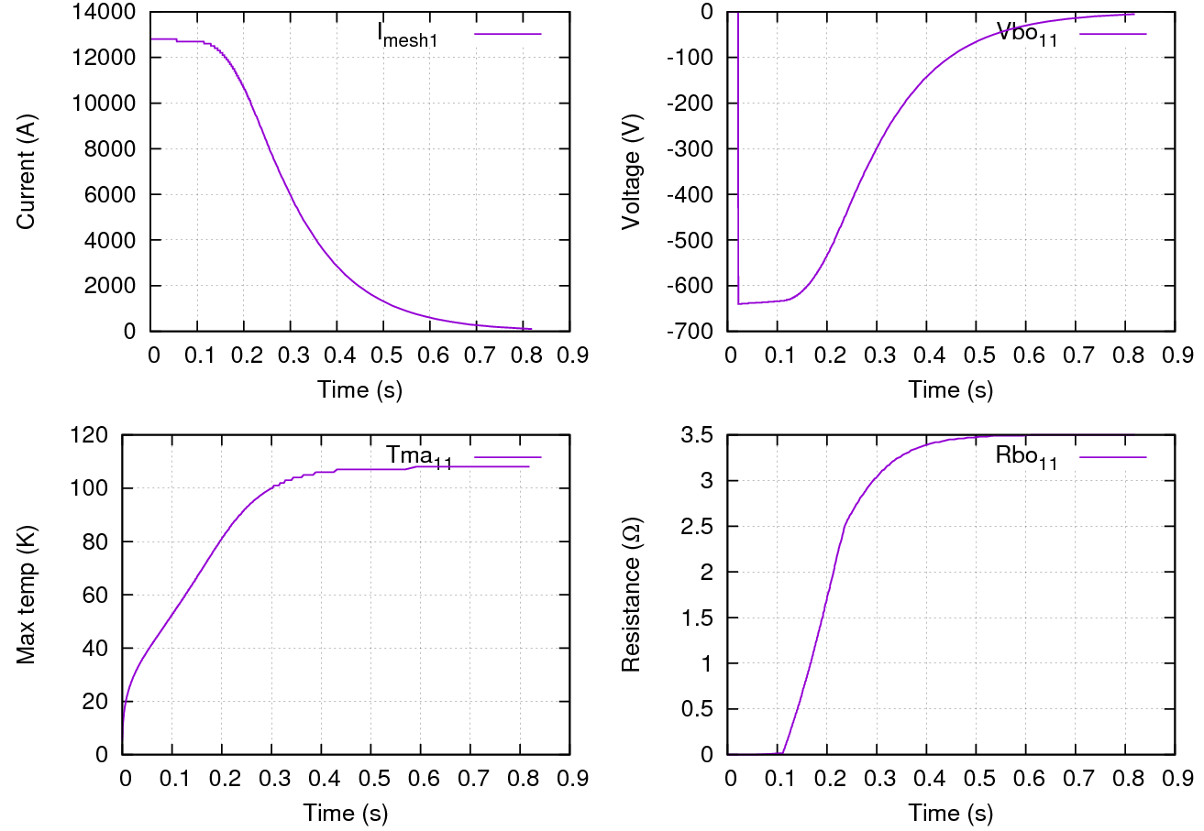
No-grading protection (v17)
Quantity | Unit | Value
Iop | kA | 12.78
Cu/nonCu | . | 0.8
W_bare | mm | 23.1
T_bare | mm | 2.0
Insul. | mm | 0.2
Cu/nonCu | . | 0.8
N strands | . | 40
Ф | mm | 1.1
N turns |  | 122
Ld 2 ap. | mH/m | 56
Energy 2 ap. | kJ/m | 4764
Rdump | mΩ | 50
Validation time | ms | 10
Vthreshold | mV | 200
QH delay | ms | 100

Slide 8
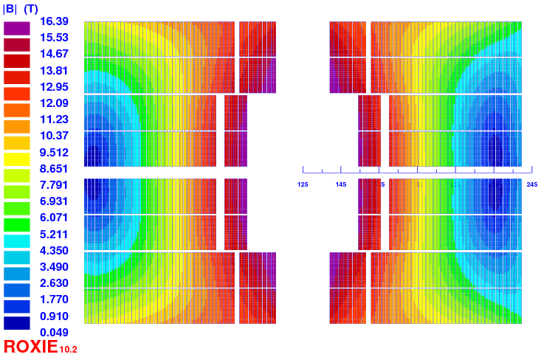
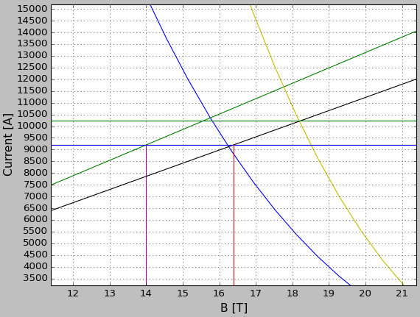
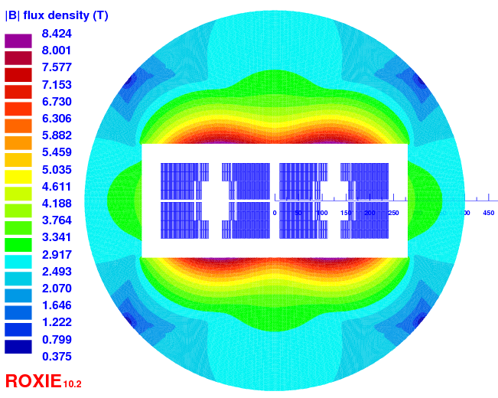
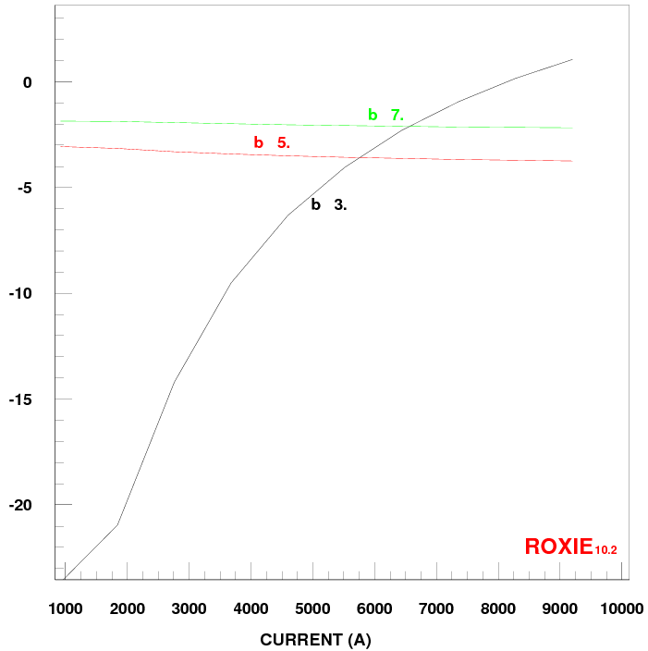
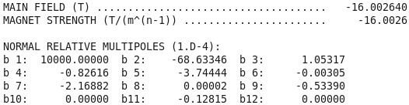
Design internal grading (v16)
Quantity | Unit | Value
W_bare | mm | 18.15
T_bare | mm | 2.0 / 1.525
Insul. | mm | 0.2
Cu/nonCu | . | 1.0 / 2.0
N strands | . | 31 / 40
Ф | mm | 1.1 / 0.85
Quantity | Unit | Value
Iop | kA | 9.2
N turns | . | 26 + 154
Bpeak | T | 16.39
Margin LL | % | 9.8
Cu/nonCu | . | 1.0 / 2.0
Outer dia | mm | 800
Fx per ½ coil | kN/m | 10,600
Ld 2 ap. | mH/m | 118
Energy 2 ap. | kJ/m | 5155
Strand area 2 ap. | m² | 0.0341

Slide 9
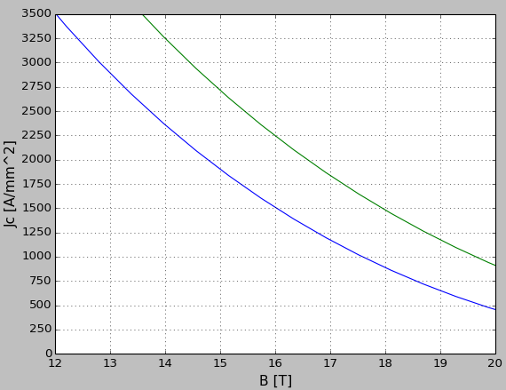
Critical current density v2
1.9 K
4.2 K
29.38
267845
0 %
Bernardo Bordini CERN
Top = 4.2 K

Slide 10
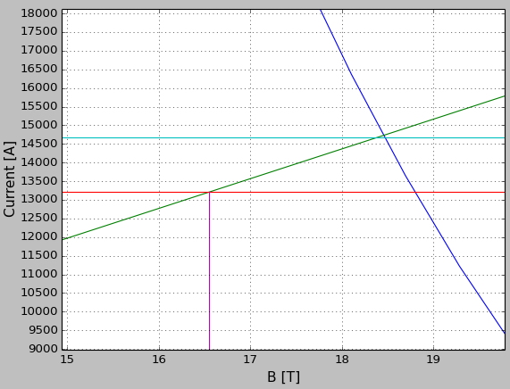
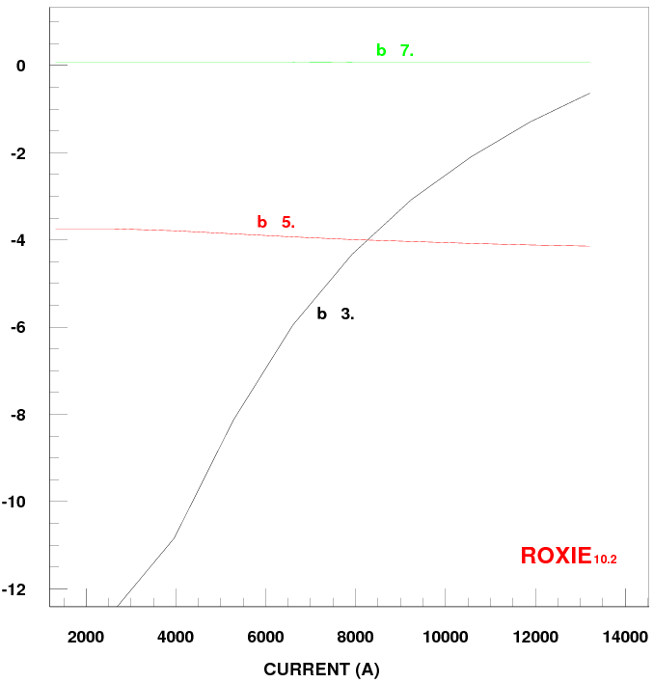
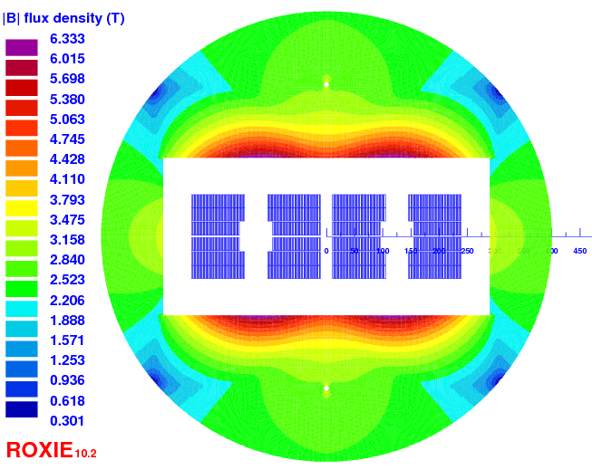

Design no-grading 3 blocks (v18)
Quantity | Unit | Value
W_bare | mm | 23.1
T_bare | mm | 2.0
Insul. | mm | 0.15
Cu/nonCu | . | 1.0
N strands | . | 40
Ф | mm | 1.1
Quantity | Unit | Value
Iop | kA | 13210
N turns | . | 119
Bpeak | T | 16.55
Margin LL | % | 10.25
Cu/nonCu | . | 1.0
Outer dia | mm | 800
Fx per ½ coil | kN/m | 9,520
Ld 2 ap. | mH/m | 52.3
Energy 2 ap. | kJ/m | 4,738
Strand area 2 ap. | m² | 0.0362
Quantity | Unit | Value
LL margin | % | 10.2
Iop/Ic@Top,Bpeak | . | 0.52
ΔT | K | 1.80
ΔH (adiabatic) | mJ/cm³ | 4.26

Slide 11
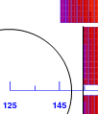
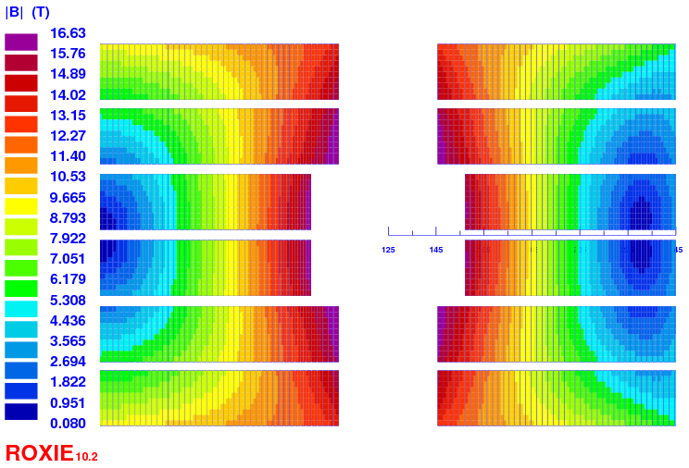
Inner wall thickness
3 pancakes design:
Forces per ½ coil similar to Fresca2 @ 15 T
~10 MN/m (Fresca2 wall: 8 mm not optimized)
Inner wall thickness = 4.4 mm -> 5.4 mm
by margin reduction (10.25% -> 10 %)
Inner wall thickness 4.4 mm -> 7 mm
by increase of turns (119 – >127)
Mechanical analysis needed
(v18)
(v19 not shown)

Slide 12
Conclusion
(v18)
Possibility for a 3 pancakes design
Mechanical analysis to be done
b3 at low field 1 T (> 10 units)
Fringe field: r = 450 mm -> 375 mT
(1 m -> 28 mT)
ryoke = 400 mm

Slide 13
Part 2
Margins
discussions

Slide 14
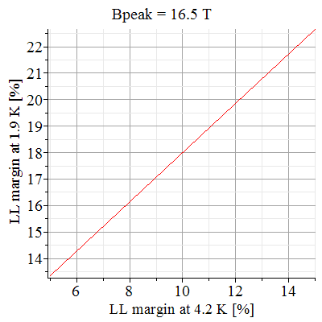
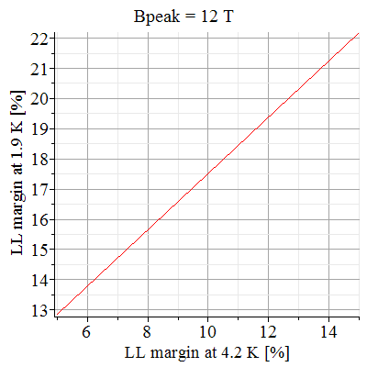
Margin 4.2 K vs 1.9 K (v1)
Basic relation
  B_{peak} in conductor from 12 T to 18 T
  M_{4.2K} from 5% to 15%
  To get 20% @ 1.9 K
  10% @ 4.2 K is optimistic

Slide 15
Physical Margins
What can be used during magnet preliminary design phase? [suggestions from Luca Bottura]
  I/Ic [adim]: « how many strands can be broken » (current margin)
  ΔT [K] : bearable temperature excursion (temperature margin)
  ΔH [mJ cm⁻³]: required energy to increase by ΔT the cable temperature in adiabatic conditions (enthalpy margin)
  MQE (t,v) [mJ cm⁻³], same as before but taking into account temporal and spatial distribution of the energy deposition.
  (MQE requires time to be properly analyzed, see: Enrico Felcini, Analysis of the stability margin of the High Luminosity LHC superconducting cables with multi-strand model, Cern report in progress 18 nov 2015)

Slide 16
Enthalpy margin
Relevance of ΔH compared to MQE
To fairly compare magnet based on ΔH we need the same:
1) specific heat capacity Cp for cable materials [J kg⁻¹ K⁻¹]
2) ‘density’ d for cable material [kg m⁻³]
3) definition of the Nb₃Sn fraction
[courtesy of Enrico Felcini]
Mid-plane cable of QXF
ΔH is obviously conservative
(adiabatic conditions)
but not too conservative.
-> Interesting

Slide 17
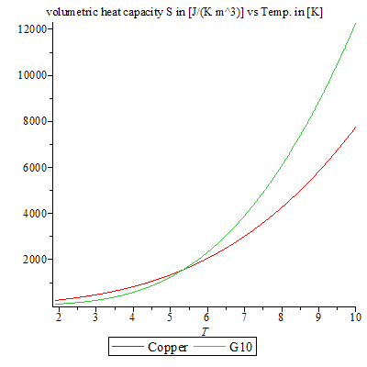
Proposition of Cp fit (Cu&G10)
Cable made of Cu, Nb₃Sn and epoxy (G10)
  G10 [1.9 K to 300 K]:
  Copper [1.9 K to 10 K]:
to get the proper reference for both fits go to:
Giulio Manfreda, Review of Roxie’s material properties database for quench simulation,
cern internal note: 2011-24 (2011)

Slide 18
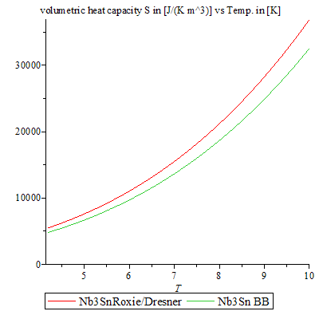
Propositions of Cp fit (Nb₃Sn)
  Option 1 [T < Tcs]:
  Option 2 [T < Tcs, B_{peak2} > 10 T]
B_{peak2} = 16.55 T
to get the proper reference go to:
Giulio Manfreda, Review of Roxie’s material properties database for quench simulation, cern internal note: 2011-24 (2011)
Bernardo Bordini, Thermo-magnetic instabilities in Nb3Sn superconductin accelerator magnets, PhD Thesis, p156-159, (2006)

Slide 19
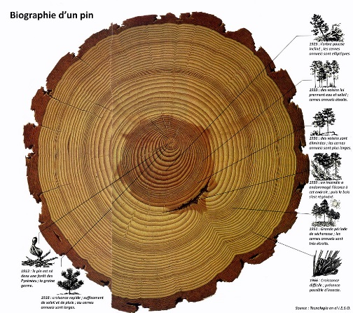
Fraction of Nb₃Sn in the non-Cu
PIT:
~45% Nb3Sn within
the non-Cu fraction
RRP:
~ 60% Nb3Sn within
the non-Cu fraction
Arbitrary proposal: 50 %
C. Tarantini et al., Composition and connectivity variability of the A15 phase in PIT Nb3Sn wires, SuST, (2015)
C. Tarantani et al., Corrigendum: Examination of the trade-off intrinsic properties in the optimization of a modern internal tin Nb3Sn conductor, SuST, (2105)

Slide 20
Enthalpy margin conclusion
Calculation proposal (open to discussion!)
with
with
with option 2 for Cp_{Nb3SN} (BB fit)
Keep in mind that we just need to be consistent in the way we do the calculation for fair comparison and that MQE analysis will certainly be performed in the future.

Slide 21
Thank you

Slide 22
Bonus
L. Bottura, « Cable stability », arxiv.org/pdf/1412.5373

