Slide 1


Common coil 16 T dipole:
Preliminary 2-D magnetic design
F. Toral, T. Martinez, J. Munilla - CIEMAT
1st Annual Meeting, Nov. 19th, 2015

Slide 2
General remarks
The first objective is to check the feasibility of a 16 T dipole in common coil configuration, with accelerator field quality.
The critical current density curve provided by Bernardo has been approximated using one of the models already available in Roxie (Summer’s fit type).
We have used the following wires:
  High field: 38 strands, 1-mm diameter, Cu:Sc=1
  Low field: 24 strands, 1-mm diameter, Cu:Sc=1.5
2

Slide 3
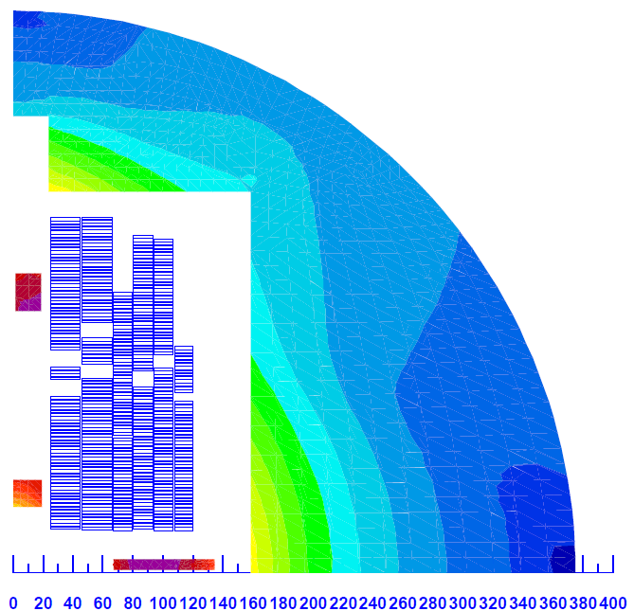
General layout
We have worked out a solution based on three double pancake coils, the innermost one wound with high field cable.
We have avoided the use of ancillary corrector coils.
A high number of conductors: 446
  High field coil: 40/4/40+46/8/32=154
  Low field coil 1: 28/43+43/41=155
  Low field coil 2: 49/35+39/14=137
The overall number of strands is 12860.
Nominal current is 10380 A.
The stored energy is 7.94 MJ, that is, a self-inductance of 147 mH/m.
Huge Lorentz forces: horizontally, 20.2 MN/m, and vertically, 9.4 MN/m.
Large pressure: for instance, in block 11, overall vertical force is 2.94 MN/m, which yields an average pressure of 147 MPa on a 20-mm wide cable.
3

Slide 4
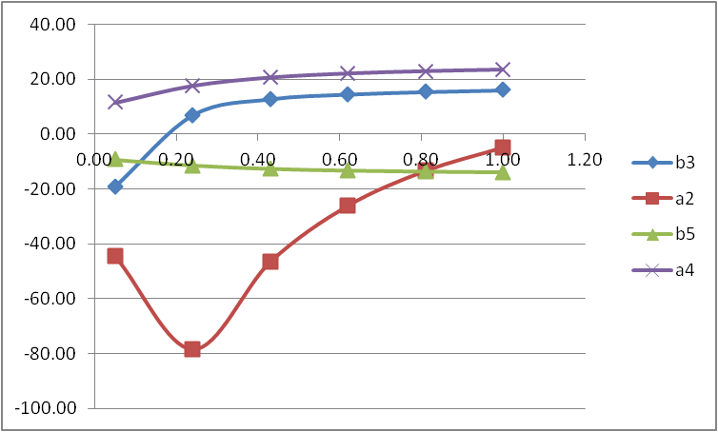
Field quality (I)
The field quality at a given current can be optimized, but the variation of the field multipoles with current is very large.
Multipole a2 shows the largest influence of iron saturation.
4

Slide 5
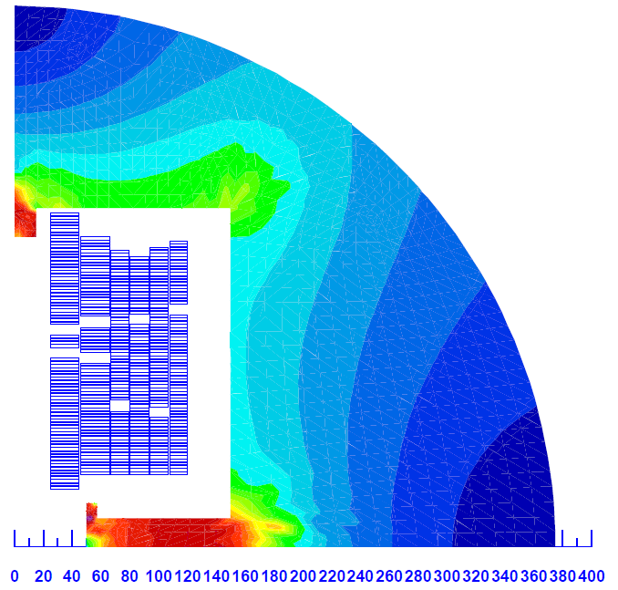
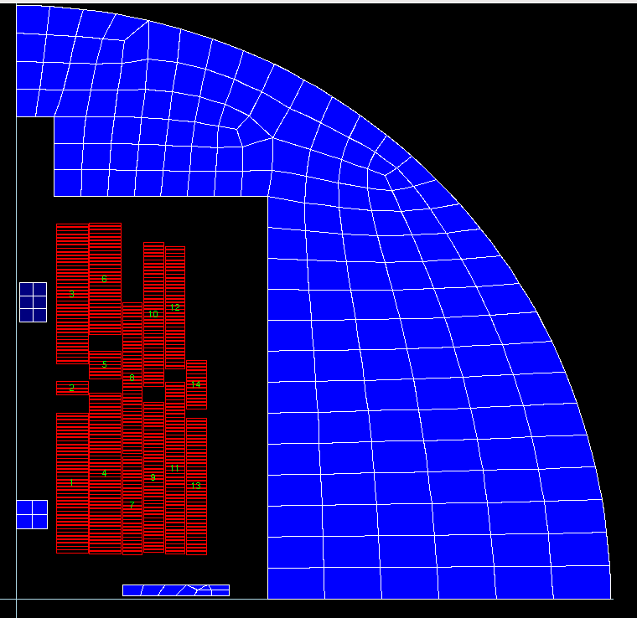
Field quality (II)
Different strategies have been tested to decrease the multipole field variation with current:
  Shaping the iron: holes, noses, simple ring, shims.
  Shifting individual blocks (no symmetry).
5

Slide 6
Operation margin
Block # | %
1 | 89.3
2 | 87.7
3 | 88.6
4 | 79.2
5 | 74.1
6 | 66.8
7 | 95.5
8 | 66.8
9 | 96.6
10 | 60.1
11 | 96.9
12 | 56.6
13 | 94.2
14 | 53.6
The peak field at HF coil blocks is 16.38 T, while it is 15.58 T at LF coil blocks.
The peak field at LF coil blocks could be reduced if they are moved away from the mid-plane, but it spoils the field quality.
A fourth coil is not very efficient and quite expensive solution.
More strands in the low field cable do not help, because the current density decreases and so the field at the aperture.
More cables could be added to the existing blocks, but they spoil the field quality.
Further work on field quality optimization is necessary.
6

Slide 7
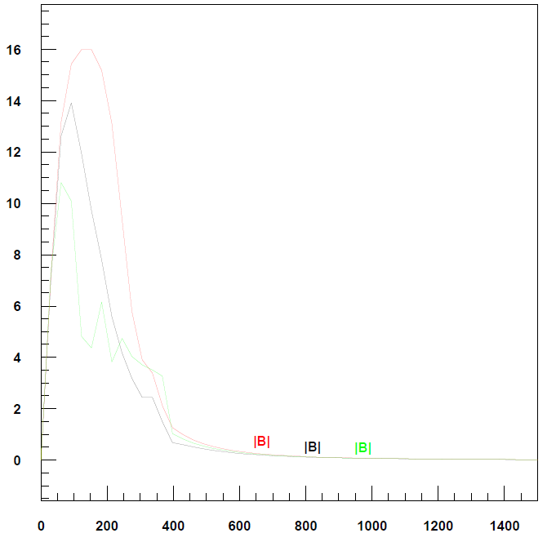
Fringe field
The fringe field in a common coil layout is relatively low.
Without iron, field is 1.35 T at 400 mm off center and 72 mT at 1 m off center.
With a 750-mm outer diameter iron, those fringe fields are reduced to 1.25 T and 72 mT, respectively.
The iron enhances the field created by free currents in 1 T.
7

Slide 8
Conclusions
Main challenges of a 16-T dipole magnet with common coil layout are identified:
  Field quality is difficult to achieve because of the iron saturation.
  Huge Lorentz forces and stresses, because of the large number of cables and high field.
Further work is necessary to refine the present solution and to identify the sensitivity of the evaluation parameters to the design variables.
A first 3-D design will be performed to evaluate the impact of the coil ends on the integral field quality.
8

