Slide 2
Circuit-protection aspects of different preliminary magnet-design options
M. Prioli, B. Auchmann, A. Verweij with input from H. Thiesen
20.11.2015, Orsay, France

Slide 3
Outline
Overview relevant parameters.
Magnet parameters from last
coordination meeting (9 Oct.).
Parametric study.
Conclusions.

Slide 4
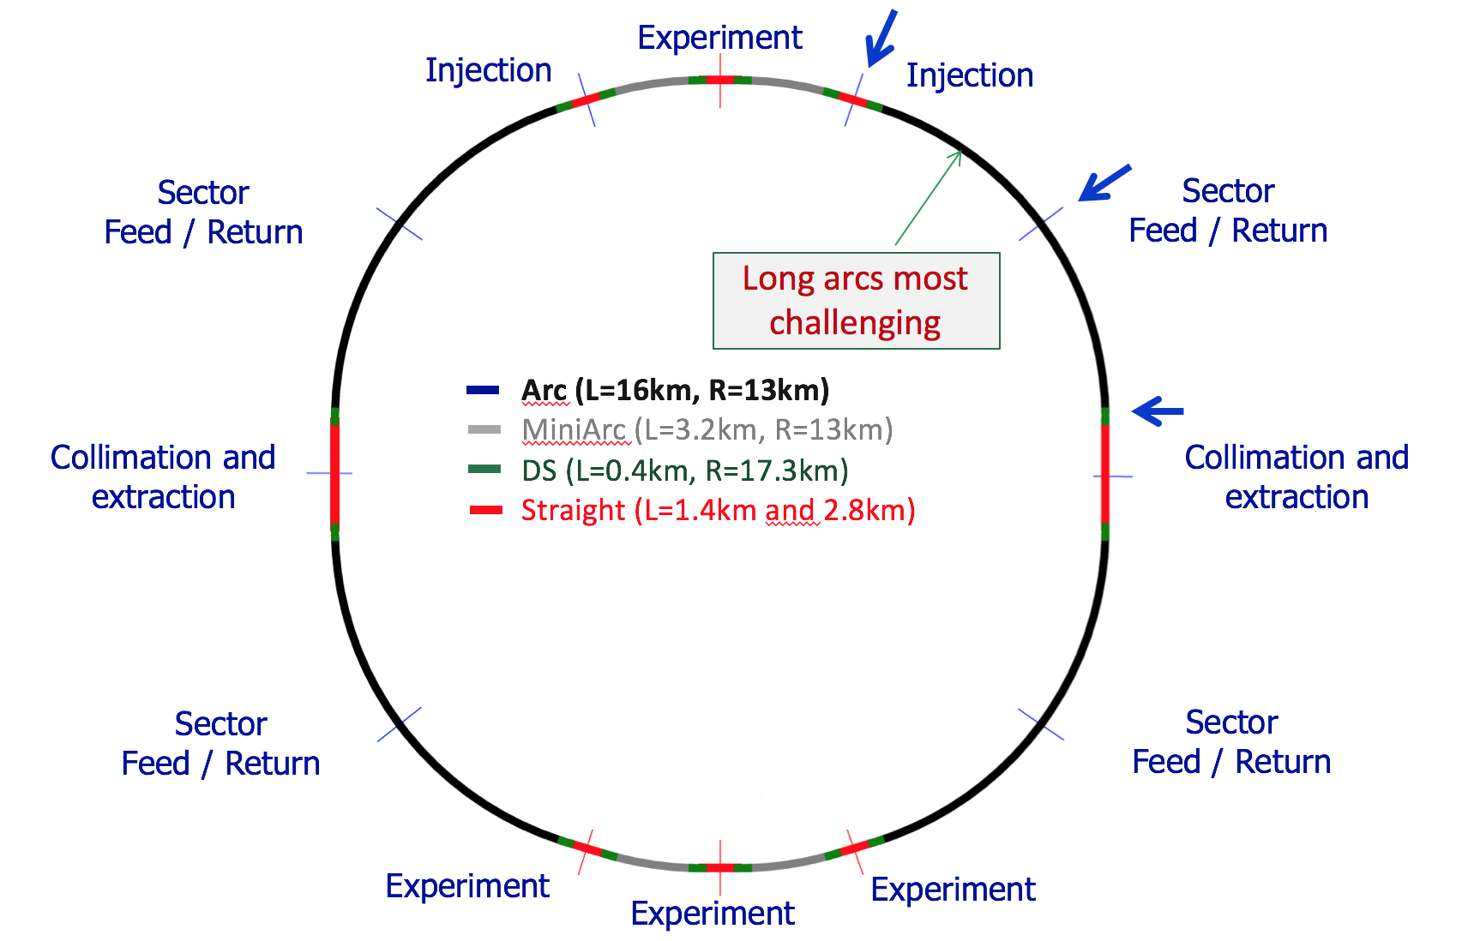
Layout
From R. Schmidt, FCC week Washington, March 2015.

Slide 5
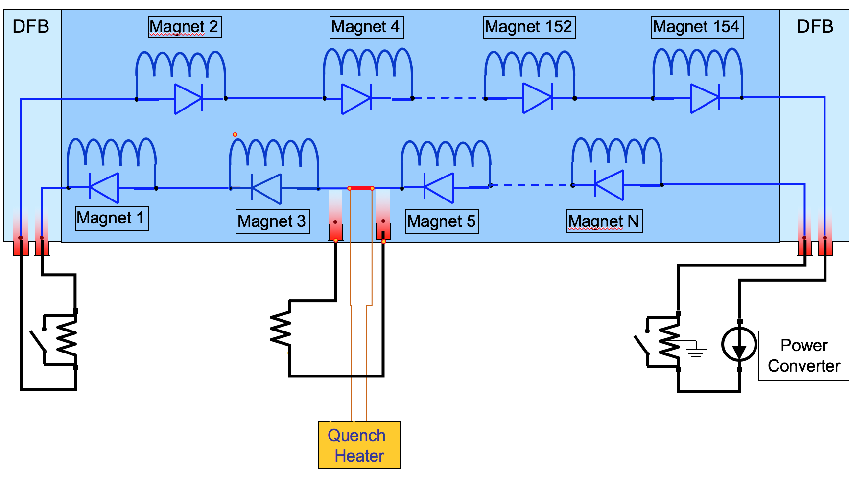
Circuit
From R. Schmidt, FCC week Washington, March 2015.

Slide 6
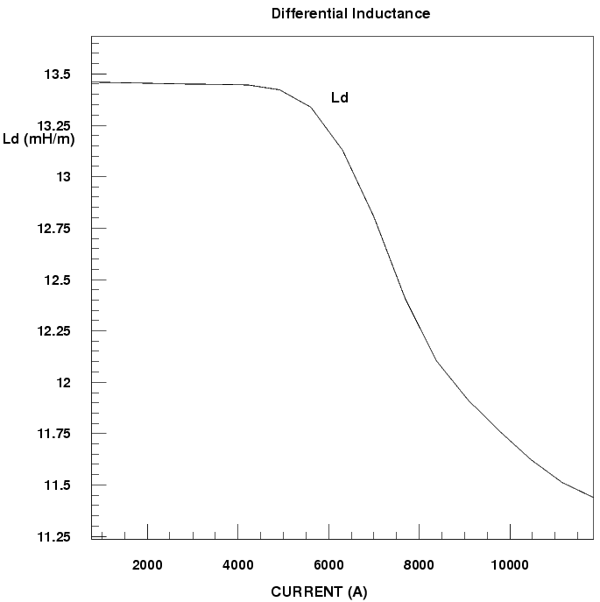
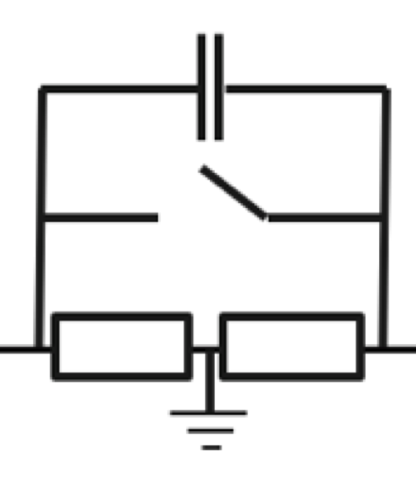
Magnet Design Parameters
I_{nom}, I_{ultim}.
L_{d}@inj, L_{d}@ultim
Stored energy E@ultim
V_{gnd}: max. voltage to ground during fast
power abort without quench or earth fault.
Derived quantity:
  test voltage to ground, e.g.,
  V_{test} = 2*V_{gnd} + V_{quench} where
  V_{quench} includes a heater failure
  (LHC RB circuit).
11-T dipole 20% vairation of L_{d}.
EE unit with central
grounding point.

Slide 7
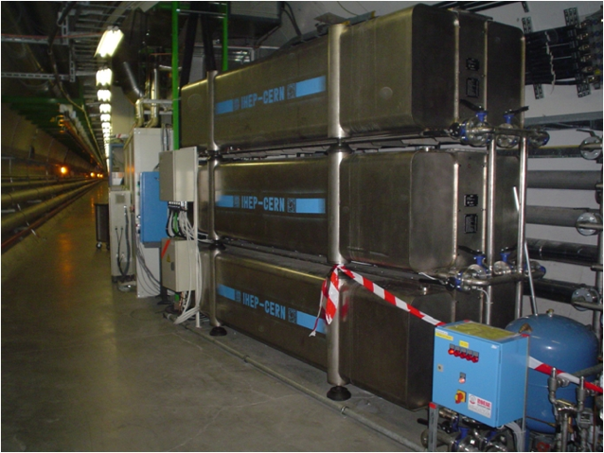
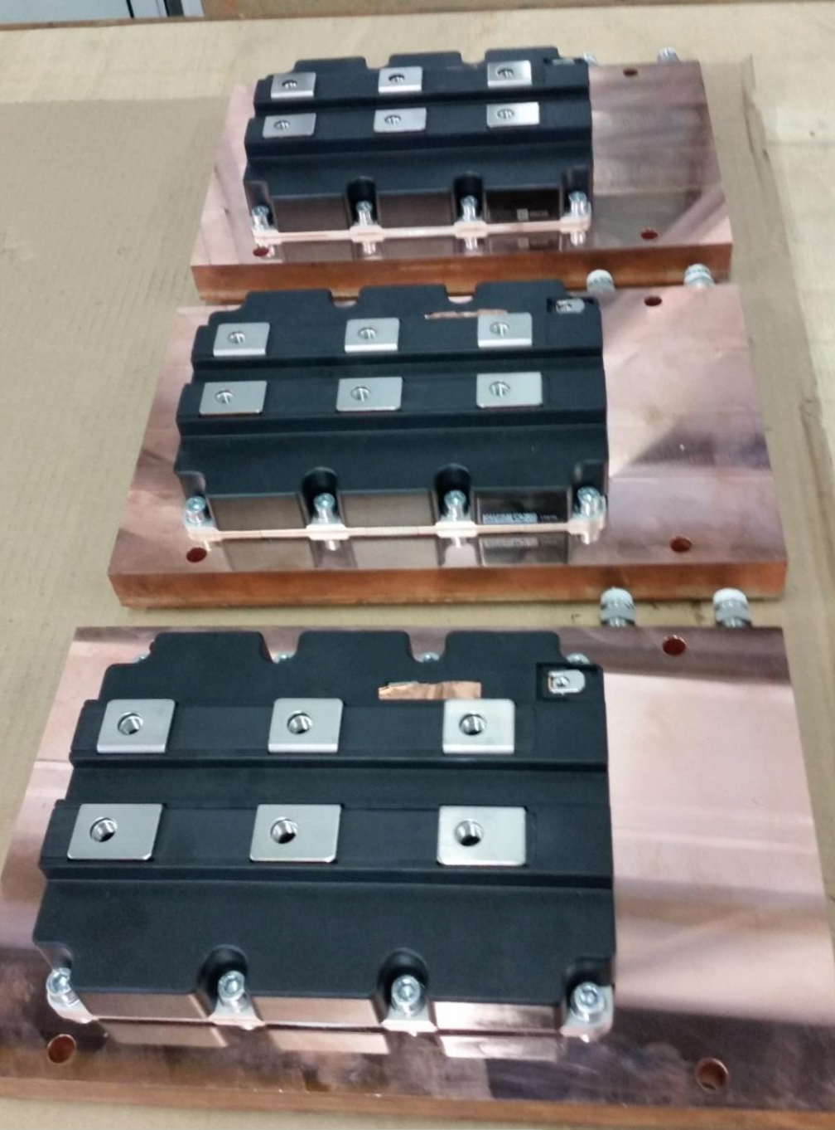
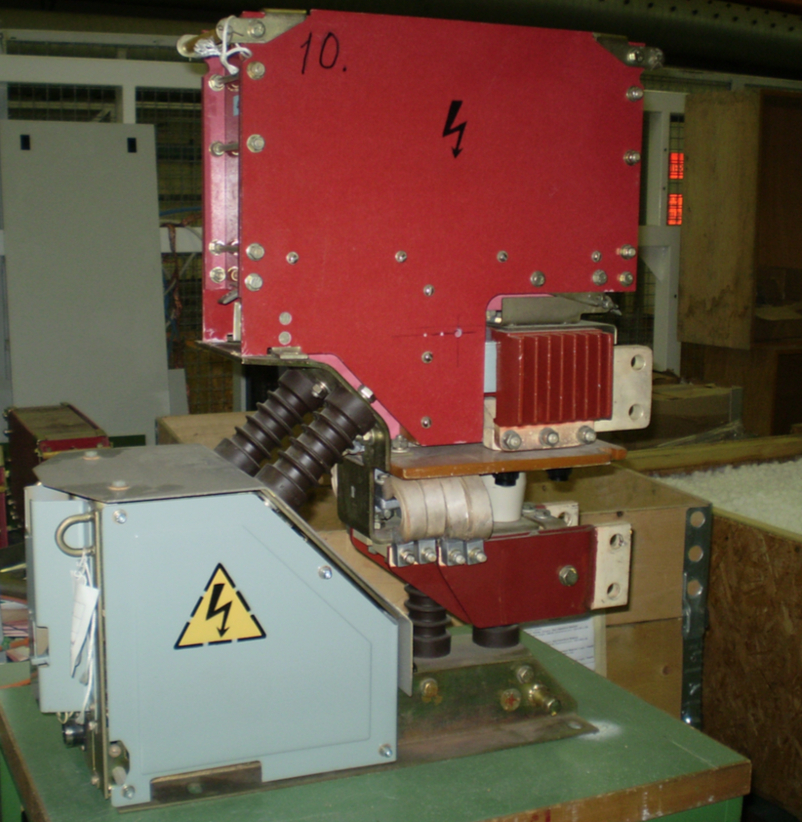
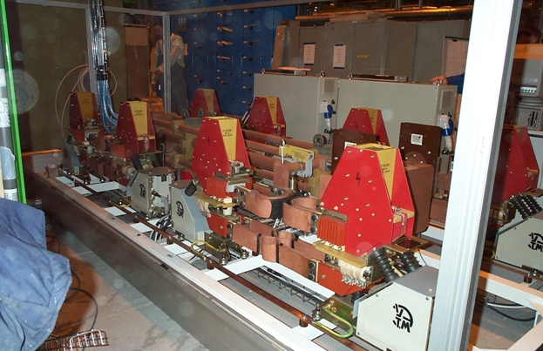
FPA time, EE parameters.
Max. MIITs for diode (heat-sink),
busbar and joint (stabilizer), and DFB leads.
Derived quantity:
  Fast power-abort (FPA) time constant t_{FPA}.
  e.g., t_{FPA} = 100 s (LHC RB).
EE design consideration:
  cool-down time (LHC ~2 hours),
  semi-conductor, electro-mechanical, or superconducting.
RB EE resistor
Electro-
mechanical
switch
RB switch
IGBTs
on heat sink
Courtesy of Knud Dahlerup-Petersen, Gert-Jan Coelingh, Alexandr Erokhin

Slide 8
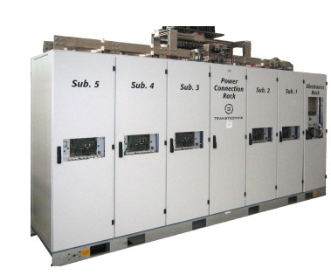
PC Parameters
PC max. voltage
  Negotiable. 2 kV may be reasonable.
PC max. current
  30 kA upper limit.
PC max. power
  60 MW?
  Total FCC power consumption
  during ramp should be minimized.
LHC RB power converter.

Slide 9
Other Parameters
Operations/Availability
  Ramp rate dI/dt ~ I_{nom}/t_{ramp}.
  e.g., t_{ramp} = 1800 s (here 30 min, LHC 20 min, faster?).
Cryogenics
  Max. heating from warm-cold transitions.
Cost
  Cost per PC ~ 1-2 MCHF*
  Cost per EE ~ 300 kCHF* (electro-mechanical)
  Cost for caverns?
Free parameters
  N_{sec} number of powering sectors, min. 8.
  N_{EE} number of EE units per powering sector.
*… roughest of estimates!

Slide 10
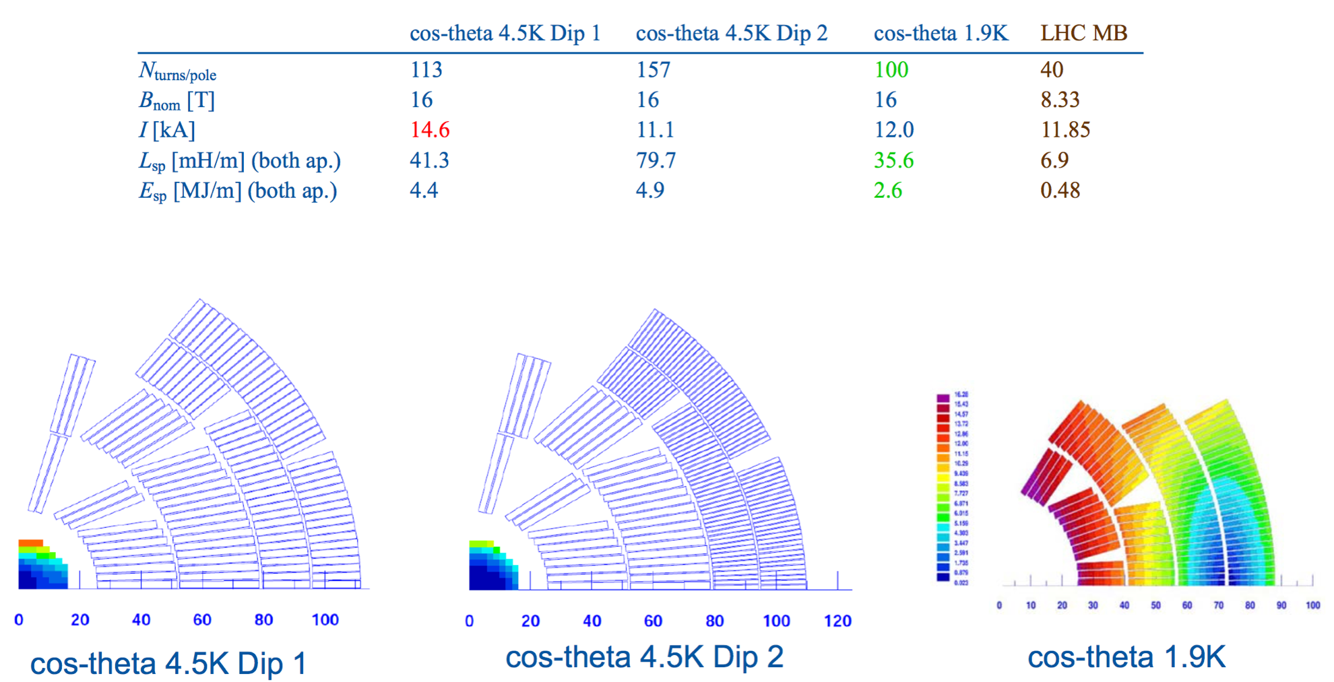
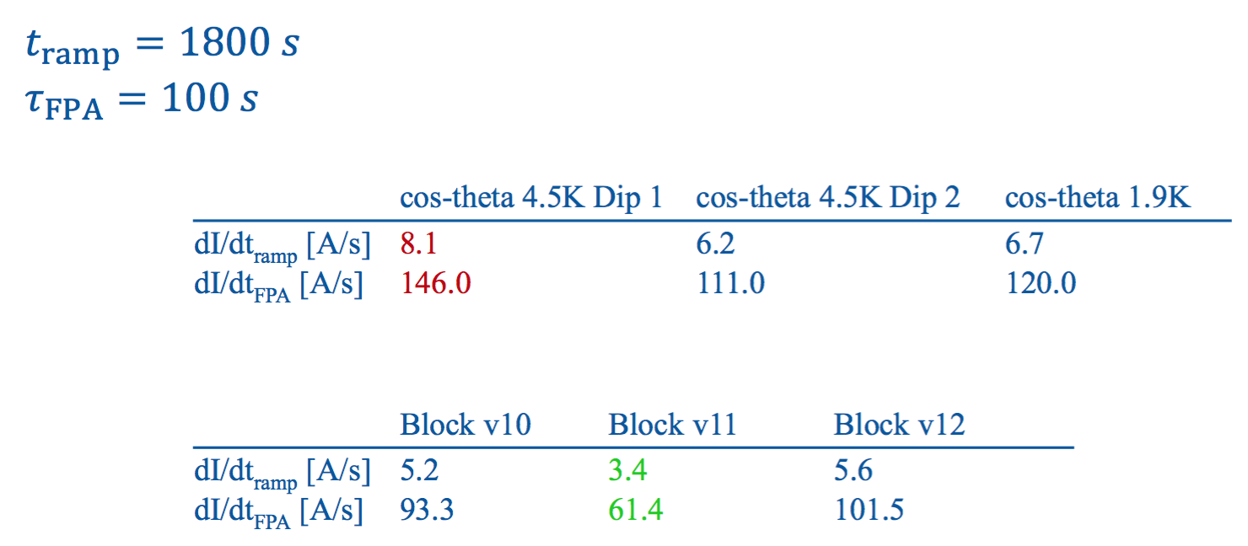
Magnet Variants Cos-Theta
Data from EuroCirCol WP5 coordination meeting on 9 Oct. 2015.

Slide 11
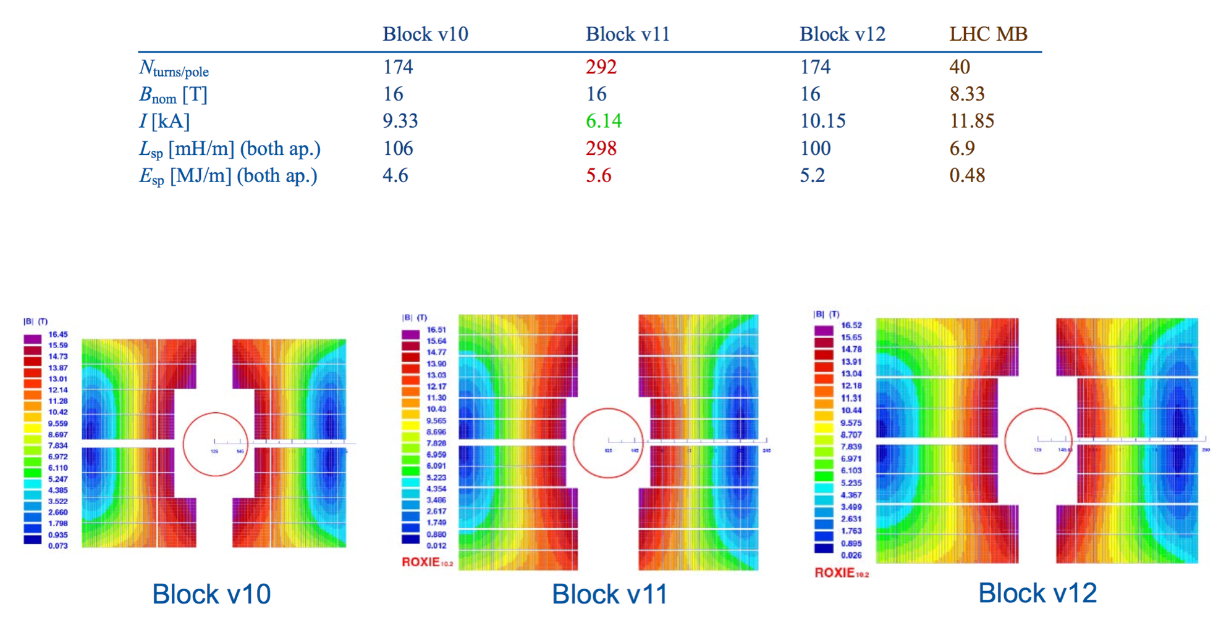
Magnet Variants Block Coils
Data from EuroCirCol WP5 coordination meeting on 9 Oct. 2015.

Slide 12
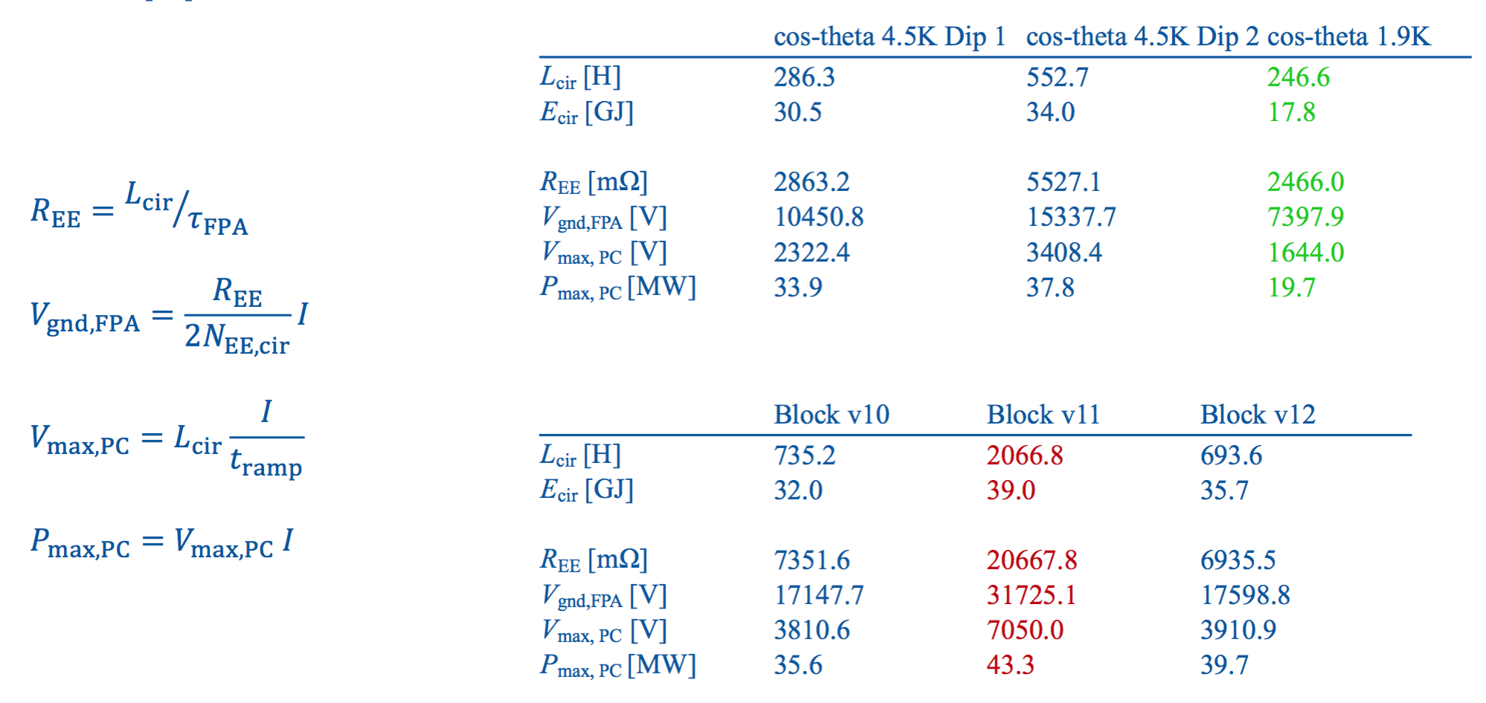
LHC Circuit Configuration
lowest Ld
N_{sec} = 8, N_{EE} = 2
highest Ld

Slide 13
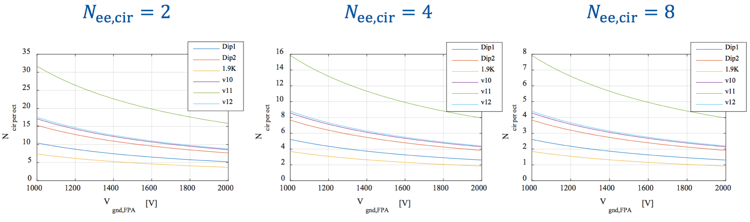
Parametric Study
N_{cir per octant} number of powering sectors per octant, N_{sec} = N_{cir per octant} * 8.
Lowest inductance, lowest N_{sec} and N_{EE}.
Highest inductance and V_{gnd} =1 kV : N_{sec} = 64, N_{EE} = 8.

Slide 14
Conclusion
Circuit protection does not put hard constraints on magnet design.
Low-inductance magnets are intrinsically advantageous:
  Reduced number of circuits and EE units.
  Reduced voltage in magnet during quench.
  Lower power consumption.
Voltage-to-ground has large impact on N_{sec} and N_{EE}.
  Need ambitious design goal and risk analysis for test voltage.
Cost of PC/EE critical only for very large N_{sec} and N_{EE}:
  Extreme example: 64 powering sectors, 8 EE units each:
  128 MCHF + 154 MCHF + cavern cost.
Availability considerations need to be studied.
  Mean-time to failure in PC, etc.
  For training, shorter powering sectors are advantageous.

Slide 15
Areas to work on
Fast transient analysis
Diode/busbar design
EE conceptual studies

