Slide 1
The hadronic matter and heavy ion collisions at relativistic energies
Ginés MARTINEZ GARCIA
Directeur de Recherche du CNRS
Subatech (CNRS/IN2P3 – École des Mines de Nantes - Université de Nantes), France
CORE-U Joint Seminar,
Monday, Oct 5th 2015, Hiroshima, Japan

Slide 2
Outlook of the seminar
Introduction.
Hadronic matter phase diagram (lQCD).
Golden probes.
Heavy Ion Collisions.
Experimental Results.
More on Heavy Flavour and Quarkonium.
Future ALICE program for run#3.
MFT project.
Conclusions.

Slide 3
Key Questions
What are the fundamental properties of strongly interacting matter as a function of temperature and density?
How do hadrons acquire their mass and how is the mass modified by the medium they move in?
What are the properties of the quark gluon plasma?
To which extent did these properties govern the
evolution of the universe?
Are there colour superconductors and highly dense gluonic objects in nature?
NuPECC Report

Slide 4
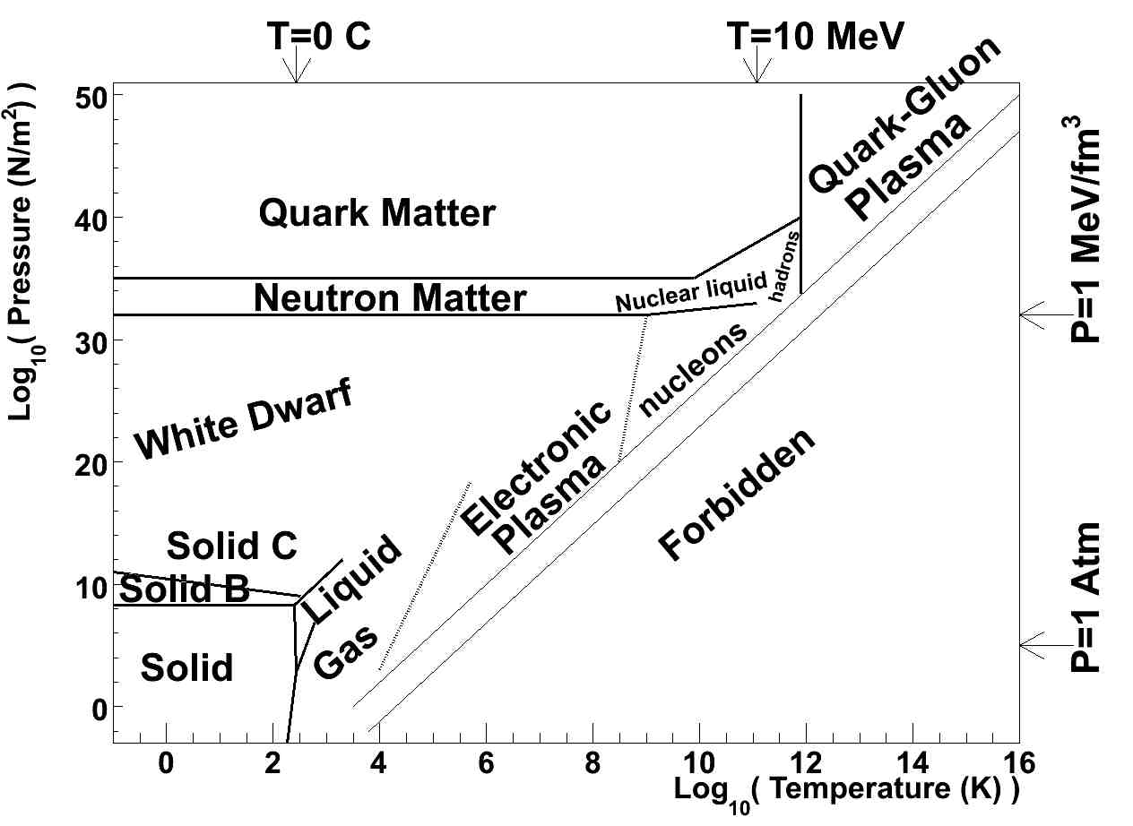
Phase Diagram of Matter

Slide 5
Hadronic matter at high T
Before the discovering of the QCD asymptotic freedom, Hagedorn tried to imagine the properties of matter at high T (in the 60’s).
Hadronic resonances are created increasing the internal degrees of freedom of the system;
Hagedorn realized that the number of hadron species increases exponentially with the hadron mass.

Slide 6
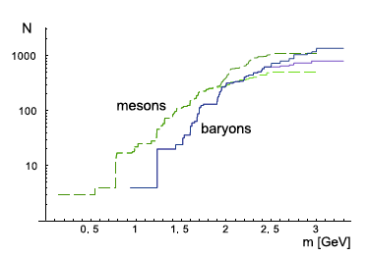

Hagedorn limit temperature
T_{H} is the Hagedorn temperature
W. Broniowski et al., PRD 70,117503(2004)
When matter try to reach the T_{H} temperature, energy is used to increase the number of hadronic resonances.
In consequence, infinite energy will be needed to reach a temperature T_{H} (~170 MeV) of matter. T_{H} becomes the limit temperature of the matter.
R. Hagedorn, Nuovo Cimento Supplementovol.3, page 147 (1965)

Slide 7
Main QCD properties
Hadron are not punctual particles!
They are bound states of quarks (meson=q-qbar, baryon=qqq).
Gluons are the carrier.
The strong force charge” is the colour.
Gluos are a coloured carrier (non abelian QFT).
Quark are confined in hadrons.
The strength of the interaction is >1.

Slide 8
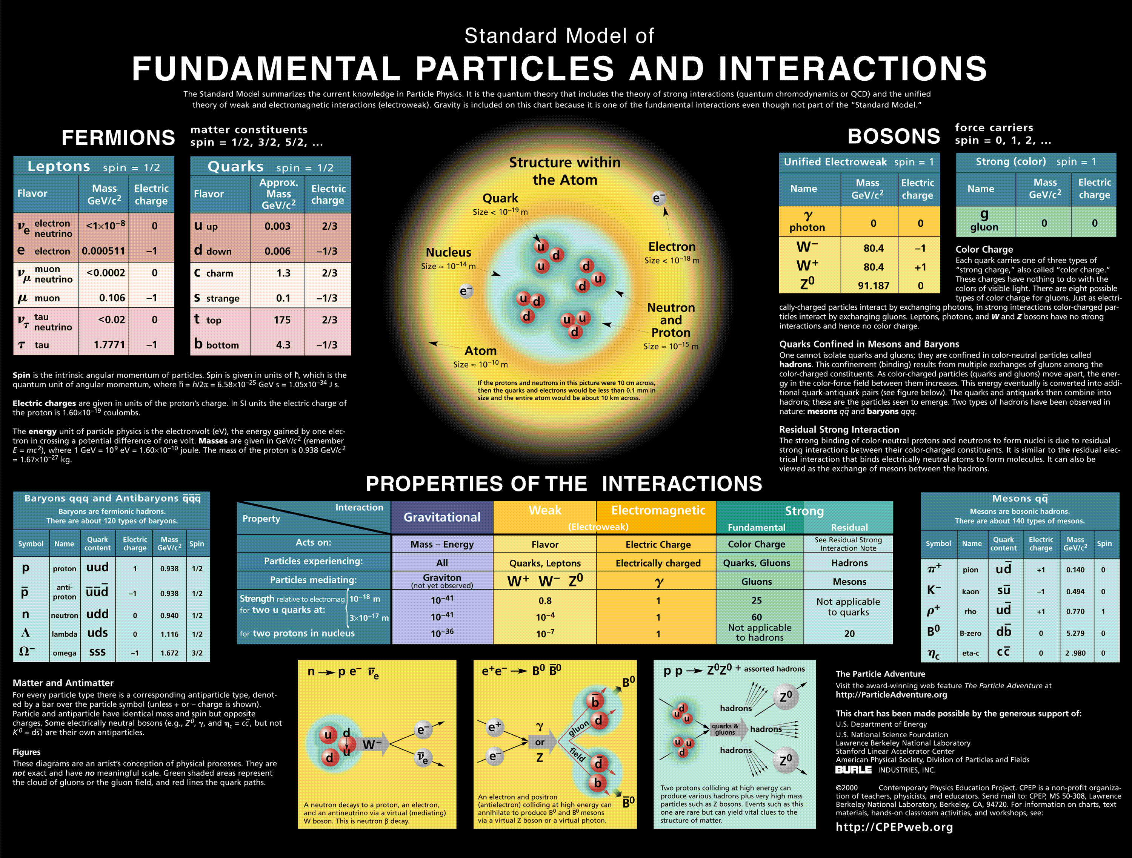
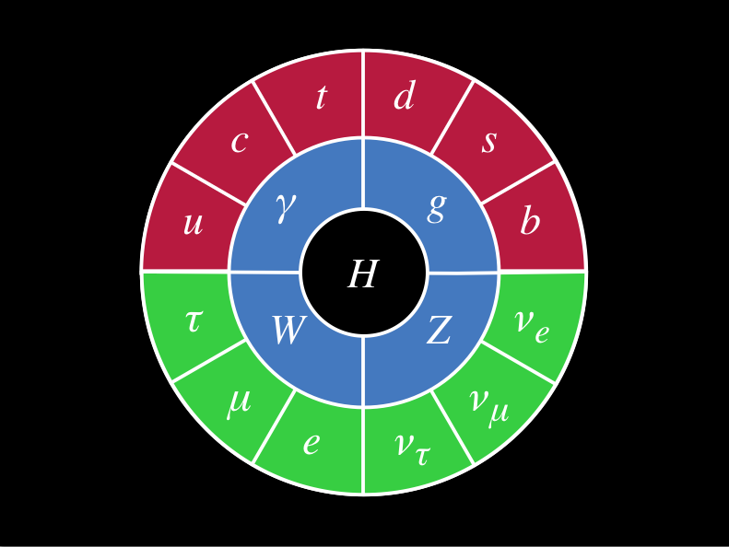
QCD part of the SM

Slide 9
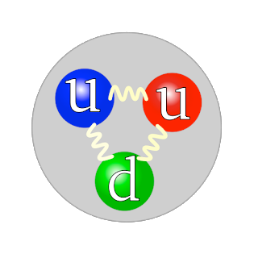

QCD mass
In QCD, the proton is the bound state of three quarks:
  M_{u} = 2.3 MeV/c²,
  M_{d} = 4.8 MeV/c².
The mass of the proton is 938 MeV/c².
Indeed, 99% of our mass is generated by the QCD interaction! 1% by the Higgs.
Frank Wilczek (1951- ), Physics Nobel Prize 2004 said:
According to QCD, it is the colour field that makes us weight. It does provide, quite literally, “mass without mass”.

Slide 10
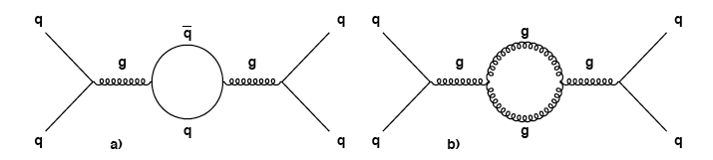
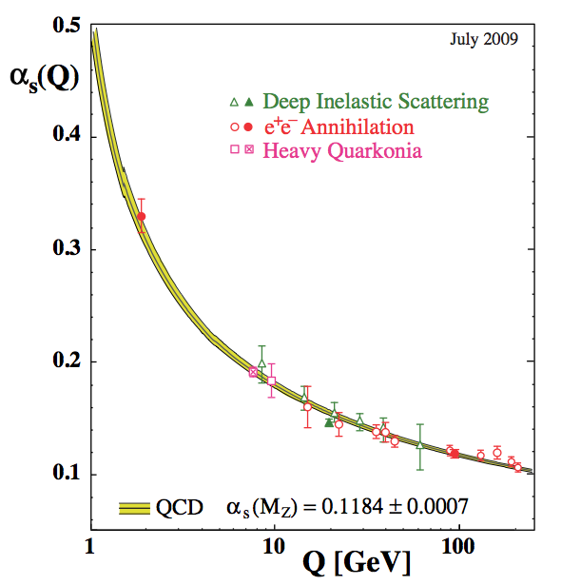

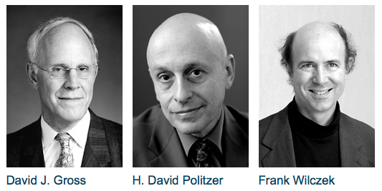
Asymptotic freedom
1st diagrams of vacuum polarization
Nobel Prize in Physics 2004
http://pdg.lbl.gov/index.html
http://www.nobelprize.org/nobel_prizes/physics/laureates/2004/

Slide 11
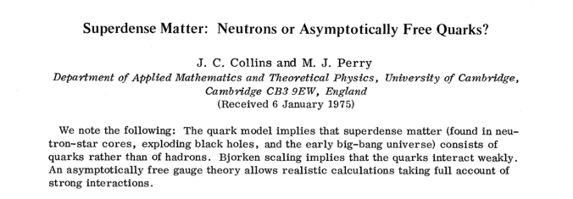
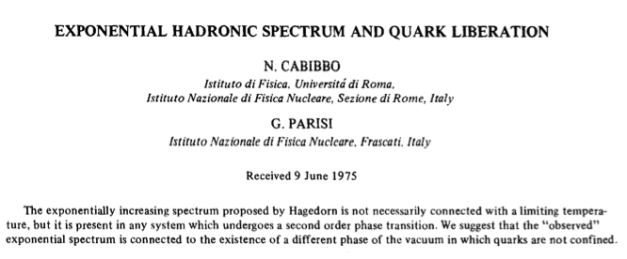
PRL 34 1353 (1975)
PLB 59 67 (1975)

Slide 12
“Quark-Gluon Plasma”
PLB 78B 150 (1978)
Collisions p,π on p and A at ISR energies
“Quark Gluon Plasma” in [5] E.V. Shuryak, Zh. Eksp. Teor. Fiz 74 (1978) 408

Slide 13
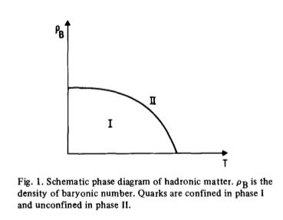
Hadronic Matter in 1975
Free Quarks
Quark Liberation
Quark-Gluon Plasma
Deconfined Matter
PLB 59 67 (1975)
Confined Matter
Why a phase transition?

Slide 14

Chiral Symmetry breaking
QCD Lagrangian of massless Quarks
Quark helicity invariant
Invariant under Chiral symmetry transformations
The Chiral symmetry is spontaneously broken
Massless goldstone bosons exist: the light hadron: pion, kaon
Chiral symmetry is restored at high energy or T
Masses of the pion, kaon ≠ 0 : Quark are not exactly massless (u,d,s). Chiral symmetry is explicitly broken
Phase transition (or cross-over) should take place
Decofinement (m=∞) and Chiral transition are the same in QCD?

Slide 15
Analogy of the Chiral Breaking
Transition | Chiral | Ferromagnetic
Spontaneously broken | SU(3)_{L}xSU(3)_{R} | Isotropie O(4)
Order Parameter | Condensate <qq>≠0 | Magnetisation≠0
Waves | Goldstone bosons: π, K, η | Spin waves
Explicitly broken | Mass of the quarks | External Magnetic field
T. Schaefer hep-ph/0509068

Slide 16
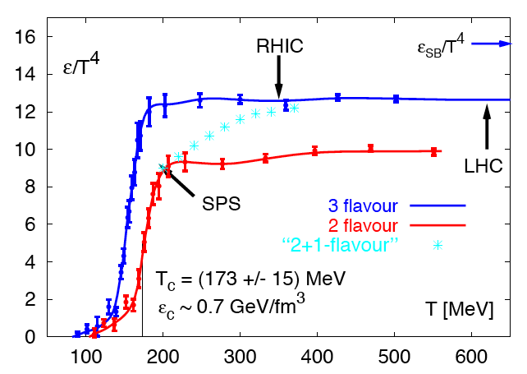
Lattice QCD calculations
μ_{B}=0
Hadron Gas to QGP phase transition
Not latest lQCD results!
F. Karsch, hep-lat/0106019 & hep-ph/0103314

Slide 17
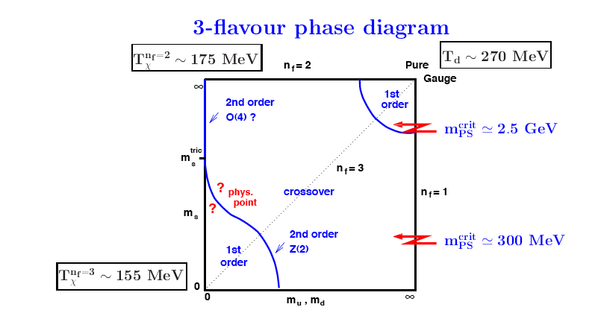
Crossover vs phase transition
Not latest lQCD results!
F. Karsch, hep-lat/0106019 & hep-ph/0103314

Slide 18
Hadronic Matter lay-out
μ_{B}=0
lQCD
μ_{B}≠ 0 models

Slide 19
Golden “probes” of QGP
Thermal radiation from QGP;
Heavy quark potential in QGP;
Parton-QGP interaction

Slide 20
Thermal Radiation
Golden probe to measure the temperature of the QGP;
It can be real (γ production) or virtual (γ*=>e⁺e⁻) dielectron production;
Black-body radiation tells us photon yield from thermal radiation strongly depend on T (T⁴);
The macroscopic QGP will “radiate” not only photons, but leptons, gluons etc … Ideed QGP radiation and QGP is somehow the same!

Slide 21
Black-body photon rates

Slide 22
Caveat for small QGP drops
Body thermal radiation is a bad approximation for a QGP of 7 fm diameter since the mean path of a photon or lepton in QGP will be larger that its diameter.
Therefore photon emitted by the QGP are not in equilibrium with the QGP.
Yields scale by a factor ~α_{QED}/α_{QCD}~0.02 (at GeV scale).

Slide 23

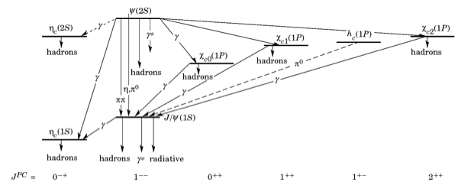
Quarkonium
Bound state of Q and its anti-Q:
  Charmonium for c-cbar: J/ψ, ψ’, χc;
  Bottomonium for b-bar: upsilon family 1S, 2S and 3S.
Properly described by QM:
Charmonium family

Slide 24

Colour Screening (CS)
Vacuum
In medium
T_{D}<T
T_{C}<T<T_{D}
r₀
Quarkonium
Bound State
Bound State
Melting of the Quarkonium
Deconfinement of Heavy Quarks
Heavy Quark: c or b
Light Quarks and Gluons
Matsui & Staz, PLB 178, 416 (1986)

Slide 25
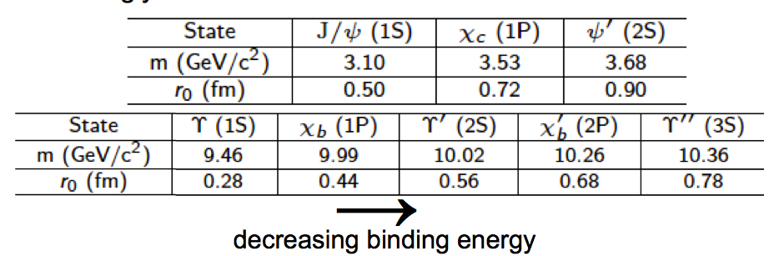
CS of the heavy quark V(r)
Colour charges in the QGP could screen the potential between two heavy quarks:
Only if λ_{D}(Debye Length)<r₀(size of the quarkonum) screening occurs;
λ_{D} depends on QGP temperature.

Slide 26
Dissociation Temperature
A. Mocsy and P. Petreczky in S. Abreu et al. Journal of Physics G,054001 (2008) arXiv:0711.0974v1.
ψ’ and χ_{c} melt at QGP transition.
J/ψ and ϒ(2S) melt at similar temperatures.
ϒ (1S) needs very hot QGP to be melted.

Slide 27
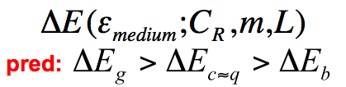
Parton-QGP interaction
E
E-ΔE
q,g
ΔE
How is the energy dissipated in the medium?
Depending on colour density in the QGP;
Casimir factor (C_{R}): 4/3 for q , 3 for g
Dead cone effect: important for beauty 5 GeV/c²

Slide 28
Heavy Ion Collisions

Slide 29
Experimental Method
Heating matter with Ultra Relativistic Heavy Ion Collisions.
The first problems to be solved:
      More complex than an incoherent superposition of individual parton-parton (nucleon-nucleon) collisions.
      Full Thermal and Chemical Equilibration of the system.
      Nuclear Dynamics under control
Looking for Probes of the equilibrated and highly excited matter.

Slide 30
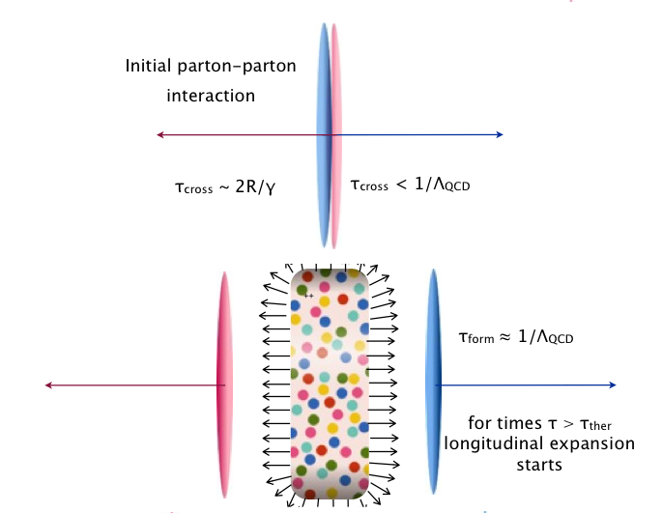
Bjorken Model I
sqrt(s)>20 GeV
At LHC
ε₀ ~ 10-40 GeV/fm3
T_{i} ~ 350-550 TeV
Bjorken PRD27 140 (1983)

Slide 31
Bjorken Model II
Bjorken PRD27 140 (1983)

Slide 32
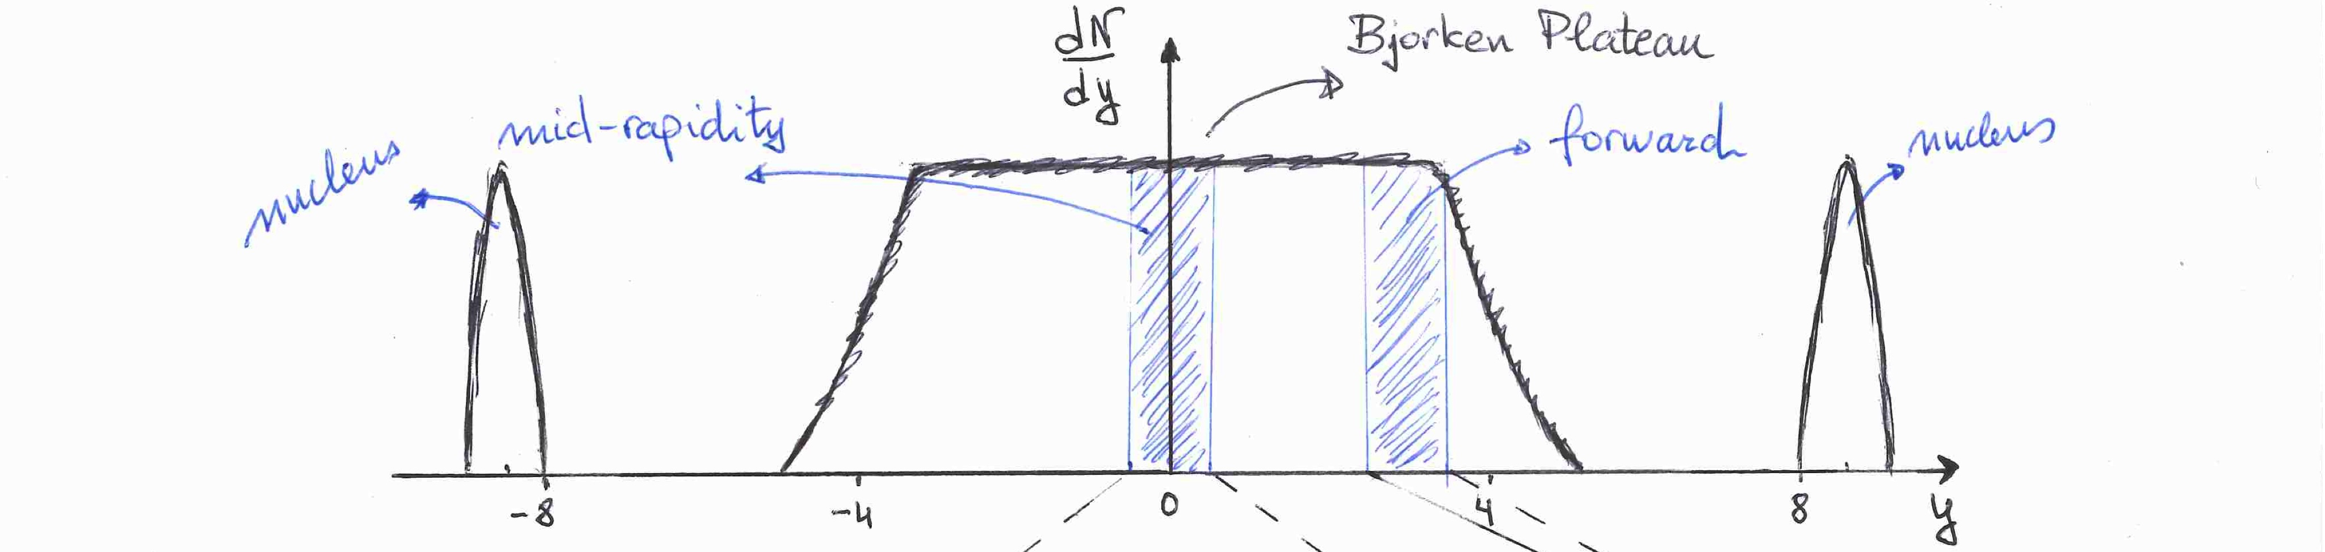
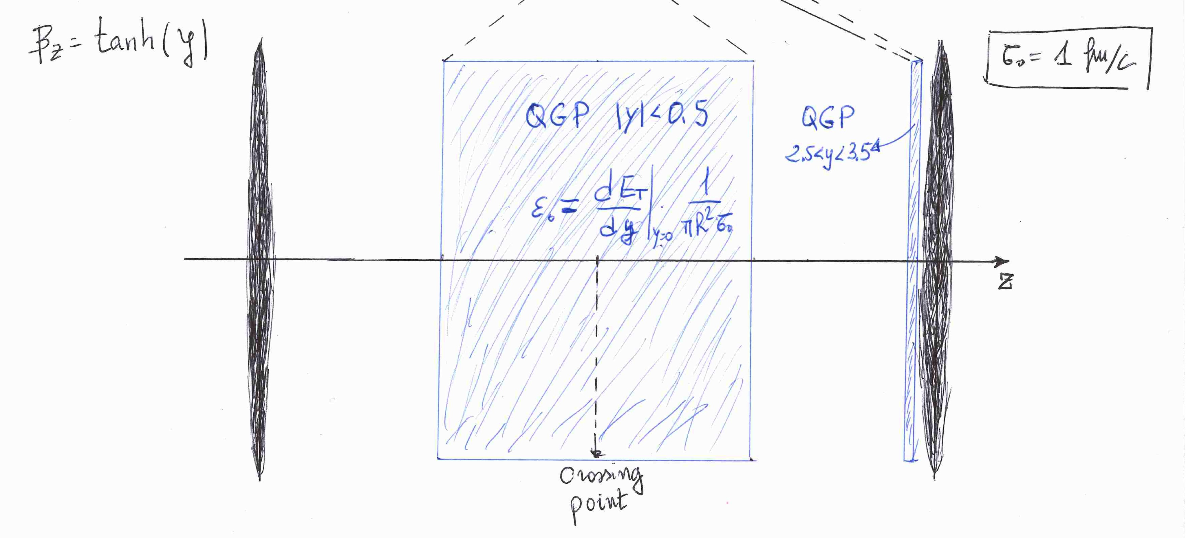
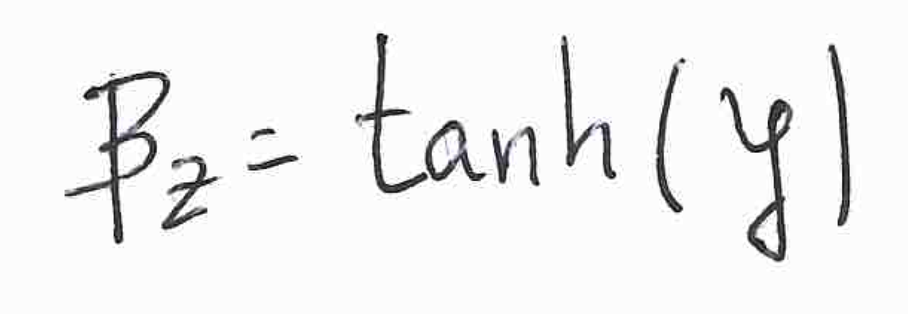

Slide 33
QGP droplet rapidity
QGP is produced along Bjorken rapidity plateau, provided that the charged particle density is large enough.
To some extend, many QGP droplets coexists in a single heavy ion collisions.
Initial condition like gluon density, energy density, charm density etc. varies with rapidity.

Slide 34
Heavy Ion Facilities
SPS Heavy Ion accelerator (1986-):
  Pb, In at 158A GeV, O, S at 200A GeV on fixed target;
  NA35,WA80, CERES, WA98, NA50, NA49, NA57, NA60..
RHIC, BNL (2000 - ?):
  Au+Au at 62, 130, 200A GeV, d+Au at 200 GeV, p+p at 200GeV and Cu+Cu at 62 and 200A GeV;
  PHENIX, STAR, PHOBOS, BRAHMS;
LHC, CERN (2010 - ?):
  PbPb at 5.5A TeV;
  ALICE, CMS, ATLAS;

Slide 35
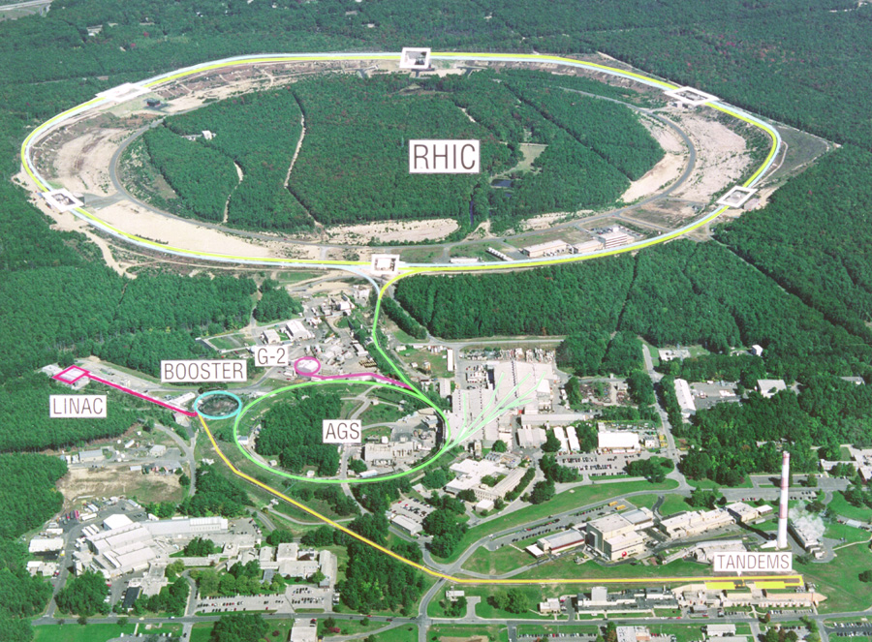
Relativistic Heavy Ion Collider
3.83 km circumference
Two separated rings
  120 bunches/ring
  106 ns bunch crossing time
A-A, p-A, p-p
Maximum Beam Energy :
  500 GeV for p+p
  200A GeV for Au+Au
Luminosity
  Au+Au: 2 x 10²⁶ cm⁻² s⁻¹
  p+p : 2 x 10³² cm⁻² s⁻¹
Mid-rapidity at 90º
Interaction Point
Upton, Long Island, New York

Slide 36
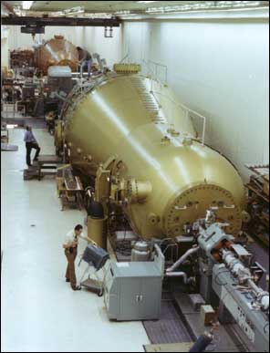
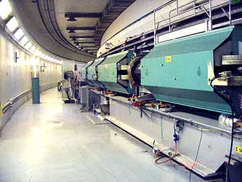
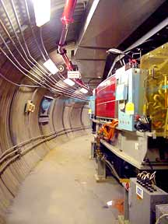
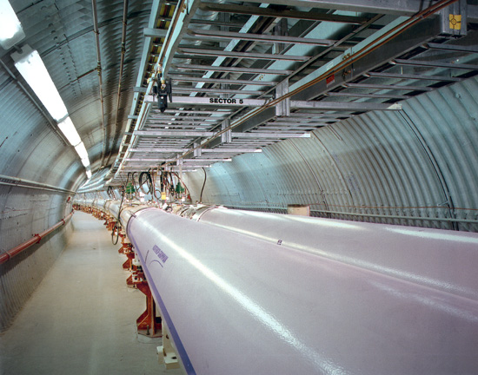
Accelerator Elements
Tandem Van de Graaff
Au+77 to Au+79
9A GeV
Booster
Au+32 to Au+77
~90A MeV
AGS
Alternating Gradient Synchroton
Au⁺⁷⁹+Au⁺⁷⁹
100A GeV
Au⁻ to Au^{+12,} Au⁺³² 1A MeV
RHIC
Relativistic Heavy Ion Collider

Slide 37
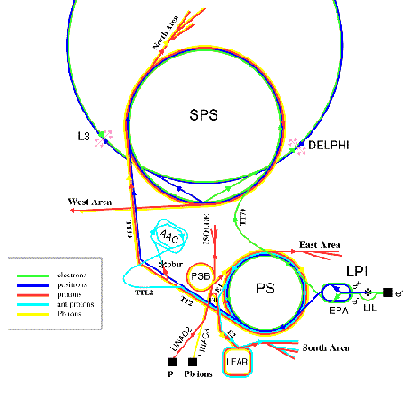
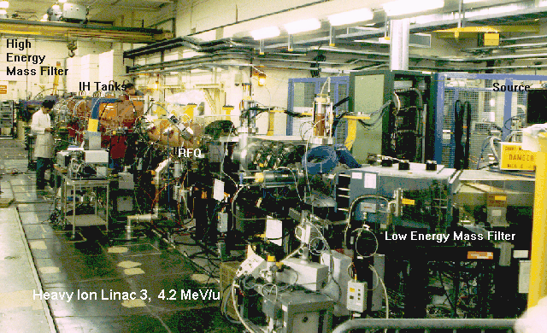
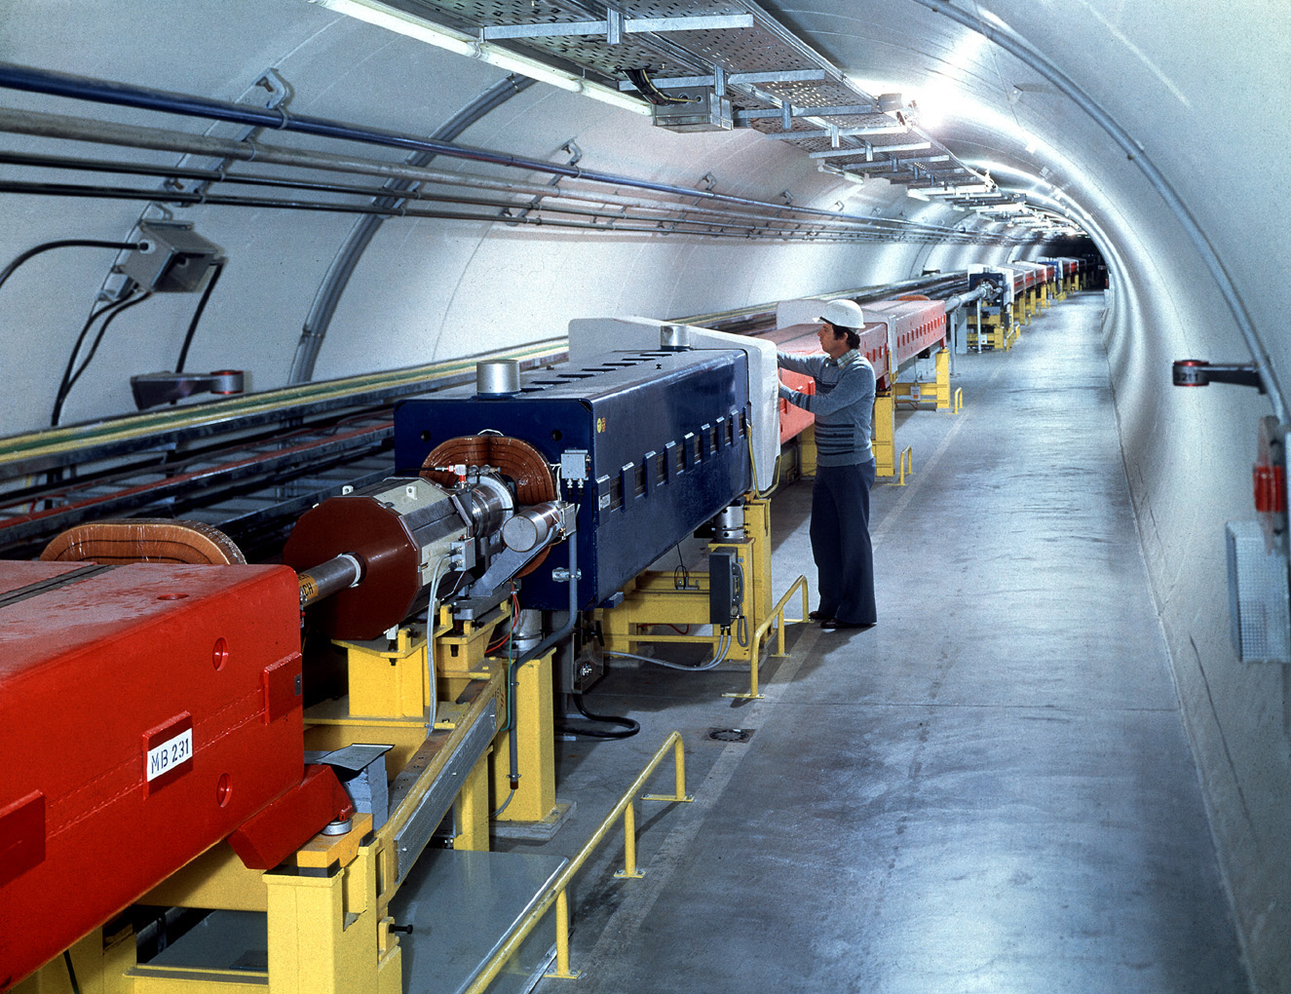
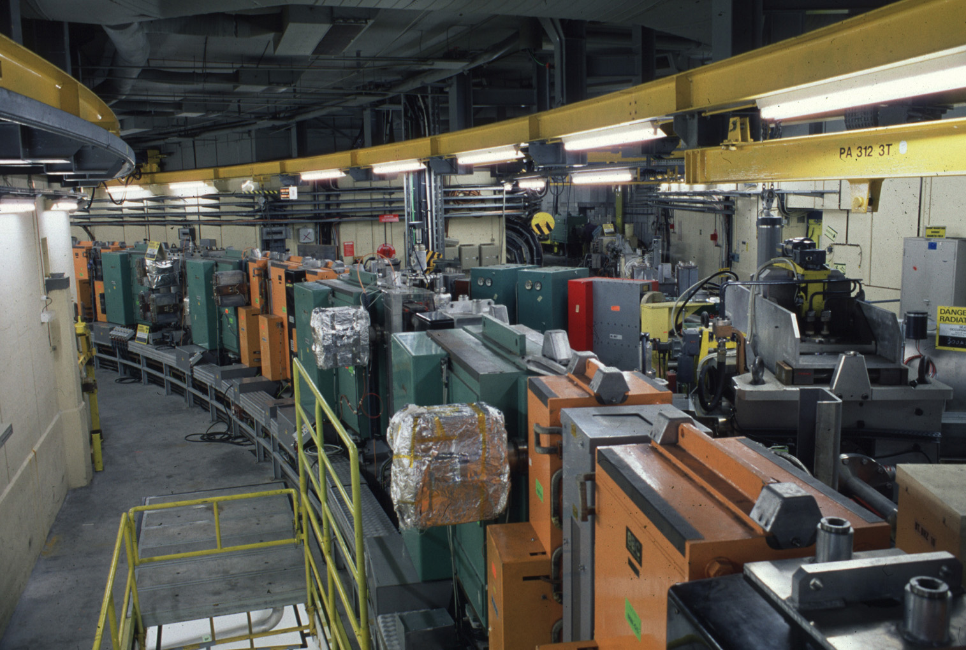
Super Proton Synchroton SPS
160A GeV Pb Beam
for physics
√s ~ 17A GeV
West Area
WAXX experiment (Switzerland)
North Area
  NAXX experiment (France)
SPS Tunnel
CERN, Geneva

Slide 38
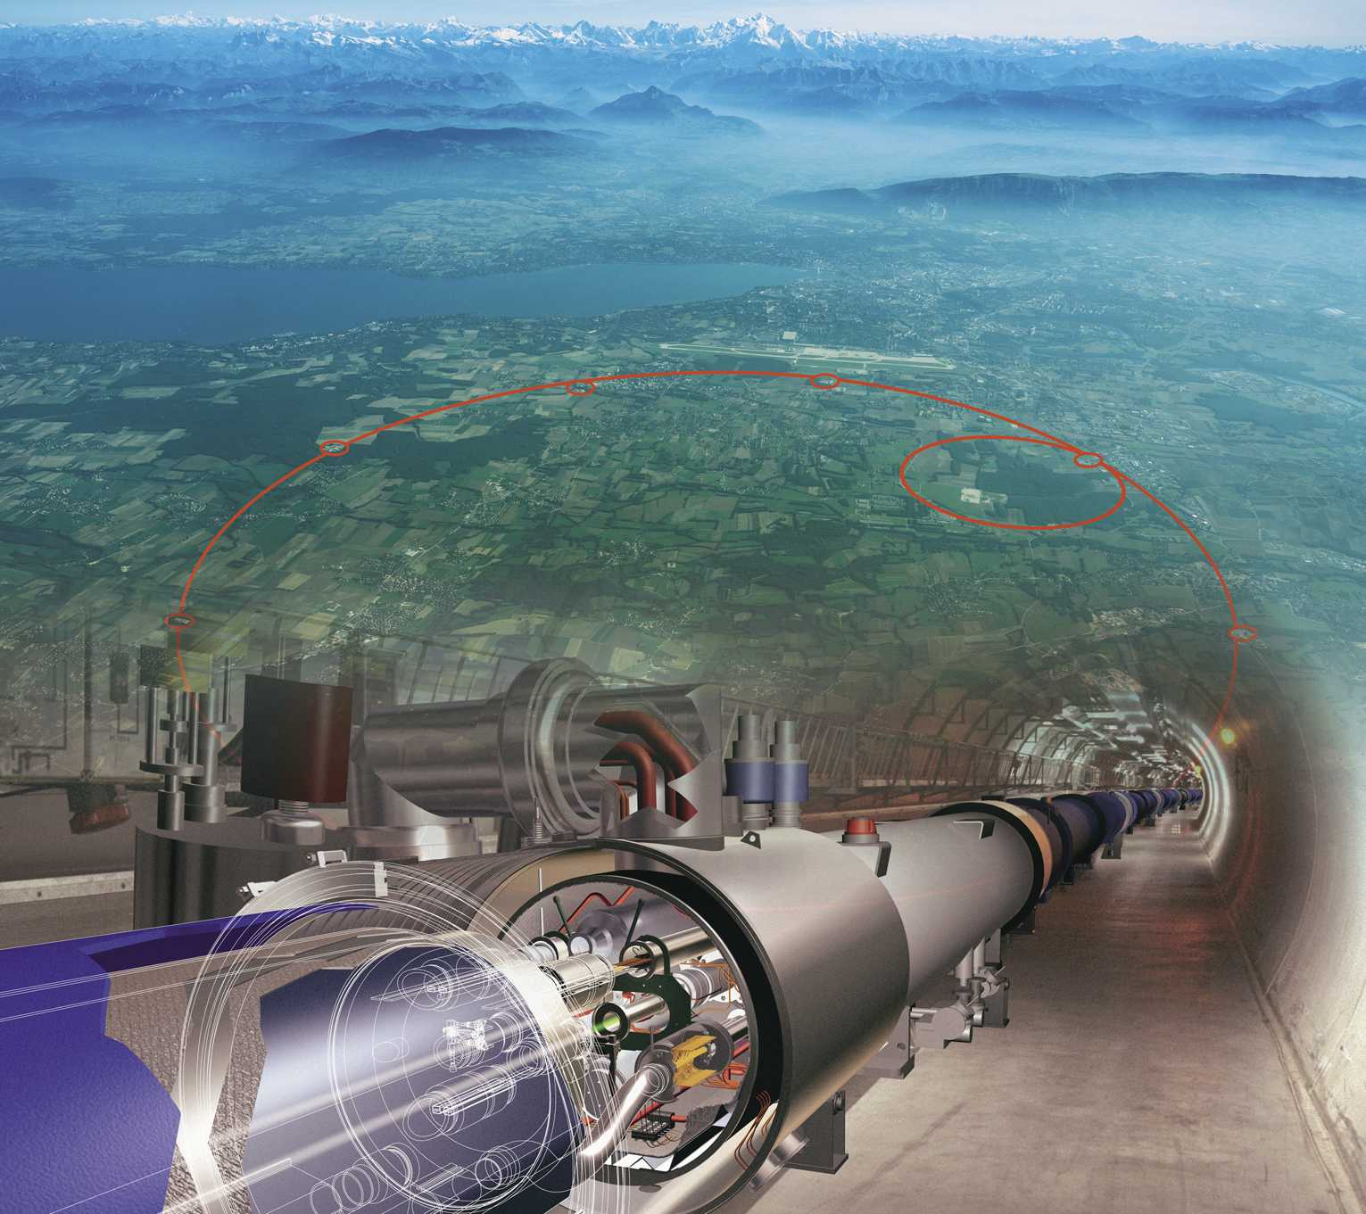
Large Hadron Collider
PbPb collisions at 5.5A TeV ( x30 step );
Luminosity 10²⁷ cm⁻² s⁻¹;
  Limited by physics;
QGP: hotter, bigger and longer;
Baryon free matter;
Large production cross-section of hard (penetrating) probes;

Slide 39
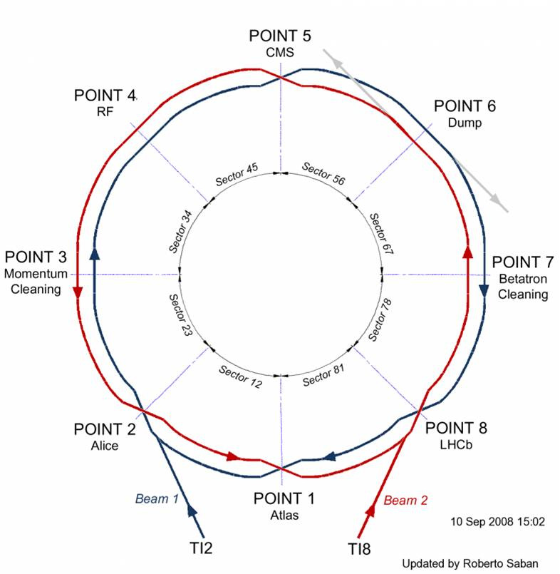
Interaction Points
4 experiments:
  ATLAS (Higgs, new physics, QGP);
  CMS (Higgs,new physics , QGP);
  LHCb (Anti-matter, new physics);
  ALICE (QGP);

Slide 40
Experimental Results
Caminante, son tus huellas el camino,
y nada más,
caminante no hay camino,
se hace camino al andar.
Traveller, the path is your tracks
And nothing more.
Traveller, there is no path
The path is made by walking.
Poem of Antonio Machado (1875 -1939).
H. Satz, Quark Matter 2002, Nantes, France

Slide 41
Heavy Ion Collisions at RHIC and LHC
Experimental study of the hadronic-matter phase diagram by means of the heavy ion collisions at ultra relativistic energies.
μ_{B}≠ 0 models
At the LHC
ε₀ ~ 10-40 GeV/fm³
T_{i} ~ 350-550 MeV
Bjorken PRD27 140 (1983)

Slide 42
Probes of QGP
Global Probes: Multiplicity, Centrality dependence, transverse energy, …
Hadronic Phase Probes (freeze-out): hadron yields, hadron y and pT distributions, elliptic flow, HBT hadron correlations, Hadron resonances, vector mesons …
Penetrating (QGP) Probes : Photons, Dileptons, Jets and Heavy Quarks.
Initial state probes: Photons, Dileptons, Electro-Weak Bosons and, naturally, pp and pA collisions.

Slide 43
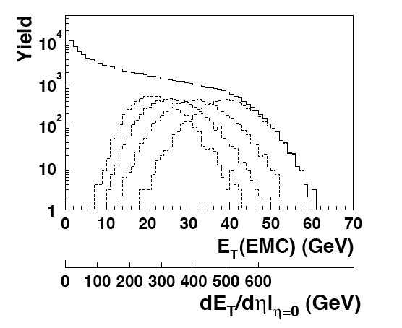
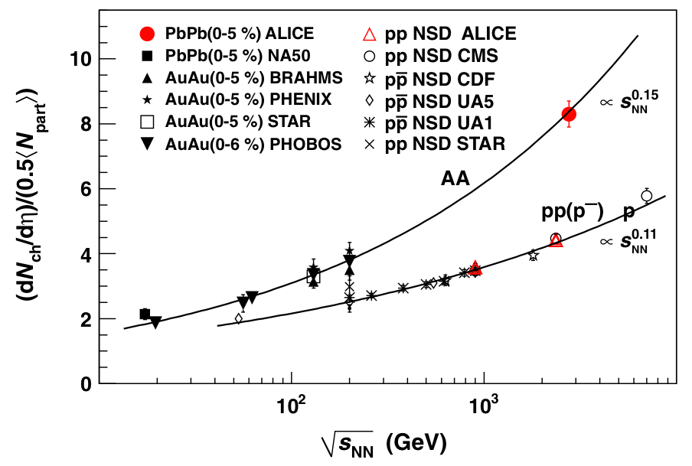
Initial Energy Density
PHENIX, PRC71, 034908 (2005)
ALICE, PRL 105, 252301 (2010)
Au-Au at 200 GeV, ε_{Bj} ~ 5 -10 GeV/fm³
Pb-Pb at 2.76 TeV, ε_{Bj} ~ 15-30 GeV/fm³

Slide 44
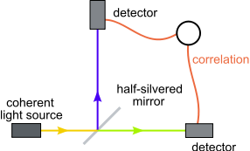
Size and Lifetime
Two pion Bose-Einstein correlations.
Larger source radii at the LHC.
Larger Lifetime (40% wrt RHC).
Larger volume (2-fold factor).
ALICE, PLB 396, 328 (2011)

Slide 45
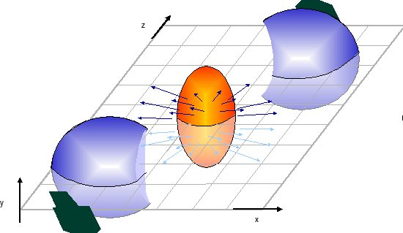
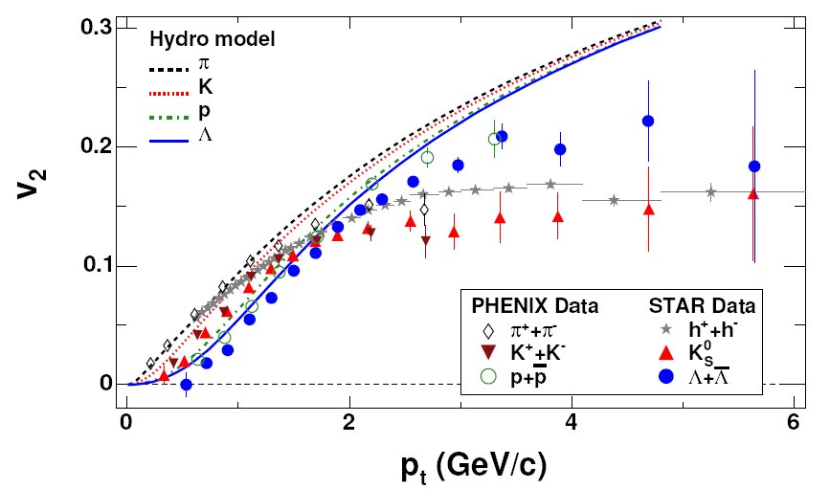

Elliptic Flow (v₂) at RHIC
STAR, PRC72(2005)014904
Elliptic flow is important in HIC;
Well understood at RHIC with Hydrodynamical models;
  sQGP concept has been suggested;

Slide 46
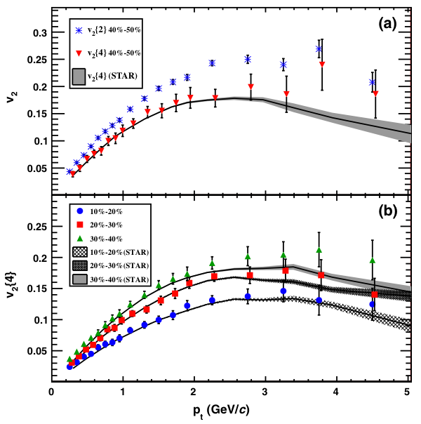
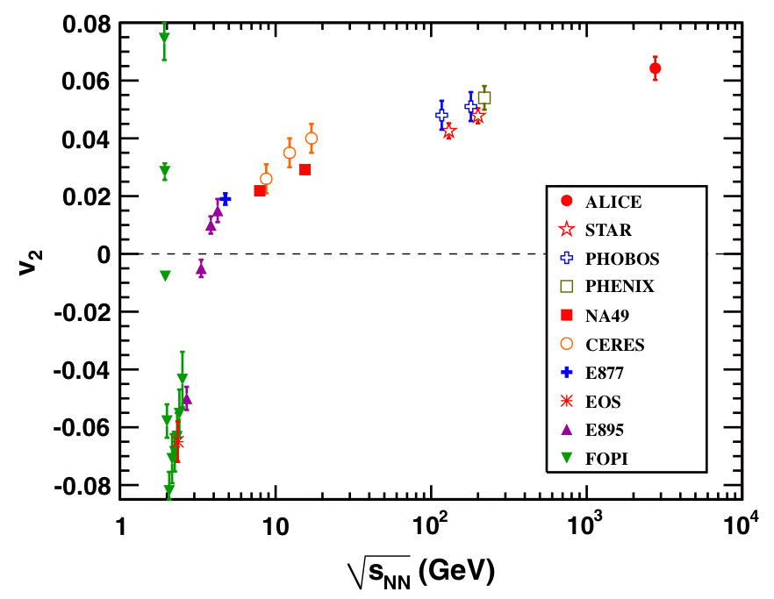
Elliptic Flow (v₂) at LHC
Strong and similar elliptic flow (v₂) observed at RHIC and LHC.
QGP behaves as a ideal fluid.
v₂ constrains the (η/s)_{QGP} via viscous RHD models.
Identified particle v₂ and high p_{T} v₂ being deeply studied.
ALICE, PRL 105, 252302 (2010)

Slide 47
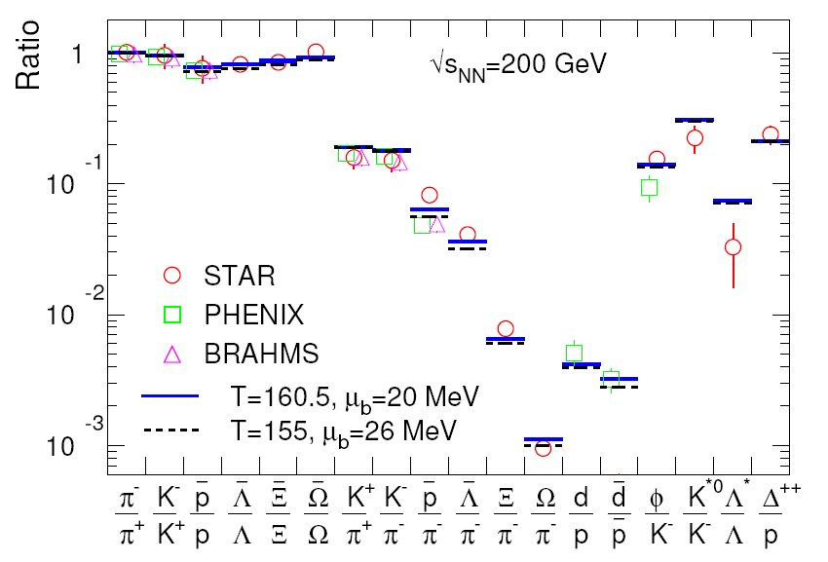
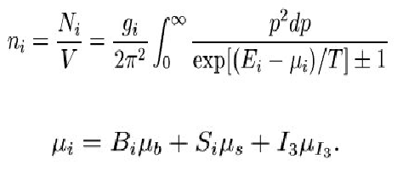
Equilibration
Chemical freeze-out;
Two parameters: T_{ch} and m_{B;}
  T_{ch} = (160±2) MeV;
  m_{B ;}= (20±4) MeV
A. Andronic et al., arXiv:nucl-th/0511071v3

Slide 48
Stat. Hadr. at the LHC
Same temperature;
μ_{b} ~ 0;
Proton and antiproton yields not understood yet.
A. Andronic et al., arXiv:1210.7724

Slide 49
Initial Temperature
PHENIX, PRL 104, 132301 (2010) arXiv:0804.4168
Difficult measurement!
Virtual direct photons (m_{e+e-}<300 MeV/c²).
T_{i} 300-600 MeV.
Recently measured by ALICE: 40% larger inverse slope.
ALICE, arXiv:1210.5958 (2012)

Slide 50
The opacity of QGP
PHENIX. PRL 91,072301 (2003) nucl-ex/0304022.
ALICE, arXiv:1208.2711 (2012)
Strong R_{AA} suppression is observed (RAA~0.13)
Increase of RAA at high p_{T}.

Slide 51
Toward a direct signal
ATLAS, PRL 105, 252303 (2010) arXiv:1011.6182
Larger asymmetry of dijet production in central Pb-Pb collisions at the LHC.
Very promising gamma+jet, Z+jet …

Slide 52
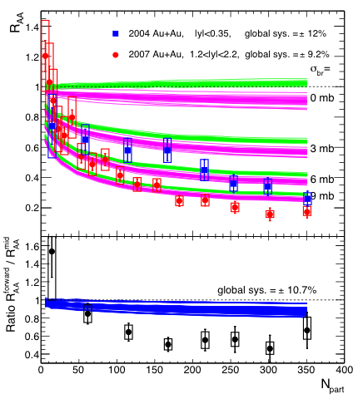
Colour Screening at RHIC
Matsui & Staz, PLB 178, 416 (1986)
J/ψ suppression observed 40-80%.
Not clear if only resonances are suppressed.
More suppression at larger rapidities
Less suppression at high p_{T}.
Cold nuclear matter effect are crucial and could mimics QGP effects
STAR, arXiv:1208.2736
PHENIX
PHENIX, PRC84, 054912 (2011) arXiv:1103.6269

Slide 53
Colour Screening at LHC
CMS, PRL 107 (2011) 052302 arXiv:1105.4894.
CMS, PRL 109 (2012) 222301, arXiv:1208.2826.
ϒ (2S) and ϒ (3S) are suppressed.
ϒ(1S) partially suppressed.

Slide 54
Suppression of ϒ(1S)
The ϒ(1S) suppression presented could be indirectly caused by the suppression of excited ϒ states.
Rapidity dependence of ϒ(1S) R_{AA} remains puzzling.
J/ψ must be strongly suppressed at the LHC since similar dissociation temperature as ϒ(2S).
ALICE, PLB738 (2014) 361, arXiv:1405.4493
CMS, Quark Matter 2015

Slide 55
J/ψ is not strongly suppressed at the LHC !
ALICE, PRL 109, 072301 (2012), arXiv:1202.1383
ALICE,PLB734 (2014) 314, arXiv:1311.0214
ALICE, arXiv:1506.08804
Note: Inclusive J/ψ. Feed-down contribution from B decays does not change the physics message.

Slide 56
Recombination hypothesis
At T>T_{D}, dissociation due to colour screening.
High charm density at the LHC.
Recombination of charm quark for T<T_{D}, to form quarkonium states.
T_{D}<T
T_{C}<T<T_{D}
Deep link between open and hidden charm production: R_{AA}, v₂, etc ....
Open heavy flavour is the natural reference for quarkonium if measured down to p_{T}=0
R.L.Thews, M.Schroedter,and J.Rafelski, PRC63(2001)054905, arXiv:hep-ph/0007323 P.Braun-Munzingerand and J.Stachel, PLB490
(2000) 196, arXiv:nucl-th/0007059

Slide 57
Non zero J/ψ v₂ at the LHC
ALICE, PRL 109, 072301 (2012) arXiv:1202.1383
Note: Inclusive J/ψ. Feed-down contribution from B decays can be dominant, namely at high pT.
CMS collaboration has measured non zero v₂ of prompt J/ψ.
Measurement of prompt J/ψ at low p_{T} is crucial (Run3 at the LHC)
Non zero J/ψ elliptic flow at intermediate p_{T} favours the recombination hypothesis.

Slide 58
J/ψ R_{AA} rapidity dependence
ALICE,PLB734 (2014) 314, arXiv:1311.0214
ALICE, arXiv:1506.08804
Larger J/ψ R_{AA} at y=0
J/ψ R_{AA}
Expected by recombination models since charm density is larger.

Slide 59
J/ψ R_{AA} momentum dependence
Large J/ψ R_{AA} at low pT in central Pb-Pb collisions.
ALICE,PLB734 (2014) 314, arXiv:1311.0214
ALICE, arXiv:1506.08804
Recombination models predict larger R_{AA} at low p_{T}. At high pT suppression is very strong.

Slide 60
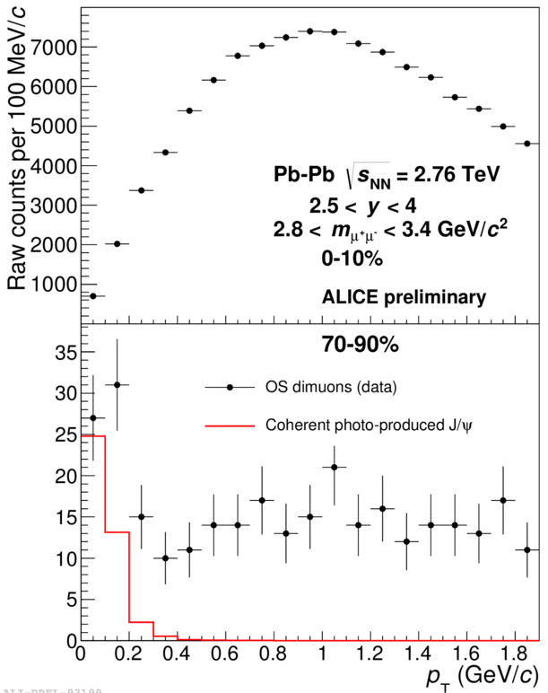
The Surprise
ALICE, arXiv:1506.08804
Excess of J/ψ yield observed at low p_{T} (p_{T}<300 MeV).
Observed in semi-peripheral Pb-Pb collisions.
ALICE, L. Massacrier, EDS2015, Corse, France
ALICE, A. Lardeux, HP2015, Monreal, Canada

Slide 61
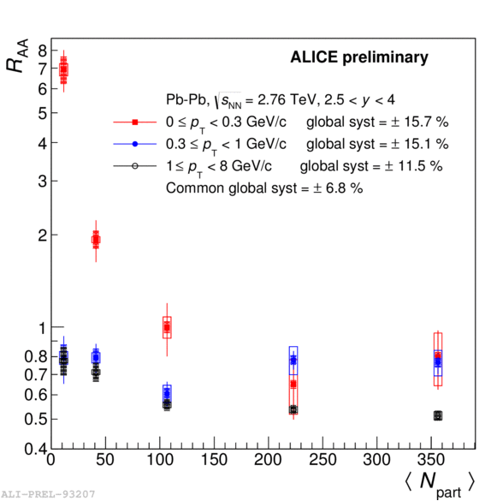
J/ψ R_{AA} at very low p_{T}
R_{AA} reaches 7 at very low p_{T} (p_{T}<300 MeV) !
No hadronic model predicts such a strong effect at low p_{T}.
Coherent J/ψ photo-production could be the natural explanation of this effect.
ALICE, L. Massacrier, EDS2015, Corse, France
ALICE, A. Lardeux, HP2015, Monreal, Canada

Slide 62
Evaluation of the J/ψ excess at very low p_{T}
5.4 (3.4)σ significance in 70-90% (50-70%) centrality bins.
1.4σ in 30-50%.
Hypothesis on the underlying mechanism
Coherent photoproduction of J/ψ in Pb-Pb collisions.
<p_{T}>~60 MeV/c (~100 MeV/c after muon spectrometer response function).
Shape of STARLIGHT calculation in ultra-peripheral collisions (UPC) in good qualitative agreement.

Slide 63
Photoproduction in Pb-Pb UPC at 2.76 TeV
Photon from the Pb EM field interacts with the Pb nucleus (coherent) or with a nucleon (incoherent).
Measured in Pb-Pb ultra peripheral collisions (b>2 R_{Pb}).
Sensitive to gluon nPDF.
ALICE Collaboration, PLB718 (2013) 1273
arXiv:1209.3715 and
EPJ73 (2013) 11 arXiv:1305.1467

Slide 64
Coherent photoproduction cross-section
ALICE Collaboration, PLB718 (2013) 1273 arXiv:1209.3715
N_{AA}^{excess J/ψ} / (1+f_{D}+f_{I}) ➔ dσ^{coh}_{J/ψ}/dy
Correction by the fraction of incoherent contribution, f_{I}.
Correction by the feed-down of coherently photoproduced ψ(2S), f_{D}.
(Axε)_{ΑΑ}^{J/ψ} assuming coherent photoproduction (transverse polarized J/ψ) from STARTLIGHT.
Uncorrelated systematics as a function of centrality:
  Measured excess,
  Incoherent J/ψ and coherent ψ(2S) contributions,
  Centrality selection, occupancy, trigger, tracking.
Correlated systematic 14%
  Luminosity, MC input, trigger and tracking efficiencies, and matching.

Slide 65

Comparison with theoretical expectations
No model is available for a complete description of coherent photoproduction in Pb-Pb nuclear collisions.
Part of the nuclei interacts.
Photon flux of a charge distribution of the nucleus for b<2R_{Pb}.
An extrapolation of measured J/ψ in UPC (b₁=2R_{Pb},b₂=∞) to 70-90% (N_{part}~11) centrality class (b₁^{70-90%},b₂^{70-90%}), provides a cross section of ~40 μb. Good qualitative agreement with the measured value 59±16 μb.
Two extreme cases for the photon flux:
  full nucleus
  spectator region
E_{γ} = ħw_{γ}
N_{γ} photon flux
₈₂Pb γ source
γ
J/ψ
<p_{T}>~1/R_{Pb}
²⁰⁸Pb nuclear
target

Slide 66
Model M.Klusek-Gawenda & A. Szczurek
(0) UPC γ flux approximation.
(1) γ flux in the whole nuclear target.
(2) γ flux in the spectator nuclear target.
“Calculation of coherent photoproduction for b<2R_{A} is not clear.”
Different ways to treat the overlap region.
Reasonable good agreement with our preliminary results.
Experimental data favour the scenario where only the spectator region contributes to the coherent photoproduction.
ALICE Results
Systematic Unc.
M. Klusek-Gawenda and A. Szczurek arXiv:1509.03173v1 and
L. Massacrier for ALICE Collab., EDS2015, Corsica, France

Slide 67
Prospects
Theoretical model addressing all the aspects is needed. Ideally to provide a reference to this observable in the absence of QGP.
Measurement of the excess in central and semi-central collisions at forward and mid-rapidity will be explored during Run2 and Run3 at the LHC.
Measurements of the mean p_{T} are also needed to study the size of the region contributing to the coherent photoproduction (<p_{T}>~1/R_{A}): wider p_{T} distribution in semi-central collisions?
The measurement of the J/ψ polarisation is a golden channel to confirm the coherent photo-production hypothesis.
Photon-photon contribution should be there and it is not affected by QGP. However it is an experimental challenge.
Whether this new probe can be used to study the QGP, is an open question.
Measurement of an excess in the yield of J/ψ at very low pT in Pb-Pb collisions at √s_{NN} = 2.76 TeV, ALICE Collaboration, CERN-PH-EP-2015-268
Wed Sep 30th 2015 arXiv:1509.08802

Slide 68
More reading
110 ALICE publications since 2010:
  http://aliceinfo.cern.ch/ArtSubmission/publications
17 on quarkonia at forward rapidity with the ALICE MUON Spectrometer.

Slide 69
The phase of deconfinement
ALICE, JHEP 09 (2012) arXiv:1203.2160
ALICE is measuring open heavy flavours at low p_{T}.
Uncertainties still larger.
A challenge for the ALICE upgrade program.
Caveat. I have not shown many interesting results of ALICE on heavy flavour at mid-rapidity. Strong complementary between mid and forward.

Slide 70
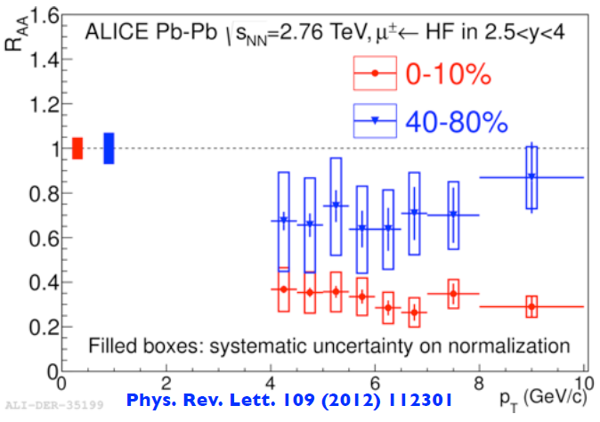
The phase of deconfinement
Measurement of open heavy flavours : charm and beauty, is mandatory.
Suppression is observed for p_{T}>4 GeV.
Decreasing to lower p_{T} is crucial.
ALICE, PRL 109 112301(2012)
Disentangling beauty and charm contributions and reaching lower p_{T} reach is challenging.

Slide 71
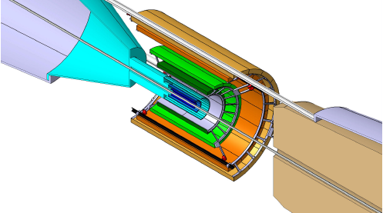
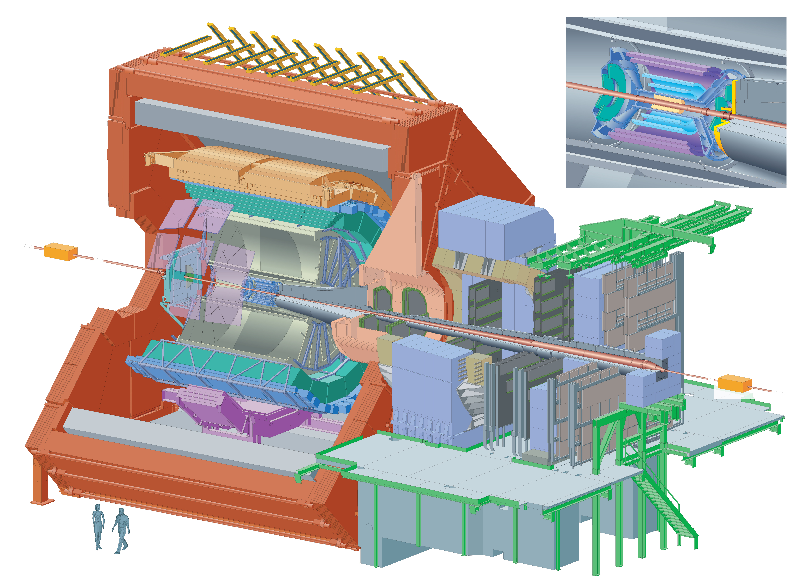
ALICE Detector Upgrade
Increase luminosity (100 kHz IR) and improve vertexing
and tracking capabilities of ALICE at low p_{T}.
Extension of EMCAL (DCAL) LS1
TPC: replacement of the readout multi-wire chambers (MWC) with Gas Electron Multiplier (GEM) detectors and new pipelined readout electronics
TRD, TOF, PHOS : upgrade of the readout electronics
New ITS,high resolution,
low-material-thickness Inner Tracking System
New beam pipe with smaller radius
29mm → 18.0 mm
Upgrade of the forward detector triggers (ZDC, T0, VZERO) for high rate operations
Muon spectrometer upgrade of the readout electronics
MFT project

Slide 72

ALICE Upgrade documents
Letter of Intent:
ALICE
ITS
MFT
TDR:
Readout-Upgrade
ITS
TPC
MFT
O2

Slide 73
Strategy of the ALICE collaboration 2015-2025
Low pT and |y|<4 coverage for heavy flavours, quarkonium, di-lepton and jet chemistry in heavy ion collision.
Heavy flavours: measurement of the total production cross-section.
Quarkonium: Precision measurement of the dissociation and recombination of quarkonium states.
Low mass di-lepton: Measurement of the thermal virtual photons and the rho meson spectral function.
Jets: Particle identification in jets, low p_{T} c and b jets and dissipation of the lost energy in the medium.
MFT+MUON

Slide 74
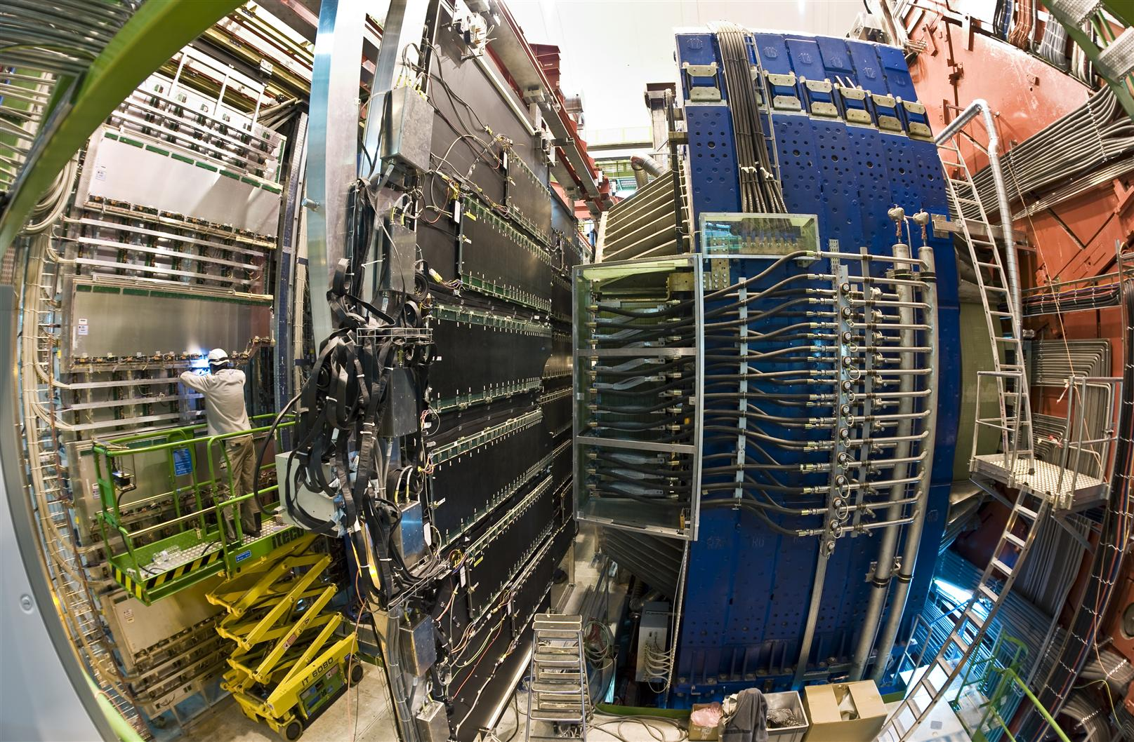
ALICE Muon Spectrometer
New read-out electronics at 100 kHz IR. Muon trigger ➔ Muon ID

Slide 75
Physics Motivations of the Muon Spectrometer Upgrade
J/ψ R_{AA} & v₂ in detail.
J/ψ polarisation.
ψ(2S) measurement.
Low p_{T} excess.
Figures 2.32, 2.38 et 2.40 ALICE LoI

Slide 76


Muon Forward Tracker of ALICE Experiment
CDS link: http://cds.cern.ch/record/1981898. The MFT TDR has been approved by the CERN Research Board during the RB meeting on September 30th 2015.
Notes:
We would appreciate feed-back from our referees

Slide 77
MFT design goals
Study QGP physics at forward rapidity in ALICE
Vertexing for the ALICE Muon Spectrometer (MS) at forward rapidity:
  5 detection disks of silicon pixel sensors O(25 μm x 25 μm),
  0.6% of X₀ per disk,
  -3.6 < η < -2.45,
  Disk#0 at z=-460 mm, R_{in}=25 mm (limited by the beam-pipe radius).
Good matching efficiency between MFT and MS:
  disk#4 at z=-768 mm (limited by FIT and the frontal absorber).
Fast electronics read-out:
  Pb-Pb interaction rate ~50 kHz, and pp interactions at 200 kHz.

Slide 78
MFT Layout
896 silicon pixel sensors (0.4 m²) in 280 ladders of 1 to 5 sensors each.
Disk#4
Disk#2
10 Half-disks
2 detection planes each
Disk#3
Disk#1
Disk#0
MFT doses
< 400 krad
< 6x10¹² 1 MeV n_{eq}/cm²
10-fold security factor
z=-46.0 cm
-3.6 < η < -2.45
5% of the ITS surface
Twice the ITS inner barrel
IP region
z=-76.8 cm
Note that final lay-out is evolving with the finalisation of the MFT disk and cone designs as it has been discussed in the MFT TB meetings.

Slide 79
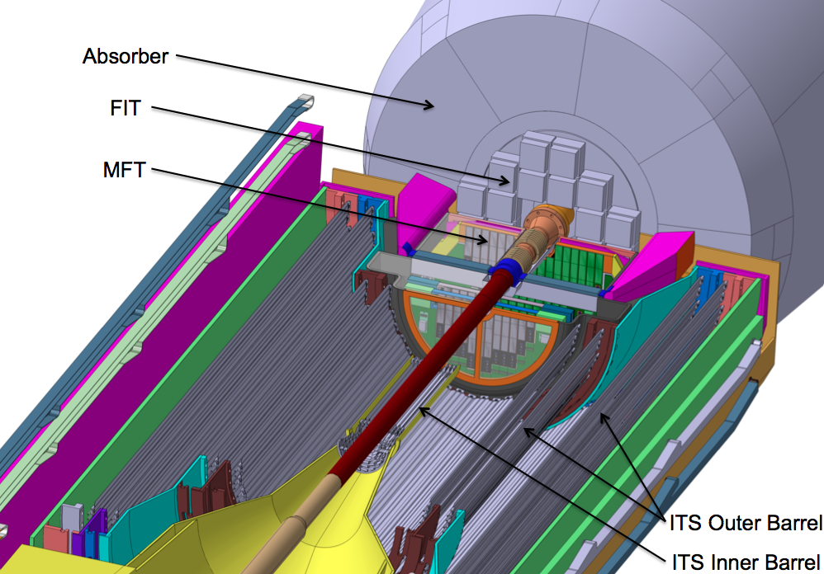
MFT environment

Slide 80
Silicon sensor technology
ITS inner barrel and MFT will consist of the same silicon pixel sensor
Parameter | Value
Spatial Resolution | ∼ 5 µm
Detection Efficiency | > 99.5%
Integration Time | < 20 µs
Sensor Thickness | 50 µm
Power dissipation | ≤ 150 mW/cm²
Radiation Tolerance (10-years operation) | ∼ O(10¹³) n_{eq}/cm² ∼ O(700) kRad
CMOS Monolithic Active Pixel Sensor (MAPS):
CMOS pixel sensor using Tower Jazz 0.18 µm CIS technology.
Sensor size 15 mm x 30 mm
The Alpide architecture exhibits good performances for the MFT:
Event time resolution below 4 μs.
Low power consumption <50 mW/cm².
MFT participates into Alpide ASIC design and characterization.
Notes:
Chip size: 15mm x 30mm, Pixel pitch ~ 30 μm, Spatial resolution ~ 5 μm, Power density < 100 mW/cm²

Slide 81
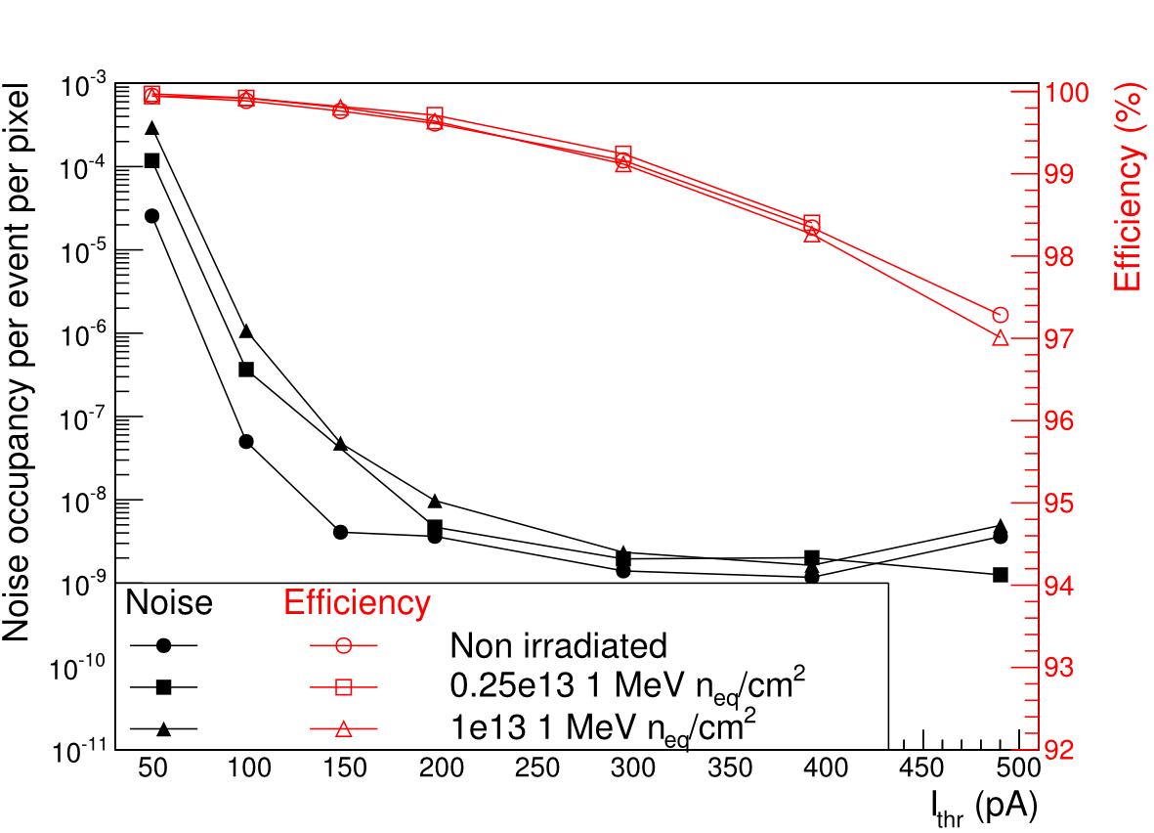
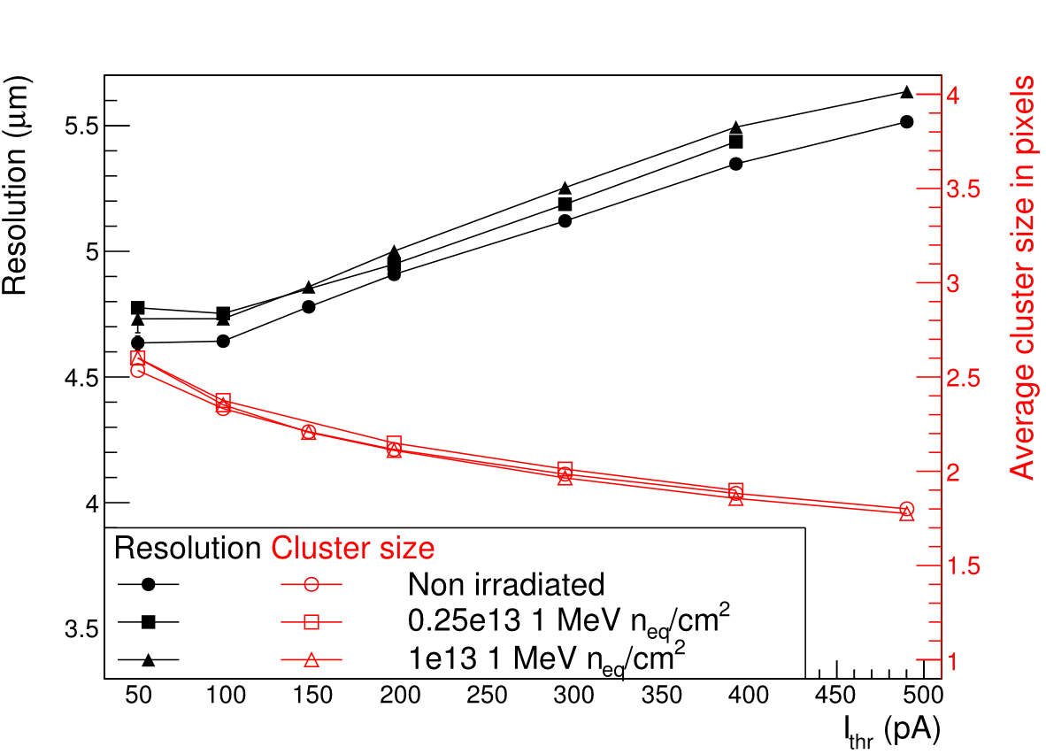
Pixel results
Example of measurement at PS test beam with pALIPIDEfs
Measurements at PS: 5 – 6 GeV π- , read-out rates 10-40 kHz
Results refer to 50 μm thick chips: non irradiated and irradiated with neutrons (0.25 x 10¹³ and 10¹³ 1MeV n_{eq} / cm2)
Note that these are the results included in the TDR. New results are available with Alpide2 and they were presented in the last ITS-MFT plenary meeting at CERN on September 9th 2015.

Slide 82
Reminder of physics cases
Reminder of the MFT LoI
Open Heavy Flavour:
  charm in the single muon channel down to p_{T}=1 GeV/c,
  beauty in the J/ψ channel, down to p_{T}=0.
Charmonium
  separation between prompt and decay J/ψ,
  measurement of the ψ(2S).
Low mass dimuon:
  improvement of the invariant mass resolution,
  higher sensitivity to the continuum.

Slide 83


The measurement of the ψ(2S)
Improvement of the precision on ψ(2S).
S/B ratio increases by a factor 3-5 .

Slide 84

Improved performances (J/ψ from B decays)
Good discrimination between prompt and B-decay J/ψ down to p_{T}=0 thanks to the Lorentz boost along the z-axis.
t_{z} is weakly dependent on p_{T} for p_{T}<M_{J/ψ}.
Reconstructed by the MFT+MS

Slide 85
Beauty production down to p_{T}=0
R_{AA} of J/ψ from B hadron decay down to p_{T}=0
Excellent performances at low p_{T}.
Unique beauty measurement at the LHC in HI.

Slide 86
Charm production
Muons from charm hadron decays down to p_{T}=0.5 GeV/c
MFT-ITS residual mis-aligment, p_{T} MC and MFT pointing resolution were considered for the evaluation of the systematic uncertainty
29% systematics at 0.5-1 GeV/c
10% at 1-1.5 GeV/c.

Slide 87
Conclusions
Very difficult to conclude when the history is being written.
Many intriguing results from the HIC at the LHC. Digesting run1 (2010-2013) and preparing run2 (2015-2018).
We are willing to continuing this fascinating adventure of ALICE at the LHC, with the ALICE upgrade projects for run3/run4 (2018-2025).

Slide 88
Disclaimer
I gave a reduced and biased selection of experimental results.
For instance:
  Electroweak boson in heavy ion collisions
  UPC measurement: measuring nuclear PDF
A non-explored domain of high multiplicity pp collisions:
p-Pb collisions: Many publications from the p-Pb run in 2012 and 2013. Enormous amount of results are available. Far from being trivial !
CMS, PLB 715, 66 (2012) arXiv:1205.6334
ALICE, PLB 718, 1273 (2012) arXiv:1209.3715
CMS J.Phys. G38 (2011) 124051 & ALICE PLB 712, 165 (2012)

Slide 89
Thanks for your attention !
An astronomer, a physicist, and a mathematician were holidaying in Scotland. Glancing from a train window, they observed a black sheep in the middle of a field. 'How interesting,' observed the astronomer, 'all Scottish sheep are black!' To which the physicist responded, 'No, no! Some Scottish sheep are black!' The mathematician gazed heavenward in supplication, and then intoned, 'In Scotland there exists at least one field, containing at least one sheep, at least one side of which is black.’
“Fermat’s Enigma” by Simon Singh

