Slide 2
Batch Factory
FCT Follow-up meeting
26th October, 2015
Fernando Meireles
fernando.meireles@cern.ch

Slide 3
Outline
Contextualization
Batch service at CERN
Batch Factory project
Development status
Conclusions

Slide 4
Contextualization
Batch Factory project (code: IT1402)
  Supervised by Dr. Ulrich Schwickerath
  Batch team
  IT-PES-PS section
Objectives:
  Flexible management of the Batch cluster
    Maximize resources allocation
  Integration with CERN cloud computing model
    Create and assign roles to virtual machines

Slide 5
Batch Service at CERN
Batch service processes batch jobs
Job – program assigned to a worker node to run without further user interaction
Computing power to the CERN experiments
  Physics event reconstruction
  Data analysis
  Physics simulations
5000 worker nodes
HTCondor and IBM LSF workload platforms
Local and WLCG (Worldwide LHC Computing Grid) Job submission

Slide 6
Batch Service Architecture

Slide 7
Batch Service at CERN
Moving to HTCondor
  Increasing number of worker nodes
Current limitation
  Manual Administration of batch resources
Batch Factory
  Integration with system tools
  Automation and monitoring of Batch resources management

Slide 8
Batch Factory
Group of workflows and libraries written in python
Integration with the system
  Administration tools, OpenStack, Puppet, Foreman, LSF, HTCondor
Monitoring using LEMon (LHC Era Monitoring)
Displaying monitoring dashboards with Elasticsearch-Kibana

Slide 9
Batch Factory (Operations)
Create and Assign Roles to VMs | Drain and Remove VMs | Ensure Cluster Stability
Fill-up Tenant | Reboot Agent | Worker Node Health
Guarantee Capacity | Batch Reinstall | Hostgroup Cleanup
 |  | Benchmark
 |  | Cloud Team Request
 |  | Interventions Intrusive Security Nonintrusive Security Security Exploit Emergency Exploit

Slide 10
Development Status

Slide 11
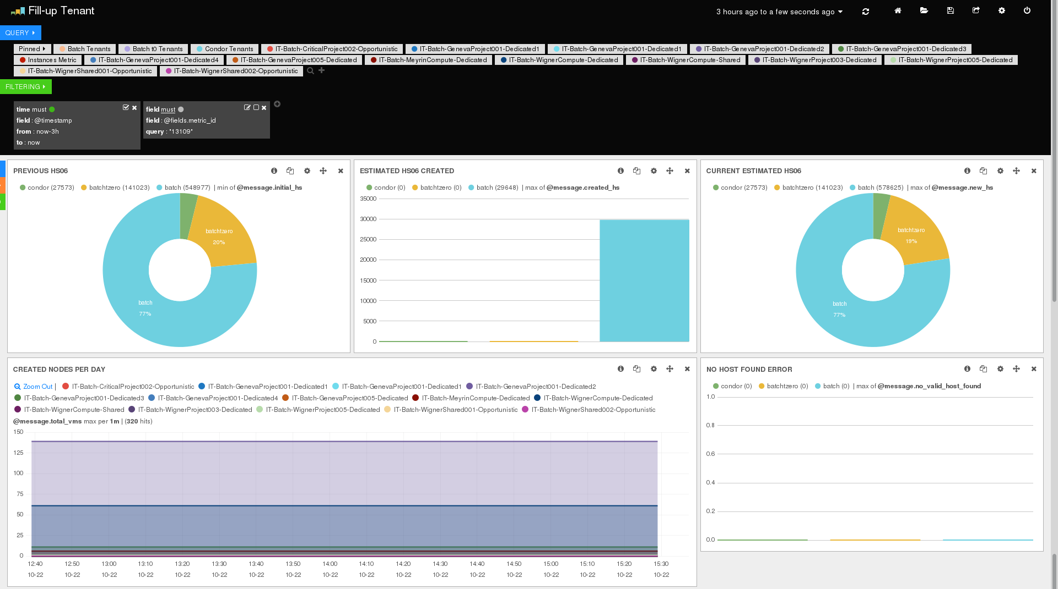
Batch Factory (Monitoring)

Slide 12
Conclusions
Becoming acquainted with the services and tools takes time
Helpful and very organized team/section
Trainings
  Agile Infrastructure & Puppet for Service Managers
  Developing secure software
Allowed me to increase my knowledge
  Batch/cloud systems integration and monitoring
  Software development
  General problem solving skills

