Slide 1


Work Status – humidity sensors based on fiber optics
May – October 2015
Tiago Filipe Pimentel das Neves
26 October 2015
Supervisors : Paolo Petagna and Gaia Maria Berruti

Slide 2
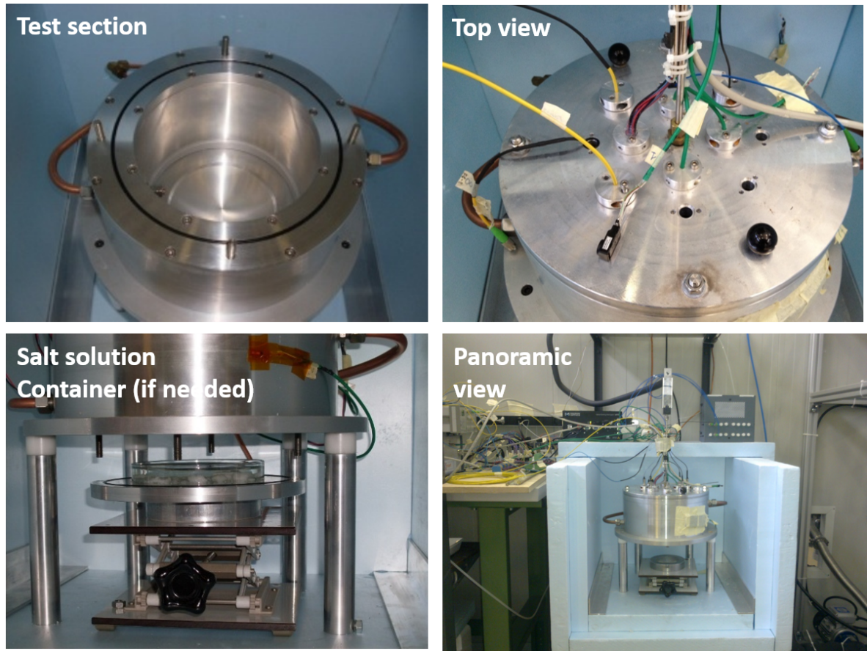
Resume
Thermo–Regulated Chamber
Specially designed for Humidity sensing applications
Built at CERN in aluminium
  Available in PH-DT laboratory (Crystal Palace)
Polystyrene box
Equipped with
  4 x Temperature sensors (PT100)
  4 x Commercial Hygrometers (HIH-4000)
  Dew Point Meter (Dew Prime II)
  FOS (Fiber Optic Sensors)

Slide 3
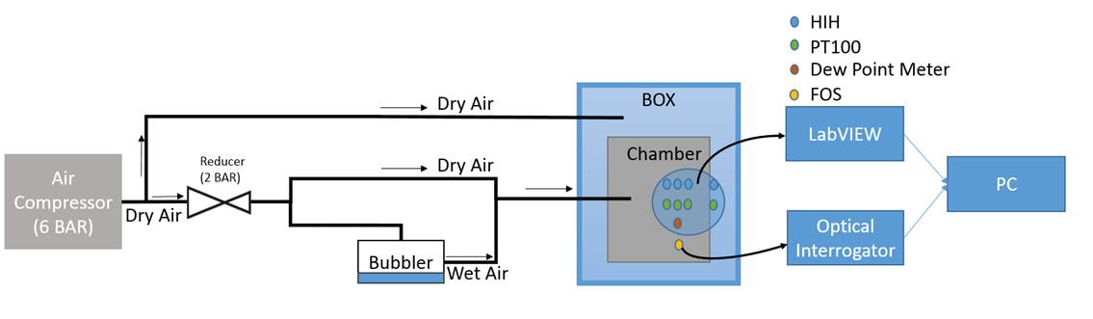
System Schemactic

Slide 4
Proposed Tasks for 6 months (May-October)
LabVIEW Visual Interface
  Need of an update
Reorganization of the setup
  Unconnected wires
  Unconnected sensors
Switch the manual system to an automatic system
  Mass flow controllers (MFCs)
Introduction to FOS
  First approach to the theoretical bases
Experimental Tests
  Temperature tests
  Humidity Tests
  Data Analysis

Slide 5
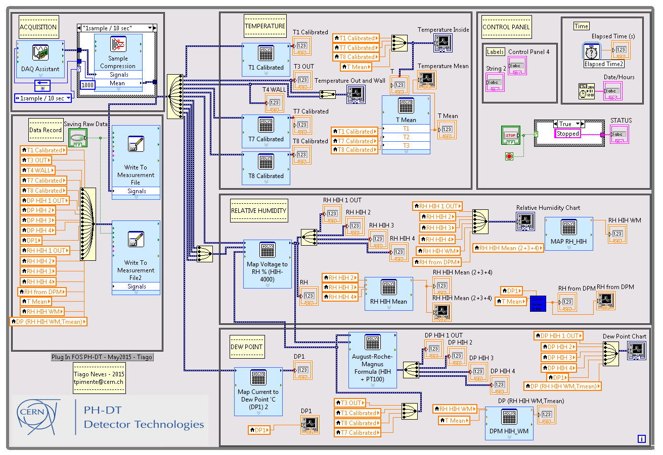
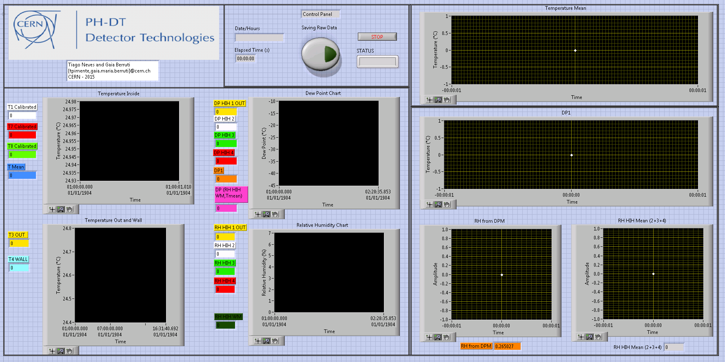
1 – Setup Developments – LabVIEW Interface
Block Diagram
Visual Interface
Report : Plug-In FOS LabVIEW VI.pdf

Slide 6
2 – Setup Improvements
Clean and re-organization of the experimental setup
  Removal of the unconnected wires
  Reduction of the length of the wires
  Removal of the unnecessary wires joints
  Reconnection of all sensors
  Connection of all the ground planes
  Reduction of the length of the tubes
  Fix some air leaks
  Before:
  After:
Report : Oscillations Problem.pdf

Slide 7
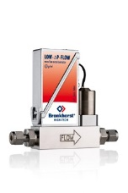
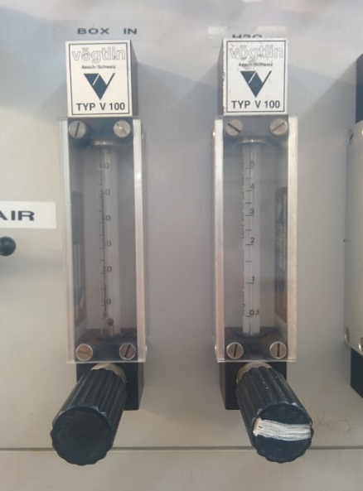
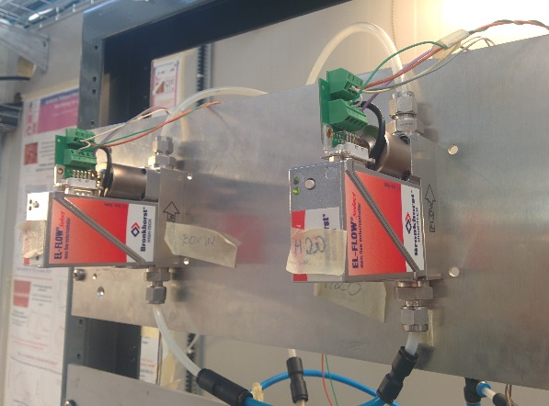
3 – Automatization of the System
Switch from the manual to automatic Valves
  2 x Mass Flow Controllers (MFCs) Implemented
    Dry Air – BOX IN (80ln/h)
    Wet Air – H2O (25ln/h)
  Bronckhorst El-Flow F-201CV
  Before:
  After:
Disadvantages:
Low precision
  Set point hard to define
Requires the presence of a test user
Advantages:
Remotely controlled
High precision
  Stable
Easily configured
Report : Valves Comparison.pdf

Slide 8
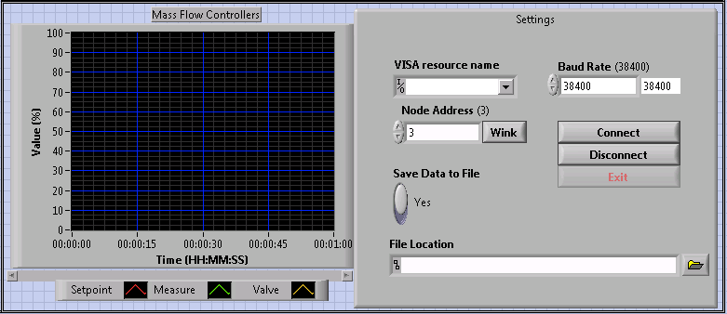
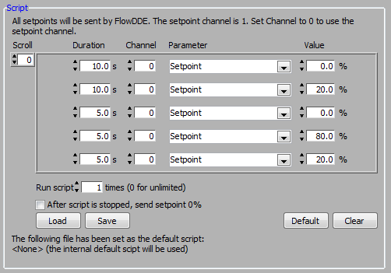
3 – Automatization of the System
  Easily programmed
  LabVIEW Interface
Programmable script to define the aperture of the valves
LabVIEW VI to control the MFCs added to the main VI

Slide 9
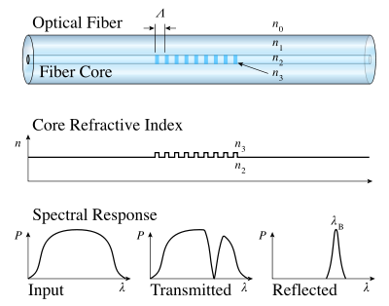
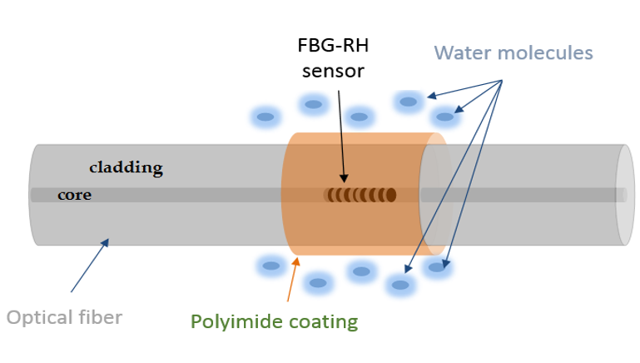

4 – Fiber Optics Sensor (FOS)
FBG – Fiber Bragg Grating
1st Generation of FOS
  Reflects particular wavelengths
    Periodic perturbation of the effective index in fiber´s core
  Bare FBG sensitive to strain and temperature
  Strain free packaging -> Thermometer
  Bare FBG not sensitive to Humidity
FBG as Humidity Sensors
  Hygroscopic polymers
Moisture Adsorption
Coating “swelling”
Strain onto the FBG
$$Δλ_{Bragg}$$

Slide 10

5.1 – Experimental Temperature Tests FBG-T
Procedure
  Define the dry air flow
    Stable during all test
  Define the Temperature
    Waiting until it stabilizes (1h30 / 2h)
  Change the Temperature ( -15ºC -> 30ºC )
Data Analysis
  Temperature Calibration
  Evaluation of the Sensitivity to temperature of the sensor
$${(S}_{T})$$

Slide 11

5.2 – Experimental Humidity Tests FBG-RH
Procedure
  Define the temperature (-15ºC -> 30ºC )
    Stable during all test
  Define the values of both flows
    Box In – DRY AIR
    H2O – Wet Air
  Define different combinations to reach different humidity values
  Set a new Temperature
Data Analysis
  Lambda variations
  Calibration
  Evaluation of the Sensitivity to Humidity of the sensor at each temperatures
$${(S}_{RH})$$

Slide 12
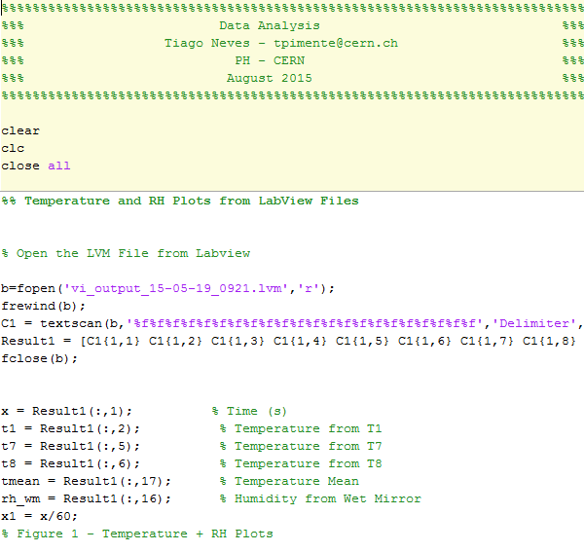


5.3 – Data Analysis – MATLAB Scripts (FBG)
SCRIPT features:
Analyse and process the .txt files from LabVIEW and from Optical Interrogator
Construct all plots needed
Evaluation of the Sensitivity of the sensors - and
${(S}_{RH})$
$${(S}_{T})$$

Slide 13
Ongoing and Future Works
Ongoing
Future
Temperature Controller
  Automatization
  Interface Developed
  Problems with connection between the PC and the controller
Study of the FBG
  Temperature reconstruction
  Temperature compensation
  …
Work on a new generation of FOS
  LPG – Long Period Grating

Slide 14
Questions?
?
Thank you!

Slide 15
5.3 – Humidity Tables Examples
Humidity Tables
  25°C, 15°C, 0°C, -15°C
  Reference values for the flows
    Ln/h – Liters nominal per hour
2 Tests per Temperature
  Small range – (0-15% of RH)
  Long Range – (0-70% of RH)
Example 2
RH Test |  |  | T = 25° C
Elapsed Time | Real Time | Box IN (ln/h) | H2O (ln/h) | RH (%)
0:00 | 09:53 | 60 | 0.0 | 0.56
1:30 | 11:23 | 50 | 8.5 | 20.40
3:00 | 12:53 | 40 | 12.0 | 35.26
4:30 | 14:23 | 30 | 12.5 | 46.52
6:00 | 15:53 | 25 | 16.0 | 64.80
7:30 | 17:23 | 25 | 18.5 | 68.50
Example 1
RH Test |  |  | T = 15° C
Elapsed Time | Real Time | Box IN (ln/h) | H2O (ln/h) | RH (%)
0:00 | 11:30 | 60 | 0.0 | 1.0
1:30 | 13:00 | 60 | 2.0 | 6.3
3:30 | 15:00 | 60 | 2.5 | 9.7
5:30 | 17:00 | 50 | 2.5 | 13.6
Notes:
Example 1 and 2

