Slide 1



Follow-up meeting FCT
26th of October
Experiment Control System
Trainee: João Barbosa
Supervisor: Clara Gaspar (Head of Control group in Online Team)
Notes:
My name is João Barbosa, I come from Lisbon, studied in Instituto Superior Técnico. I started working here at CERN on the 1st of April this year.

Slide 2
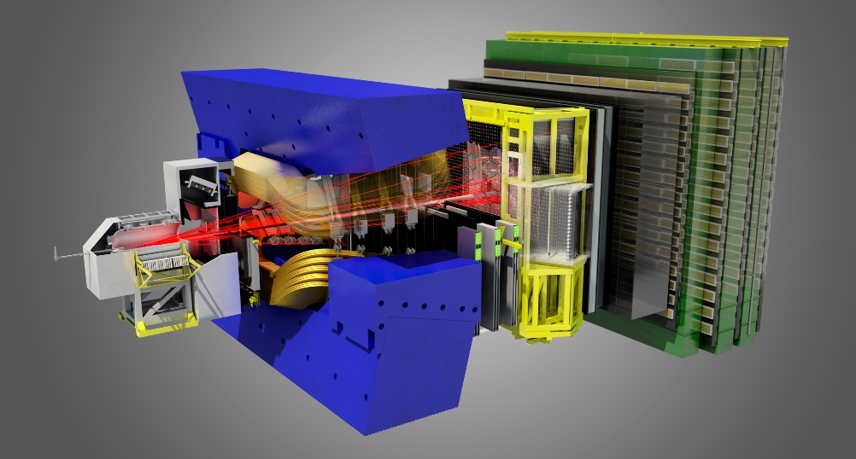
LHCb Experiment
Notes:
I was integrated into the LHCb experiment, one of the big experiments using the LHC beam for collisions. This particular experiment is the one trying to find an explanation for the asymmetry of matter-antimatter of the universe. The picture depicts the heart of the experiment, the detector that measures the results of the collisions between particles accelerated by the LHC beam. I am part of the online team which is the one responsible for the whole online system, meaning the real-time data acquisition and triggering. In this team I work in the Experiment Control System developed by the central control group. This system is the one responsible for the configuration, control and monitoring of all the components of the online system.

Slide 3
ECS and DAQ
DCS Devices (HV, LV, GAS, Temperatures, etc.)
Detector Channels
40 MHz
L0
TFC
Front End Electronics
1 MHz
Experiment Control System
Readout Network
High Level Trigger
5 kHz
Storage
Data Acquisition System
External Systems (LHC, Technical Services, Safety, etc)
Notes:
This is a schematic representation of the system developed and controlled by the online team. It’s a schematic of all the phases the data goes through, from the detectors until it is stored, and also of the scope of the control system.
The Data acquisition system is composed firstly of a layer of Front End Electronic Boards and Readout Boards where the events measured by the detector suffer a first filter through hardware trigger. Then, we have the High Level Trigger, composed of approx.. 1700 PCs that will run more complex software triggers on these events and reduce the number of events considered interesting. These events are then stored in the storage module temporarily for later reconstruction and data analysis.
This all happens under the supervision and control of the ECS. This system is the one in charge of configuring, controlling and monitoring the data taking runs. It interacts with the DCS (detector control system), the DAQ (Data acquisition) and other external systems.
My main contribution so far was to build a system that would summarize what is happening in the DAQ subsystem and display it in an intuitive manner.

Slide 4
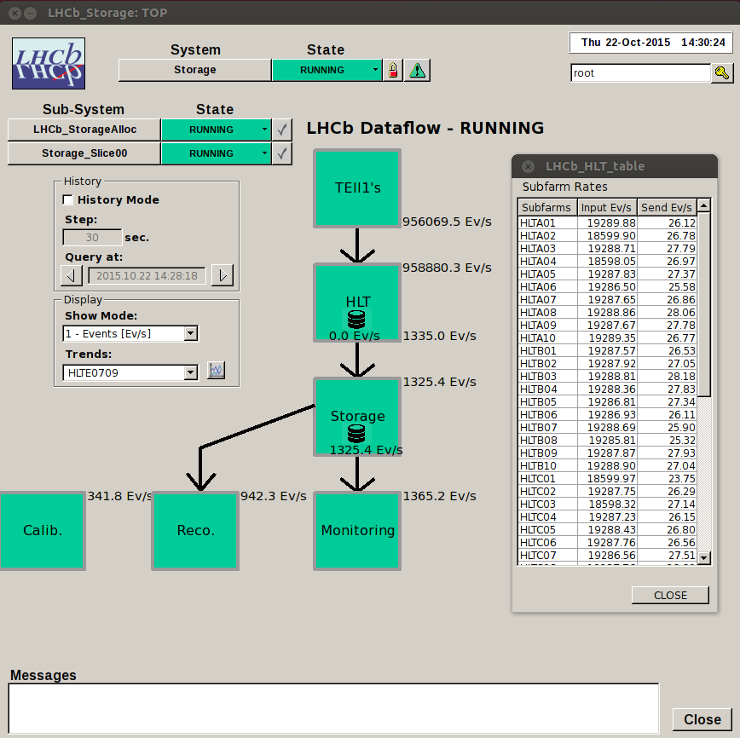
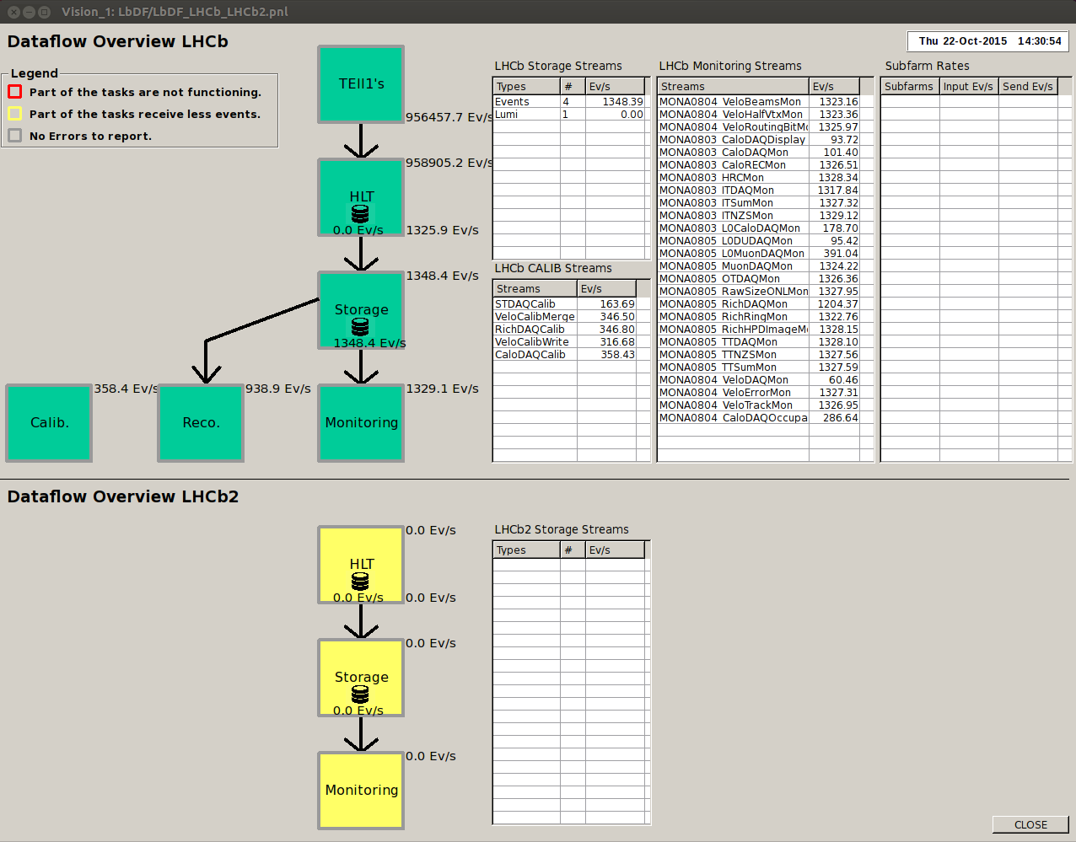
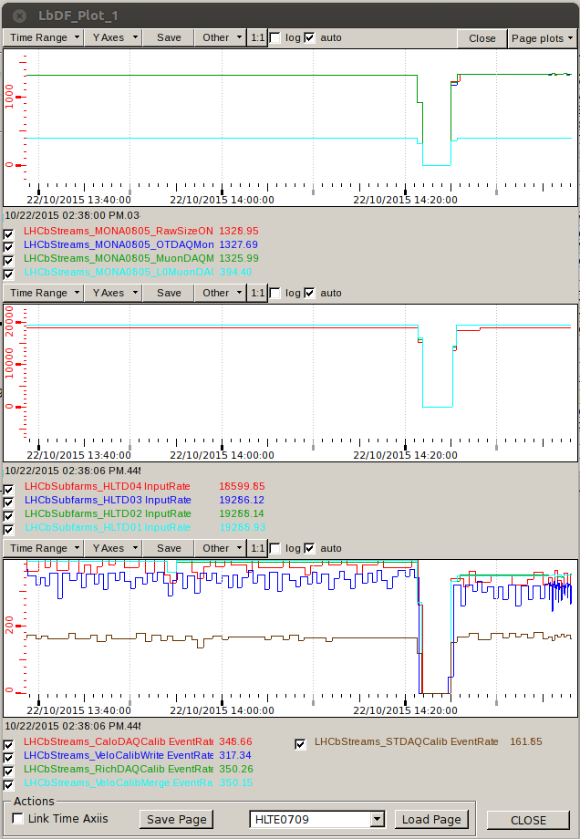
Dataflow Monitoring
Implemented features
Adaptability to any main partition
Adjustable information
Real Time dataflow overview
WinCC-OA Archiving
History Mode
Comprehensible Split-HLT representation
Trending tool
Definition of alarm/warning situations
Forwards to main Alarm screen
Operating in LHCb Control Room
Proven useful for debugging
Notes:
My first contribution was to build a system that would summarize what is happening in the DAQ subsystem and display it in an intuitive manner.
It gathers the information from every partition that is running and have it ready to display on demand in a panel. With this panel you can see how many events per second (mb/s or packets/s) are going through each phase of the data taking process, and you can have that information detailed per readout card, HLT node or storage stream type. These tables also show if some of the nodes are actually being used or if they have been excluded in the automatic configuration (due to errors). (click for figure change).
This display is available in several ways and one of them, representing both HLT1 and HLT2 running simultaneously, is now operating in the control room.
There is also a trending feature that allows for any of the data selected from the tables to be displayed in an intuitive and organized set of plots that can be saved and viewed at any given time by the operator/expert.

Slide 5
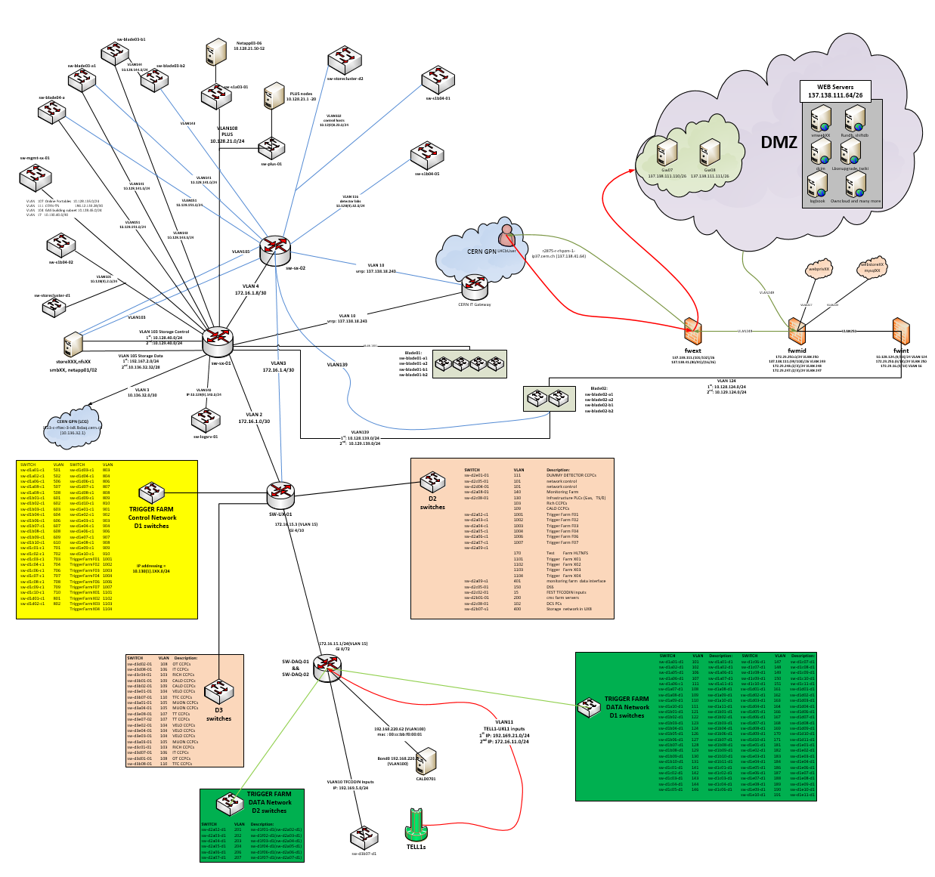
Network Devices Monitoring
Objectives
Automatic device and link discovery.
Hardware and interface status monitoring
Done so far…
Agent management
Server prototype (tested on device subset)
Rudimentary alarm specification
Future Work (standby)
Display specifications
Test with all devices
Finish link discovery
Integrate services developed by other team members.
Notes:
Another of my contributions consisted in developing a Network Device Monitoring system. Its job is to find all the devices in the technical network automatically, report on what devices are connected on which ports, provide an health check on each of the devices (memory, cpu usage, temperatures, fans, etc…) and also provide a check on the status of the interfaces declared in each of the switches/routers. Some of these devices have thousands of interfaces (the main readout switches) and there are approximately 430 devices to monitor.
The whole monitoring is done through WinCC-OA making use of its SNMP protocol agents (one for each device). So far the agent management is done, there is a server prototype tested on a subset of devices and there are already some alarm specifications put in place. Still lacking is the graphical interface, testing with the full network and also finish the link discovery. This project has been put in standby because there were other projects that needed a little more attention.

Slide 6
Electronics Upgrade
New Challenges in 2018
Luminosity increase in the future LHC upgrade
No first-level hardware trigger (Trigger-less DAQ)
DAQ (Data Acquisition) has to cope with increase in data transfer
Detector front-end electronics
New Electronics Control Solutions
Optical links
GigaBit Transceivers and GBT chips
SCA chips to interface directly the FEBs (Front-End Boards)
PCIe40 boards (logically SODIN, TELL40 and SOL40)
The GBT-SCA provides:
  16x I2C controllers
  1x JTAG controller
  1x SPI controller
  32x ADC channels
  4x DAC channels
  4x PIA (Parallel Interface Adapters) controllers
  1x Memory bus (32 bits) controller
Clock & fast commands
Eventbuilder PCs
TFC
Eventbuilder network
subfarm switch
subfarm switch
Online storage
Eventfilter Farm
~ 80 subfarms
Notes:
The efforts for the upgrade to be done during LS2 are starting now (actually started some time ago), and I was integrated in this effort. In 2018 the LHC is going to prepare to increase luminosity, which translates in some way to more collisions per cross section, bringing a big increase of data coming from those collisions. Not only that, but LHCb is also preparing to implement a trigger-less DAQ, meaning there is not going to be any hardware trigger in L0 like we have now, and so the data that is passing to the High Level Trigger is much higher. Given all that and also taking into account that the detector itself is going to change, new front-end electronics are going to be needed (most already are in a very advanced stage of development). This in turn calls for the development of a new control system. This is already taking place, and it comprises the introduction of optical links for the data and control links, GigaBit Transceivers and the chips that interface them, PCIe40 Boards and SCA chips that interface the front-ends directly. The SCA can use a set of protocols that interface these boards.

Slide 7
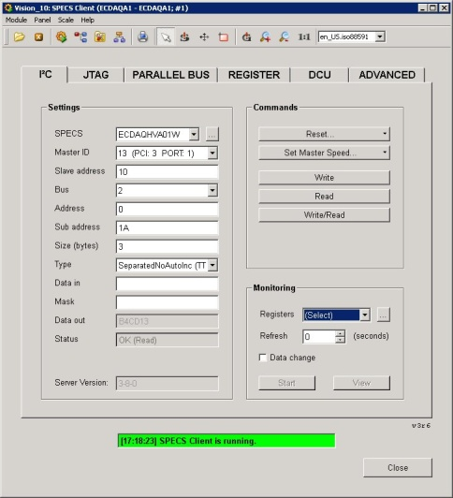
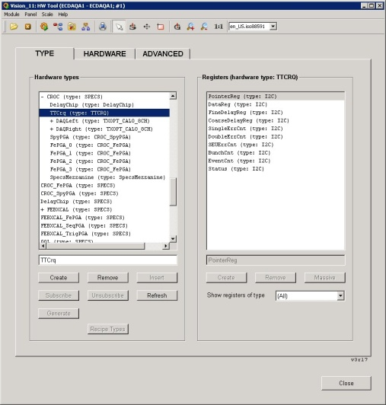
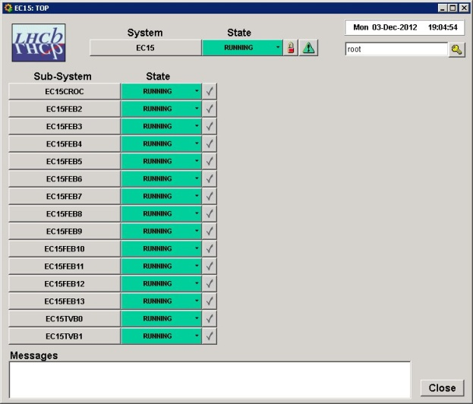
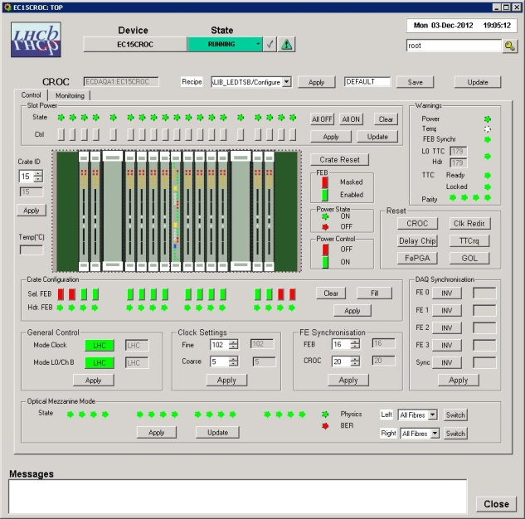
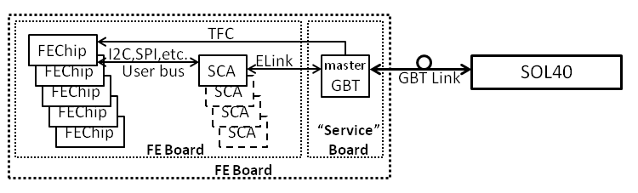
Electronics Upgrade
WinCC-OA
Control PC
Firmware
GbtServ
DIMServer
PCIe Library P
FPGA
PCIe driver P
SOL40
PCIe
SOL40
Host PC
Notes:
This slide shows the structure of the control system from the user end all the way to the front end boards. Commands will departure from a user interface of any kind, pass through a control pc running WinCC-OA and communicate with a DIMserver located in the SOL40 boards. My current contribution is in this GbtServer, I am building, integrating and testing the low level libraries that implement the SCA specific protocols through the firmware. Firmware is also going to need some work in order to take some of the effort out of the cpu and then work can deviate in any way it is necessary.

Slide 8
Other work done
Split-HLT Alignment and Calibration
Migration of SPECS Master cards
Modification and deployment of FSM subtrees for HLT2 Monitoring and Reconstruction
Online team Piquet duties
…
Notes:
I have also helped with the construction of panels that will facilitate the configuration of the new HLT architecture that is going be used in the next run and also with others that map the new SPEC master cards architecture into the old architecture to allow for the reusability of what’s already built. I have of course attended trainings regarding the software, framework and FSM with which the system is controlled, and I will also soon have a training in VHDL.

Slide 9
Trainings
International School of Trigger and Data Acquisition (ISOTDAQ 2015)
CERN School of Computing (CSC 2015)
French course
WinCC-OA and the JCOP Framework
Finite State Machines in JCOP Framework
Introduction to Accelerator Physics
Introduction to VHDL
Comprehensive VHDL for FPGA design (today!)
Notes:
I have also helped with the construction of panels that will facilitate the configuration of the new HLT architecture that is going be used in the next run and also with others that map the new SPEC master cards architecture into the old architecture to allow for the reusability of what’s already built. I have of course attended trainings regarding the software, framework and FSM with which the system is controlled, and I will also soon have a training in VHDL.

Slide 10
My experience
DAQ and Control project of big dimensions
Convenience of FSM and SCADA
Working in a distributed system
Learned general technical skills
First steps in firmware design (following weeks)
Many trainings!
Amazing working environment!
Notes:
To conclude, I’d like to say that’s been very interesting to be inserted into a big DAQ and Control project and that it’s quite refreshing to see topics that I studied such as FSM be so convenient in such intricate paradigms as an experiment of this level. It was also my first experience in a professional team and it has been an enjoyable ride since the working environment is actually great.

Slide 11
Acknowledgements:
Questions?
  FCT
  Clara Gaspar
  Luis Cardoso
  CERN
  All my PH-LBC colleagues

