Slide 2
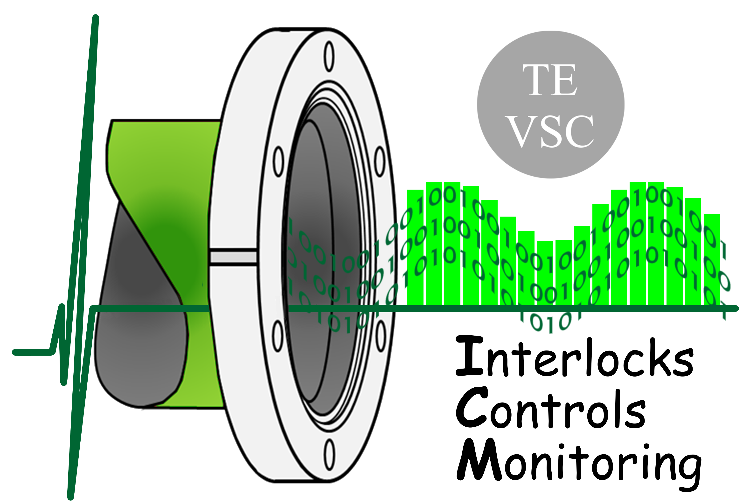
FCT and CERN
Portuguese Trainee Programme Report
Claudia Dias
CERN, Technology Department
Vacuum, Surfaces and Coatings Group
FCT and CERN Portuguese Trainee Programme Report
| 26th October, 2015

Slide 3

Resume
Overview of Vacuum at CERN
TE-VSC-ICM Section
Vacuum Control Systems Architecture
Projects
  Sector Valves Performance Monitoring
  UNICOS Framework Convergence
Competences

Slide 4
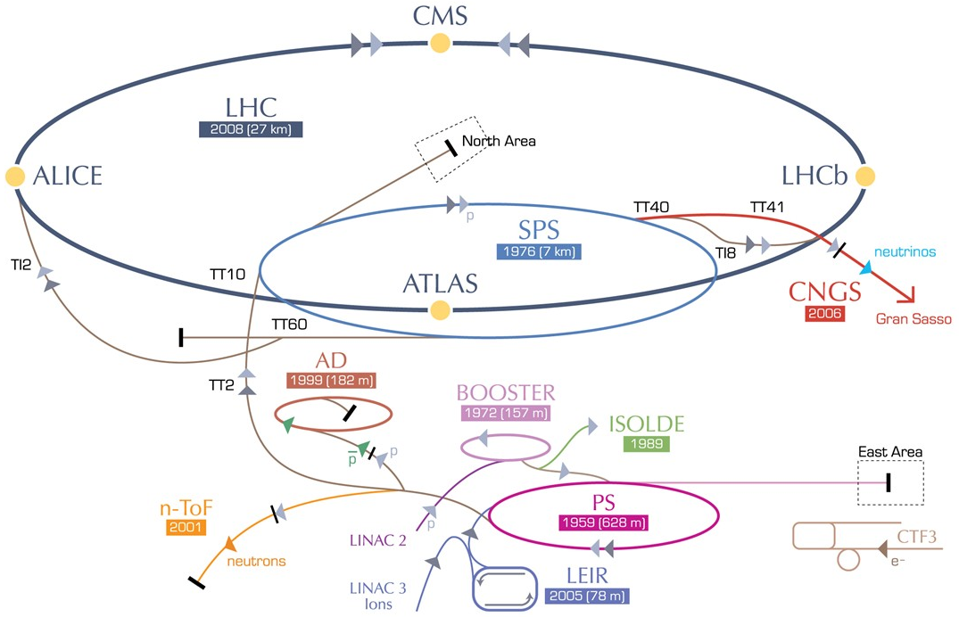
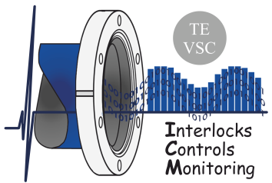
Overview of Vacuum at CERN
Beam and Insulation vacuum systems
> 128km of vacuum chambers across all accelerators
Pressure range from 10⁻⁴ to 10⁻¹¹ mbar achieved by:
  ~3000 vacuum pumps
  ~3000 vacuum gauges
  ~500 sector valves
How to supervise and control such a large system?
  7 SCADA servers
  ~300 PLCs
  Backboned by vacuum-specific software frameworks
TE-VSC-ICM

Slide 5

TE-VSC-ICM Section
TE Technology Department
VSC Vacuum, Surfaces and Coatings
ICM Interlocks, Controls and Monitoring Section
Design, Maintenance and Consolidation of vacuum control systems,
for all Accelerators and Detectors

Slide 6
Vacuum Control System Architecture
Supervision
SCADA systems
DB and Archiving
Interface with other systems
Control
Control Logic
PLCs
Standalone controllers
Field
Process sensors, actuators: valves, gauges, pumps

Slide 7
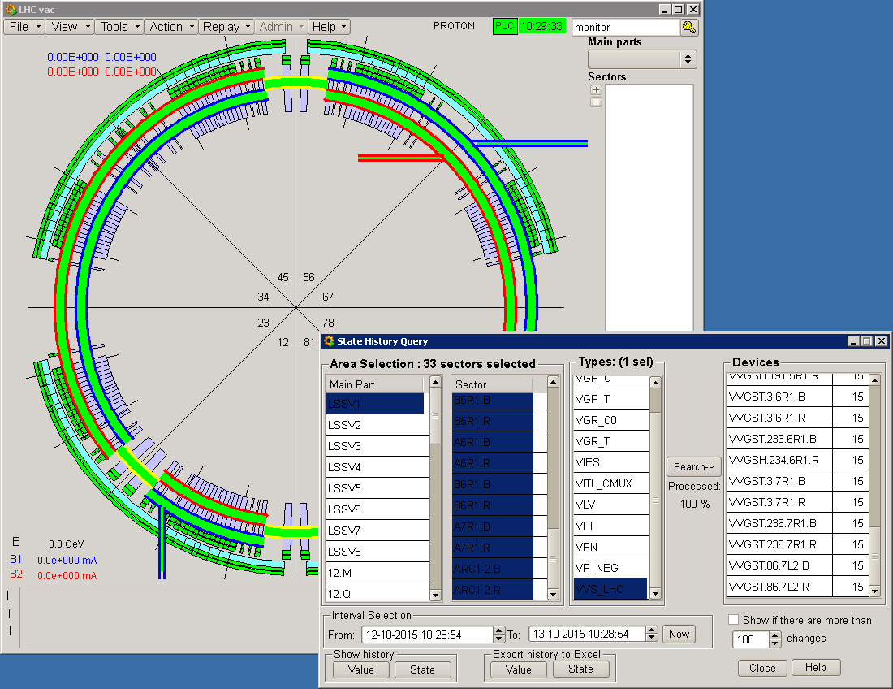
Vacuum Sector Valves Performance Monitoring
Current status:
  305 Sector Valves on the LHC
  No data on current status or number of cycles
  Sector valve performance analysis done manually
  Not practical to continue with manual monitoring
New developments:
  Embedded monitoring tools
  Real-time and continued valve fatigue follow-up
  Archiving of main parameters (# open/close cycles, answering time)
  User notification features (system warnings, errors)
  Communication with asset management systems
Improvements:
Automatic and continued monitoring
Predictive maintenance
Enhanced fault detection
Improved system reliability
Inventory control
SCADA update, new features development.
Current SCADA method to extract the valves historical behaviour.

Slide 8

UNICOS Framework Convergence
Currently: Vacuum-framework
  Used in the biggest accelerators (LHC, SPS, PS)
  Produces the SCADA configuration and PLC programs from the vacuum controls database (vacDB)
  Collaboration with Russian institute IHEP (tech support)
UNICOS framework
  UNified Industrial Control System
  CERN’s industrial control systems standard
UNICOS for Vacuum
Vacuum specific objects, panels, scripts
All Vacuum-framework features into UNICOS
Duplicated effort for maintenance
In-house support (EN-ICE)
First step
Second step
Framework convergence: UNICOS-Vacuum Package

Slide 9
Competences
Competences to acquire/develop:
  SCADA (WinCC-OA, PVSS) programming
  PLC programming (IEC 6-1131)
  Systems Integration
  General programming (JAVA, C++, QT, VBS)
  Databases (SQL, architecture)
Overall purpose:
  Vacuum SCADA features extension
  UNICOS-Vacuum package development
  Vacuum control system user-support

Slide 10
Questions?
FCT and CERN Portuguese Trainee Programme Report
| 26th October, 2015

