Slide 2
CERN/FCT Trainee Report
Jorge Fraga – VSC/ICM
April 2014-October 2016

Slide 3
Training
Siemens STEP7: level 1.
WinCC-OA and JCOP Framework
Sputter Ion Pumps: Operation and Working principles
WhiteHat computer security training
French course

Slide 4
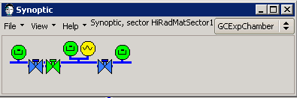
HiRadMat
First experience with deployment of control system with vacuum framework.
Controls for one vacuum sector consisting of:
  1 PLC
  3 valves
  4 gauges
  Software interlock for safety valve
Test and debug software interlock function.

Slide 5
CHARM
Controls and data logging for radiance tolerance test of power supply crates for pumping groups.
Developed skills:
SCL programming
  HMI - WinCCFlexible

Slide 6
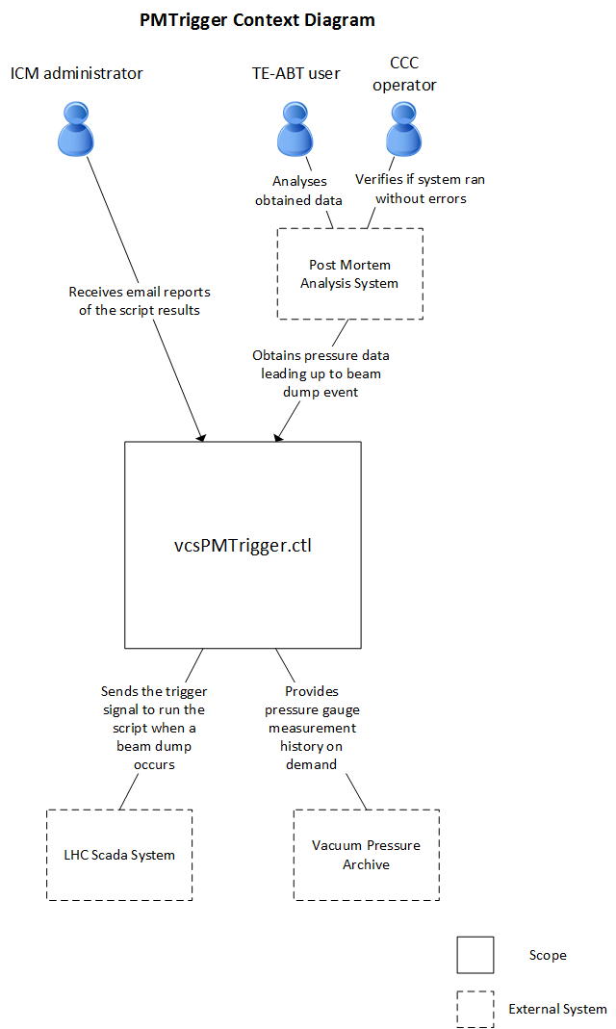
PMtrigger
SCADA script for reporting pressure in beam dump lines during a beam dump event.
Any missing values generate an alarm that has to be checked by LHC operators.
Provided valuable experience with WinCC-OA, CTRL scripting language and Oracle data archiving.

Slide 7
Other responsabilities:
PLC updates – organization, deployment, reporting
Vacuum monitoring – support for monitoring room computers and website.
Version control – stored PLC projects for all accelerators in version control software.

Slide 8
Current Projects

Slide 9
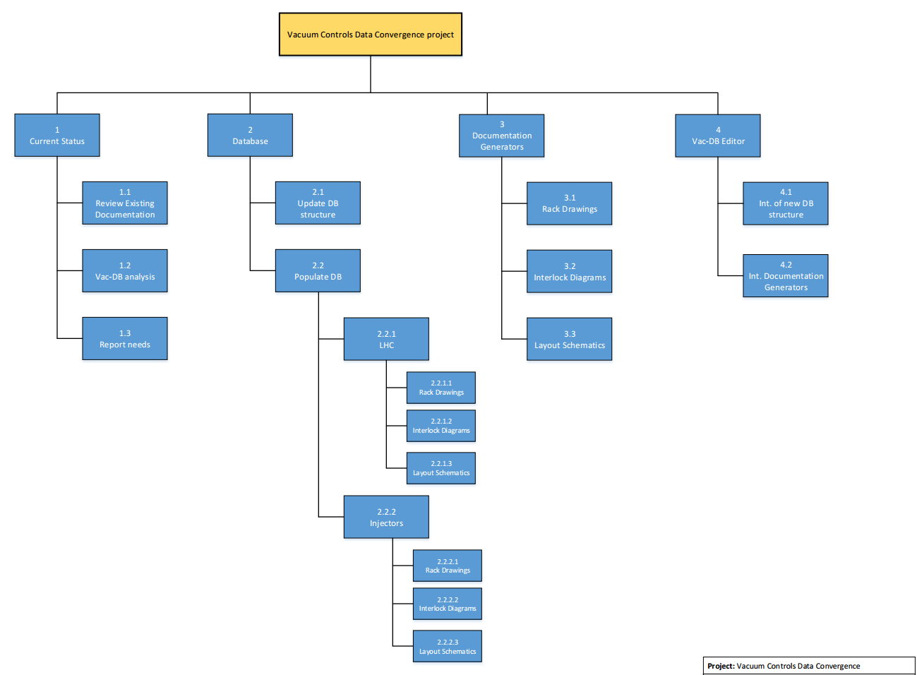
Vacuum Data Convergence

Slide 10
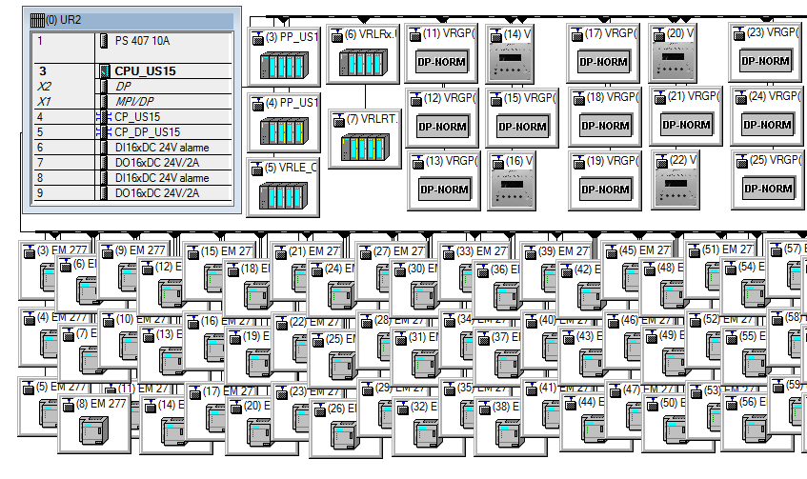
PLC Hardware Configuration
Project to generate the hardware configuration for vacuum PLC automatically from the database

Slide 11
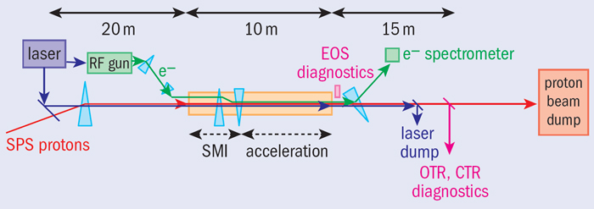
AWAKE
Similar task to the HiRadMat project but on a larger project:
  Setup project with hardware configuration, vacuum baseline functions and database exports
  Deploy and verify the result

