Slide 1
EHN1 extension
Quai H4
S. Girod

Slide 2
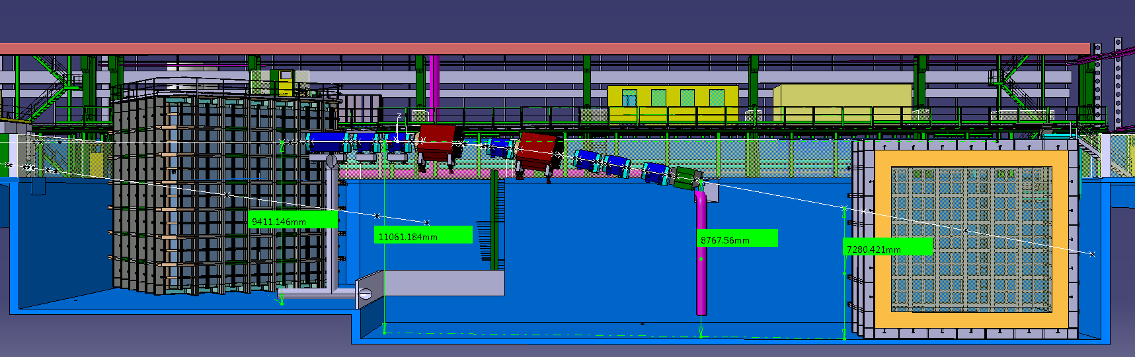
H4 beam line magnets - tot: 116t
QPL
11 t
QPS
5 t
QPS
5 t
MBPL
30t
QPS
5 t
MBPL
30t
QPS
5 t
QPS
5 t
QPS
5 t
MBPS
15t

Slide 3
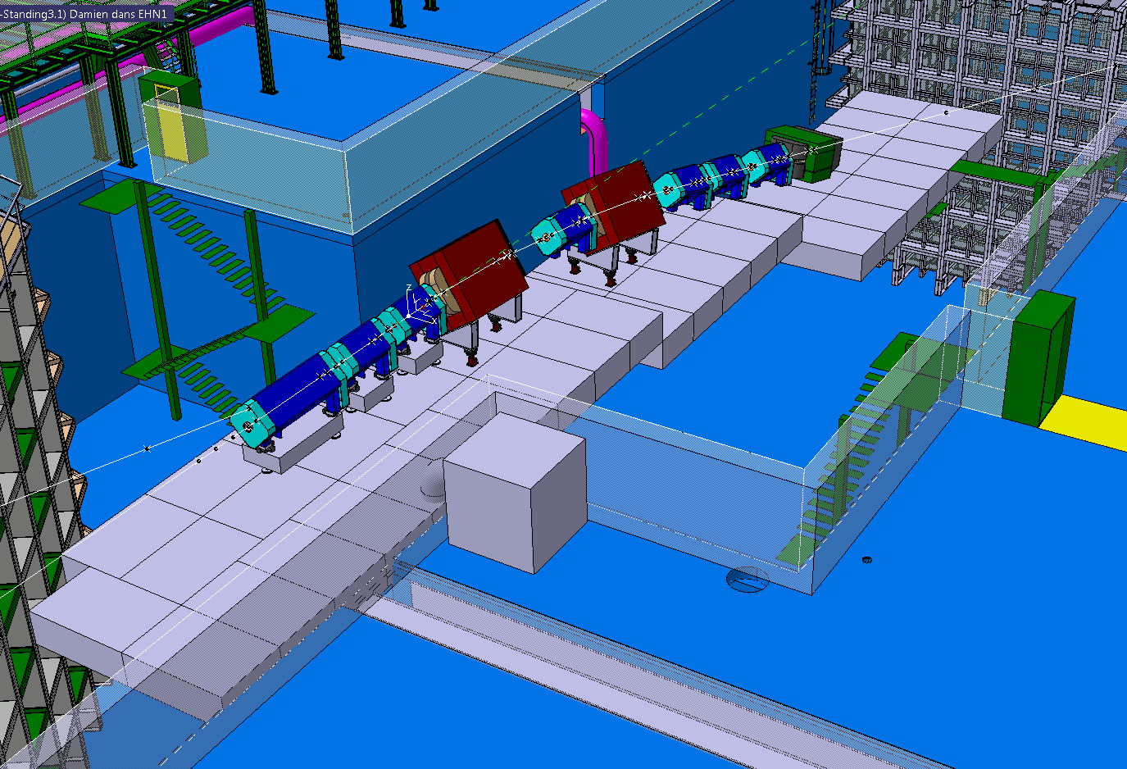
Tapis ht 800mm
334 t
4.8m
11.2 m
8 m
4.8m
16 m
5.6 m

Slide 4
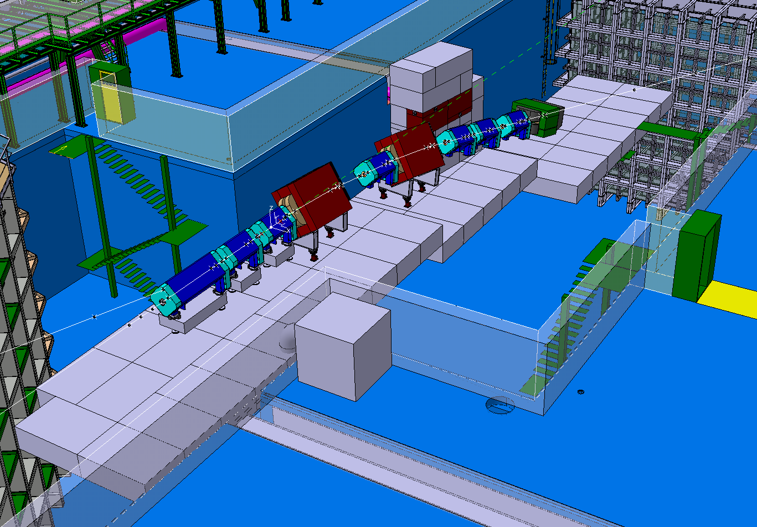
Beam dump
80 t
11.2 m

Slide 5
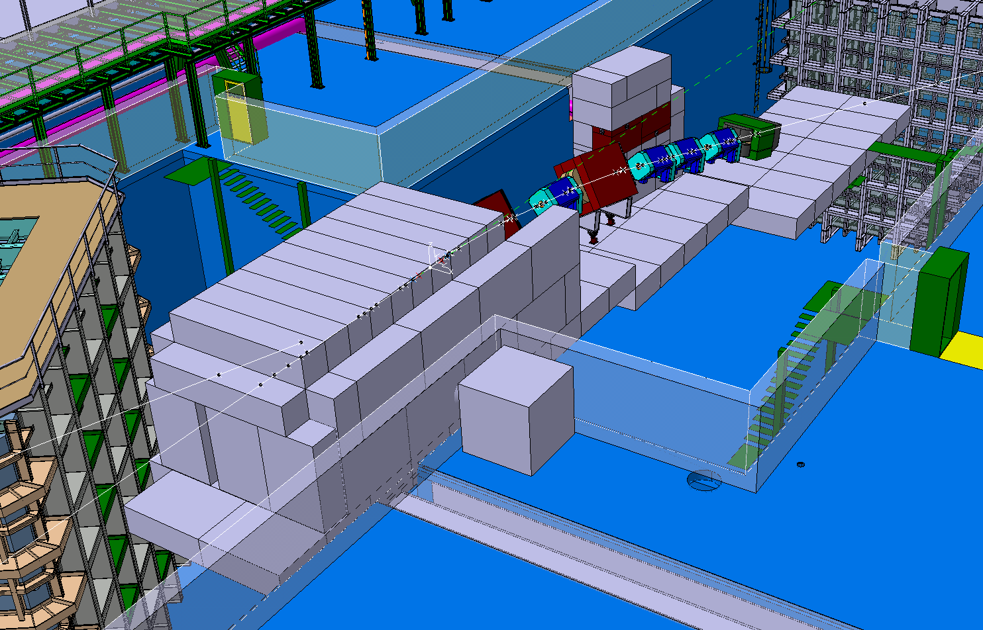
Target shielding 292 t
Total: 882 t

Slide 6
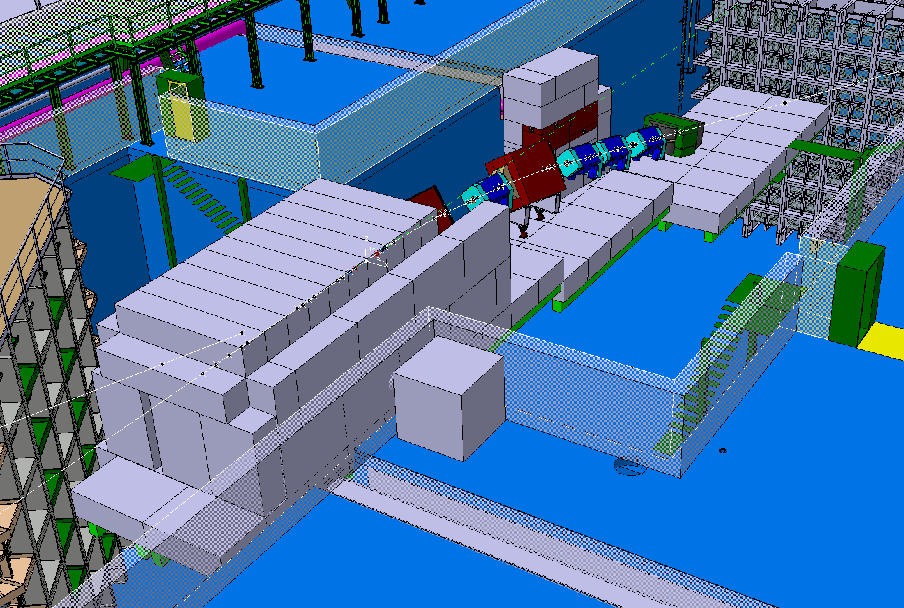
very draft proposal for supporting structure
HEB 400

Slide 7
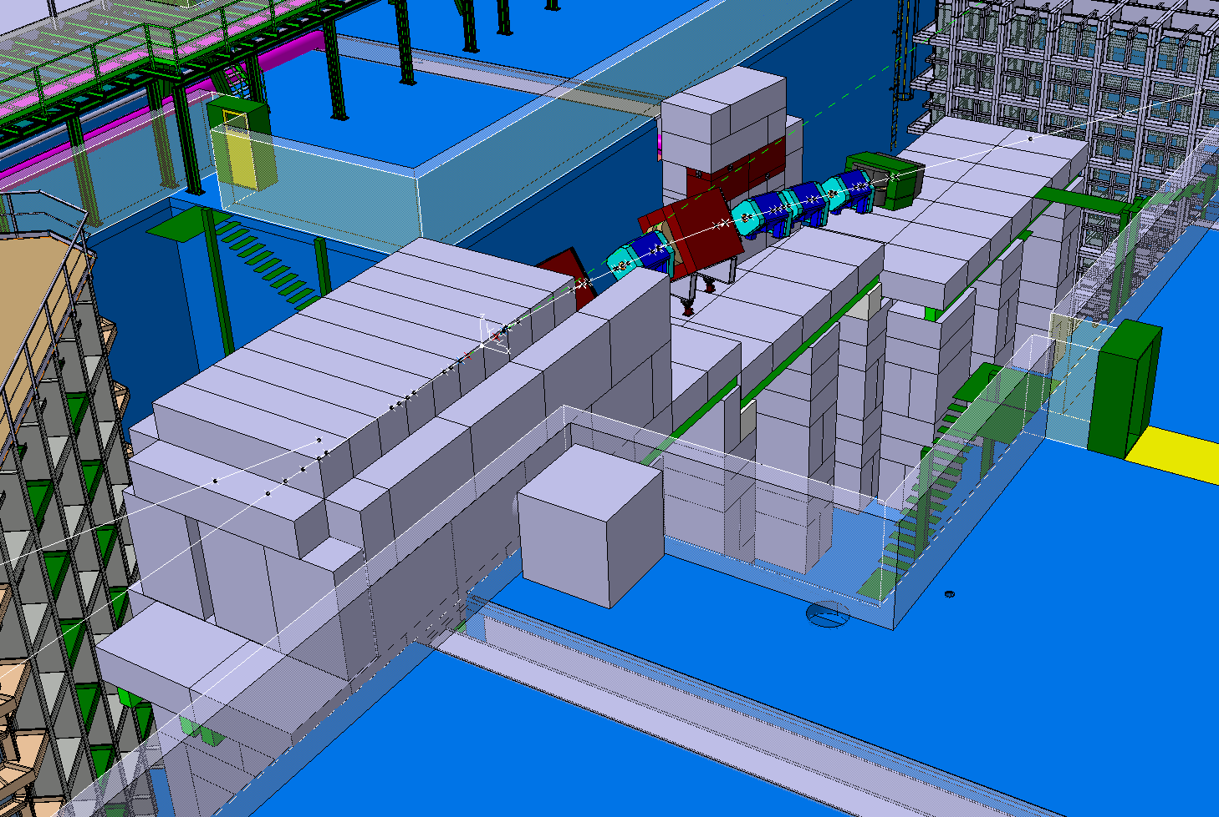
very draft proposal for supporting structure
Concrete blocks pillar 1137 t

Slide 8
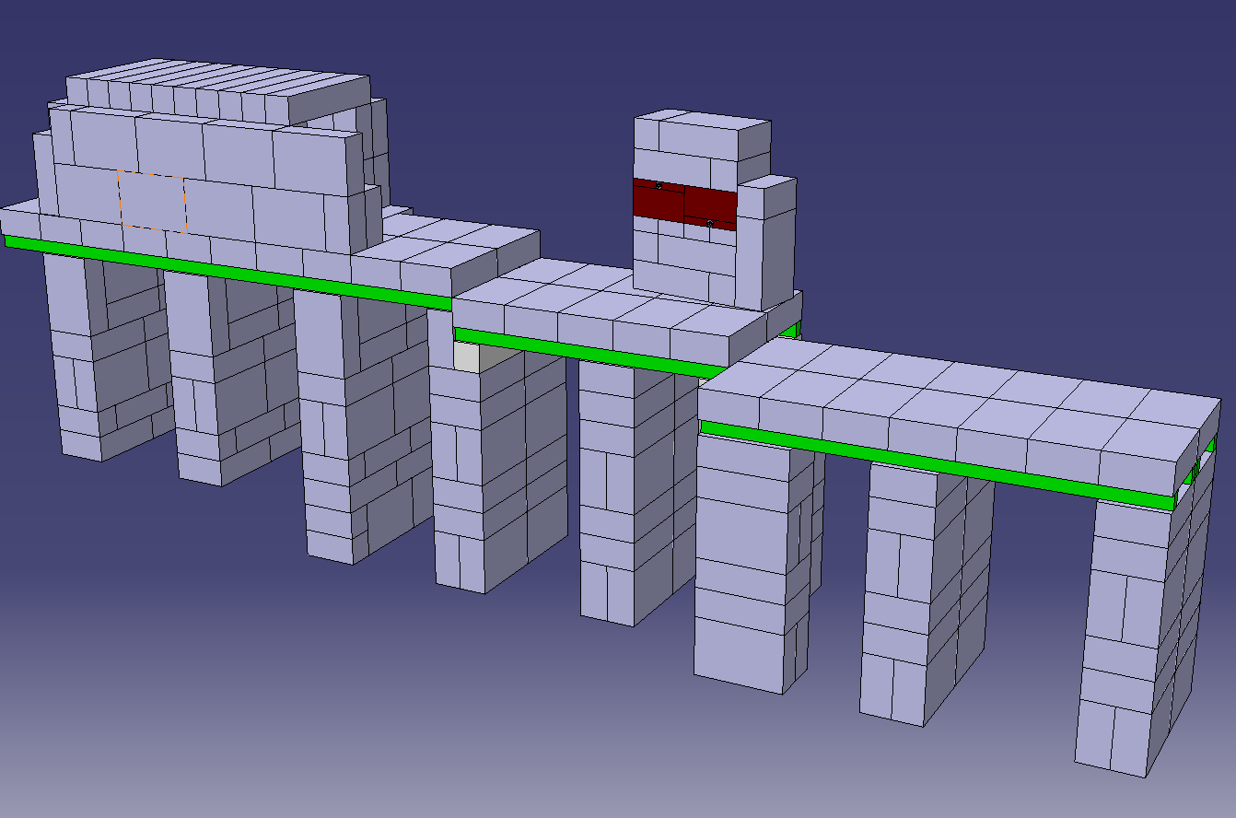
Tot 800 m³ concrete

