Slide 1
IT/CS Network for Experiments
Experiments require IT-CS services for :
  Infrastructures, databases, network development, network investigations, monitoring and all other telecom technologies

Slide 2
General topology, networks and domains
The 4 big Experiments have 2 or 3 different parts
  Trigger : HLT (High Level Trigger network)
    Managed by the Experiment
  Data : DAQ (Data AcQuisition network), TDAQ (Trigger and Data AcQuisition network)
    Managed by the Experiment, equipment and services registered in IT-CS databases for ATLAS
  Control : DCS (Detector Control System network), ATCN (ATlas Control Network)
    Managed and operated by IT-CS
Each Experiment has its own Domain
  Domain names : ALICE, ATLAS, CMS, LHCb, NA62, Compass, …
The main connection come from the GPN network to the Experiment Control network

Slide 3
General topology, networks and domains
ATLAS
  Control network : 5 routers and ~60 switches
  Data network : 6 routers and ~ 300 switches
ALICE
  Control network : 5 routers, ~ 150 switches (DCS)
CMS
  Control network : 5 routers, ~180 switches
LHC-b
  Network fully managed by LHC-b. Network equipments bought through IT/CS, Services (IP addresses) and devices registered in CSDB.
NA62
  Fully managed by IT/CS
  1 router, ~ 50 switches

Slide 4
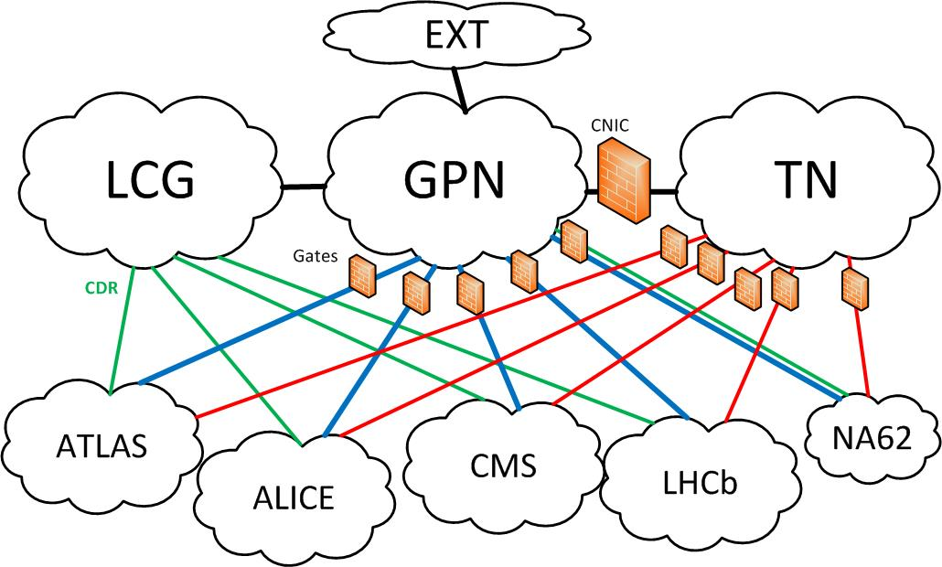
General topology, networks and domains

Slide 5
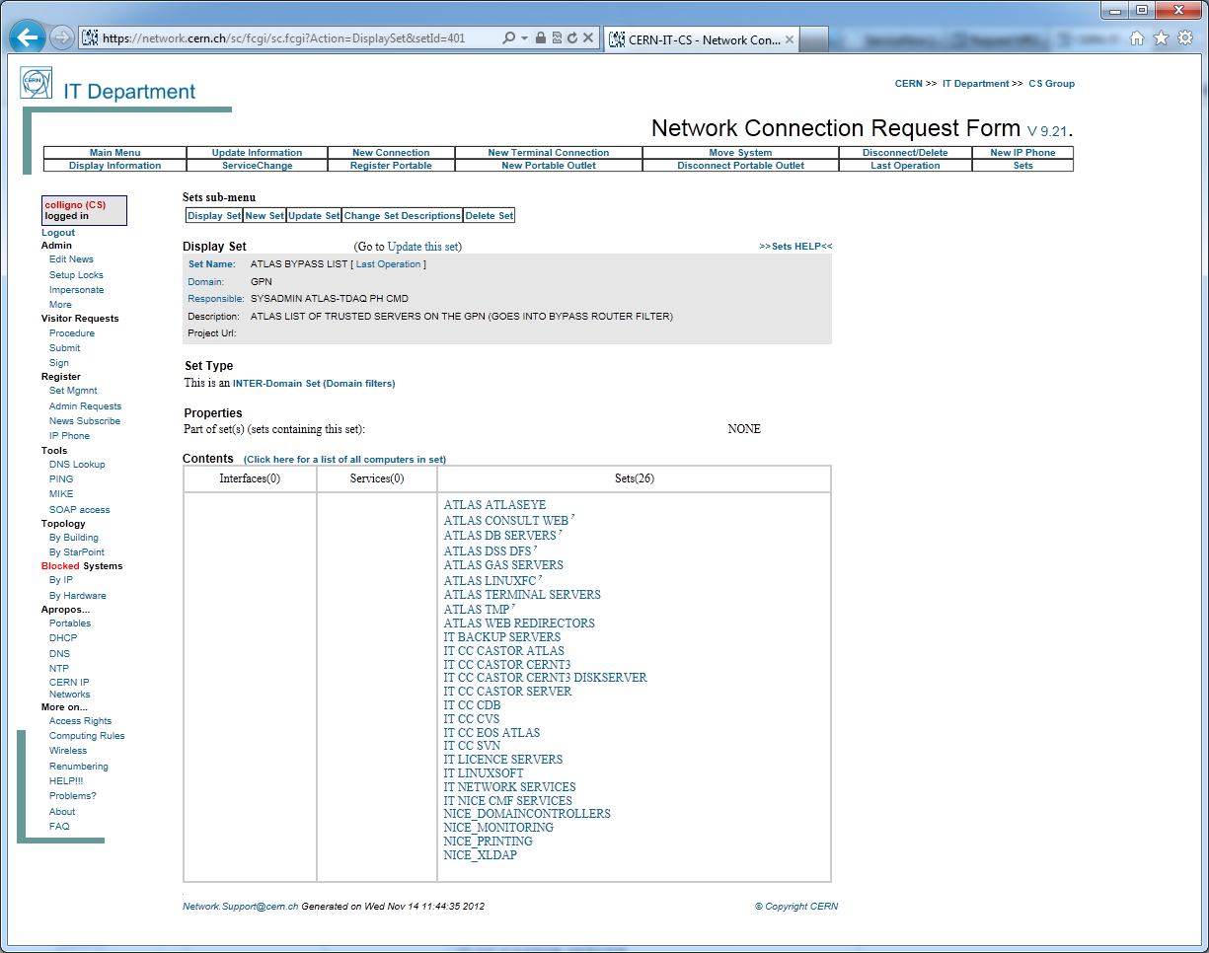
General topology, networks and domains
GATE / Bypass Set
Bypass list
List of equipments open to Exp. network

Slide 6
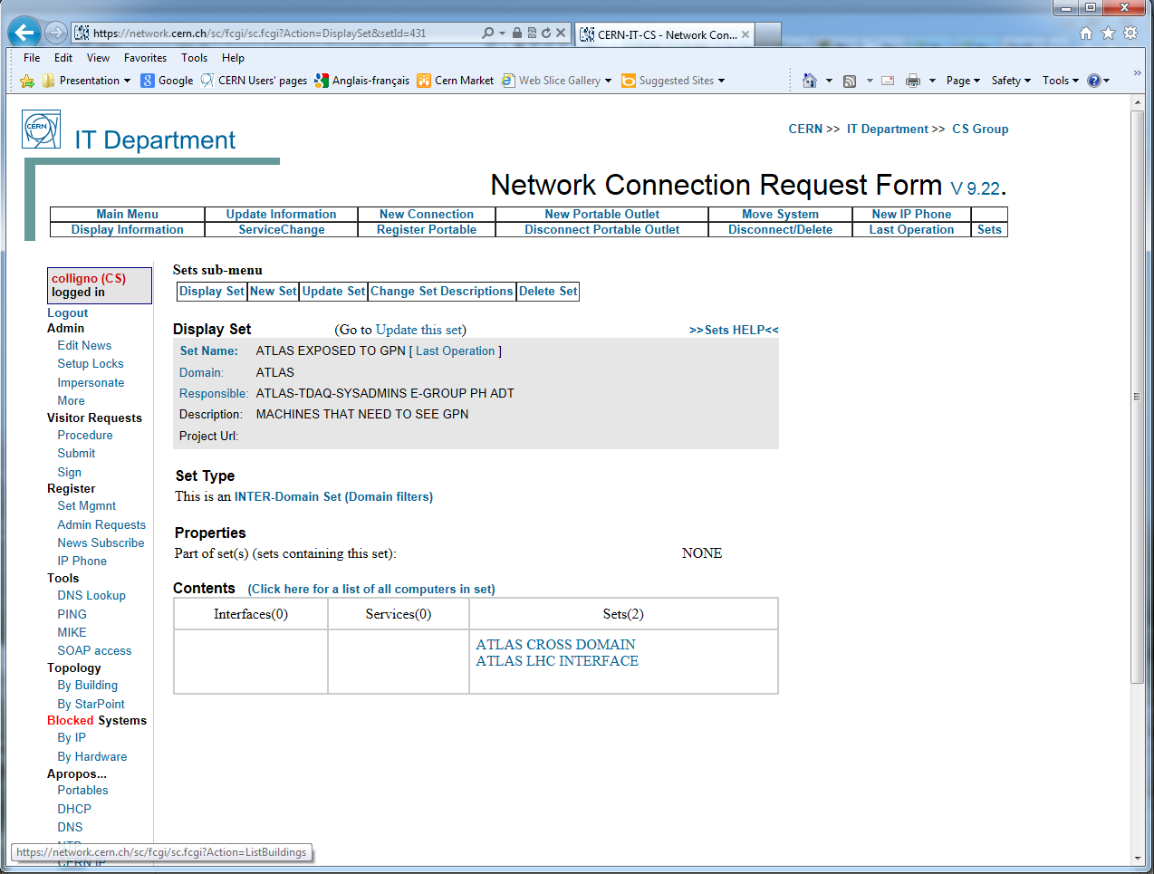
General topology, networks and domains
GATE / Exposed Set
Exposed list to GPN
List of equipments open from GPN

Slide 7
Typical topology for small/medium experiment

Slide 8
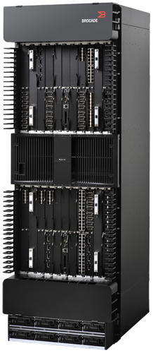
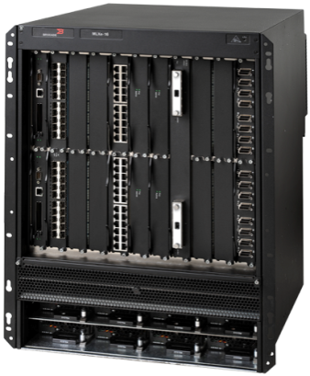
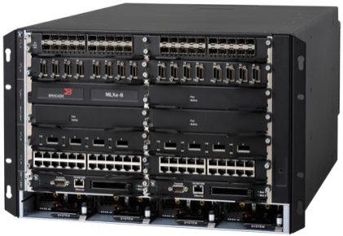
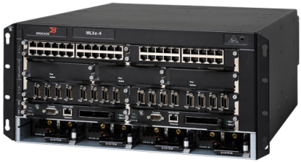
Network equipment
MLXe routers
4 types of chassis
  MLXe4 not at CERN
2 families:
  MLXe –M
  MLXe –X
MLXe32
MLXe16
MLXe8
MLXe4
8
Notes:
[Add Presentation Title: Insert tab > Header & Footer > Notes and Handouts]
11/26/13
Page 8
© 2010 Brocade Communications Systems, Inc. CONFIDENTIAL—For Internal Use Only

Slide 9
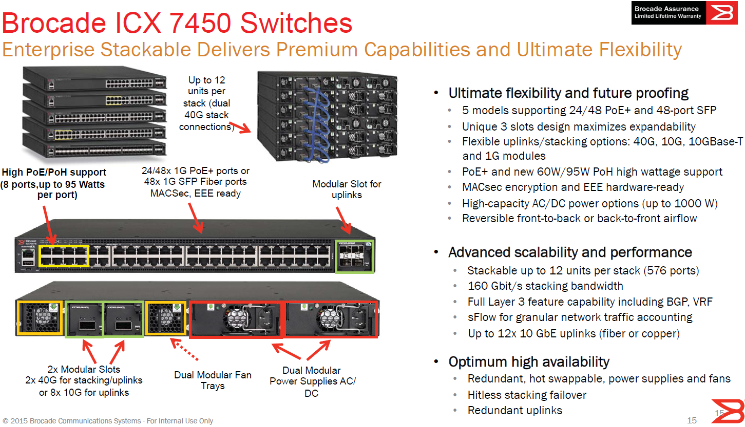
Network equipment

Slide 10
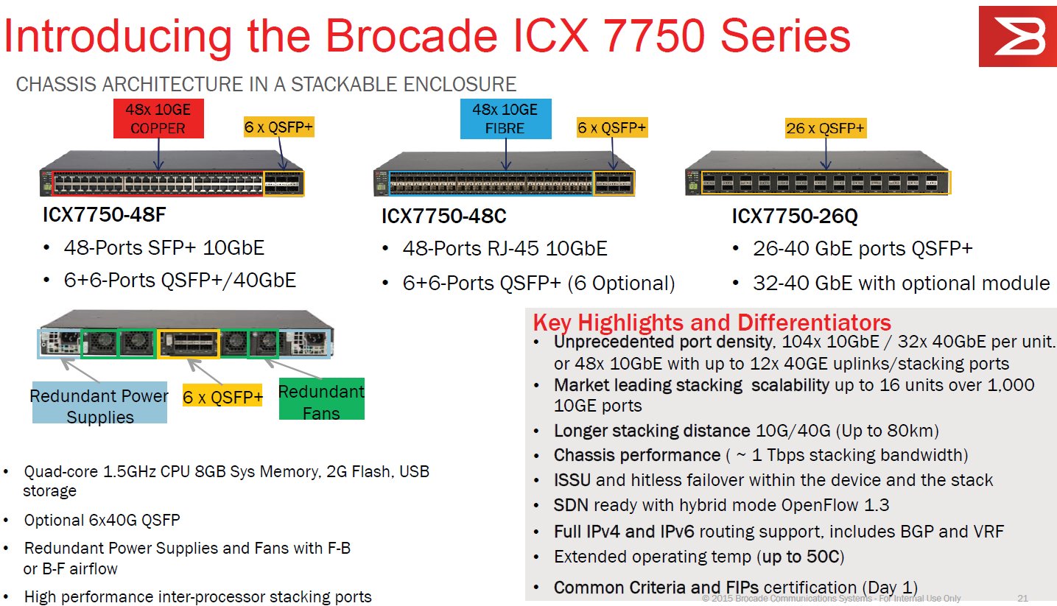
Network equipment

Slide 11
Conclusion
Open questions and responsabilities :
Infrastructure (cabling, racks, etc..)
Network equipment (requirements)
Network configuration (routing, size of the network, redundancy, etc..)
Monitoring and support

