Slide 1
ENH1 – Cryostats Layout
Dimitar MLADENOV

Slide 2
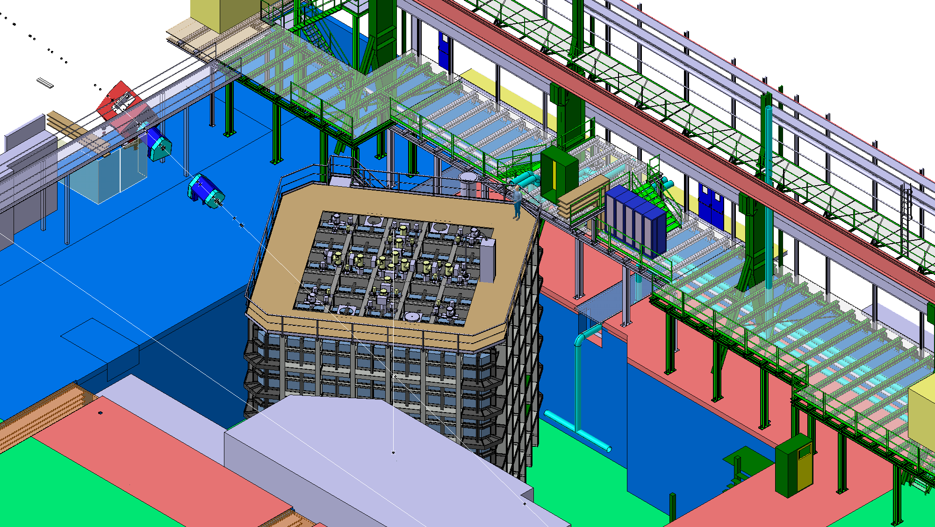

Slide 3
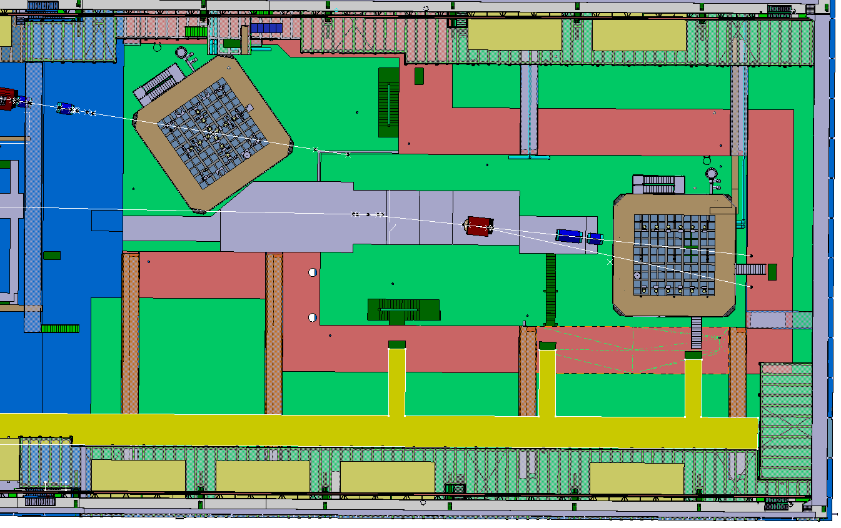
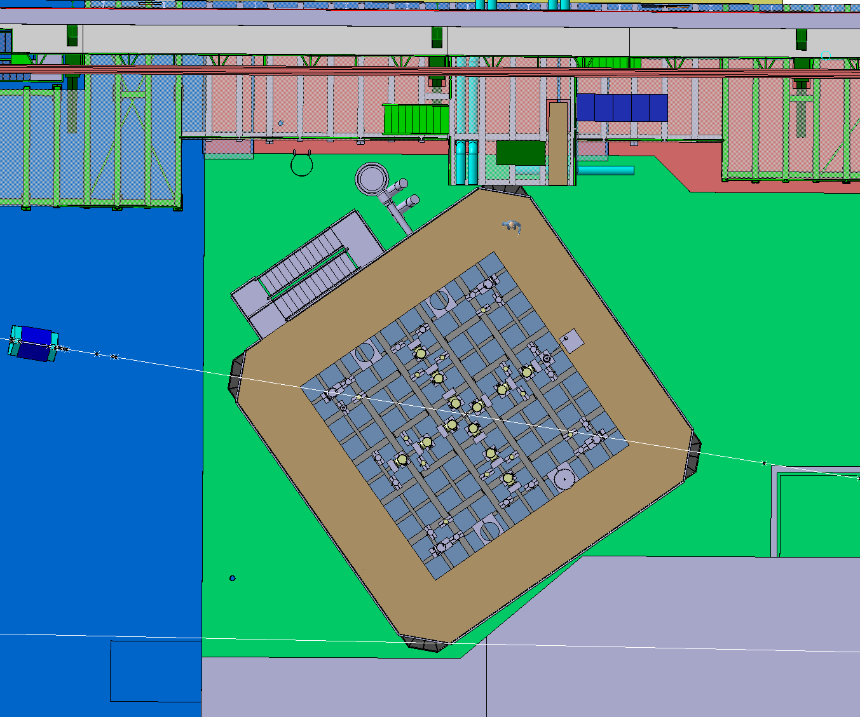
ENH1 - Layout
We are expecting to deliver the structure in ENH1 at the first half of next year and to do the final pre-assembly in the second half. The plan is to pre-assemble as much as possible and store complete walls in the existing building.
Investigating a possibility to start the mechanical work even before the building extension is ready.
Currently working on the installation procedure in ENH1.

Slide 5
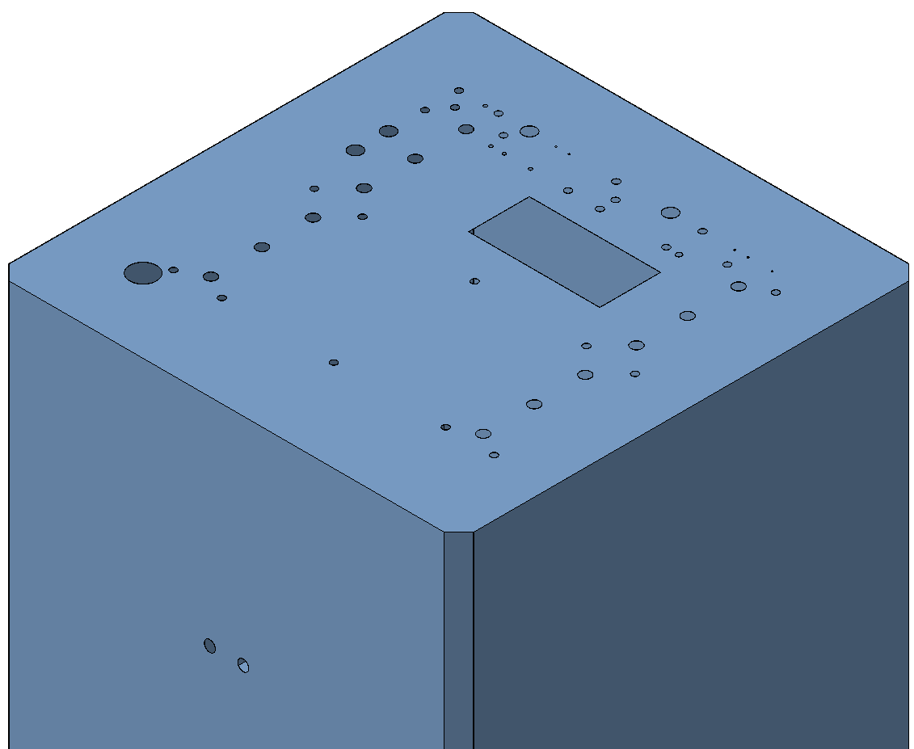
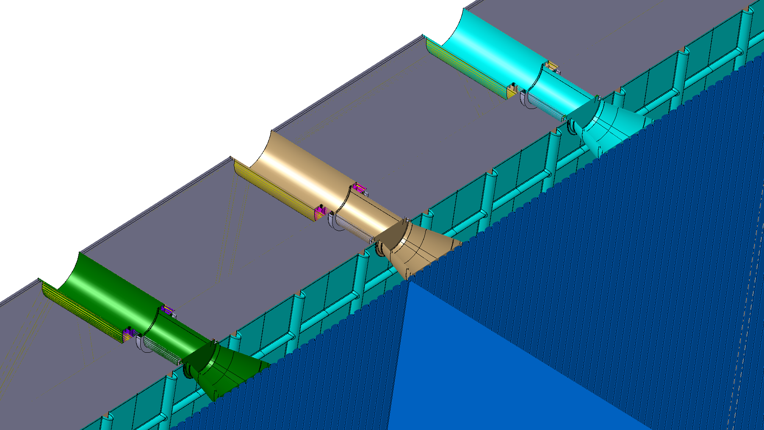

Slide 6
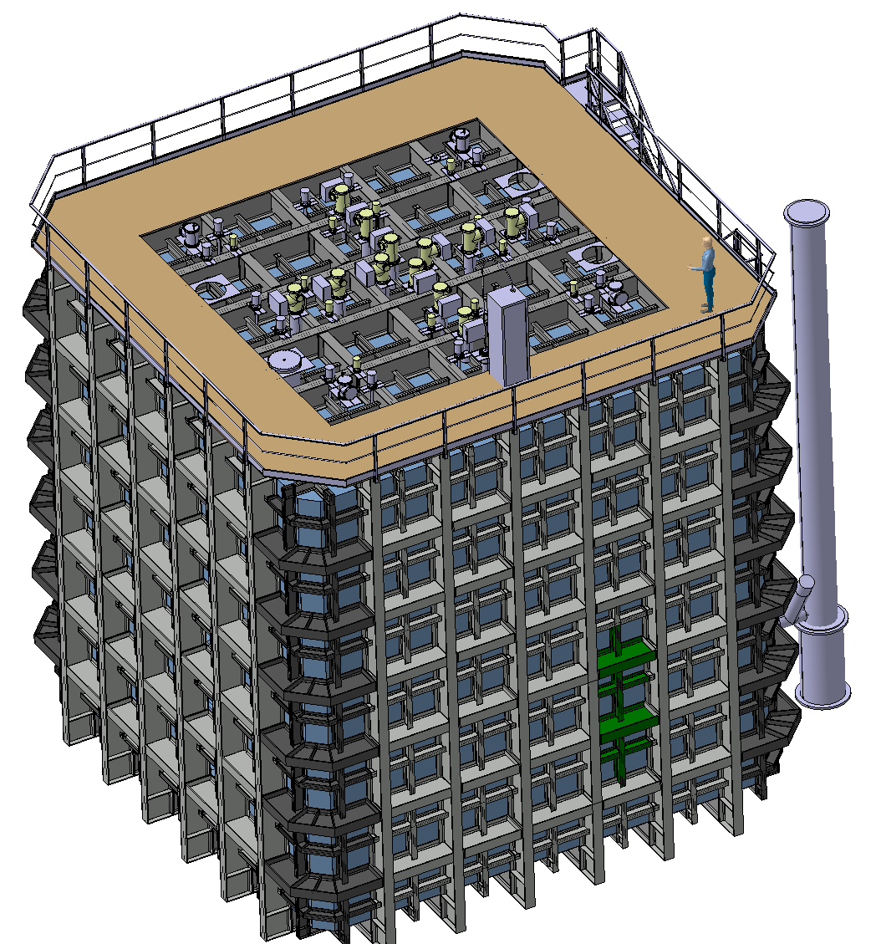
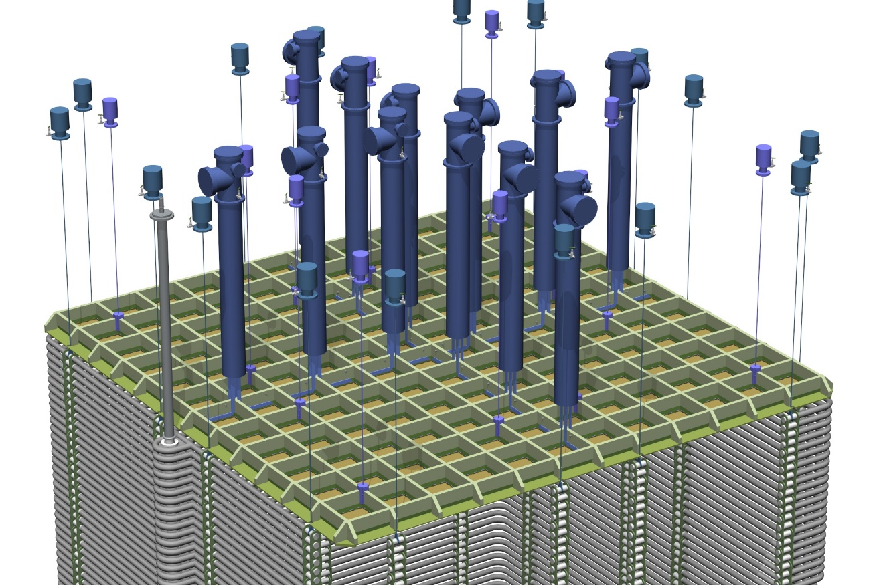
Franco Sergiampietri
Integration of all the feedthroughs at the roof structure.
Closely working with Franco Sergiampietri.
12 x Anode deck supports
12 x Signal FT
16 x Field Cage supports
4 x Slow Control FT
1 x High Voltage FT
1 x Manhole
Total: 46 roof penetrations

Slide 7
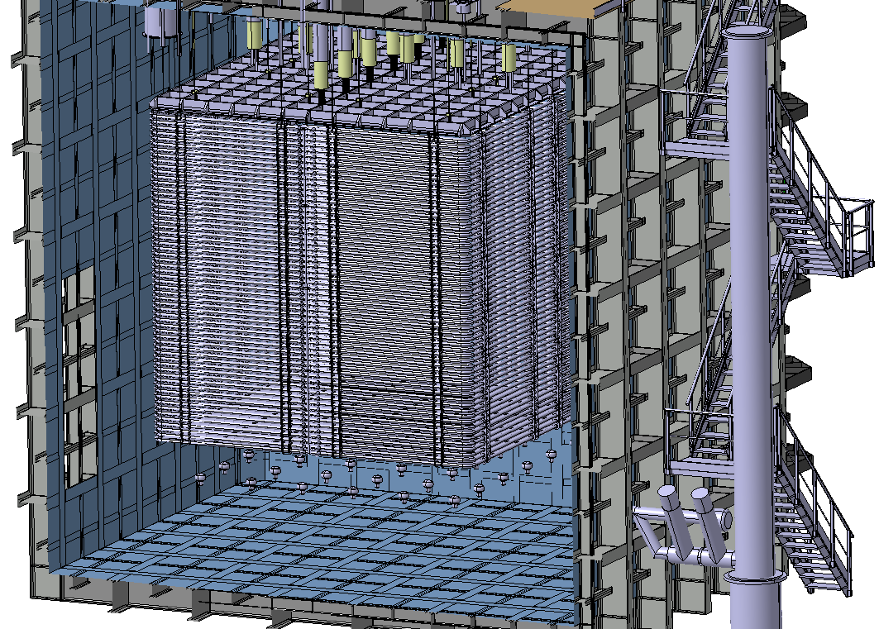

Slide 8
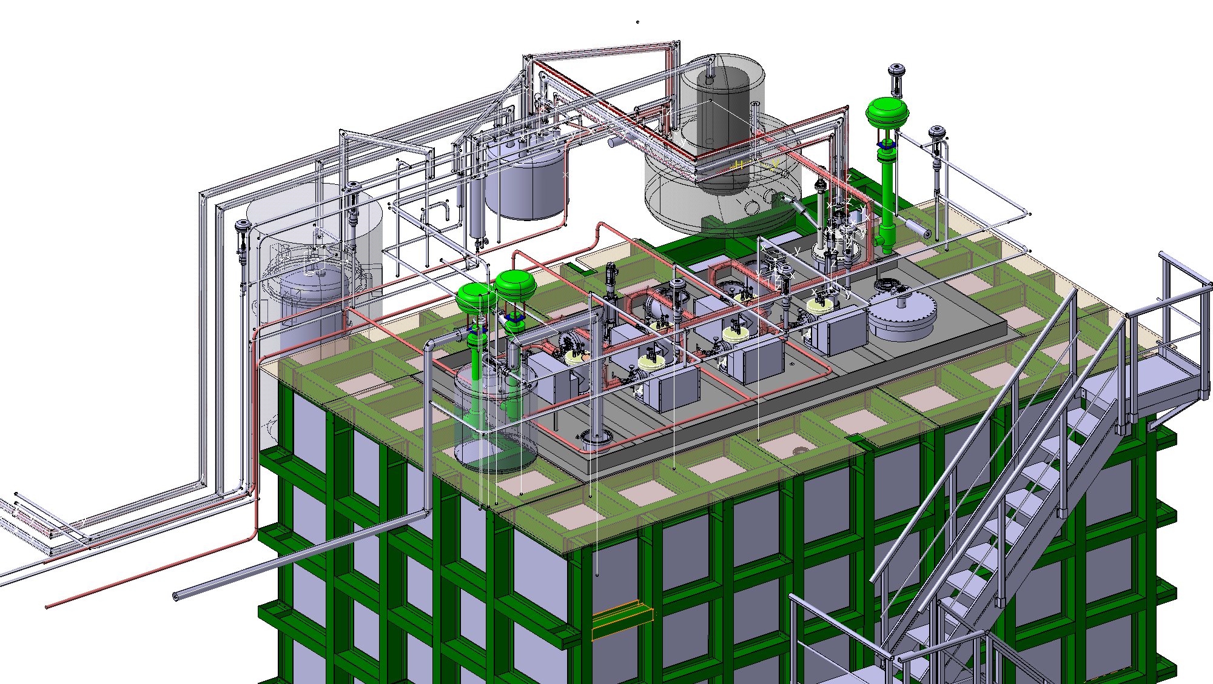

Slide 9
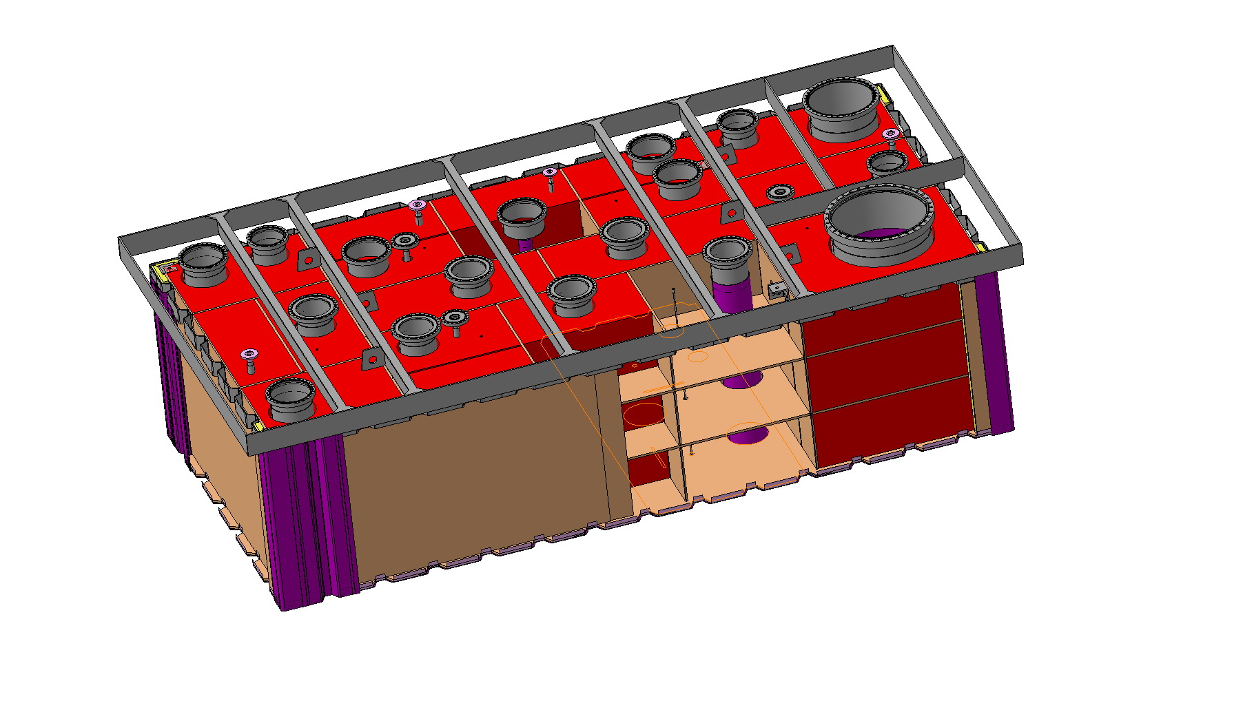

Slide 10
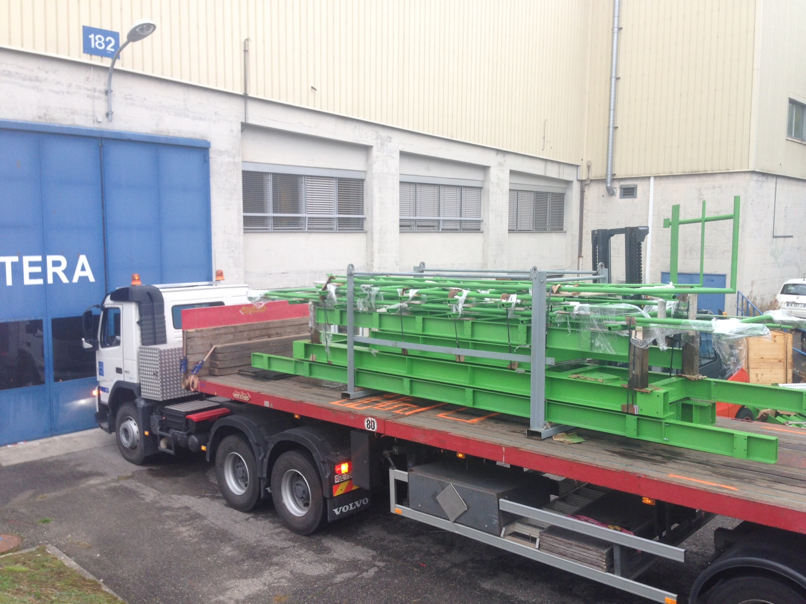

Slide 11
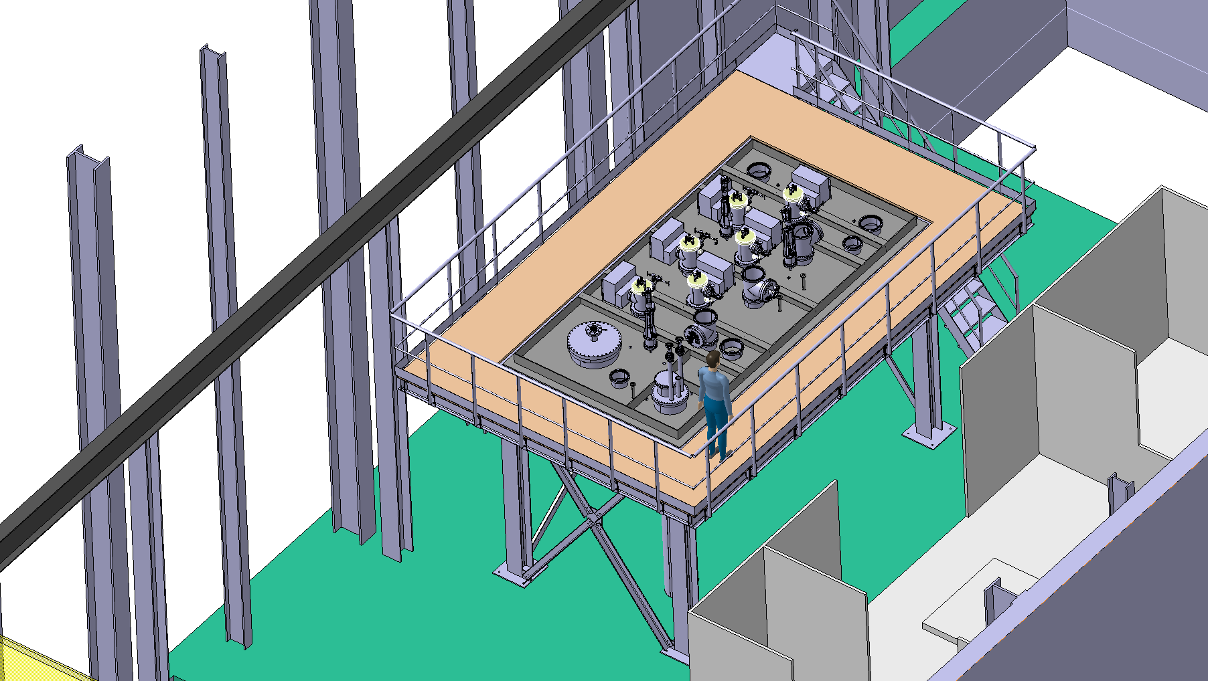

Slide 12
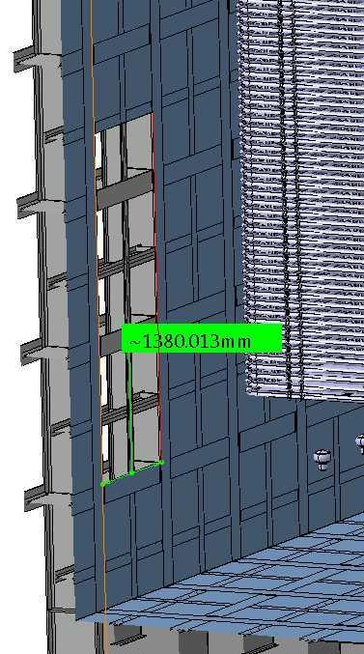

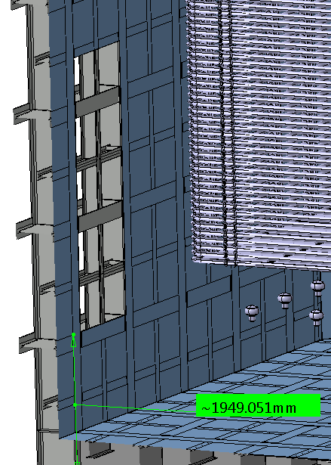
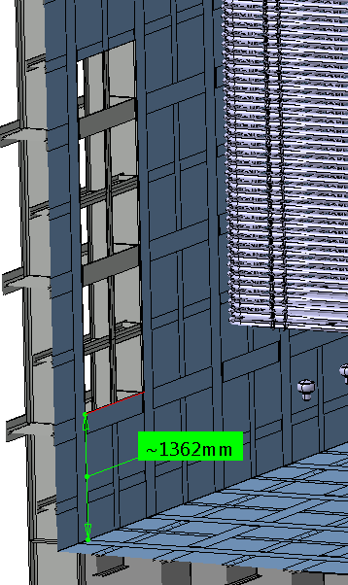

Slide 13
