Slide 1
Status of the 1.2 MW MB-IOT for ESS
Morten Jensen
www.europeanspallationsource.se
CLIC Workshop 2016, 18-22 January, CERN

Slide 2
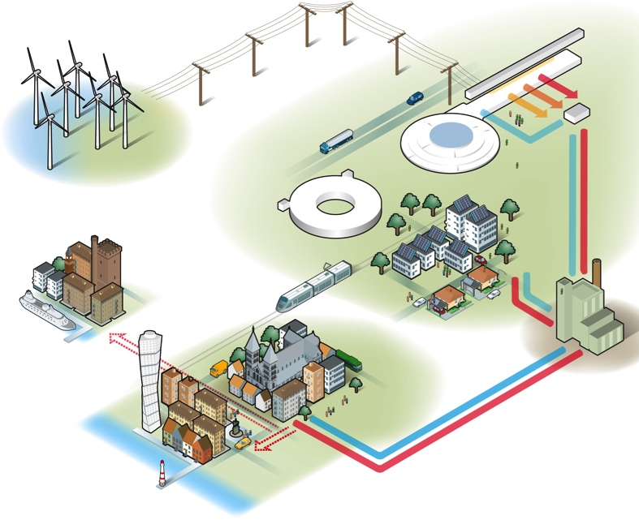

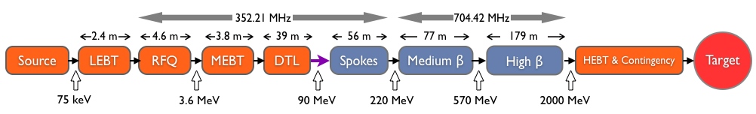
The European Spallation Source (ESS) will house the most powerful proton linac built.
  Average beam power of 5 MW (Peak > 130 MW RF)
  Acceleration of 62.5 mA to 2 GeV
  Pulse length of 2.86 ms at a rate of 14 Hz (4% duty factor)
97% of the acceleration is provided by superconducting cavities
Over 150 individual high power RF sources
  with 80% requiring over 1.1 MW of peak RF power

Slide 3
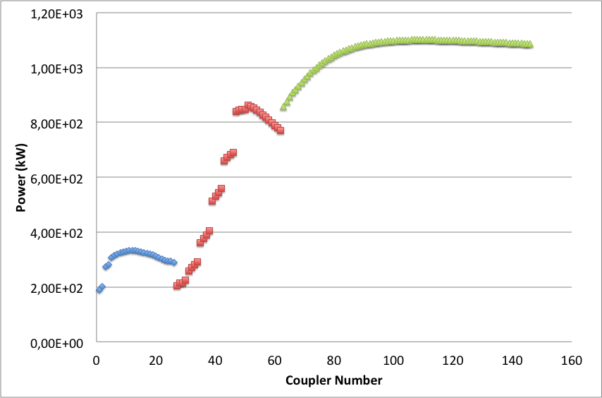
ESS accelerator power profile
Average beam power: 5 MW > 130 MW peak
Pulse repetition rate: 14 Hz
Beam pulse length: 2.86 ms
36 Medium beta cavities: 704 MHz
1.5 MW Klystrons
26 spoke cavities:
352 MHz
Tetrodes
Normal-conducting Linac:
One RFQ and 5 DTL tanks
6 off 352 MHz klystrons
3 MW
3 Solid state amplifiers for bunchers
352 MHz, 30 kW
84 High beta cavities: 704 MHz
1.2 MW MB IOTs (klystrons as backup)
Installation after 2020. Time to develop a new source

Slide 4
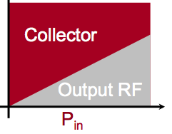
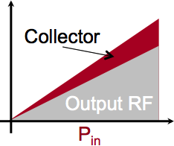
The Main Principles
Klystron
(Velocity modulated)
RF input
RF output
Cathode
(DC Beam)
Collector
IOT
(Density modulated)
RF input
Biased Control Grid
RF output

Slide 5
Key advantages of IOTs
High efficiency even when operating ‘backed-off’ for reduced RF output or regulation
Good linearity
Small and compact
Power is pulsed by RF instead of HV
Lower operating voltage
Lower Gain therefore needs more drive
Particularly beneficial for machines with:
  Varying power loads
  Non uniform power profiles
  Margins for overhead for regulation
  One-to-one relationship with amplifier to accelerating structure
  High average power applications

Slide 6
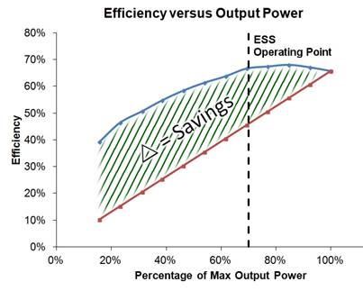
Efficiency comparison of Klystrons and IOTs
traditional
IOT measurements courtesy of M. Boyle, L3
Based on broadcast IOT L-4444
System setup limited by drive power and beam voltage
IOT setup for maximum gain (not efficiency) without breakdown
No optimisation of coupling, grid voltages etc. for different power levels
IOT
Klystron
Klystron assumed to have same saturated efficiency as the IOT
No optimisation of coupling, voltages, perveance for different power levels

Slide 7
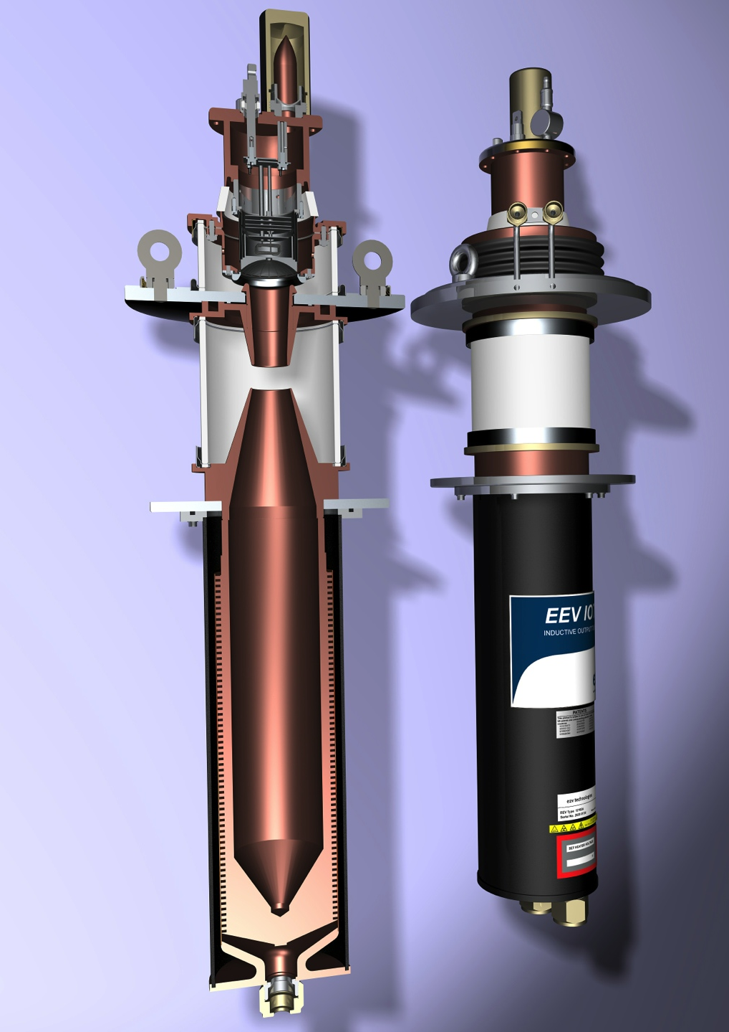
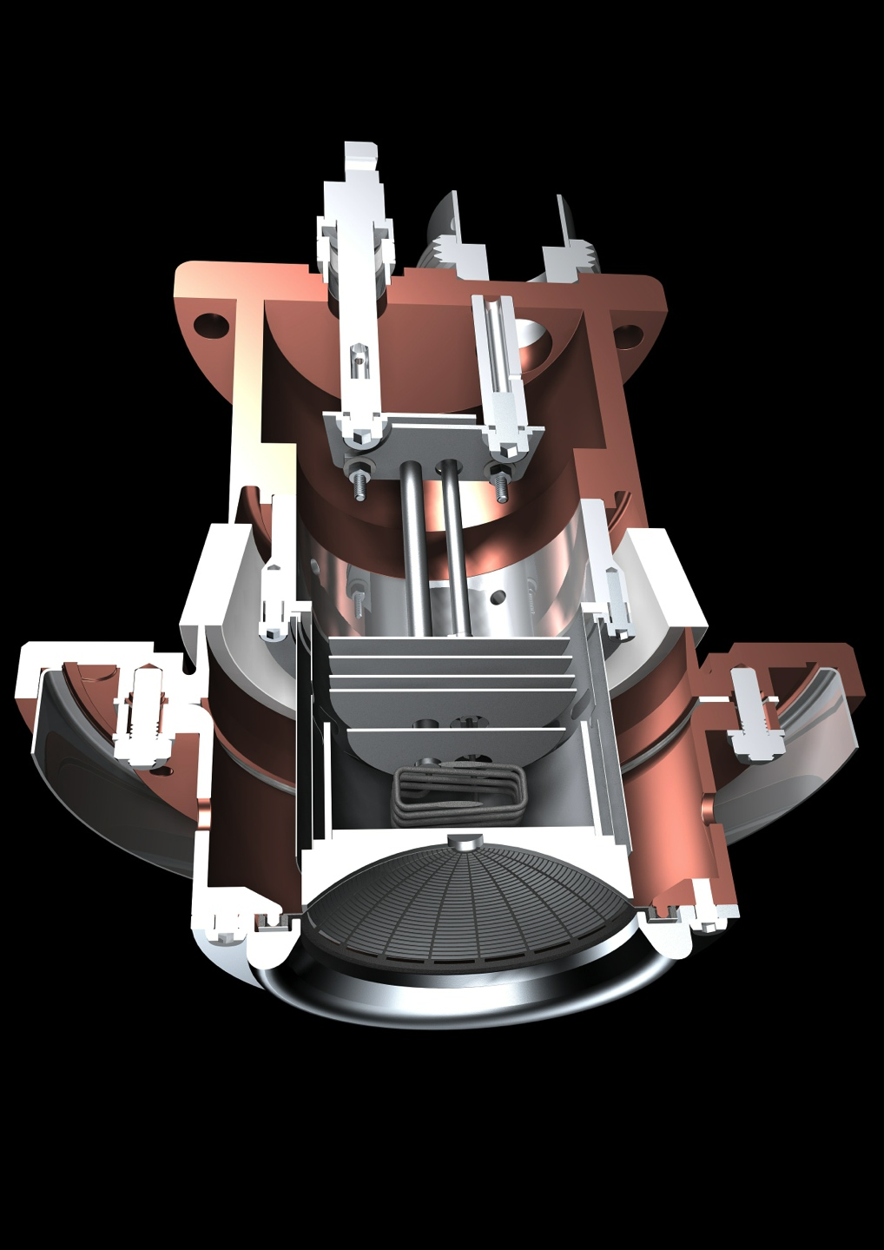
Typical Broadcast IOT
Courtesy of e2v

Slide 8

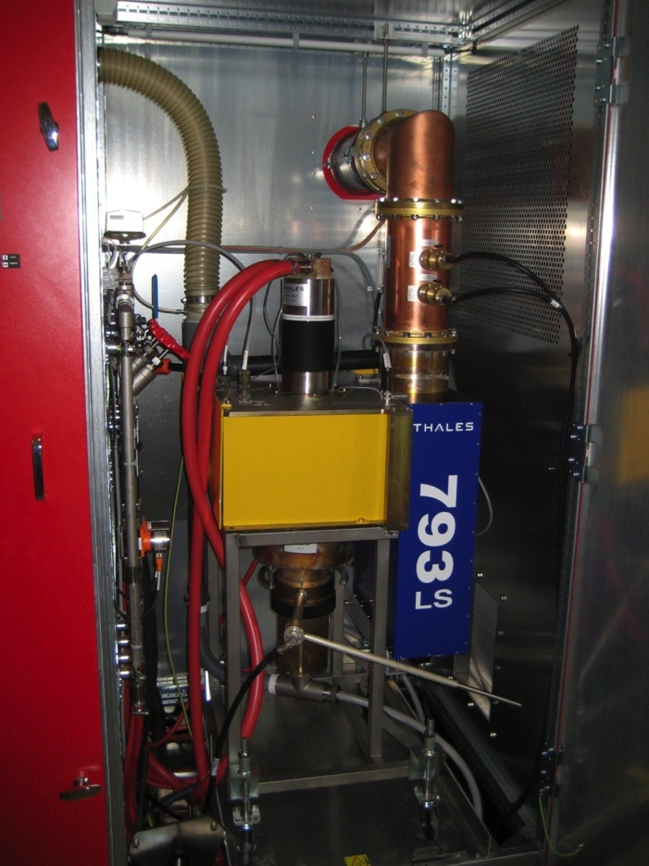
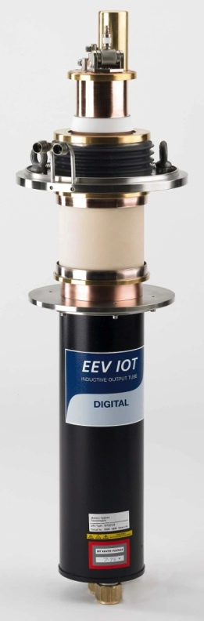
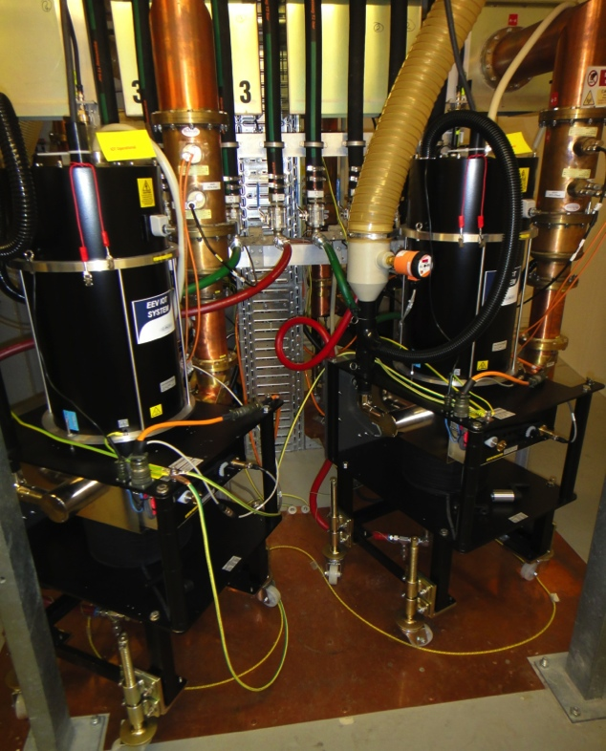

3rd Generation Light Sources
Three 500 MHz 300 kW amplifier for Storage Ring: 4 x 80 kW IOT combined
One 80 kW for the Booster
IOTs from E2V
6 RF plants of 160 kW
500 MHz
2 IOTs combined per cavity
IOTs from Thales Electron Devices and L3

Slide 9
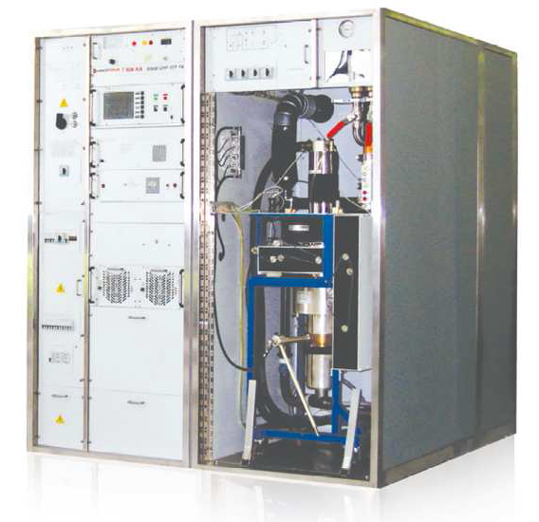
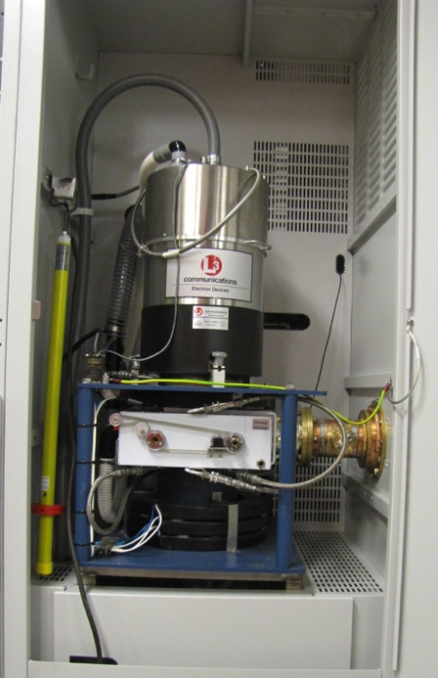
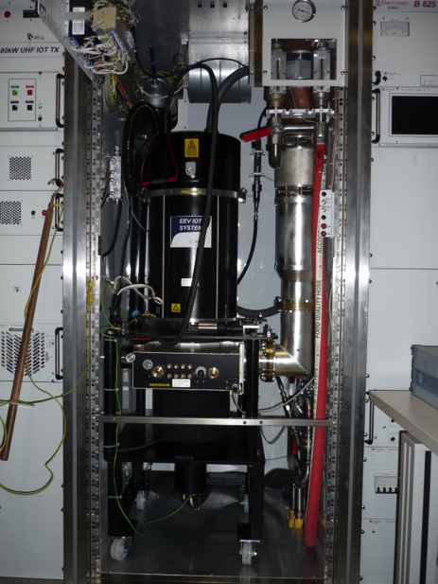
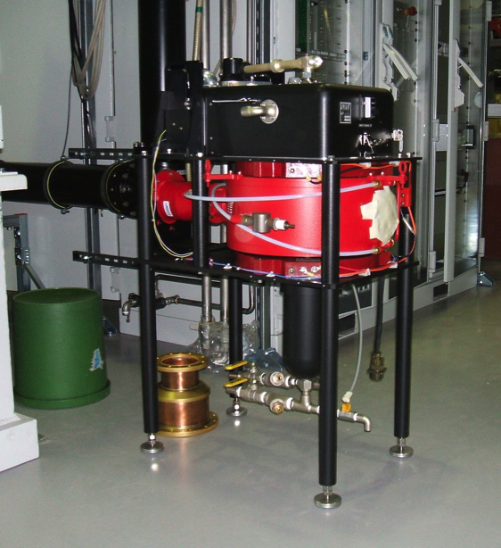
Selection of other Facilities using IOTs
NSLS II
L3 IOT, 500 MHz 80 kW CW
CERN
800 MHz
60 kW
Metrology Light Source
(Willy Wien Laboratory)
CPI 90 kW IOT (K5H90W1)
Elettra
500 MHz
150 kW IOT based amplifier for Combination of 2x80 kW

Slide 10

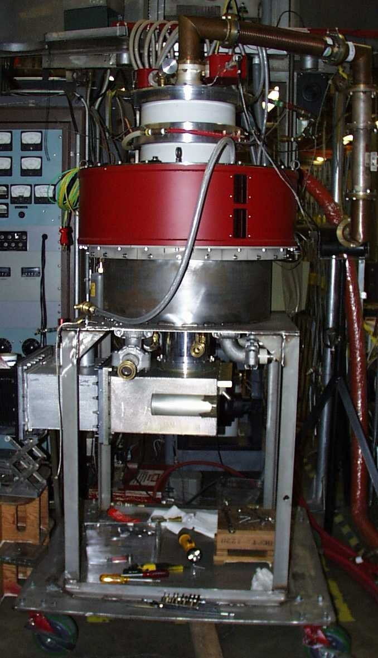
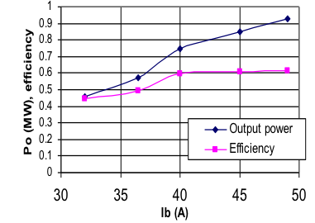
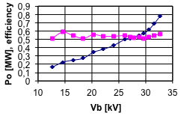
700 MHz HOM IOT Experience
Design Parameters value units
Power Output 1000 kW (min)
Beam Voltage 45 kV (max)
Beam Current 31 A (max)
Frequency 700 MHz
1dB Bandwidth ± 0.7 MHz (min)
Gain 23 dB (min)
Efficiency 71 % (min)
Diameter 30/76 in/cm
Height 51/130 in/cm
Weight 1000/450 lbs./kg
Collector Coolant Flow 220 gpm
Body Coolant Flow 10 gpm
O/P Window Cooling (Air) 35 cfm
RF Input
Gun
@ 31kV
Solenoid,
O/P Cavity
RF Output
Collector
Test Results
(pulsed)
  VHP-8330A IOT

Slide 11
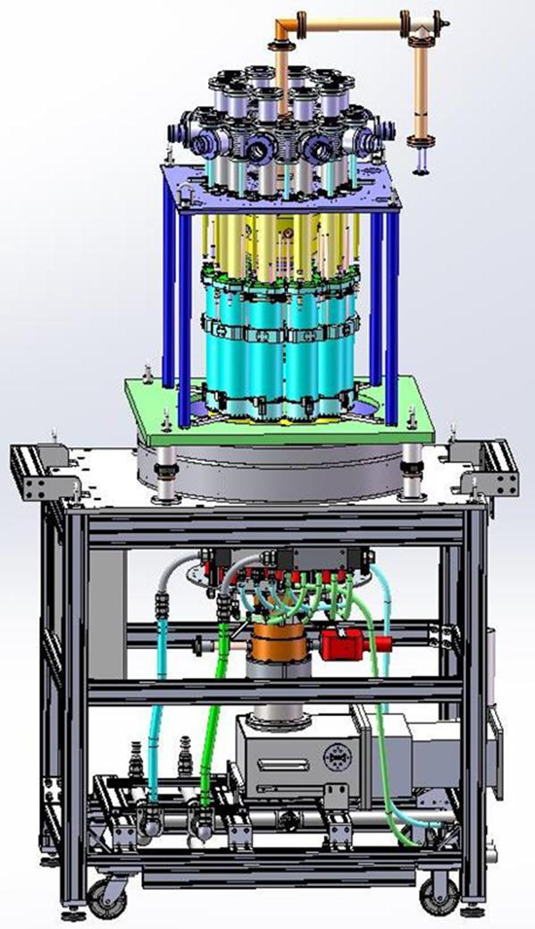
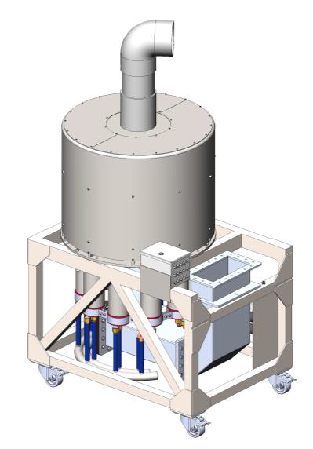


Multi-Beam IOTs for ESS
10 Beam Multi-Beam IOT
1.2 MW
704 MHz
Thales/CPI Consortium and L3
Contracts signed in September 2014
Project duration: 24 months
Site and extended testing at CERN

Slide 12
The IOT for ESS
Parameter |  | Comment
Frequency | 704.42 MHz | Bandwidth > +/- 0.5 MHz
Maximum Power | 1.2 MW | Average power during the pulse
RF Pulse length | Up to 3.5 ms | Beam pulse 2.86 ms
Duty factor | Up to 5% | Pulse rep. frequency fixed to 14 Hz
Efficiency | Target > 65%
High Voltage | Low | Expected < 50 kV
Design Lifetime | > 50,000 hrs
Saving:
3.3 MW power reduction by using IOTs for High Beta
Target: Approval for ESS series production in 2017/18

Slide 13
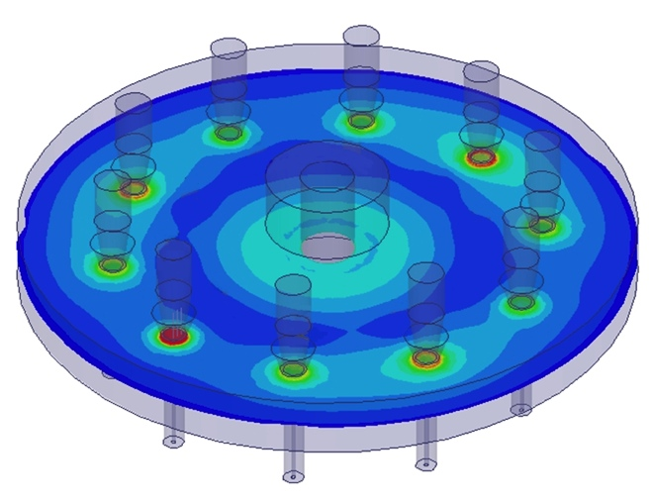
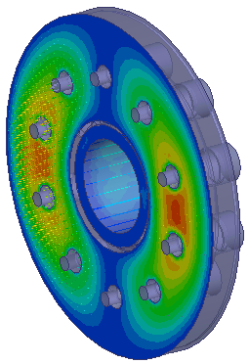
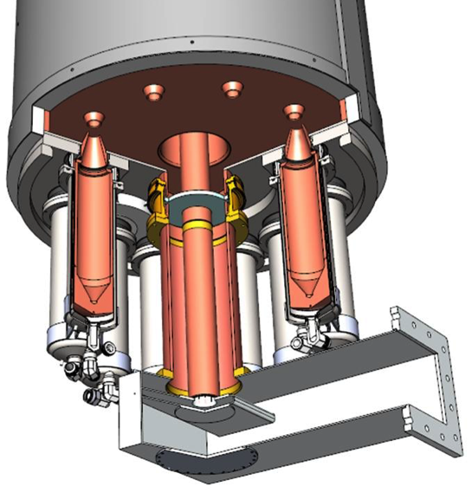
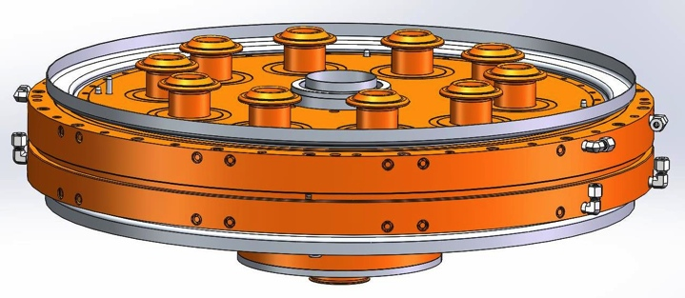
Output Cavity and DC Beam Studies
Ten beams, 10 collectors and a single output cavity
Output cavity supports a large number of modes
HFSS used to map modes near harmonics of the drive frequency
Fundamental
One of a number possible higher order modes

Slide 14
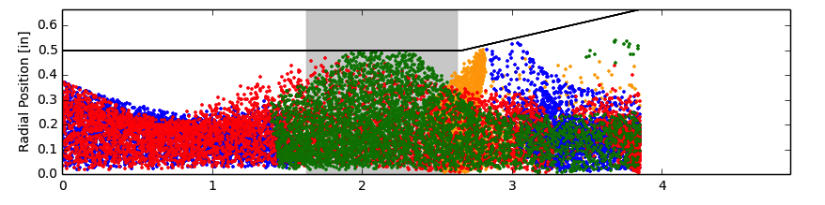
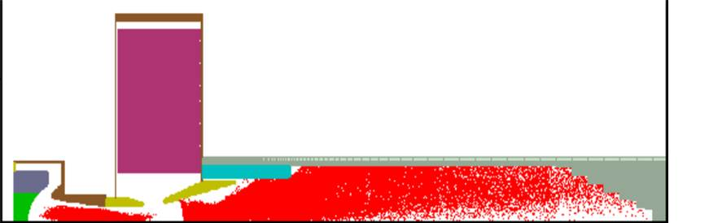
Status
Beam optics
Beam propagation
Static and RF simulations complete
Mechanical simulations complete
Manufacture and assembly files complete

Slide 15


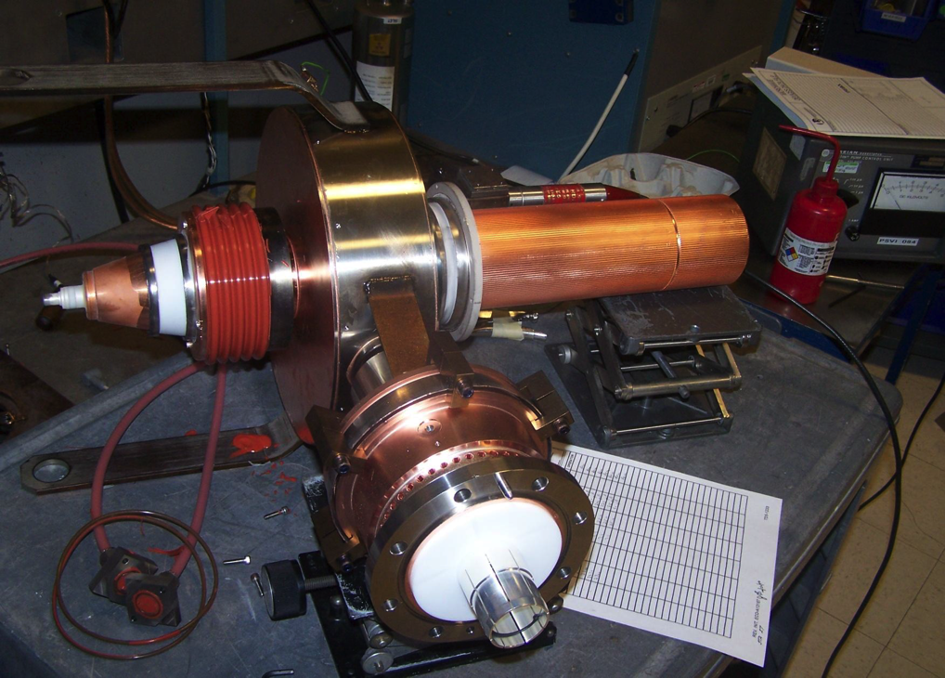
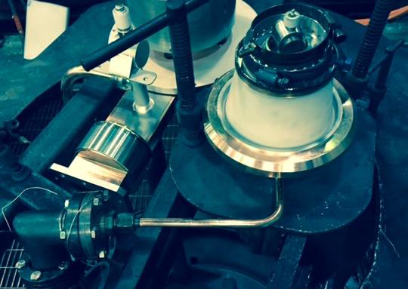
Single beam demonstrator
Output Cavity
Electron Gun
Output Window
Single Beam IOT
Single beam output cavity
Scales output window
Gun Test Vehicle

Slide 16
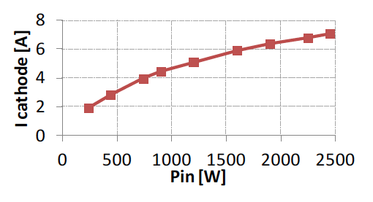
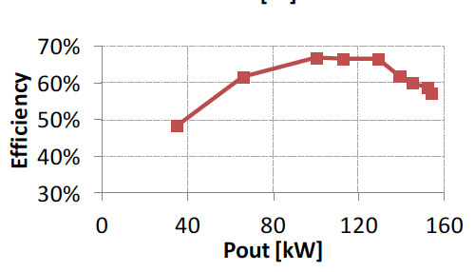
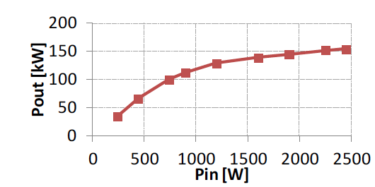

Single Beam Prototype IOT Test Results
Tested to 10% duty
Peak output power 150 kW
HV limited to 38 kV due to the test stand

Slide 17
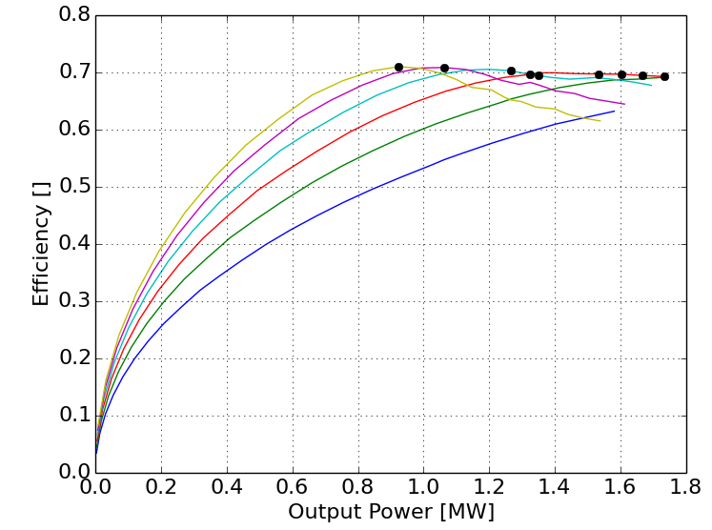
Operational Optimisations
Courtesy of L3 Communications
1.3 MW
70% eff
Power and Efficiency
Impact of HV
Plot shows maximum achievable efficiency for various operating points
Increased beam voltage provides for better performance
  Increases gain
  Increases efficiency
  Decreases body current

Slide 18
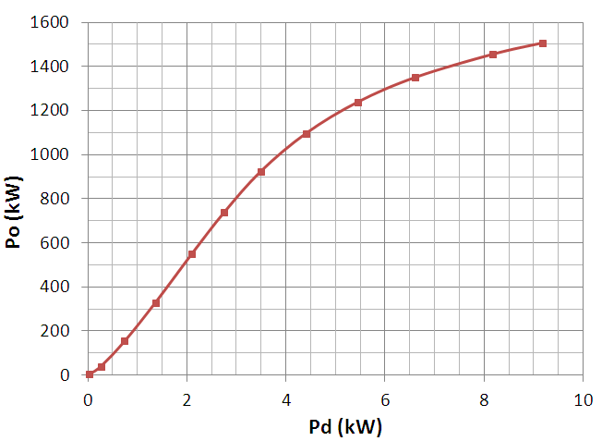
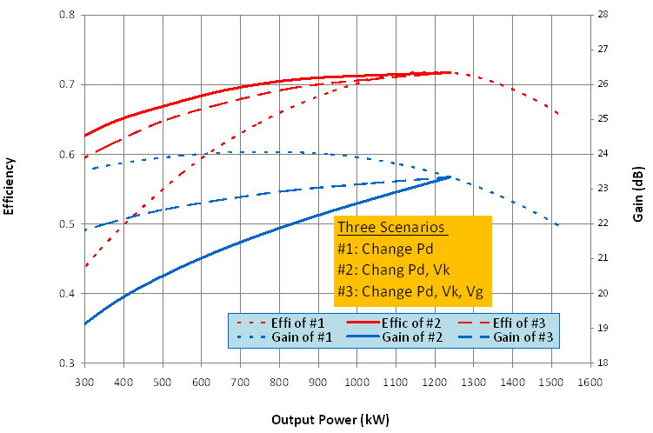
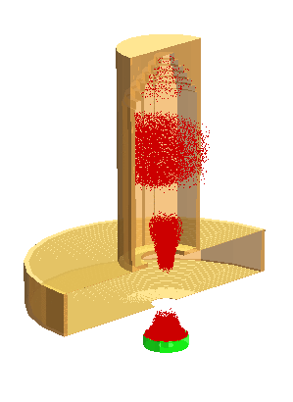
MAGIC Prediction of MB-IOT Performance
Courtesy of Thales and CPI
Power Transfer Curve
Efficiency & Gain vs Output Power
1.2 MW
Efficiency
Gain
V_{k} = 48 kV
Class-C
MAGIC-3D simulation of one beam with MB-IOT off-axis B-field
At 1.2 MW, η = 72% with V_{k} = 48 kV
At 600 kW
  η = 59% with V_{k} = 48 kV
  η = 68% with V_{k} = 34 kV

Slide 19
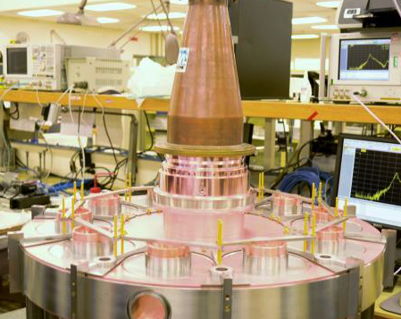
Current Status
L3
Single beam tests complete
Design Review Complete
Long lead procurement well advanced
MBIOT and circuits currently in manufacture
‘Internal’ factory testing: March
FAT March
Thales/CPI
Design Review Complete
Long lead procurement well advanced
IOT manufacture expected to complete July
Incorporation with external circuits and ‘internal (CERN) factory testing: September
FAT: October
Output Cavity under cold test
Both IOTs on schedule for delivery within 24 Months

Slide 20
Extended Testing
Extended testing to include:
  Repeat of FAT
  Operation at additional operating points
  Performance with one or more beam off
  Emission and phase variation between beams
  Extended soak testing
2016/17 should prove very exciting

Slide 21
Acknowledgements
Special thanks to
Thales, CPI and L3 for agreeing to publish some of the design details, calculations and predictions

