Slide 1
Experiment on the interaction of electron bunch train with a W-band wakefield structure at AWA: high power and high gradient
Dan Wang
On behalf of the AWA and Euclid group
CLIC Workshop 2016
Jan 18-22

Slide 2
Outline
Motivation
Method
Single bunch experiment
Bunch train experiment
Summary

Slide 3
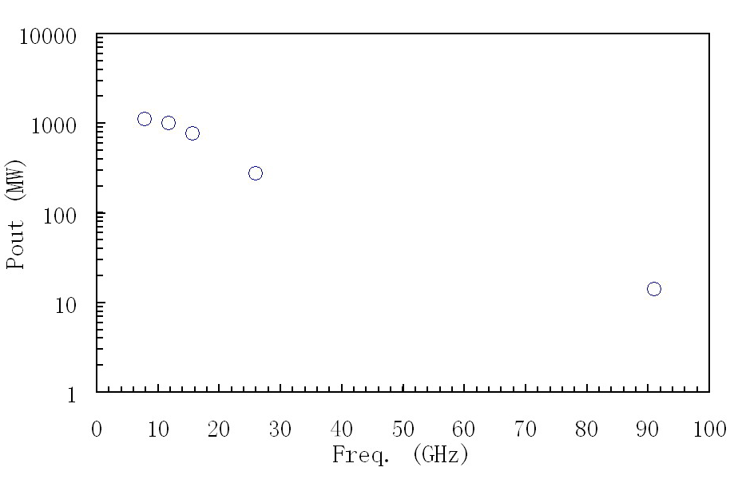
Motivation: AWA map
High Power RF Generation plan at the AWA
( Argonne wakefield accelerator)
√
√
√
√
Freq. (GHz) | Aperture (mm) | L (cm) | Q (nC) | σz (mm) | Form factor | Grad. (MV/m) | Power (MW)
C-Band (7.8) | 12 | 30 | 100 | 2.5 | 0.92 | 62 | 1107
X-Band (11.7) | 10 | 30 | 80 | 2.5 | 0.83 | 79 | 1012
Ku-Band (15.6) | 8 | 30 | 60 | 2.3 | 0.75 | 88 | 766
K-Band (26) | 6 | 30 | 30 | 1.7 | 0.65 | 75 | 276
W-Band (91) | 1 | 10 | 10 | 0.6 | 0.5 | 100 | 10

Slide 4
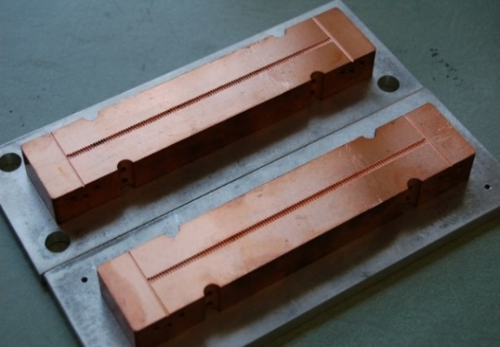
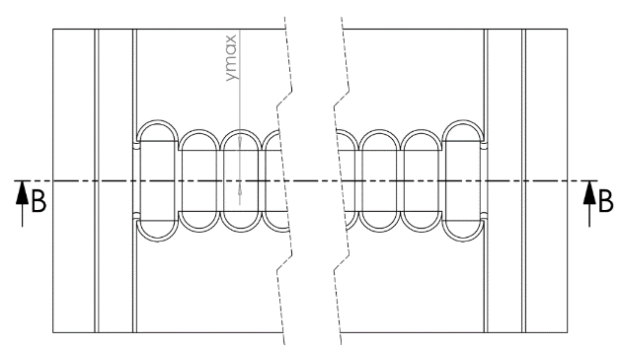
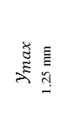


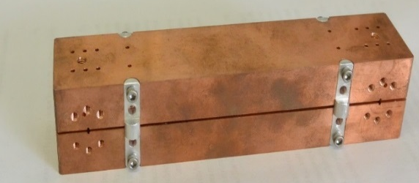
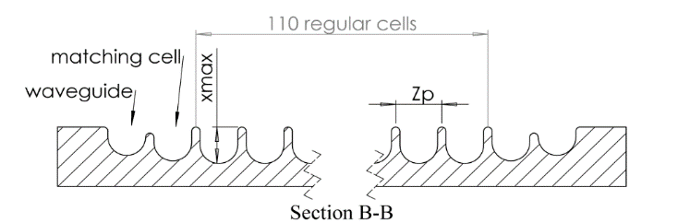


Method: design of the W-band* PETS
Power Extraction and Transfer Structure : PETS
RF
e-
X
Z
RF
Y
Matching cell
110 regular cells
X
e-
Waveguide
Z
RF
Section B-B
Total length of the grooved structure : 12 cm
When fixed the gap = 0.94 mm : $f_{0}=91 GHz, λ_{0}=3.3 mm$
70th harmonic of L-band (1.3 GHz) RF at the AWA
* Similar to Valery Dolgashev (SLAC) 100 GHz structure

Slide 5
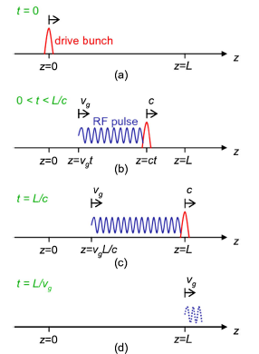


Method: wakefield (RF) generated by single bunch
Duration of rf pulse:
$$3.4\left[ns\right]$$
Gradient in the structure :
$26.6[MV/m/nC]$ $⋅F\left(σ_{z}\right)⋅q_{b}$
RF power :

Slide 6



Method: enhance power with drive bunch train
RF bucket with adjustable time structure：
: bunch spacing
RF pulse packet
from first bunch
From m-th bunch
Power saturated
From n-th bunch
Total RF peak power:

Slide 7
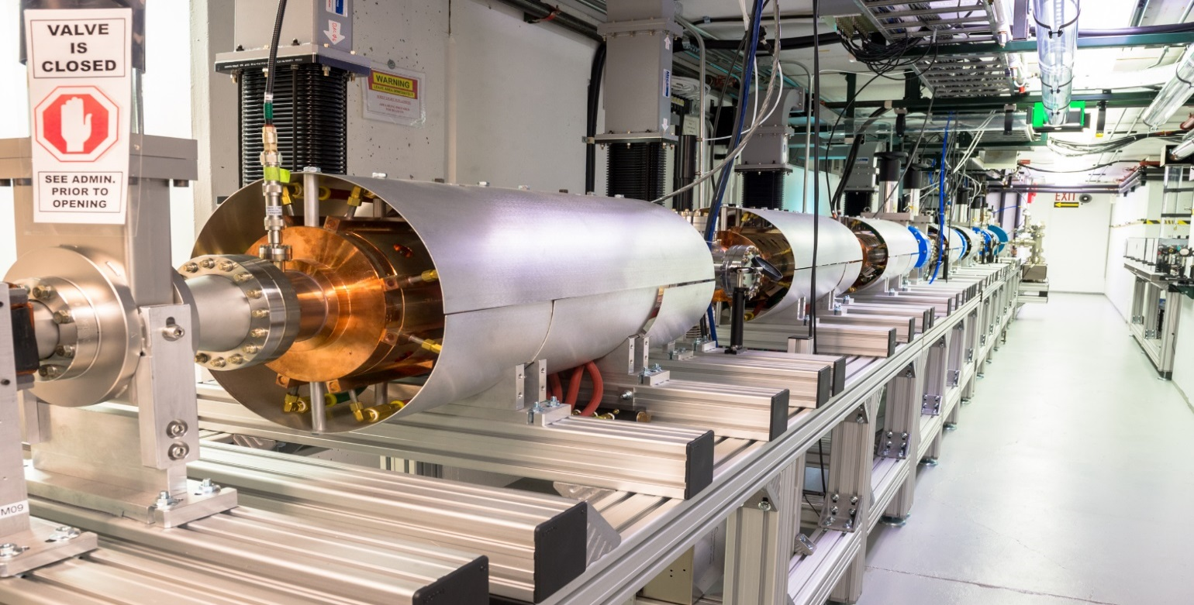
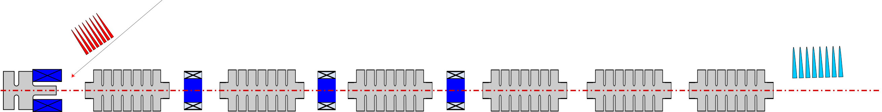
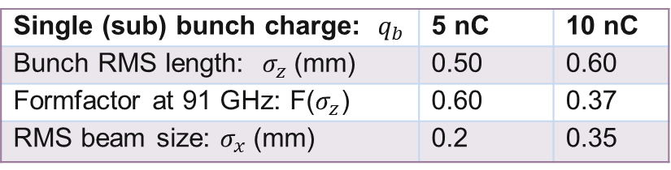
Method: drive beam line at AWA
Single (sub) bunch charge: $q_{b}$ | 5 nC | 10 nC
Bunch RMS length: $σ_{z}$(mm) | 0.50 | 0.60
Formfactor at 91 GHz: F($σ_{z}$) | 0.60 | 0.37
RMS beam size: $σ_{x}$(mm) | 0.2 | 0.35
Solenoids
L-band (1.3 GHz) linac tanks
65 MeV electron train
RF gun
Laser train
photocathod

Slide 8
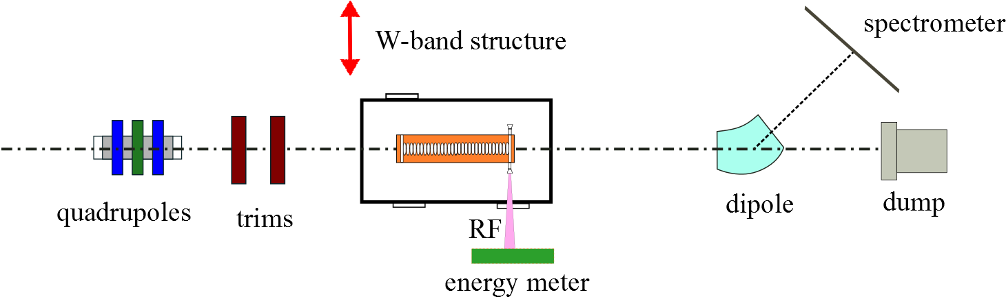

Single bunch experimental set up
Detectors :
1. Energy meter (calibrated): RF output energy
2. Spectrometer: energy loss of electron beam
②
ICT 1
ICT 2
①

Slide 9
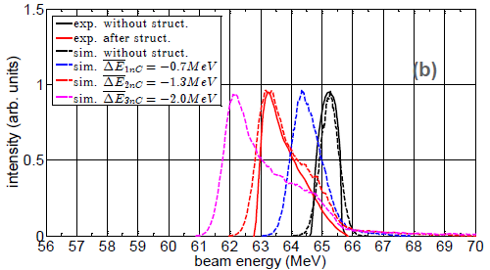
Single bunch experimental results_(1)
ICT 1
ICT 2
‘effective charge’: charge contribute to the wakefield
RF simulation code: CST
Beam dynamics simulation code: ASTRA
(a)
Charge before structure (ICT 1): 3nC
Transmitted charge after (ICT 2): 1nC
Effective charge convert to the RF: 2nC
Charge of the drive bunch → average loss
2.6 mJ (Fig.a) = 1.3 MeV (Fig.b) * 2nC
energy conservation : beam energy loss = RF output
RF: 0.77 MW * 3.4 ns

Slide 10
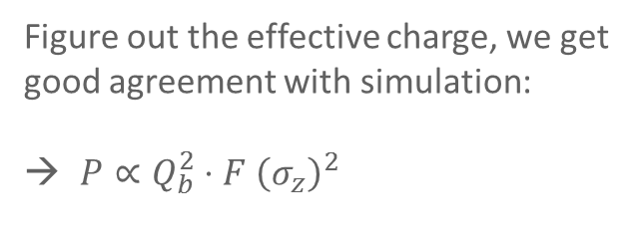
Single bunch experimental results_(2)
ICT 1
ICT 2
Power vs. drive bunch charge
RF simulation code: CST
Figure out the effective charge, we get good agreement with simulation:
$P∝Q_{b}^{2}⋅F {\left(σ_{z}\right)}^{2}$

Slide 11
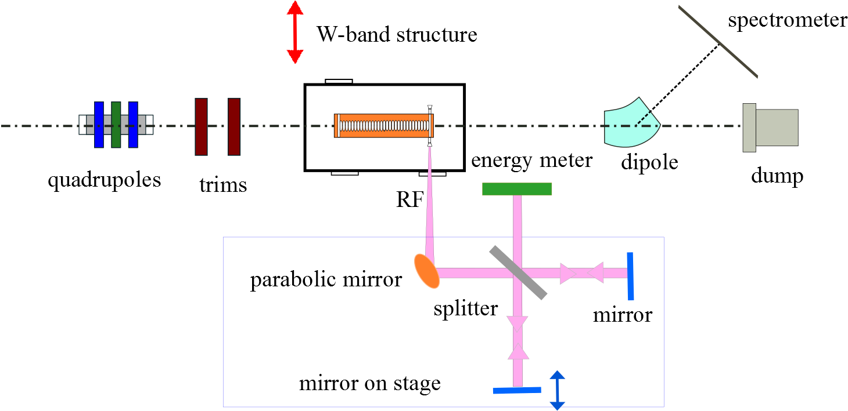
RF frequency measurement set up
Detectors :
1. Energy meter (calibrated): RF output energy
2. Spectrometer: energy loss of electron beam
3. Michelson interferometer: RF frequency measurement
③
Michelson interferometer

Slide 12
RF frequency measurement results
Frequency measurement of the W-band structure:
91.3 GHz

Slide 13
Challenges : diagnose the high frequency RF envelope
? No detector to look at the 91 GHz RF pulse directly, currently oscillator (up to 60 GHz at most)
? No easy way to figure out how to alignment the bunch train in right wakefield phase

Slide 14

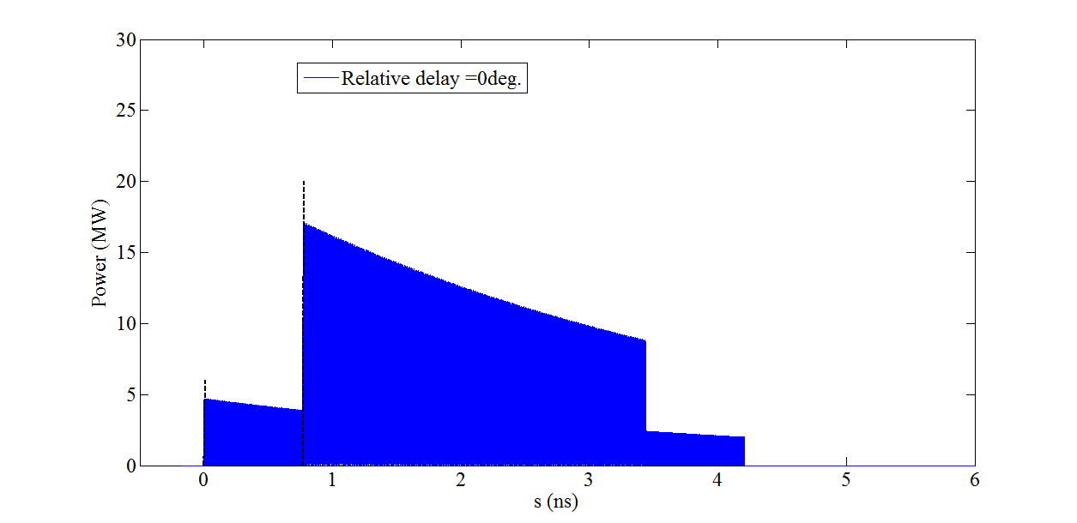
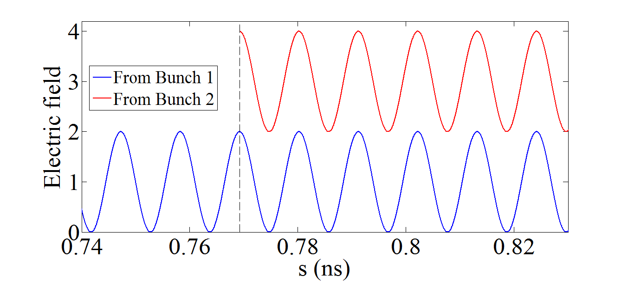

Highlight : two wakefield interferometry method
? No detector to look at the 91 GHz RF pulse directly, currently oscillator (up to 60 GHz at most)
? No easy way to figure out how to alignment the bunch train in right wakefield phase
two wakefield interferometry method :
$$P∝{\left|E\right|}^{2}$$
Expected signal
W-band RF pulse

Slide 15
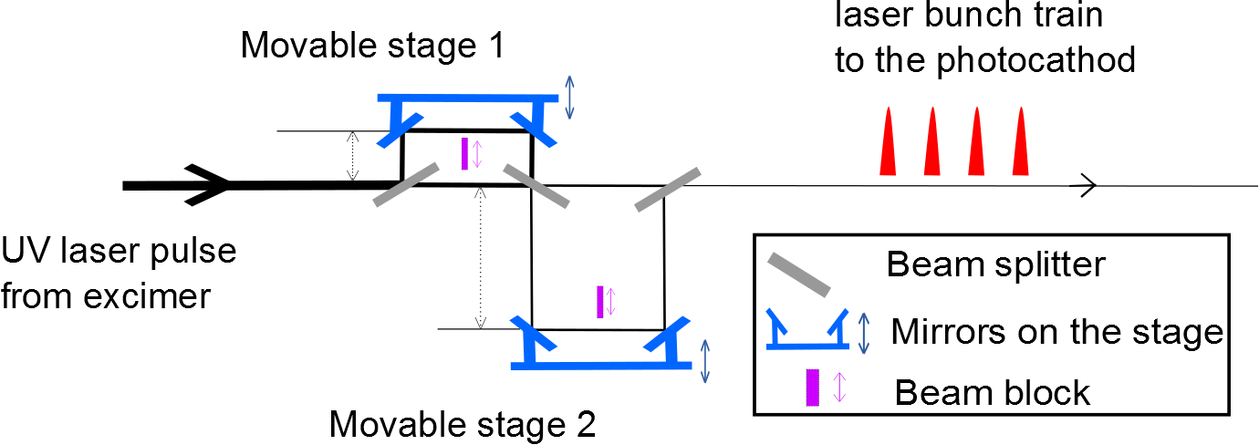

Bunch train experimental set up: laser train
Generation of tunable bunch train:
1. UV laser slitter
2. Movable mirror on stage
Initial interval around : $z_{0}=230 mm$ (1.3 GHz / 0.769 ns)
$${\sim z}_{0}$$

Slide 16
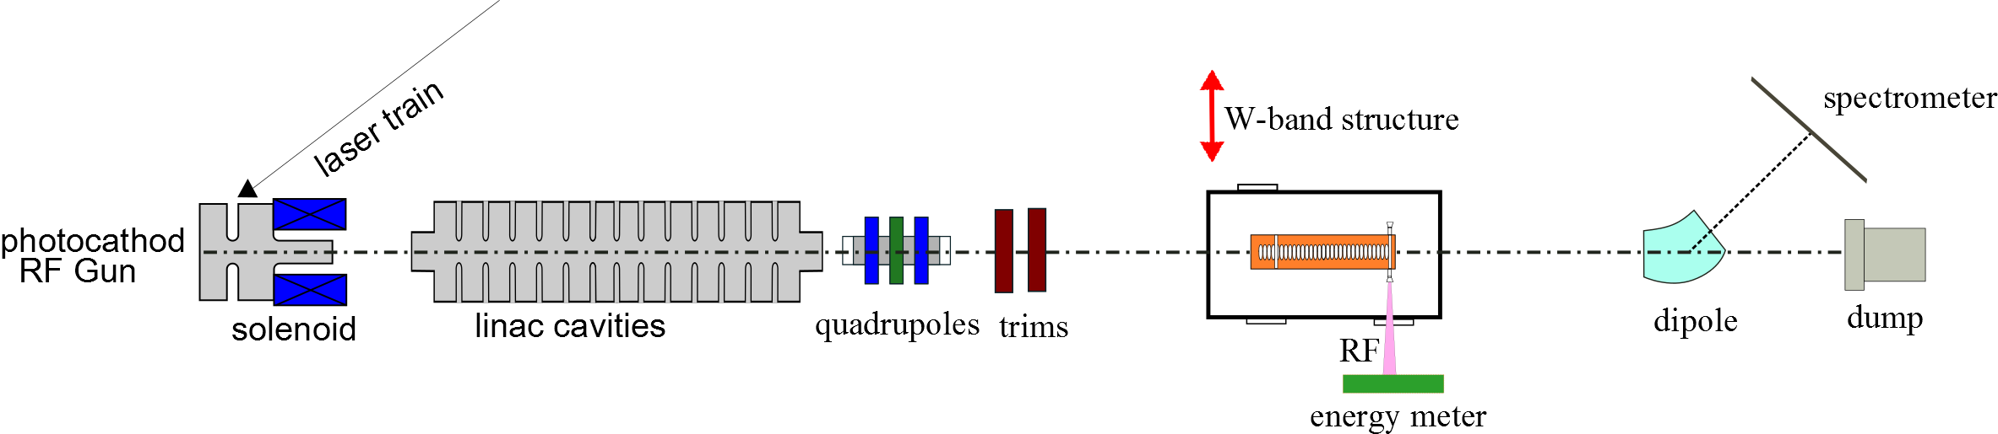


2-bunch train experimental results
$$z$$
$$2$$
$$1$$
$$z$$
①
simulated
①
intensity
①
bunch 2
bunch 1
position(mm)
③
②
④
intensity
②
④
RF energy (arb. units)
bunch 1
bunch 2
①
③
intensity (a.u)
③
③
$∆z=z−z_{0}$ (mm)
RF width (ns)
beam energy (MeV)
(a)
(b)
(c)

Slide 17
2-bunch train experimental results
$$z$$
$$2$$
$$1$$
$$z$$
①
simulated
①
intensity
①
bunch 2
bunch 1
position(mm)
③
②
④
intensity
②
④
RF energy (arb. units)
bunch 1
bunch 2
①
③
intensity (a.u)
③
③
$∆z=z−z_{0}$ (mm)
RF width (ns)
beam energy (MeV)
(a)
(b)
(c)
sensitivity comparison (other case) : $1μJ=1\left[nC\right]⋅1[keV]$

Slide 18
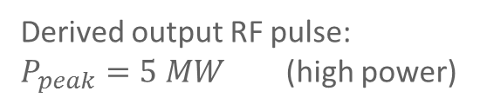
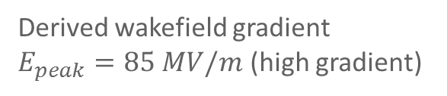
3-bunch train experimental results
intensity
position(mm)
gradient (MV/m)
measured
simulated
intensity (arb. units)
power (MW)
beam energy (MeV)
wakefield (RF) duration (ns)
(a)
(b)
With wakefield interferometry method
→ Precise control of RF phase (bunch1~3 loss energy of :1.3 MeV, 3.2 MeV, 4.4MeV)
Generate maximum RF power
Derived wakefield gradient
$E_{peak}=85 MV/m$ (high gradient)
Derived output RF pulse:
$P_{peak}=5 MW$ (high power)

Slide 19
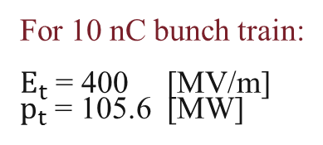
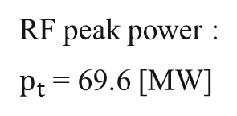

Plan: increase the power and gradient
With structure attenuation coefficient $α$:
RF peak power :
$p_{S}$ = 4.2 [MW]
RF peak power :
$p_{t}$ = 69.6 [MW]
For 10 nC bunch train:
$E_{t}$ = 400 [MV/m]
$p_{t}$ = 105.6 [MW]
Results from CST simulation

Slide 20
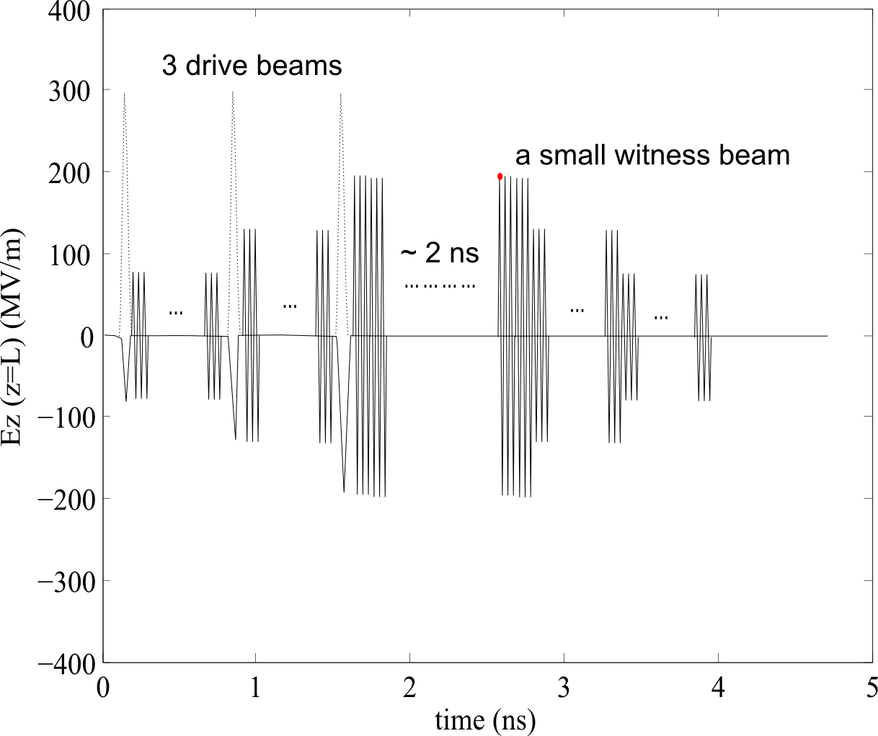
Plan: accelerate the witness beam to higher energy
of 5nC for example
91 GHz RF signal
Energy gain of witness beam ~ 20 MeV after the structure (~0.12 m)

Slide 21
Summary
We measured 5 MW RF @ 91.3 GHz, wakefield gradient is 85 MV/m. The W-band structure turns out to be a high power RF generator & also compact /advanced accelerator of high gradient
The newly-developed two-beam wakefield interferometry method is an effective diagnostic for wakefield, which benefits the precise RF phase control in advanced wakefield accelerators.
We plan on the 100 MW & 400 MV/m in the W-band structure in future (promising)

Slide 22
Acknowledgement
S. Antipov, C. Jing and J. Qiu from Euclid
M.E. Conde, J.G. Power, W. Liu, E. Wisniewski, D.S. Doran, C. Whiteford, G. Ha, J. Shao, Q. Gao, N. Neveu and W. Gai in AWA group
V. Dolgashev from SLAC
D. Schegolkov and J. Simakov from LANL
T. Benseman and Y. Hao from ANL
P. Piot from FNAL

Slide 23
Thanks for your attention

Slide 24
Back up

Slide 25
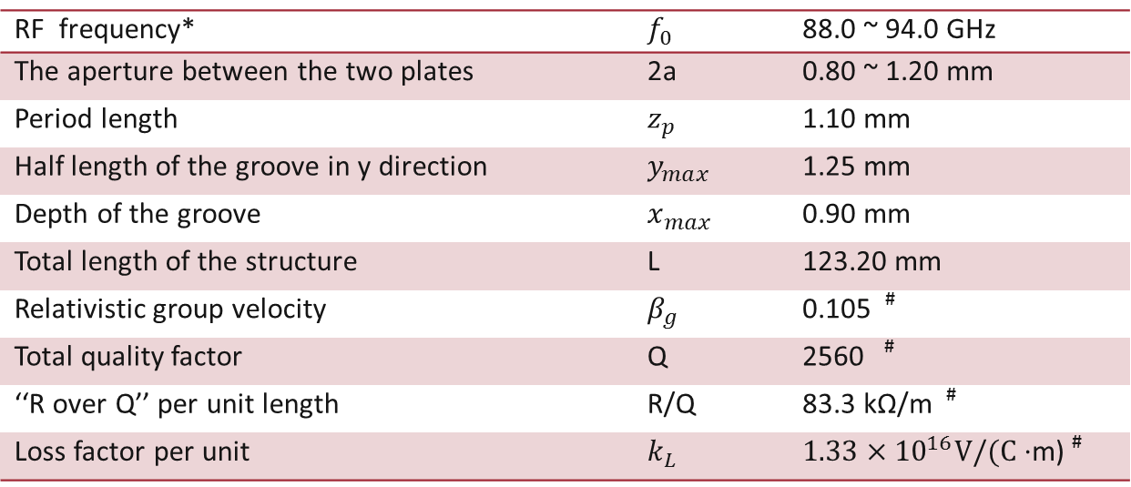
Method: parameter of the PETS
Table. parameters of the W-band PETS
RF frequency* | $$f_{0}$$ | 88.0 ~ 94.0 GHz
The aperture between the two plates | 2a | 0.80 ~ 1.20 mm
Period length | $$z_{p}$$ | 1.10 mm
Half length of the groove in y direction | $$y_{max}$$ | 1.25 mm
Depth of the groove | $$x_{max}$$ | 0.90 mm
Total length of the structure | L | 123.20 mm
Relativistic group velocity | $$β_{g}$$ | 0.105 #
Total quality factor | Q | 2560 #
‘‘R over Q’’ per unit length | R/Q | 83.3 kΩ/m #
Loss factor per unit | $$k_{L}$$ | $1.33×{10}^{16}V/(C⋅$m) #
*Frequency f₀ can be tuned by adjusting gap 2a
# Value at f₀ = 91 GHz

Slide 26
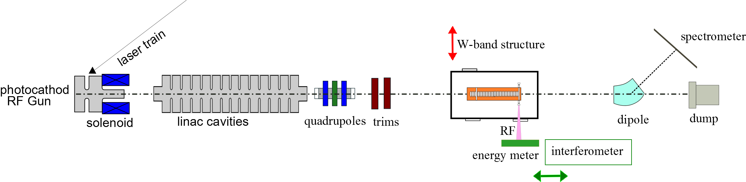

W-band RF generation with two electron bunches
$$z$$
$$2$$
$$1$$
$$z$$
frequency measurement
(with interferometer)
RF measurement vs. delay of bunch 2
(with energy meter)
electron beam energy measurement
(on spectrometer)
①
①
intensity
RF signal (mV)
bunch 2
bunch 1
②
④
position(mm)
③
intensity
delay of interferometer (mm)
RF energy (arb. units)
bunch 1
bunch 2
91.3 GHz
①
③
intensity (a.u)
③
FFT(a. u.)
$∆z=z−z_{0}$ (mm)
beam energy (MeV)
(a)
(b)
(c)

