Slide 1
Reminder of the
CLICdp-Draft-2015-019
on the new detector model
CLICdet_2015
( latest version of the CLICdp note is publicly available at: https://edms.cern.ch/document/1572676/ )

Slide 2
List of Contents (of the draft note):
1. Introduction
2. Working Hypotheses
3. Overall Dimensions and Parameters
4. Vertex Detector
5. Silicon Tracker
6. Electromagnetic Calorimeter
7. Hadronic Calorimeter
8. Magnet System
9. LumiCal, BeamCal and Intratrain Feedback
10. Beam Pipe and Vacuum System
11. Detector Opening and Maintenance
12. Summary

Slide 3
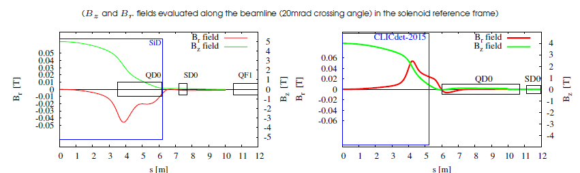
2. Working Hypotheses
2.1 One Detector at CLIC
2.2 QD0 outside of the detector region
F. Plassard, CLIC workshop this afternoon https://indico.cern.ch/event/449801/session/0/contribution/98/attachments/1213533/1770895/clic-workshop-2016-long-l-study.pdf

Slide 4
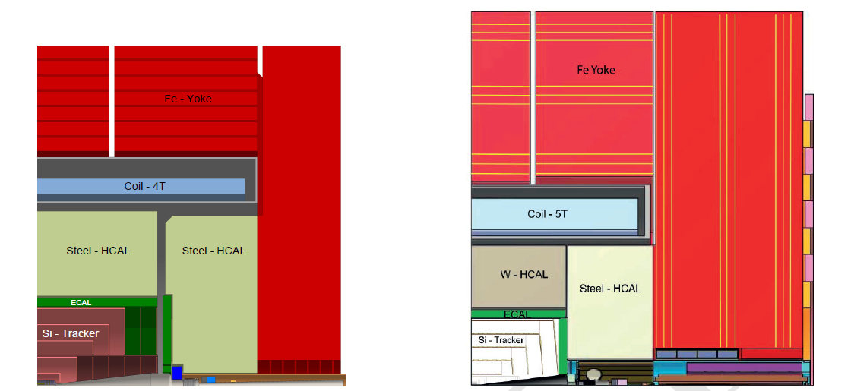
3. Overall Dimensions and Parameters
CLICdet_2015
CLIC_SiD (CDR)

Slide 5
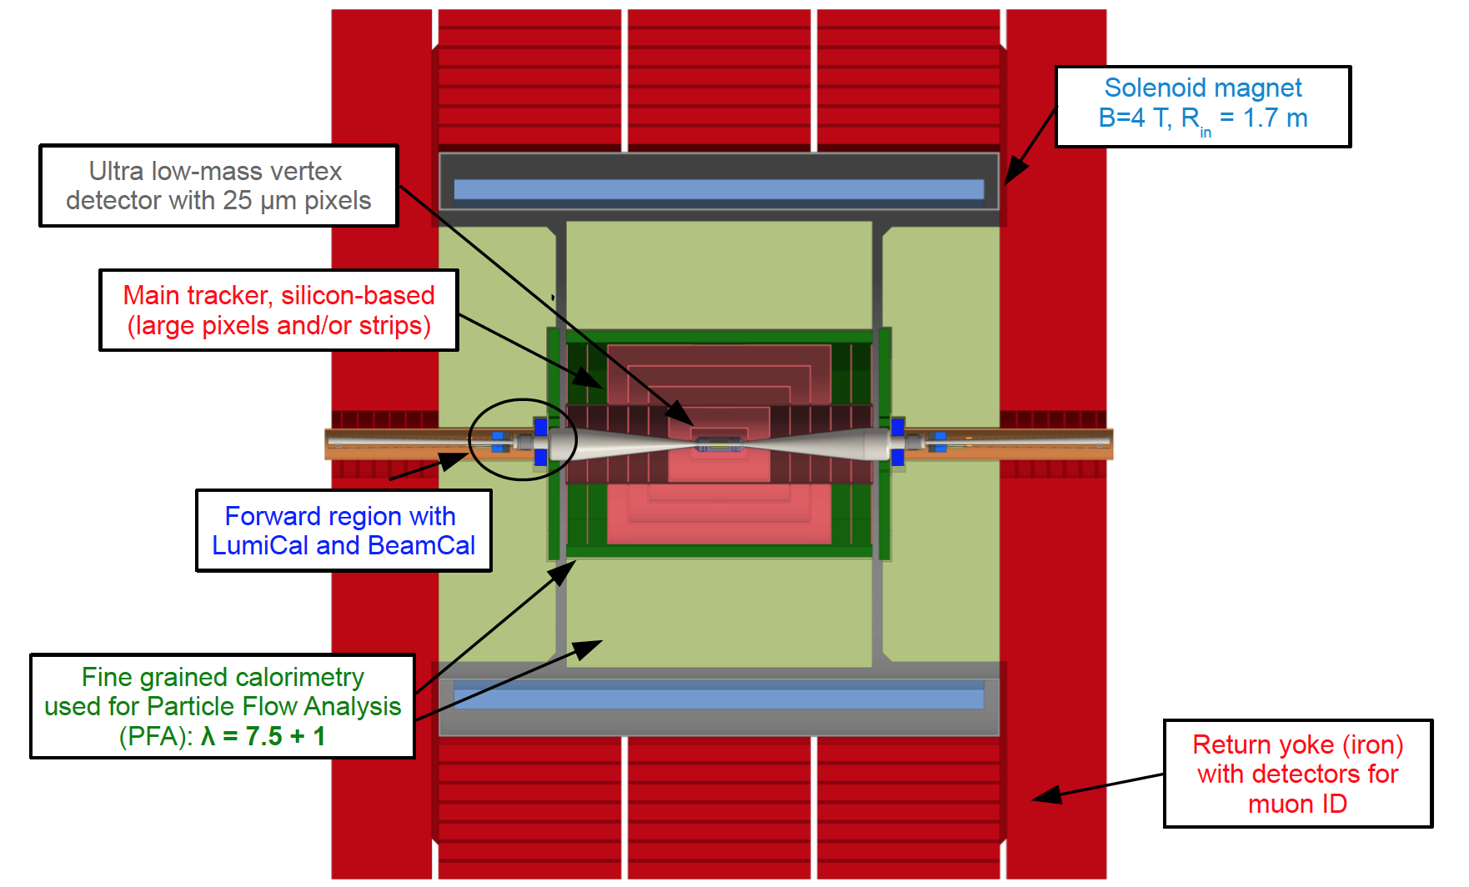
Detector model CLICdet_2015
Note: final beam focusing is outside the detector
11.4 m

Slide 6
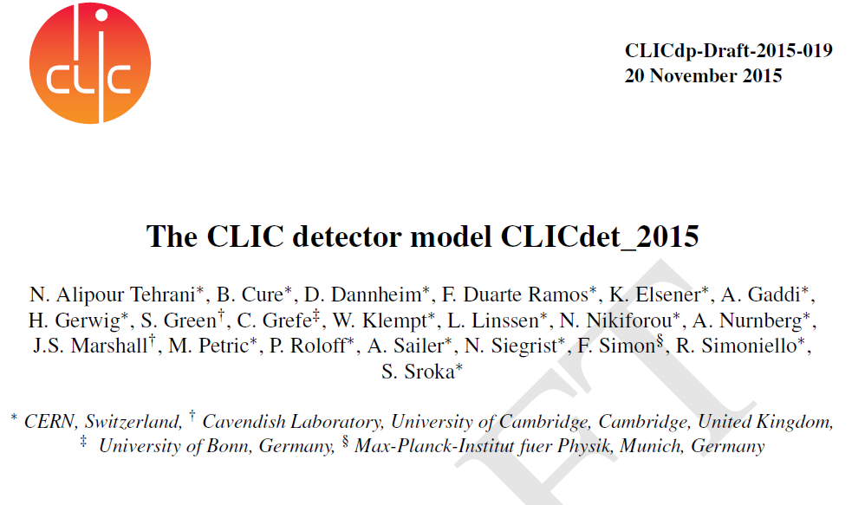
( latest version of the CLICdp note is publicly available at: https://edms.cern.ch/document/1572676/ )
(search for “FIXME”)

Slide 7
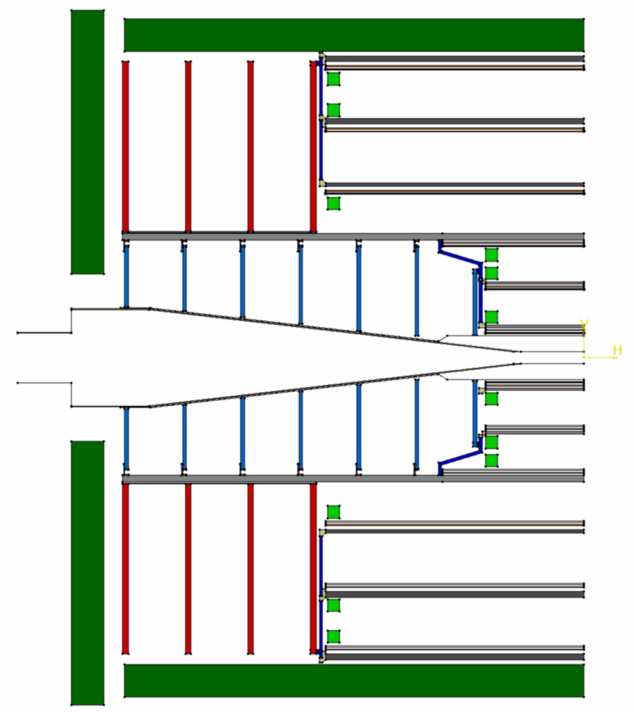
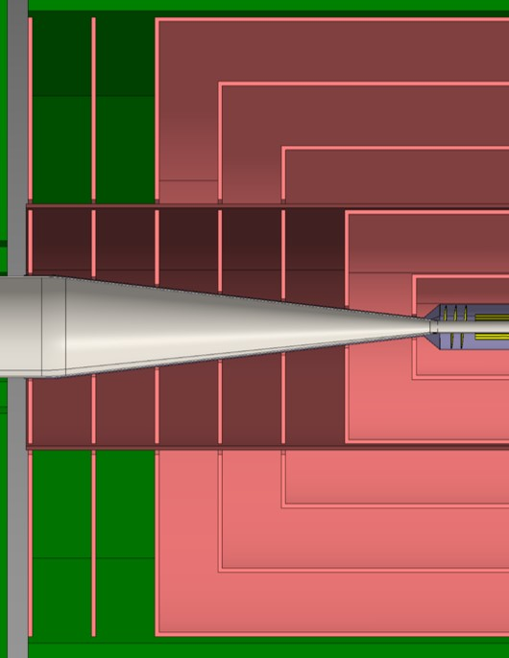
evolving tracker layout

Slide 8
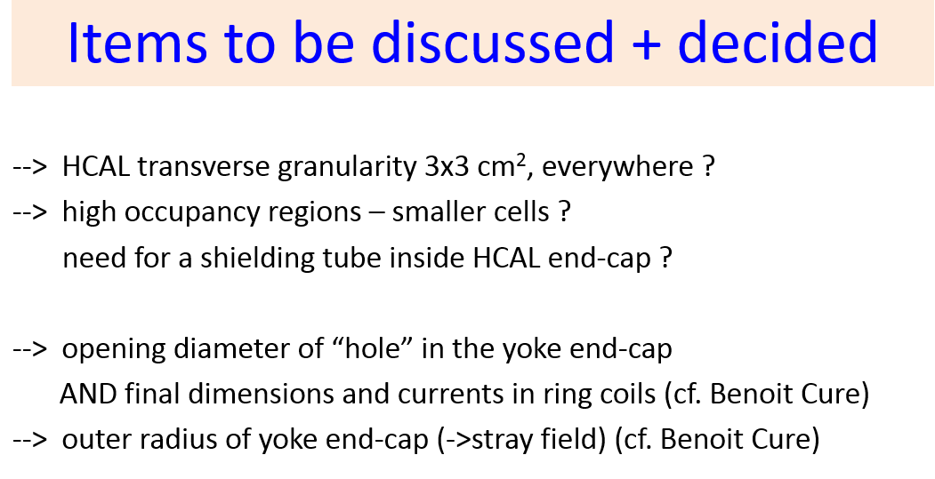
from CLICdp workshop, 2 June 2015:
DONE !

Slide 9
Reminder of the
CLICdp-Draft-2015-019
on the new detector model
CLICdet_2015
PLEASE SEND YOUR COMMENTS asap. to Konrad.Elsener@cern.ch
( latest version of the CLICdp note is publicly available at: https://edms.cern.ch/document/1572676/ )

