Slide 1





CLIC Workshop 2016:
Main Beam Cavity BPM
J. Towler, S. Boogert, B. Fellenz,
T. Lefevre, A. Lyapin, M. Wendt

Slide 2
CLIC MB BPM Requirements
50 nm spatial and 50 ns time and resolution.
  Multiple measurements
  in a 156 ns long bunch train
  Range of ±100μm
  >4000 BPMs
14 GHz for CLIC
  Design is scalable
15 GHz resonant frequency for CTF prototype.
Prototype design based on stainless steel cavity,
new design uses copper.
Q factor tailored to match the required time resolution
MB parameters and BPM Requirements
Machine | CLIC | CALIFES
Bunch Spacing | 0.5 ns | 0.667 ns
Bunch Length | 44 μm | 225 μm
Train Length | 156 ns | 1 – 150 ns
BPM Spatial Resolution | <50 nm | <50 nm
BPM Time Resolution | <50 ns | <50 ns
BPM Accuracy | <100 μm | <100 μm
BPM Range | ±100 μm | ± 100 μm
BPM Resonant Frequency | 14 GHz | 15 GHz

Slide 3
Cavity BPM Basics
Centered beam excites monopole mode (TM₀₁₀).
  Amplitude dependent on charge
Away from the center, other modes are excited.
  First order dipole mode (TM₁₁₀) depends linearly on beam offset and charge.
TM₁₁₀ splits in 2 orthogonal modes.
Beam excites other unwanted higher order modes.
  Requires suppression of unwanted modes.
CLIC Workshop 2015
3

Slide 4
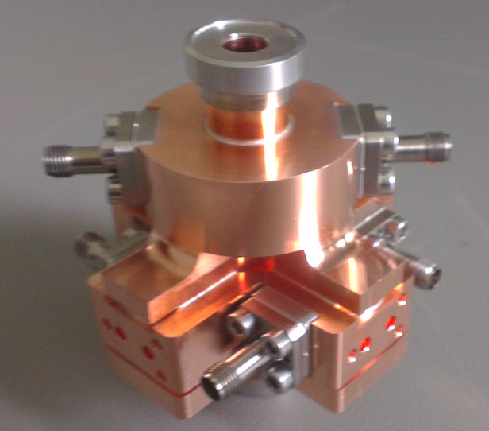
Copper Cavity BPM Design
Modified cavity BPM design
  Main geometry unchanged.
  Copper to raise Q to 500
  New feedthrough design eliminate tuners.
Prototype manufactured for RF testing
  Poor dimensions, particularly the reference cavity
Measurements compared with simulations
  Before and after brazing
  Frequencies and Q factors
  External Q’s high – feedthroughs
  Excellent low cross coupling
Cavity | Q_{L} | F₀ /GHz
Reference | 938 | 14.772
Predicted | 500 | 15.0
Position | ~830 | 14.996
Predicted | 524 | 15.0

Slide 5
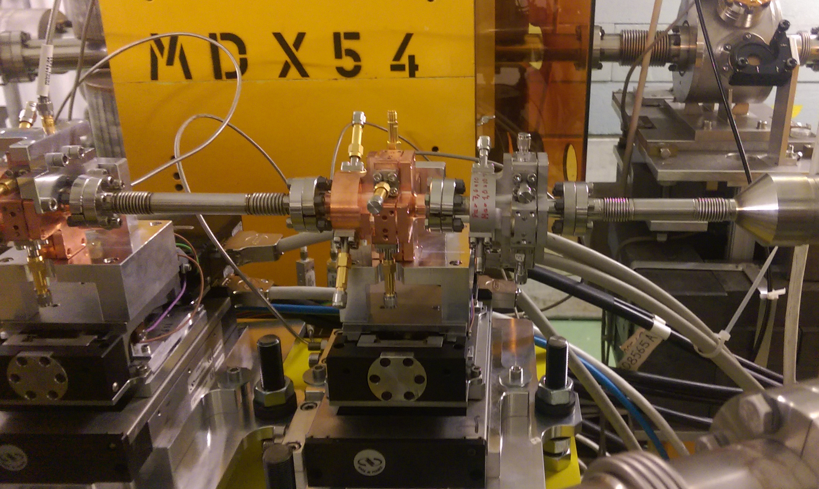
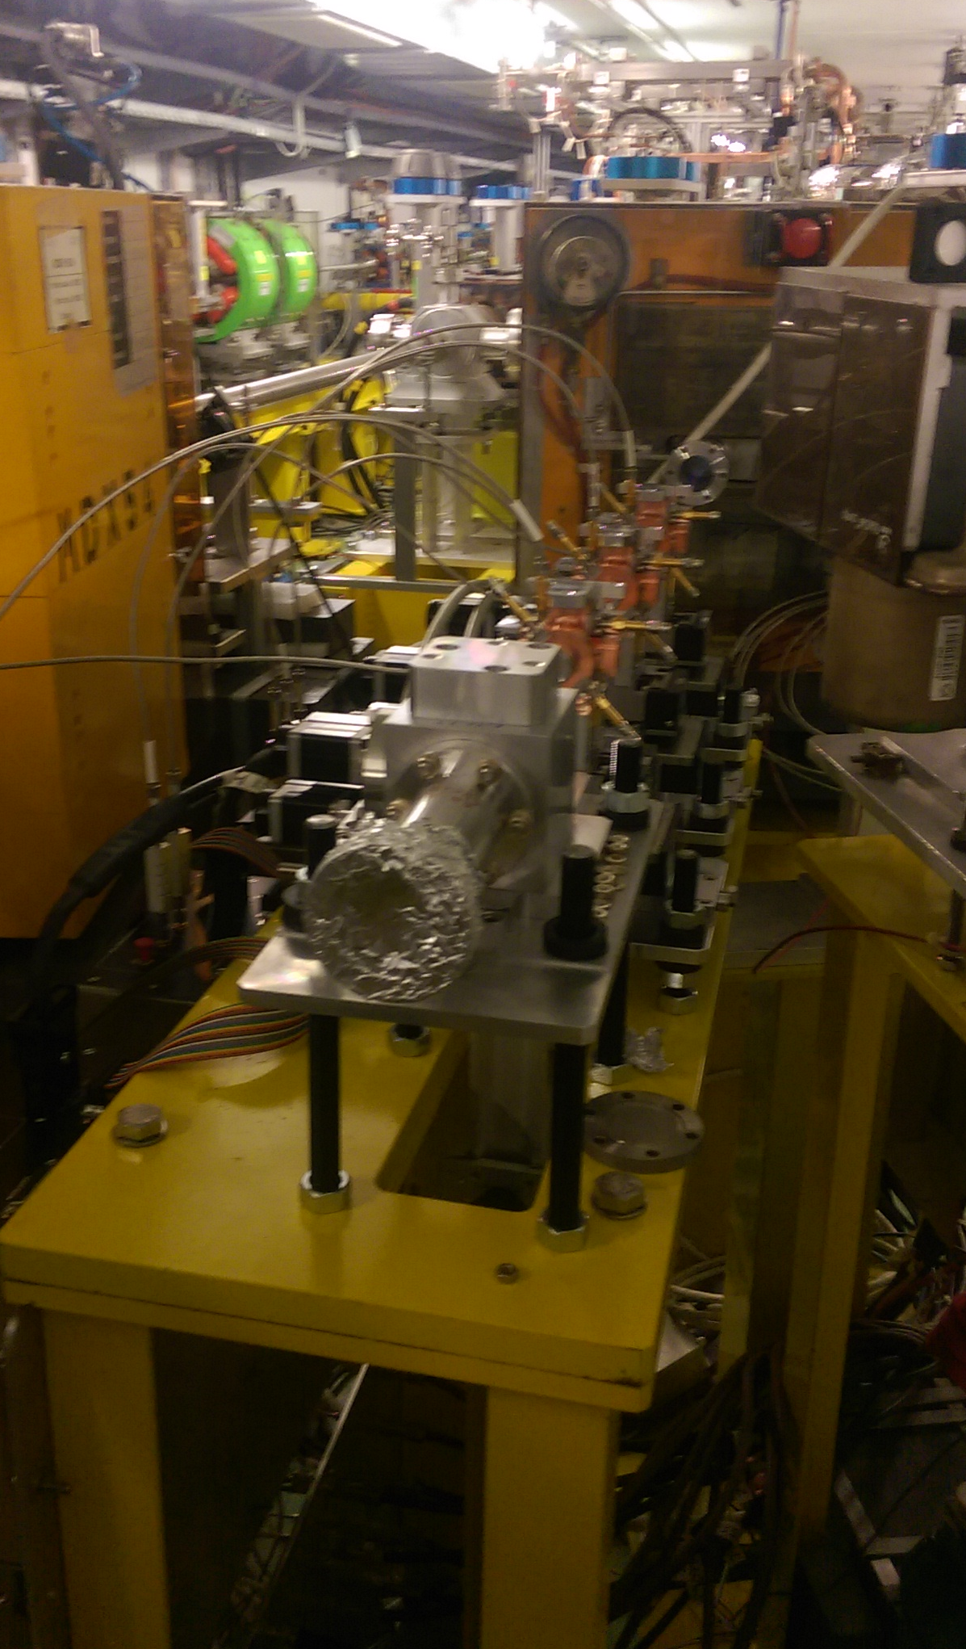
2015 Installation
Four prototype BPMs in CLEX (CTF3)
  3 copper, 1 old stainless steel
End of probe beam line
All 3 new BPMs on X and Y movers
Old BPM added as ref cavity
OTR screen for ensuring beam transmission
Electronics next to the beamline
Higher resolution (12-bit), lower rate (250MS/s) digitiser to demonstrate spatial resolution

Slide 6
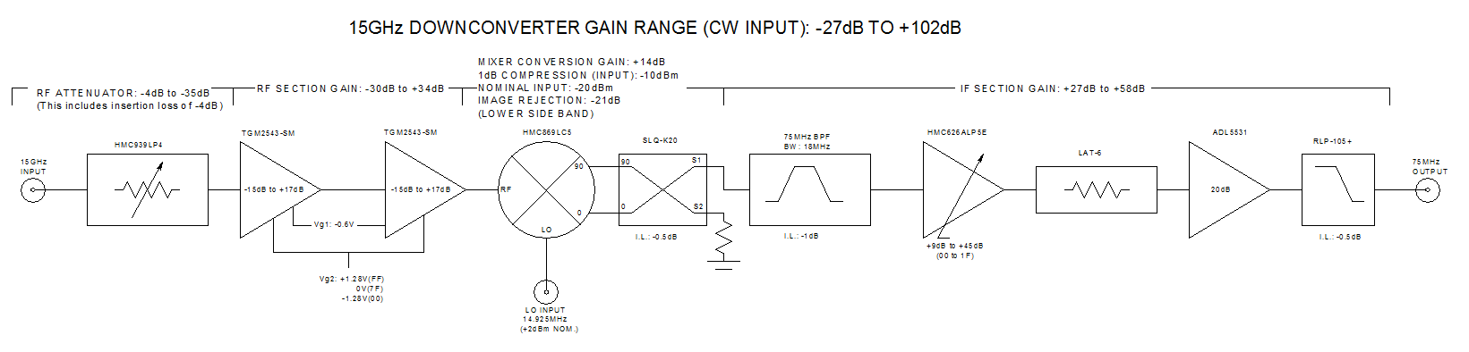
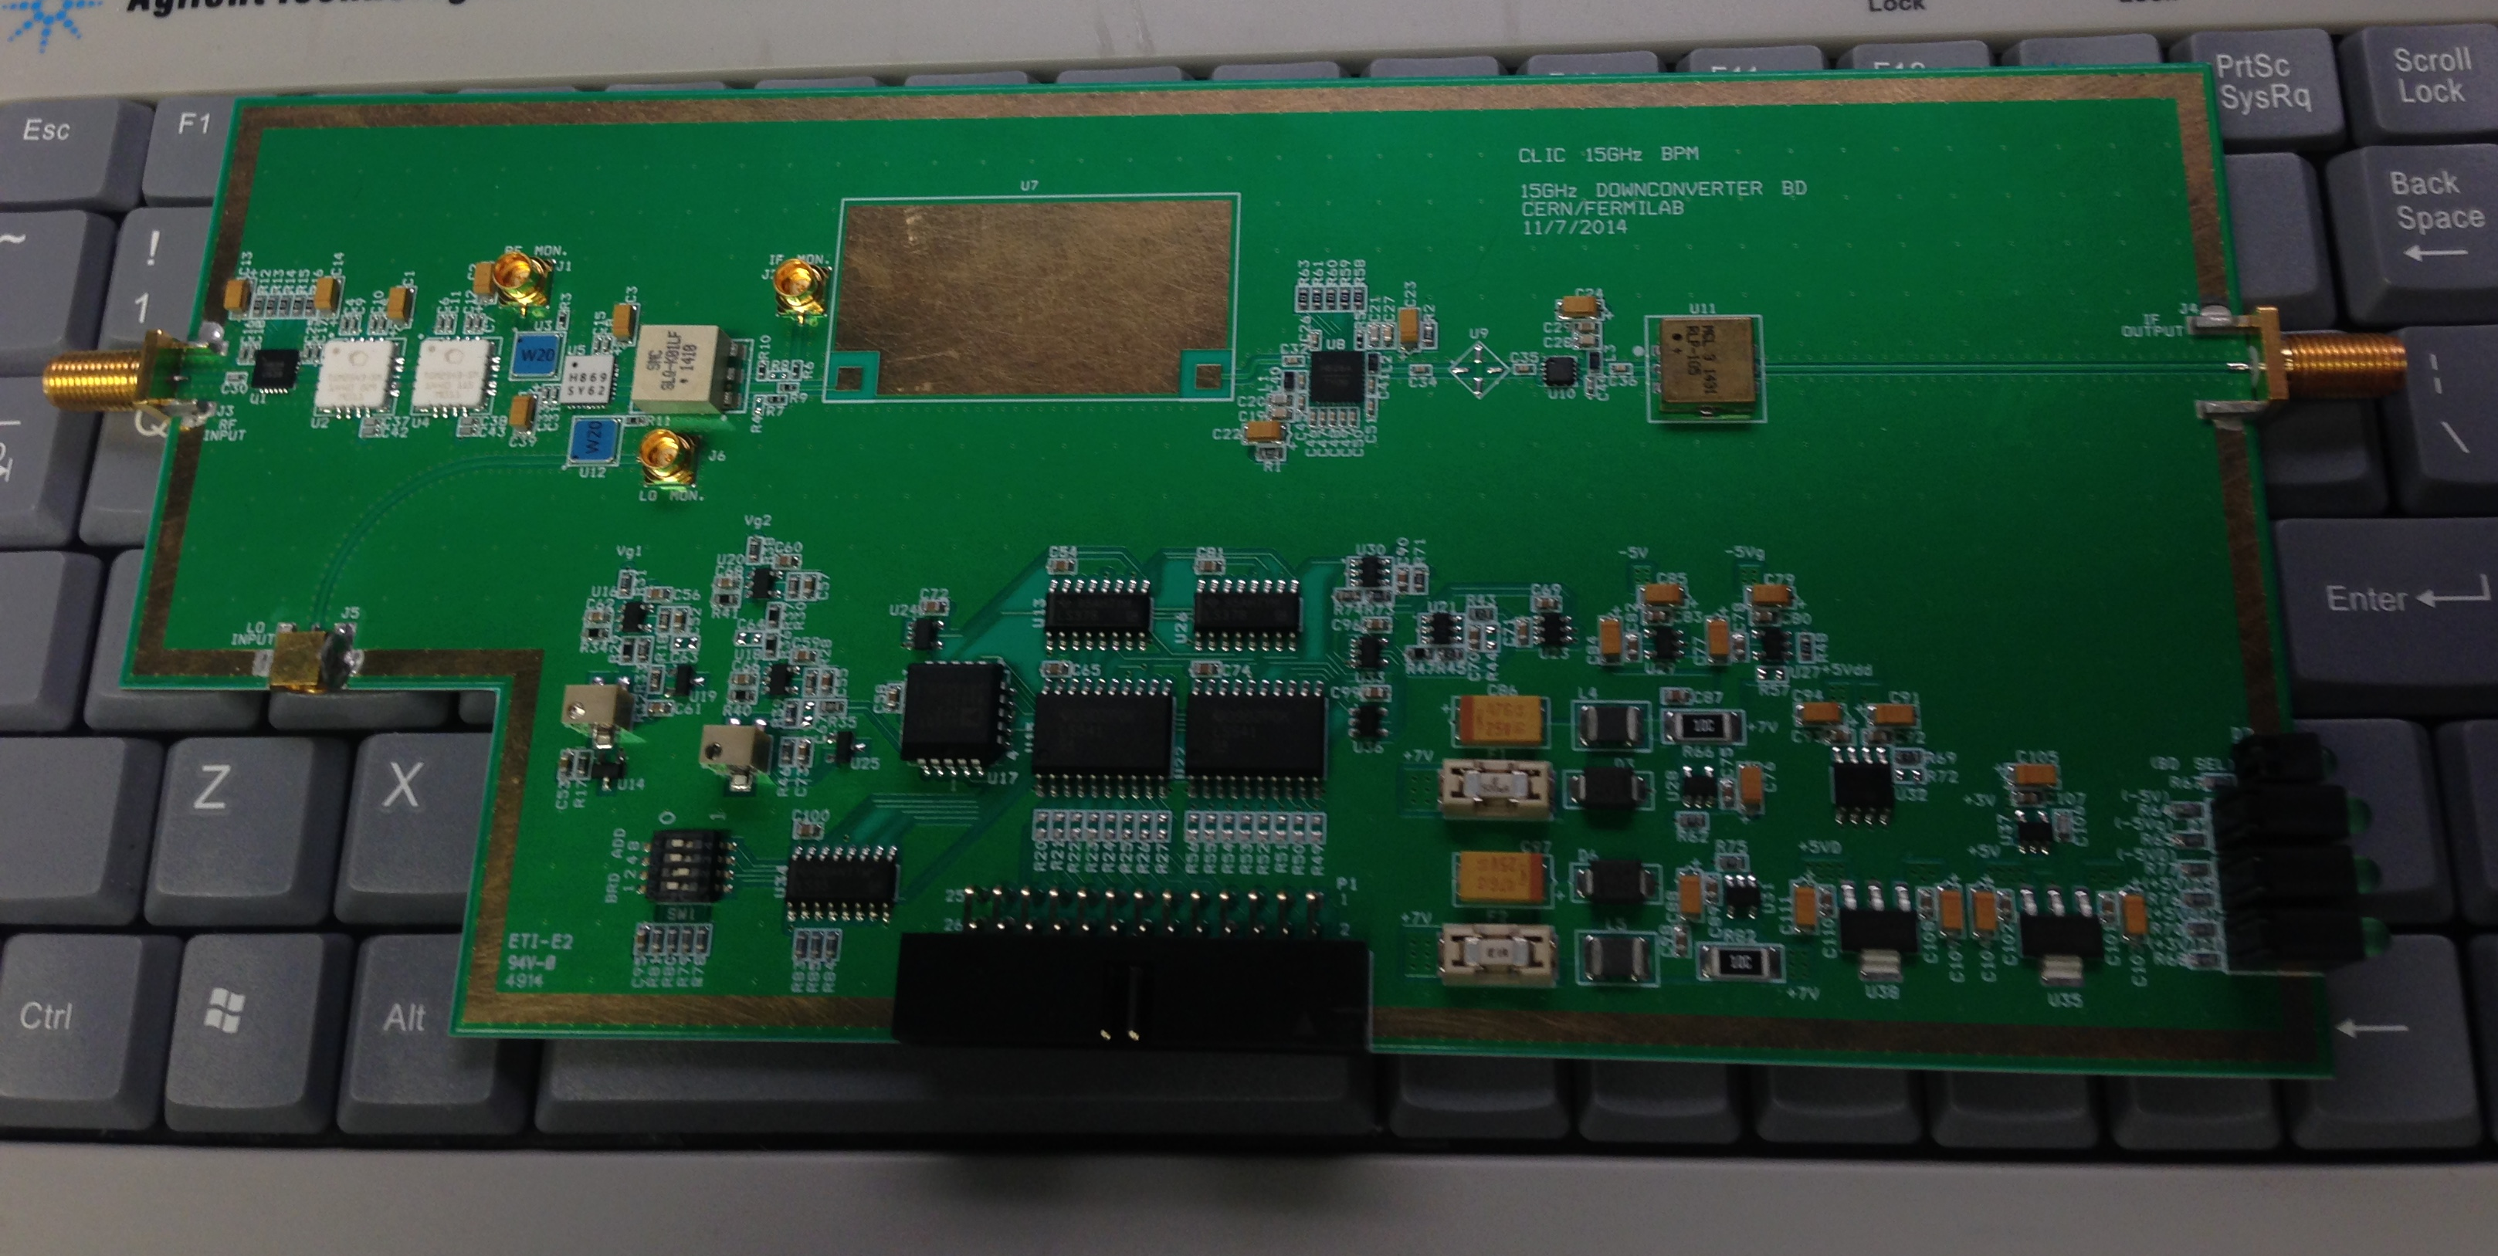
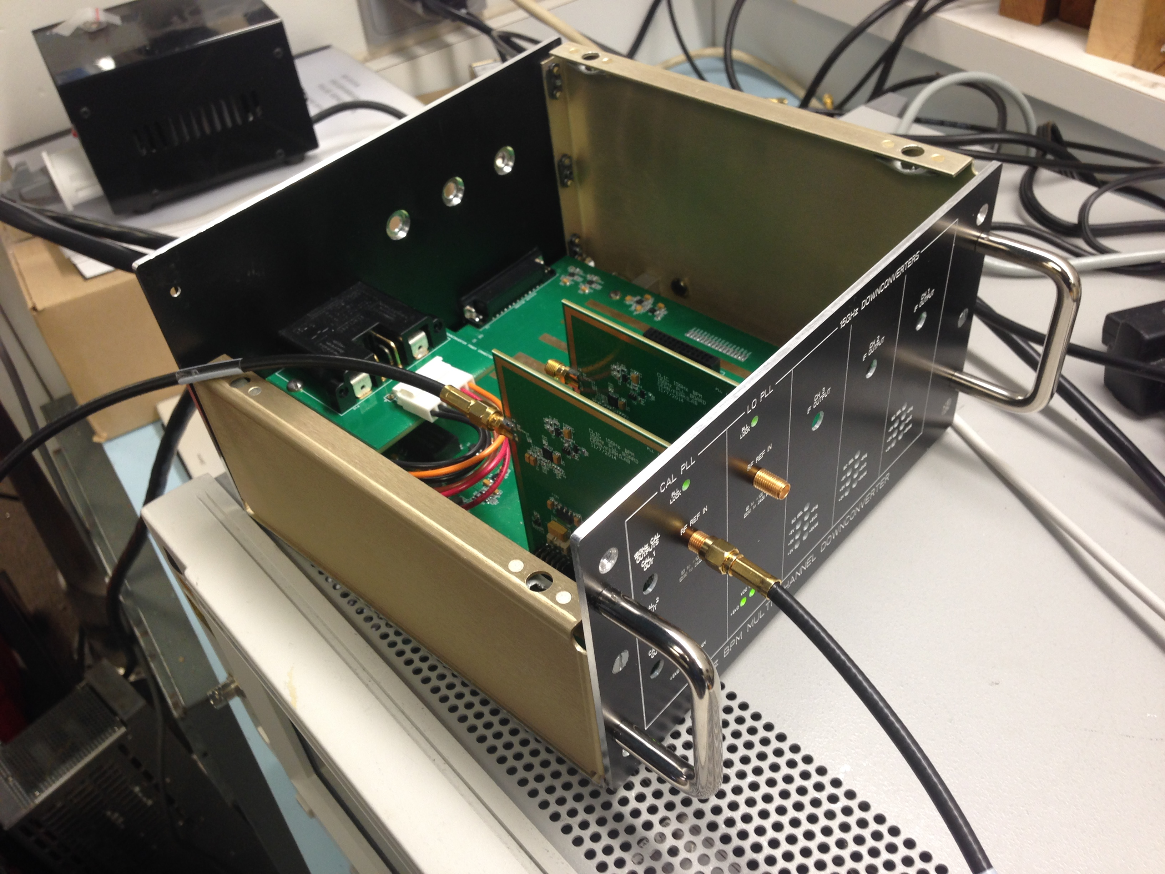
Downconverter Electronics
Concept tested with a single cavity at CTF3
Single-stage downconverter mixer electronics
Draft design, signal estimates and control interface by RHUL
Detailed design and PCB fabrication by FNAL
(N. Eddy, B. Fellenz, J. Bogaert)
Gain flexibility, remote control, custom IF filters
9 downmixer channels and 3 LO/CAL signals
Three units installed in CLEX, one for each BPM

Slide 7
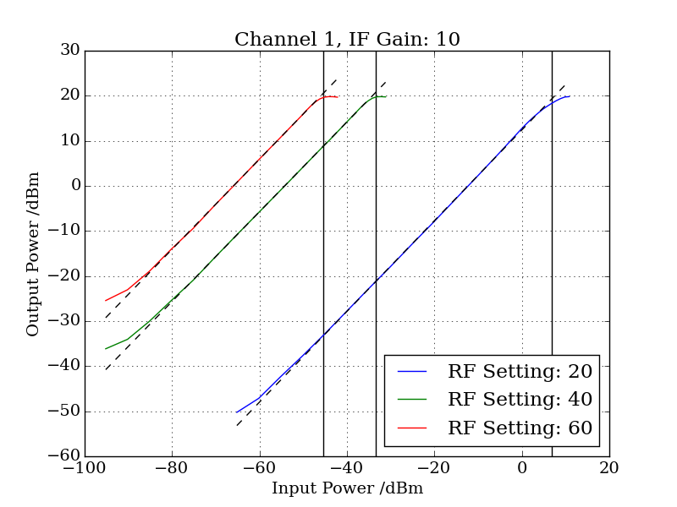
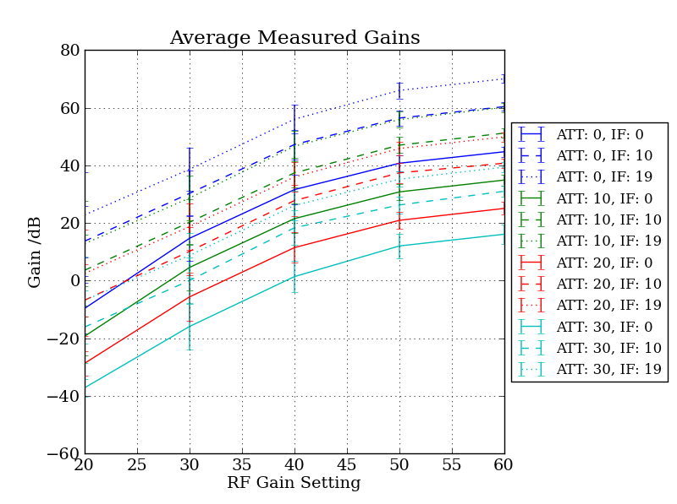
Downconverter Tests
All 9 downconverter channels were characterised
Gain measured for range of variable gain and attenuation settings
Operational values were determined
Dynamic range also measured at various settings
A nominal dynamic range of 80dB can be achieved

Slide 8
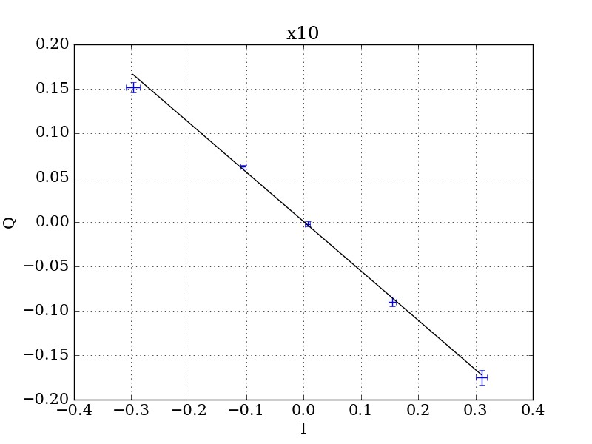
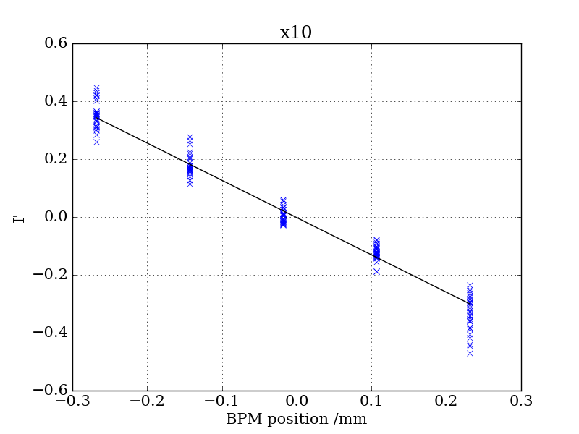
Beam Tests
BPMs calibrated with a stable beam and scanning the BPM position with the stages.
I’s and Q’s are measured and the position and tilt dependent parts of the measured signal are determined.
A position sensitivity factor is calculated from this and is used to measure beam position.
Charge sensitivity of the reference cavity also needs to be determined.

Slide 9
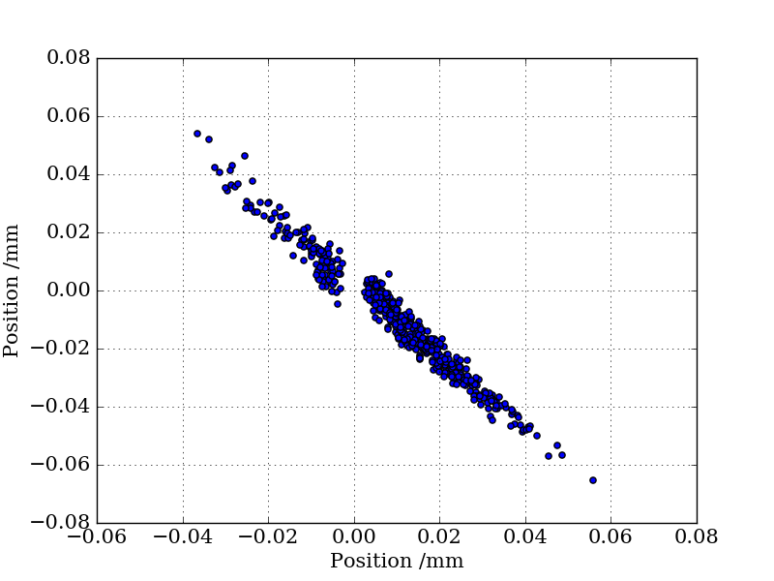
Beam Tests
Resolution measured with 3 BPMs where the position in pickup is predicted by the signals measured in the other 2
1000s of shots taken
Simple correlation between BPMs gives a resolution of ~1 μm.
Due to the phase behaviour in the centre of the BPM and the angled trajectory of the beam, the position is not accurately measured around 0
  A model is required to predict the behaviour in this region

Slide 10
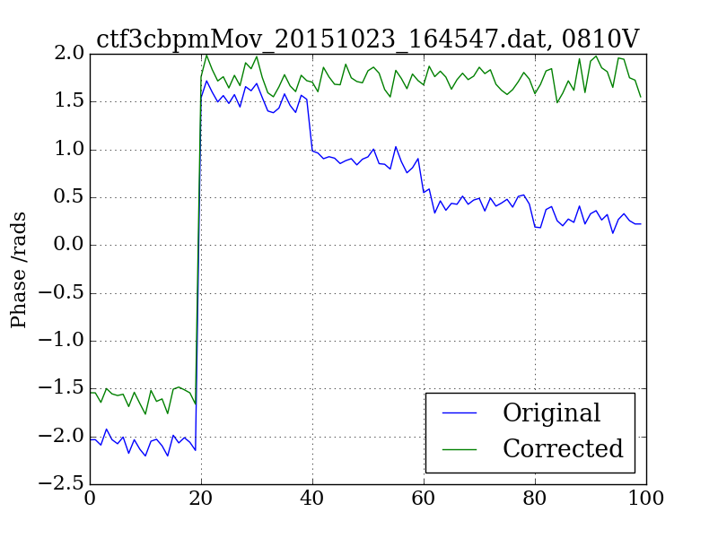
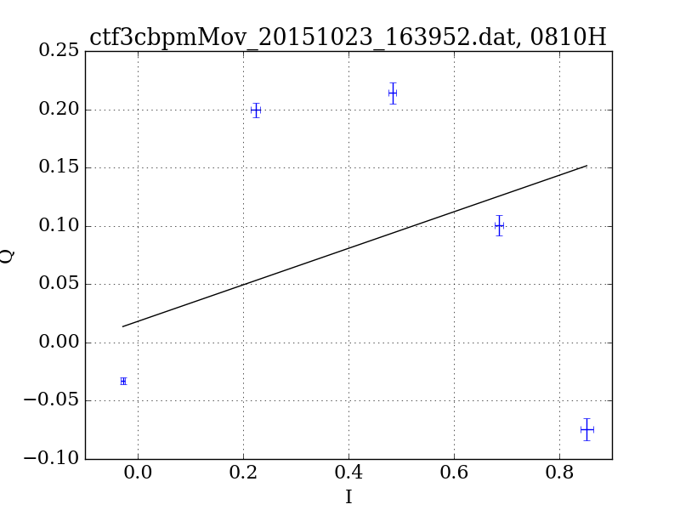
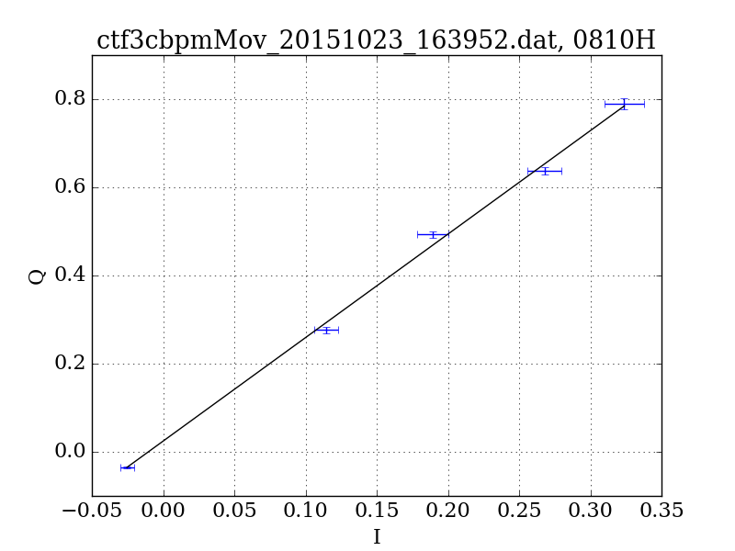
Amplitude-Phase Modulation
It was seen that phase changed with amplitude due to non-linearities in electronics
To combat this, the modulation was measured and corrected
Restores the IQ curve to a line
correction

Slide 11
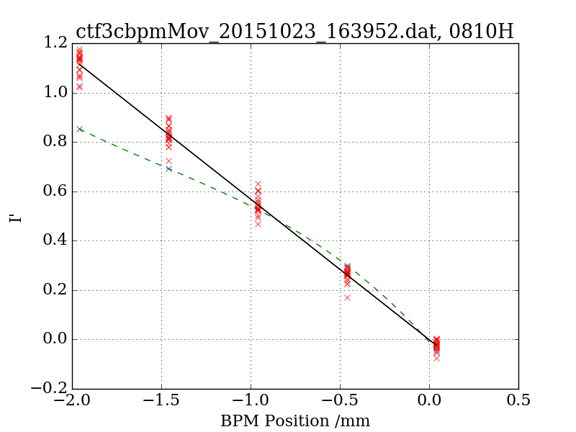
Long Range Nonlinearity
In long range scans the position response becomes nonlinear
Fitting a 3rd order polynomial to the measured signal
Measure the difference and correct for it.

Slide 12
Conclusion and Future Plans
A system of 4 BPMs has been installed in CLEX
Beam measurements have been taken
Resolution measurements so far are sub micron
With an appropriate model and additional data taken a better resolution is expected
A simultaneous measurement of the spatial and temporal resolution is required
  Apply a chirp to the beam

