Slide 1

Development of the high efficiency MBK klystron for FCC
C Lingwood, Lancaster University/Cockroft Institute
on behalf of HEIKA (High Efficiency International Klystron Activity)
Notes:
LANCASTER UNIVERSITY POWERPOINT TEMPLATES
These PowerPoint templates are for use by all University staff. Please see below for further information regarding the use of these templates. Should you have any further queries, please contact the marketing team via webmaster@lancaster.ac.uk
Template slide 3: Insert a new slide
If you need to insert a new slide, from the ‘home’ toolbar, click on ‘new slide’ and select from the templates the style you require from the dropdown box.
Template slide 4: Typing new text and copying text from another document
New text should be typed over the text in the appropriate template. Copy and pasting text from another document will result in changing the style of the typography and layout. This is unavoidable as it is part of the Microsoft software. We appreciate that in sometimes you will need to copy text from another document into this template. Once you have pasted the existing text into the template, you will need to change the formatting so that they typefaces, sizes, colour, line spacing and alignment are consistent with the rest of the template.
Template slide 5: Inserting images
There are three choices of templates with images already inserted. Please use the template with the relevant image size and positioning. To insert an image, please go to ‘insert’ then ‘picture’ and find your image, highlight it and ‘insert’. Resize the image and position as per the example template.
Template slide 6: Text boxes
If a text box is deleted, either insert a new slide (using the appropriate template) or go to another slide and copy a text box. To select a text box for copying, please click on the outer edge of the text box so that the line goes solid (not dashed). Right click your mouse and select ‘copy’, then go back and ‘paste’ it into the slide where the text box is missing which should paste into the correct position on the slide.
Template slide 7: Other information
Typefaces, sizes and colours
All copy is Calibri.
Slide title copy throughout:
Size: 36 point
Colour Lancaster University red: (RGB) R: 181 G: 18 B: 27 (recent colours on PowerPoint)
Small copy on first and last slide:
Size: 16 point
Colour grey: (RGB) R: 102 G: 102 B: 102 (recent colours on PowerPoint)
Sub-headings:
Size: 24 point – italics
Colour grey: (RGB) R: 102 G: 102 B: 102 (recent colours on PowerPoint)
Bullets copy and body copy:
Size: 24 point (see below for a further option)
Colour grey: (RGB) R: 102 G: 102 B: 102 (recent colours on PowerPoint)
It isn’t advisable to have too much text on a slide, however on rare occasions it may be necessary, therefore there is a slide using 20 point bullet pointed text.
Line spacing and alignment
Single line spacing (apart from the main headings which is ‘exactly 35 point’)
All text is aligned left
Slide title options
There are two options for titles on the slides – one line or two lines for longer titles. Ideally, the one line title should be used, however on rare occasions a two line title maybe needed.

Slide 2
Introduction
Increase in RF generation efficiency is high priority for the future large accelerators (CLIC, ILC, FCC, ESS)
“Recent” klystron developments targeted high power neglecting high efficiency
Few high power klystrons offer 65%+ efficiency
Deeper understanding of the klystron physics, new ideas and modern computational power will help us towards 90% efficiency
HEIKA collaboration of many experts working towards this

Slide 3
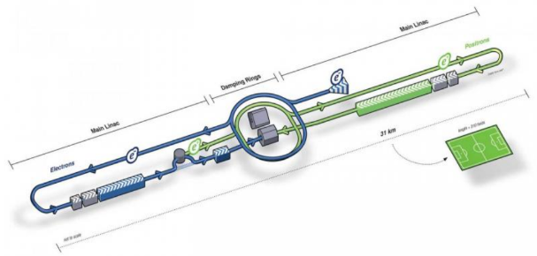
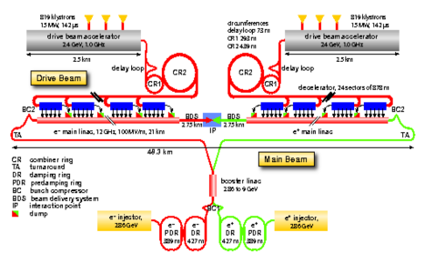
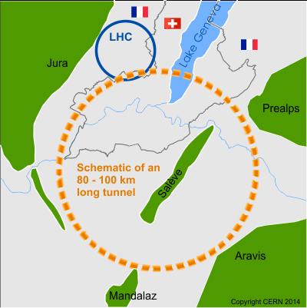
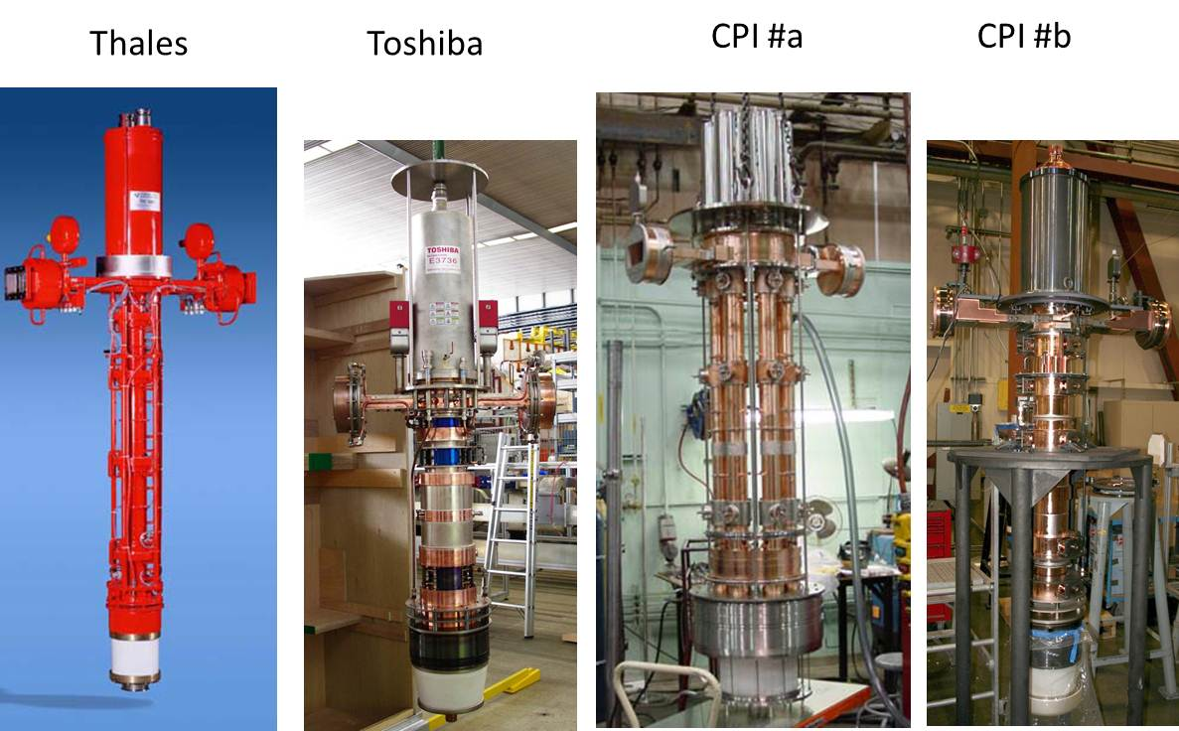
Future Machines…large numbers!
linear
Achieved efficiency at 10 MW peak RF power level
The existing MBK klystrons provide efficiency very close to 70%
0.5 TeV
ILC ^{e+e-}: Pulsed, 1.3 GHz, P_{RF} total= 88 MW
3.0 TeV
CLIC ^{e+e-}: Pulsed, 1.0 GHz, P_{RF} total= 180 MW
circular
FCC
FCC ^{ee}: CW, 0.8 GHz, P_{RF} total= 110 MW

Slide 4
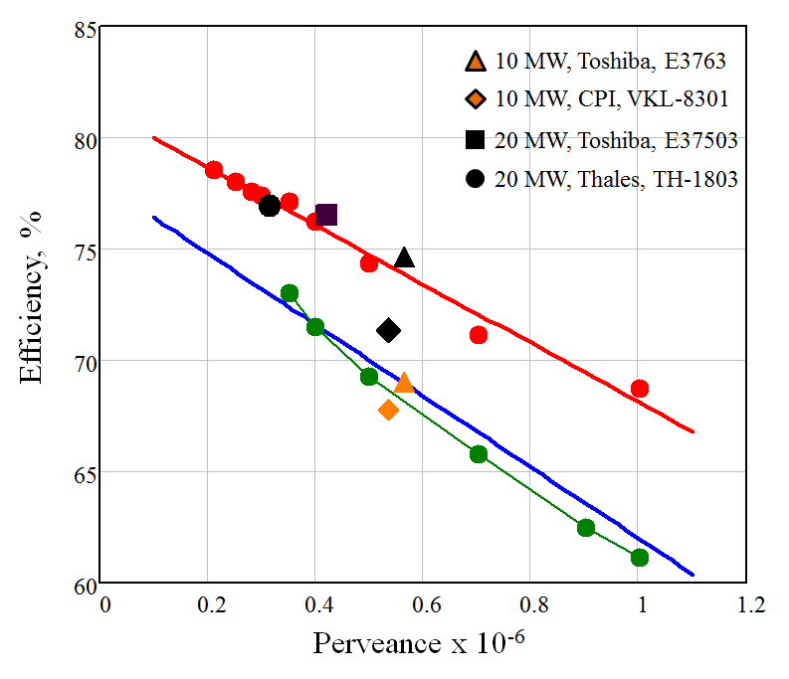
Traditional Approach
For high efficiency traditionally we chase
low perveance:
  High voltages
    or
  Low currents (many beams)
For high power both become “unpleasant”.
Performance limited by the slowest electrons (must avoid reflecting electrons)
Traditional theoretical efficiency limited to 80% @ 0.1-0.2ish microperv

Slide 5
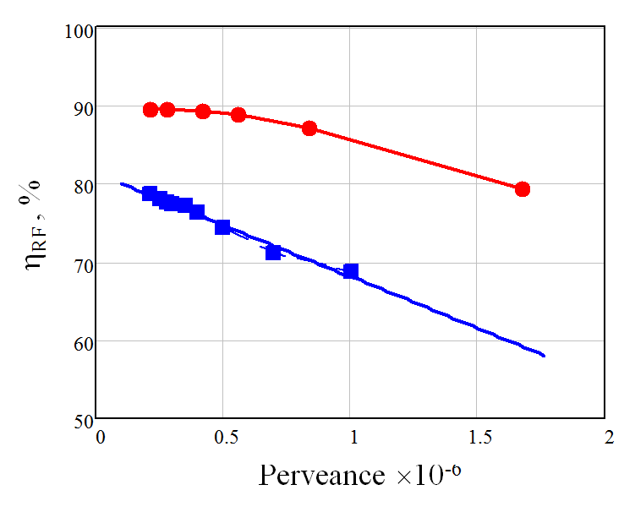
Method to get high efficiency
Core Oscillation (space charge debunching)
Bunching split into two distinct regimes:
  non-monotonic: core of the bunch periodically contract and expand (in time) around center of the bunch
  outsiders monotonically go to the center of the bunch
Core experiences higher space charge forces which naturally debunch
Outsiders have larger phase shift as space charge forces are small
Very long, very efficient tubes result.
Traditional bunching
Core oscillations
Core oscillations
Phase
Traditional approach
Cavity
Cavity
Cavity
Cavity
Cavity
Space
Notes:
ё

Slide 6

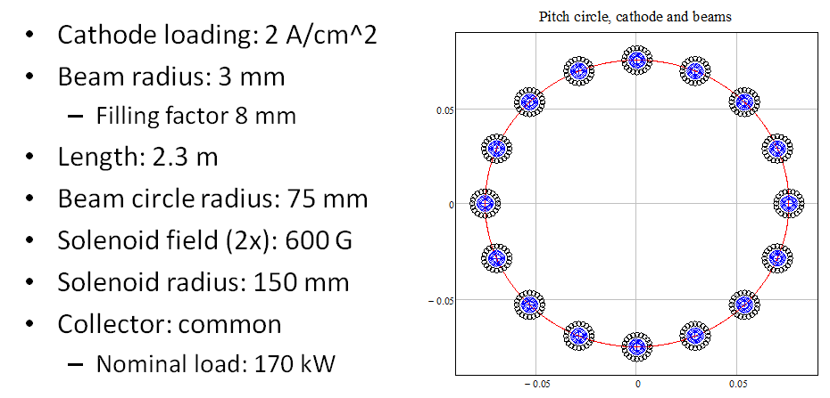
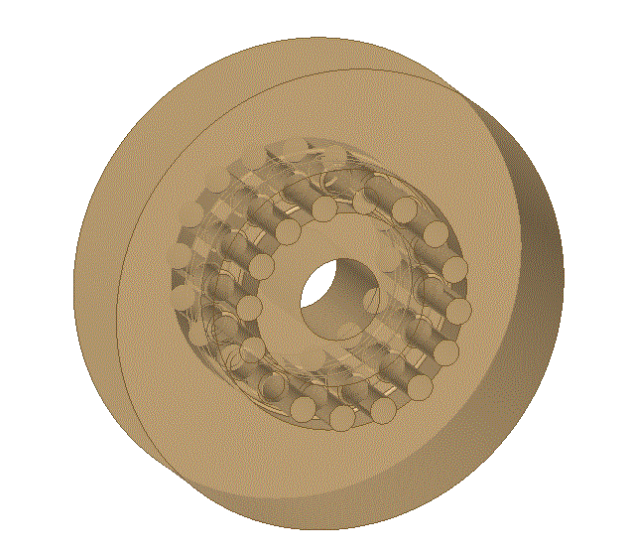
HEKCW Tube
HEIKA/HEKCW working team:
I. Syratchev (CERN)
C. Lingwood (Lancaster)
G. Burt (Lancaster)
D. Constable (Lancaster)
V. Hill (Lancaster)
R. Marchesin (Thales)
Q. Vuillemin (Thales/CERN)
A. Baikov (MUFA)
I. Guzilov (VDBT)
C. Marrelli (ESS)
R. Kowalczyk (L-3com)
Tube parameters:
1.5MW
Voltage: 40 kV
Total current: 42A
N beams: 16
µK/beamx10⁶ : 0.33
N cavities: 7
Bunching method #1: COM
HEKCW
16 beams MBK cavity
R/Q = 22 Ohm/beam

Slide 7
PIC Simulation complexities
Working in 2D for speed
Coaxial cavity not possible in 2D
It is not possible to get a re-entrant cavity to replace the coax cavity
R/Q cannot be reached with beam pipe parameters (353 Ohm)
Use GSP technique to translate tube through generic parameters while keeping bunching “equivalent”:
  In this case move to higher voltage to lower R/Q
    Required R/Q is now 182 Ohm (easy)
  Results should be equally applicable

Slide 8
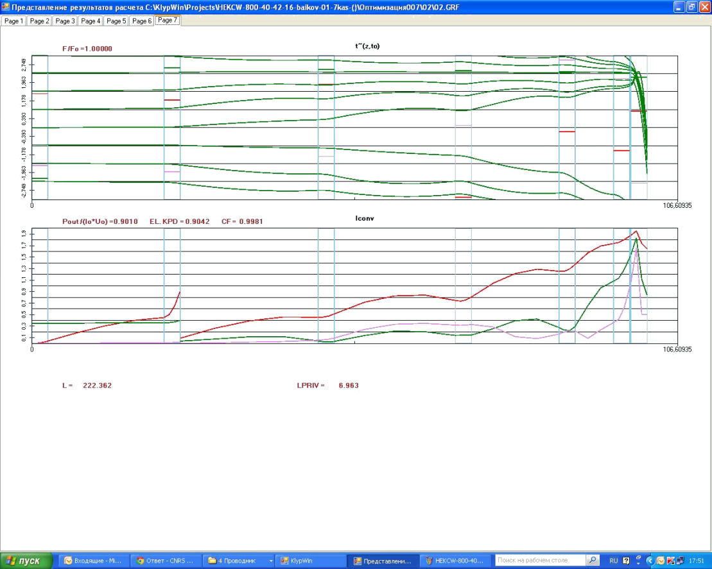
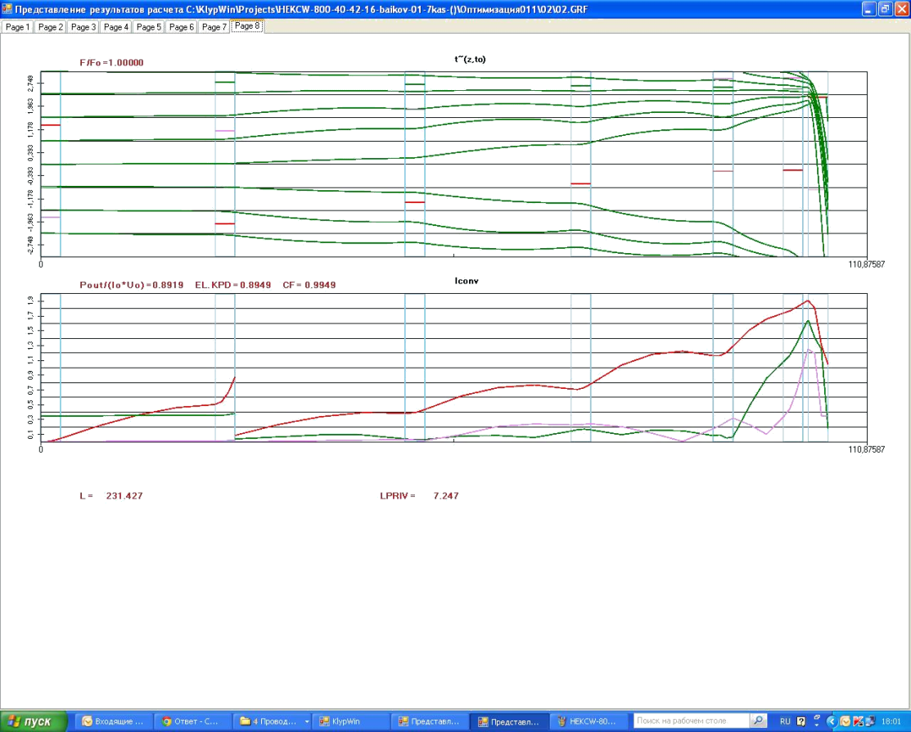
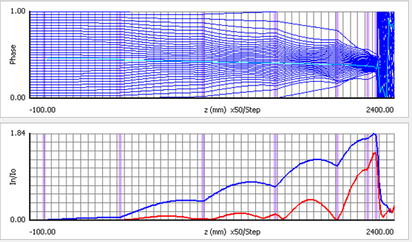
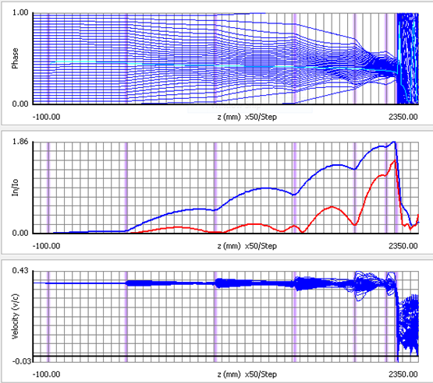
Initial Proposed Structures
A Baikov
HEKCW #11-02 (highest efficiency) η= 90.1%
HEKCW #11-07 (‘cleanest’ phase trajectories) η=89.2%
PIC Unstable!
High efficiency confirmed by another non-commercial 1D code AJDisk
η= 88.0%
η= 88.5%

Slide 9

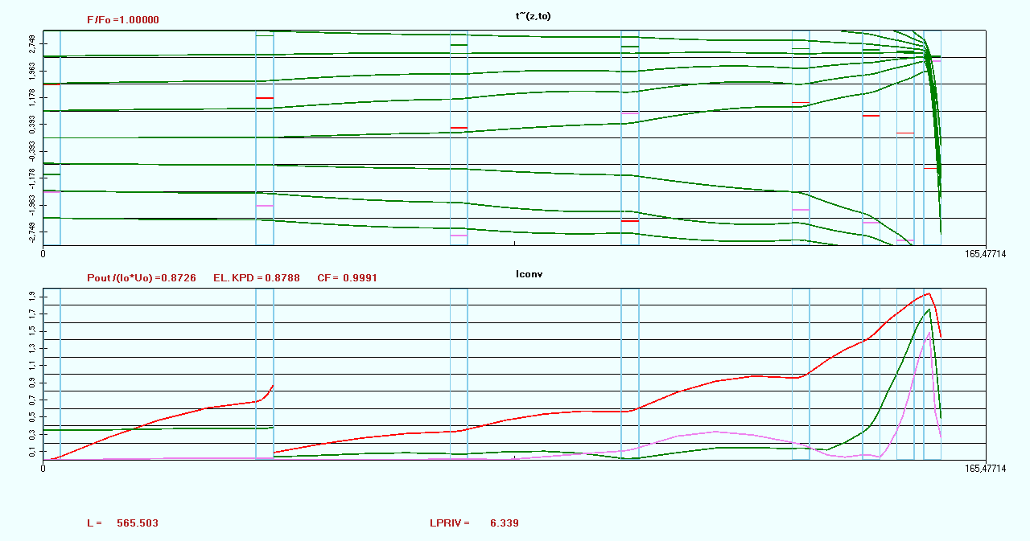
Candidate Structure #08-01
A Baikov
Learnt lessons to produce the first ‘robust’ (2D) design 87% in Klypwin, 82% in Klys2D
No overtaking - Larger cavity F separation – 8 cavities (from 7)

Slide 10
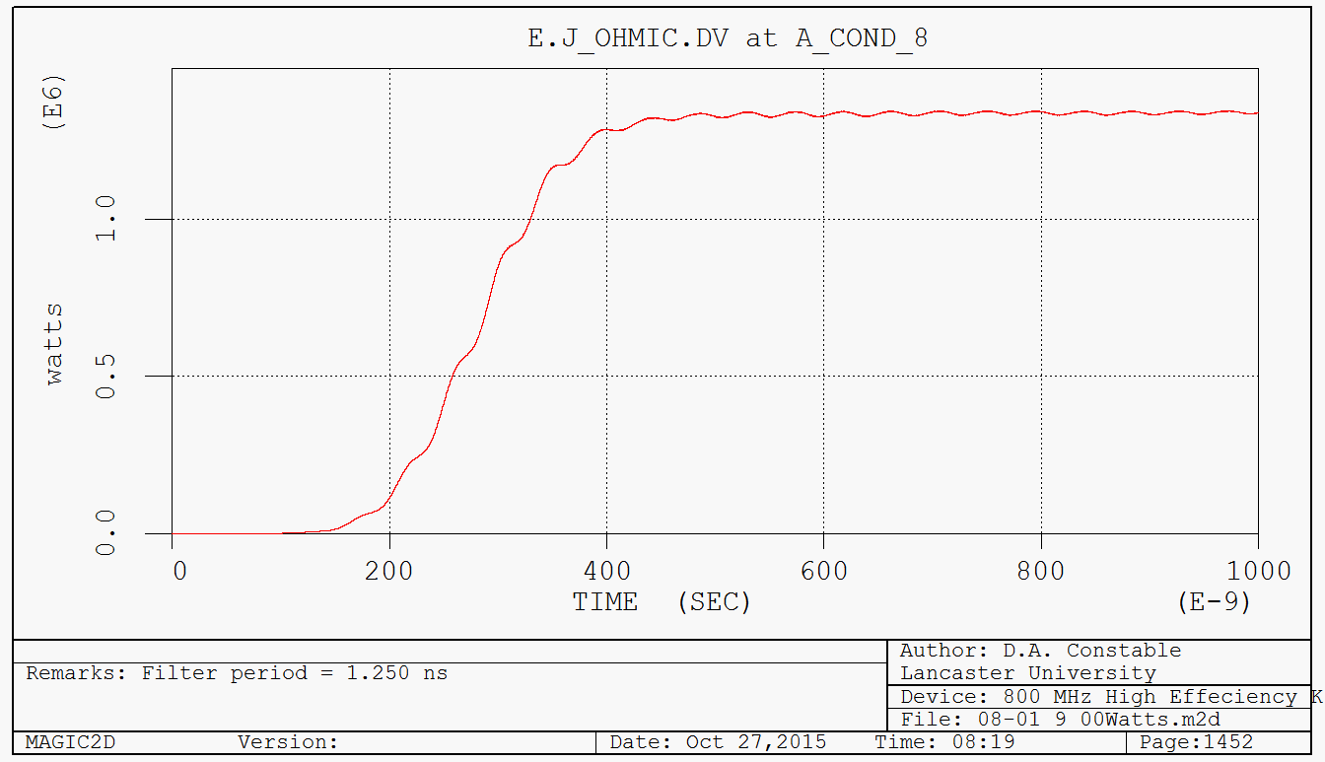
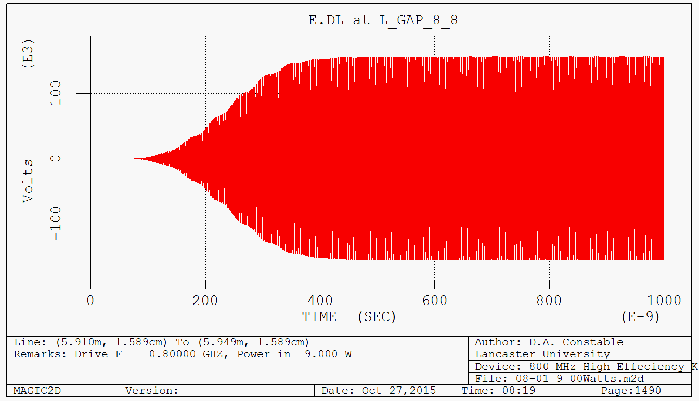
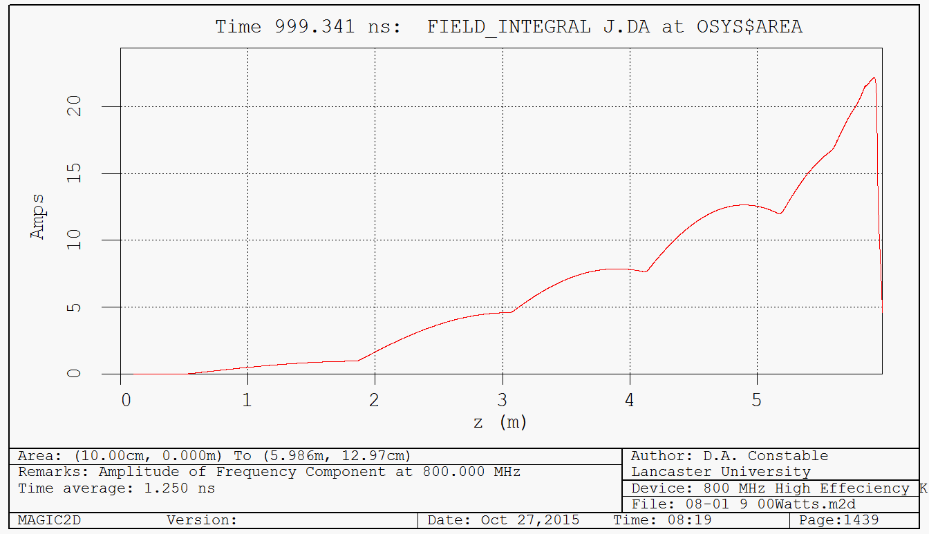
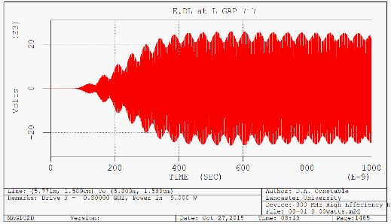
Magic2D PIC HEKCW #08-01
First Stable PIC Results!
Cavity 1 voltage, 1.28 kV:
Normal modulation for COM (good match)
Fairly Stable output
  Cavity 7 beats a bit
Efficiency…….
79.75%
Output power
Cavity 8 Volts
Cavity 7 Volts

Slide 11
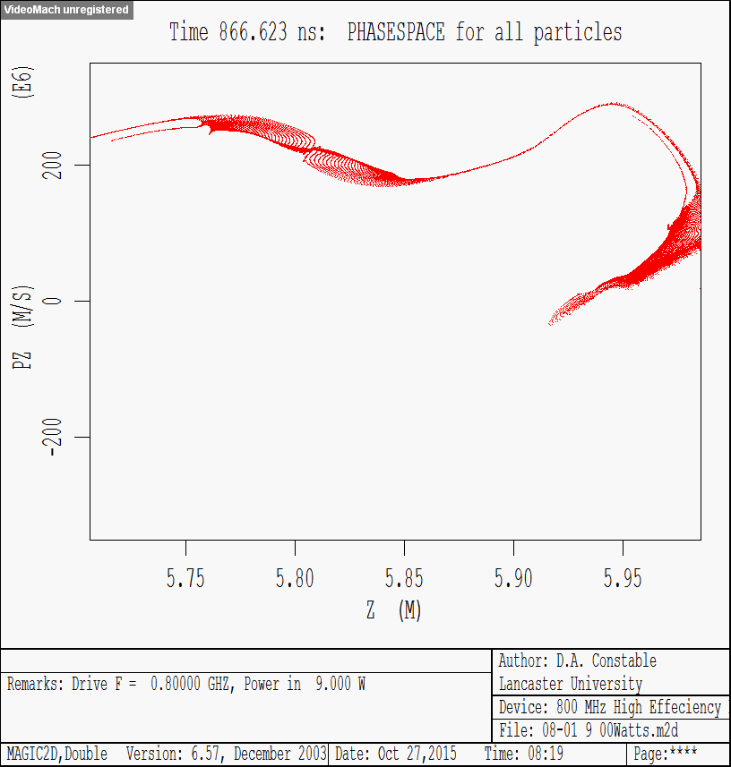
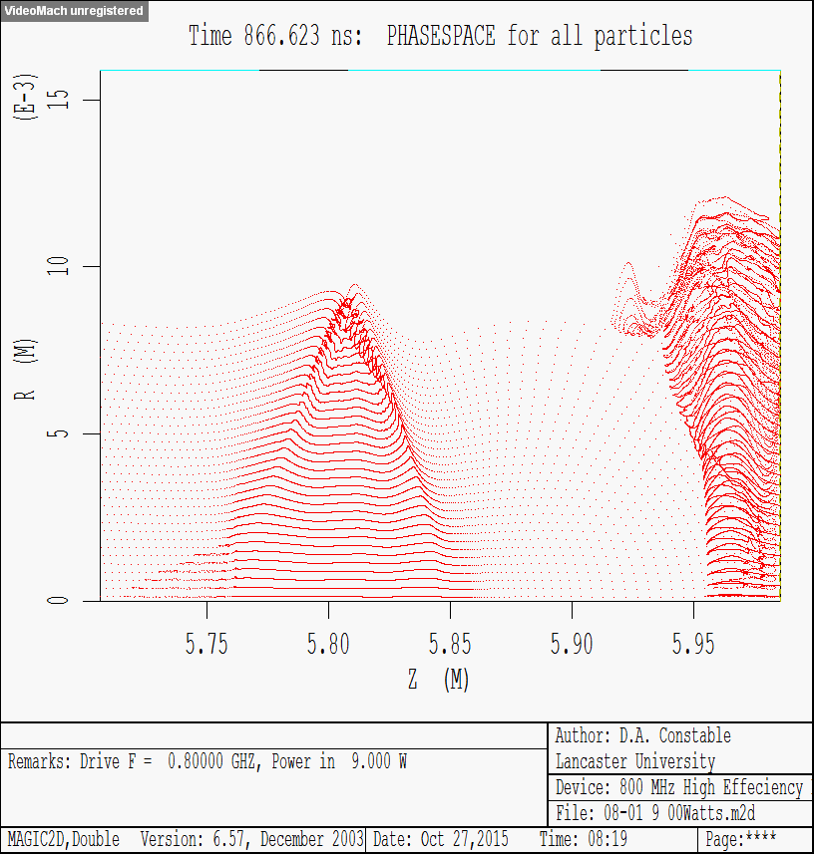
Magic 2D PIC #08-01
Electrons “bounce” in output gap but are not reflected
Phase space fairly clean
Cavity 7
Cavity 8

Slide 12
Radial Variation
The centre of the beam does not behave in the same way as the outer
  “Lens” shaped bunch
At least one of these regimes is not optimal (maybe both)
  Outside looks over decelerated for instance

Slide 13
#08_02 revised by Rodolphe and Quentin (Thales)
Similar to #08-01, with modified output cavity.
Klys2D predicts no reflections predicted along transfer curve (#08_01 not clean in Klys2D)
Klys2D predicted efficiency, ~82.14%.

Slide 14
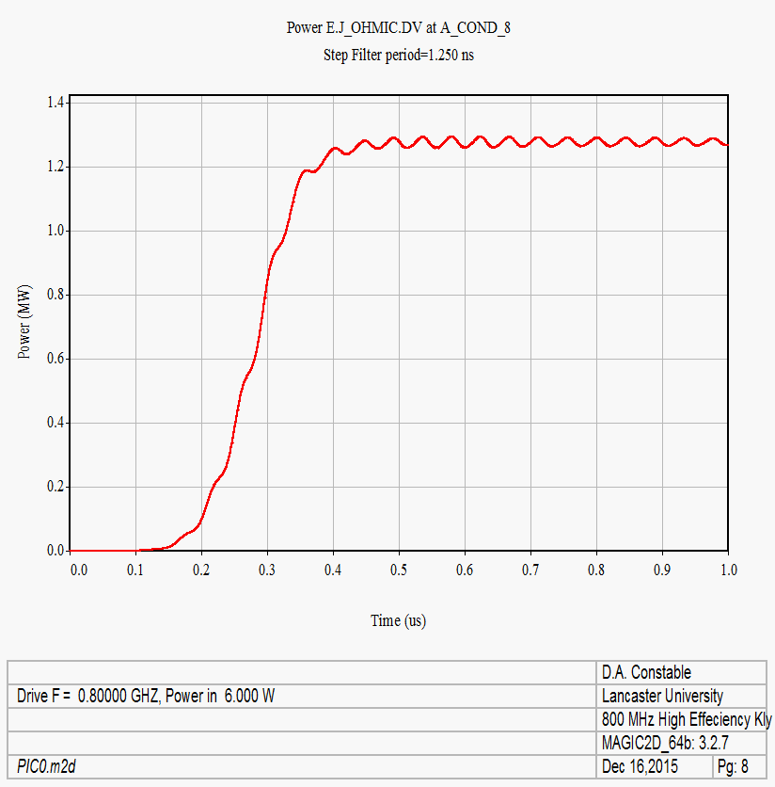
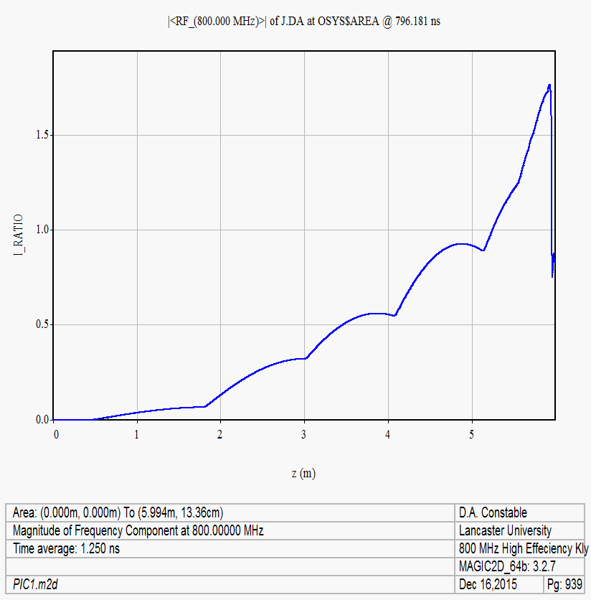
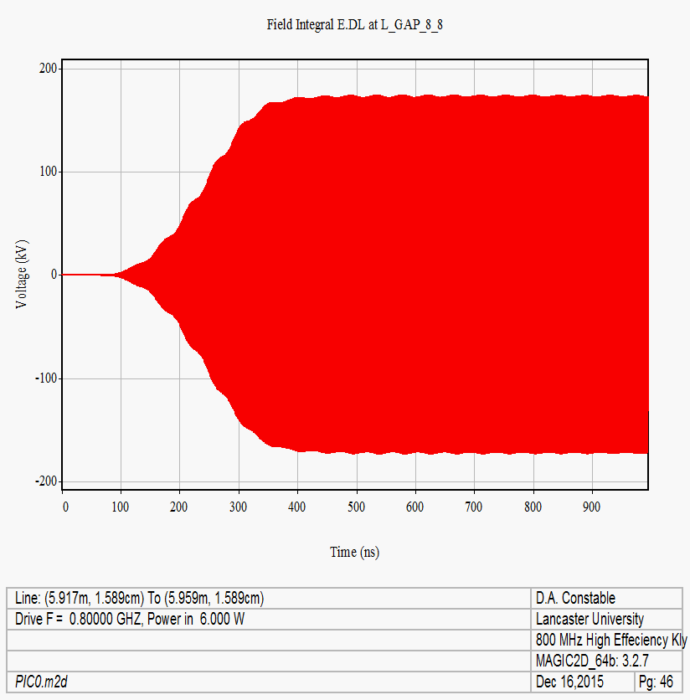
Magic HEKCW #08-02
Cavity 1 voltage, ~1.21 kV
Fairly stable output
No reflected electrons.
Efficiency….
Output power
77%
Cavity 8 Volts

Slide 15
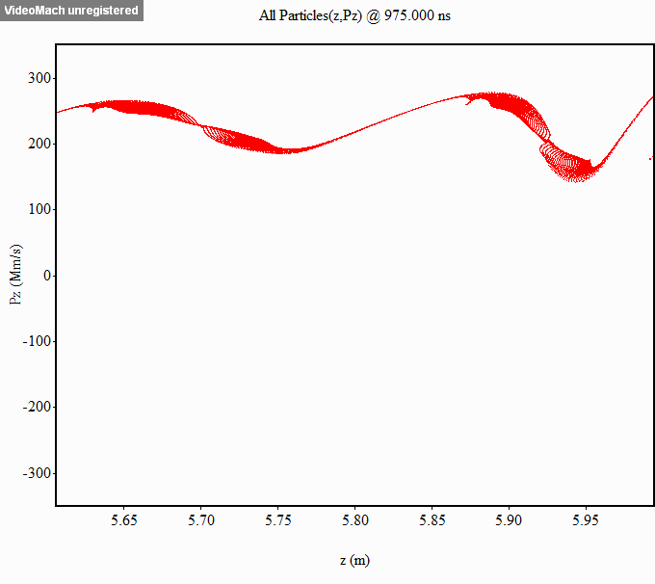
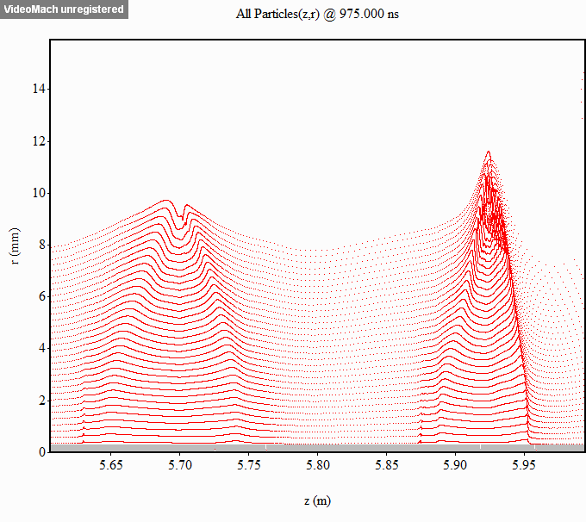
Magic HEKCW #08-02
Electron Animations
Same clean phase space
Kept lensing shape
Cavity 7
Cavity 8

Slide 16
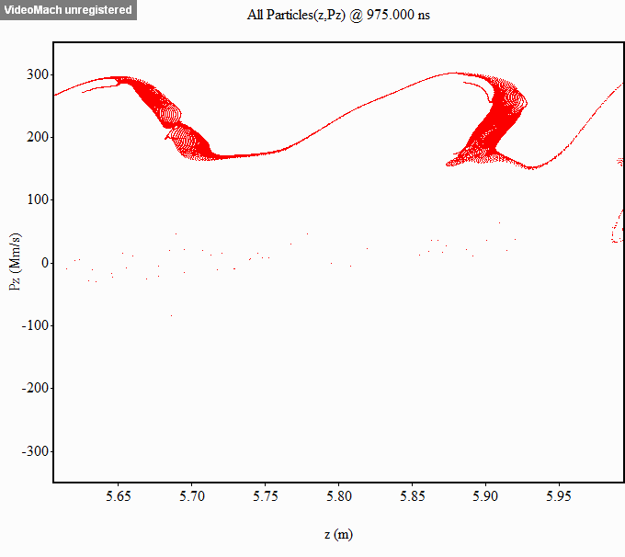
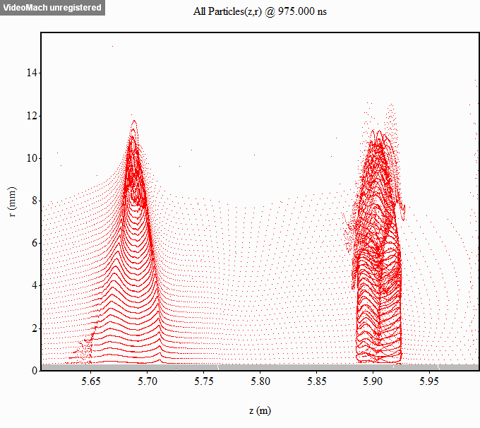
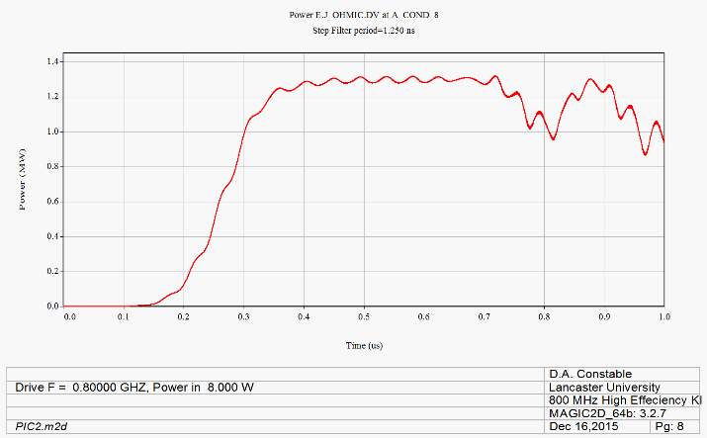
Magic HEKCW #08-02
Overdriven
Nice slab bunches
Cavity 1 voltage, 1.27 kV
  Only up 0.06kV
  #08_01 is 1.28kV
Brief efficiency, ~79%
Output power

Slide 17
#08_01 vs #08_02
08_01
08_02

Slide 18
#08_03
Rich Lowalczyk (L3)
Redesign of 08_01 targeting the slab like bunch.
No reflections predicted along transfer curve (in Tesla)
Tesla predicted efficiency, ~80% (1.34 MW).

Slide 19
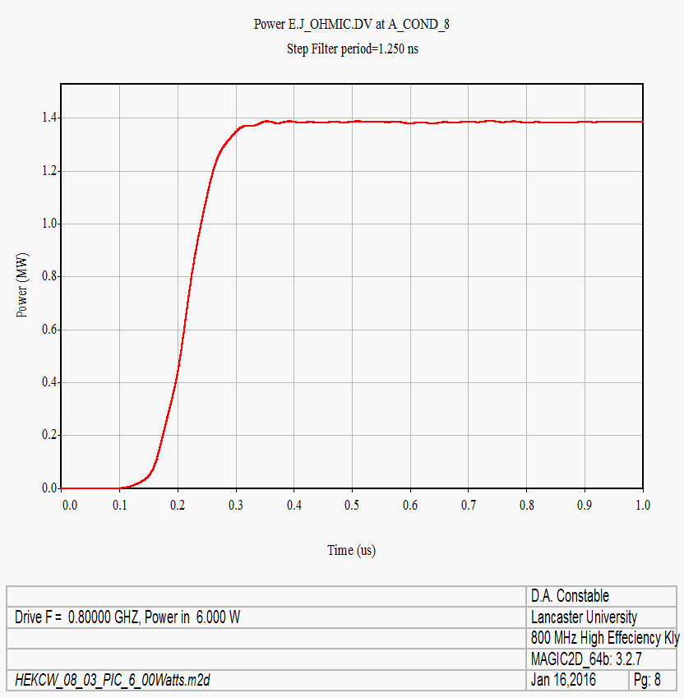
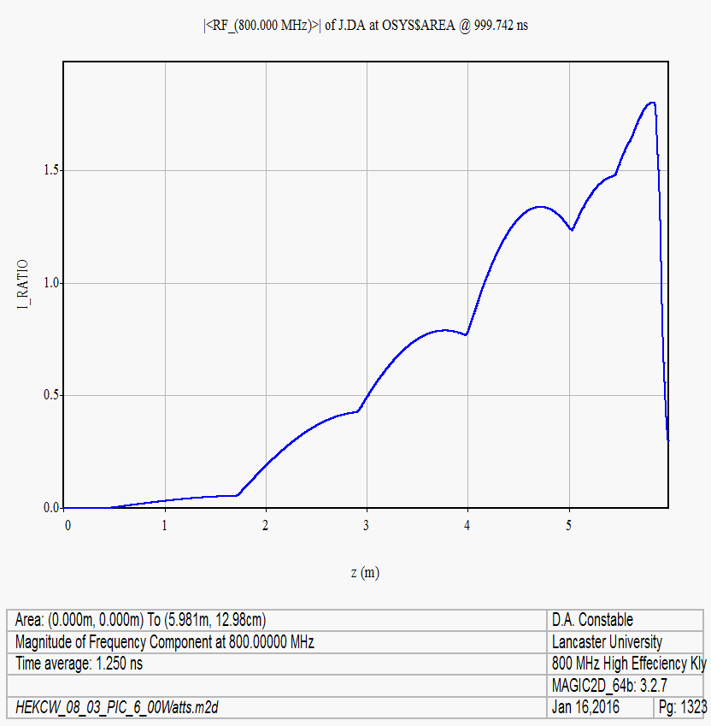
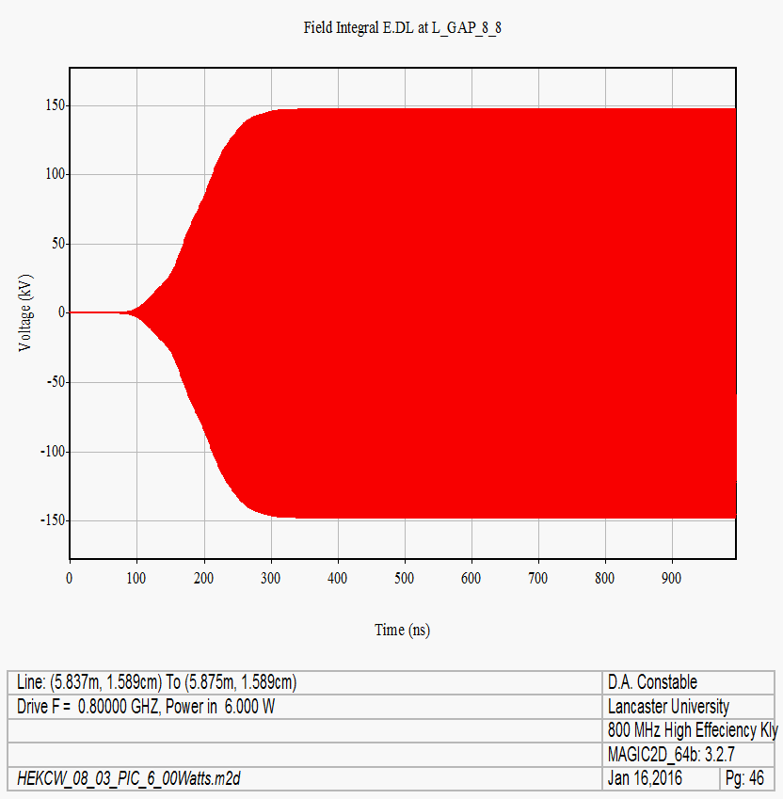

Magic HEKCW #08-03
Cavity 1 voltage, 0.83 kV:
Nice Stable output
No reflected electrons
Slightly odd modulation current
Less beating in cavity 7 signal.
Efficiency…..
83%
Output power
Cavity 8 Volts
Cavity 7 Volts

Slide 20
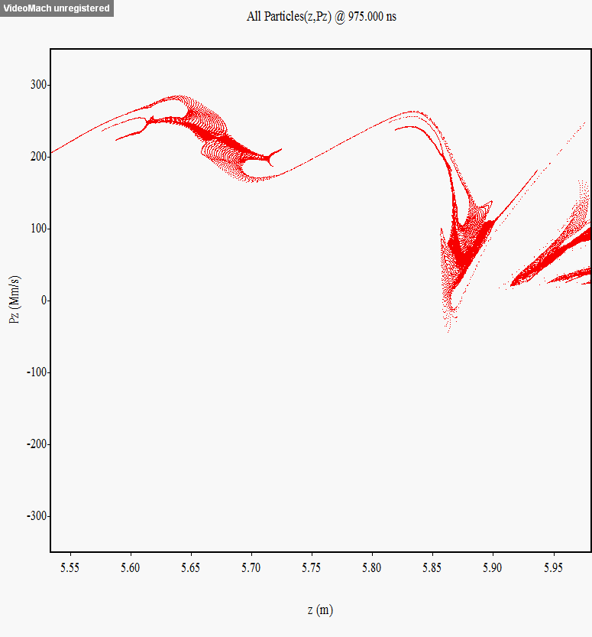
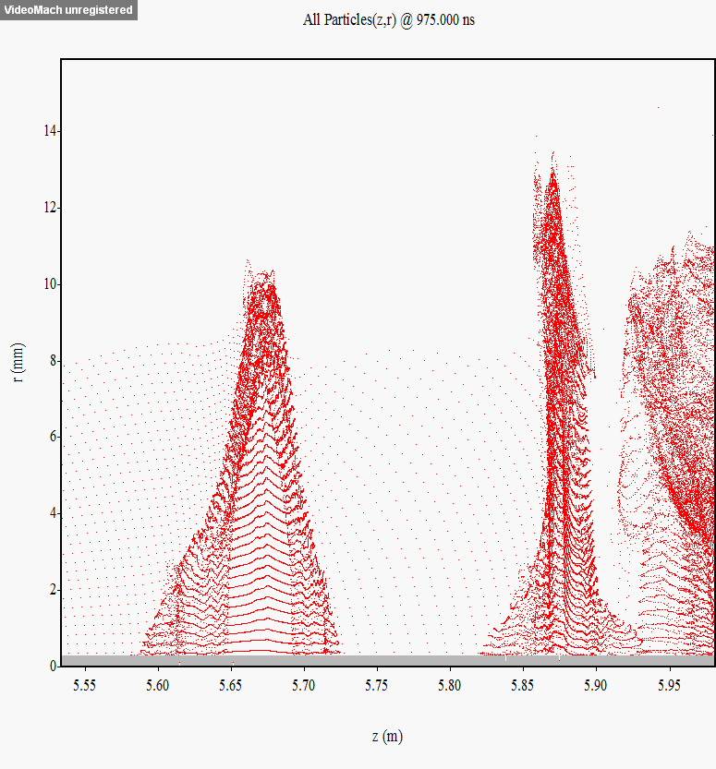
Magic HEKCW #08-03
Electron Animations
Bunch ”bounces” (less?)
Superficially nightmarish phase space
  Good chunk decelerated well though
Quite a good slab bunch
  but not great in the center
Cavity 7
Cavity 8

Slide 21
#08_01 vs #08_03
08_01
08_03

Slide 22
Conclusion and Outlook
Using new bunching theory 80%+ looks possible for FCC/CLIC/ESS/ILC klystrons
  No new materials or manufacturing techniques needed
  Little additional complexity
  Simply existing technology reconfigured
  Prototypes for proof of concept in progress
  Lower voltages combined with high efficiency appears achievable
83% Achieved in PIC
90% and stable in PIC so far elusive, but not ruled out
Prototypes and further validation required
Lessons learned directly applicable to CLIC tubes
International collaboration at work (08_04 is currently running)

