Slide 1



CALIFES beyond 2016: status
Erik Adli (University of Oslo, Norway)
For the CALIFES study group : EA,
Roberto Corsini, Steinar Stapnes (CERN),
Philip Burrows (Oxford University),
Roger Ruber (Uppsala University)
January 22, 2016
CLIC workshop 2016, CERN, Switzerland

Slide 2
Background
CTF3 on schedule to reach its main objectives by the end of 2016 (thorough demonstration of the CLIC two-beam scheme, and much more)
Scheduled to shut down end of 2016
We propose to continue the operation of the electron probe beam, CALIFES, beyond 2016
Strong interest in using CALIFES for R&D, both CERN and external institutes
We first made the case to the new CERN management this fall, in a compact document. Some encouraging signals. We have been asked to provide more details.

Slide 3
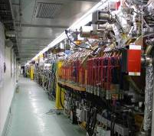
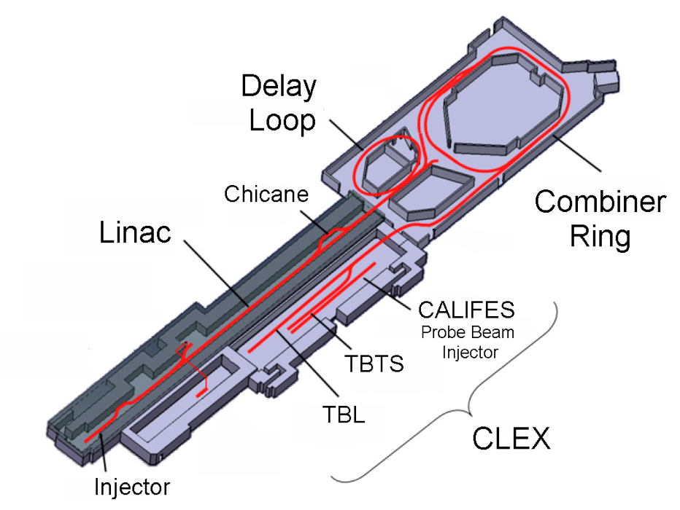

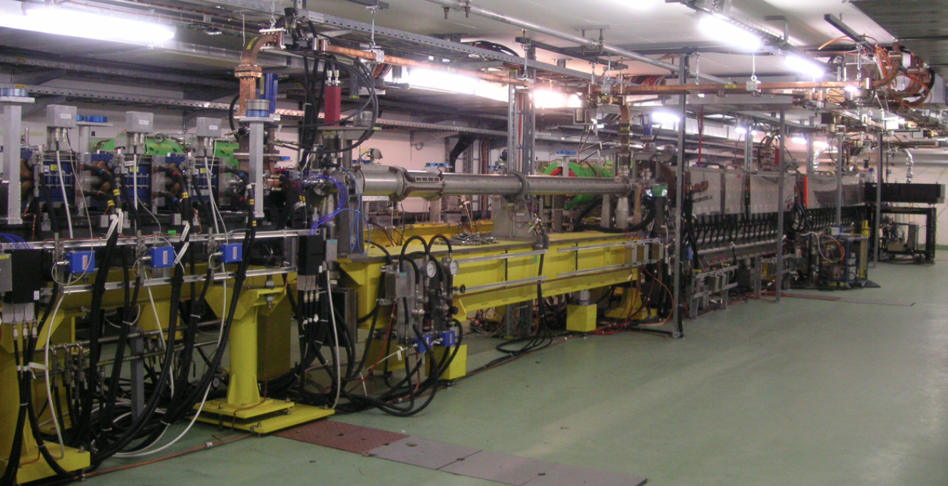
CLIC Test Facility
Drive Beam Linac
4 A, 1.4us
120 MeV
30 A, 140 ns
120 MeV
30 A, 140 ns
60 MeV
Probe Beam Linac
CALIFES

Slide 4
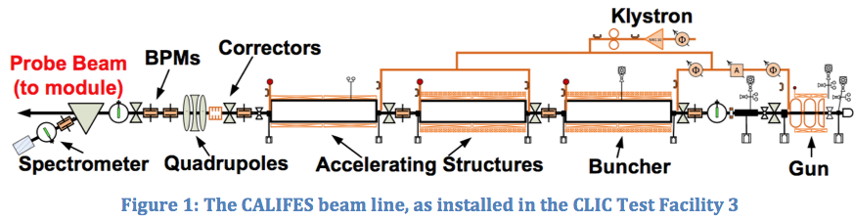
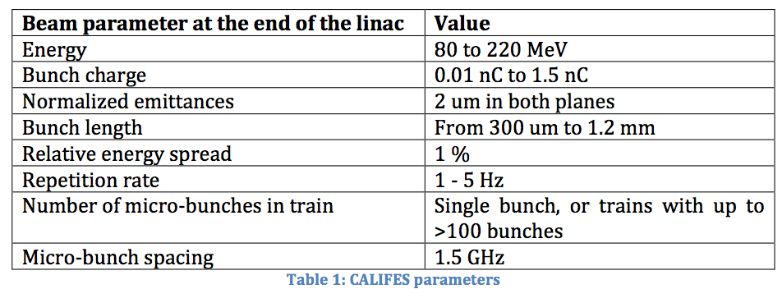
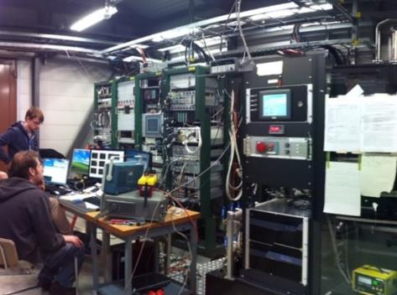
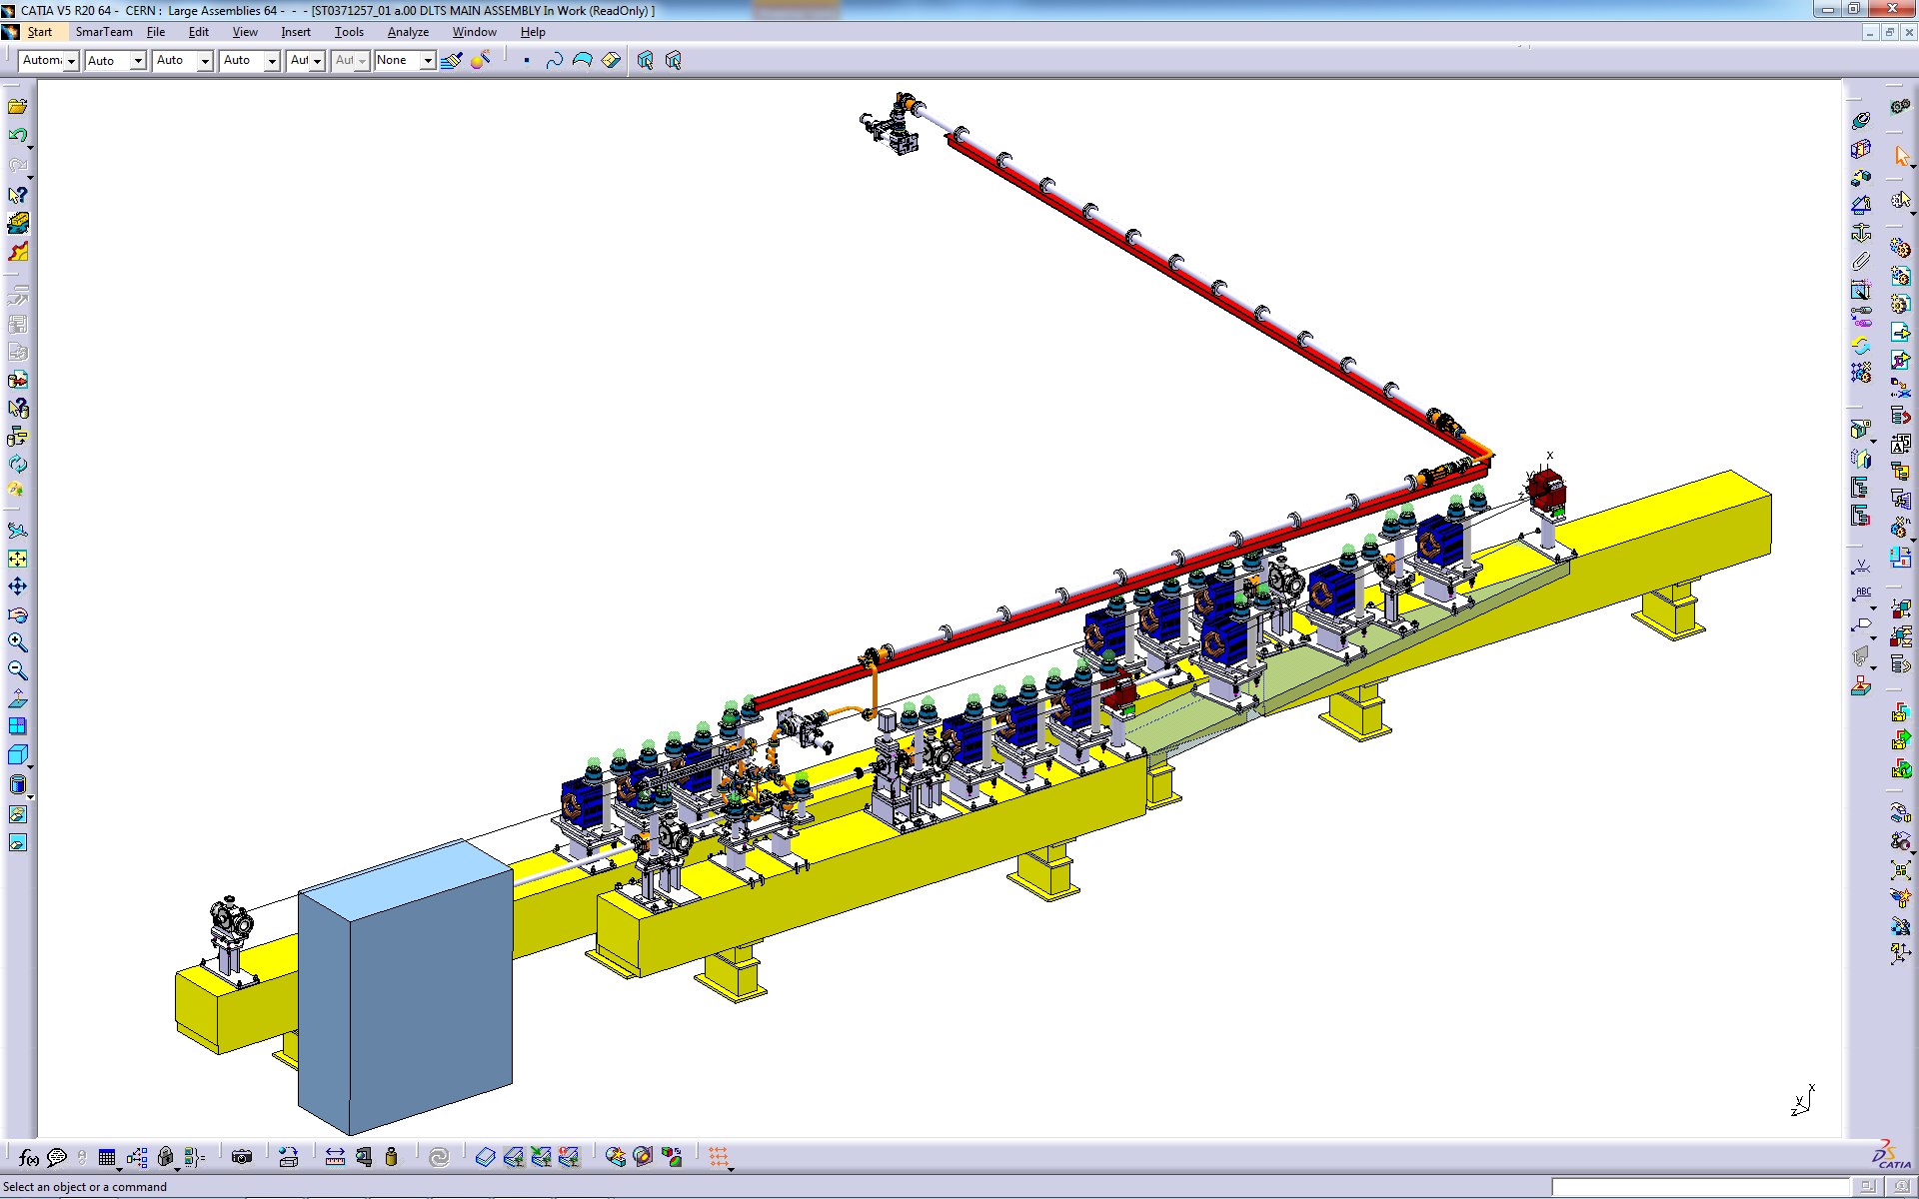
CALIFES parameters
Photo-injector: provides easily adjustable beam parameters, over a large range.
Already used for the beam loading experiment (35 m transport)
Important additional asset: Xbox 1
Provides the possibility of providing 12 GHz RF power to CALIFES X-band components

Slide 5
General motivations to keep CALIFES
Post CTF3 there will be no electron test facility at CERN, unless operation of CALIFES continues. We believe that maintaining electron beam expertise at CERN is important to push high gradient research, and to ensure CERN remains a plausible alternative for the next lepton collider at the energy frontier
Very few electron beam lines worldwide are available for advanced R&D. The number of available electron beam test facilities world wide is decreasing. NLCTA at SLAC shut down last year. FACET this April. The long term future of ATF2 is not clear.
Educational aspects : educating the next generation of accelerator physicist is an important task for CERN. Based on the experience from the CTF3/CLIC collaboration (~70 accelerator students), a large number of students and researchers from external institutes may get hands-on expertise with electron beam operation if CALIFES remains operational

Slide 6
R&D: Beam Diagnostics
Overview of proposed R&D at CALIFES

Slide 7
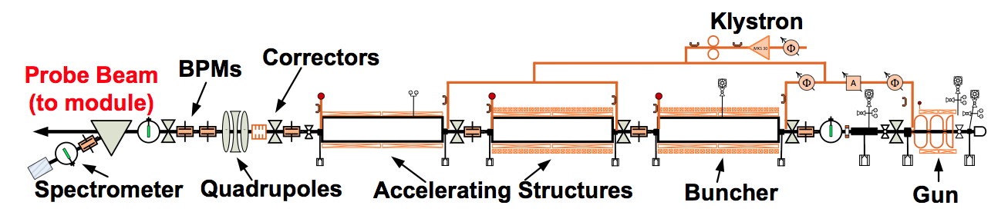

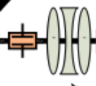
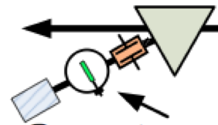

CALIFES for diagnostics R&D - Why
T. Lefevre
Machine operation schedule @ CERN
  Long periods without the capability of performing beam tests
  Limited beam time available for Machine Developments combined with a high number of requests
Hardware installation periods are limited
  Any further improvements/modifications can not be implemented quickly
    Testing at Independent Facility will faster the developments and ensure that we installed well-understood devices on operation machine
Developing new concept versus Reliable operation
  Operational machine have strict requirements in terms of vacuum-outgassing performance/ bakeability not always compatible with R&D needs
    e.g. Testing gas ionization monitor and their performance as function of gas pressure
Instrumentation test-bench could be installed at TPM location (orbit control, diagnostics)
  Most (all) hardware already existing
Spectrometer

Slide 8
What for
Perspectives for a CALIFES test facility beyond 2016 – R. Corsini, LCWS2014
http://agenda.linearcollider.org/event/6389/session/18/contribution/115/material/slides/0.pptx
CERN accelerators
  LHC, HL-LHC, LIU (SPS, PS, PSB) projects
  CLIC/ILC, AWAKE, FCC studies
Future Challenges in Beam Instrumentation
  Unprecedented request for precision
    Positioning down to below the micron level
  Treatment of increasingly more data
    Bunch by bunch measurements for all parameters: Test of state of the art acquisition system (electric or optical domain)
  Dealing with high beam powers
    Non-invasive measurement techniques (Gas profile monitor, Quadrupolar PU, ..)
    Robust and reliable machine protection and beam loss monitoring systems
  Dealing with the (ultra) fast
    Sub-picosecond bunch lengths in AWAKE and CLIC
    Longitudinal tomography in LHC (picosecond range)
    Fast transverse beam position monitors (HL-LHC Crab cavities and transverse beam Instability diagnostics)
A test beam provides system performance under realistic conditions that are not easily achievable in laboratory
Strong interest from CERN, outside and within CLIC project.
Interested institutes: CERN, Uppsala University

Slide 9
R&D: Impedance studies

Slide 10
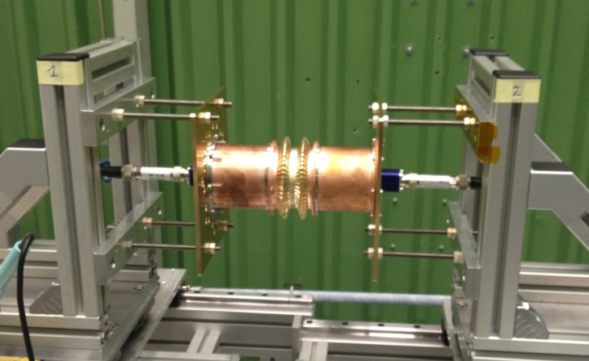
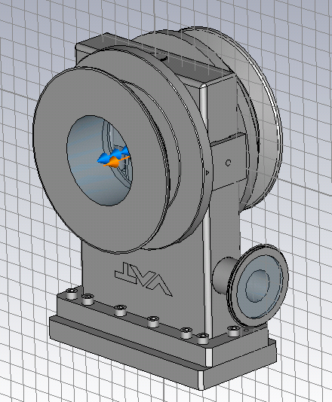
Impedance measurements - Context
B. Salvant - CERN
Collective effects: one of the main limitations in modern particle accelerators
Impedance team involved in design and approval of new and modified equipment in all CERN circular machines (in particular PSB, PS, SPS and LHC, but also AD, ELENA and CLIC damping rings).
Tools at our disposal:
    Bench measurements with wires and probes
    → problem: not direct measurement of
    impedance or wake, and possibly strong
    perturbation of the EM fields
    Numerical simulations
    → problem: difficulty to reproduce reality with
    a model (e.g. design errors, small features,
    coatings, matching errors) , simulated exciting
    bunch is not a delta function.
→ Measurement with electron bunches could be an interesting complement to these existing tools

Slide 11
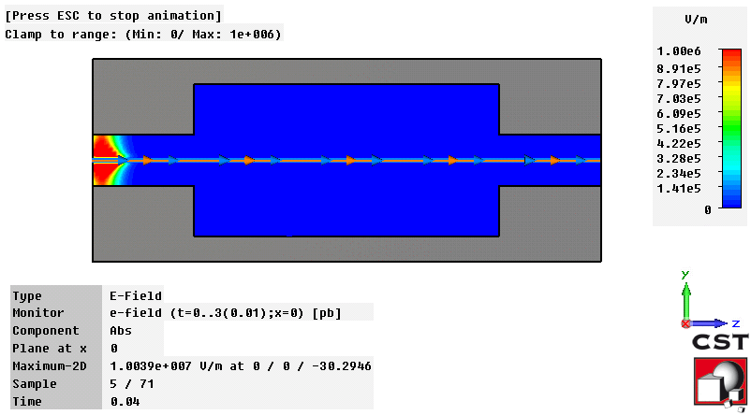
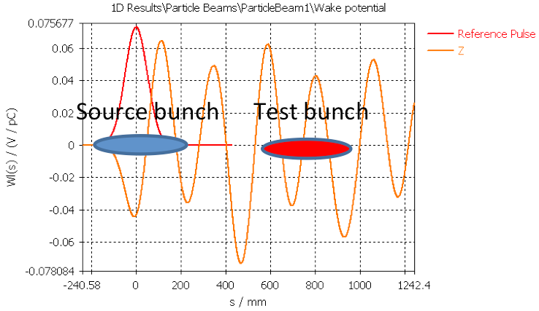
B. Salvant - CERN
Measurement of generated electromagnetic fields
Possibility to measure EM fields from available
antennas, buttons, striplines, wires, all mode couplers
already in the device (or installed just for that reason).
Possibility of direct benchmark of simulations with fields monitors
→ probe measurements only validate the Qs from eigenmode simulations
→ wire measurements can perturb significantly the modes.
→ real interest in using an electron source
Potential for direct measurements
→ Very small bunch length achievable with electron beams (2 to 3 ps in CALIFES)
→ Spacing of the drive and probe bunches with GHz spacing is straightforward
→ “wake function” could be measured provided the sampling is sufficient
Source bunch
RF pickup
A strong interest within CERN to explore the possibility of using CALIFES for this aim.
Interested institutes: CERN, PSI, Uppsala University

Slide 12
R&D: X-band FEL development

Slide 13
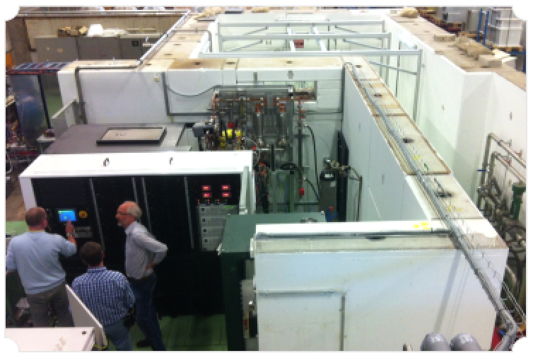
“XbFEL” Collaboration:
developpement of an X-band FEL
Institutes access to CERN-developed X-band technology (expertise, test facilities).
Allows smaller countries with limited resources to work towards a FEL design report. Reduce significantly the risk for each partner.
Matures X-band technology for a linear collider
Access to test facilities, including beam tests, will greatly benefit the progress of X-band FEL design
Example of X-band test facility at CERN
ST Elettra - Sincrotrone Trieste, Italy.
CERN CERN Geneva, Switzerland.
JU Jagiellonian University, Krakow, Poland.
STFC Daresbury Laboratory Cockcroft Institute, Daresbury, UK.
SINAP Shangai Institute of Applied Physics, Shanghai, China.
VDL VDL ETG T&D B.V., Eindhoven, Netherlands.
OSLO University of Oslo, Norway.
IASA National Technical University of Athens, Greece.
UU Uppsala University, Uppsala, Sweden.
ASLS Australian Synchrotron, Clayton, Australia.
UA-IAT Institute of Accelerator Technologies, Ankara, Turkey.
ULANC Lancaster University, Lancaster, UK.

Slide 14
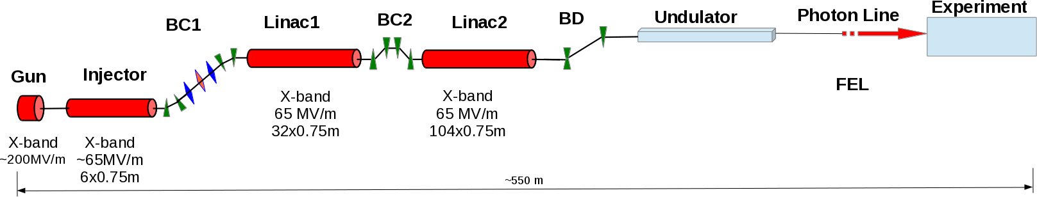
Development for X-band FEL
All X-band FEL concept. A. Aksoy.
Component tests and technology demonstrations are an important part of this study, and needed to demonstrate that sufficiently high peak current and good beam quality can be obtained (linearized phase space, bunch compression)
To achieve the required beam parameters a number of X-band components including phase-space linearizers, transverse deflecting cavities (for bunch length diagnostics and RF spreaders) and wakefield monitors must be further developed and tested
CALIFES would be the only facility in Europe where a significant amount of time could be dedicated to X-band tests
For the collaboration it is also of great interest to test novel bunch compression schemes and advanced beam physics including purely magnetic compression systems (instability studies)
Synergy with CLARA: CLARA a future UK facility focusing on FEL research, Could use proven X-band tech for photon production, however, first, X-band technology must be demonstrated in a facility like CALIFES

Slide 15
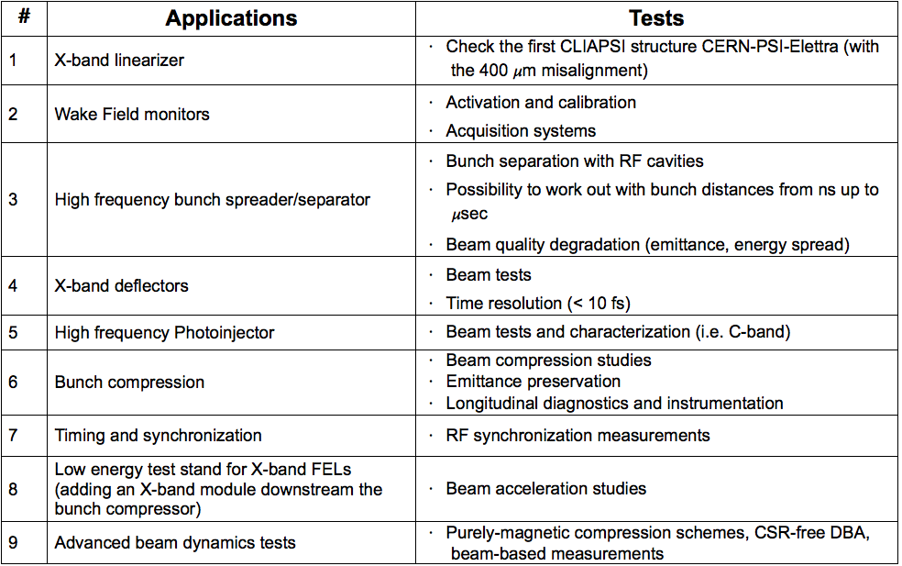
Potential tests for an X-band FEL using the Califes beam
From presentation A. Latina from CLIC workshop 2015
New hardware required
Hardware already available

Slide 16
Institutes expressing interest
The use CALIFES would strongly benefit the entire XbFEL project (10 institutes from member states, 2 from non-member states, CERN). In addition, a few institutes has expressed particular interests :
Elettra-Sincrotrone Trieste; Gerardo D’Auria
For upgrades of the machine, many advanced ideas for electron beam manipulation have been studied, including arcs with CSR compensation and experiments to study the microbunching instability. As for the SwissFEL, the accessibility of the production machine for beam dynamics R&D is very limited, and CALIFES could provide an excellent test bed for electron beam manipulation schemes. In addition, Trieste has an interest in testing X-band phase space linearizer and HF bunch separator at CALIFES.
Ankara University – TAC project; Avni Aksoy
The tests of X-band structures with/without beam and existing pulse compressor set-ups at CALIFES would let TAC team gain a lot of expertise for the future XFEL project of Turkey. Additionally CALIFES could provide very useful test bench to the TAC team for beam dynamics, electron beam manipulation and diagnostics studies for their future project. The Turkish team may contribute hardware to CALIFES depending on the next period of their XFEL project.
PSI; Micha Dehler
It is therefore of interest for the SwissFEL project to have access to an electron beam for hardware development studies beyond 2016, including short bunch studies, X-band RF deflectors and wakefield monitors. The SwissFEL project could also possibly contribute hardware to CALIFES test facility, including the magnetic chicane for bunch compression currently installed at the SwissFEL test facility. Furthermore, an on-going PSI program is the development work on wake field monitors. The X-band linearizer structures of SwissFEL, which were developed and built in collaboration which CERN and Sincrotrone Trieste, have integrated wake field monitors to align beam and structure with high precision. we are currently developing front ends for these monitors. Ideas for future work are more compact designs for the pickups and – possibly of high interest for CLIC – the use of these devices as break down monitors. Given the rather limited options at PSI, testing these devices at CALIFES (possibly with the structure under power for break down applications) would be extremely helpful.

Slide 17
R&D: PWFA

Slide 18
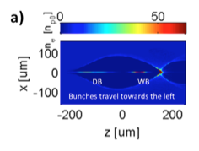
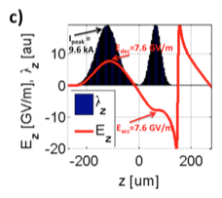
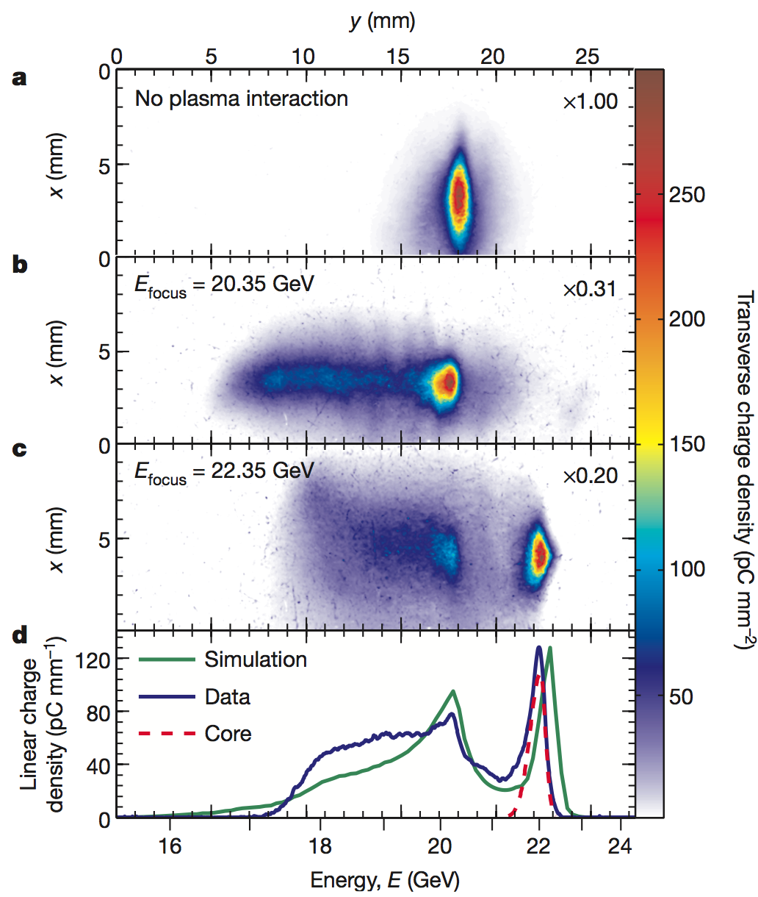
PWFA research
Recent years: increased interested for beam-driven plasma wakefield acceleration (PWFA) as a potential future technology for HEP applications
AWAKE, the main PWFA program at CERN, will study proton-driven PWFA
In CALIFES, complementary electron-driven PWFA experiments can be performed. The CALIFES beam, with its wide range of parameters and precise diagnostics is well suited for precision PWFA studies (emittance preservation, tolerances). Advantages of CALIFES :
  The beam-plasma physics, for collider PWFA parameters (blow-out regime), can be scaled to fit the CALIFES beam
  Easy experimental set-up, easy acces
  Available during LHC shut-down (unlike AWAKE)
PWFA LC simulations
Recent PWFA experiments (FACET)
For more details:
E. Adli at CLIC project meeting Dec 2014: https://indico.cern.ch/event/356495/

Slide 19

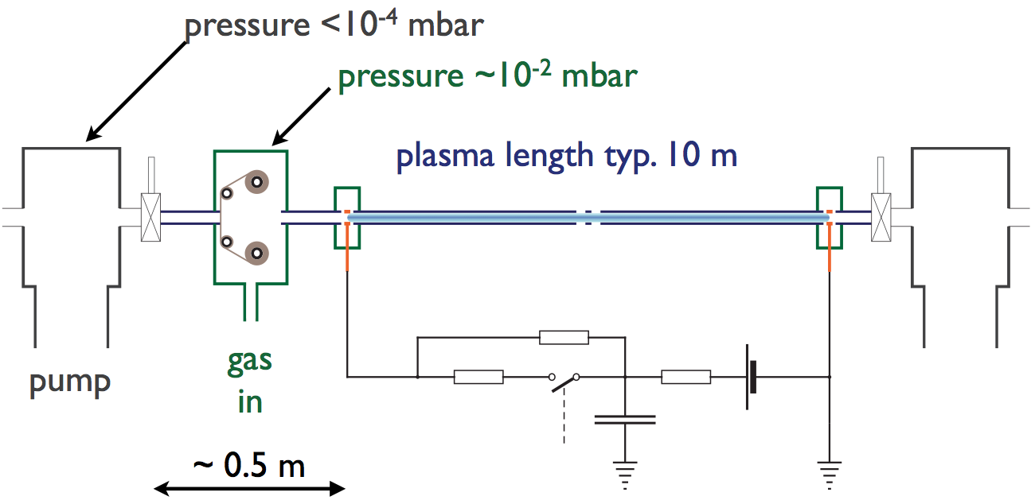
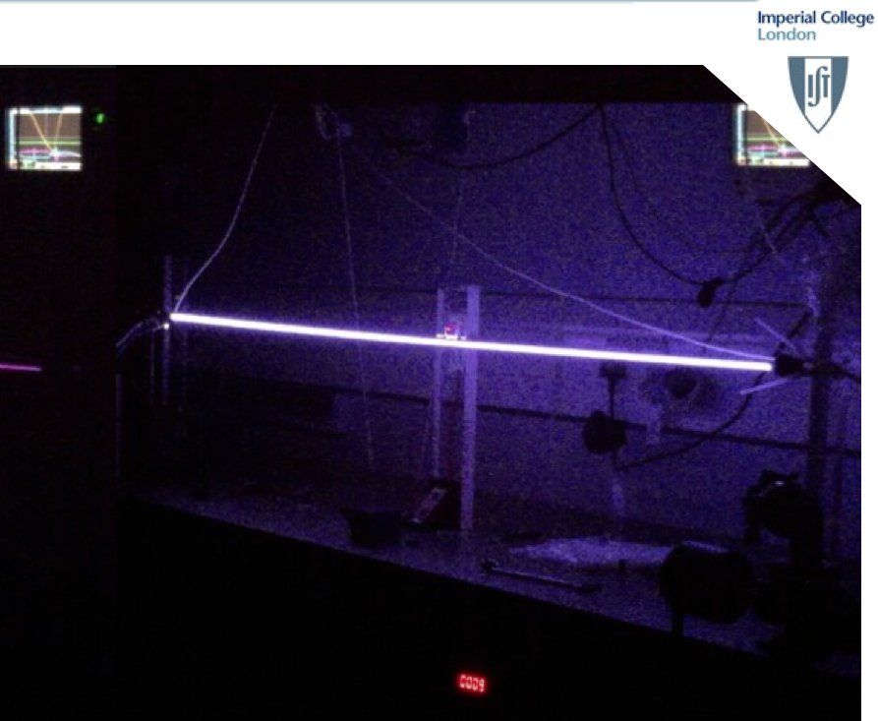
CALIFES: complementary PWFA
We foresee a gas discharge plasma source. This has a relatively simple design, easy to fit into CTF3, and does not require a costly laser system for ionization.
As the CALIFES beam line is already well equipped with beam diagnostics, both before and after the TBM, first PWFA experiments could be performed just after adding the plasma source at/close to the location of the TBM.
Interested institutes: University of Oslo, Uppsala University, Imperial College, Max Planck Institute for Physics

Slide 20
R&D: ESA / Irradiation test facility

Slide 21
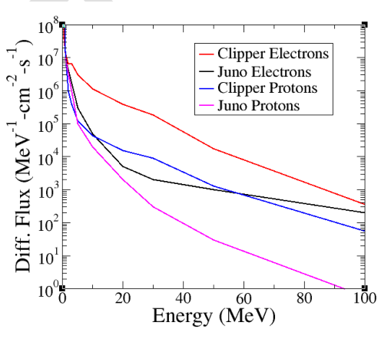
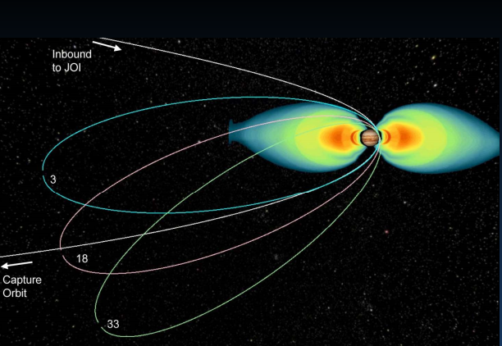
ESA-CERN irradiation tests
See presentation M. Brugger from CLIC workshop.
CERN and ESA have signed a bilateral co-operation agreement (ICA-ESA-0125) in March 2014 in order to facilitate knowledge exchanges and synergies exploitation in key technological fields. One of the most promising areas of potential collaboration is “Rad-hard components and radiation testing and facilities”.
…JUICE (Jupiter Icy Moon Explorer) mission; spacecraft and payload design activities executed and the project is moving into the implementation phase. The spacecraft will be located in an electron dominated environment, including high-energy electrons ranging up to a few hundred MeV. Such high-energy electron radiation test facilities are not available today.

Slide 22
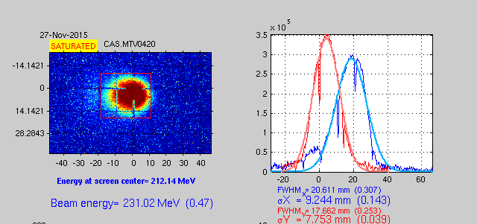
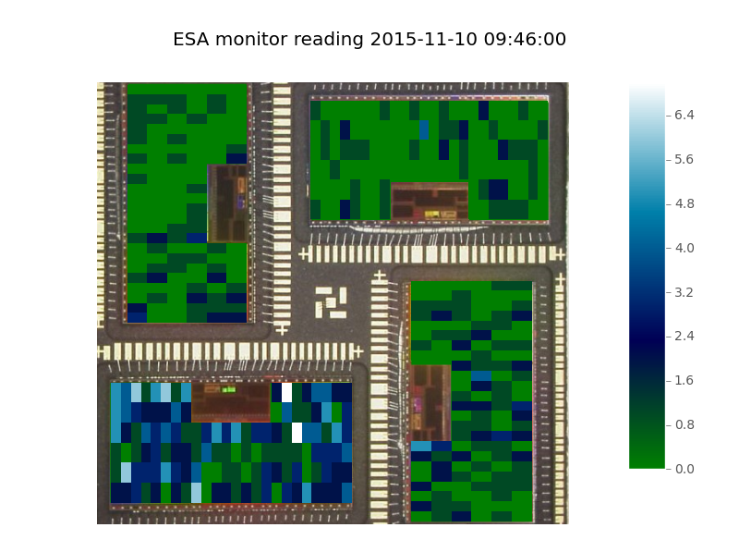
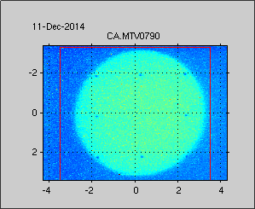
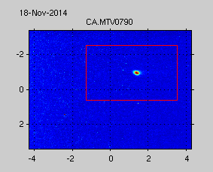
First CALIFES beam tests successfully concluded (2015)
Using CALIFES dark current beam. Beam successfully enlarged (6 x 6 mm2). Semi-autonomous tests (running at nights).
See talk from : M. Tali, Tuesday 16:55
Maris Tali (University of Jyväskylä)
Rubén García Alía
Optimized dark current settings
0.31nC
Flat beam (6 x 6 mm²) after collimation
And nominal beam (100 μm)
ESA is interested, after beam improvements, in conducting SEE/TID tests at the CALIFES facility. Other institutes: Laboratório de Instrumentação e Física Experimental de Partículas, University of Montpellier, University of Jyväskylä.

Slide 23
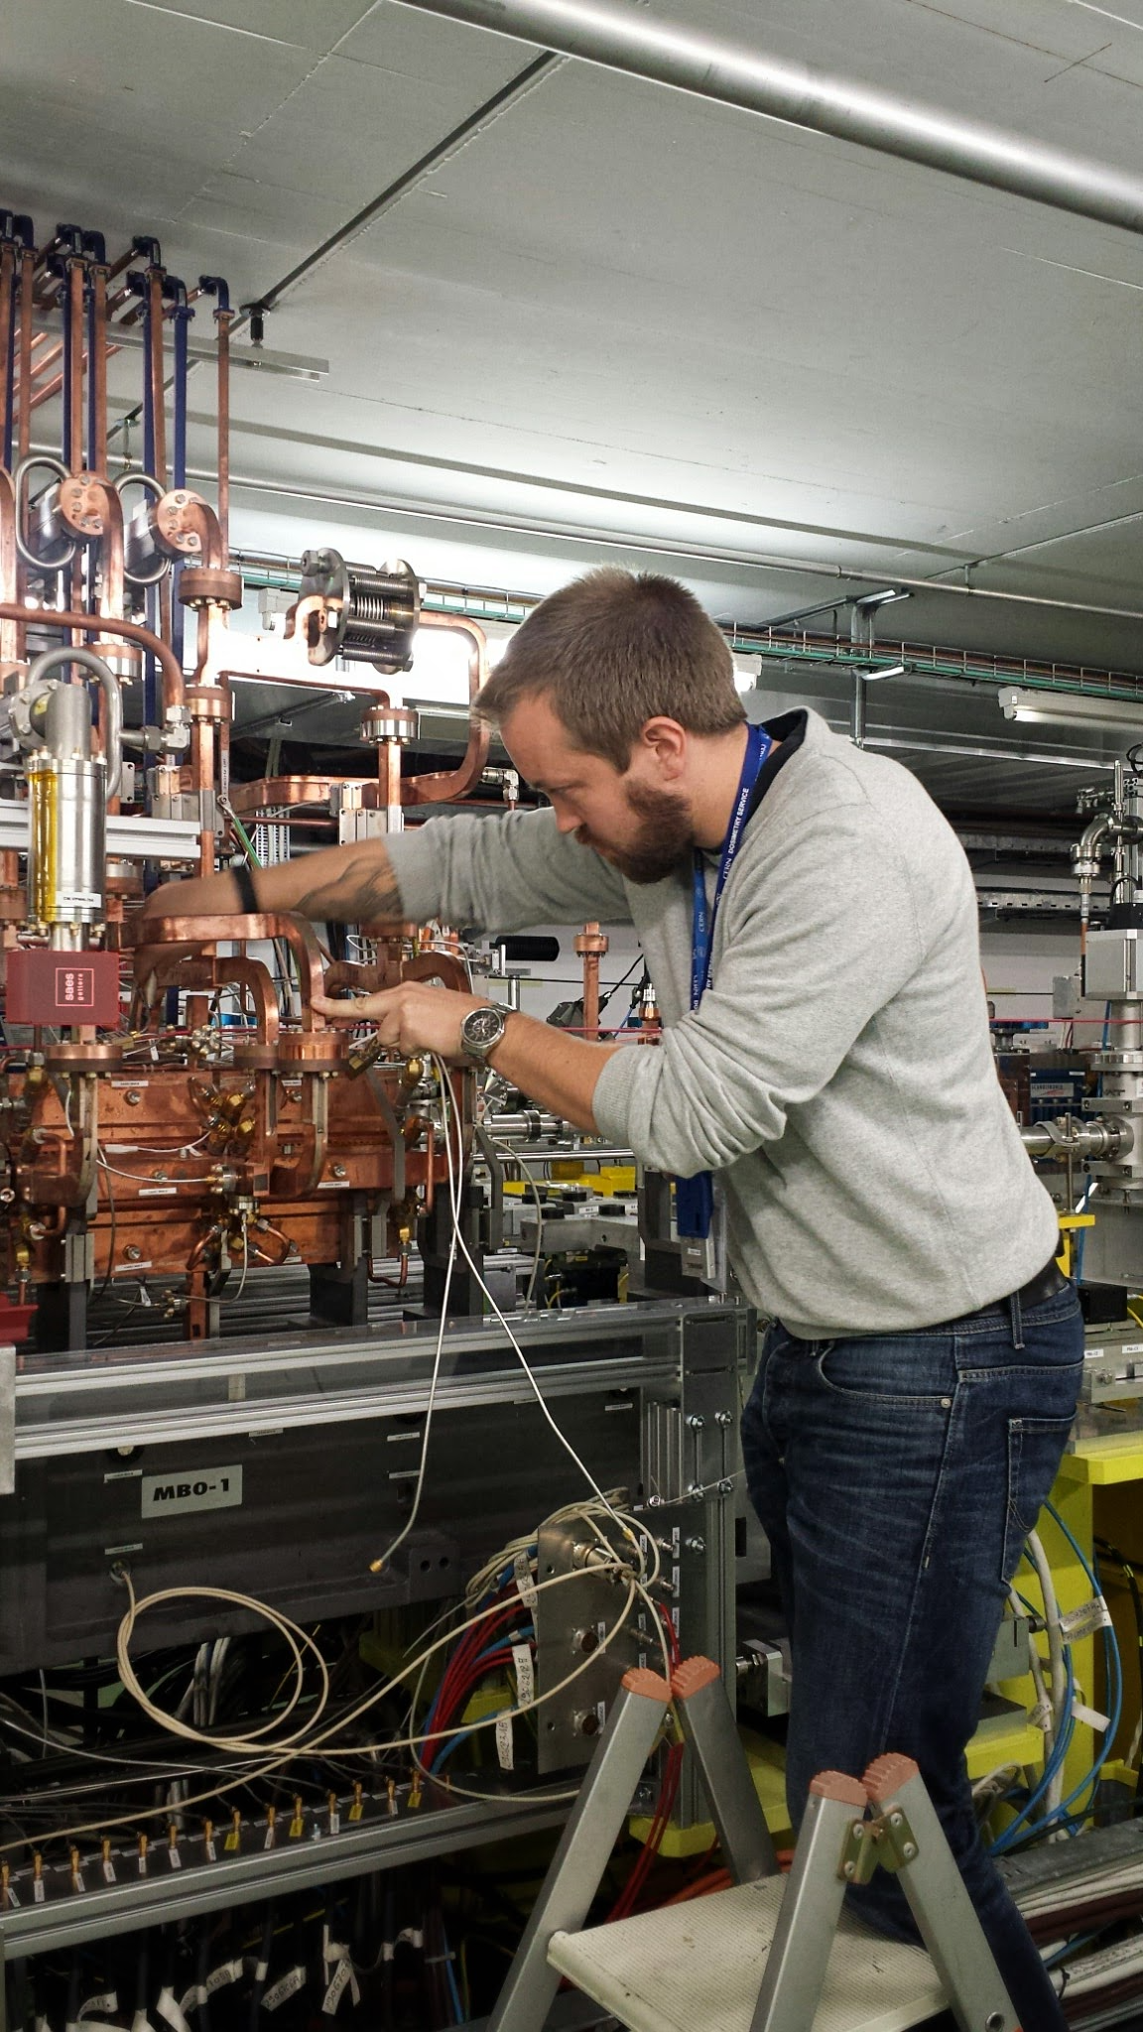
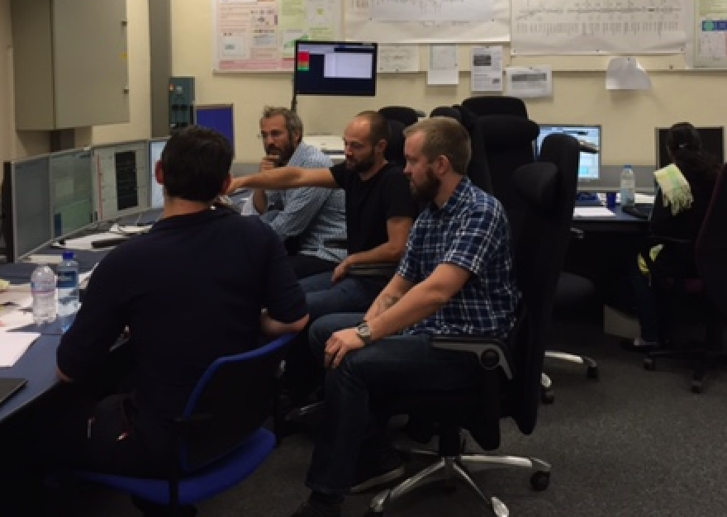
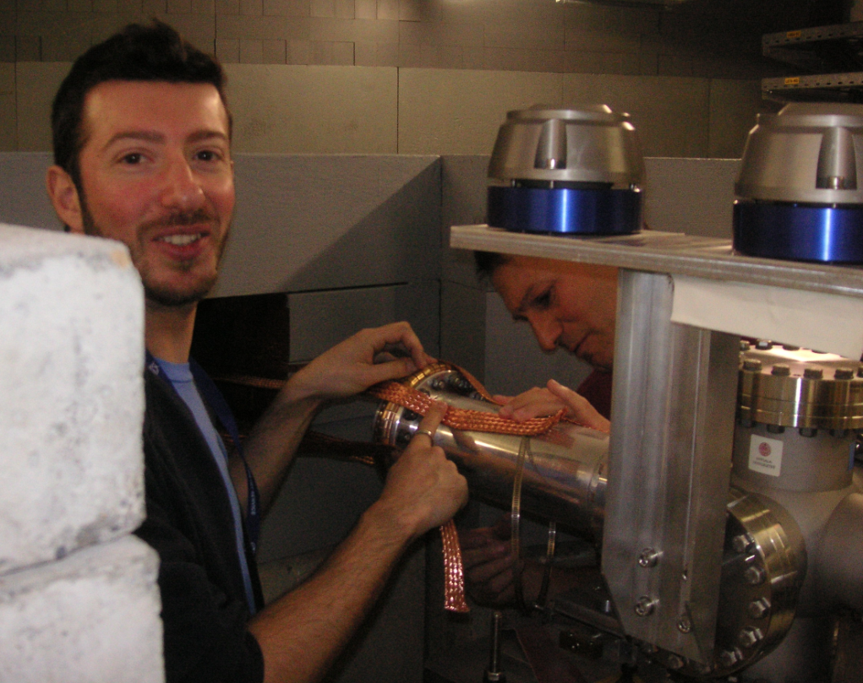
Personal final remarks (Univ. of Oslo)
From the DGs talk this week “…encourage users to think about CERN as your local laboratory”.
For some member states and institutes, CERN is our only accelerator laboratory
Continuation of CALIFES will provide all member state institutes with a local electron laboratory, where young researchers can perform hands-on accelerator research and gain competence for the future

Slide 24
Plan forward
We have been asked provide a document with details for the case for CALIFES, to the CERN management (planned within 1-2 weeks).
A draft of the document has been sent to the CLIC/CTF3 collaboration board members.
We will discuss the document in tomorrow’s CB meeting. Collaboration approval for the document will be sought.
Thank you for your attention!

