Slide 1
CLIC plans for the next European strategy update, and beyond
Roberto Corsini for the CLIC Accelerator Collaboration

Slide 2
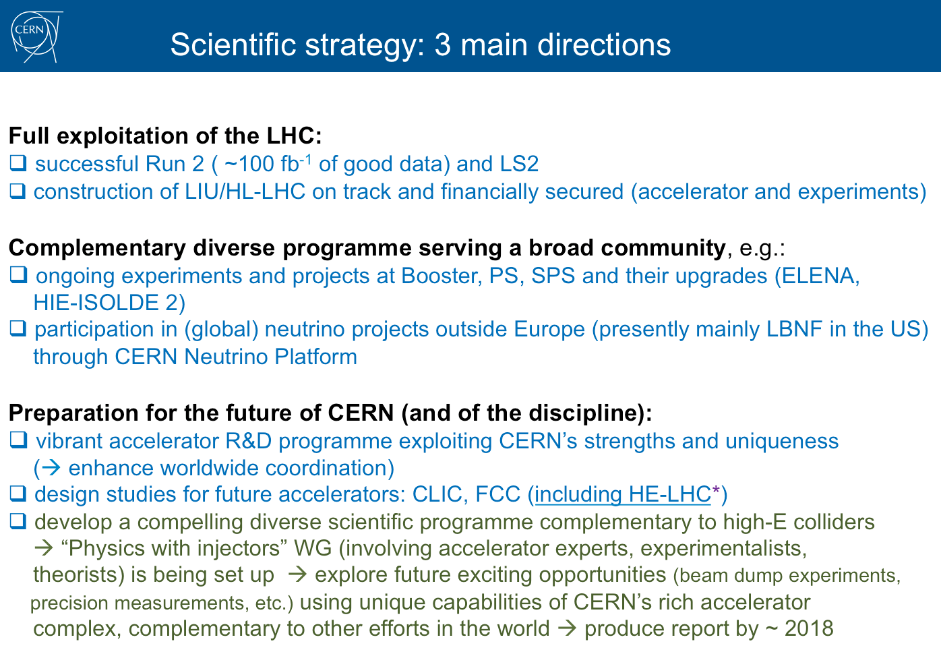

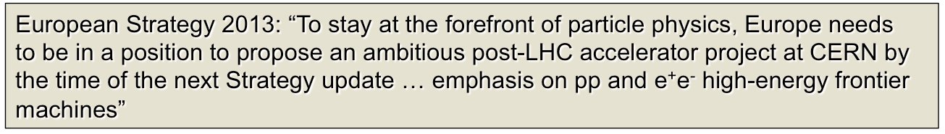
CLIC position in the HEP (and CERN) landscape
F. Gianotti,
A great year ahead of us
We know where we stand
… should keep the momentum

Slide 3
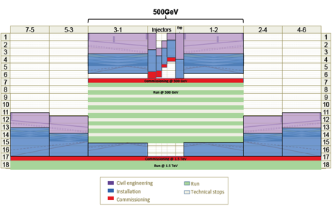
CLIC Timeline
2013-18 Development Phase
Develop a Project Plan for a staged implementation in agreement with LHC findings; further technical developments with industry, performance studies for accelerator parts and systems, as well as for detectors.
4-5 year Preparation Phase
Finalise implementation parameters, Drive Beam Facility and other system verifications, site authorisation and preparation for industrial procurement.
Prepare detailed Technical Proposals for the detector-systems.
Construction Phase
Stage 1 construction of CLIC, in parallel with detector construction.
Preparation for implementation of further stages.
2018-19 Decisions
On the basis of LHC data
and Project Plans (for CLIC and other potential projects as FCC), take decisions about next project(s) at the Energy Frontier.
2024-25 Construction Start
Ready for full construction
and main tunnel excavation.
Commissioning
Becoming ready for data-taking as the LHC programme reaches completion.

Slide 4
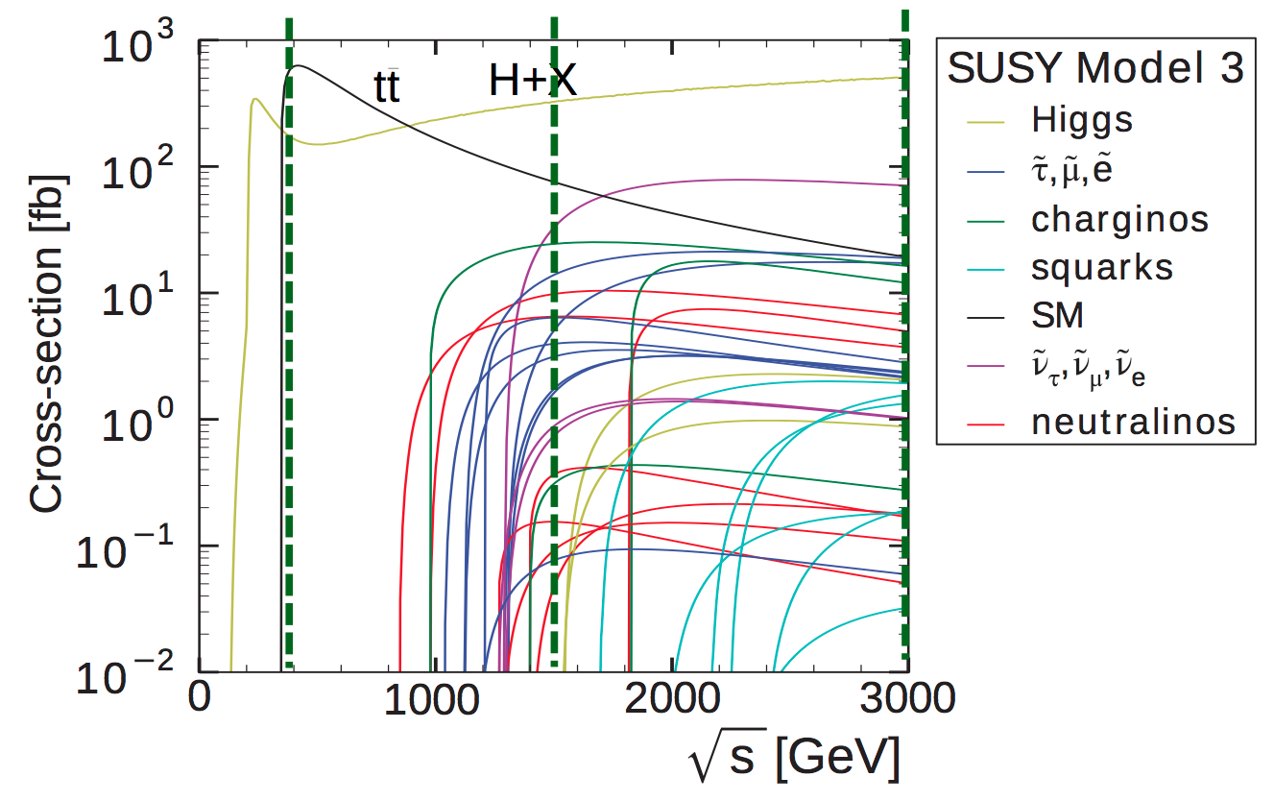
Development phase
Develop a Project Plan for a staged implementation of CLIC, consistent with LHC findings, as an option for CERN in post-LHC era, for consideration in next European Strategy update 2019/20
Update physics studies in light of LHC results
Rebaseline, cost/staging strategy with a 20-30 year perspective
Complete key technical R&D
More advanced industrialization studies
Perform more system tests + verification

Slide 5
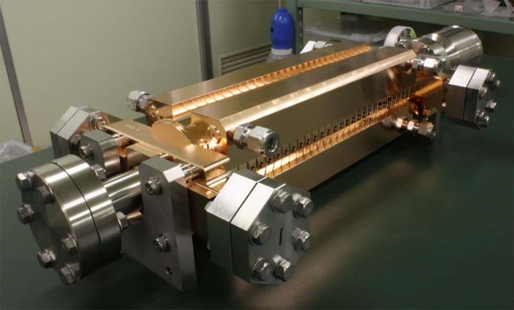
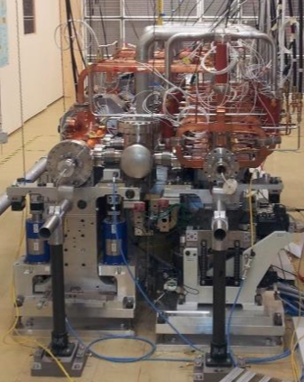

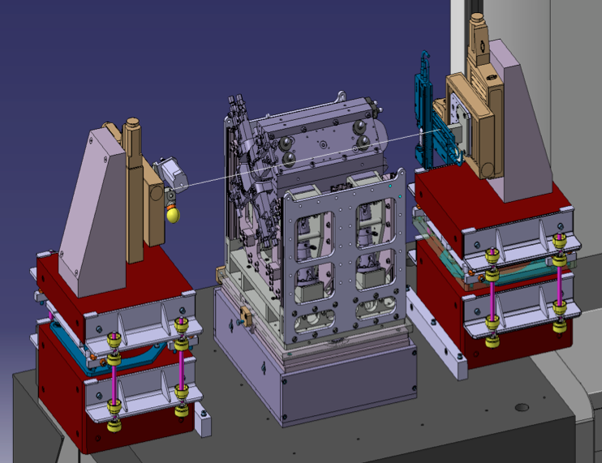
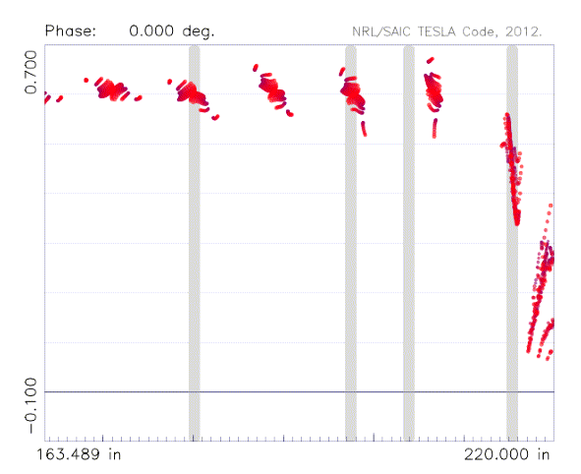
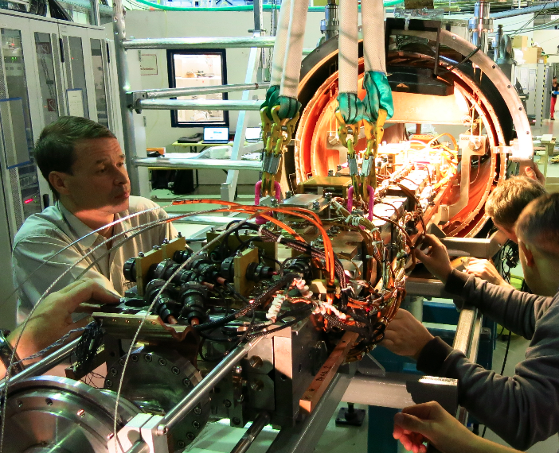
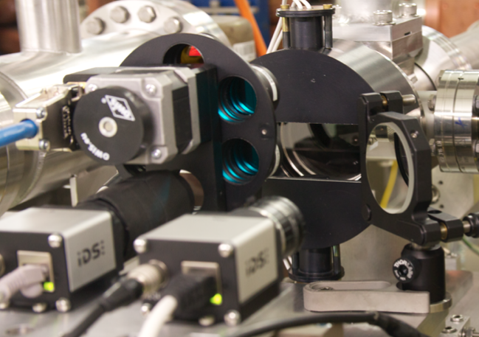
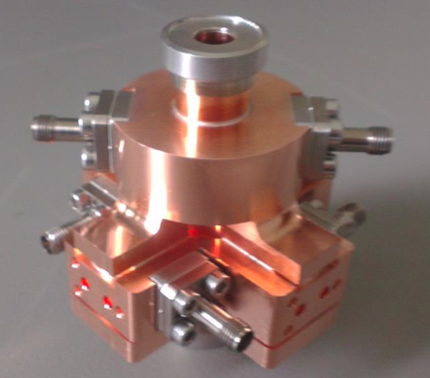
Key technical R&D
Module – alignment – assembly
X-band accelerating structures
High Efficiency klystrons
Key diagnostics equipment
Other critical components
(NbTi Wiggler test at ANKA)

Slide 6
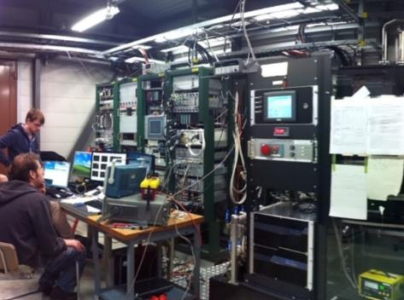
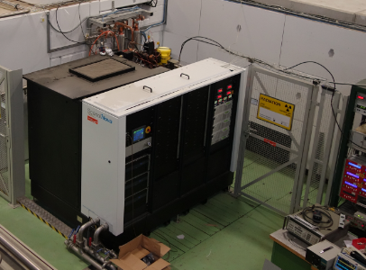
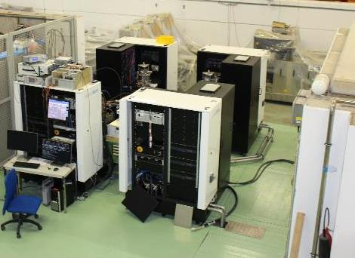
High-power X-band testing at CERN
Xbox-1
Xbox-2
Xbox-3
OPERATIONAL
OPERATIONAL
Xbox-3A: OPERATIONAL
Xbox-3B/C/D: COMMISSIONING
CPI 50MW 1.5us klystron
Scandinova Modulator
Rep Rate 50Hz
CPI 50MW 1.5us klystron
Scandinova Modulator
Rep Rate 50Hz
4x Toshiba 6MW 5us klystron
4x Scandinova Modulators
Rep Rate 400Hz
Current test:
Dogleg beam-loading experiment, TD26CC#1 (in CTF3 LINAC)
Previous tests:
TD24R05 (CTF2, 2013)
TD26CC#1 (CTF2, 2013)
T24 (Dogleg, 2014-15)
Current test:
T24_OPEN (in halves)
Previous test:
CLIC Crab cavity (2014-15)
LLRF, pulse compressors and waveguide network to be completed at the end 2015
Medium power test:
3D printed Ti waveguide (Xbox-3A)

Slide 7
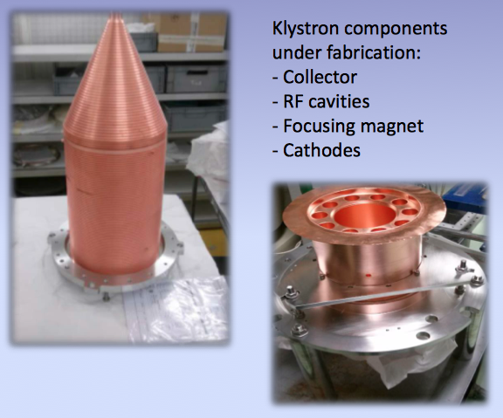
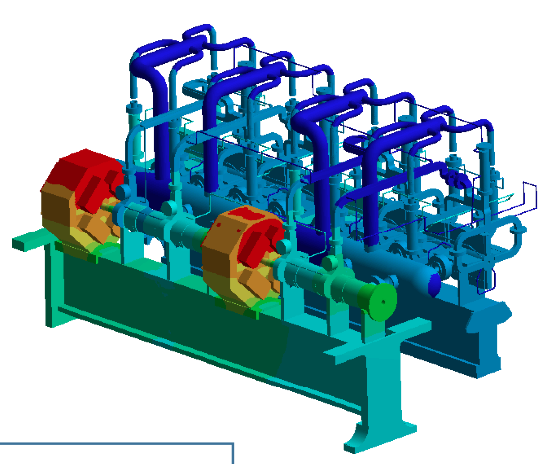
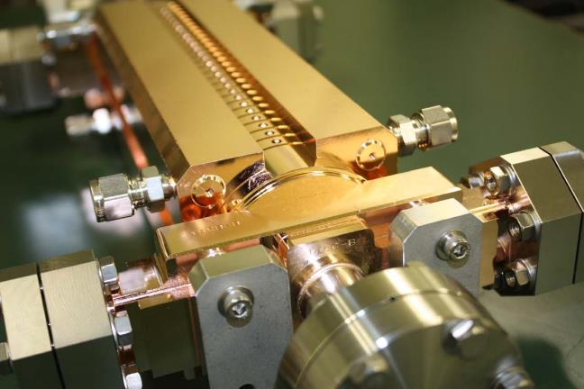
Industrialization
Prepare for industrialization of individual main components
Study mass production/qualification process/assembly/installation procedures adapted to CLIC requirements
L-band klystrons/modulators
Accelerating structures and other main components of the Two-Beam Module

Slide 8
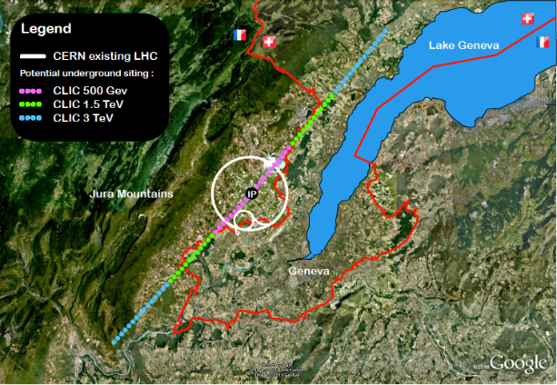
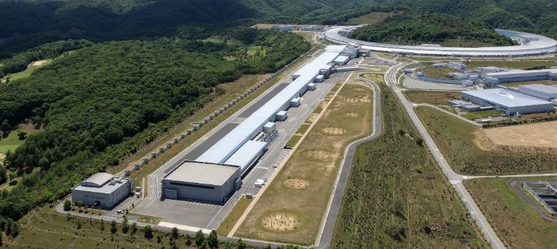
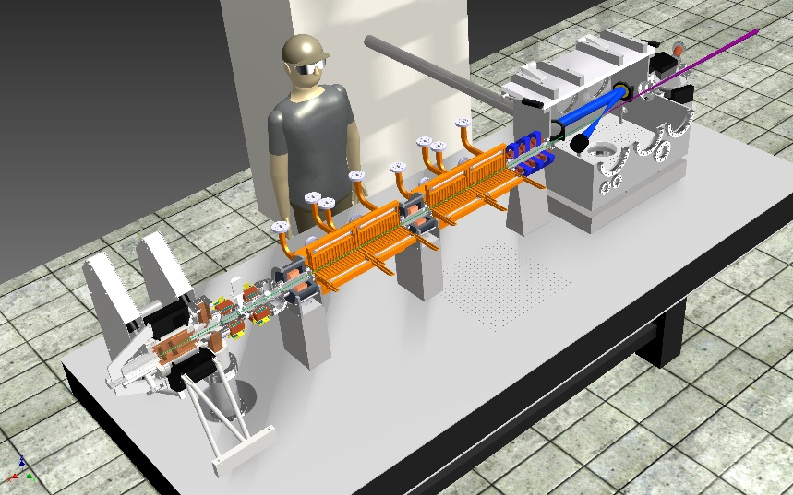
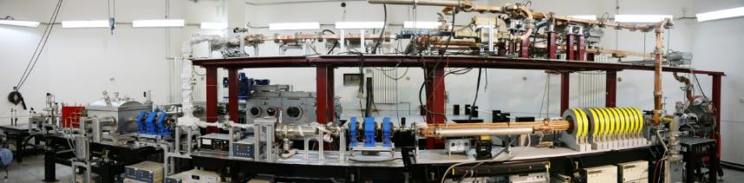
X-band technology
CLIC
SACLA
http://www.lightsources.org/facility/sacla
Linear collider - TeV
XFEL – 1 to 10 GeV
Tsinghua U.
https://indico.cern.ch/event/358352/session/7/contribution/40
Thompson/Compton
source – few 100s MeV
Compact Compton source
few 10s MeV

Slide 9
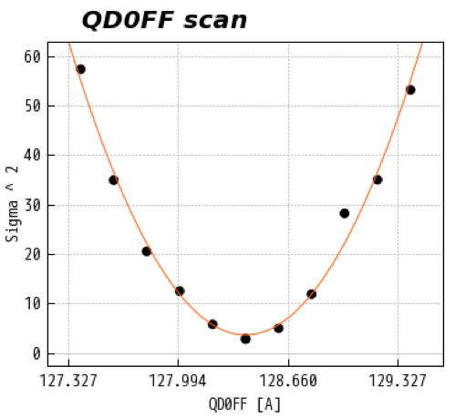
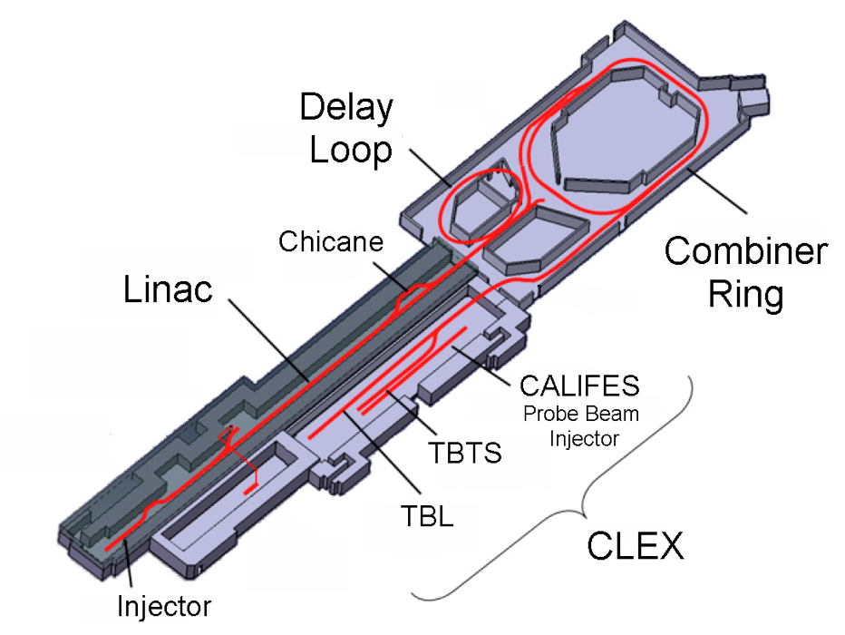
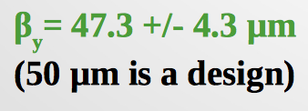
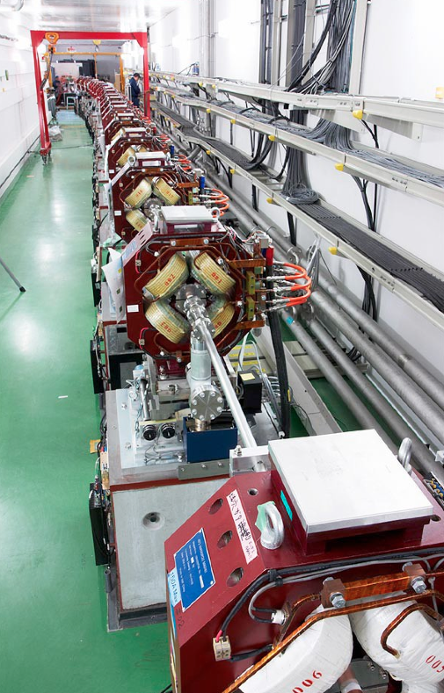
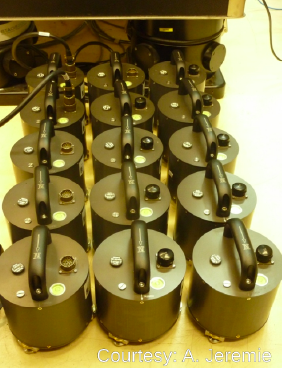
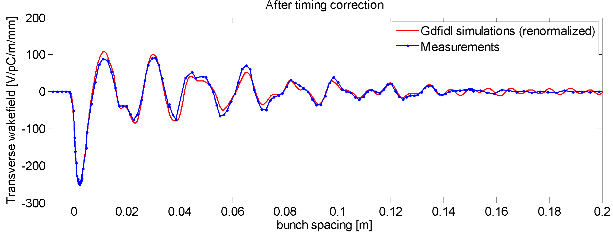
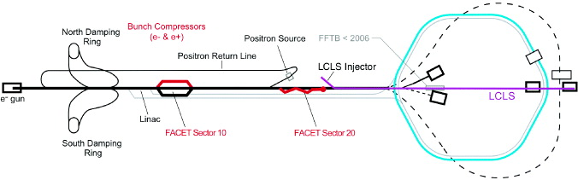
System Tests
CTF3
ATF2
FACET
Measure of transverse long-range
wake-fields in a CLIC structure @ FACET

Slide 10
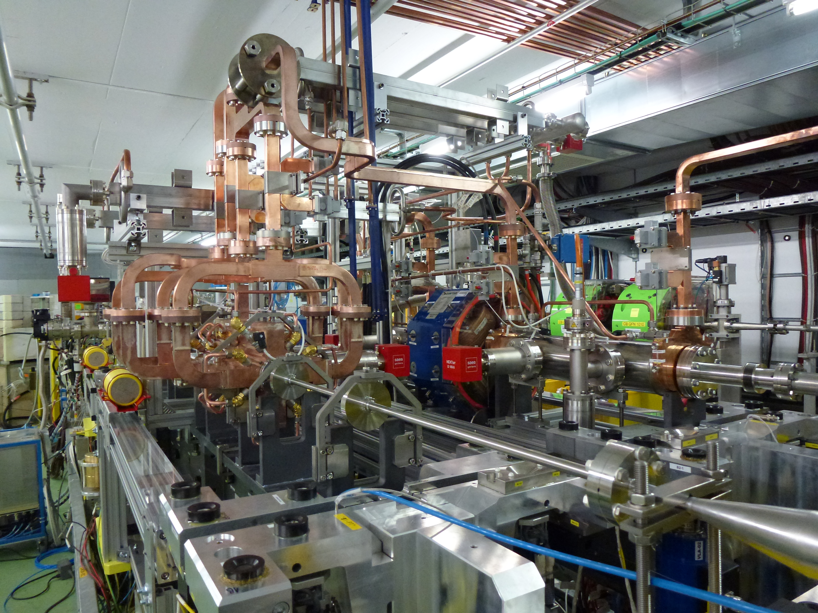
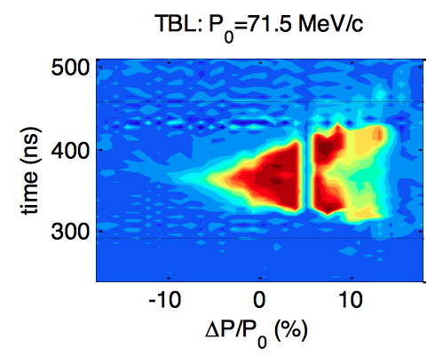

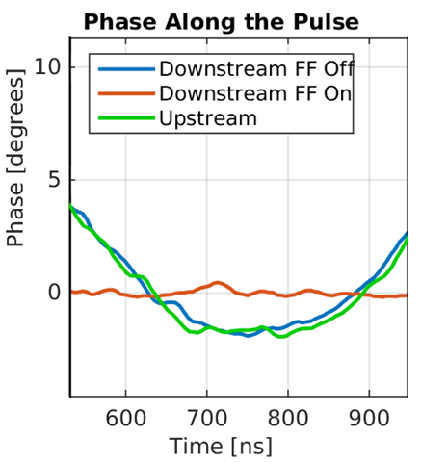

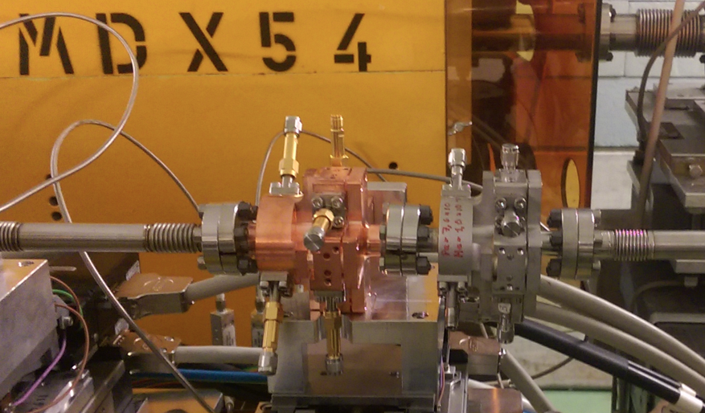
CTF3 Experimental Program 2016
  CLIC two-beam module tests
Power production, stability + control of RF profile (beam loading compensation)
RF phase/amplitude drifts along TBL, PETS switching at full power
Alignment tests
  Drive Beam
  Dispersion free-steering, dispersion matching, orbit control, chromatic corrections, emittance, stability
Beam deceleration + optics check in TBL
  Drive-beam phase feed-forward tests
Increase reproducibility
Demonstrate factor 10 jitter reduction
  Ongoing instrumentation tests
Wake-Field Monitors
Main and Drive beam BPMs …

Slide 11
Discussions on a CALIFES - based facility
Keep testing CLIC components (X-band structures, diags…) with beam
Advance high-gradient e- accelerator R&D
Support strategic partnerships with relevant communities: XFEL, medical, industrial, space
Enable instrumentation/equipment tests for consolidating CERN accelerator complex (LHC and injectors)
Provide unique + complementary test facility for CERN’s European (and worldwide) users
Maintain accelerator training facility for next generation of accelerator scientists + engineers
Re-use 1/3 CTF3 area; 80% equipment available

Slide 12
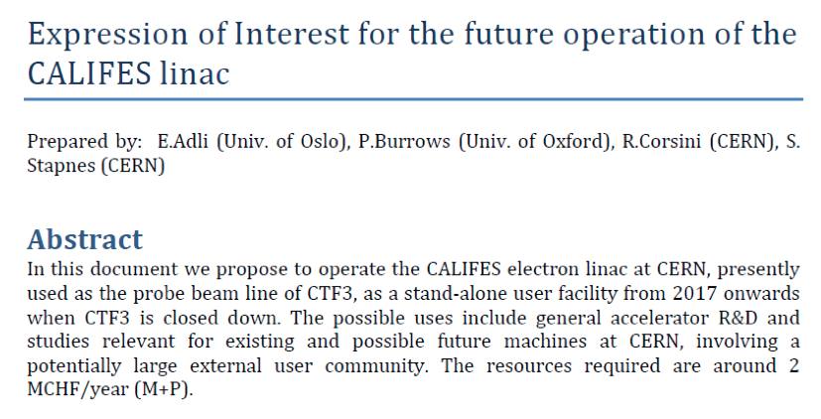
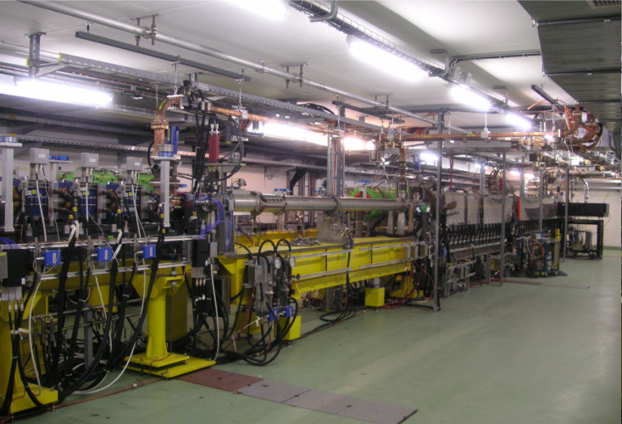

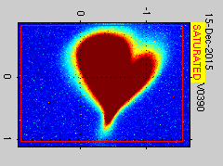
Proposal of a CALIFES-based Accelerator Test Stand

Slide 13
Development phase - Main goals/deliverables
Concise project plan document: physics, machine parameters, cost, power, site, staging, construction schedule, main technical issues, preparation phase (2019- 2025) summary, detector studies.
Comprehensive physics and detector documentation: summary papers planned 2015-2018 covering physics topics, detector studies and R&D.
Detailed, consistent technical documentation across project: EDMS/WBS based.
Technology transfer/spin-off document, including training (PhDs, postdocs, fellows).
Preparation phase plan document: critical parameters, status and next steps 2019-2025 - what is needed before project construction start up, strategy, risks and how to address them, inside and outside CERN, and involving industry.

Slide 14
The Preparation phase - “Technical” considerations
What we will have in 2019:
  A basic design for the first low energy stage
  A reasonable & flexible upgrade scenario
  A credible cost and power consumption update
  Prototypes of several key components (NOT in final state)
  A work plan for the next phase (project preparation, 2020-2025)
What will be missing, but will be needed before construction could start:
  A Technical Design
  Site detailed studies and authorizations
  Finalized prototypes of all main components
  Fully developed industrial basis for main components
  Facilities for testing and qualification of components

Slide 15
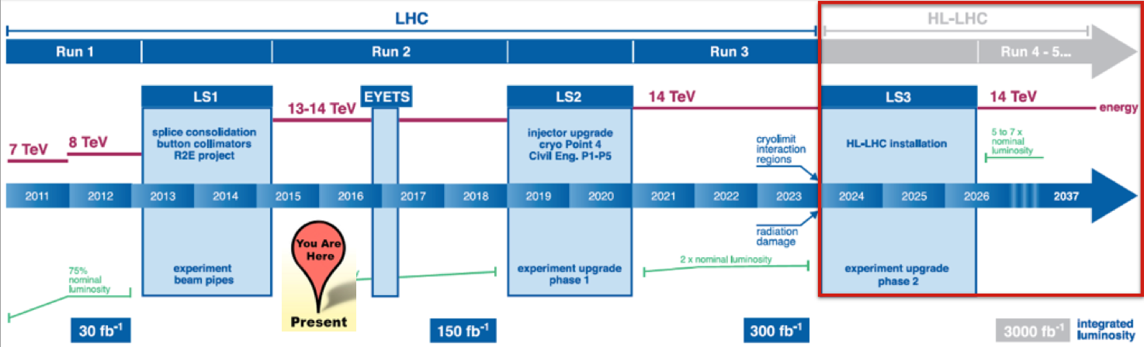
“Other considerations”
Timeline & resources availability at CERN
What kind of decision may we expect in 2019?
What will be the approval procedure of the project after that?
What resources may we expect in the period 2020-2025?
Should we propose a technically limited plan, or anticipate at least to some extent resources and time constraints?
CLIC CDR
CLIC post-CDR development
CLIC Project Preparation
CONSTRUCTION

Slide 16
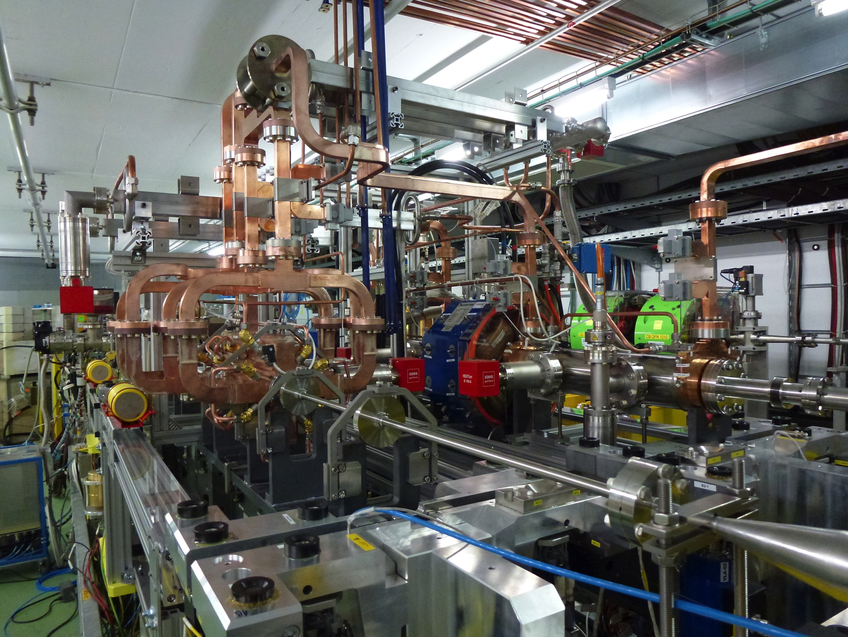
Finalized prototypes of all main components I
Modules – status before 2020
  Two-Beam Modules – LAB, design more or less
  consistent with CDR parameters, but
  not fully representative (use of components
  mock-ups, …)
  TBM – CLEX, fully operational components,
  but design adapted to CTF3
  PACMAN – Fundamental input to new design
  Klystron-based Modules – Only sketches so far
  Should have full design of both two-beam
  and klystron based versions before 2020
Drive Beam accelerator units
  Klystrons (1st generation) under procurement in Industry.
  Modulators under development
  Structure design exist
  R&D on higher efficiency klystrons ongoing
  Should have full unit (1st generation) by 2020, RF tested

Slide 17
Finalized prototypes of all main components II
Main linac modules should be the first priority, will need time to build – and test – prototypes (even more if we should iterate the process).
Drive beam linac modules should be in a more advanced state by 2020. However, in case we will aim at a CLIC Zero like facility for the preparation phase, they may also be very much on the critical path.
Of course full prototypes of main linac modules and DB accelerator units prototypes are mandatory before construction start.
However:
We should review what other components will need prototyping (mainly items critical for performance, e.g., extraction kickers, SC wigglers, phase feed-forward components, specific diagnostics components…).
Even more than that, we have to define and include in the plan a meaningful testing program for all prototypes.

Slide 18
Fully developed industrial basis for main components
Modules – still a long way to full industrialization for all components ➔ full industrialization must be addressed after new generation design.
Further considerations:
  Industrialization of accelerating structures including assembly should be done as soon as possible
  X-FEL projects based on X-band are an invaluable opportunity to develop industrial basis
  However, they are not fully applicable to CLIC modules (even for klystron-based)
Drive Beam Accelerator components – R&D on CLIC front-end components have put us on the right track
However:
  Modulators will not be fully industrialized in 2020
  Same for accelerator structures (but they are relatively standard components…)
  Klystrons may need a second iteration if R&D on high efficiency tubes successful
  Need to keep momentum and critical mass…

Slide 19
Facilities for testing and qualification of components
Such facilities will be needed at the latest in the early stage of construction
May have a very long lead time, so their construction should be part of the project preparation
CLIC Zero may be one of these, its main use should indeed be the qualification of two-beam modules. It is therefore critical to understand early what will be the needs for qualification and the corresponding procedures

Slide 20
RF conditioning, structure qualification, operational issues
Possibly the main critical issue linked to that is RF conditioning of accelerating structure and subsequent breakdown behavior
It is paramount to collect a good statistics in the high-gradient tests in order to understand the process and develop a realistic strategy for conditioning.
Important questions:
  How many structures will have to be rejected? How to detect the faulty ones early on during conditioning?
  How many structures will have to be (pre-)conditioned in parallel?
  Would it be acceptable to condition the structures in situ?
  How much of the conditioning should be done before?
  Will we need special procedures to preserve performance during transport?
  Will we need to reprocess installed structures occasionally? Do we need a very fast PETS on-off mechanism?
  …

Slide 21
The CLIC Zero issue
CLIC Zero was proposed in the past as part of the post-CDR phase. Motivations:
  Focus to develop main components to large scale
  Needed for modules qualification tests
  Gain experience/time in operation of full scale drive beam complex
  Full-scale system test for Two-Beam
Main issue: cost (~300 MCHF, to be reviewed) and time (a few years)
Will need a serious commitment
towards CLIC
May CLIC Zero be integrated in
early construction stage?
Were will we test modules?
What kind of facility will we need
if we choose the klystron option?

Slide 22
Two-beam and/or klystron based 1st stage
Prototypes, testing procedures and testing facilities may be very different for the two cases
The two options should be pursued in parallel in the present stage
However, we should soon define a decision point, in order to not duplicate efforts in a period were investment will have to go up
Will we have a decision already before 2020?
Should we present two alternative plans for the next phase?

Slide 23
Conclusion and Outlook
CLIC is one of the main options for the future of CERN and of high energy physics in general after LHC.
We have a well defined mandate to complete and document the CLIC study in preparation for the next European Strategy exercise (2018/2019), when an informed decision should be taken (hopefully with good indications from physics results from LHC run2) and we have a clear plan to fulfill such a mandate.
One of the deliverables of the present phase is a detailed plan for the CLIC Preparation Phase (2020-2025), to bring the project at the start of construction in case of a positive decision.
It is now time to start developing in detail such a plan. Most of the needed information exists, and we should be able to get what is still missing in the next couple of years, in the framework of the present program.

Slide 24


Slide 25
