Slide 1
Beam Loading Dog-leg experiment status
Frank Tecker (BE-OP)
on behalf of the dogleg team
Introduction
2014 Data Analysis
2015 Spring Run
2015 Autumn Run
Conclusion
18/1/2016

Slide 2
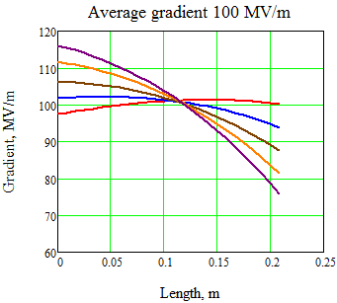

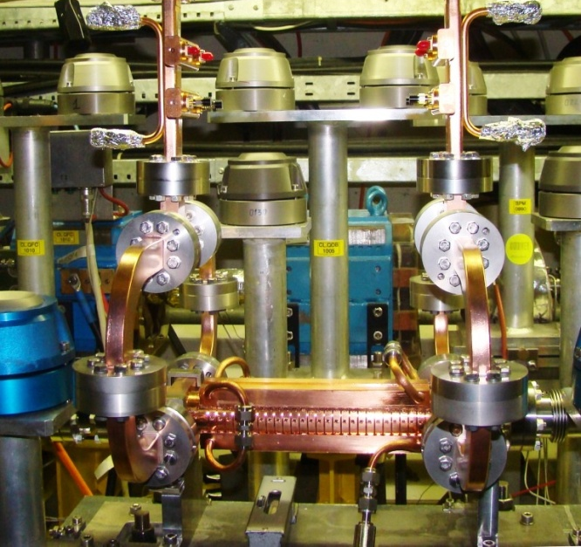
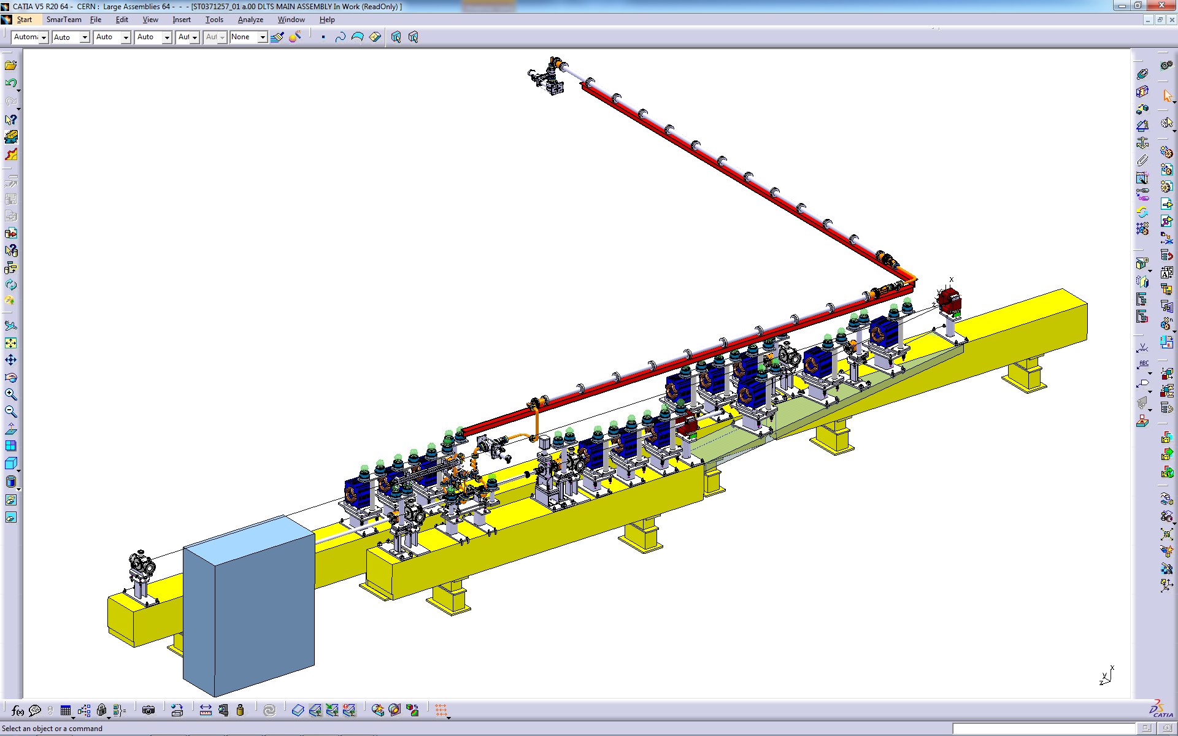
Dogleg Beam-Loading Experiment
Gradient along the structure
Beam loading changes the field distribution for the same average gradient
⇨ how is the break-down rate affected?
Unloaded
Reactivated an old beam line (dogleg)
~1.2 A DB current (like CLIC Main Beam)
Measure BDR with/without beam
for a direct comparison
Average gradient 100 MV/m
Increasing current
Loaded (CLIC)
12 GHz RF from klystron
CTF3
12 GHz accelerating structure
DELAY LOOP
BL - BDR experiment
COMBINER
RING
LINAC
Drive beam
1-3A
130-50 MeV
CLEX
J.L. Navarro

Slide 3
Measurement goals
Final goal:
measure BDR
  loaded
  unloaded
for the same average gradient
Alternative: measure BDR for constant input power
(when power limited)
=> BDR decreases?
even decelerate the beam
=> antiloaded
Unloaded
Loaded
Unloaded
Loaded
Antiloaded

Slide 4
2014 Measurement Analysis
Constant input power
Constant average gradient
Unloaded
Loaded
Gradient, (au)
Length, m
Data biased ☹
Transmitted power channel broke
=> most relevant interlock missing ☹
Gradient, (au)
Unloaded
Loaded
Length, m

Slide 5
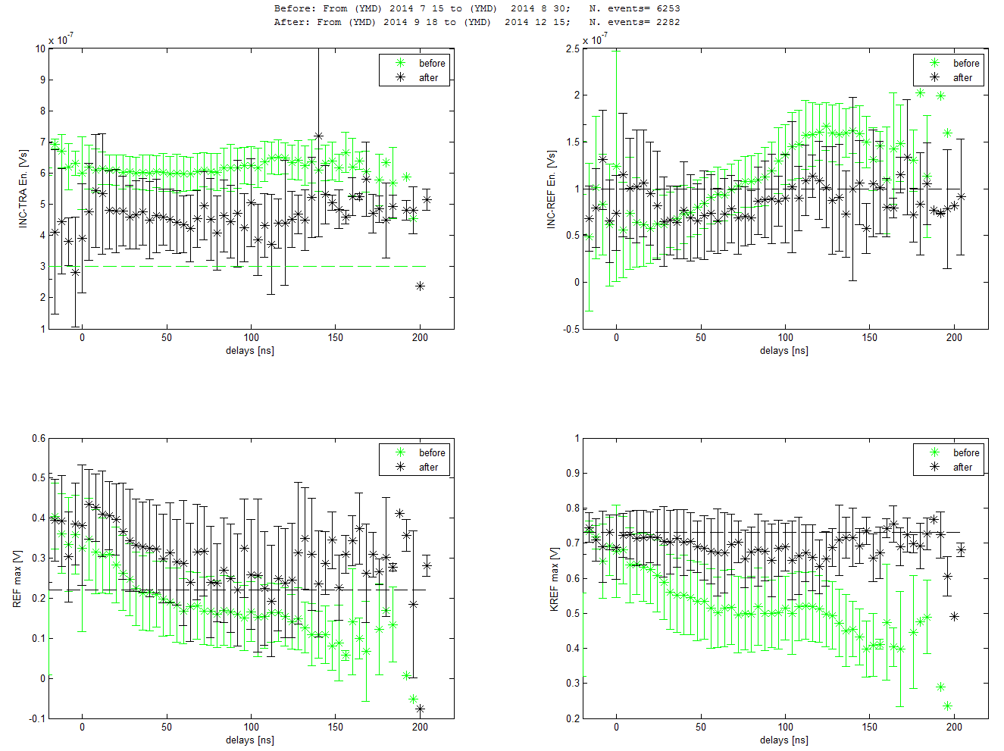
Interlock vs Cell position
Transmitted power channel
Interlock triggers
many Downstream Breakdowns not detected

Slide 6
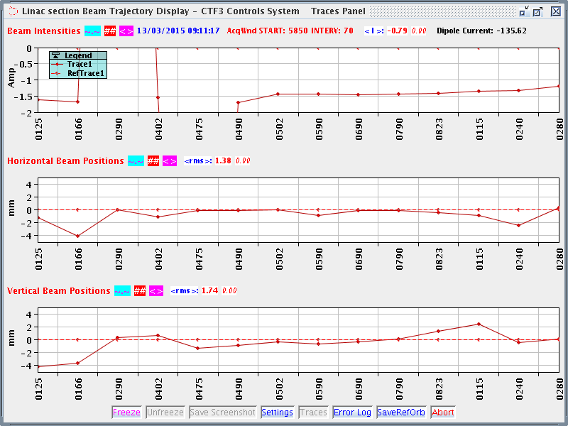
Running March-April
Xbox RF acquisition fixed (broken transmitted channel)
Beam quickly set up
BDR measurements
  unloaded (26 MW)
  loaded (26 MW)
  anti-loaded (10 MW)

Slide 7
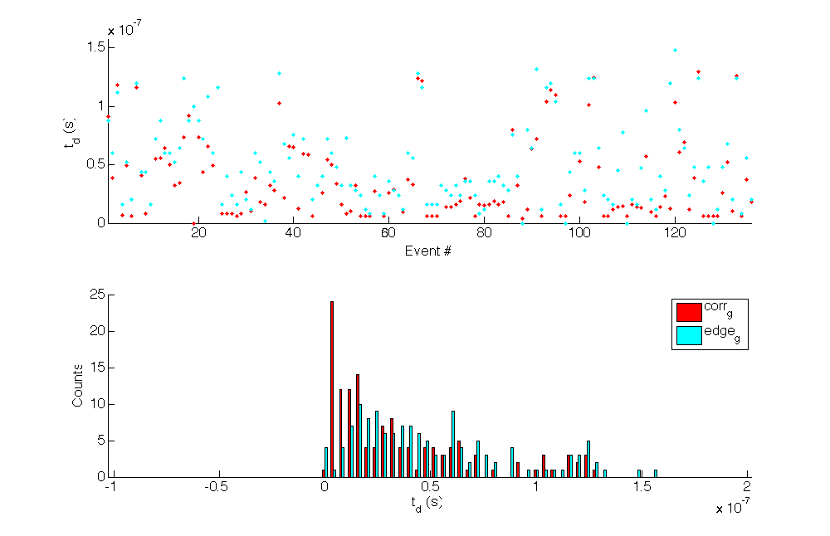
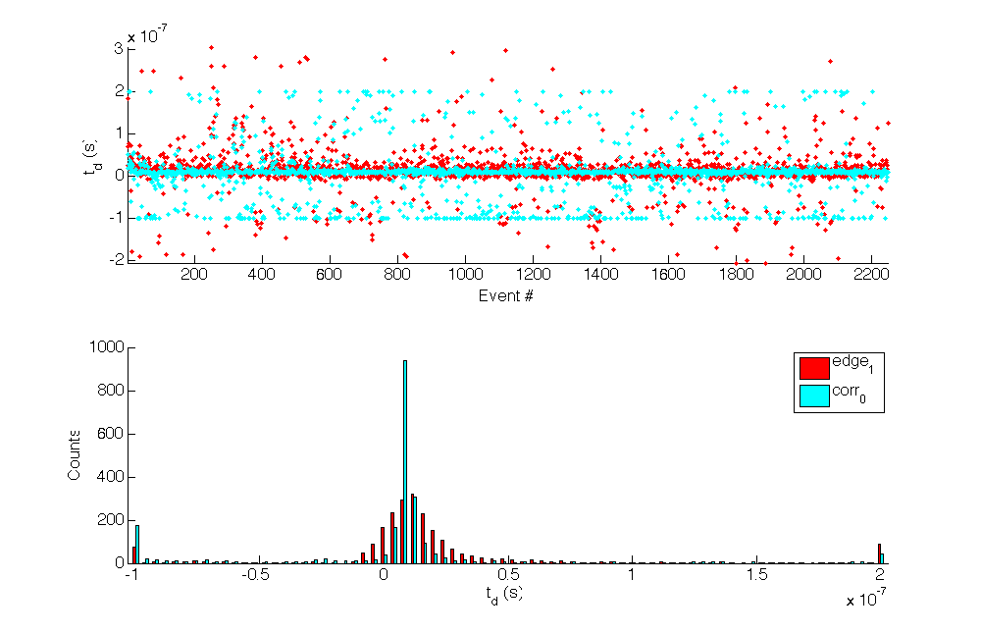
A hot spot on the Dogleg
Initially: breakdown distribution inside structure as expected ☺
Later: breakdowns mostly detected at beginning of structure ☹
=> hot spot for breakdowns had developed there
structure unusable for beam-loading experiment => changed
Aug 2014
position along structure
Apr 2015

Slide 8
2015 History (cont.)
T24 structure was changed in shadow of the access system change in May against a TD26CC that had been previously in CTF2
pulse compressor breaking down, backlash => taken out
=> limited in RF power
June: Realignment of the 8mm-diameter collimator (2mm off)
several unavailability periods with
  Xbox klystron solenoid power supplies
  drive beam gun
  pulse compressor installation (6-12 August)
  drive beam priorities for other users
restarted drive beam RF for dogleg on 14 Oct., RF setup completed but no beam due to dogleg line magnet problem
finally restarted on 25/26 Nov

Slide 9
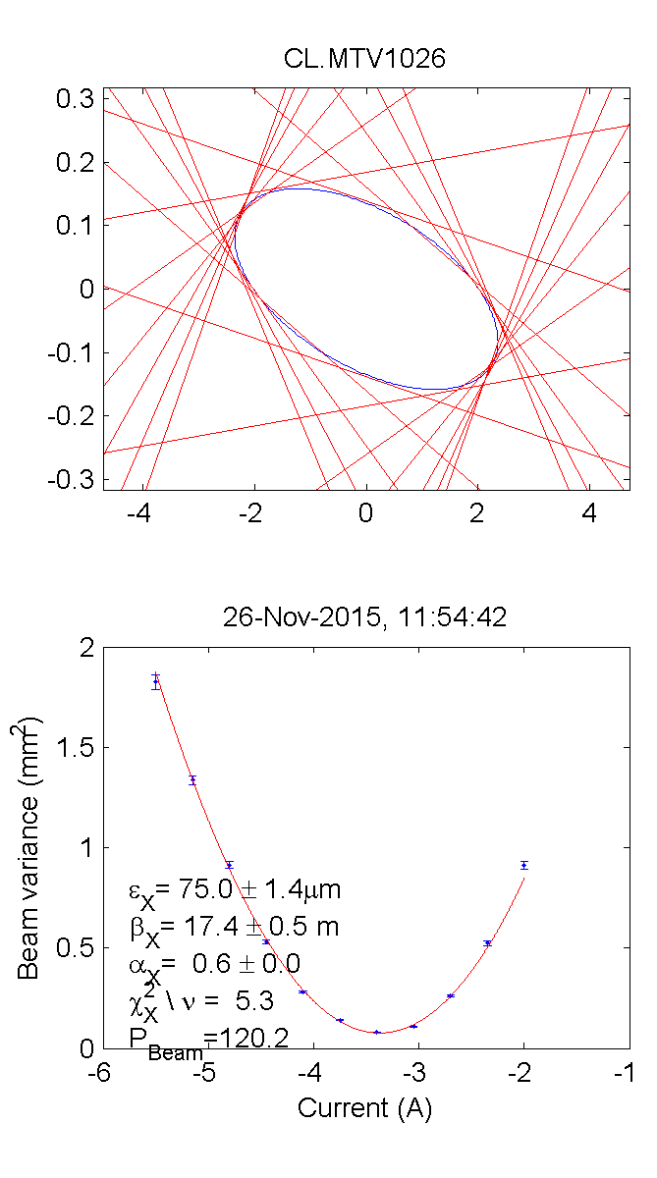
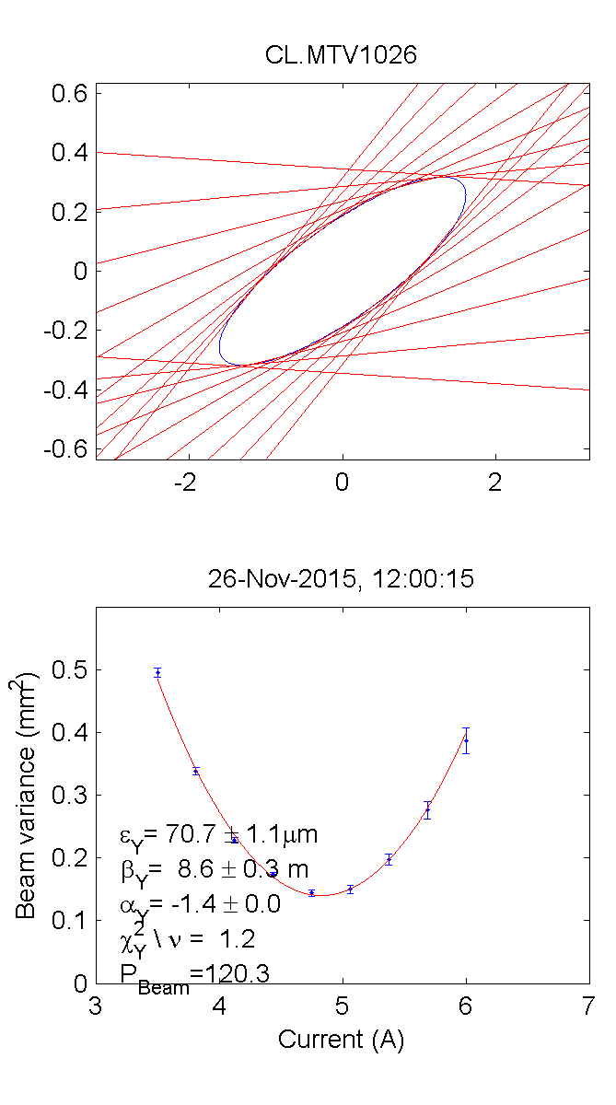
Quad scans
Dogleg optics initially rematched based on quad scans in girder 10
followed by
empirical
optimisation

Slide 10
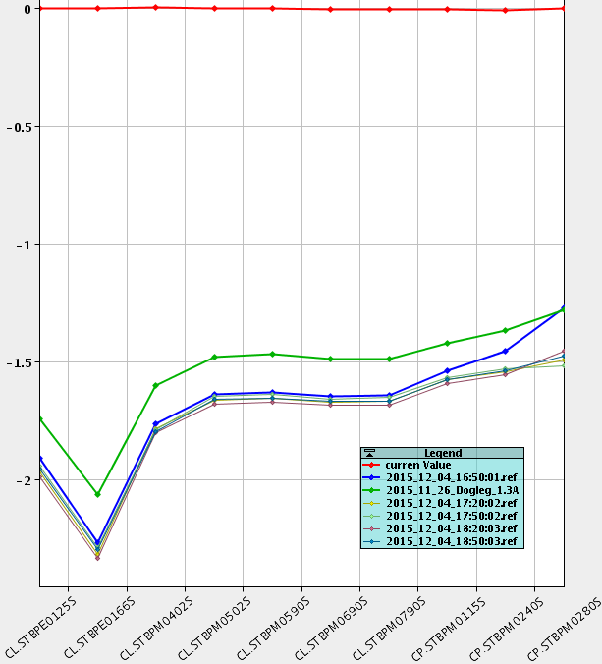
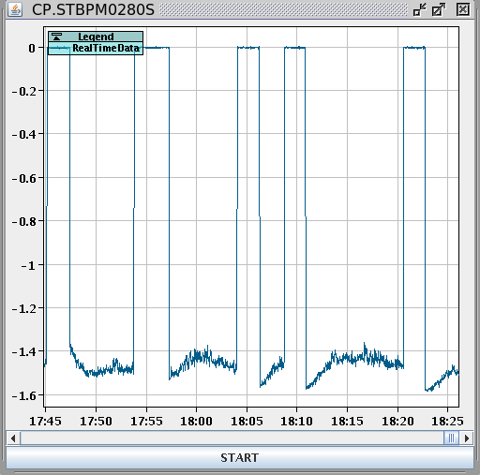
Beam Setup - Transmission
Gradually improving transmission
no big corrector kicks any more
still small losses through the accelerating structure
intensity varying over time
=> need to improve still

Slide 11
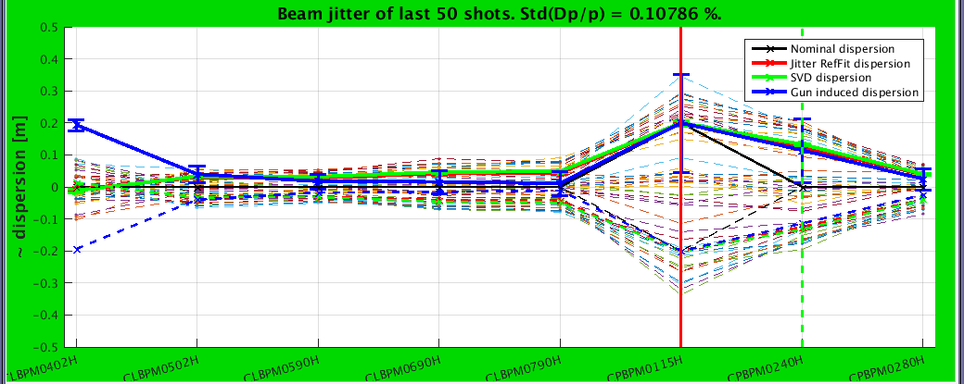
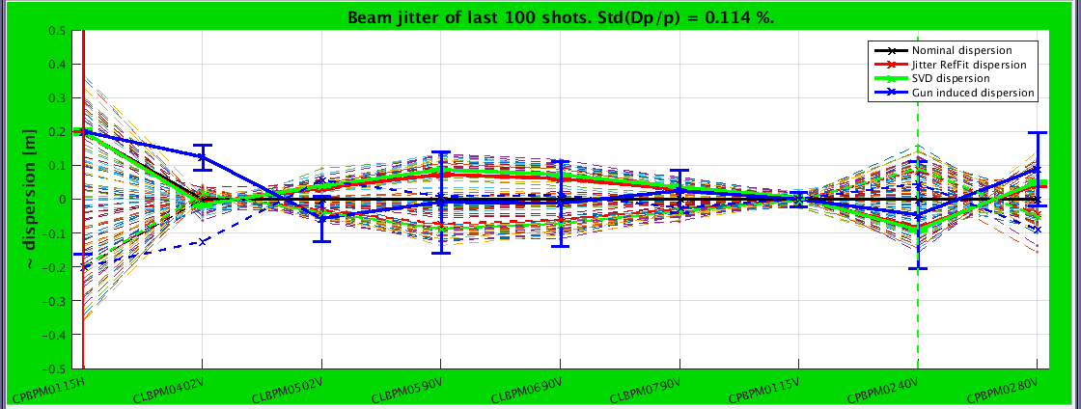
Dispersion
horizontal dispersion
not fully closed
vertical dispersion can still be improved

Slide 12
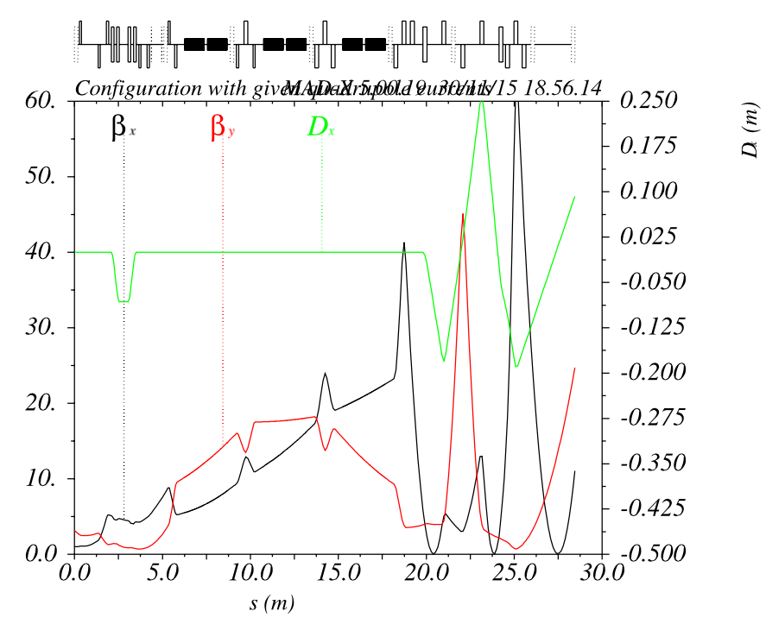
Empirical optics setup
Empirical optics found for best transmission has
  non-closed dispersion
  small horizontal waist
=> need to improve
dispersion
correction

Slide 13
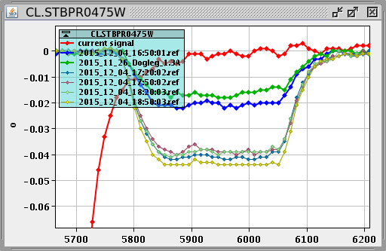
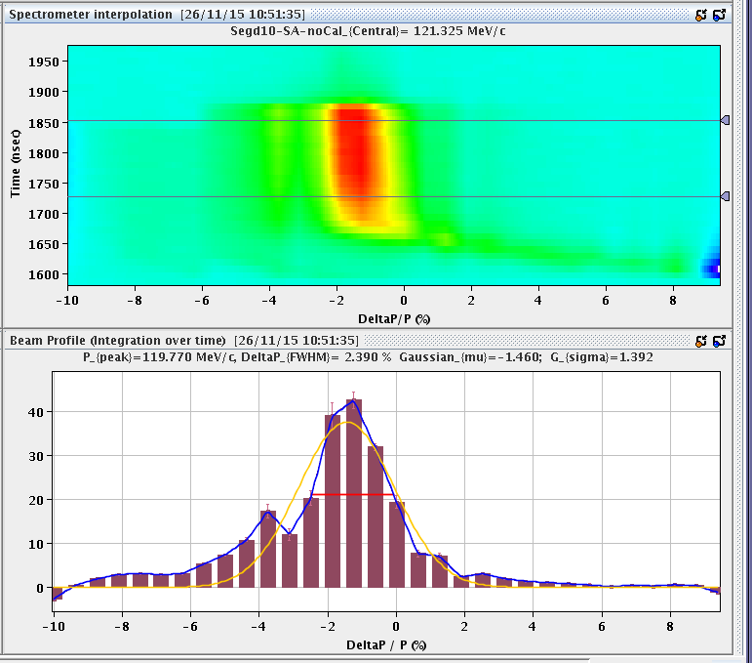
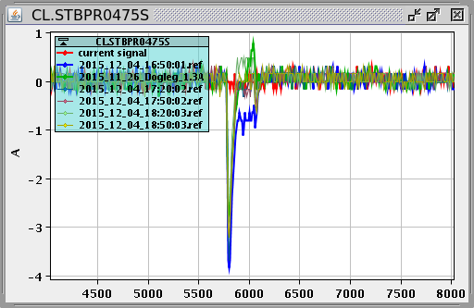
Beam Phase + Energy profile
BPR0475W (bunch length) + energy nicely flat along the pulse
beam phase constant after transient

Slide 14
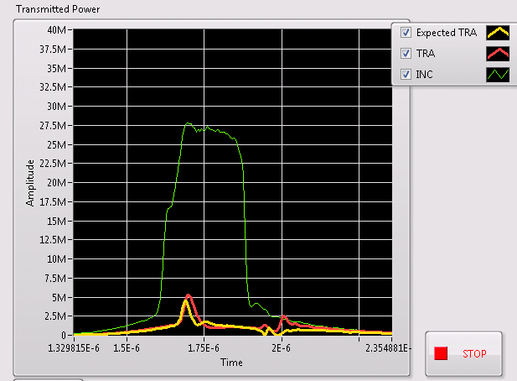
Loaded RF pulse
Beam phase and RF phase have to match to assure constant loading along the pulse
Beam and RF setup OK and output power matches expectations

Slide 15
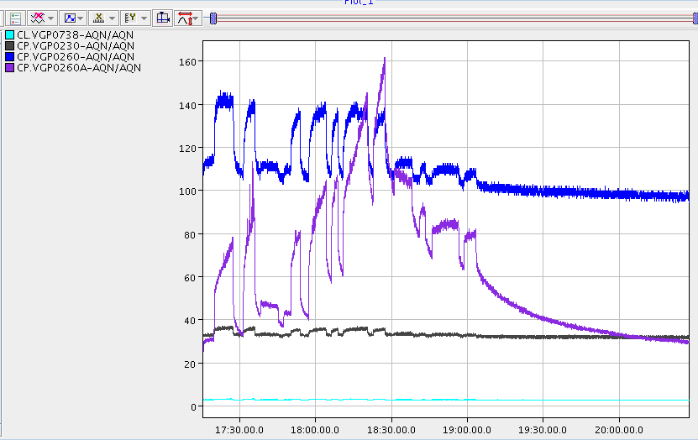
Vacuum behaviour
Vacuum on dump side increased when going to 25 Hz beam frequency
Stabilized at 10 Hz
Losses limiting operation?
10 Hz

Slide 16
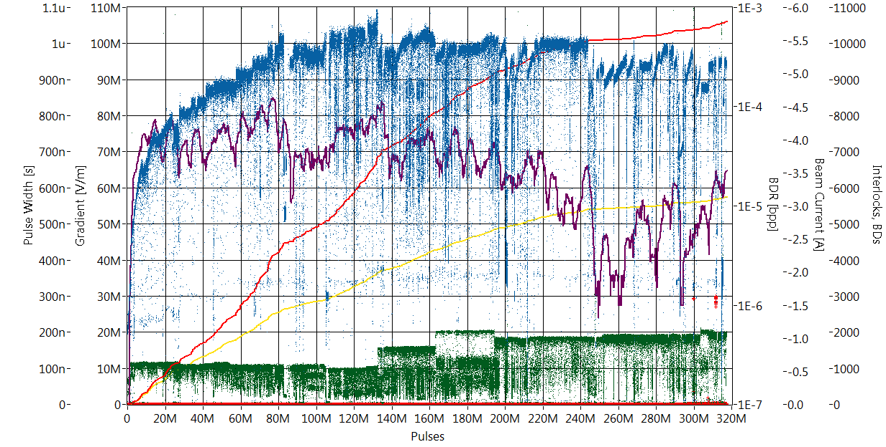
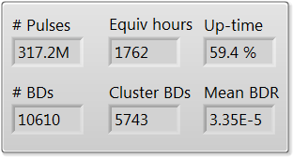
Full history of the TD26CC-N1 structure
Pulse length = 100 ns
150 ns
200 ns
180 ns (CLIC pulse shape)
Gradient
BDR
#BDs
#BD-clusters
Pulse width
12/08/2015
14/12/2015
First measurements with beam ~1.5 A
Jorge Giner
Navarro
See Jorge Giner Navarro’s talk: “High-gradient structure performances” on Monday afternoon

Slide 17
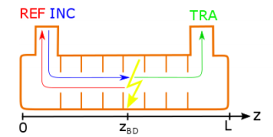
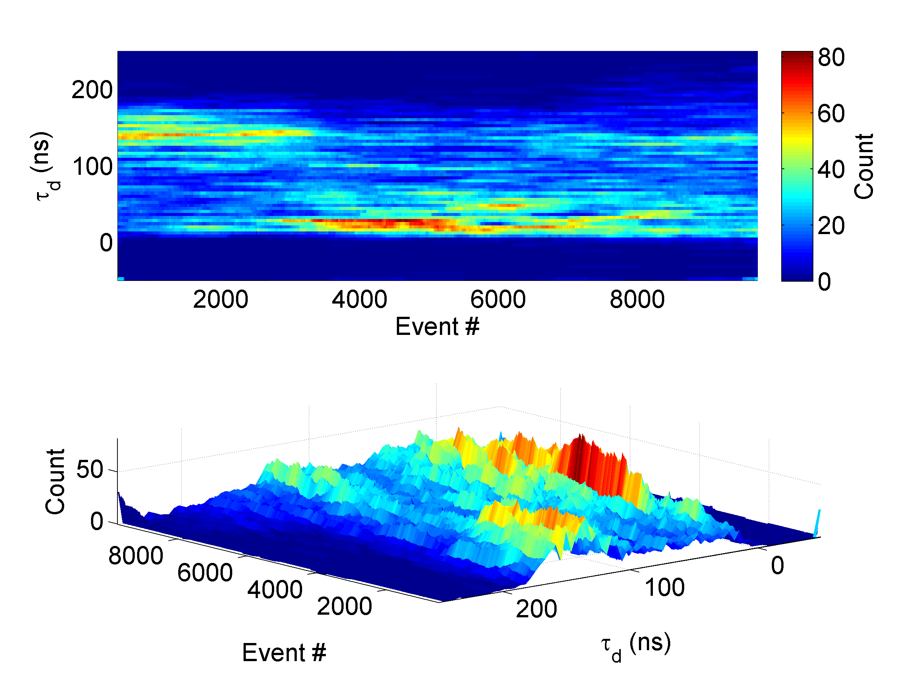
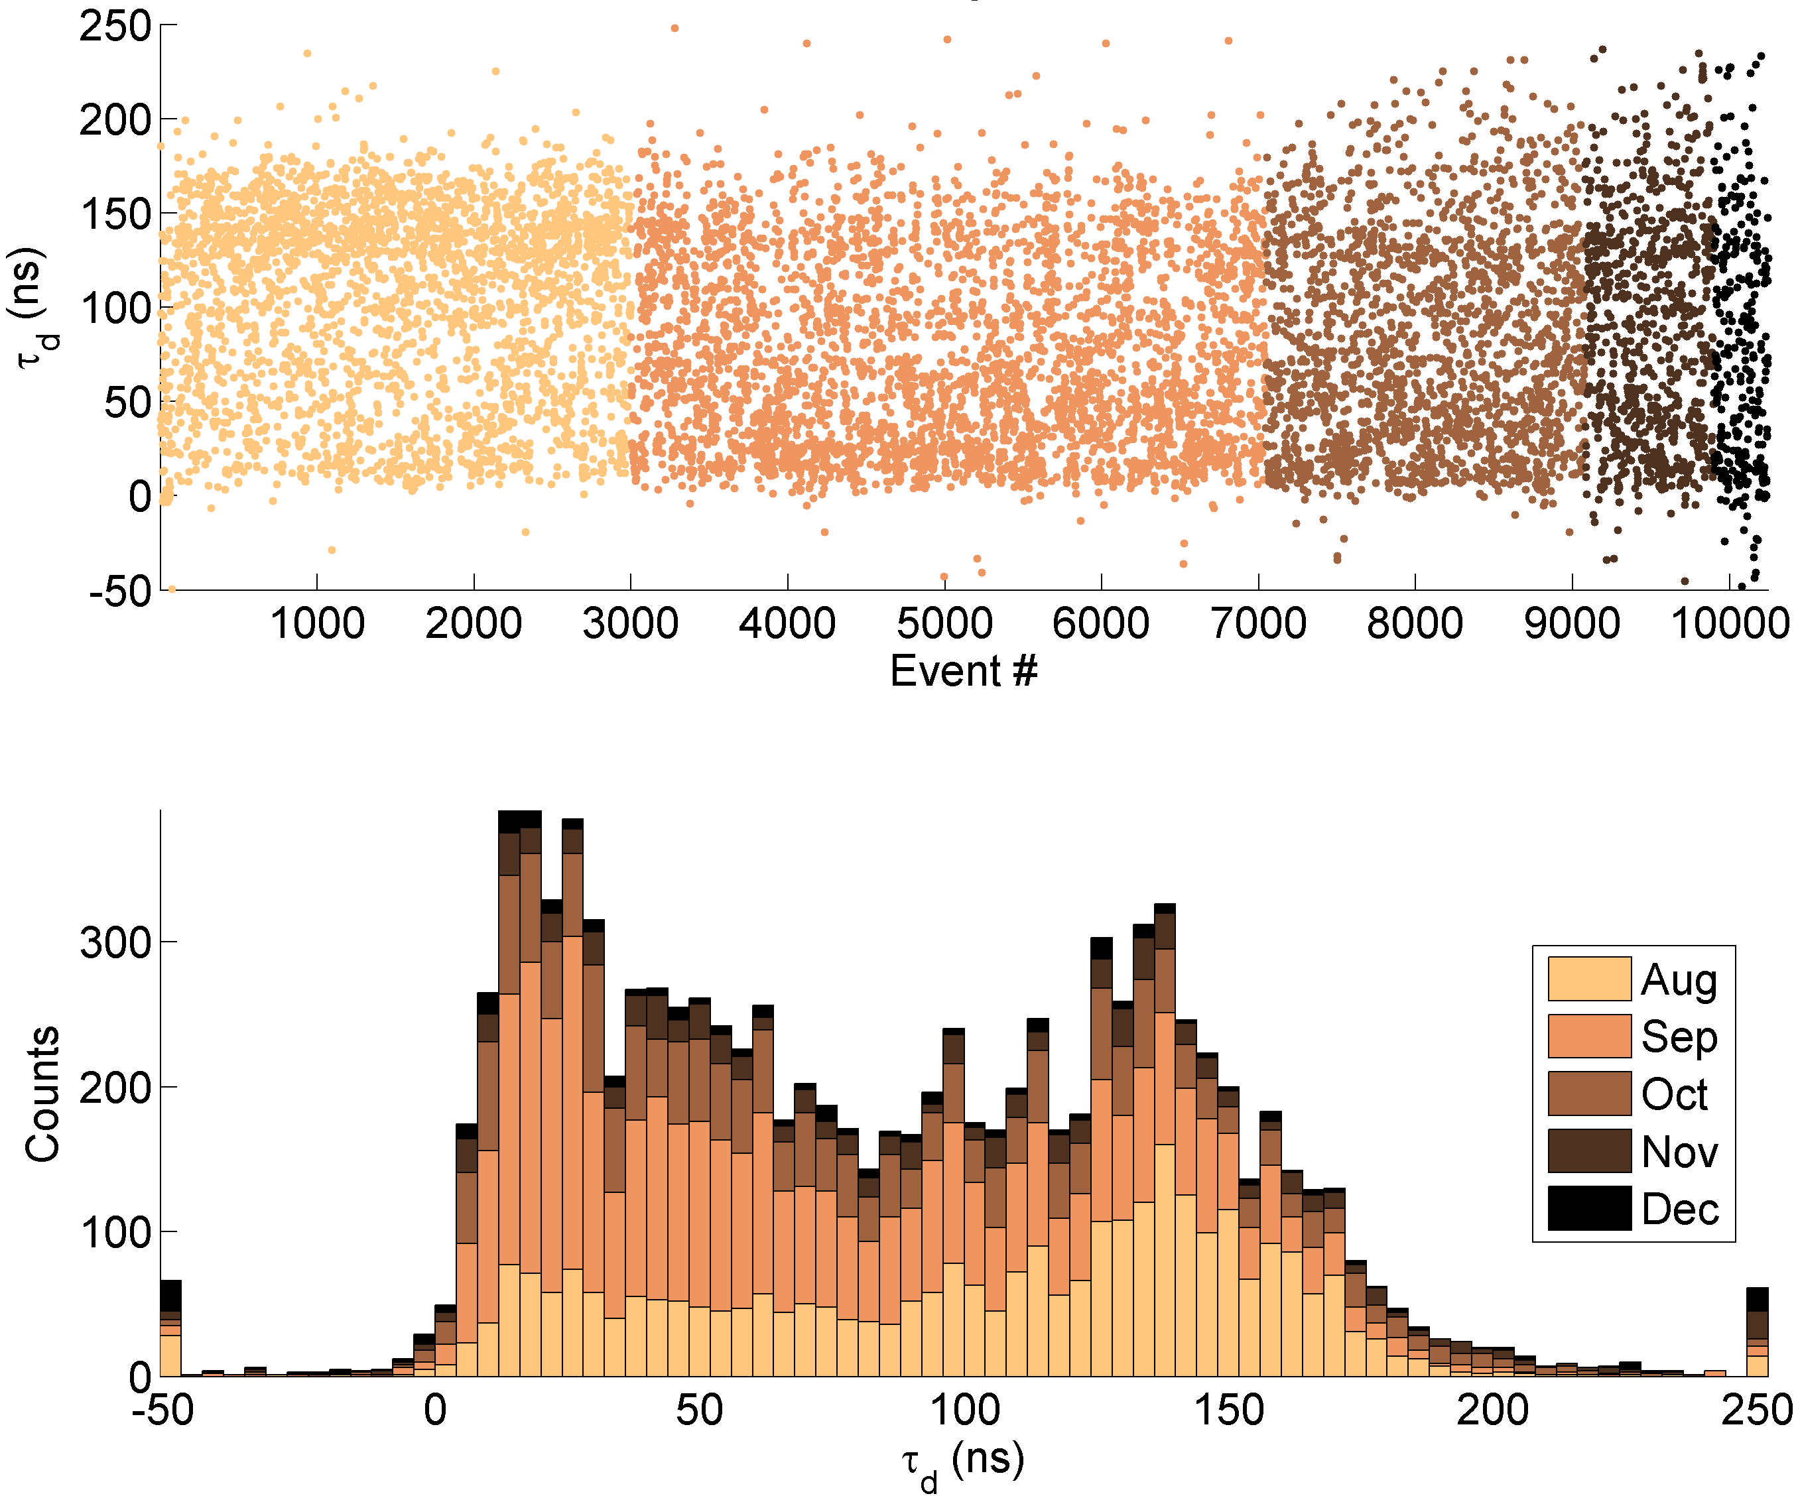
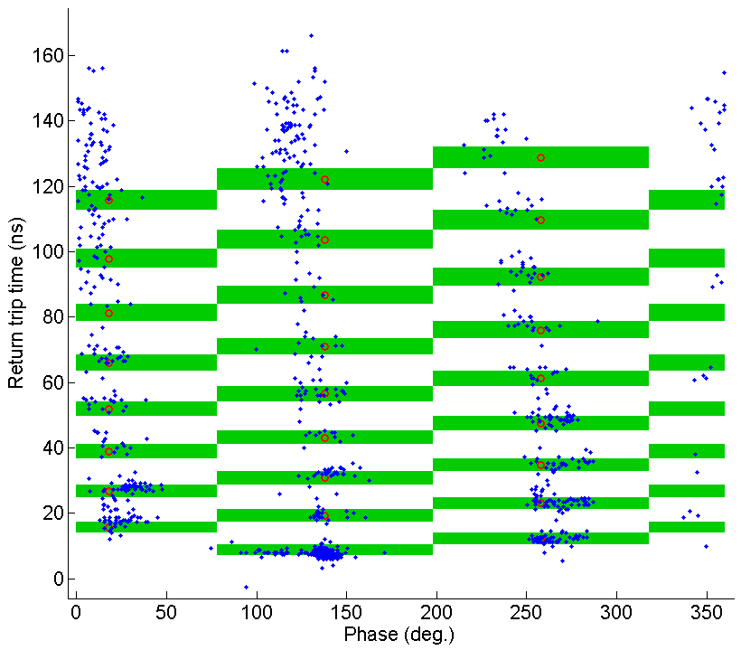
BD position in TD26CC-N1 structure
Initially BD more at downstream end
Later at the beginning
Now uniformly distributed
See Robin Rajamäki’s talk: “Breakdown positioning” on Tuesday afternoon
Aug
Sep
Oct
Nov
Dec
Phase information + timing
Robin Rajamäki
In the structure

Slide 18
2016 initial plans
Structure conditioned to ~95 MV/m @ CLIC pulse 180ns
with ~10⁻⁵ BD per pulse
pulse compressor presently limits significant increase in power
=> compare unloaded and loaded operation at constant power
back off in input power to have same unloaded gradient as loaded
100 BDs with 10⁻⁵ BDR => 111h = 4.6 days @ 25 Hz
(longer! if we are limited by vacuum to 10 Hz)
=> we need to
  schedule some days to improve beam quality and transmission
  plan routine running week-ends (+ nights)
after some results we can think of pulse compressor replacement

Slide 19
Summary
2014 relevant data compromised
Good stable running April/March but structure with hot spot
Difficulties: Pulse compressor replacement, klystron solenoid power converters, drive beam unavailability and priorities
Pulse compressor easier to operate but still power limiting
=> replacement in 2-3 month?
last weeks 2015: finally restart with beam
  almost full transmission achieved
  orbit without strong corrector kicks
  12 GHz RF interlocks set up
2015 run time very limited, need much more in 2016
consolidate beam setup => ready to go for data taking
A BIG Thank You to everyone involved!

Slide 20
Acknowledgements
RF/PM
CTF3
XBOX
BI
M. Filippova
A. Grudiev
D. Gudkov
P. Guyard
S. Lebet
A. Olyunin
A. Samochkine
A. Solodko
P. De Souza
R. Corsini
S. Doebert
W. Farabolini
D. Gamba
L. Malina
J.L. Navarro
T. Persson
P. Skowronski
T. Argyropoulos
N. Catalan
S. Curt
A. Degiovanni
J. Giner Navarro
G. McMonagle
R. Rajamäki
S. Rey
I. Syratchev
J. Tagg
L. Timeo
B. Woolley
W. Wuensch
M. Kastriotou
E. Nebot
VAC
A. Bruton
H. Rambeau
SU
P. Bestmann
T. Dobers
J.F. Fuchs
M. Tortrat

Slide 21
Spare slides

Slide 22
2015 running overview
Xbox RF acquisition fixed (broken transmitted channel), cleanup
March: machine restart, rapid beam setup and measurements
May: Accelerating structure had to be replaced due to hot cell
(during access system change)
pulse compressor breaking down, backlash => taken out
June: Realignment of the 8mm-diameter collimator (2mm off)
Klystron solenoid power supply problems
since July: DB gun problems
6-12 August: refurbished pulse compressor installed
14 Oct: RF setup, no beam (faulty magnet)
25/26 Nov: finally beam again
4 Dec: beam setup, MKX stopped
11 Dec: beam, vacuum crate stopped

Slide 23
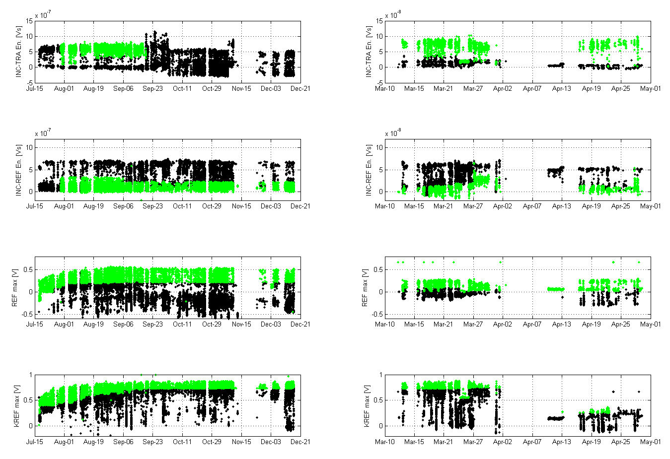
Interlock history

Slide 24
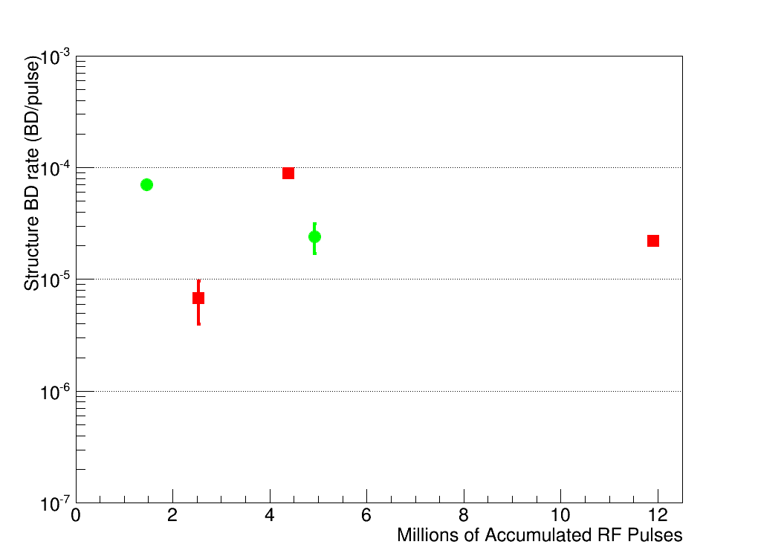
First “comparison”
We did not observe an increase of breakdown rate with the beam but…
… the beam could have develop a hot-cell.
Only March and April data.
Error bars account only for statistical errors.
Structure with hot cell
Unloaded
Loaded
Beam zero crossing
Antiloaded
!
Nothing conclusive yet

