Slide 1
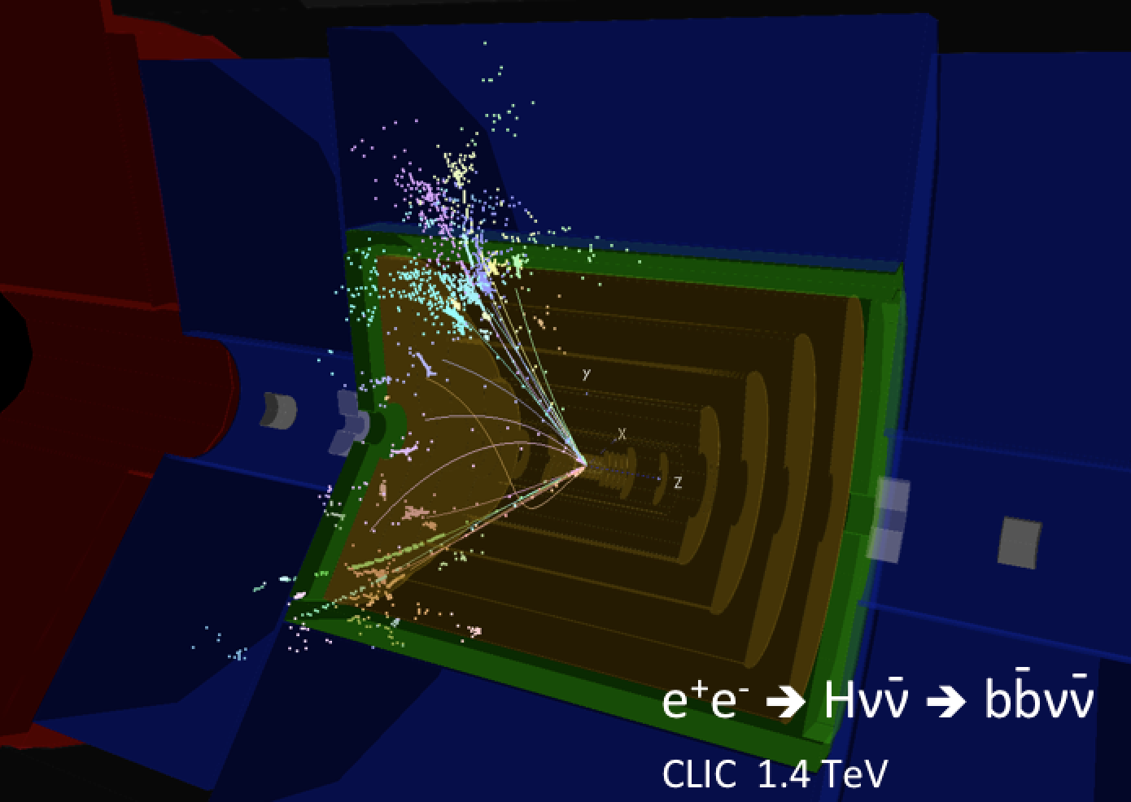
CLICdp welcome and news
Lucie Linssen, CERN
CLIC workshop 2016, January 19th 2016

Slide 2

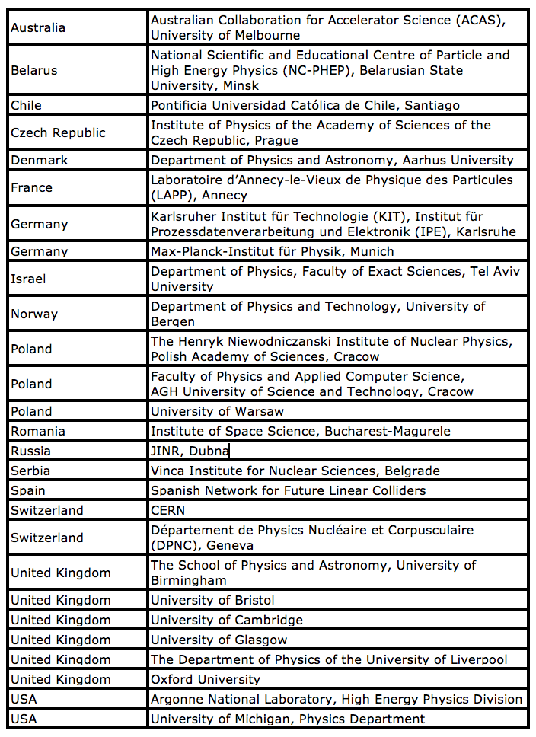
CLIC detector and physics (CLICdp)
27 institutes from 17 countries
http://clicdp.web.cern.ch/
JINR Dubna joined in December 2015

Slide 3
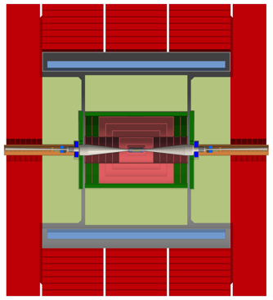
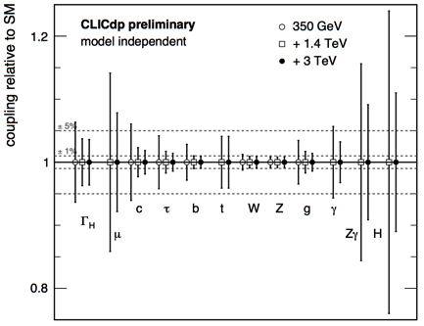
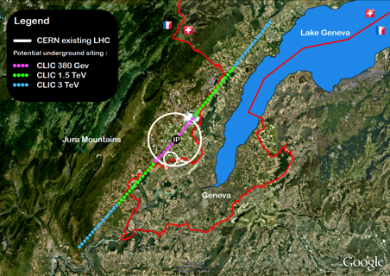
“collaboration-wide” documents
As part of the CLICdp efforts to prepare for the next European Strategy Update,
There are currently three “collaboration-wide” documents that are nearing completion.
Your comments on these documents are most welcome!
CLICdp-Draft-2015-019, draft Note on the new detector model:
https://cds.cern.ch/record/2104268?ln=en
(or https://edms.cern.ch/document/1572676/)
Comments to Konrad Elsener (see also talk 19/1)
The CLIC Higgs paper => EPJC publication draft
Soon after the workshop an updated version will appear here:
http://proloff.web.cern.ch/proloff/clichiggspaper/
Comments to Philipp Roloff (see also talk on 20/1)
The CLIC staging baseline paper => paper draft (for arXiv)
http://esicking.web.cern.ch/esicking/ClicStagingBaseline/
Comments to Eva Sicking (see also talk 22/1)

Slide 4
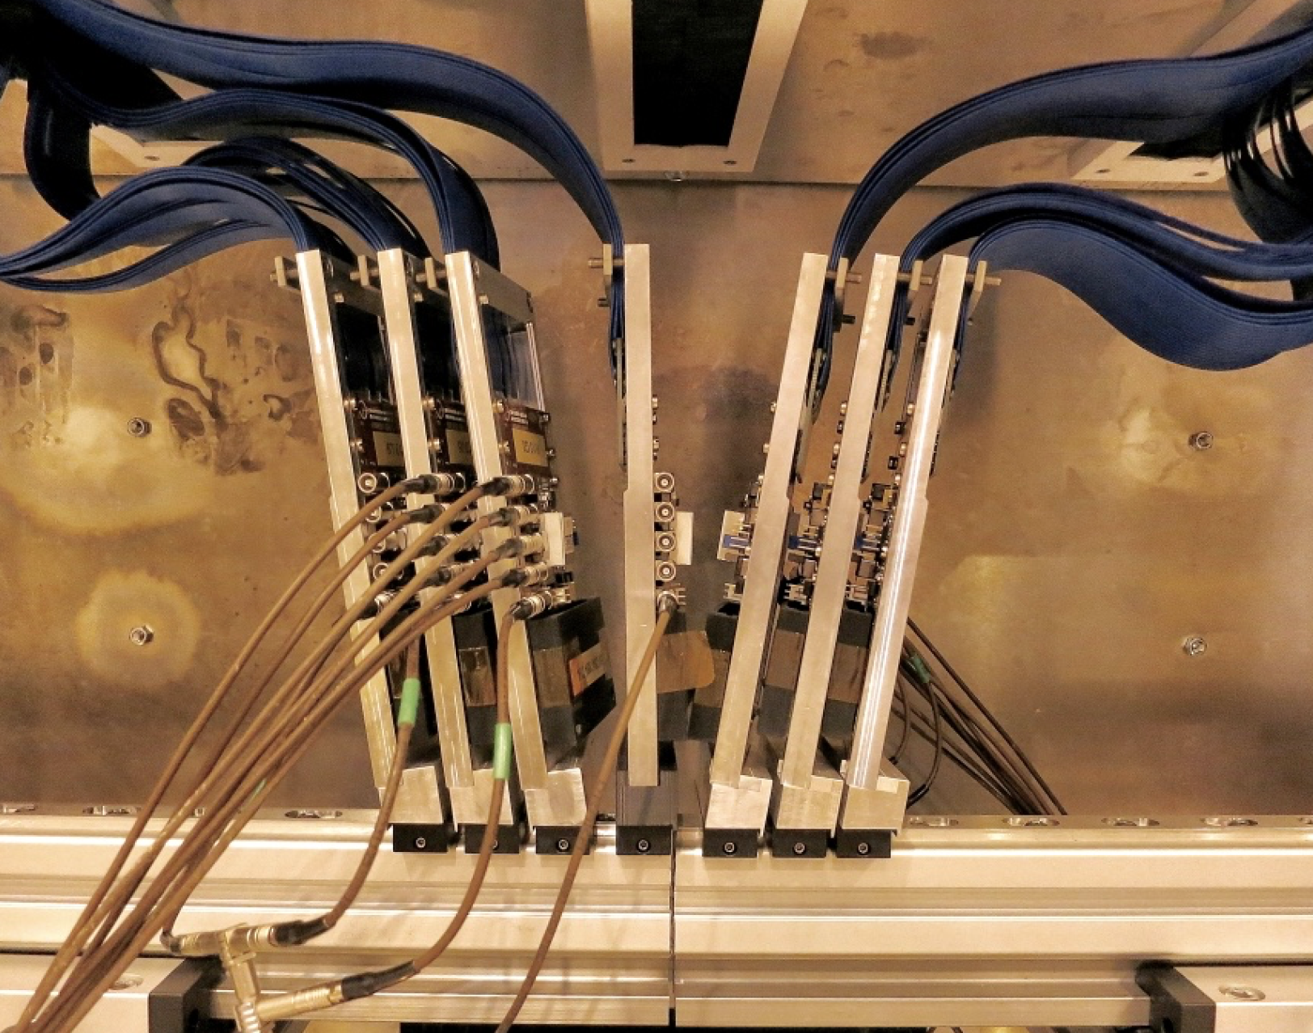
Vertex R&D beam tests in 2016
Preliminary beam schedule and first ideas about use of the beam time:
April 18 - April 25 (7 days)
Timepix3 Telescope improvements/commissioning
Advacam edgeless Timepix3 assemblies
if available: CLICpix with thin planar sensors
June 22 - June 29 (7 days)
CLICpix with thin planar sensors
if available: Cracow SOI chip
possibly: TowerJazz test chips (tbc)
August 24 - August 31 (7 days)
CLICpix2 + Advacam thin edgeless planar sensors
CLICpix2 + C3PD HV-CMOS
If available: Cracow SOI chip
November 9 - November 13 (5 days)
To be defined later
New Timepix3 telescope

Slide 5
CLICdp at this workshop
CLIC 2017 workshop
~220 registrants
Of which ~70 registrants for physics/detectors
On recommendation of CLICdp collaboration
Avoid parallel sessions
=> therefore “topical sessions” => limited time available
In total: ~50 presentations on physics+detector
All physics+detector presentations in the main auditorium
CLICdp institute board meeting (1 representative/institute)
Thursday 21/1 @ 12:30 hrs in room 4-S-030

Slide 6
Social events => dinners
Workshop dinner + drink (included in the fee)
Wednesday evening, 19 hrs, Restaurant #1
Detector&physics dinner (everyone welcome)
Thursday evening 21/1, 19:15 hrs, Le Coq Rouge, St. Genis
Contribution: 50 Euro including drinks
Transport: private cars + public bus
We bring everyone “home” at the end of the dinner!
Please register with kate.ross@cern.ch before Wednesday noon

Slide 7

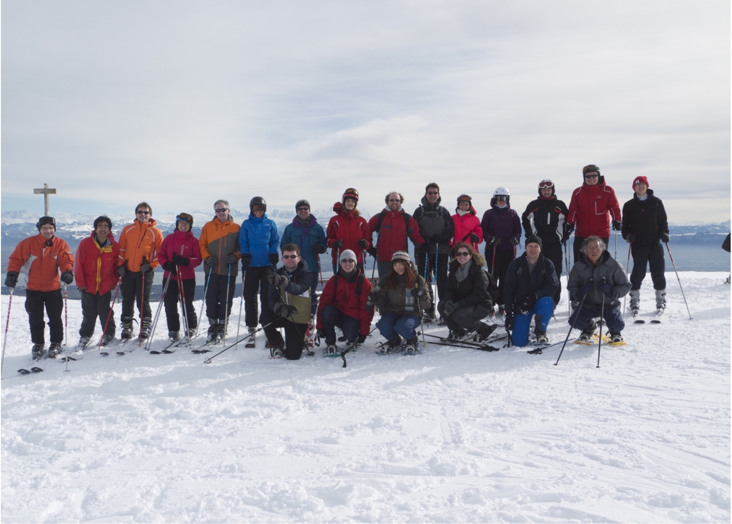
Social events => snow!
Snow shoe outing on the Jura
Friday afternoon 22/1, after the sessions. No experience required.
Equipment can easily be rented.
Please inscribe here: https://docs.google.com/spreadsheets/d/1E2xYYSGNMxPLO4NLvTYXmBvSy9fGx0MomVDEWmcC1pU/edit?usp=sharing
Contact: estel.perez.codina@cern.ch
Ski outing in Jura or Alps
Saturday 23/1 all day. Skiing skills required.
Transport by private cars. Equipment can easily be rented.
Please inscribe here: http://doodle.com/poll/wdz3vkahu862bptq
Contact: dominik.dannheim@cern.ch

Slide 8
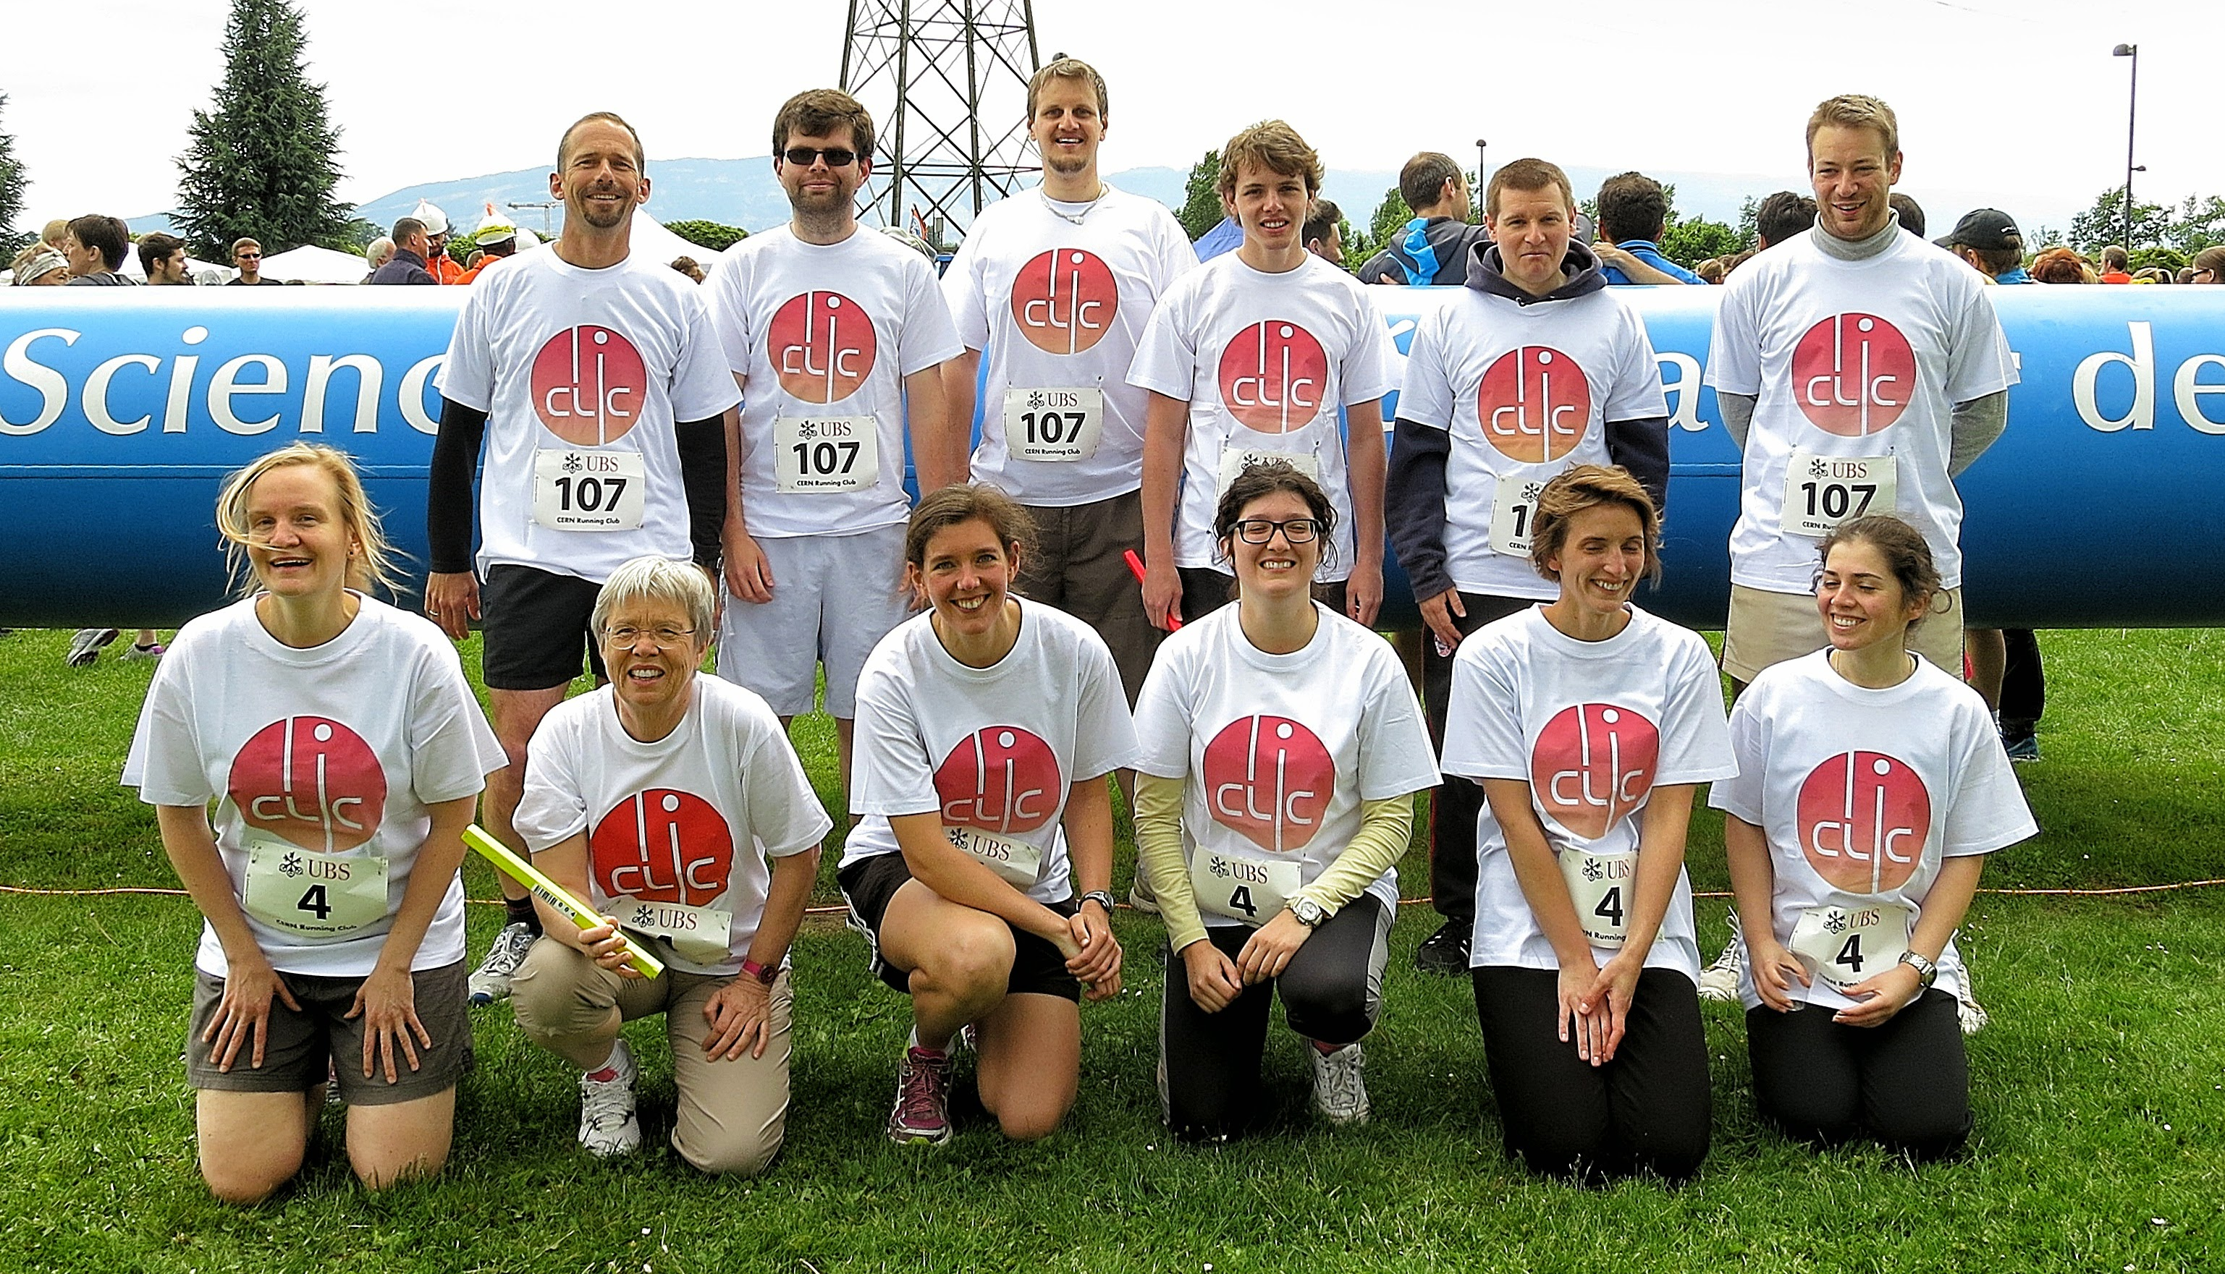
Have a nice workshop!

