Slide 1
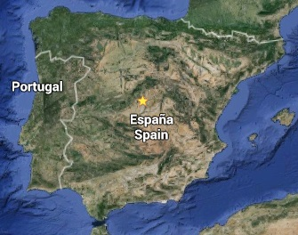
Santander
ECFA-LC2016

Slide 2
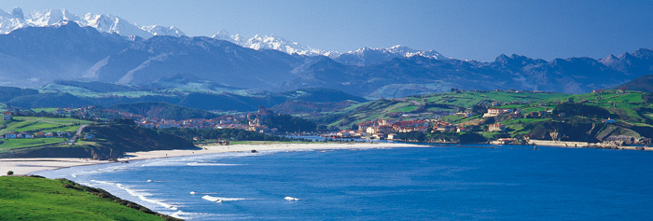
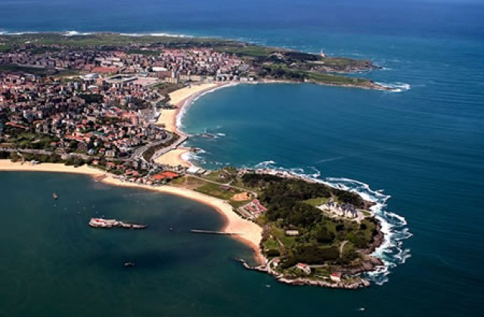

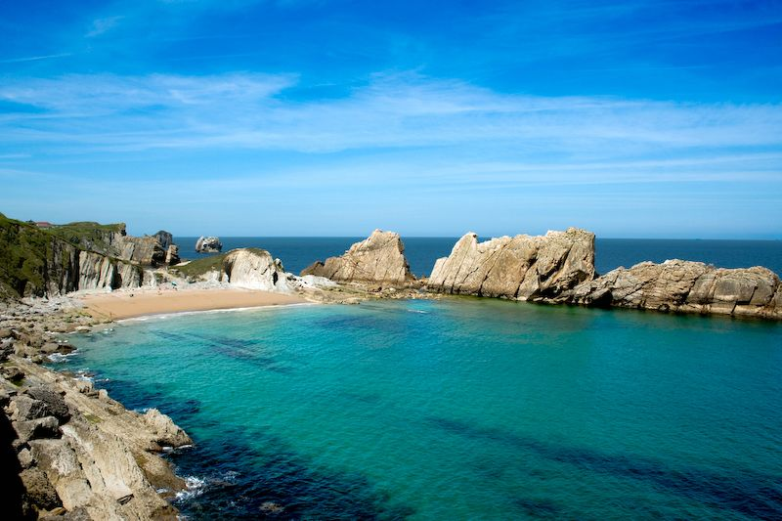
ECFA-LC2016 from 30-May to 5-June
Santander, Cantabria
Magdalena Palace

Slide 3
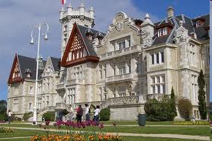
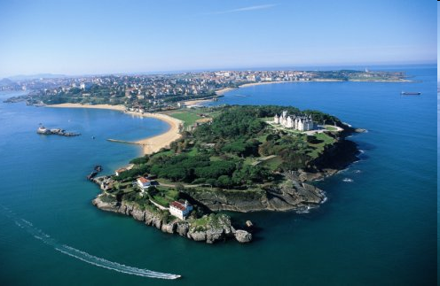
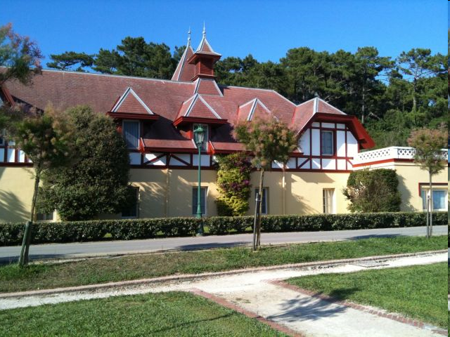
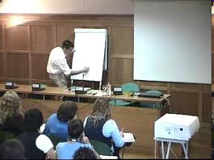

ECFA-LC2016
Auditorium: ~350 places
7 rooms Palace + Living room, Royal dinning room, Hall + 4 classrooms at old stables

Slide 4
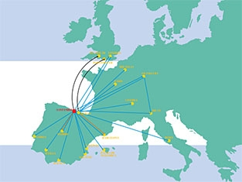
How to get there Road Santander-Bilbao road (A-8) Santander-Torrelavega Road (A-67) Autovía del Cantábrico Road Bus Station Rail RENFE. FEVE. Plane Parayas Airport. IBERIA Santander. AirNostrum RyanAir + Bilbao multiple intern. flights (100 km. from Santander) Boat Ferry Port Ferries to England.

Slide 5
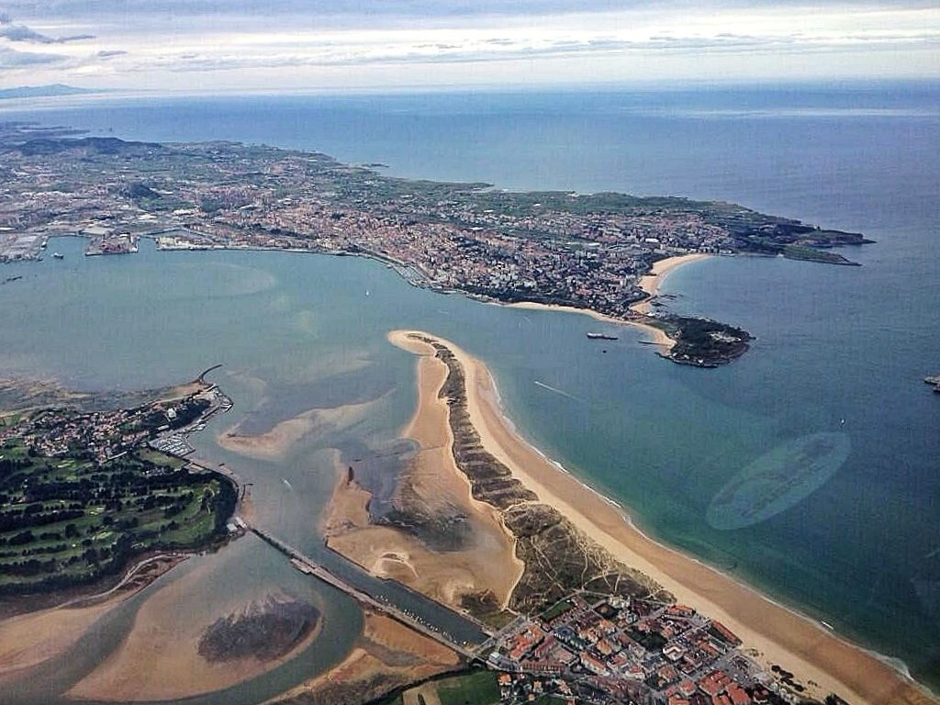
See you at ECFA-LC2016, in Santander, from 30 May-5 June 2016
http://www.ifca.unican.es/congreso/ECFALC2016/welcome
(web site under construction)

