Slide 1
High gradient structure fabrication pipeline and trends
M. Aicheler, S. Atieh, N. Catalán Lasheras, M. Garlasche, A. Grudiev, M. Filippova, S. Lebet, A. Olyunin, A. Perez Fontenla, L. Pradera, E. Rodriguez Castro, A. Solodko, A. Xydou, H. Zha.

Slide 2
Outline
Structures produced in 2015
  PSI N5.
  TD24_SiC.
  TD26CC_2.
  HGTW_1.
Structures under fabrication
  TD26CC_N3.
  TD24R05_SiC_2.
  HGTW_2
  T24_4/5.
Trends
  CLIC G*
  Studies on alignment features
  Bonding quality

Slide 3
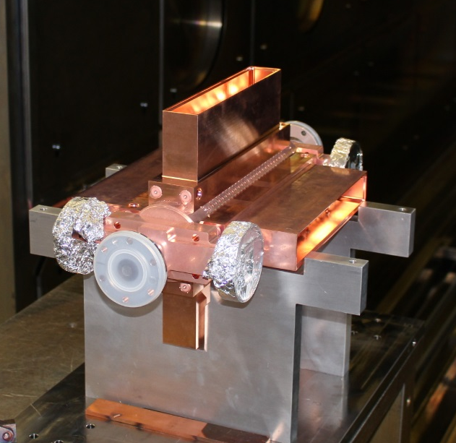
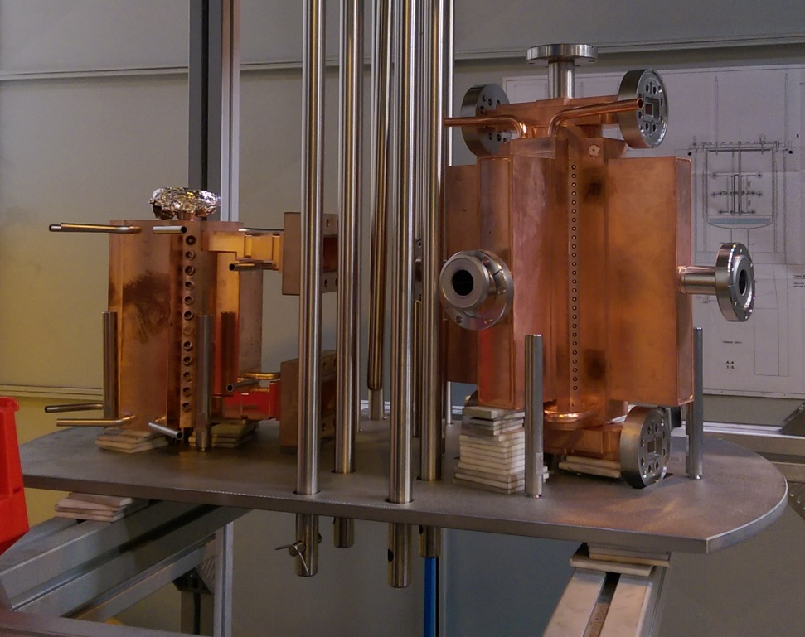
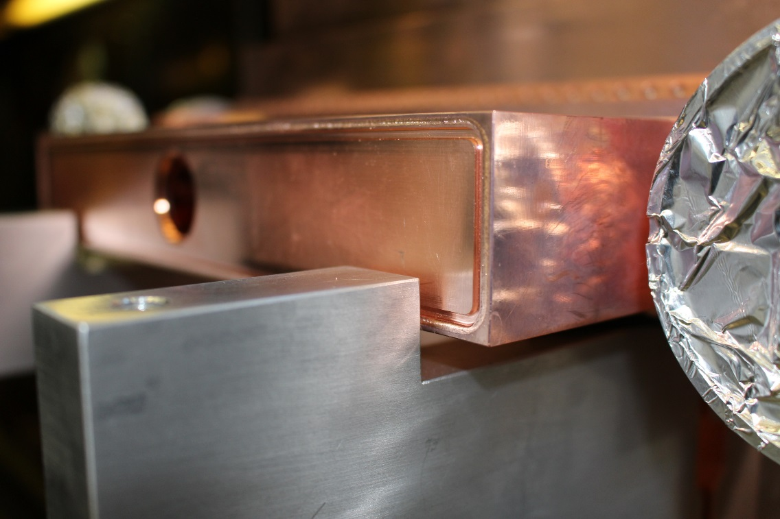
TD24R05_SiC_1
Damped structure with SiC absorbers.
Manifold covers Eb-welded successfully. No leaks observed
Baked at the end of the year together with HGTW structure
Fiducialization is next
Ready for firsts tests in Xbox3

Slide 4
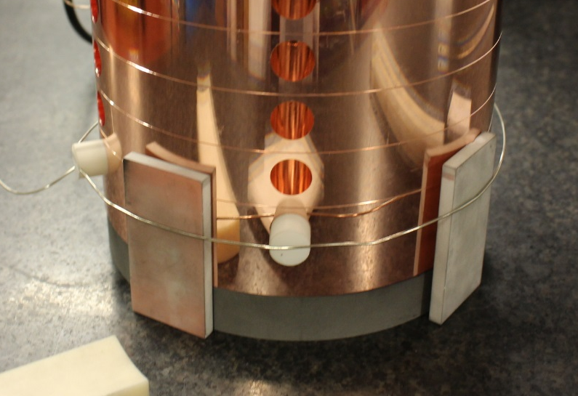
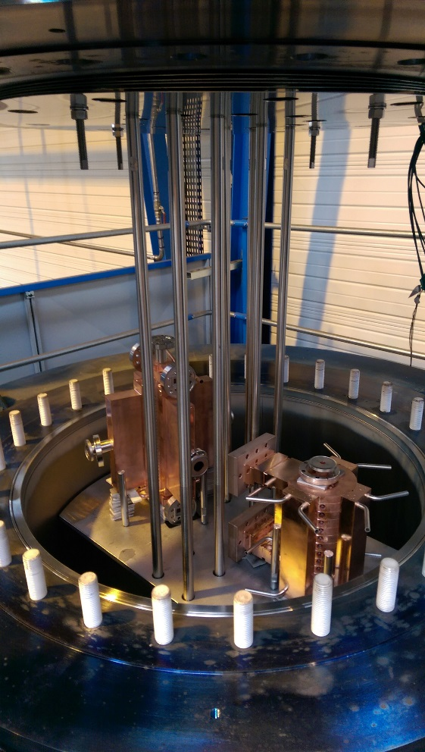
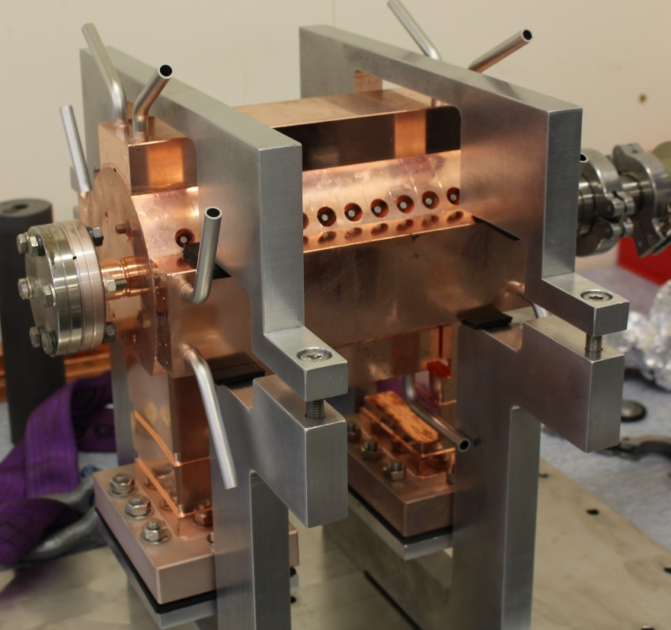
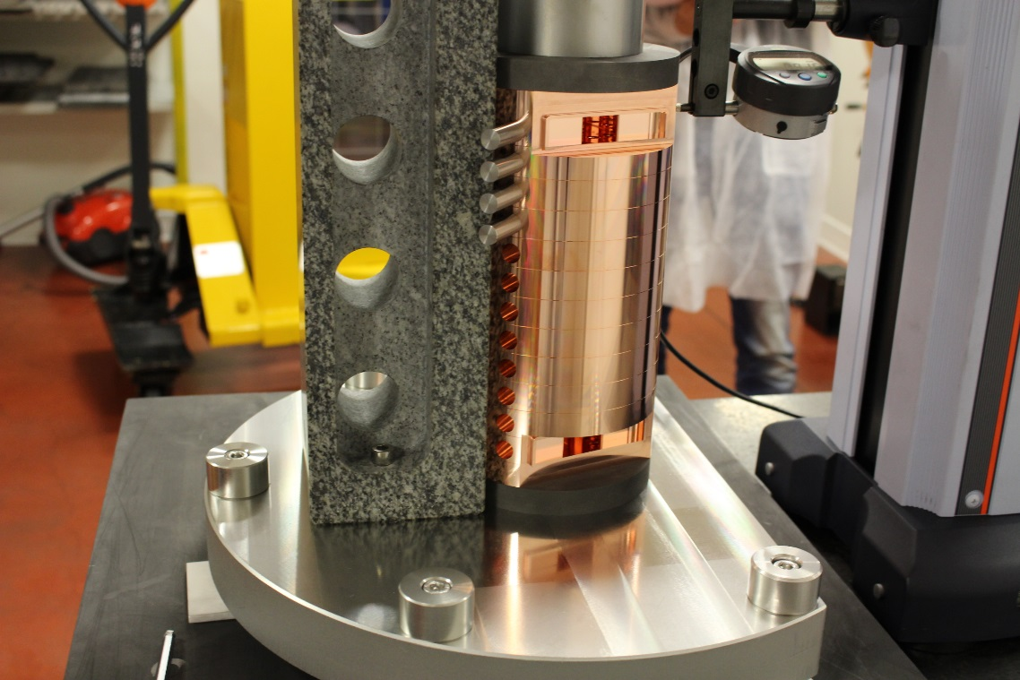
HGTW_N1 aka. KT_1
3 GHz travelling wave medical structure
made with the same procedures and suppliers as CLIC prototypes
Re-using most of the tooling
Successfully completed at the end of 2015 and waiting now for tests
Second structure being launched

Slide 5
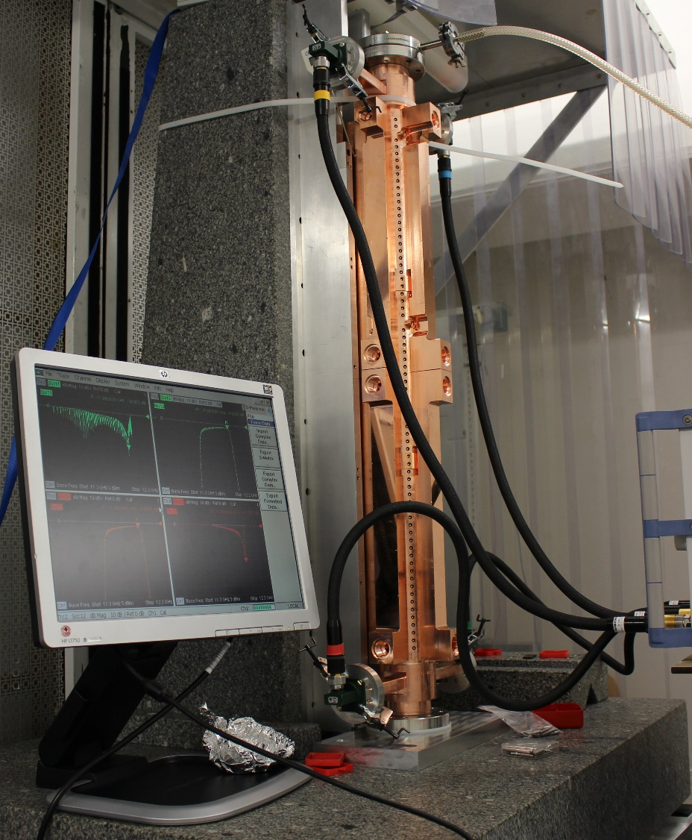
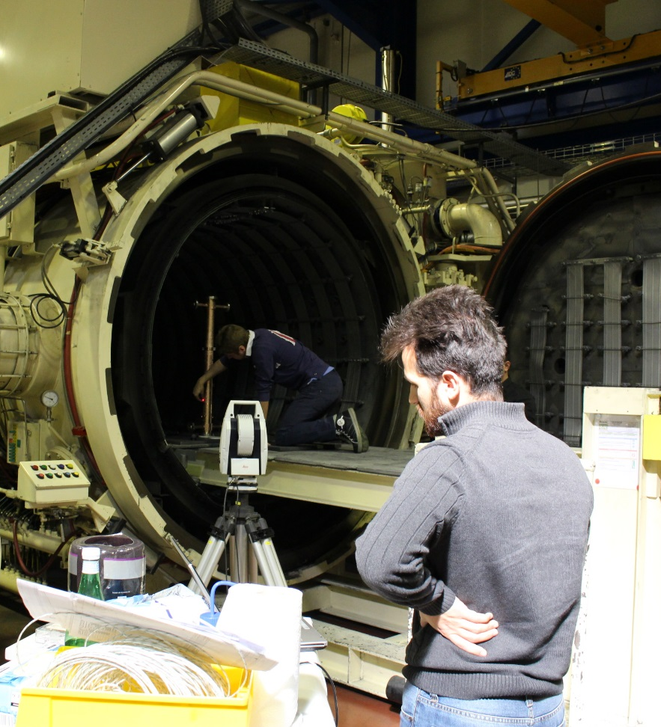
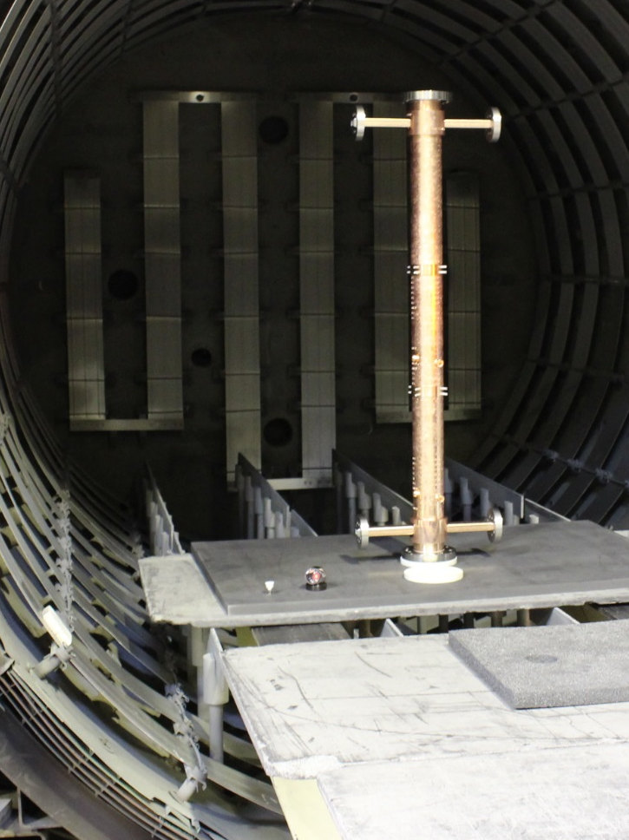
PSI_N5
Last linearizer structure for Elettra (spare) in the Elettra-PSI-CERN collaboration
Alignment of both structures before brazing made in the oven
Tuned and shipped to Trieste in October

Slide 6
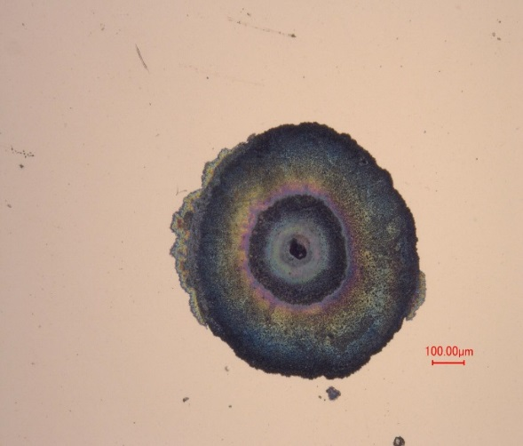
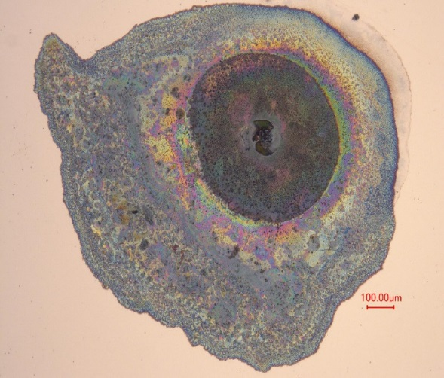
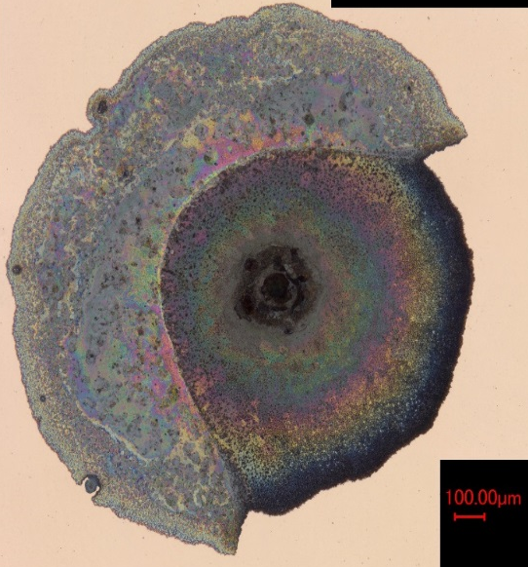
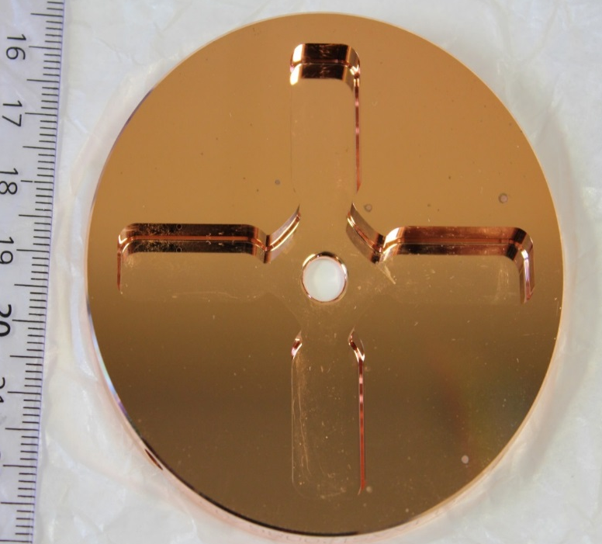
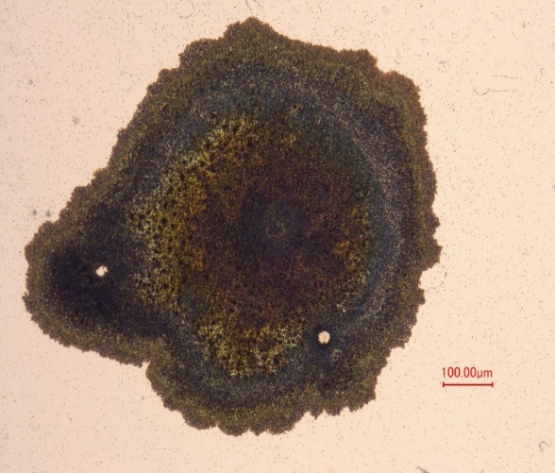
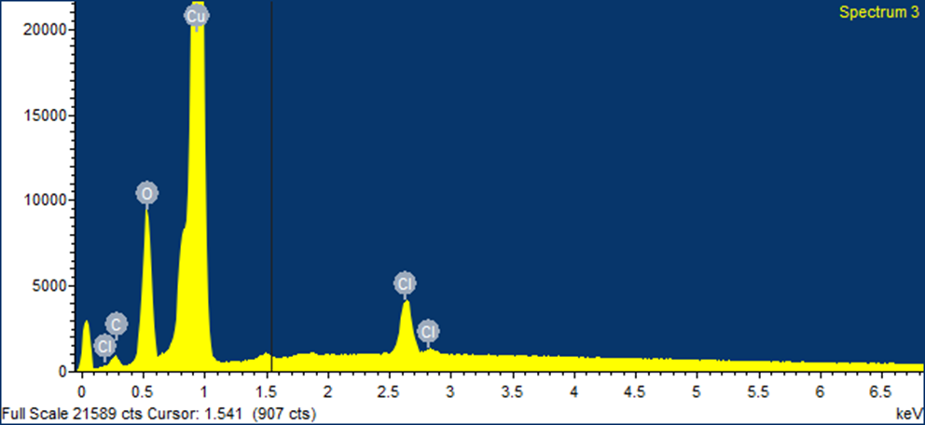
TD26CC_N3. Disk surface quality
Lots of visible spots after some months of storage
Presence of Cl and oxidation
Soft pickling removed the pollution with minimum impact on Ra
Proceed with bonding
Seen in all disks stored
Digital microscope image 200x
Digital microscope image 200x
Digital microscope image 300x
SOI 2
SOI 1
SOI 3
SOI 4

Slide 7
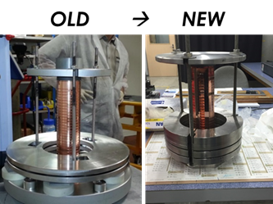
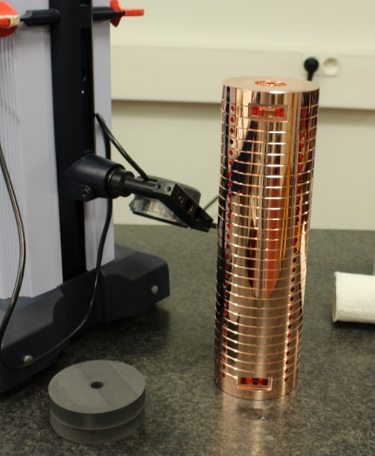
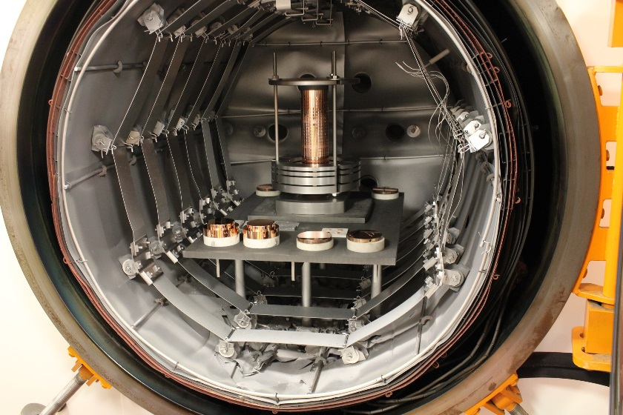
TD26CC_N3. New bonding tooling
Made of DENSIMET®185. A high density tungsten alloy
Machined to 10 micron flatness
Allows for bonding the disk stack without leaving the preparation room
Will be used for all future small prototypes

Slide 8
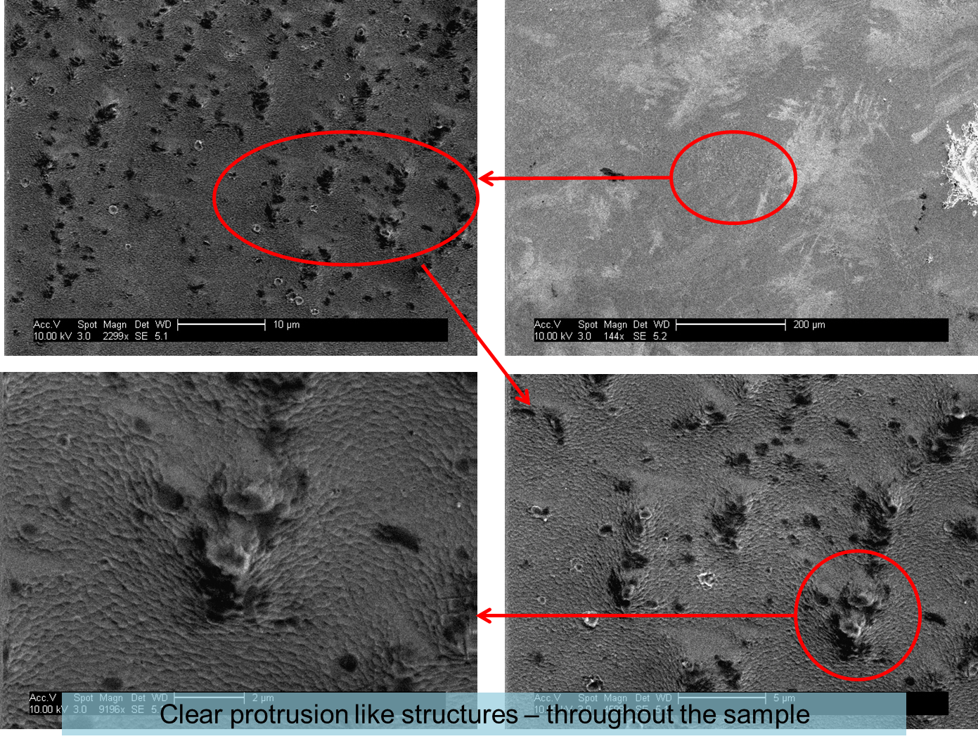
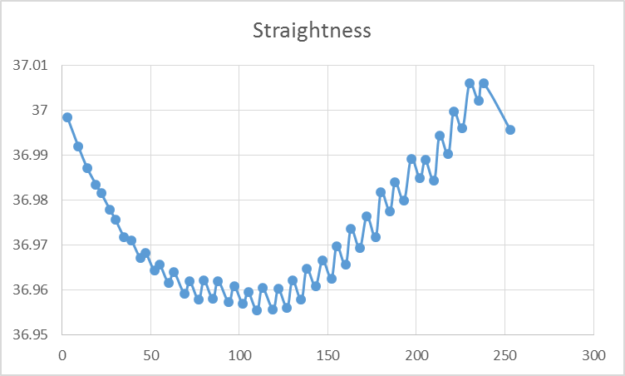
TD26CC_N3. Slow cooling
Bubbles observed in small cathode samples
May be due to the fast cooling after bonding
Slow cooling implemented for TD26CC_3
First structure to undergo dimensional control after bonding in metrology
Heavy sagging observed!

Slide 9
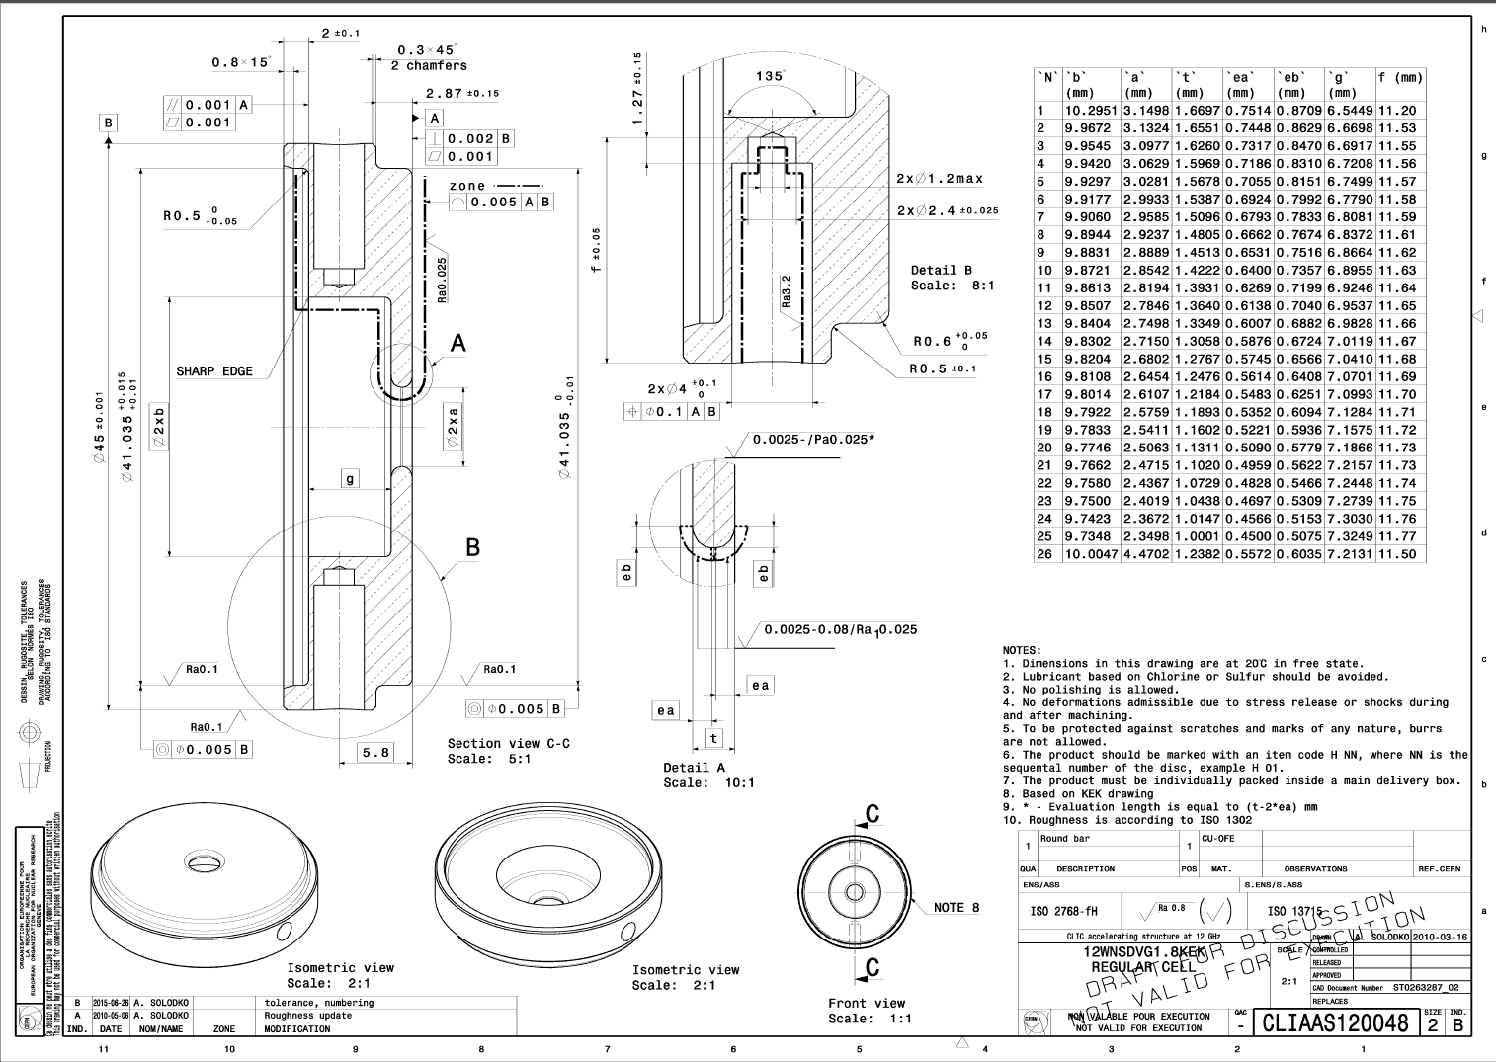
T24 12 GHz updated
Based on the X-band AS review
Two sets of disks under procurement
Tolerance on the external diameter à+-0.001 mm - √
Sharp edge - √
Numbering: short name - √
Interlocking - X

Slide 10
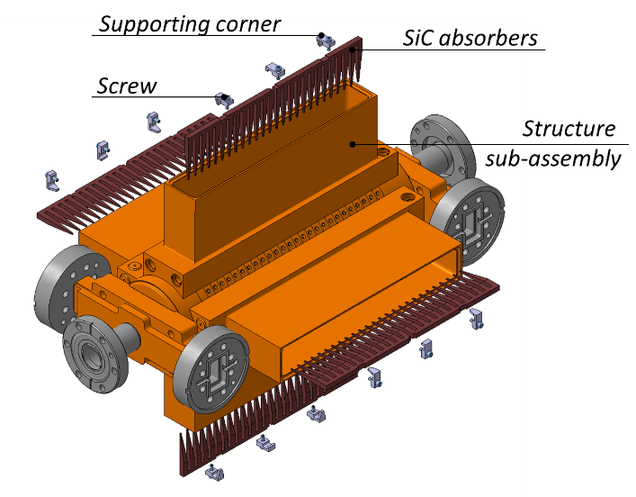
TD24R05_SiC2
Three firms qualified for full assembly of disks into one structure based on:
  Hydrogen partial or total pressure capability
  Clean environment
  Technical visit
  Oven pollution tests
Call for tender launched in November
All parts ready for assembly
Expect some technology transfer work.

Slide 11
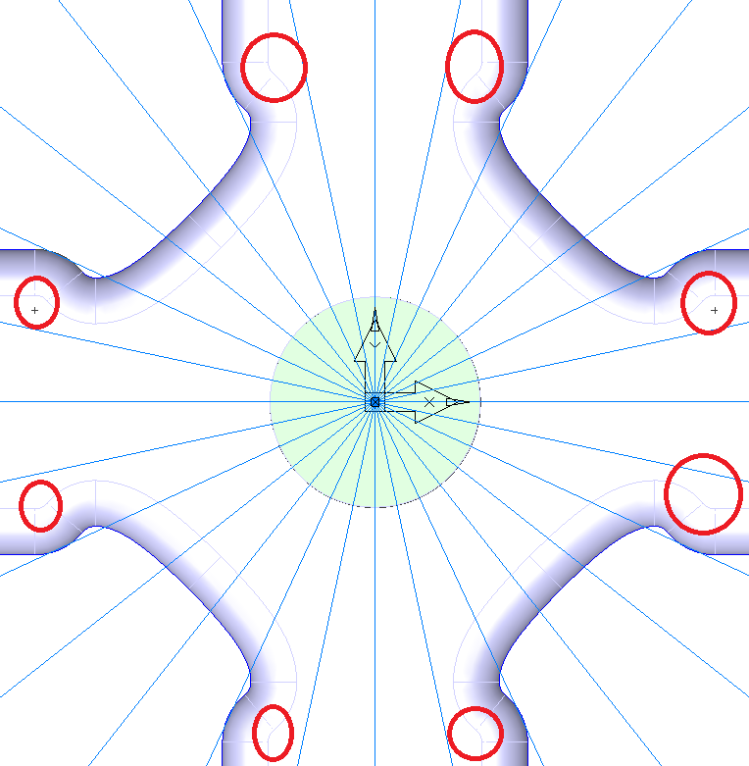
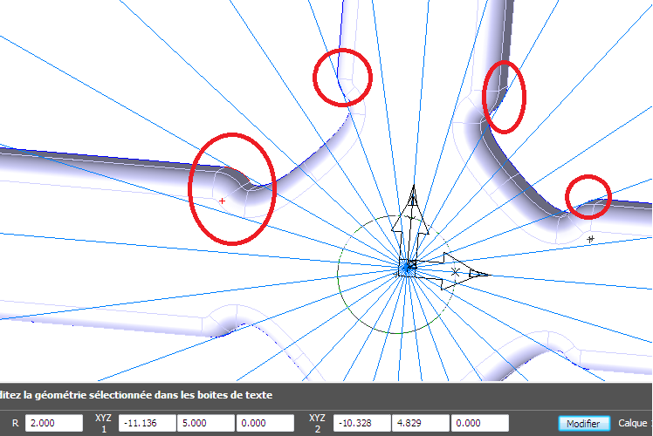
New CLIC-G* prototype. Machining otimization
Bottom limiting radius (1,5;1;0,5;0;0)
Optimization of the radius in the disk RF design to minimize
  Machining time
  Machining costs
  Disk yield
Decided on a bottom radius of 0.1 mm
Studied wall radius (0,5;1;1,5;2;2,5)
Corner radius 2mm

Slide 12
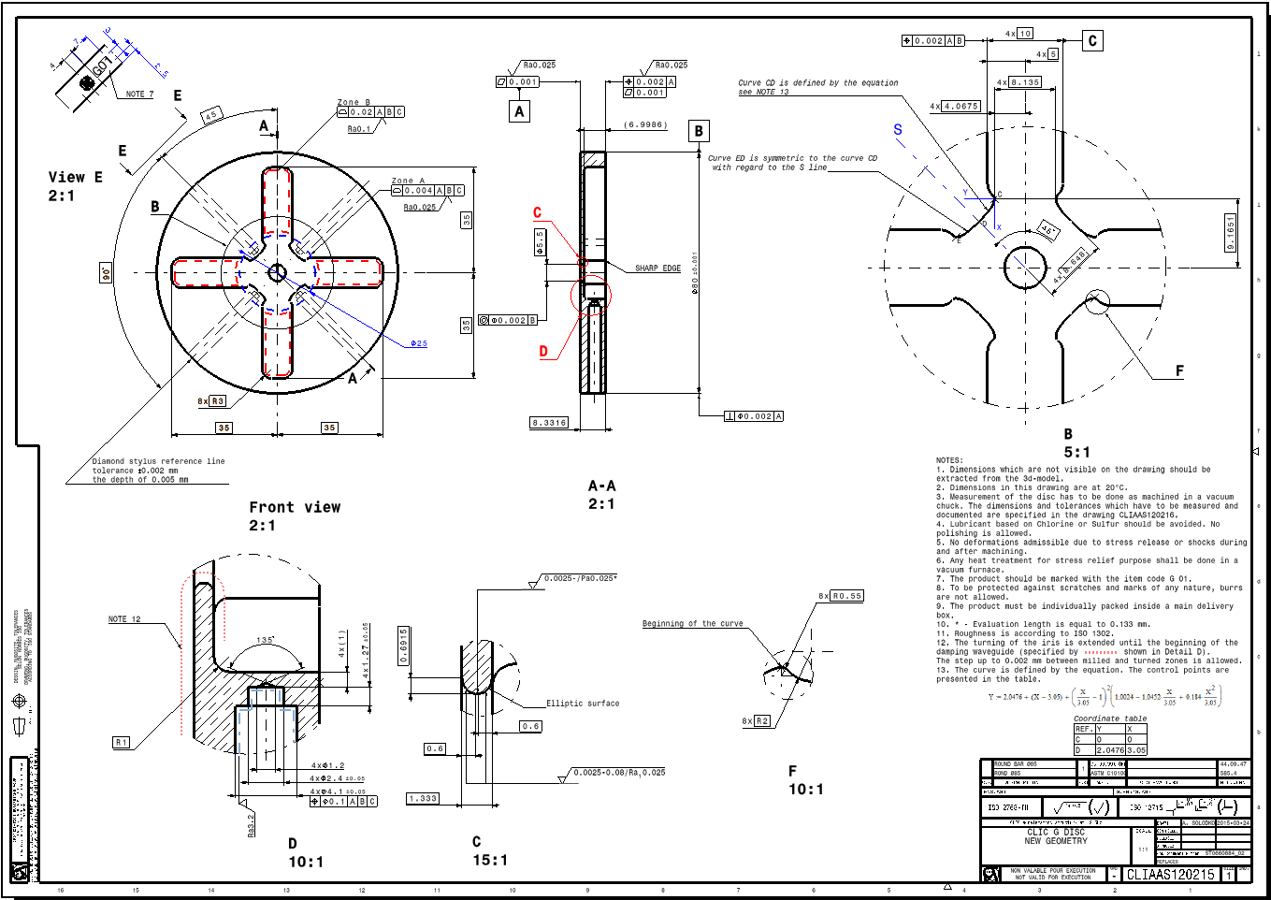
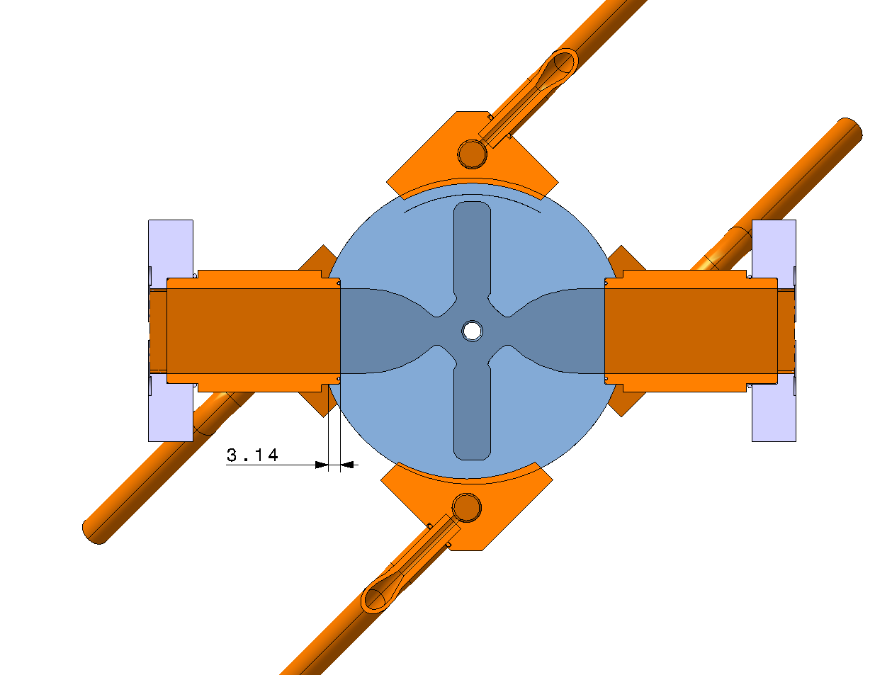
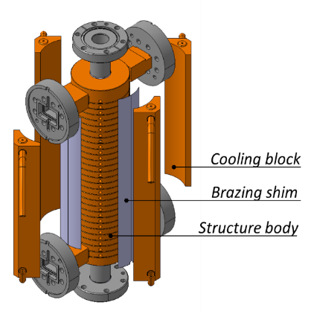
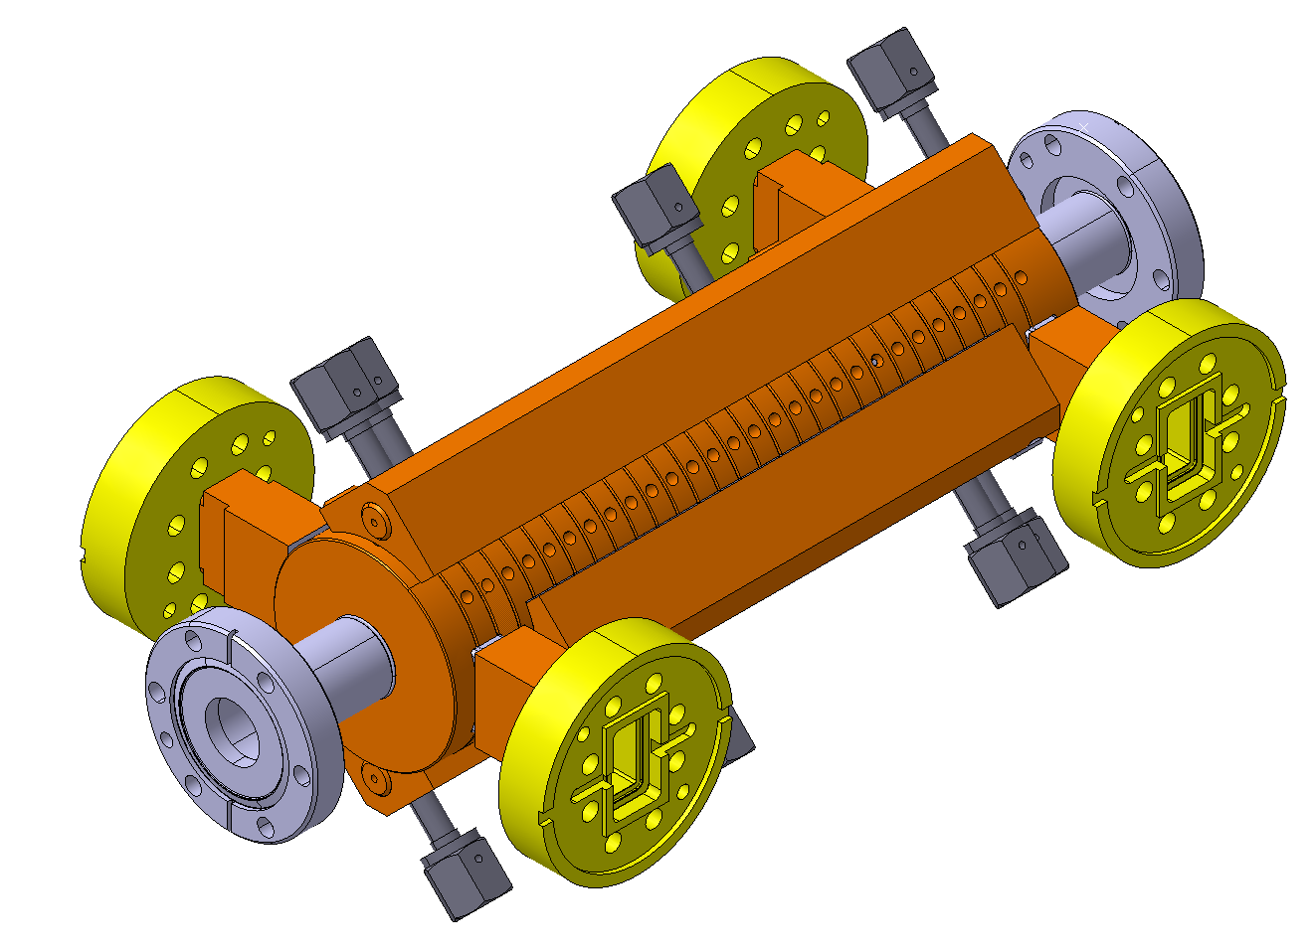
New CLIC-G* TD26 R1 CC mechanical design
2
6
4
5
3
N | Modification | TD26 CC R0.5
1 | R1 mm | R0.5 mm
2 | Cell geometry given by the equation | Ellipse
3 | Ø80 mm → Ø83 mm (see next slide) | Ø74 mm
4 | 70 mm waveguides | 64 mm waveguides
5 | Sharp edge | R0.02 mm
6 | Short name | Drawing name
2
1

Slide 13
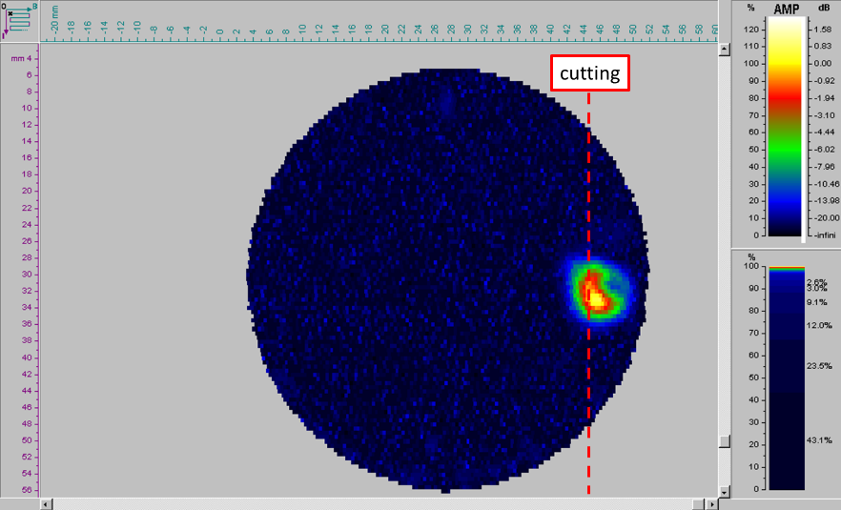
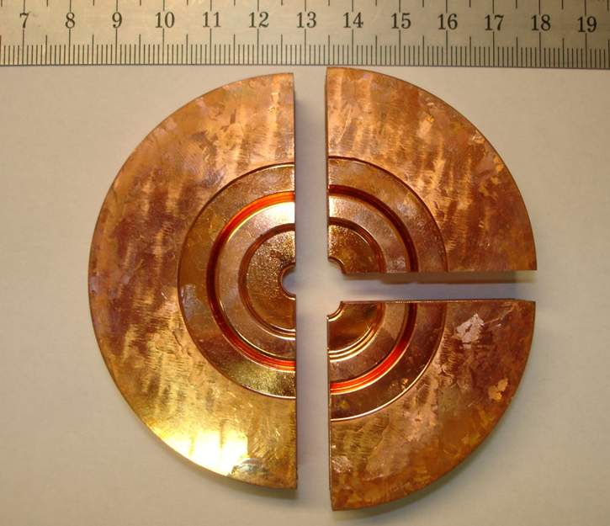
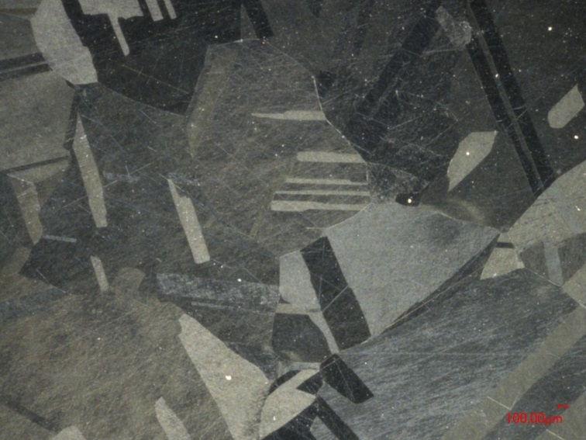
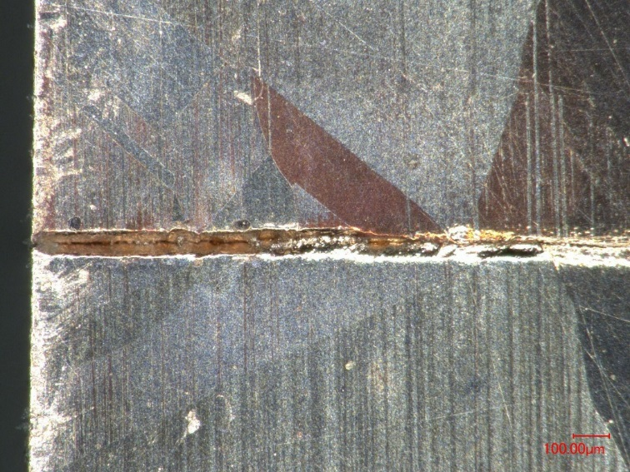
Assessing the bonding quality
Bonding quality in the past judged from ultra sound
  Quantitatively no decisive
  Very dependent on initial settings
  Info used for destructive tests
Cutting the sample and observing it in the microscope
Time and resource consuming
Crossing/non crossing grains used as ultimate measure

Slide 14
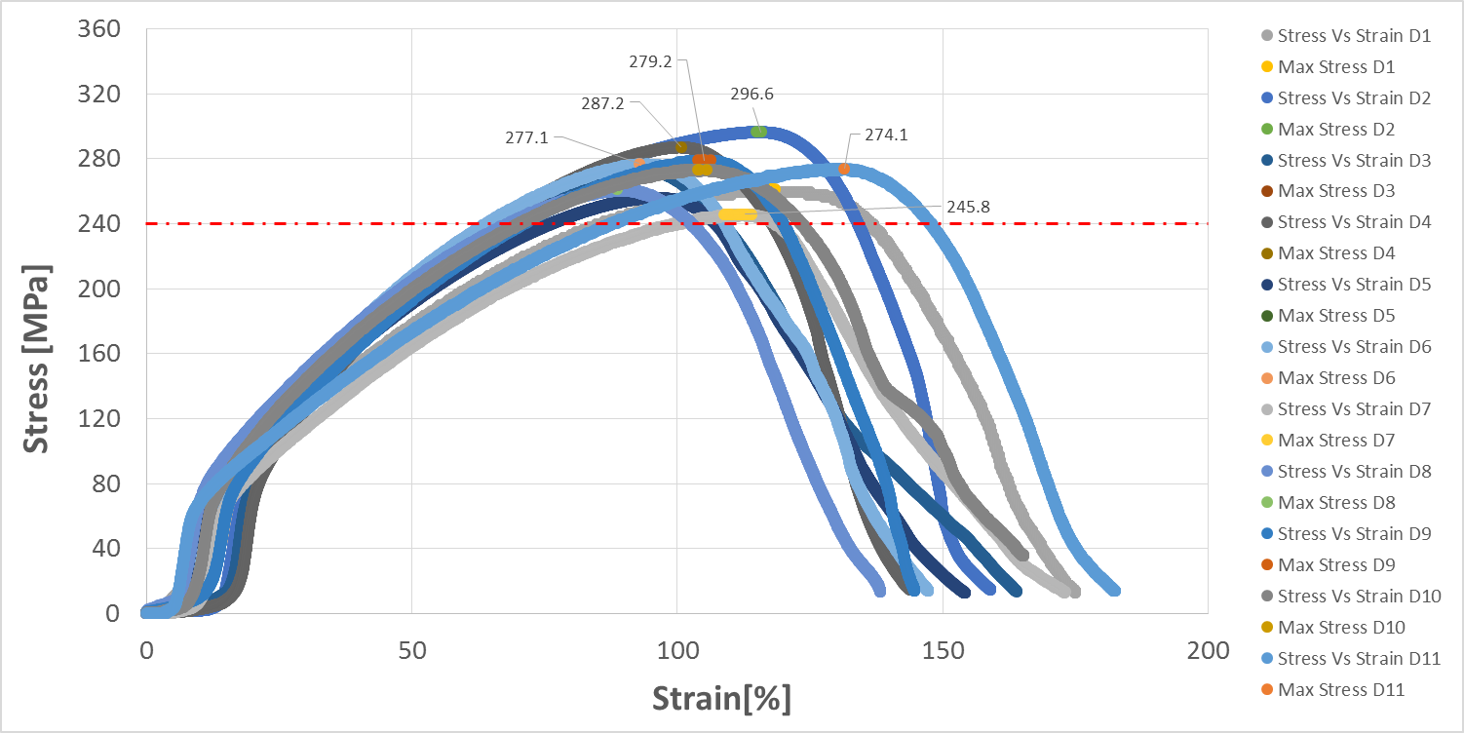
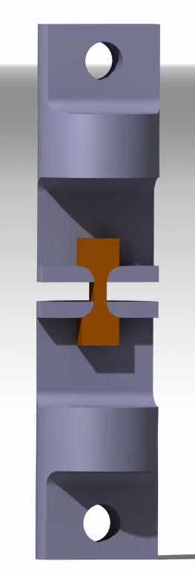
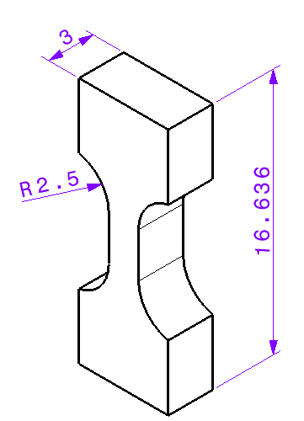
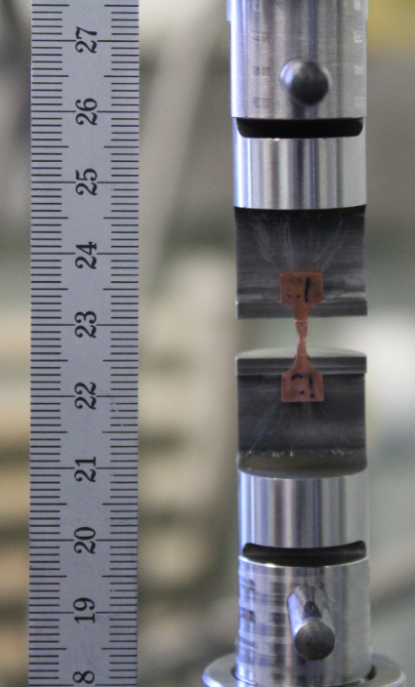
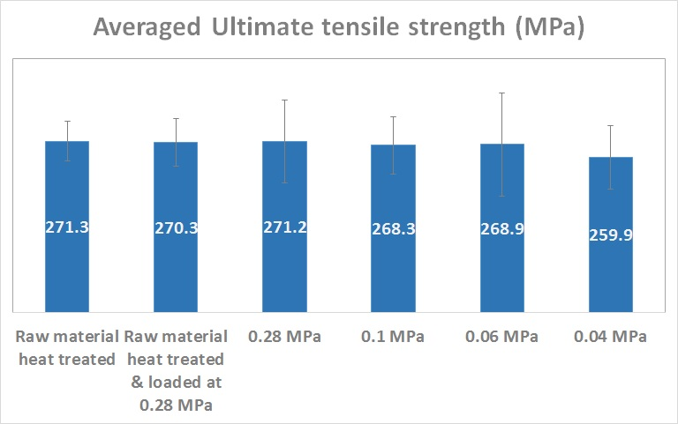
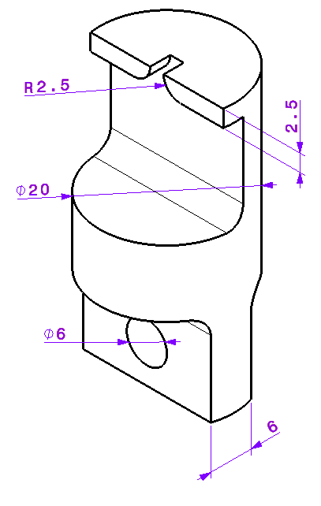
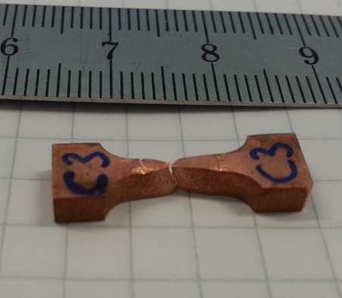
Assessing the bonding quality
Tensile tests used to quantitatively asses bonding quality
Comparison with raw and heat treated copper
Average tensile strength is similar for all bonded samples
Spread increases for bonded samples
Bonding quality is good in all cases!

Slide 15
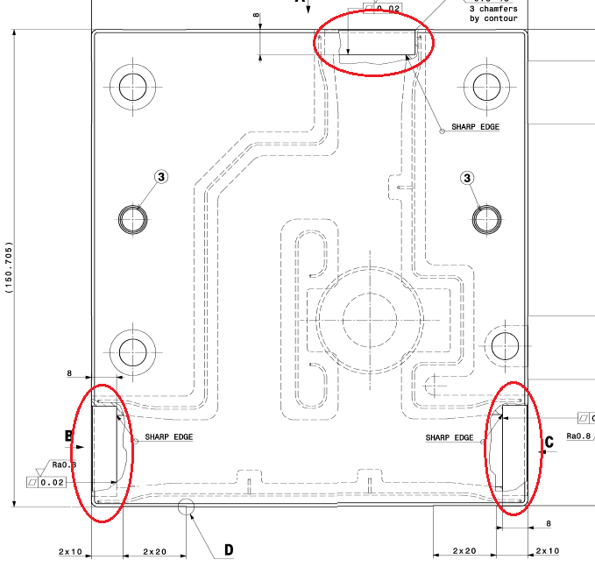
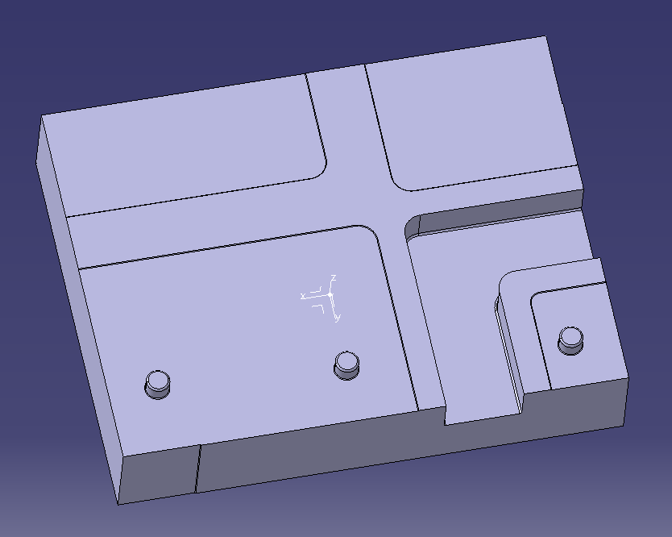
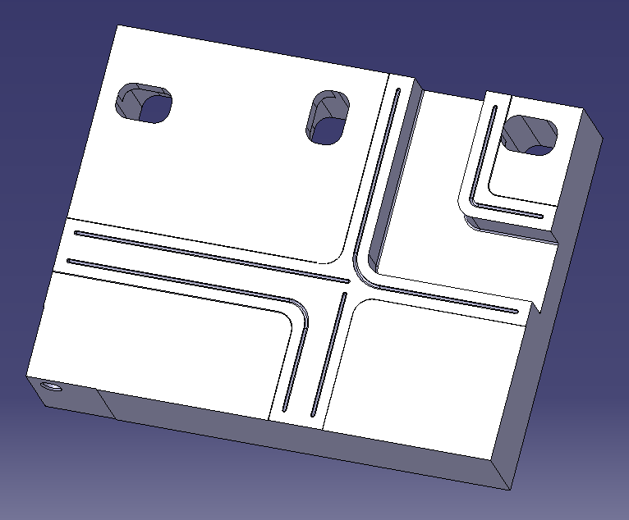
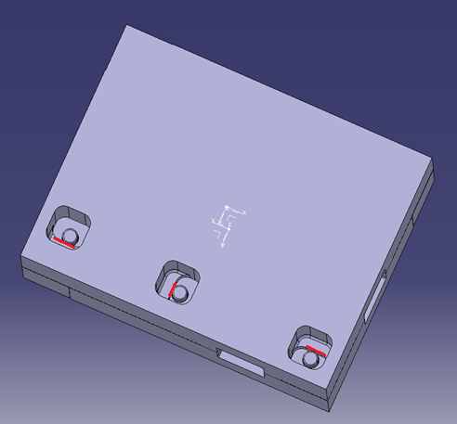

Alignment features study
Ensure perfect alignment of components and structures made from halves
  Improve performance by minimizing steps
  Avoid re-machining of the waveguides
  Relaxing tolerances in external surfaces

Slide 16
Conclusions and future
Steady production of CLIC prototypes
  Introducing functional changes in the already existing structures
  Quality assurance improved.
  Feedback on design
Procurement of disk re-started
  2 new T24 prototypes under procurement
Assembly fully outsourced to industry
  Full technical specifications
  Call for tender launched to qualified companies
New CLIC G* prototype mechanical design and procurement for 2016
On-going studies for structures and components
  Cu-SiC joining, Additive methods
Increasing industrial involvement in fabrication
  Machining, forming, brazing, coatings, joining, assembly, etc.

