Slide 1
Paul Scherrer Institut
Riccardo Zennaro
SwissFEL: structure and component fabrication status

Slide 2
SwissFEL in a nutshell
ARAMIS
  Hard X-ray FEL, λ=0.1-0.7 nm
  Linear polarization, variable gap, in-vacuum undulators
  First users 2017
  Operation modes: SASE & self seeded
ATHOS
  Soft X-ray FEL, λ=0.7-7.0 nm
  Variable polarization, Apple III (Apple-X?) undulators
  First users 2019, 2020?
  Operation modes: SASE & self seeded
  Main parameters
  Wavelength from 0.1nm–7nm
  Photon energy 0.2-12 keV
  Pulse duration 1 fs - 20 fs
  e⁻ Energy (0.1 nm) 5.8 GeV
  e⁻ Bunch charge 10-200 pC
  Repetition rate 100 Hz

Slide 3
Schedule overview
tech. infrastructure
2015 | Q1
 | Q2
 | Q3
 | Q4
2016 | Q1
 | Q2
 | Q3
 | Q4
2017 | Q1
 | Q2
 | Q3
 | Q4
machine installation
Building completed
TIME
RF modulators
photonics installation
Start injector commissioning
First electron beam through Aramis undulator line
Start first experiments with E_{ph}=3.4 keV
Start first experiments with E_{ph}=12.4 keV

Slide 4
Talk’s introduction
This talk presents the activities in PSI concerning only the passive C-band components
Module’s component
Structure production x 104 in house
Cell production x ~12000 VDL ETG CH
J-couplers production x 208 VDL ETG
Pulse compressor “BOC” x 27 in house
Waveguide production MHI-MS
Module assembly x 26+1 in house
~9m

Slide 5
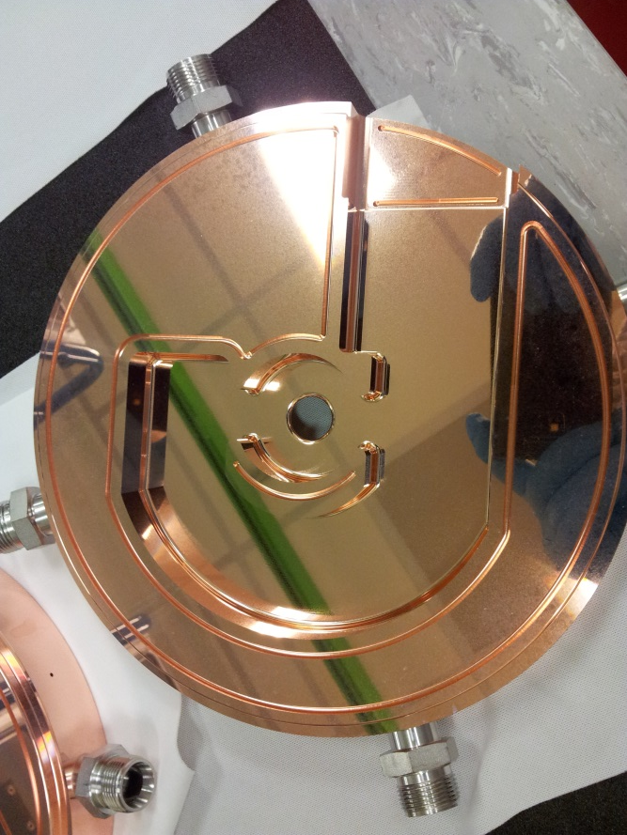
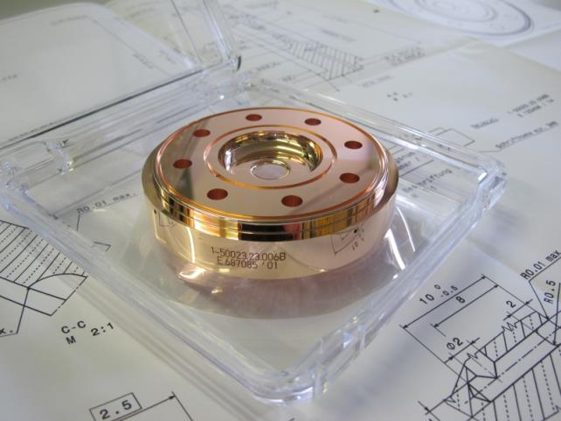
Cups and J-couplers production
Coupler production from VDL ETG on schedule
Disk production from VDL ETG Switzerland on schedule and around 10-12 structures ahead of coupler production
Structure production dominated by delivery time of coupler production
PSI allowed VDL ETG Switzerland to switch from 3 shifts/day to 2 shifts/day

Slide 6
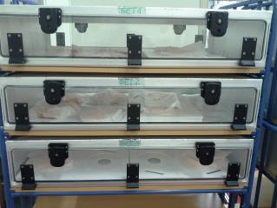
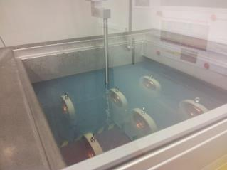
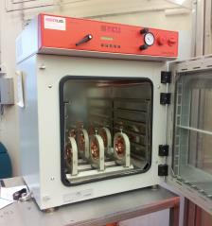
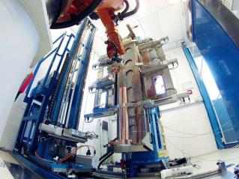
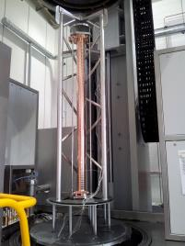
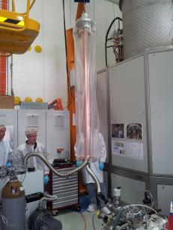
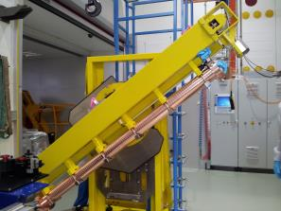
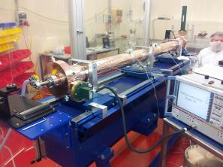
Structure production
1
2
3
4
Transport to Minor
Storage and transport under N2
Cup washing
Vacuum dryer
5
6
7
8
Heat treatment
in vacuum oven
Cooling channels pressure test
(with 9 bar nitrogen)
Disk stacking
Vacuum brazing
9
10
11
12
Wire insertion for the bead pulling
leak test for vacuum part and cooling channels
Structure reversed to horizontal position on a temporary girder
Bead pulling

Slide 7
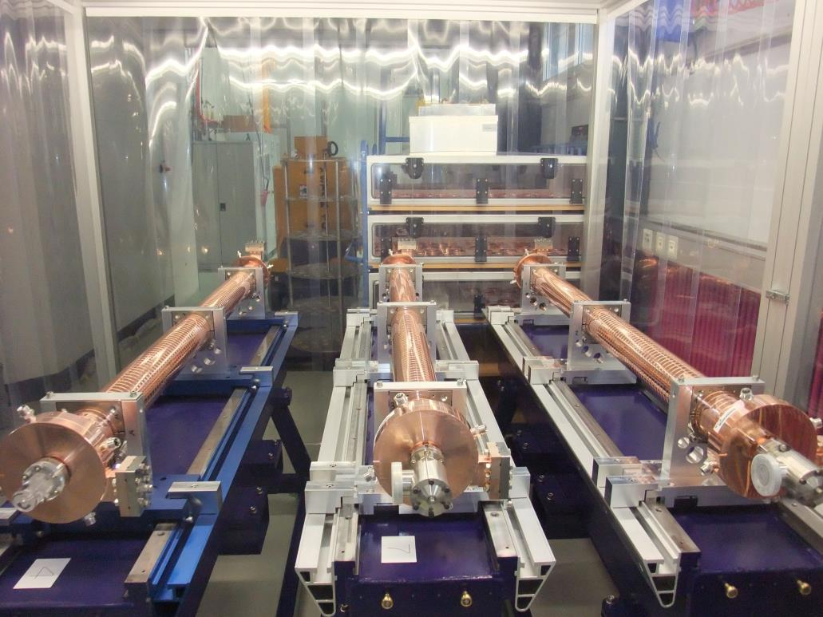
Accelerating structure: the final result
https://accelconf.web.cern.ch/accelconf/LINAC2012/papers/tupb012.pdf
J. Y. Raguin et M. Bopp
Design
http://accelconf.web.cern.ch/AccelConf/LINAC2014/papers/mopp119.pdf
R. Zennaro et al.
Power test

Slide 8
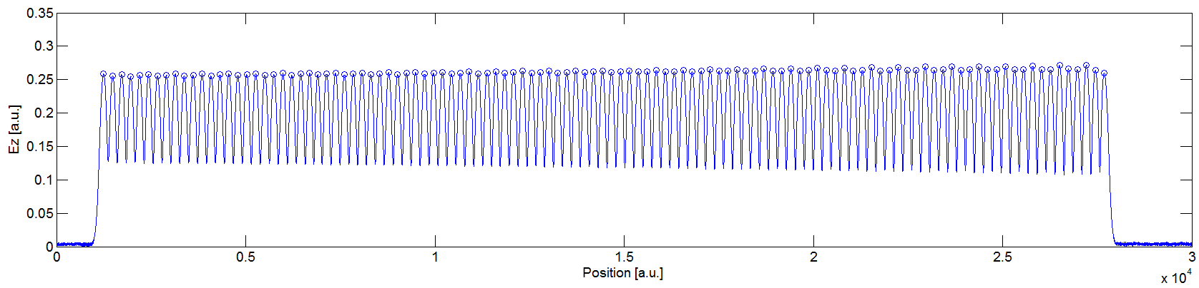
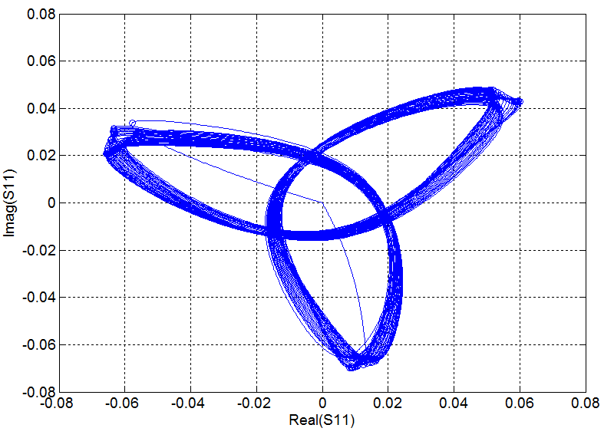
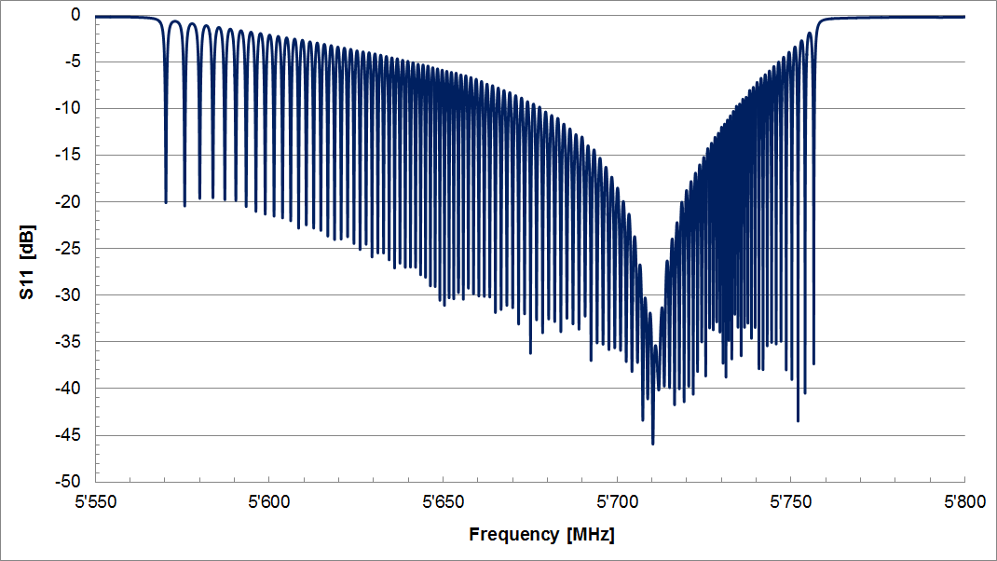
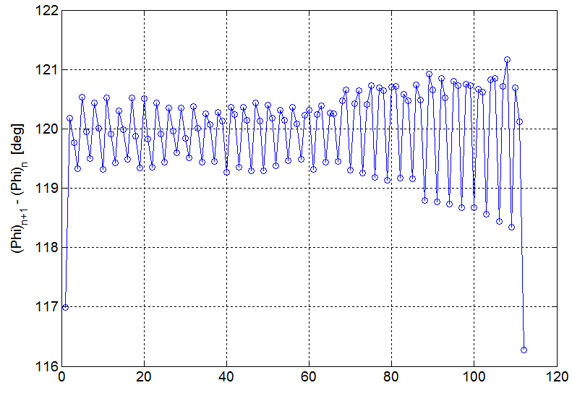
RF measurements: example
Optimal T_{op.} in vacuum: 28.3°C
S11 = -35.4 dB
RMS (ph. adv. – 120°) = 0.64°
N.B. No tuning applied

Slide 9
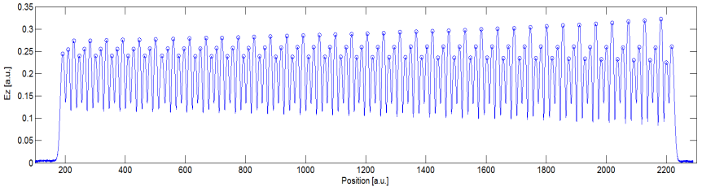
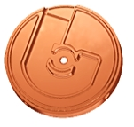
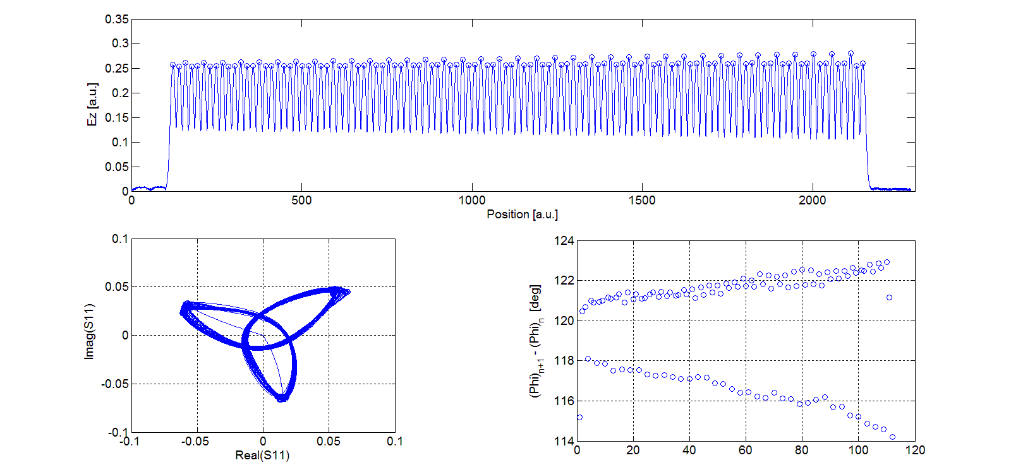
Coupler brazing problems
From RF measurements there is the evidence of a serious problem in the output coupler of T12 and T14. S22 is respectively -11 dB and -14 dB and S11 is around -20 dB for both. From the inspection with an endoscope we suspect to have brazing issues in the output coupler. By drilling a hole from outside to the “central island” of the J-coupler the structure is not vacuum tight anymore. This confirms the suspects on the brazing issue. New brazing alloy was inserted through these holes and the two structures successfully re-brazed.
J-coupler “central island”
T14 first bead pulling (phase adv./cell rms 10.1°)
T14 bead pulling after reparation (phase adv./cell rms 2.5°)

Slide 10
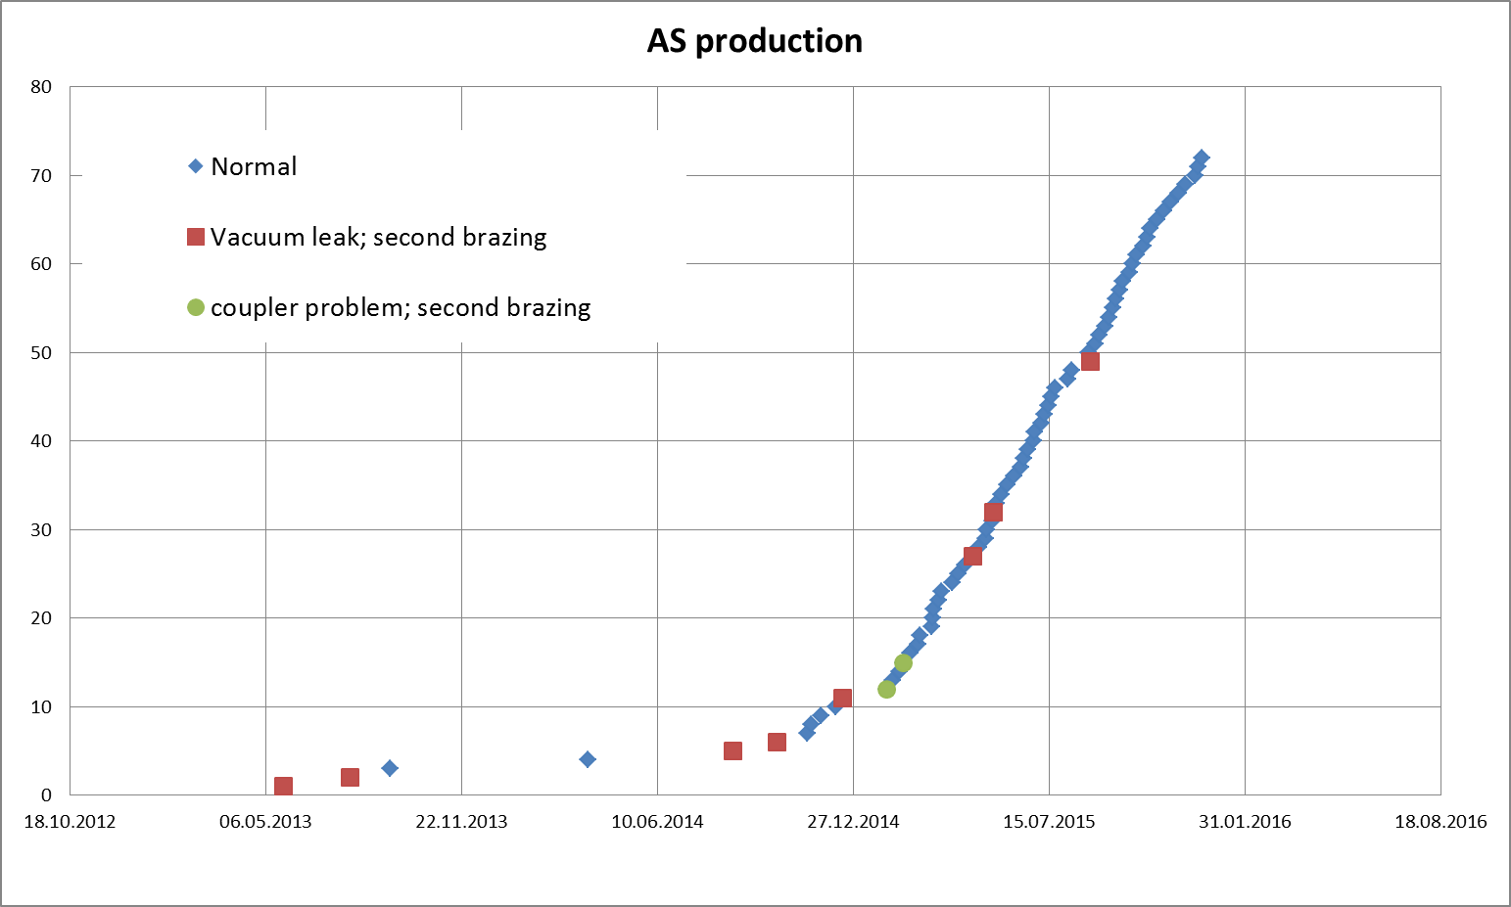
Structure production
Serial production starts
10 structure had problems, 8 of them had multiple vacuum leaks in between the cups, two had brazing problems in the output coupler. All these 10 structures required a second brazing. The frequency of these problems seems to be largely reduced.

Slide 11
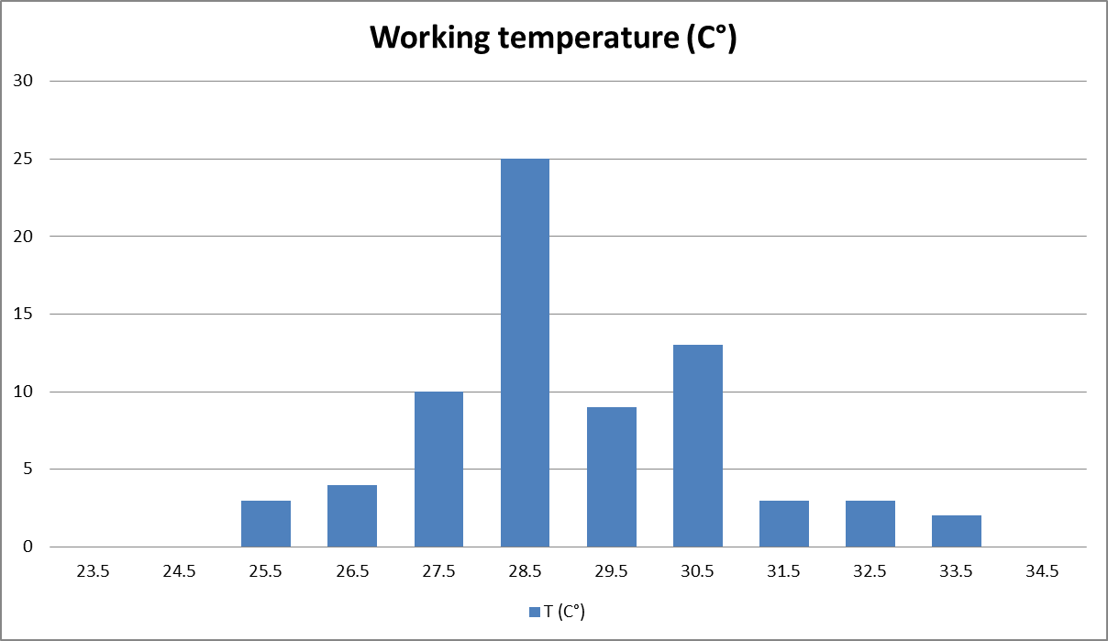
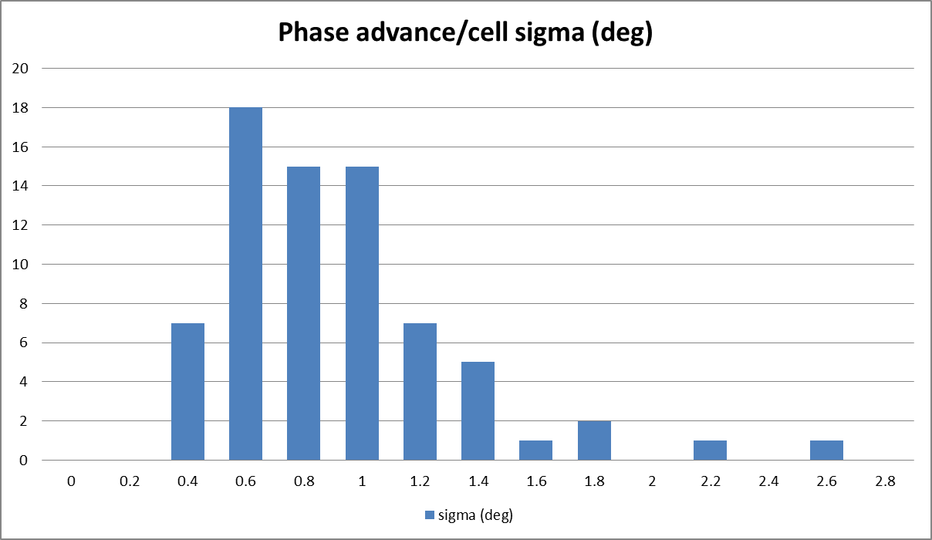
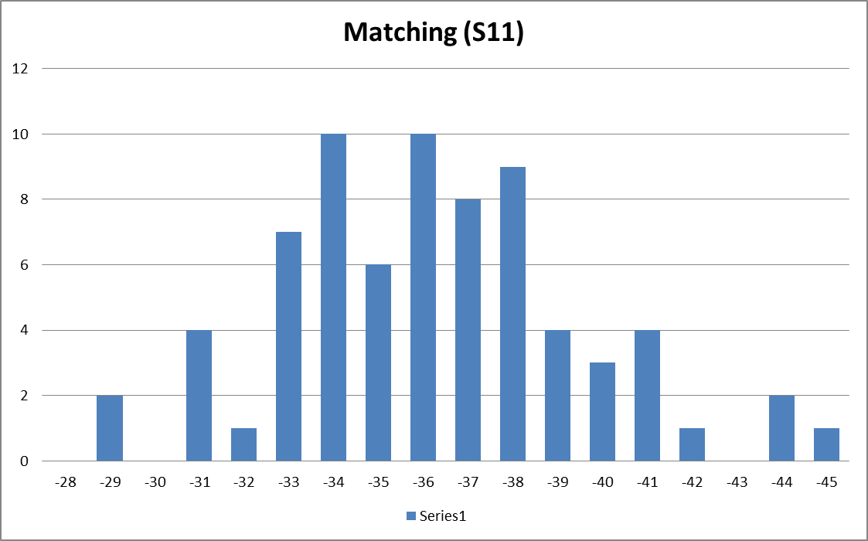
AC statistics
Pre-series production
T14 Re-brazed coupler

Slide 12
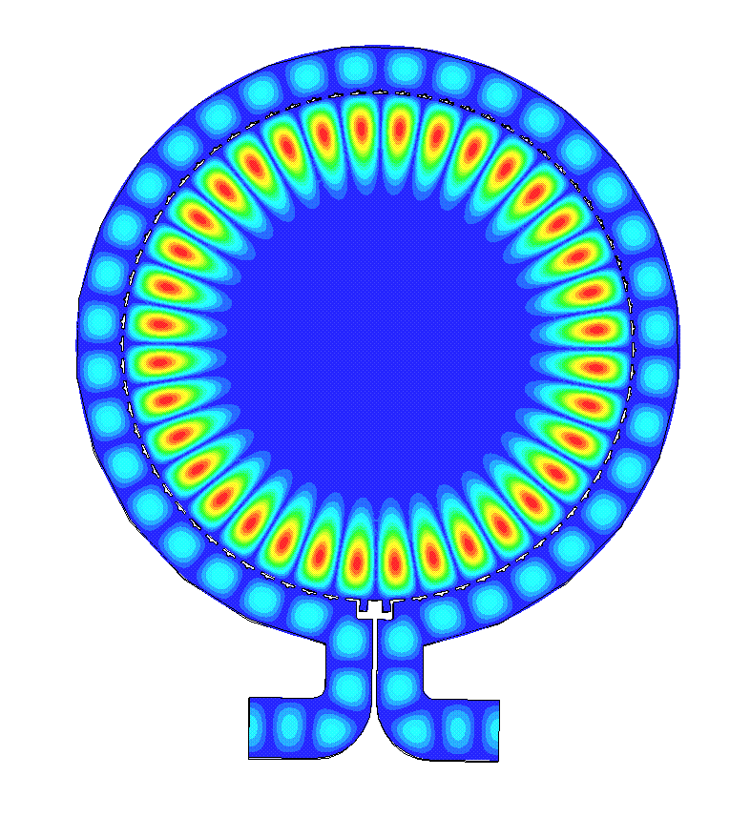
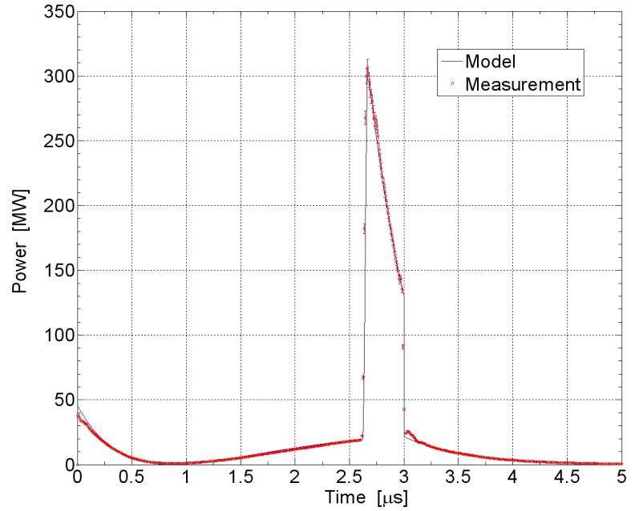
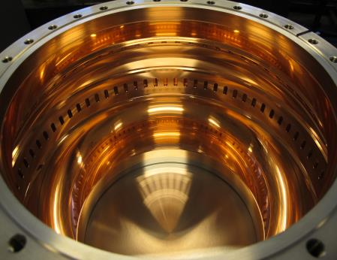
BOC: introduction
The BOC is a Barrel Open Cavity using the TM_{18,1,1} mode. It is designed to operate at 5712 MHz and with a maximum input power of 50 MW for 3 μs and 100 Hz. Combined with our structures (330 ns filling time) the energy multiplication factor is 2.13.
TM_{18,1,1} resonance: snapshot of the magnitude of the electric field in the middle plane.
Compressed pulsed from 50 MW 3 μs
5*10⁻⁷ BDR at 40 MW 3 μs and 3*10⁻⁸ at 35 MW 3 μs
R. Zennaro et al., C-band RF pulse compressor for SwissFEL,
IPAC 2013 Conference, Shanghai, China, 2013. https://accelconf.web.cern.ch/accelconf/IPAC2013/papers/wepfi059.pdf

Slide 13
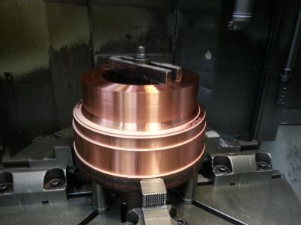
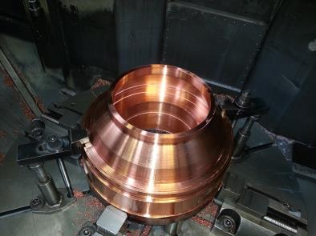
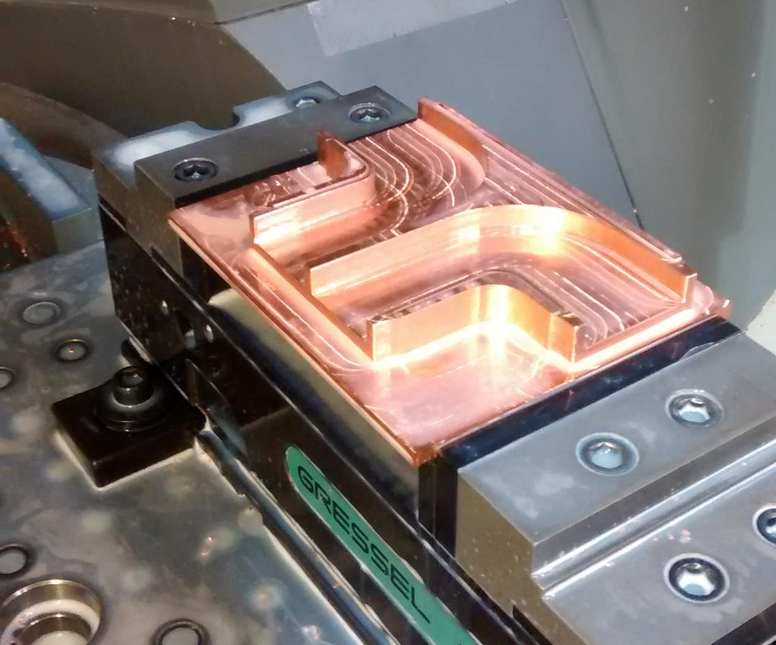
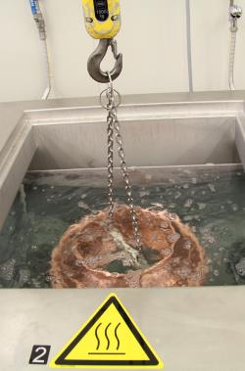
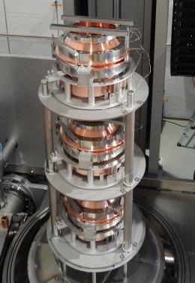
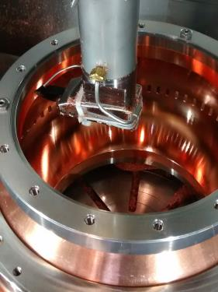
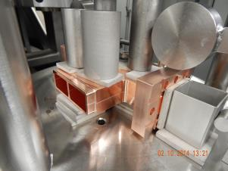
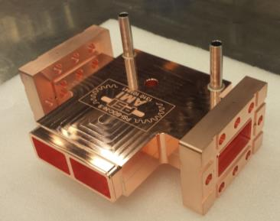
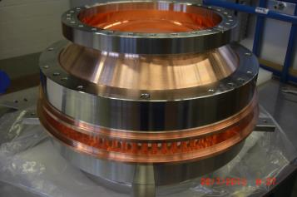
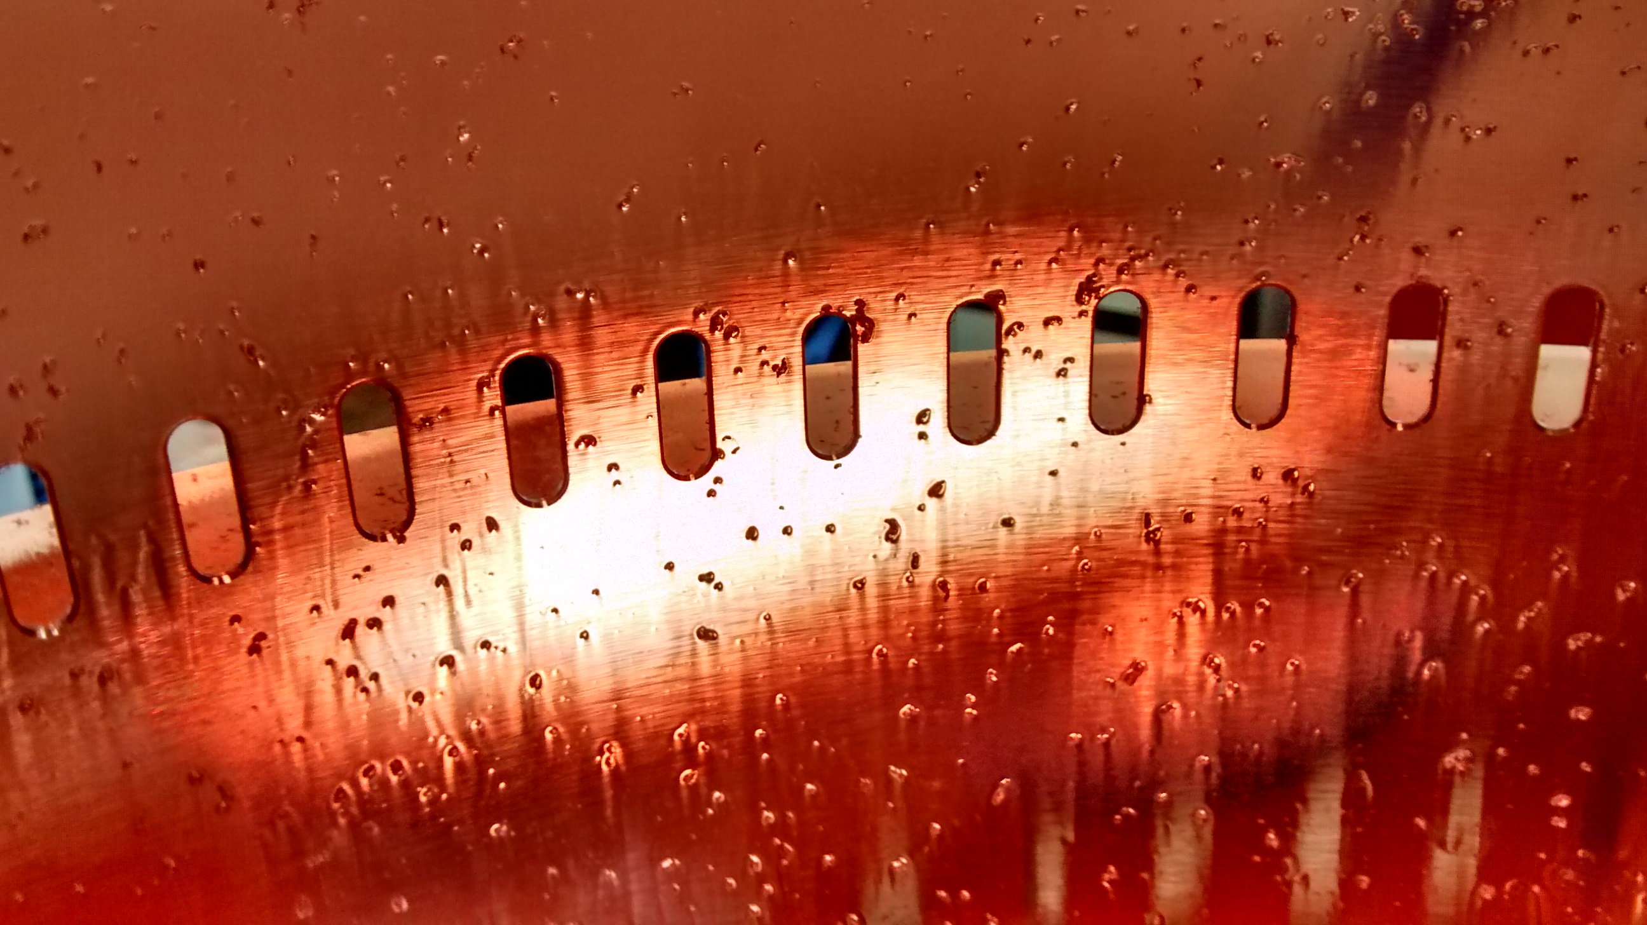
BOC production
1
2
1
3
4
5
2
3
6a
6b
Central body
Coupler

Slide 14
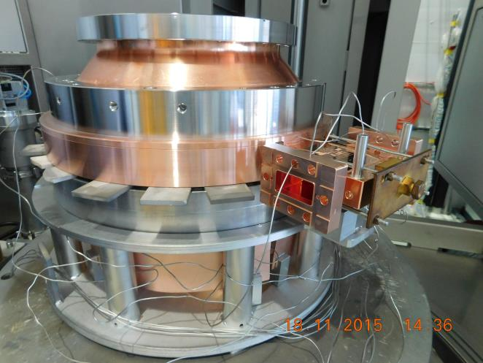
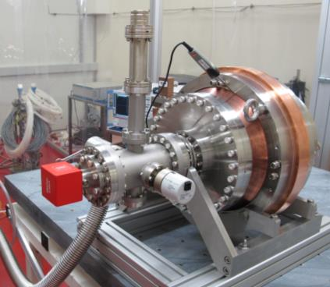
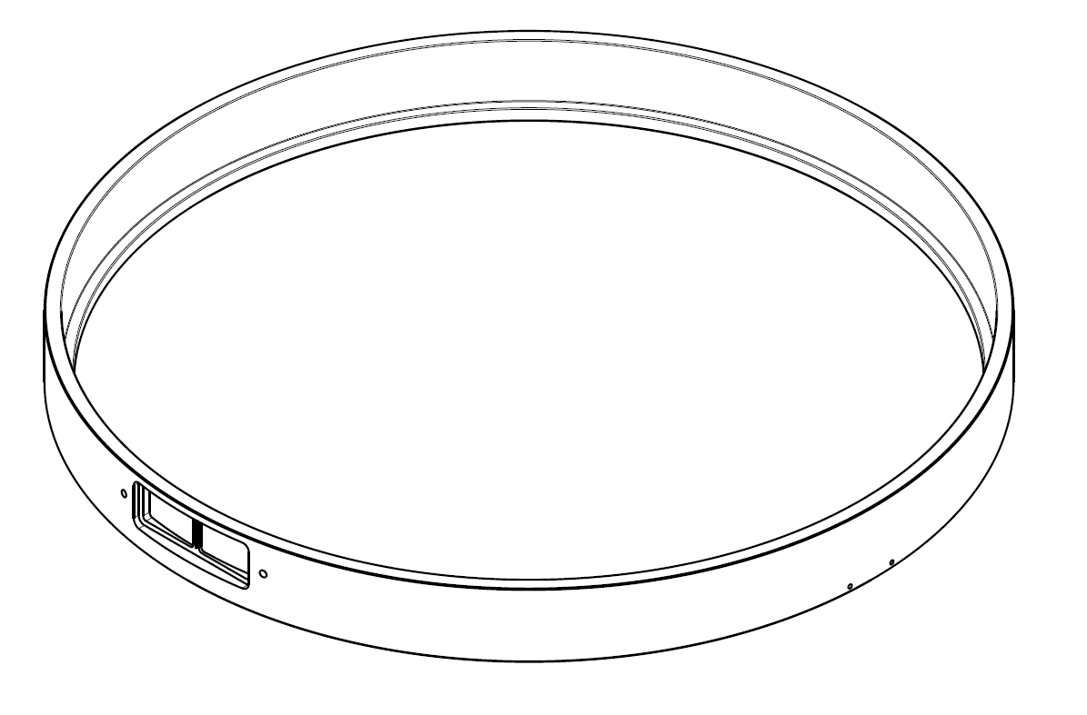
BOC production
Central body
+
External ring
+
Second brazing
Final vacuum and RF tests
Coupler

Slide 15
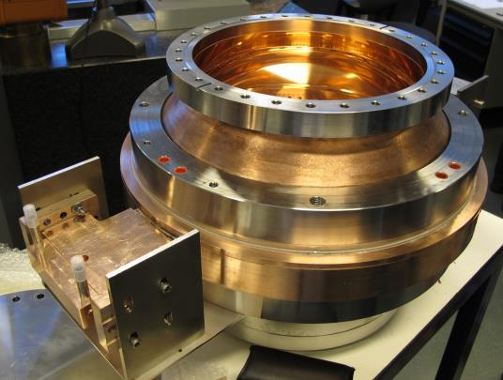
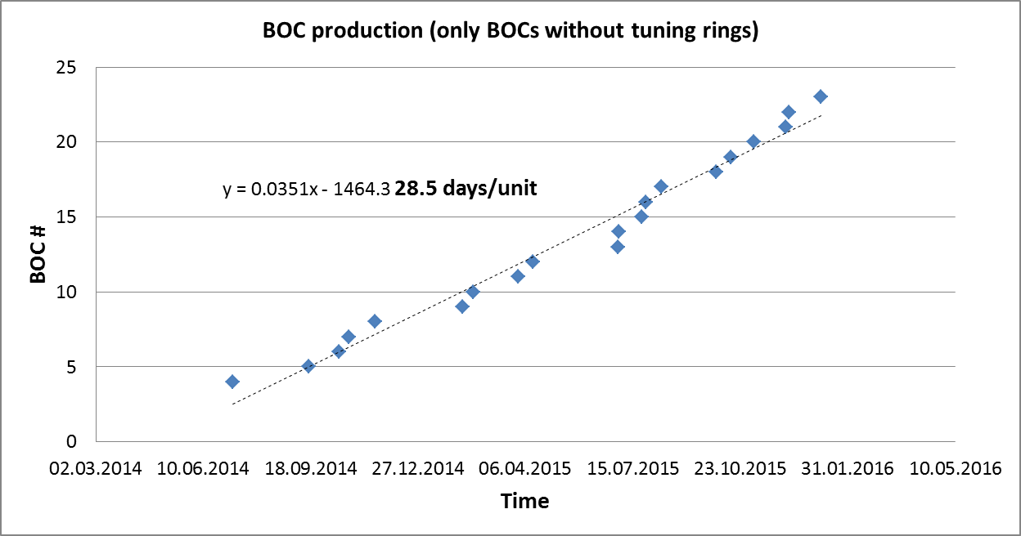
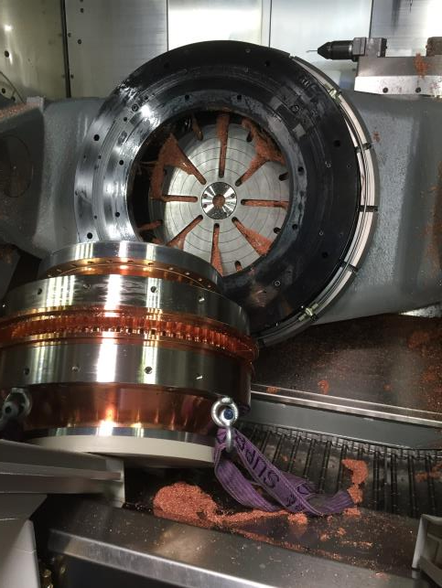
BOC production
We have completed the production of 24 BOC, one from VDL (prototype) and 23 by PSI.
Things not always go as they should (this BOC was brazed anyway and it was on frequency).

Slide 16
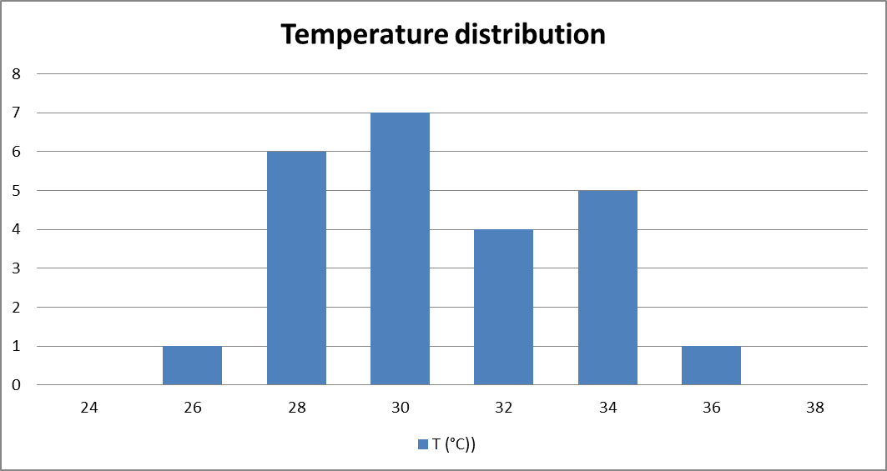
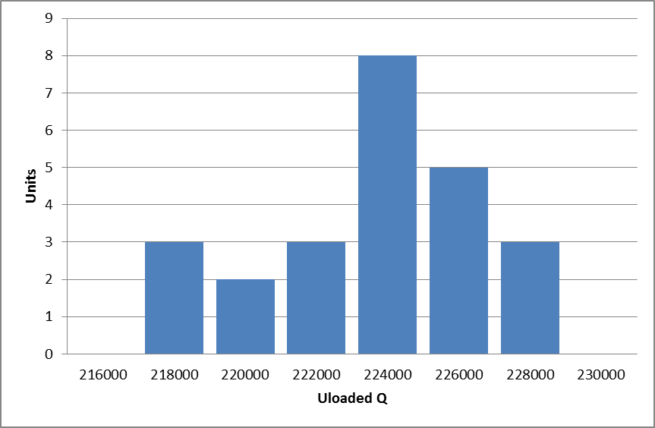
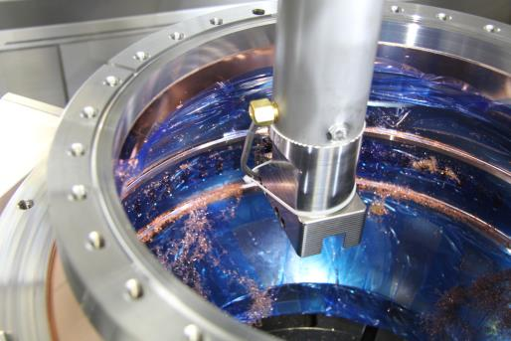
BOC production
New design: the number of tuning steps has been gradually reduced from 4 to 0.
Starting from BOC 4 the two tuning ring have completely removed requiring a small adjustment of the RF design.
Advantages:
By removing completely the tuning rings we do not need anymore the machining of the rings, the final washing of the BOC and a baking cycle in the vacuum oven. Around 1 week /BOC time saving.
We expect to have better high power performance (cleaner surface) and reduction of the field enhancement (no rings and much better control of the surface quality)
Disadvantages:
Risk to have unusable BOCs (wrong frequency)
Machining of the tuning rings in the old design
Frequency and Q reproducibility is good also without tuning rings.

Slide 17
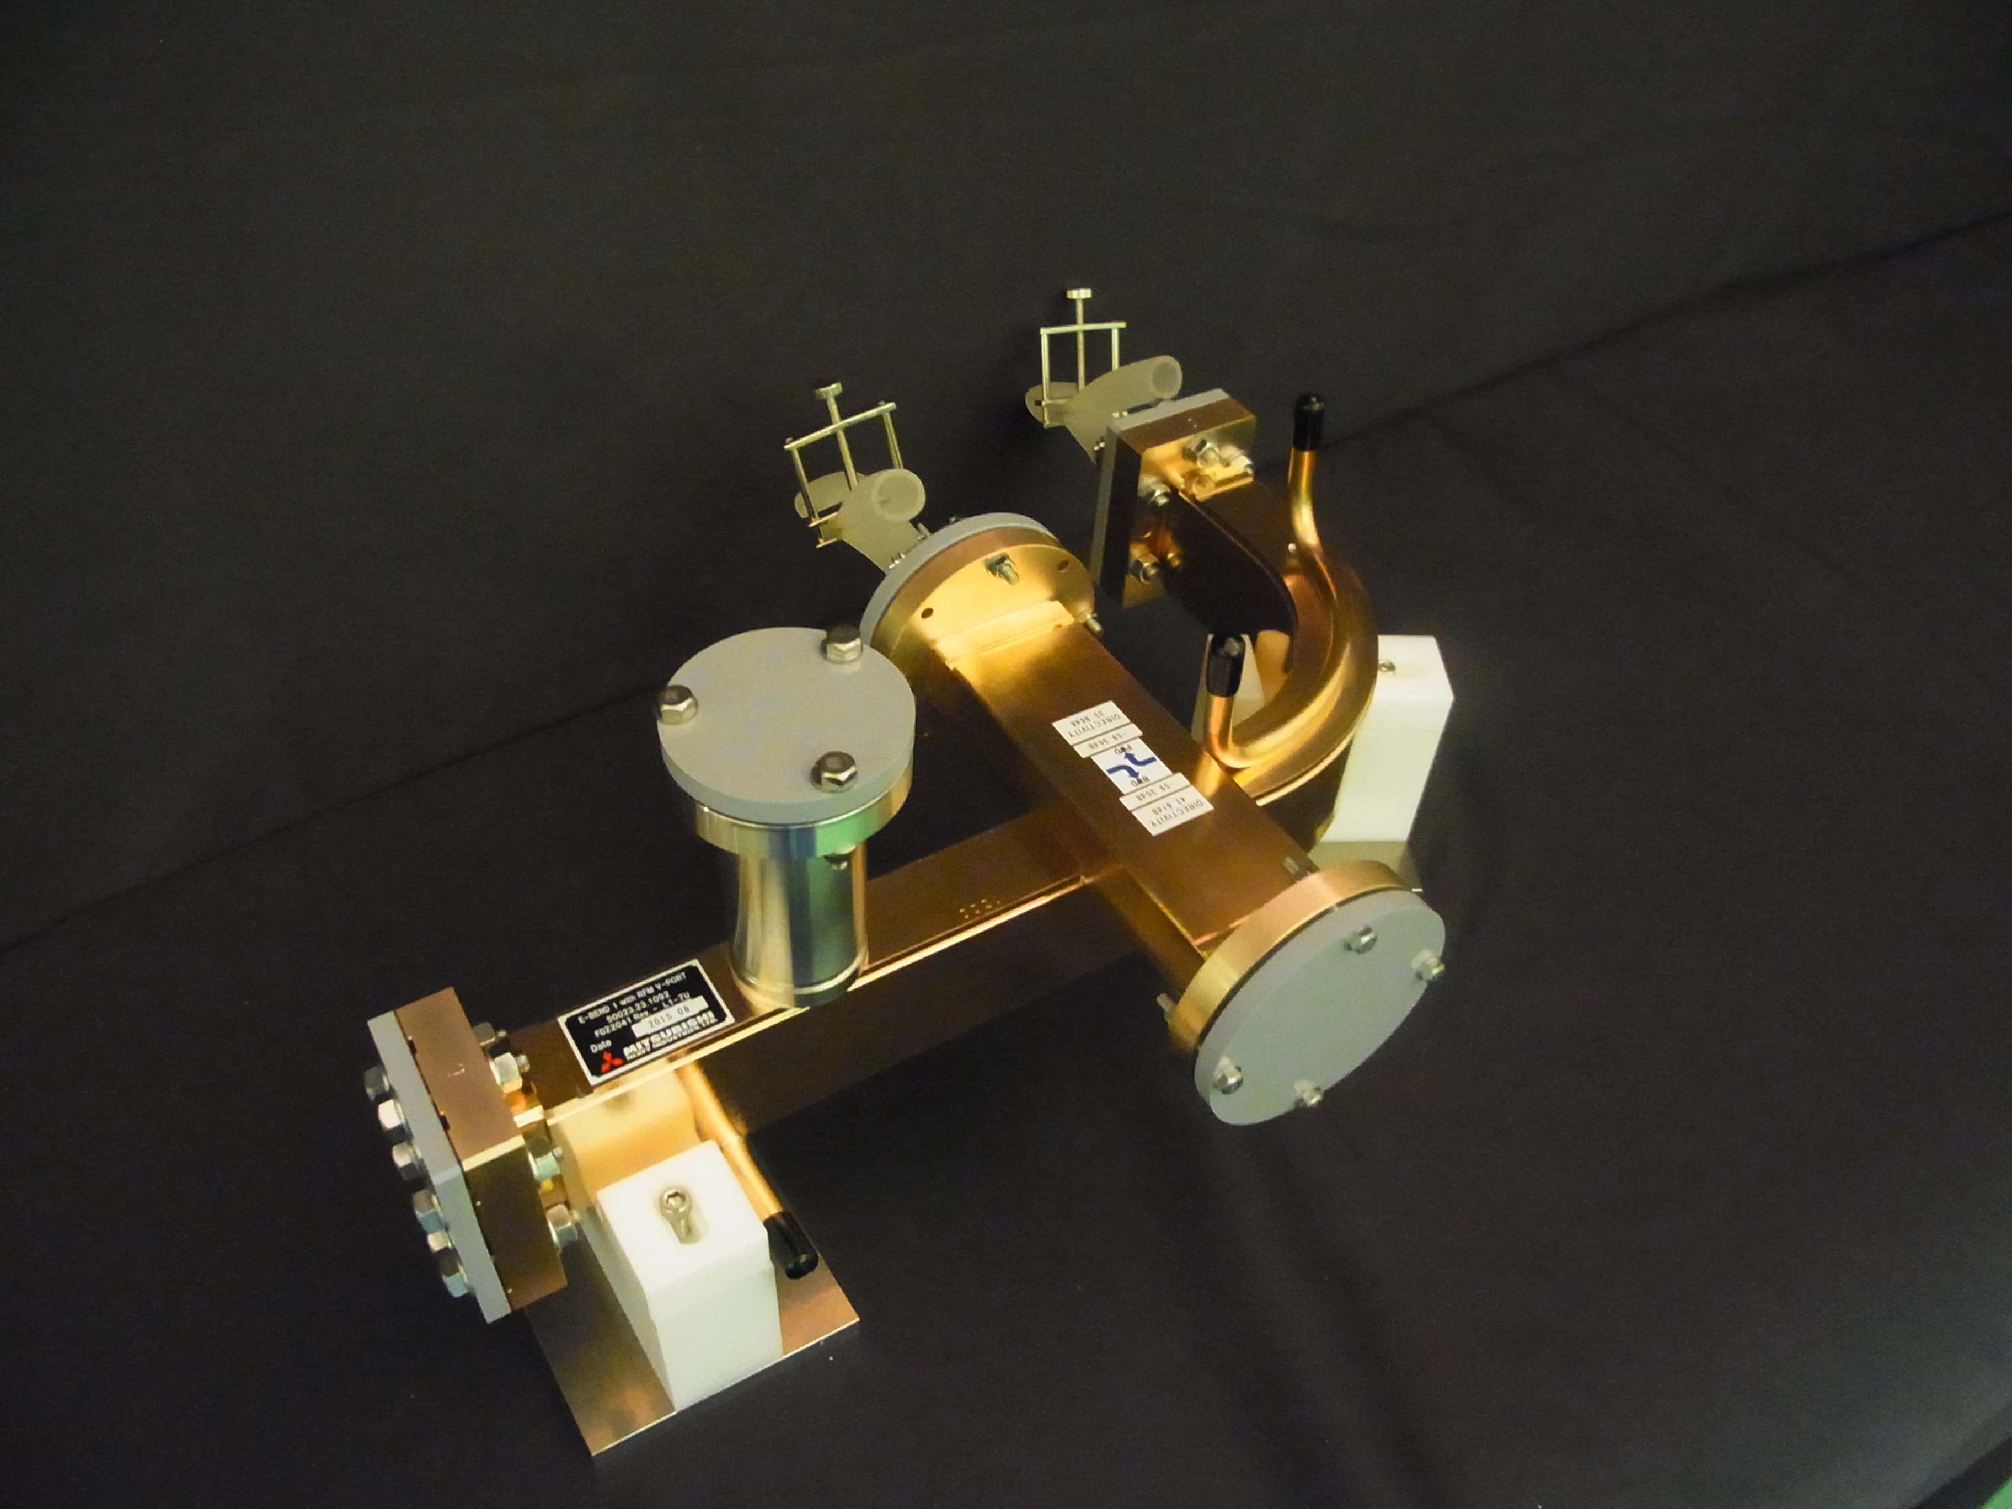
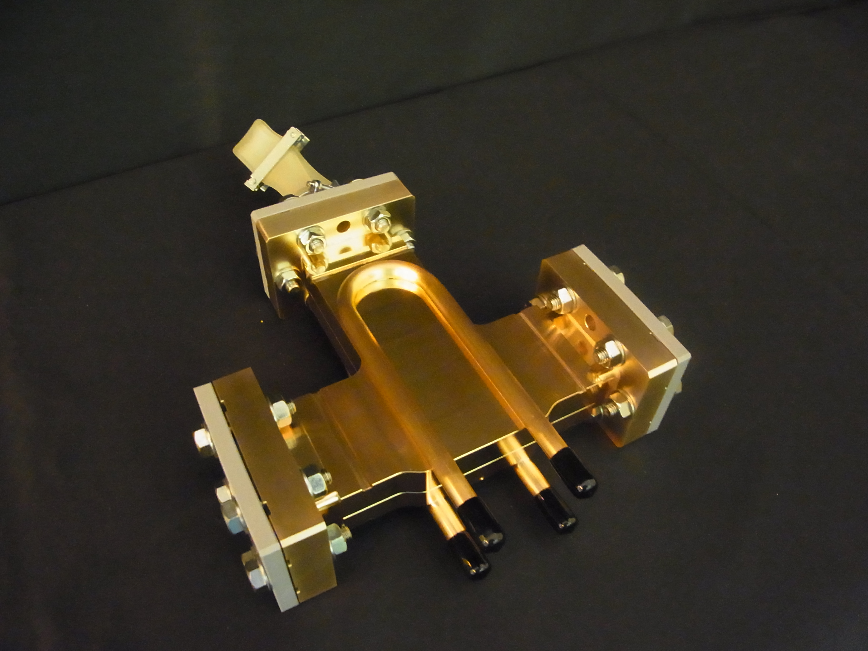
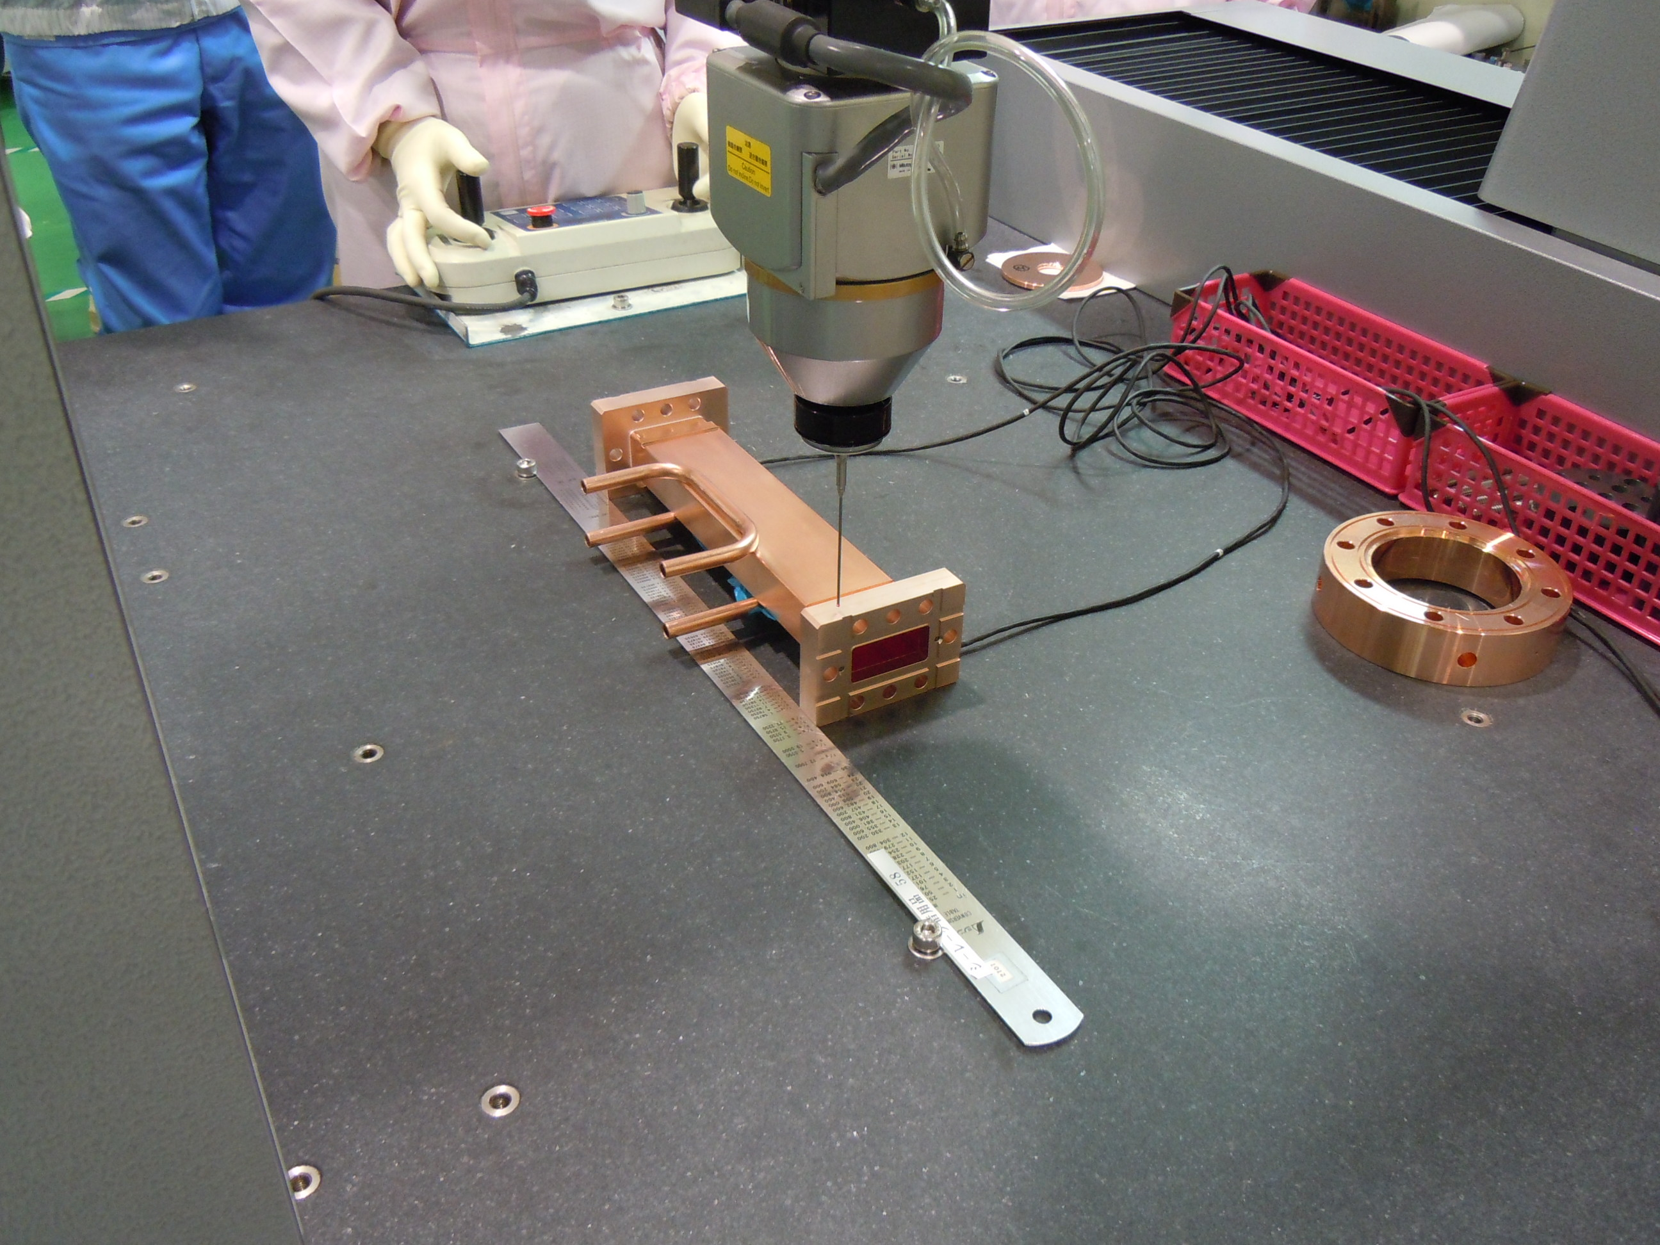
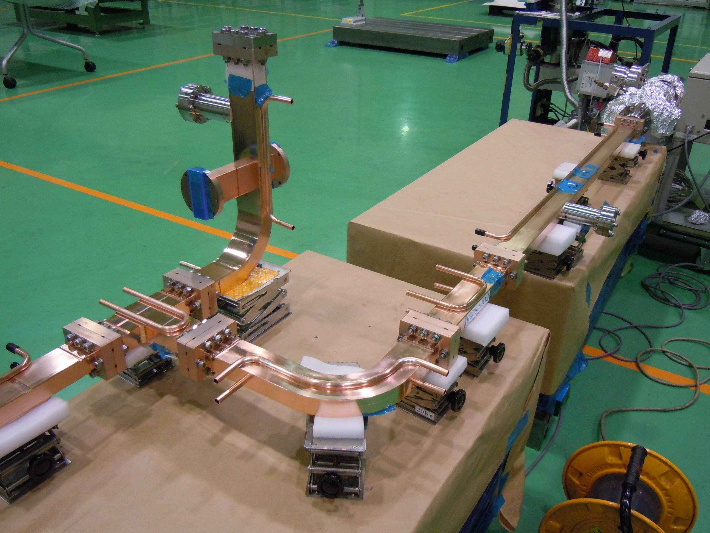
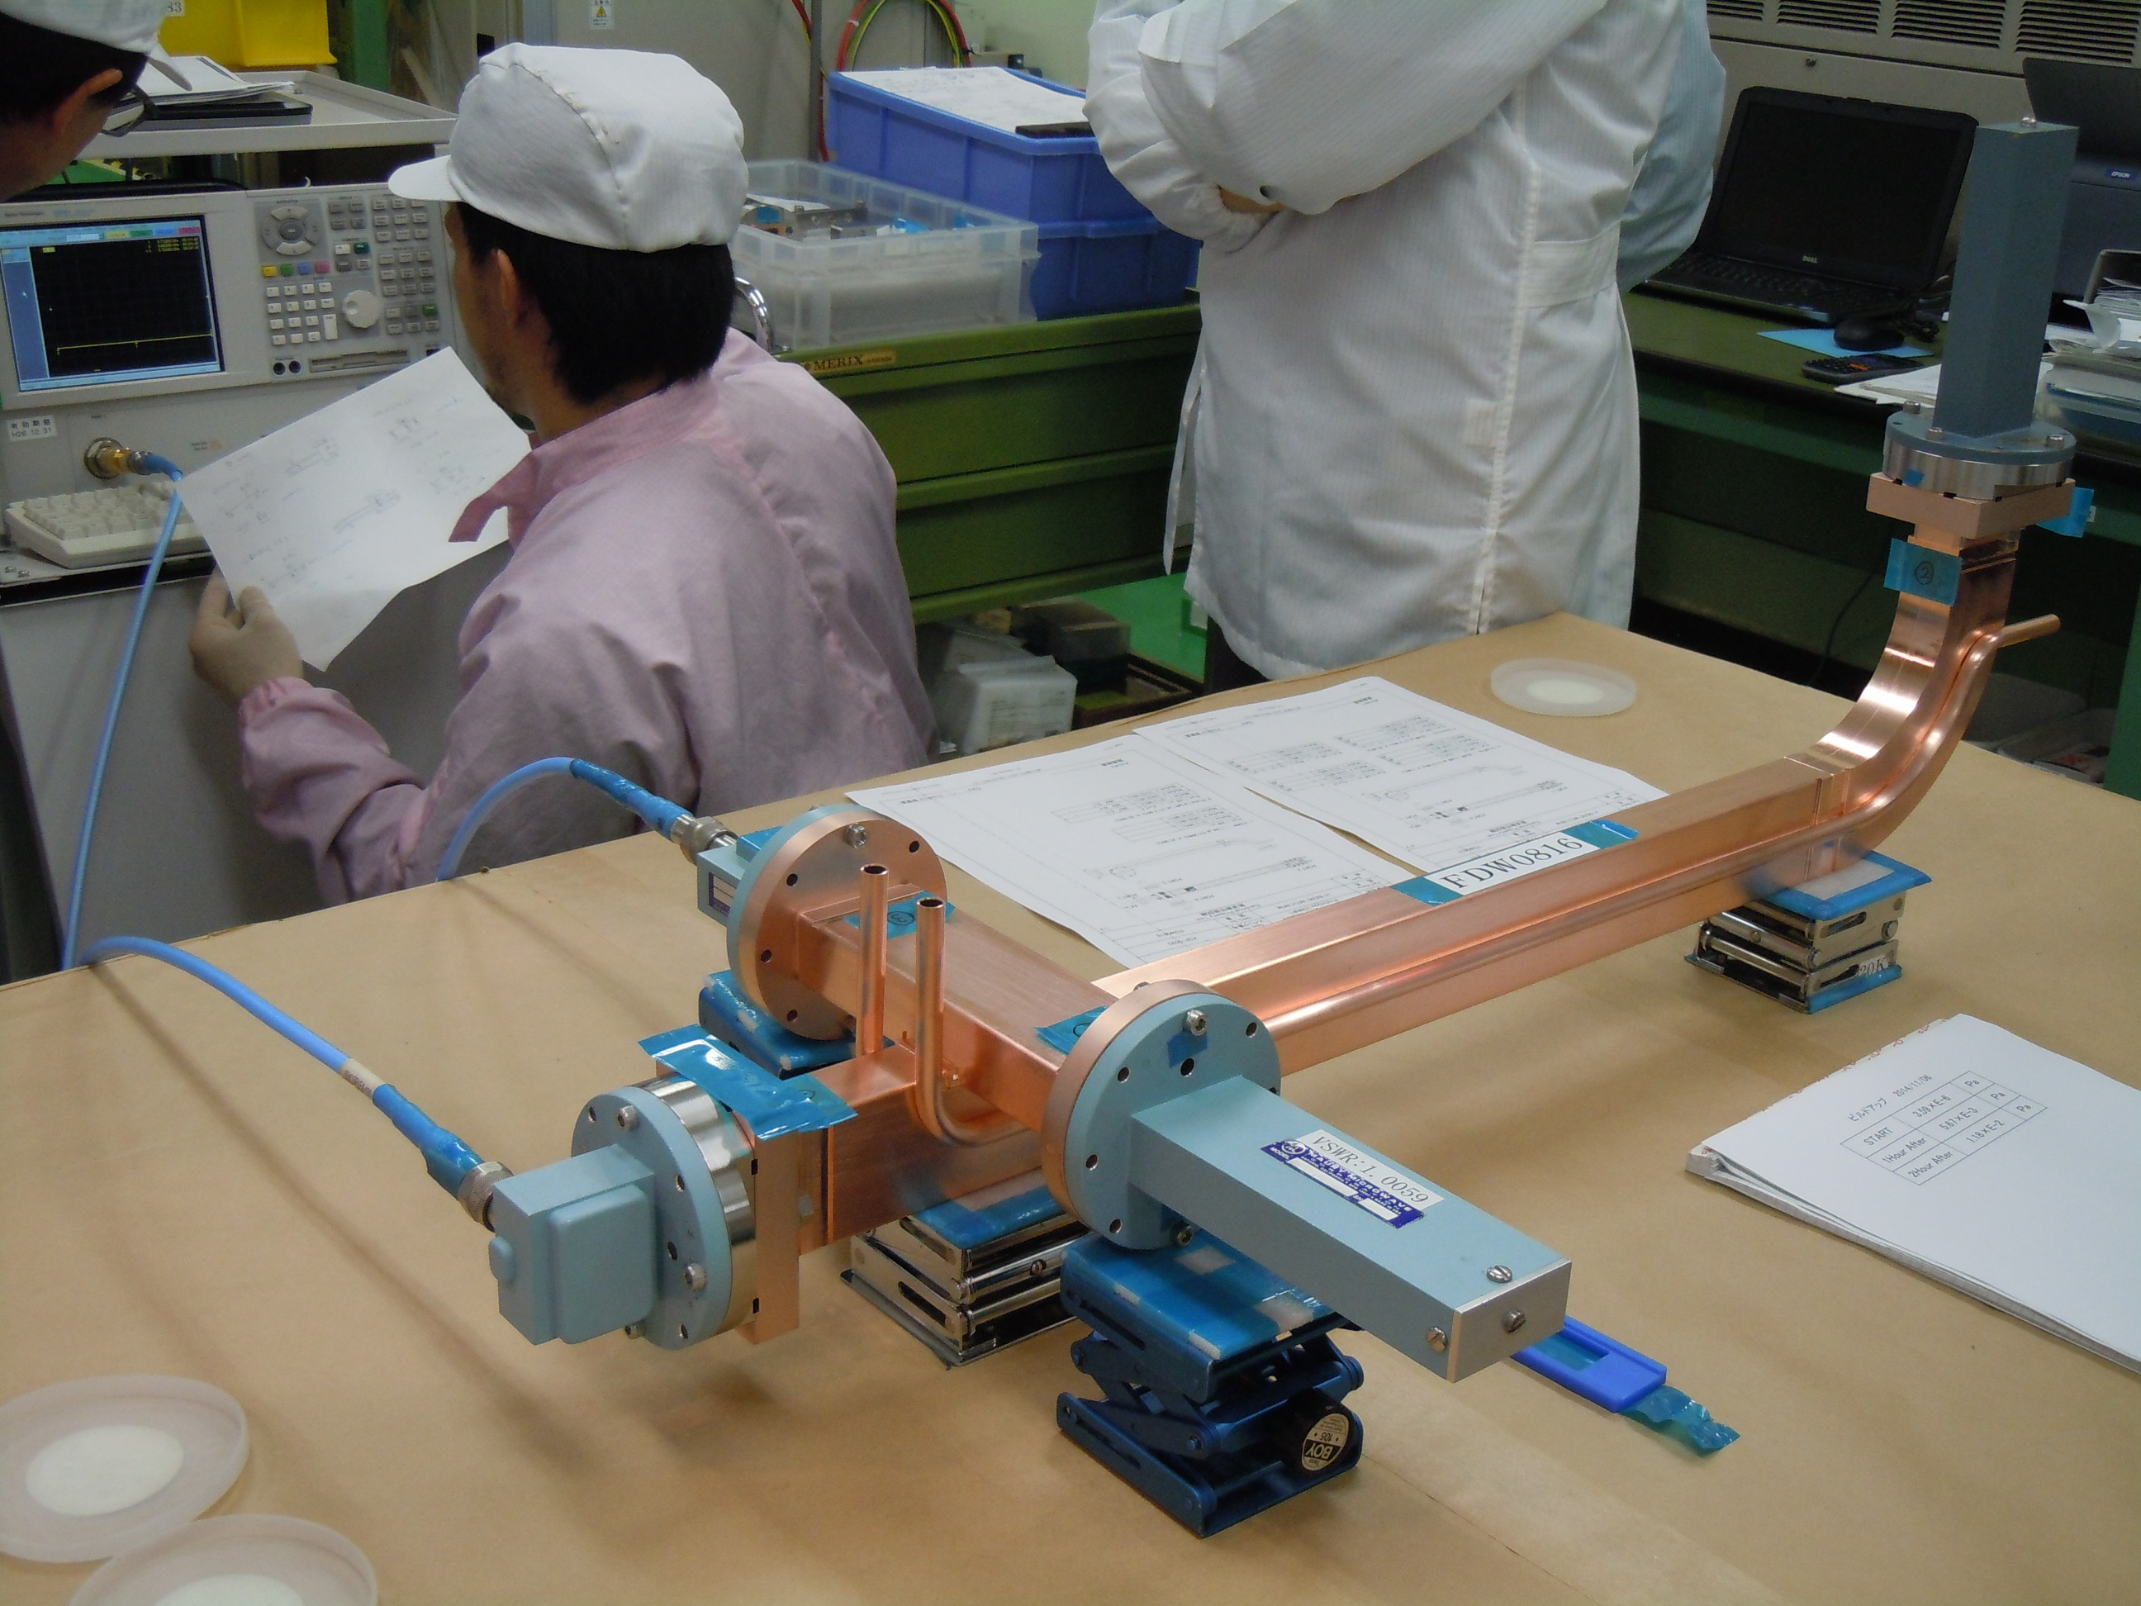
C-band waveguides
1
All the C-band waveguide are delivered by MHI-MS^{[1]}
Some RF waveguide components such as the RF monitors and splitter have been designed together with PSI (Fig. 1,2)
The quality control includes RF characterization, outgassing rate and RGA analysis (Fig. 3,4)
Due to the compactness and consequently the rigidity of the waveguide assembly the mechanical tolerances are quite small
Each piece of waveguide undergoes to metrology measurements (Fig. 5)
Three short spacers are produced to allow submillimeter tolerances to the full assembled network
2
^{[1]} Mitsubishi Heavy Industries Mechatronics Systems, Ltd.
5
4
3

Slide 18
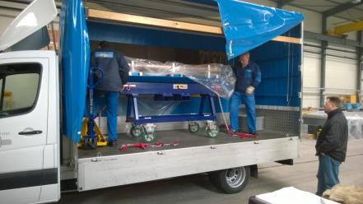





Module assembly 1
Structures are transported under nitrogen to ESFM; the Swissfel storage and assembly area. Here all the final girders are placed in proximity of the vacuum hatch. the structures are sorted by frequency (i.e. operating temperature) and placed into the final girder together with the BOC and magnets. The girder are so moved into the vacuum hatch by using the crane and opening the roof of the hatch. Here the module is aligned all components fully assembled and the waveguide tuned. To keep the schedule we should fully assemble a couple of module in four weeks. We recently increased the manpower.

Slide 19



Module transport and tunnel installation
The roof of the hatch is removed and each single girder is moved outside. It is transported to the SwissFEL tunnel and here installed and aligned.
At the moment 6/26 modules are installed in the SwissFEL.

Slide 20

C-band module schedule
We intend to install the last module in the SwissFEL tunnel in September 2016.
At the moment the structure production meets the schedule.

Slide 21


Deflecting cavities
Last module in Linac3
Deflecting cavities
PSI ordered two C-band deflecting cavities and related waveguides to MHI-MS
They will be ready for commissioning in October 2016
The two deflecting cavities we be powered by the last station of Linac3 using an high power RF switch
The waveguide switch is provided by Nihon Koshua
The power test of the switch is in progress

Slide 22
Conclusions
Cups: production is going very smoothly, quality under control; 83 sets already delivered
J-coupler, VDL is keeping the required production rate
Brazing, vacuum leaks on few structures, reason not clear, problem seems to be less and less frequent
72 structures produced so far
BOC production going on, new design without tuning rings,24 BOCs produced so far
Waveguide production on schedule
Module assembly proceeds without significant problems but it is very time consuming. New manpower to speed it up
Deflecting cavities have been ordered. Installation in September/October

