Slide 1
Phase Feedforward Status at CTF3
J. Roberts (CERN, Geneva, Switzerland; JAI, Oxford, UK),
P.K. Skowroński, R. Corsini (CERN, Geneva, Switzerland),
P.N. Burrows, G.B. Christian, C. Perry (JAI, Oxford University, UK),
A. Ghigo, F. Marcellini (INFN/LNF Frascati, Italy).

Slide 2
Overview
Introduction and status in 2014.
Improvements made in 2015:
  Hardware.
  Beam conditions.
  Correction setup.
Best results from 2015.
Remaining issues for 2016.

Slide 3
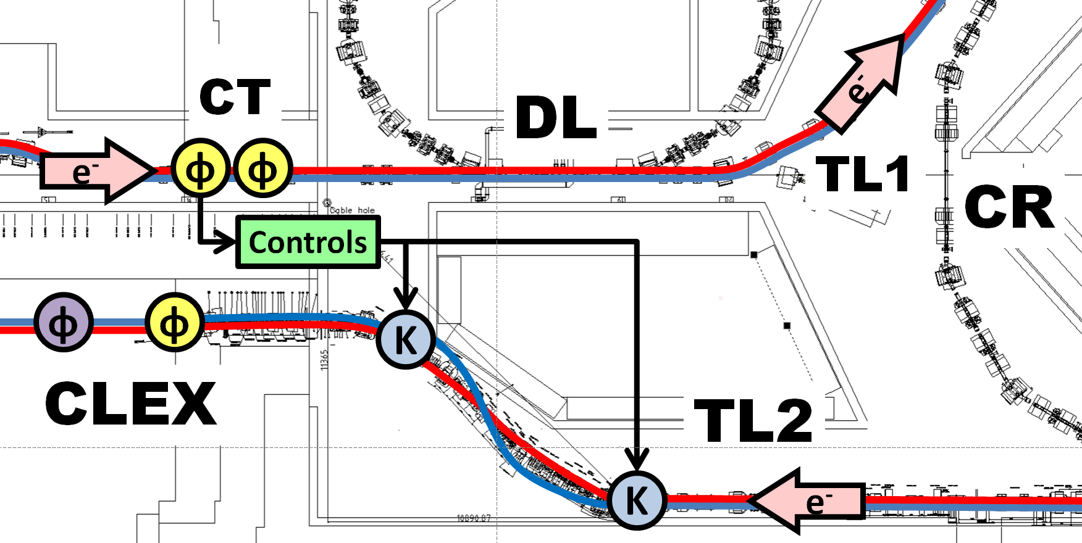
Introduction

Slide 4
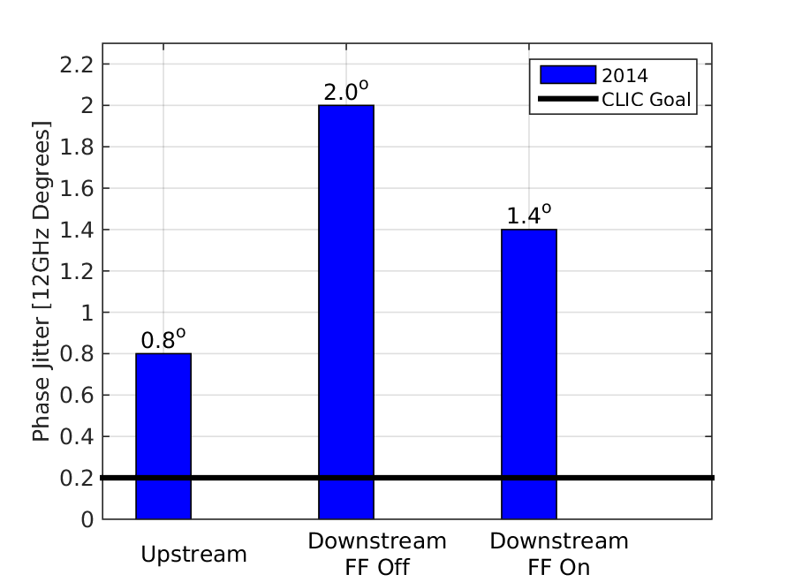
Status 2014
First feedforward tests in December 2014: hardware installations, timings setup etc.
Demonstrated ~30% reduction in downstream phase jitter from 2 degrees to 1.4 degrees.

Slide 5
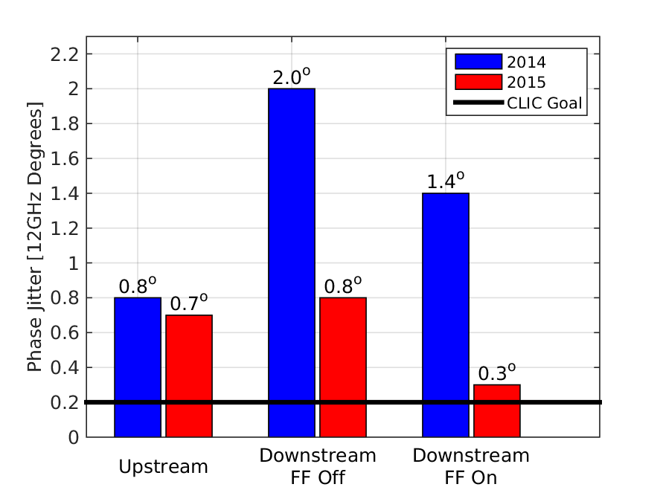
Status 2015
2.5x lower uncorrected downstream phase jitter (2 degrees -> 0.8 degrees).
5x lower corrected downstream phase jitter (1.4 degrees -> below 0.3 degrees).

Slide 6
Issues Limiting 2014 Performance
Phase propagation:
  Low correlation (~50%) and large jitter increase between the upstream (FF input) and downstream phase.
Phase monitor performance:
  Poor resolution: Up to 0.8 degrees instead of expected <0.2 degrees.
Correction range:
  Regularly saturating amplifier (±3 degrees range) with 2 degrees phase jitter downstream.
All have been addressed and improved during 2015.

Slide 7
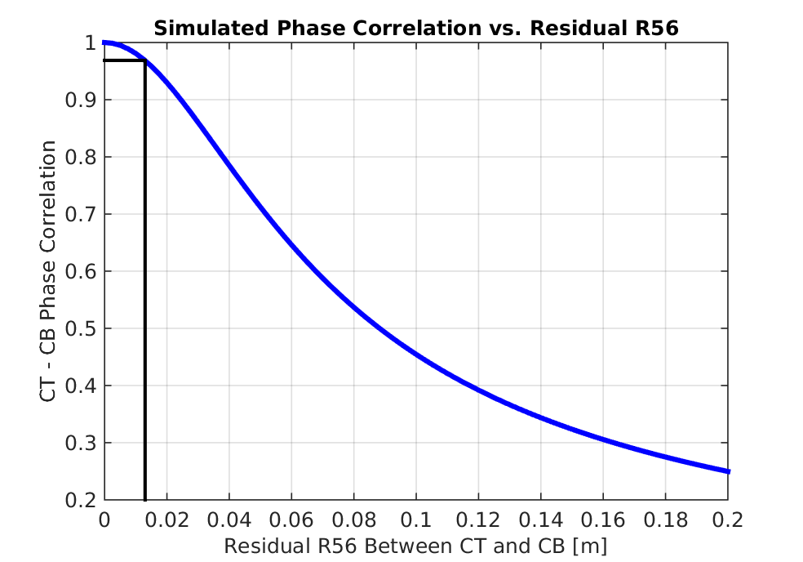
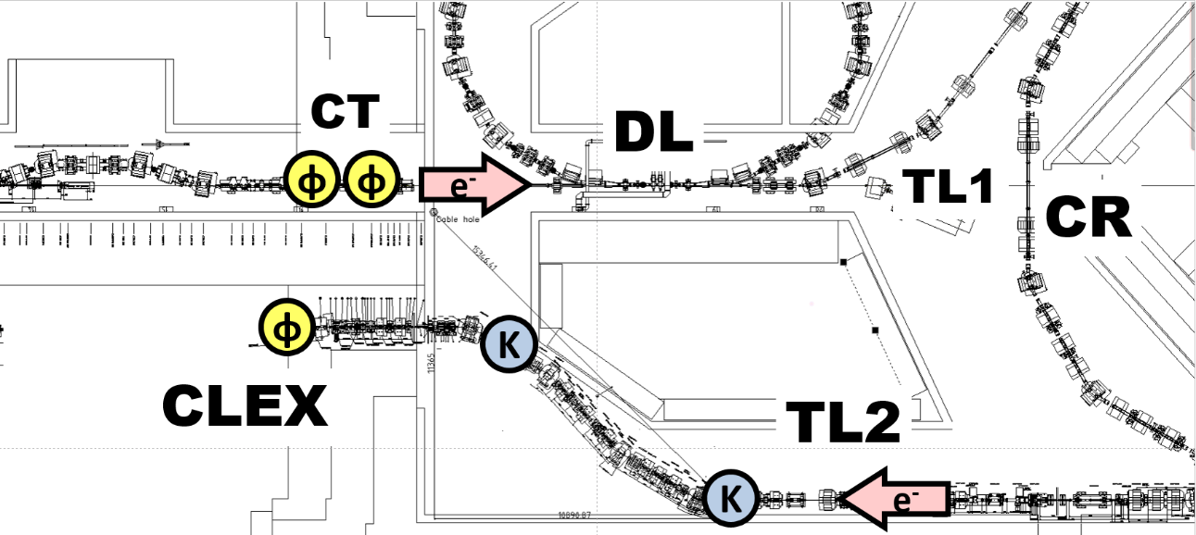
Phase Propagation
R56 = 0 m
R56 = -0.2 m
Non-zero R56 between the upstream and downstream phase monitors causes additional uncorrelated phase jitter downstream (via energy jitter).
To achieve 0.2 degrees stability at CTF, R56 must be controlled at the 1 cm level.
Compensate for negative R56 in TL2 with positive R56 in TL1.

Slide 8
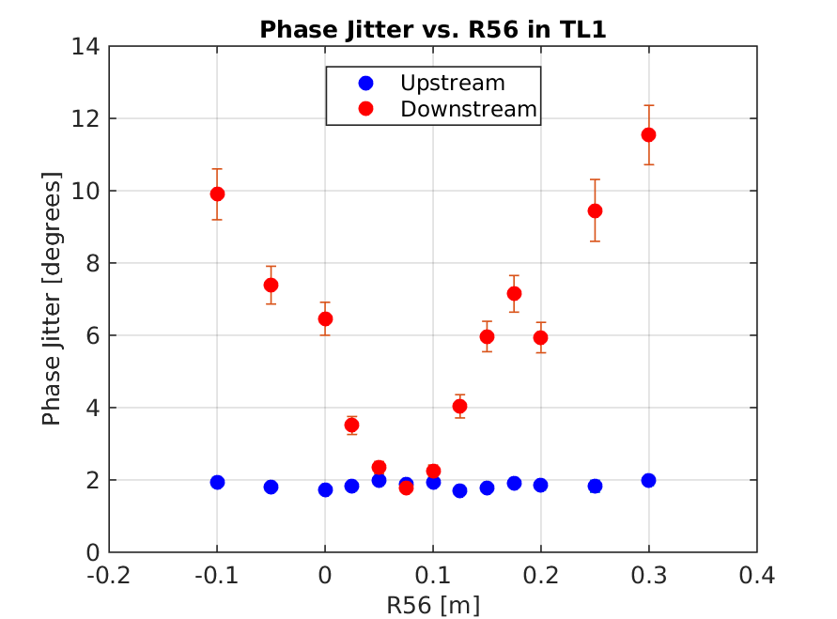
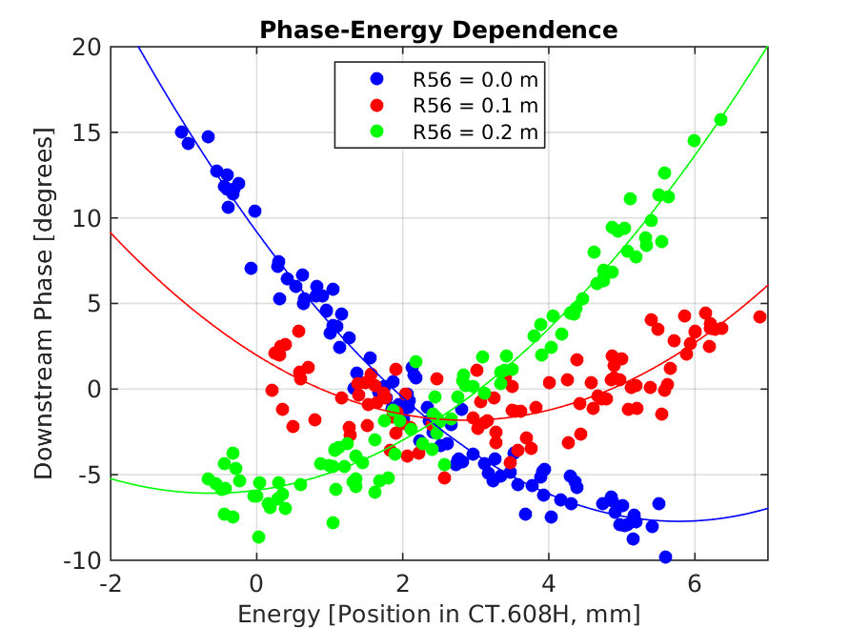
Phase Propagation
Beam energy varied ±1%
By varying R56 in TL1 we reduce the downstream phase jitter to the same level as the upstream phase jitter.
Higher order energy dependencies clearly visible: mitigated by flattening energy variations along the pulse.
Achieved 95% correlation, but extremely sensitive to small changes in injector.

Slide 9
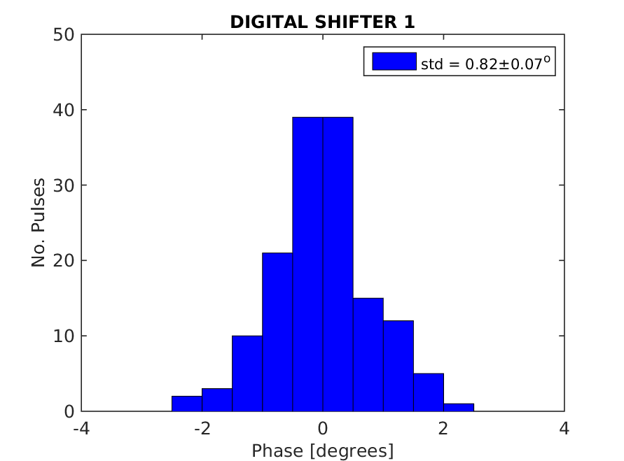
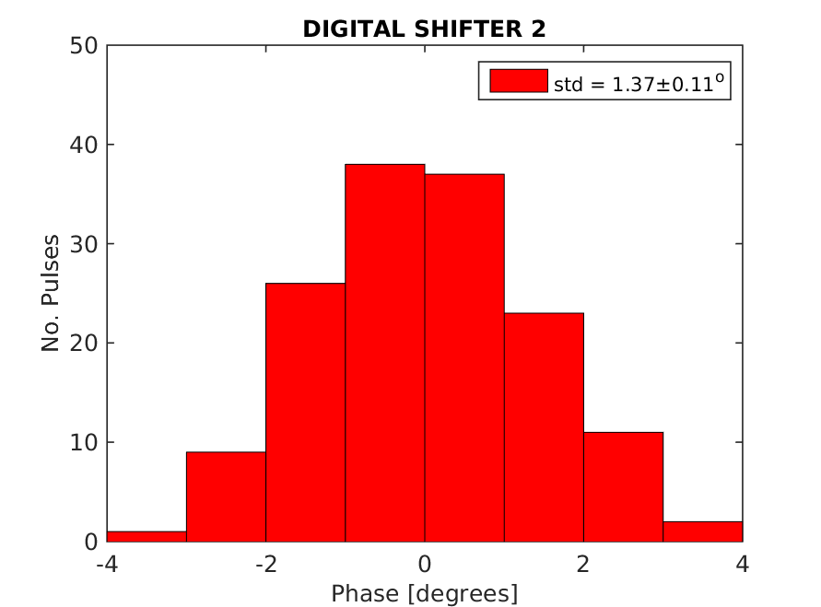
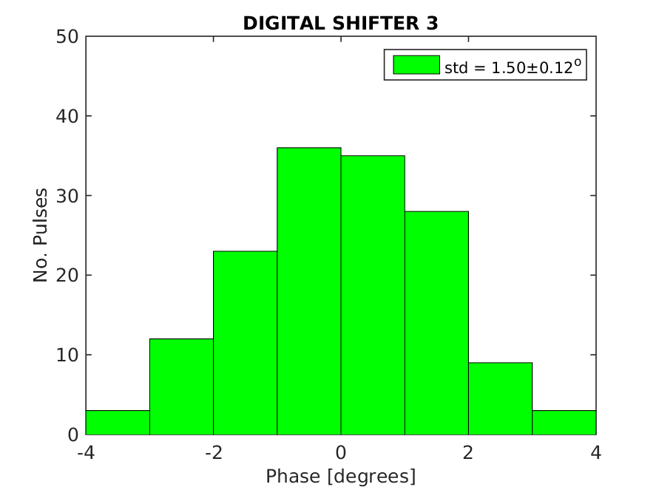
Phase Monitor Performance
3 purpose built phase monitors (from INFN Frascati): 2 upstream, 1 downstream.
Only achieved ~0.7 degrees resolution in late 2014/early 2015. Limits theoretical corrected phase stability to 1 degree.
Identified source of problem to be noise originating from the digital phase shifters used in the electronics.

Slide 10
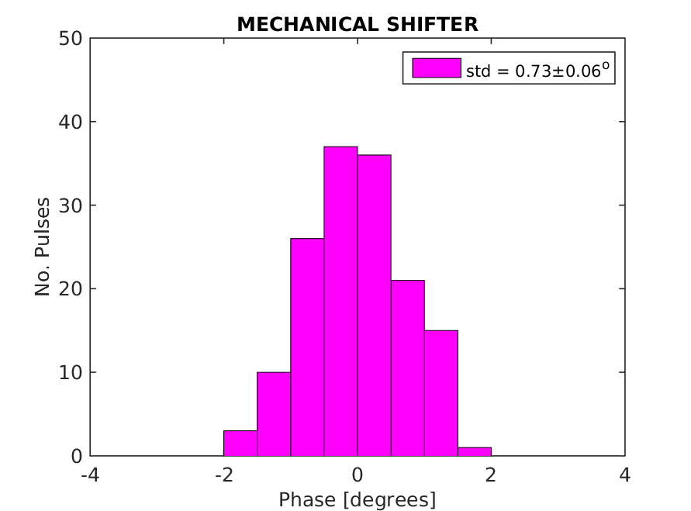
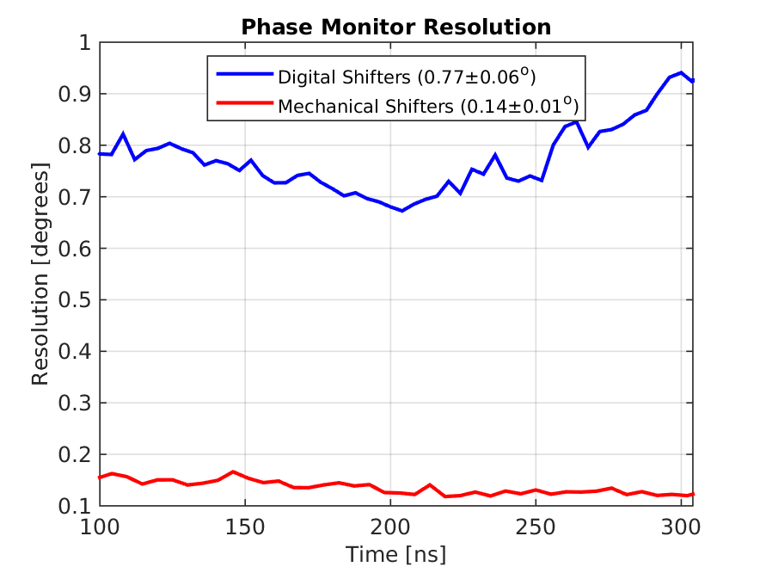
Phase Monitor Performance
Changed all the digital shifters to new mechanical phase shifters.
Upstream phase jitter (beam jitter, not noise floor) consistently ~0.75 degrees for each set of electronics.
Resolution between two upstream monitors 0.14 degrees across the pulse.
Theoretically possible to achieve 0.2 degrees stability with this resolution.

Slide 11
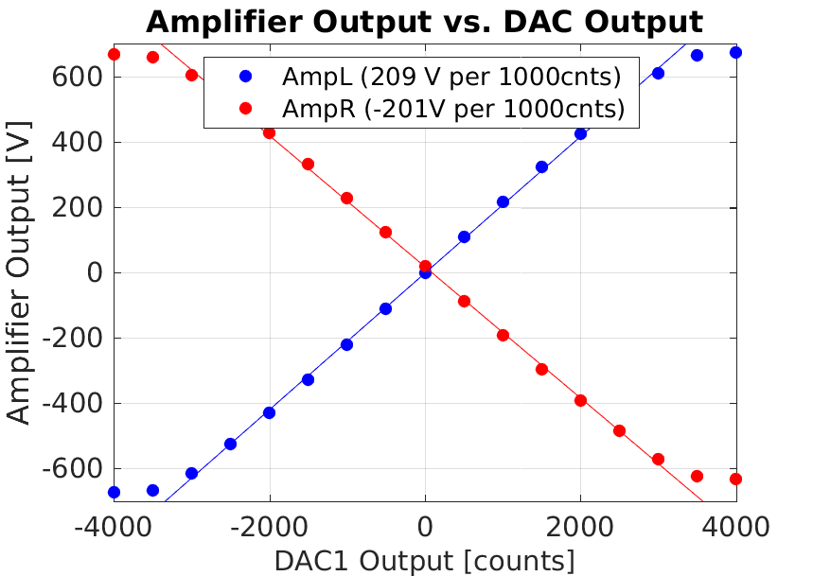
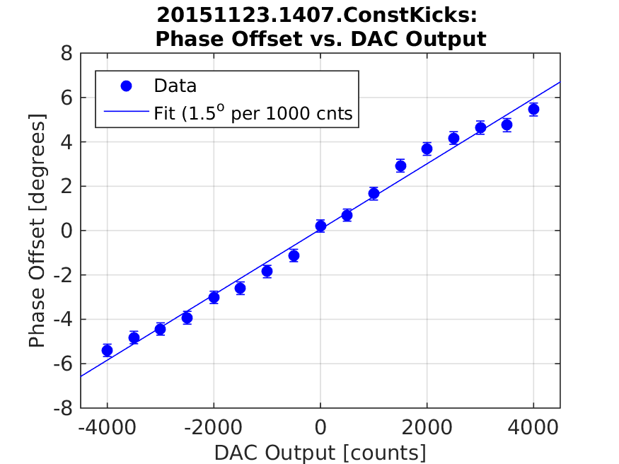
Correction Range
Range set by power of amplifiers designed and built by the FONT group (JAI/Oxford University) used to power correction kickers.
  First version: 345 V for ±3 degrees range (Nov 2014-Oct 2015).
  Second version with additional FETs to give 690 V output voltage, doubling the correction range to ±6 degrees, available November 2015.

Slide 12
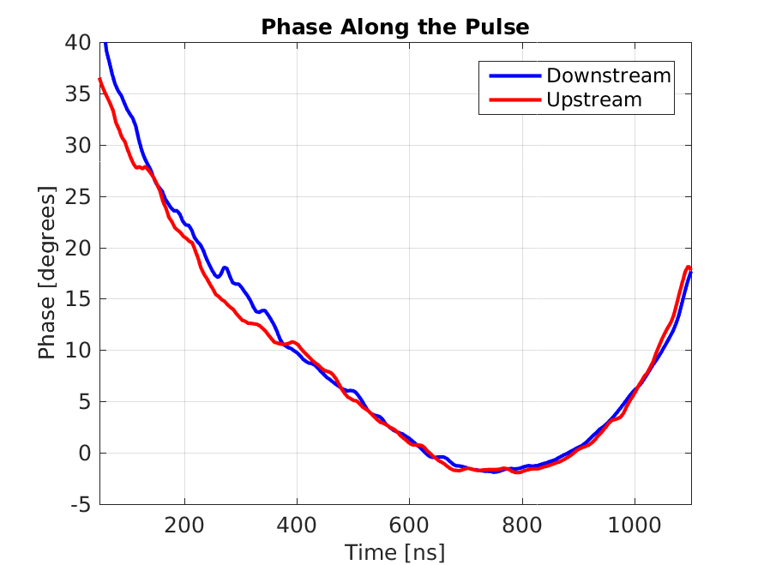
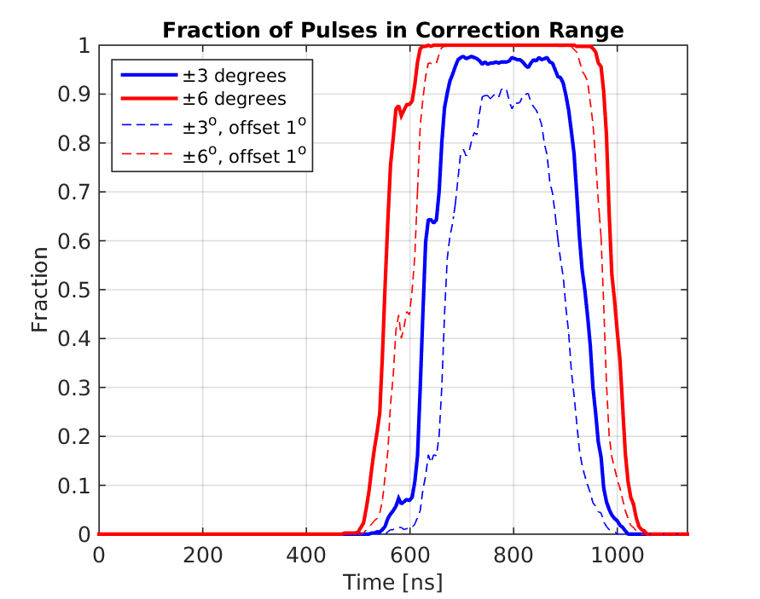
Correction Range
Pulse length:
  CTF3: PFF operates on 1.2 µs (uncombined) pulse.
  CLIC: PFF will operate on 240 ns (combined) pulse.
~40 degrees phase sag at CTF3 means whole pulse can’t be corrected.
With new +/- 6 degrees range can optimally correct ~350ns of the CTF pulse (longer than needed for CLIC).

Slide 13
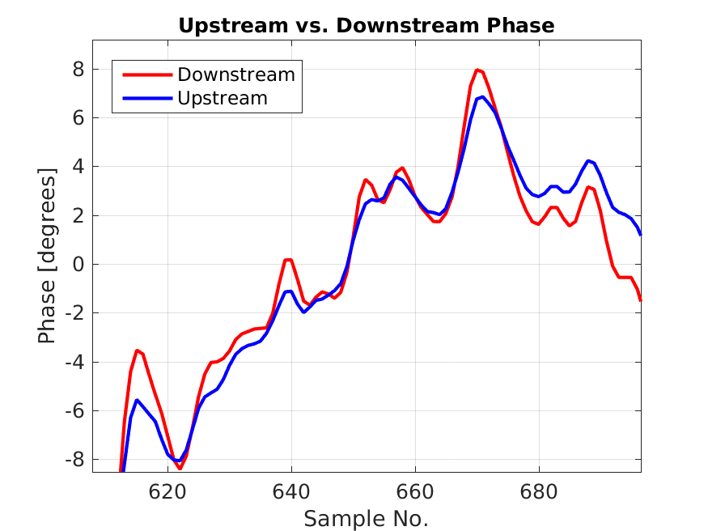
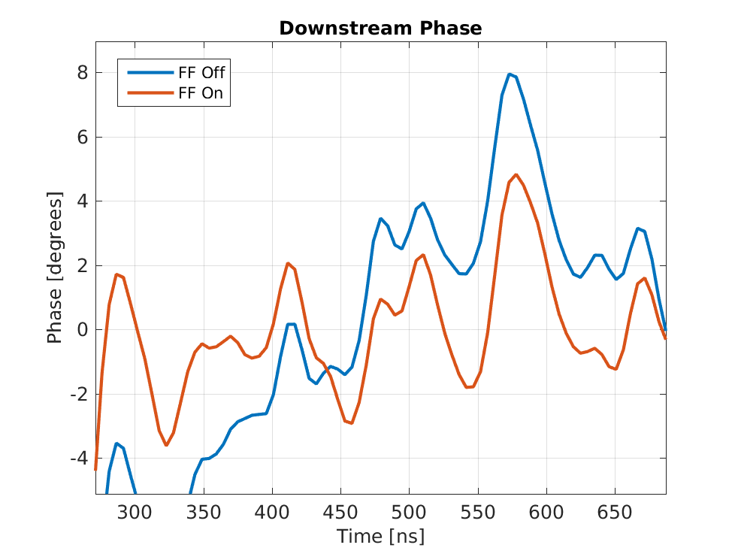
October 2015 PFF Results
Phase along pulse: overall phase sag (in central range) flattened but faster variations remain.
Possible explanations:
  Features uncorrelated? Features clearly visible in upstream phase.
  Bandwidth? Features ~5MHz compared to 30MHz correction.
  Timing?...

Slide 14
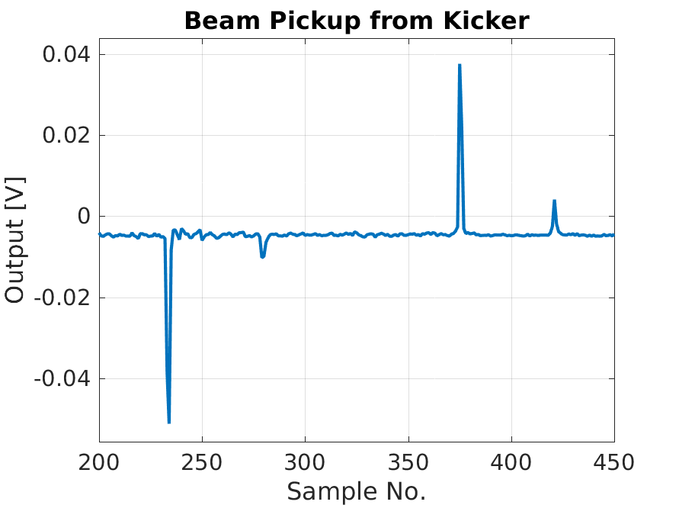
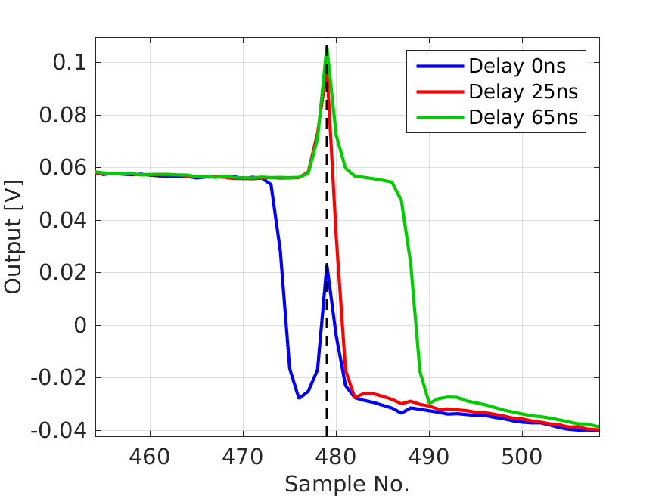
Kick Timing
Observe beam pickup returning to amplifier from kickers.
Compare to timing of output pulse from amplifier.
Correction was previously applied ~25ns early!
  Delay applied in PFF firmware.
End of beam pulse.
KICKERS POWERED
End of pulse from amplifier.
End of beam pulse.
Start of beam pulse.
KICKERS NOT POWERED

Slide 15
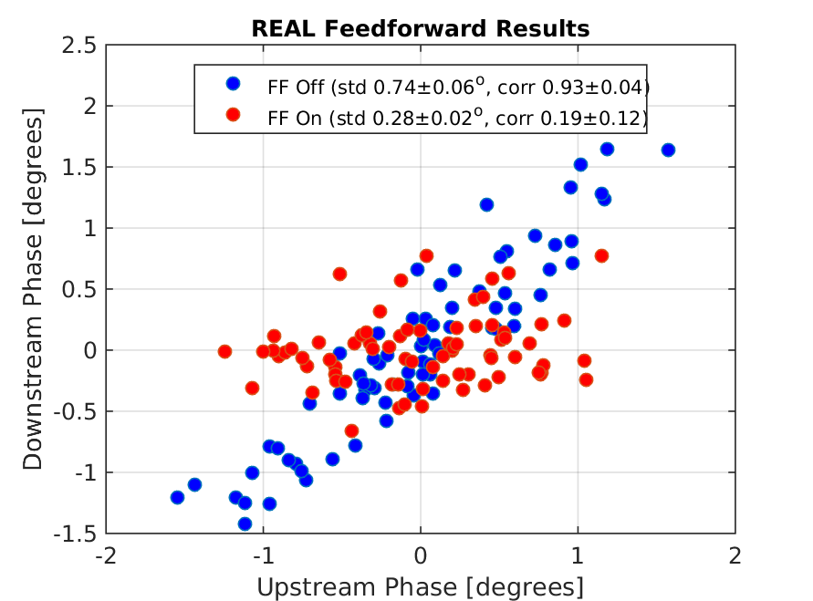
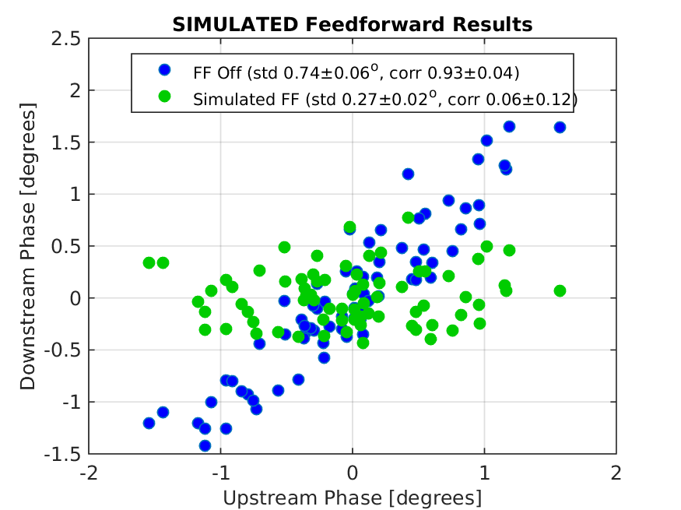
Phase Feedforward: Current Jitter Record
Interleaved data: Even pulses have FF on and odd pulses have no correction applied.
0.74 degrees phase jitter reduced to 0.28 degrees.
Simulated best possible (unlimited) FF correction given beam conditions 0.27 degrees.

Slide 16
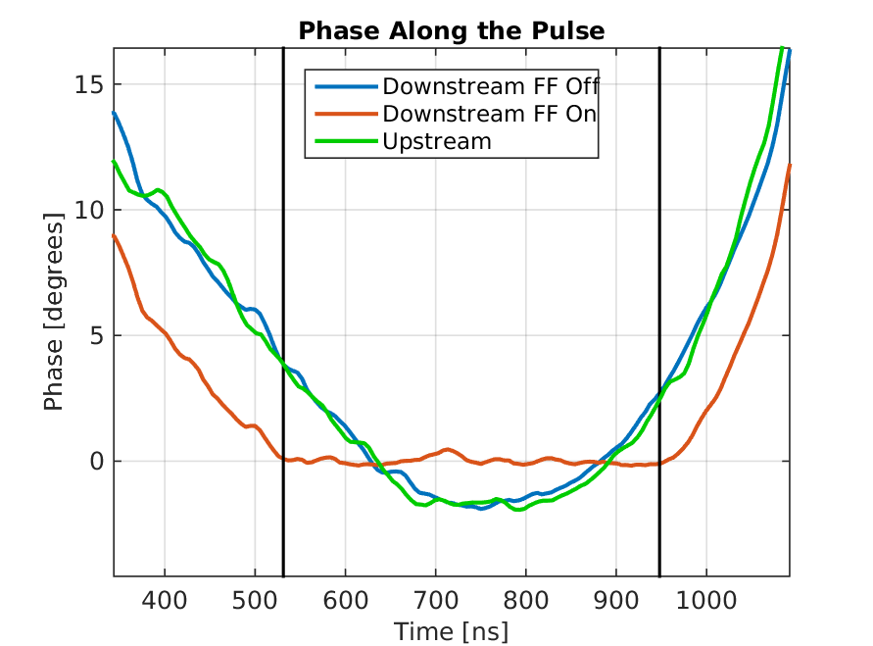
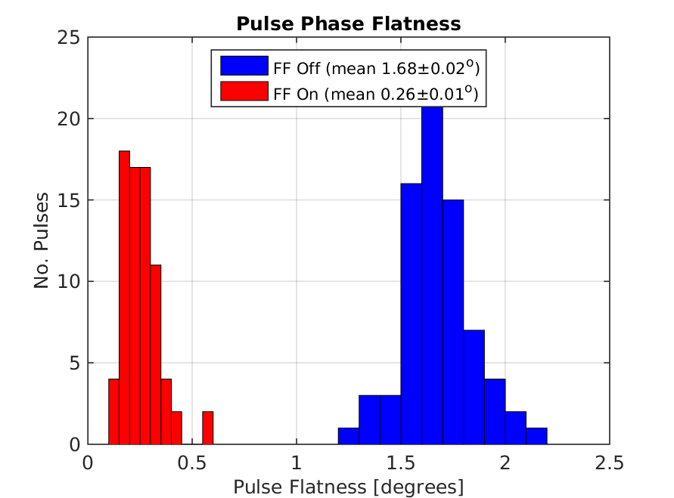
Phase Feedforward: Current Jitter Record
Amplifier Saturated
Amplifier Saturated
High bandwidth (~30 MHz) correction: Correct variations along the pulse not only jitter on the mean.
Phase variation along the pulse (between black lines) reduced from 1.68 to 0.26 degrees (mean deviation of samples along pulse).

Slide 17
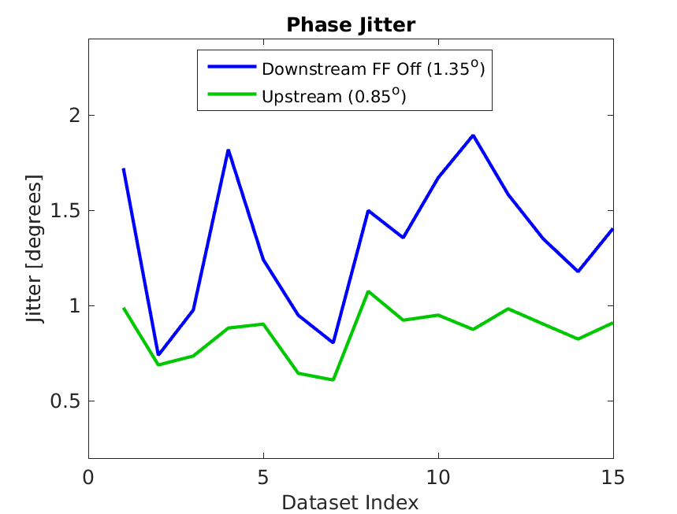
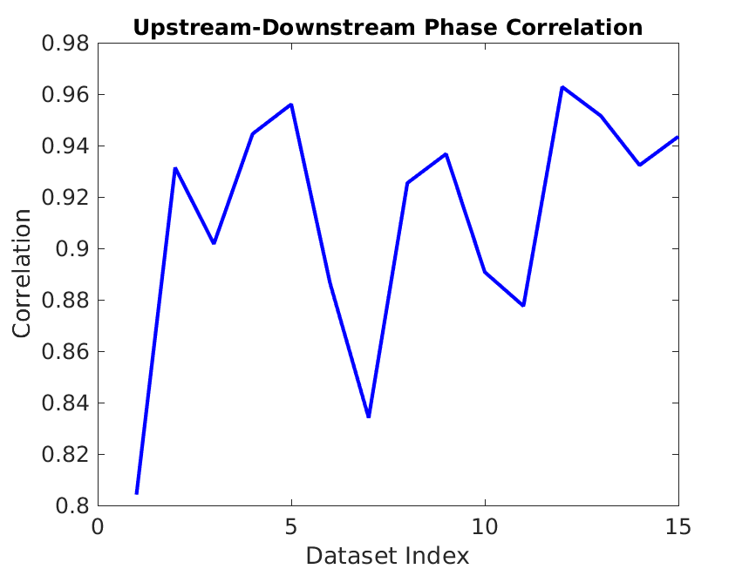
Remaining Challenges: Beam
Biggest remaining issue is the longevity of beam conditions (whilst not correcting).
Plots below: 15 datasets across 2.5 hours around the time of the best results shown previously.
Downstream phase jitter varies by a factor 2.
Correlation varies between 80% and 96%.

Slide 18
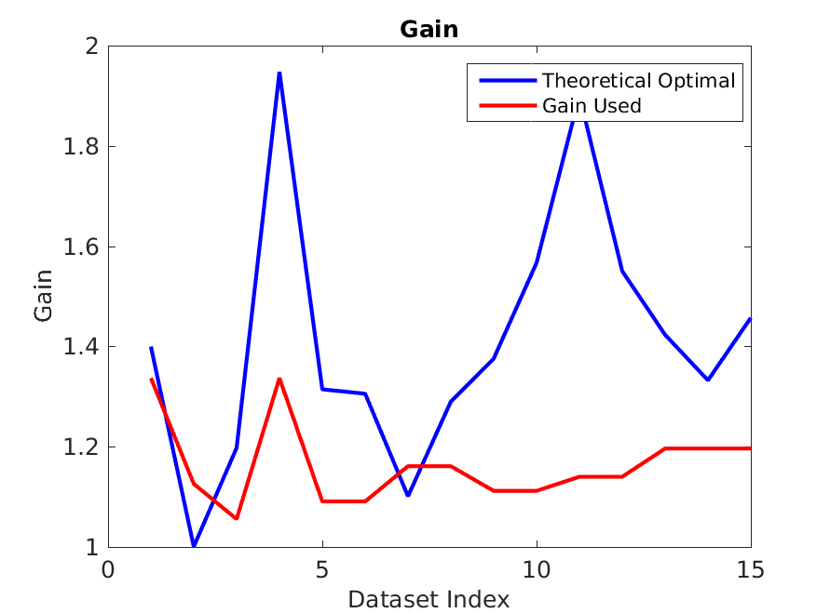
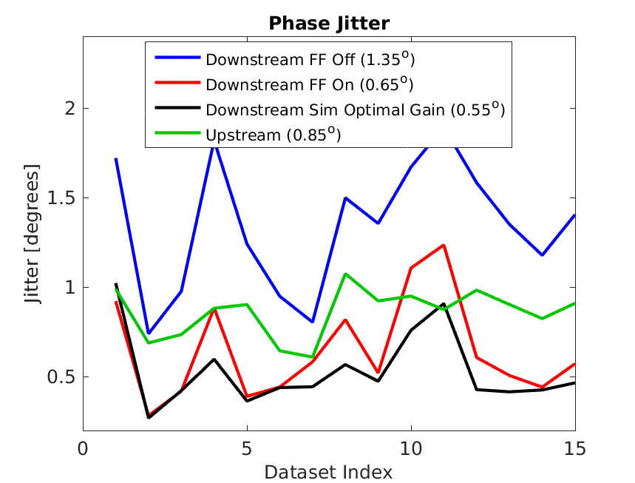
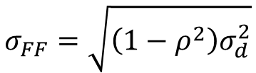

Remaining Challenges: Beam
Optimal Gain and corrected jitter:
Optimal gain varies by a factor 2 during these few hours -> not taken in to account in FF operation.
Correction better than 0.4 degrees rarely achievable due to beam conditions.
$$g=ρ\frac{σ_{d}}{σ_{u}}$$
$$σ_{FF}=\sqrt{\left(1−ρ^{2}\right)σ_{d}^{2}}$$
g = gain, ρ = correlation, σ_{u/d/FF} = phase jitter (upstream/downstream/corrected)

Slide 19
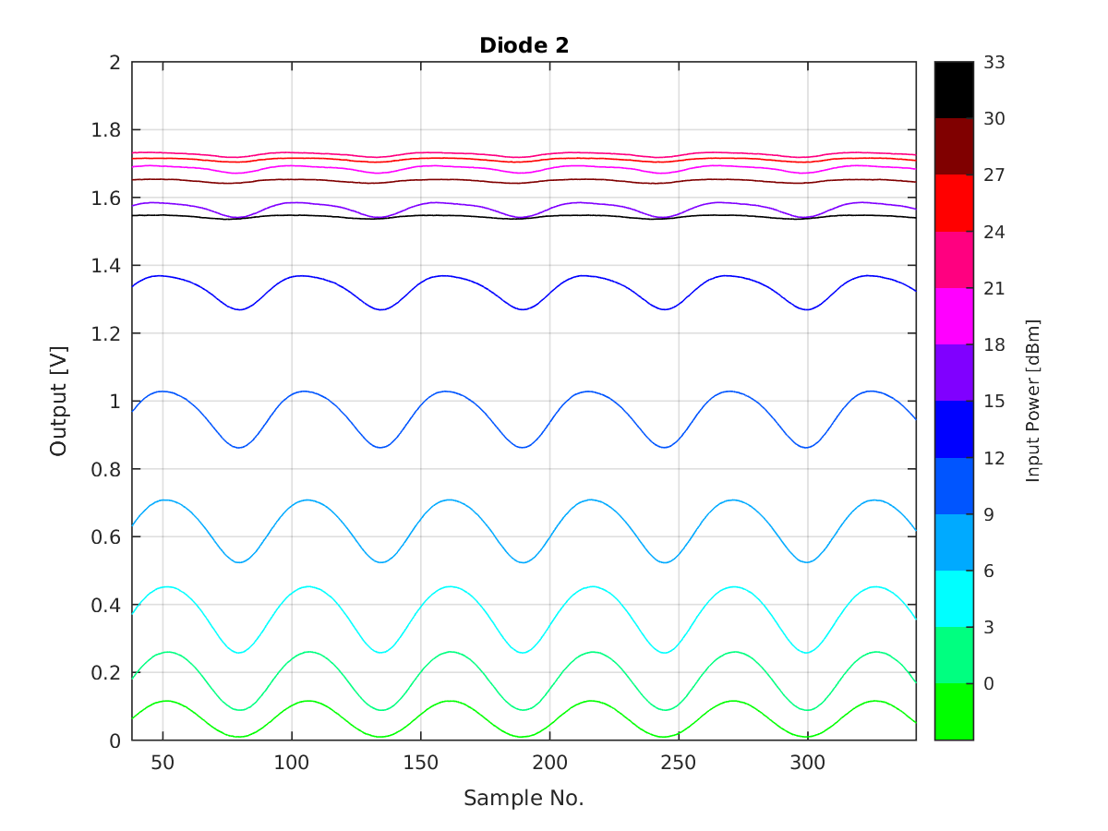
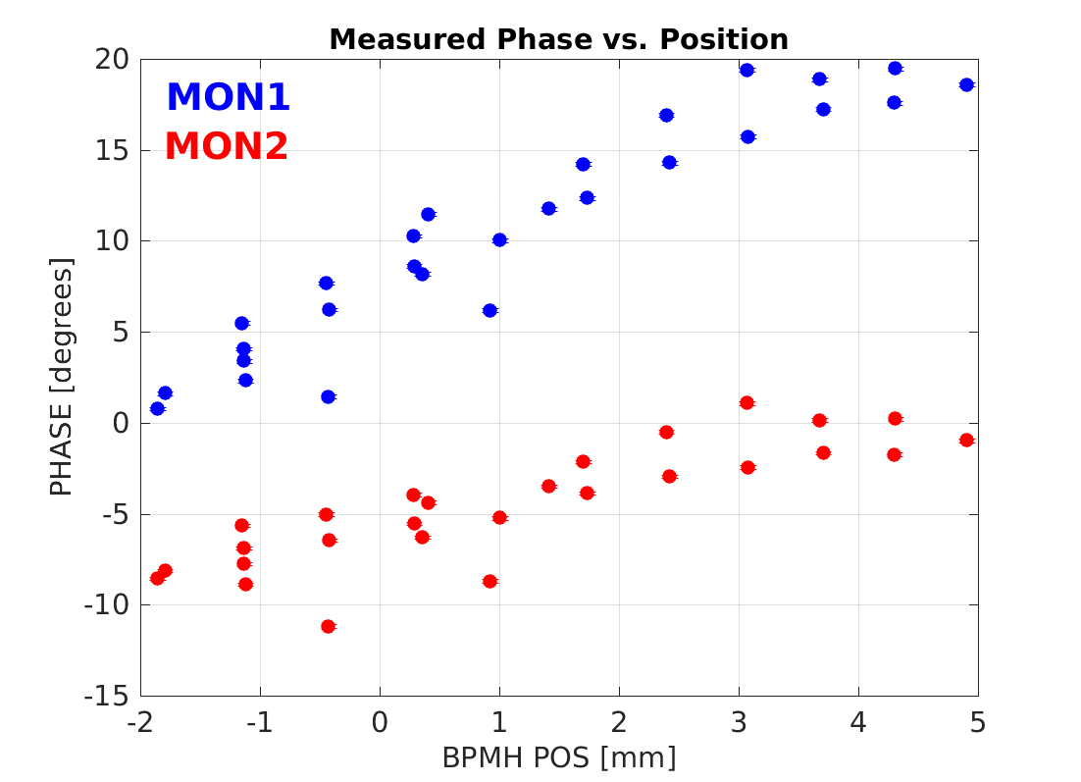
Remaining Challenges: Hardware
Approaching phase jitter where small hardware effects become significant.
Phase Monitors
  Cross-talk between channels.
  Dependence of measurement on beam position.
Amplifier
  Slew rate/droop correction.

Slide 20
Summary
Achieved 0.28 degrees phase stability at CTF, getting very close to the CLIC goal of 0.2 degrees.
Result thanks to:
  Increasing upstream-downstream phase correlation from 50% to 95% via a campaign of R56 and energy optimisation, plus much improved stability at CTF.
  Changes to phase monitor electronics improved resolution from 0.75 to below 0.15 degrees.
  New amplifier to double the correction range.
Remaining points:
  Increase reproducibility/longevity of 95% correlation and 0.8 degrees jitter.
  To achieve 0.2 degrees stability: >97% correlation required.
  Demonstrate factor 10 jitter reduction: 99.5% correlation with upstream jitter amplified to >2 degrees.

